Slide 1

Just Chillin Messenger
IT488 Software Product Development using Agile
Team- The Sharpest Tools in the Shed
December 19, 2020

Slide 2

Product Overview
Just Chillin Messenger
Local Communication
Login Page
Main Chat Area

Slide 3

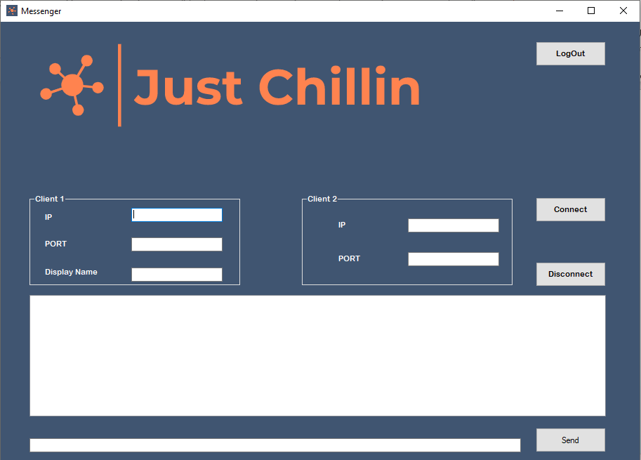
Overview of Major Functionalities
Login/Logout Buttons
Connect/Disconnect Buttons
Local Chat Functions
Client 1 & 2 IP/Port Information
Send Button

Slide 4
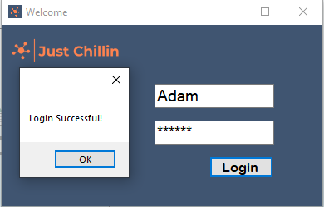
Login Form
Easy Navigation to and from main page
Connected through Server Explorer
Username & Password Required
Login Successful

Slide 5
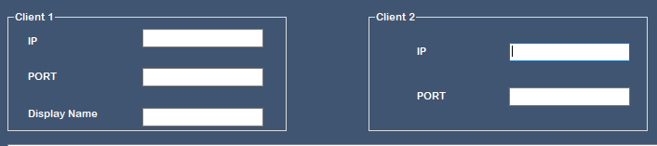
Client Information
Enter Client 1 IP & Port Information
Enter Client 2 IP & Port Information

Slide 6
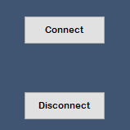
Connect & Disconnect
Connect Locally
Disconnect when done

Slide 7
Sending Message
Send Button
Enter Messages

Slide 8

Logout of Application
Logout back to Login page
New User can Login
Simple Navigation
Security Feature

Slide 9

Thank you
Scrum Master
Adam Helton
Developed By
Adam Helton
Brandon Ford
Bryant Paul
Joshua Snipes
Joynene Botha

