Slide 1
ARSENAL FC RESULTS PREDICTOR

Slide 2
Introduction
What is Arsenal?
Arsenal Football Club is an English professional football club based in Holloway, London, that plays in the Premier League, the top flight of English football
What is Premier League?
The Premier League is an English professional league for men's association football clubs
The Premier League is a corporation in which the 20 member clubs act as shareholders, Seasons run from August to May.
Teams play 38 matches each (playing each team in the league twice, home and away), totaling 380 matches in the season

Slide 3
Problem & Solving
What is the Problem?
Predicting the correct winner for a game
Predicting the points for each game
How to solve the Problem?
By creating an Intelligence System which has the ability of predicting the most accurate winner

Slide 4
Technique to solve the problem
I propose Native Bayes Algorithm to create an Intelligence System which could solve this problem
What is Native Bayes Algorithm?
It is a classification technique based on Bayes’ Theorem with an assumption of independence among predictors
In simple terms, a Naive Bayes classifier assumes that the presence of a particular feature in a class is unrelated to the presence of any other feature

Slide 5
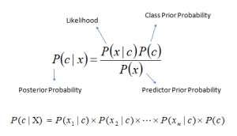
Naive Bayes model is easy to build and particularly useful for very large data sets
Along with simplicity, Naive Bayes is known to outperform even highly sophisticated classification methods
Bayes theorem provides a way of calculating posterior probability P(c|x) from P(c), P(x) and P(x|c). Look at the equation below:

Slide 6
Feasibility
Scope
Scope of this project would be predicting the results of the team Arsenal FC throughout the season and to view the predicted results in a graphical way where a user can read and understand it properly. And the system will have different predicting methods to predict the results
Time
To get all the required data from Internet | 1 Day
To make Flow Chart | 4 Days
To do the Mathematical and Algorithm Parts | 15 Days
To Finalize the AI part | 10 Days
Make the GUI | 7 Days

Slide 7
Cost
Since all the data which are needed to complete the project such as previous match results are available on the internet, cost wouldn’t be much high
Technical
To build the project I will be using my personal computer which has Matlab installed in it and I have a stable internet connection at home thus any other technical requirement will not be needed.

Slide 8
Delivarables
As mentioned earlier the technique that I will be using to predict the results would be Naïve Bayes System, by using this technique there will be couple of manual methods that I’m expecting to include Such as:
Without considering home/away games
Without considering cup games
There will be three outputs when considering a game and those are Win, Draw and Lose.
While predicting for the whole season I’m planning to make a point table which would elaborate the final points in the season for the team.

Slide 9
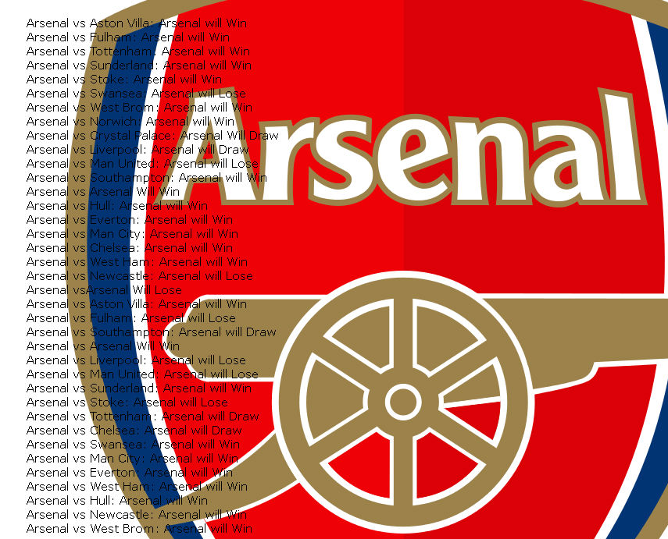
SAMPLE GUI

Slide 10
THANK YOU

