Slide 1


Major/Minor Project
Creative text generation from Images
Presented by:
Abhishek Shrivastava - 500075340 - R177219007
Animesh Sundriyal - 500075335 - R177219031
Akash Joshi - 500075323 - R177219016
Aditya Rathore - 500076006 - R177219013
Mentored By:
Mr. Shiv Naresh Shivhare
(Assistant Professor, Department of Informatics, SOCS, UPES)

Slide 2
Content
Introduction
Literature Review
Objectives
Methodology
Working Model
Results
Conclusion
References
Colour Code:
Synopsis: Red
Mid term: Orange
End Term: Purple
Note: The Following presentation will have all the content of the later.

Slide 3
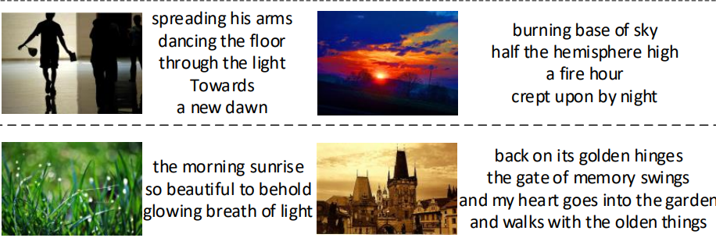
Introduction
Vision is a common source of inspiration for poetry and as correctly stated by someone “an image is worth thousand words”. The objects and the sentimental imprints that one perceives from an image may lead to various feelings depending on the reader.
In old days there used to be concept of “situational poetry” where artists would write poems on any given situation. We aim to achieve this result through machine learning techniques.
Generating poetry from image involves the task of text generation from a given image. The area of focus being - image captioning and literature creation.
The generated sentences should attain poetic grammar, structures, and language styles. and the semantic content should be relevant to the visual clues discovered from the images.
Figure 1: Images described as a poem by people

Slide 4
Objective
Millions a taken aback by awe-inspiring beauty of poetry and yet there’s just a little bit of empirical research done in developing computational models for poetry generation
The purpose of our project is to test the creative capabilities of AI. For most pictures, humans can prepare a concise description in the form of a sentence relatively easily.
The real challenge is achieving a somewhat accurate piece of poetry with the help of AI.
For simple analysis we define poetry as a piece of natural language text that complies with the constraints of grammaticality, meaningfulness, and poeticness.
Grammaticality: This states that poem should be syntactically well formed.
Meaningfulness: Poem should convey some thought or concept.
Poeticness: Poem should follow certain guidelines for style, rhyme and word-stress.

Slide 5
Area of application
Generating poetry from images has application in the creative writing industry, as a spur for artists seeking inspiration for their work.
It can also be used in advertising and marketing for captioning on unlabeled images.
e.g. Instagram can use auto captioning for images posted with no caption.
It can improve online marketing and customer segmentation by identifying customer interests through interpreting their shared images via social media platforms.
This can be used to test the creative capabilities of AI. For most pictures, humans can prepare a concise description in the form of a sentence relatively easily. The real challenge is achieving a somewhat accurate piece of poetry with the help of AI.

Slide 6
Related Work
Traditional approaches for poetry generation include template and grammar-based method, generative summarization under constrained optimization and statistical machine translation model.
By applying deep learning approaches recent years, researches about poetry generation have entered a new stage.
Another approach is to build a scoring procedure that evaluates the similarity between a sentence and an image. This approach is attractive, because it is symmetric: given an image (resp. sentence), one can search for the best sentence (resp. image) in a large set. This means that one can do both illustration and annotation with one method.
Another attraction is the method does not need a strong syntactic model, which is represented by the prior on sentences.
One of the scoring procedure is built around an intermediate representation, which we call the meaning of the image (resp. sentence). In effect, image and sentence are each mapped to this intermediate space, and the results are compared; similar meanings result in a high score. The advantage of doing so is that each of these maps can be adjusted discriminatively.

Slide 7
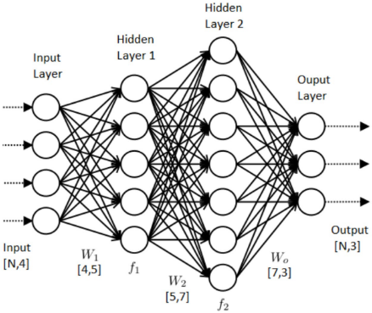
Technical Concepts
Artificial Neural Networks
A neural network is made of artificial neurons that receive and process input data. Data is passed through the input layer, the hidden layer, and the output layer.
A neural network process starts when input data is fed to it. Data is then processed via its layers to provide the desired output.
It is defined as having
one input layer,
one output layer,
and a few (more than one) hidden layers

Slide 8
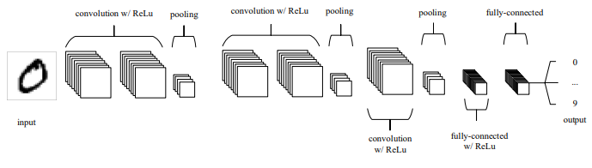
Convolutional Neural Networks (CNN)
CNNs are analogous to traditional ANNs in that they are comprised of neurons that self-optimize through learning. Each neuron will still receive an input and perform a operation (such as a scalar product followed by a non-linear function) - the basis of countless ANNs.
One of the largest limitations of traditional forms of ANN is that they tend to struggle with the computational complexity required to compute image data.
CNNs are primarily used in the field of pattern recognition within images. This allows us to encode image-specific features into the architecture, making the network more suited for image-focused tasks - whilst further reducing the parameters required to set up the model
CNNs are comprised of three types of layers. These are convolutional layers, pooling layers and fully-connected layers. When these layers are stacked, a CNN architecture has been formed.

Slide 9
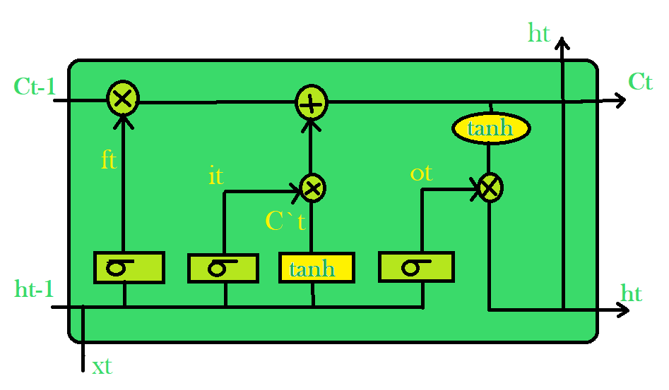
Recurrent Neural Networks & LSTM
Recurrent neural networks (RNNs) are connectionist models with the ability to selectively pass information across sequence steps, while processing sequential data one element at a time.
RNN architecture faces from vanish exploding gradient to tackle this we have used LSTM “long short-term memory". Simple recurrent neural networks have long-term memory in the form of weights. The weights change slowly during training, encoding general knowledge about the data.
They also have short-term memory in the form of ephemeral activations, which pass from each node to successive nodes. The LSTM model introduces an intermediate type of storage via the memory cell.

Slide 10
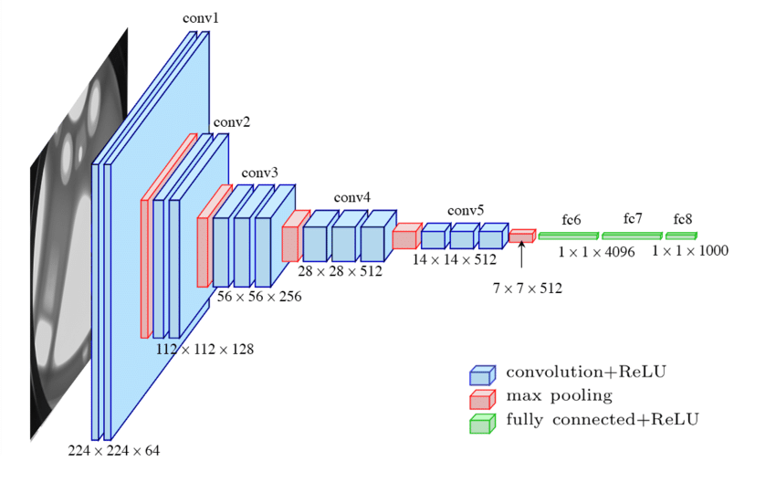
VGG16
VGG stands for Visual Geometry Group; it is a standard deep Convolutional Neural Network (CNN) architecture with multiple layers.
Developed as a deep neural network, the VGGNet also surpasses baselines on many tasks and datasets beyond ImageNet. The “deep” refers to the number of layers with VGG-16 or VGG-19 consisting of 16 and 19 convolutional layers.
There are a few convolution layers followed by a pooling layer that reduces the height and the width. If we look at the number of filters that we can use, around 64 filters are available that we can double to about 128 and then to 256 filters. In the last layers, we can use 512 filters.

Slide 11
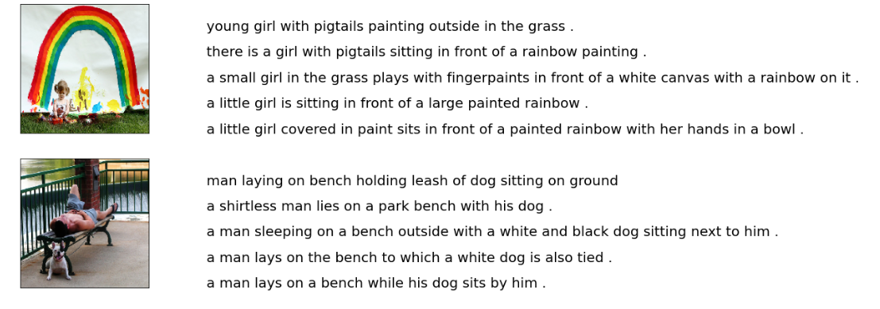
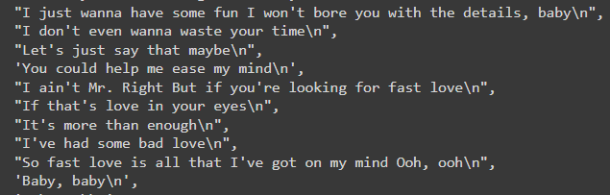
Dataset
Collection for sentence-based image description and search, consisting of 8,000 images that are each paired with five different captions which provide clear descriptions of the salient entities and events. The images were chosen from six different Flickr groups. Image data is of 234 x 234 size with 3 channels (RGB).
For Poem Generation we have create a dataset manually consists of different poems, rhymes and lyrics. A small size data that used for initial phases of training has numerous poems added to it many of them are from famous poets. Poems are taken from various sources like poetryfoundations.org and google.

Slide 12
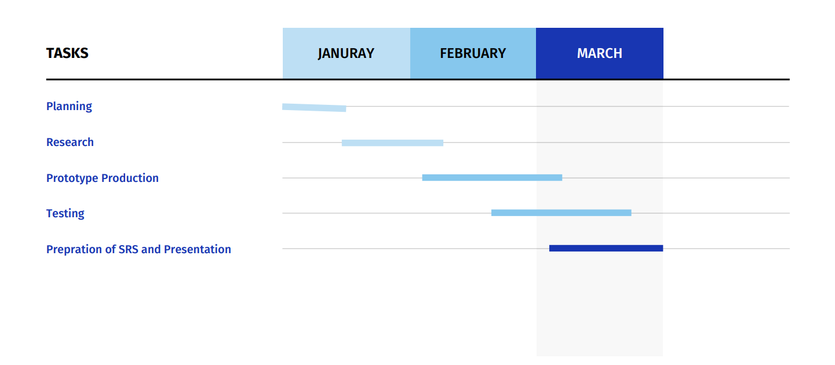
Gantt Chart

Slide 13
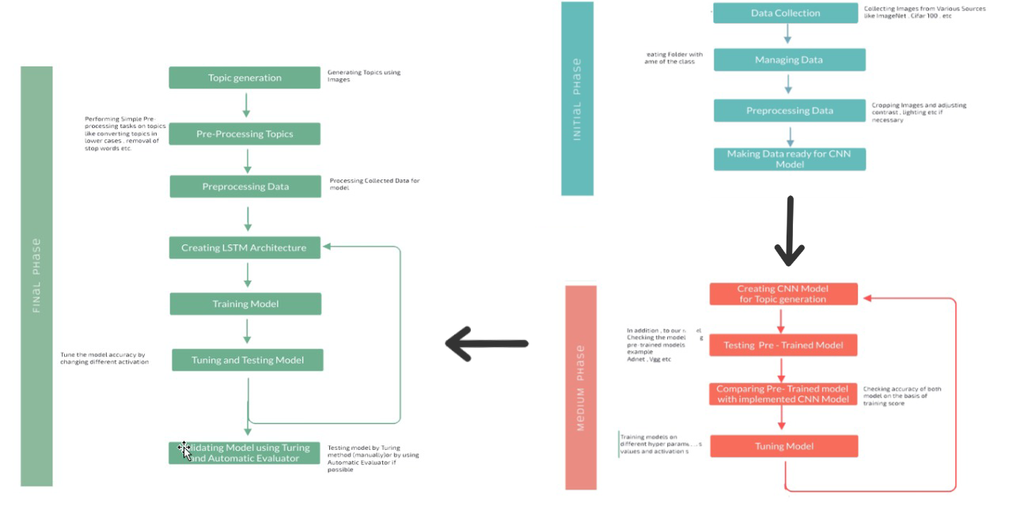


Methodology

Slide 14
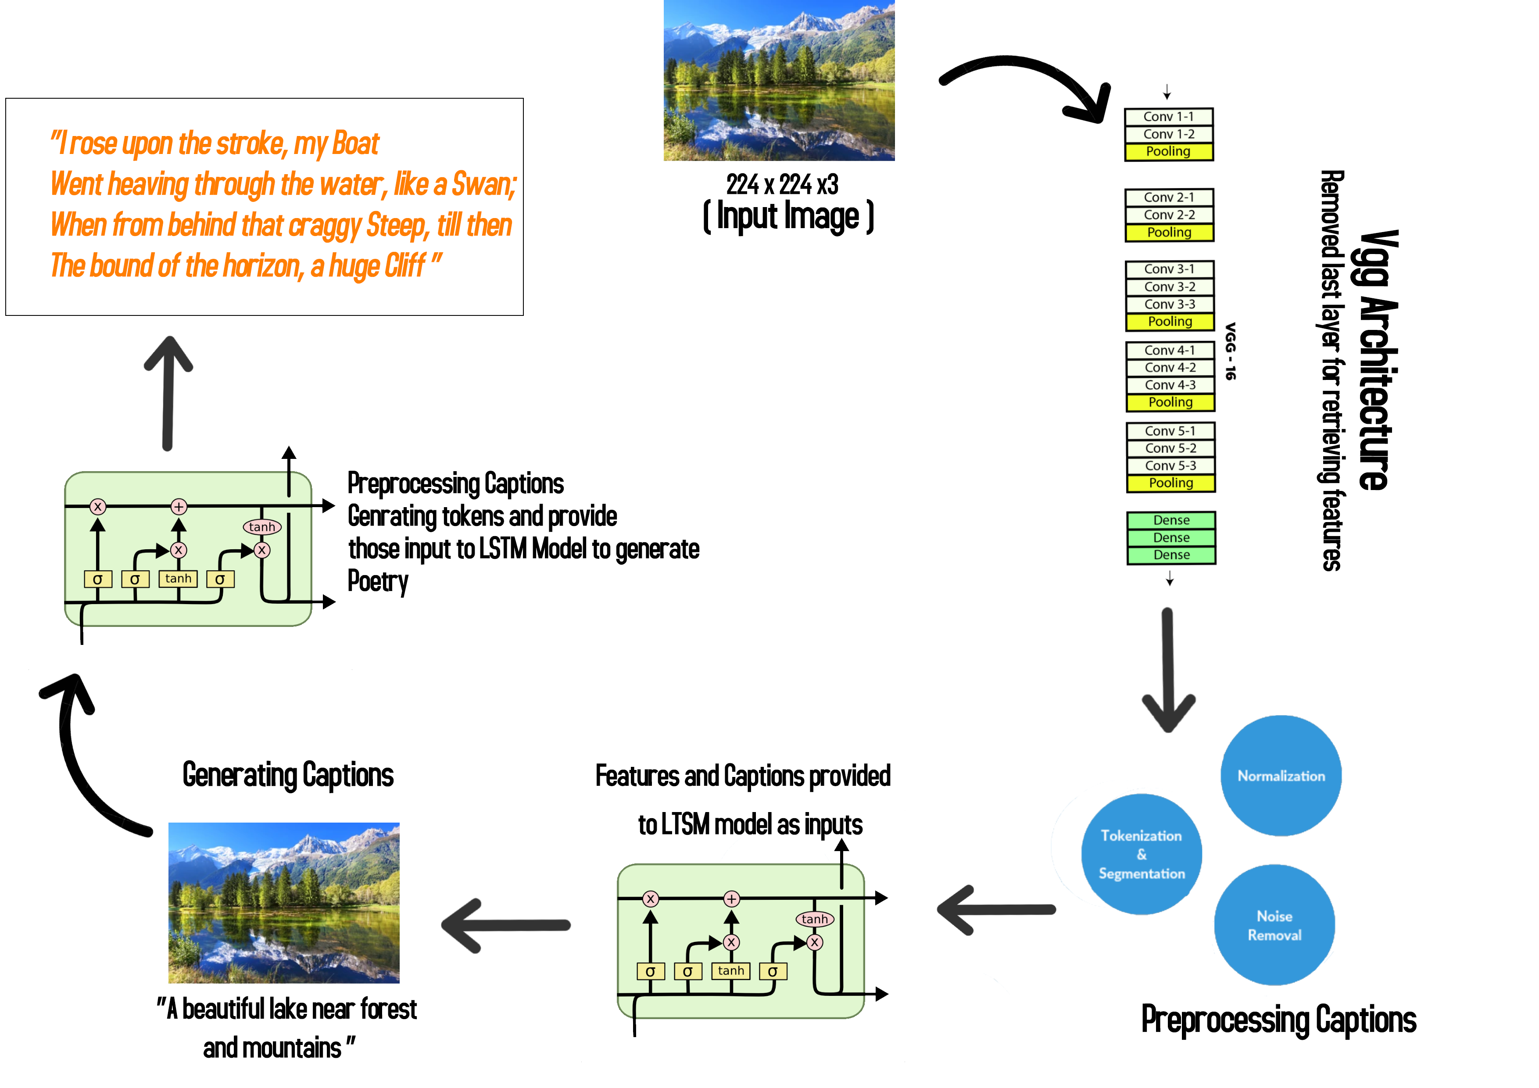
Working Model

Slide 15
SWOT Analysis
Strength:
As an image is one of the strongest inspirations for poetry as the dynamic nature of poetry makes it able to be constructed from any object that we pull from an image.
We also have used transfer learning, The use of transfer learning helps the model to generate more accurate data. We don't have to do everything on our own, we use the pre-trained model that has been already trained on large datasets and extract the features from these models and use them for our tasks.
Weakness:
Since poetry is one of the most expressive ways to use verbal language, computational generation of texts recognizable as good poems is difficult. Unlike other types of texts, both content and form contribute to the expressivity and the aesthetical value of a poem. The extent to which the two aspects are interrelated in poetry is a matter of debate
Opportunities:
Generating poetry from images has application in the creative writing industry, as a spur for artists seeking inspiration for their work. It can improve online marketing and customer segmentation by identifying customer interests through interpreting their shared images via social media platforms.
Threats:
An incorrectly captioned image will result in a nonsensical poem being formed.

Slide 16
Reference
Li, L., Yang, S., Su, L., Wang, S., Yan, C., Zha, Z. J., & Huang, Q. (2020, October). Diverter-guider recurrent network for diverse poems generation from image. In Proceedings of the 28th ACM International Conference on Multimedia (pp. 3875-3883).
Corpus-Based Generation of Content and Form in Poetry Jukka M. Toivanen, Hannu Toivonen, Alessandro Valitutti and Oskar Gross
Farhadi, A., Hejrati, M., Sadeghi, M. A., Young, P., Rashtchian, C., Hockenmaier, J., & Forsyth, D. (2010, September). Every picture tells a story: Generating sentences from images. In European conference on computer vision (pp. 15-29). Springer, Berlin, Heidelberg.
An Introduction to Convolutional Neural Networks Keiron O’Shea and Ryan Nash
A Critical Review of Recurrent Neural Networks for Sequence Learning Zachary C. Lipton, John Berkowitz, Charles Elkan.
Felix A. Gers, J¨urgen Schmidhuber, and Fred Cummins. Learning to forget: Continual prediction with LSTM. Neural computation, 12(10):2451–2471, 2000
Liu, B., Fu, J., Kato, M. P., & Yoshikawa, M. (2018, October). Beyond narrative description: Generating poetry from images by multi-adversarial training. In Proceedings of the 26th ACM international conference on Multimedia (pp. 783-791).
Cheng, W. F., Wu, C. C., Song, R., Fu, J., Xie, X., & Nie, J. Y. (2018). Image inspired poetry generation in xiaoice. arXiv preprint arXiv:1808.03090.
Asghar, N., Poupart, P., Hoey, J., Jiang, X., & Mou, L. (2018, March). Affective neural response generation. In European Conference on Information Retrieval (pp. 154-166). Springer, Cham.
Donahue, J., Anne Hendricks, L., Guadarrama, S., Rohrbach, M., Venugopalan, S., Saenko, K., & Darrell, T. (2015). Long-term recurrent convolutional networks for visual recognition and description. In Proceedings of the IEEE conference on computer vision and pattern recognition (pp. 2625-2634).
R.Bowman, Luke Vilnis, Oriol Vinyals, Andrew M. Dai, Rafal Jozefowicz & Samy Bengio Generating Sentences from a Continuous Space Samuel
Poetry Analysis and Generation Marmik K Pandya
A Review of Recurrent Neural Networks: LSTM Cells and Network Architectures Yong Yu Xiaosheng Si, Changhua Hu, Jianxun Zhang
Very Deep Convolutional Networks for large-scale image recognition Karen Simonyan & Andrew Zisserman

Slide 17
Thank You

