Slide 1

PLUGIN MAP GENERATOR FOR 3D WORLD MAKING IN GAME
By :
Georgius Bagas Wicaksono
Nrp 4210161025
RIZKY YUNIAR HAKKUN, S.Kom., M.T
NIP. 198106222008121003
ZULHAYDAR FAIROZAL AKBAR, S.ST., M.Sc.
NIP. 2000000251

Slide 2
Background
Plugin in modern era
Use of Plugins
Plugin Performance
Generator Plugin
Augmented Reality Plugin
Virtual Reality Plugin, ETC
How To Use
Step To Use
Memory Usage
Device Requirement

Slide 3
Aim
Detailed Model
Less Memory Usage
Create a 3D Game World
Easily To Operate
Not From The Scratch

Slide 4
Scope Of Problem
Just For Unity
Not Include Object (Animals / Building/ ETC)
Scope Of Problem

Slide 5
Previous Works
Procedural generation of optimized maps for survival video games
-Jacob Olsen
Realtime Procedural Terrain Generation
-Jesus Bachiller Cabal
Research
Designer Worlds : Procedural Generation of Infinite Terrain from Real – World Elevation Data
-Ian Parberry

Slide 6
Literature Review
Noise Mapping
Amplitude
Using
Octave
Consist
Consist
Frequency

Slide 7
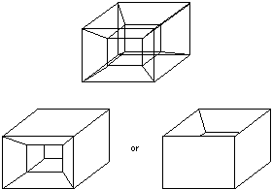
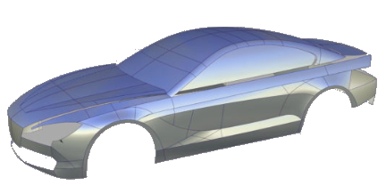
Continue
Wireframe Model
Solid Model
Curves
Surface Model

Slide 8
Continue
Level Of Detail
Procedure
Decrease Number Of Polygon
To Draw Object
Create Model Architecture
Function

Slide 9
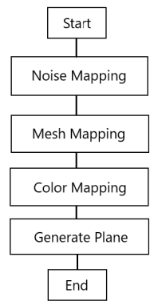
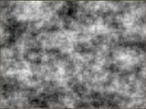
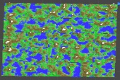
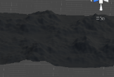
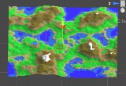
Approach Method

Slide 10
Noise Mapping
Noise mapping is the first step to create this plugin, in this step it used perlin noise to help determine the highest value to and the lowest value by randomly apply it to a plane object to identify which one are sea, mountain, snow, etc by using grayscale color.

Slide 11
Mesh Mapping
Mesh Mapping is the second step to create this plugin, in this step after got to identify which one will act as the lowest and the highest plateau randomly by system with the help of peril noise, one big 3D plane will create the mesh for the world by the help of some numbers of small planes (default plane) that include 2 triangle in one small plane.

Slide 12
Color Mapping
Color Mapping is the third step to create this plugin, after the world mesh created the next is one is to give colors to the world mesh by giving it parameters like height and color palette, in this step the given color palette can act as gradient color to create different color in certain height because the help of noise mapping in the first step.

Slide 13
Generate Plane
Generate Plane is the last step to create this plugin, after finish to gave color to the world in this step the system will generate one complete 3D world from one big plane but with smaller size ratio and spawn it in a certain number to give the final result of the 3D world.

Slide 14
Test Result
No. | Parameter | PC (Low End)
 |  | Nilai Pengujian | CPU Usage | Memory Usage
1 | Level Of Detail | 6 | 60 FPS | 0.52 GB
2 | Noise Scale | 1000 | 60 FPS | 0.57 GB
3 | Amplitude | 1 | 60 FPS | 0.58 GB
4 | Frequency | 2 | 60 FPS | 0.58 GB
5 | Seed | 800 | 60 FPS | 0.57 GB
6 | Height Multiplier | 80 | 60 FPS | 0.61 GB

Slide 15
No. | Parameter | Macbook Pro 2018 (HIGH END)
 |  | Nilai Pengujian | CPU Usage | Memory Usage
1 | Level Of Detail | 0 | 100 FPS | 0.81 GB
2 | Noise Scale | 100 | 100 FPS | 0.96 GB
3 | Amplitude | 1 | 100 FPS | 1.14 GB
4 | Frequency | 4 | 100 FPS | 1.03 GB
5 | Seed | 50 | 100 FPS | 0.99 GB
6 | Height Multiplier | 100 | 100 FPS | 1.22 GB

Slide 16
Conclusion
Goal = Desired Plugin
(Achieved)
Note :
This plugin lesser memory usage than Open World Nature Kit
This plugin easier to use than Kubikos 3D
Easily To Use
Satisfactory Performance
Less Memory Usage

Slide 17


