Slide 2
C₀: an Imperative Programming Language for N00bs

Slide 3
Motivation

Slide 4
Intro Curriculum Redesign
Old
15-100
15-121
15-123
15-211
15-212
15-213
New
15-110
15-122
15-150
15-210
15-213
15-214
Notes:
Flatten Dependency Graph
Emphaize: Computational Thinking, Software Reliability, Parallel Computing

Slide 5
Intro Curriculum Redesign
Old
Java
Java
C / Perl
Java
ML
C
New
Python
??
ML?
ML
C
Java

Slide 6
15-122
15-122
Reasoning
Proto Competent Systems Hackers
Java/Python N00bs
Data Structures
Unix Skills

Slide 7
Goal
Let students focus on writing correct code
Good error messages
Safety
Fully defined behavior
Only as powerful as needed for the course
Can always grow more
Easily incorporate existing libraries
Notes:
Catch errors early at runtime, locally at compile time
No surprises at behavior – principle of least surprise

Slide 8
Why not Java?
public static void main(string[] args)
Complex for beginners
Constraining
Notes:
Differences in parsing the declaration for n00bs vs professionals

Slide 9
Why not C?
Still too complex for novices
Manual memory management
Undefined semantics
Integer overflow
Division
Numerical range and representation
Poor tools
gcc/gdb are not user friendly
Notes:
Mention talk – even advanced programmers

Slide 10
Java Environment
APIs for graphics, sound, text, I/O
Enables interesting assignments
Eclipse is helpful
Good error UI
Integrated debugger
Notes:
Compelling -> more interest -> research shows better learning due to more time

Slide 11
C₀: Reasonably Refined C

Slide 12
Overview
Concrete language
Abstract language

Slide 13
Booleans and Integers
bool x = true;
bool y = !x && (z > 0);
Required for all control flow checks
int z = 4 + 9 / 0;
Signed 32 bit integers
two’s complement representation
modular arithmetic
guaranteed exception

Slide 14
Booleans and Integers
Concrete
Abstract
!a
-a
a + b
a > 0
monop(lognot, a) : bool
monop(neg, a) : int
binop(add, a, b) : int
binop(cmpg, a, b) : bool

Slide 15
Strings and Characters
string s = “hello, world”
Immutable
Opaque representation
char c = ‘4’;
char z = ‘\0’;
ASCII

Slide 16
Declarations and Assignment
Explicitly typed
Block-delimited scope
No shadowing
Mutable
Variables must be defined before use
int x;
{
int y;
y = 9;
}
// Error
x = y + 4;

Slide 17
Declarations and Assignment
Concrete
Abstract
int x;
x = 4;
int x;
int y;
y = 9;
x = y;
decl(x, int,
assign(x, 4)) : cmd
decl(x, int,
decl(y, int,
binop(seq,
assign(y, 9),
assign(x, y))))
: cmd

Slide 18
Conditions
Concrete
Abstract
if (x > 0)
y = 0;
else
y = 9;
y = x > 0 ? 0 : 9;
if(binop(cmpg, x, 0),
assign(y, 0),
assign(y, 9)) : cmd
assign(y,
if(binop(cmpg, x, 0),
0, 9)) : cmd

Slide 19
while Loops
Concrete
Abstract
while (x > 0) {
x--; }
while (true) {
break;
}
loop(
binop(cmpg, x, 0),
assign(x,
binop(sub, x, 1))
)) : cmd
loop(true, break) : cmd

Slide 20
for Loops
for(int i = 0; i < 10; i++) {
if (i % 2 == 0) continue; }
{ int i = 0;
for (; i < 10; i++) {
if (i % 2 == 0) continue;
} }
{ int i = 0;
for (; i < 10;) {
if (i % 2 == 0) {
i++; continue;
}
i++;
}}
{ int i = 0;
while (i < 10) {
if (i % 2 == 0) {
i++; continue;
}
i++;
}}

Slide 21

Functions
Concrete
Abstract
int triarea(int b, int h)
{
return sqrarea(b, h) / 2;
}
func(b, h,
return(
binop(div,
call(ptr(sqrarea),
(b, h)),
2)
)
) : tuple(int, int) $→$ int

Slide 22
Hello World₀
int foo() {
return 0;
}
func(return(0)) : tuple() → int
K ; ∙ ▷ return(0)
K ; return(∙) ▷ 0
K ; return(∙) ◁ 0
K ◁ 0

Slide 23
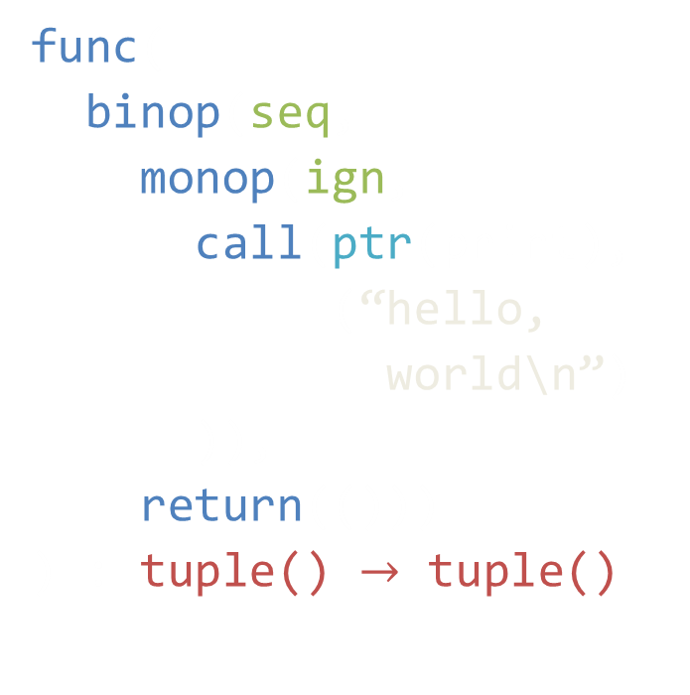
Hello World
Concrete
Abstract
void hello()
{
print(“hello, world\n”);
}
func(
binop(seq,
monop(ign,
call(ptr(print),
(“hello,
world\n”)
)),
return(()))
) : tuple() $→$ tuple()

Slide 24
Pointers
int *p = alloc(int);
int zero = *p;
Either NULL or valid heap address
No pointer arithmetic
No casting
Garbage collected heap
Heap values always initialized

Slide 25
Pointers
Concrete
Abstract
NULL;
alloc(bool)
int *x;
*x
*x = 9
ptr(null) : τ*
alloc(bool) : bool*
monop(read, x) : int
binop(write, x, 9) : int

Slide 26

Heap (μ)
A function which maps addresses a to values v
Signature Σ maps addresses a to types τ
if ∀ a ∈ dom(μ). Σ $⊢$ μ(a) : Σ(a) then μ : Σ

Slide 27
Arrays
Concrete
Abstract
int[] A;
alloc_array(int, 4)
A[4] = 9
A[0]
decl(A, int[], …) : cmd
allocarray(int, 4)
: int[]
binop(write,
binop(arrayindex, A, 4),
9) : int
monop(read,
binop(arrayindex, A, 0))
: int

Slide 28
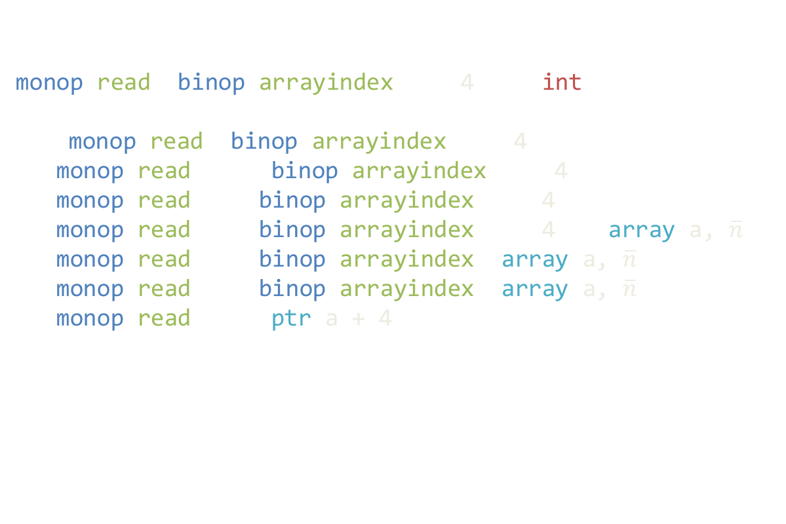
Arrays
A[4]
monop(read, binop(arrayindex, A, 4)) : int
F ▷ monop(read, binop(arrayindex, A, 4))
F, monop(read,∙) ▷ binop(arrayindex, A, 4)
F, monop(read,∙), binop(arrayindex, ∙, 4) ▷ A
F, monop(read,∙), binop(arrayindex, ∙, 4) ◁ array(a, $\overline{n}$)
F, monop(read,∙), binop(arrayindex, array(a, $\overline{n}$), ∙) ▷ 4
F, monop(read,∙), binop(arrayindex, array(a, $\overline{n}$), ∙) ◁ 4
F, monop(read,∙) ◁ ptr(a + 4)
if μ(a+4) = v then
F ◁ v
else
F ◁ exn

Slide 29
Structures
Nominally typed
Cannot be used as
parameter types
return types
local variable types
Heap allocated
May nest
struct Node {
struct Node *next;
int i;
};
int head(struct Node *n)
{
return n->i; }

Slide 30
Structures
Concrete
Abstract
struct S {
int x; };
struct S *s;
s->x
struct(∙, S$x : int)
monop(read,
monop(field(S$x), s)
: int

Slide 31

Formal Semantics
Progress
If $μ :Σ$and $Σ ⊢ K d t : τ$ then
either $Σ ⊢ K ◁ t$ final
or $μ | K;F d t → μ’ | K’ d′ t’$
Preservation
If $μ : Σ$and $Σ ⊢ K d t : τ$
and $μ \left| K;F d t → μ’ \right|K’ d t’$
then $∃ Σ’. μ’ : Σ’$ and $Σ’ ⊢ K′ d′ t ′: τ$ and $Σ ≤Σ’$

Slide 32
Summary
Basic types:
bool, int, char, string, pointers, arrays, structures
Basic control flow
Simple memory model
Abstract semantics
Simple elaboration
Formally defined

Slide 33
C₀ In Action
Where have we gone from here?

Slide 34
Libraries
Used for exposing OS APIs in a safe manner
Currently C/C++-only
Libraries provide:
a C₀ header
a native shared library
Very easy to wrap existing C/C++ libraries
Notes:
Native libraries can use C0’s garbage collector, the system allocator or some combination.

Slide 35
Libraries
C₀
C/C++
bool
int
T*
T[]
char
string
bool
int
T*
c0_array*
char
c0_string

Slide 36
Specifications
Embedded as special comments
Optional dynamic checking
Static checking someday!
Primary means reasoning about code
loop invariants
pre/post conditions
assertions
Slight superset of expressions
Notes:
Mention roc’s talk?

Slide 37
Specifications
int binsearch(int[] A, int len, int e)
//@ requires \length(A) == len
{
int lower = 0;
int upper = len-1;
while (lower < upper)
//@ loop_invariant lower >= 0 && upper < len
{ … } }

Slide 38
Specifications
//@ requires \length(A) == len
// @ensures issorted(\result)
int[] mergesort(int[] A, int len);
//@ requires \length(L) == len
//@ requires \length(R) == len
//@ ensures issorted(\result)
int[] merge(int[] L, int[] R, int len);

Slide 39
Missing Features
Maybe later, maybe never

Slide 40
Immutable values / const
void strrev(char[] dest, const char[] src)
{
int len = strlen(src);
for (int i = 0; i < len; i++)
//@ loop_invariant partial_rev(dest, src, i)
dest[len – i - 1] = src[i];
dest[len] = ‘\0’; }
strrev(A, A);
// Now what?
Notes:
C’s const is not that useful
Shallow
Only protects the view
Want an immutable heap
Constrained by C compatibility

Slide 41
Immutable values / const
struct Node {
struct Node *next;
int i; };
int length(const struct Node *n) {
// Foiled!
n->i = 9;
// Success!
struct Node *next = n->next;
next->next = NULL;
return 2; }

Slide 42
Address-of (&)
int parse_int(string s, bool *p);
int tonum(string s) {
int i;
bool b;
i = parse_int(s, &b);
assert(b, “Bad input string”);
return i;
}
Notes:
Idiomatic C
Many students don’t know about this feature
Aliasing
Annotating pointers or escape analysis

Slide 43
Unions
union Value {
int i;
bool b;
Value *p; };
int main() {
Value v;
// Writes tag b
v.b = false;
// Fails
return v.i; }

Slide 44
Unions
struct Box {
int tag; // 0 for int, 1 for pointer
union U { int i; int *p; } value;
};
int *f(Box *b, int *p) {
b->tag = 1;
b->value.p = p;
return p;
}
void cisawesome () {
Box b; b.tag = 0; b.value.i = 0;
int *s = f(&b, &b.value.i);
// Can now get a pointer
// to arbitrary memory
*s = 40;
}
Notes:
Interaction with address-of a concern

Slide 45
Unions
union Box {
int Int;
int* Ptr;
};
void SomeComputation(Box *b);
int main () {
Box b = Int (0);
Box *pb = &b;
SomeComputation(&b);
switch (b) {
case Int i:
*pb = Pointer(alloc(int));
return i;
case Pointer p:
*pb = Int(0);
return *p;
}
}
Notes:
C’s model of sum types is broken
Tag and value must be paired
Can have hidden tag to track which type is valid
How do you inspect it then?
Can let the user have an explicit tag
How do you update then?

Slide 46
Module System
Global namespace is bad
A single file goes only so far
C doesn’t have a good solution
Partial solutions
Libraries
Compiler accepts multiple files

Slide 47
Contributions
C₀
Simple to learn
Very similar to C
Formally specified
Emphasizes reasoning
Simple library system
Easy to bind existing libraries
Several already written

Slide 48
Extra Slides

Slide 49

Types
Concrete (T)
Abstract (τ)
bool
int
T*
T[]
struct F { … }
bool
int
τ $→$ τ’
τ*
τ[]
struct(p)
cmd
tuple(τ₁,…,τ_{n})

Slide 50

Formal Semantics
Types τ = bool | int | τ* | cmd | …
Values v = true | $\overline{0}$ | ptr(a) | …
Addresses a = l | a + n | a + f
Expressions
e = v | binop(op, e₁, e₂) | call(e_{f}, e)
| x | decl(x, τ, e) | assign(x, e)
| return(e) | loop(e_{c}, e) | break
| alloc(τ) | allocarray(τ, e) | …

