Slide 1
Algorithm Design and Analysis
算法设计与分析

Slide 2
Zhang Sheng（张胜）
Research interest: Distributed Computing System
Cloud Computing
Edge Computing, Edge Intelligence
Office: 计算机系楼537
Email: sheng@nju.edu.cn
Homepage：http://cs.nju.edu.cn/sheng/

Slide 3

Prologue
As soon as an Analytical Engine exists, it will necessarily guide the future course of the science. Whenever any result is sought by its aid, the question will then arise – By what course of calculation can these results be arrived at by the machine in the shortest time?
- Charles Babbage, 1864

Slide 4
Main Contents
Introduction (including asymptotics, recursion, etc.)
Sorting algorithms and their analyses
Selection and adversary arguments
Hash and amortized analysis
Mid-term Examination
Graph traverse
Greedy strategy
Dynamic programming
NP-complete theory
Final Examination

Slide 5
Example 1: Selection
Suppose E is an array containing n elements with keys from some linearly order set, and let k be an integer such that 1≤k≤n. The selection problem is to find an element with the kth smallest key in E.
Special Cases:
Find the max: k=n
Find the min: k=1
Question: How many comparisons do we need?

Slide 6
How many comparisons do we need?
Find the max or min
at least (n-1) comparisons. Why?
How many comparions if we want to find the max and min simultaneously?

Slide 7
Find the max and min simultaneously
The strategy
Pair up the keys, and do n/2 comparisons(if n odd, having E[n] uncompared);
Find the max in the larger key set and find the min in the small key set respectively (if n odd, E[n] included in both sets)
Number of comparisons
For even n: n/2+2(n/2-1)=3n/2-2
For odd n: (n-1)/2+2((n-1)/2+1-1)=⎡3n/2⎤-2
We can prove later that, this is indeed the optimal solution.
Notes:
Is this strategy the optimal one?

Slide 8
Example 2: Memory allocation
Insert(Table H, Item x)
integer size=0, num=0;
if size=0 then allocate a block of size 1; size=1;
if num=size then
allocate a block of size 2size;
move all items into the new table;
size=2size;
insert x into the table;
num=num+1;
return
After inserting lots of items, what is the average cost of inserting one item?

Slide 9
After inserting lots of items, what is the average cost of inserting one item?
Table
Insert | Cost of Insertion
a | 1
c | 2
e | 3
g | 1
s | ?
a
a
c
a
c
e

Slide 10
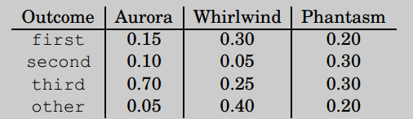
Example 3: Predict your horse
The annual county horse race is bringing in three horses who have never competed against one another. You study their past 200 races and summarize these as probability distributions over four outcomes.
Question: which horse is the most predictable?

Slide 11
Solution: Write down the history of each horse as a string of 200 values. Use Huffman’s algorithm to encode them. This works out to 290 bits for Aurora, 380 for Whirlwind, and 420 for Phantasm. Aurora has the shortest encoding and is therefore in a strong sense the most predictable.
Remark 1: Consider a fair coin and a biased coin. A biased coin is more predictable.
Remark 2:
more compressible ≡ less random
≡ more predictable ≡ small entropy

Slide 12
Example 4: The halting problem
Given a program written in your favourite language, and given an input. Will the program terminate on the input?

Slide 13
Given a program written in your favourite language, and given an input. Will the program terminate on the input?
Suppose we can write an algorithm terminate(p,x) that can check whether program p will terminate on input x.
Consider the following program:
Note what paradox() does: it terminates if and only if z does not terminate when given its own code as input.
Will paradox(paradox) terminate? Neither answer is possible. A contradiction!
Therefore, we cannot write an algorithm terminate(p,x).
Function paradox(z)
1: if terminates(z, z) goto 1

Slide 14

Textbook
[黄] 黄宇, 算法设计与分析，第2版，机械工业出版社，2020.

Slide 15
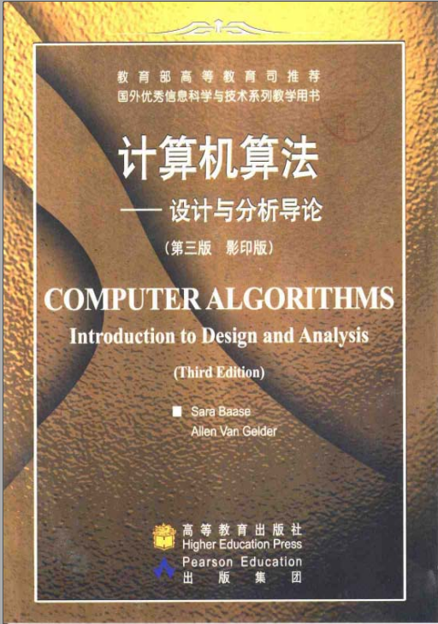
Textbook
[BG] Sara Baase and Allen Van Gelder, Computer Algorithms: Introduction to Design and Analysis (3rd Edition), Pearson Education, 1999.

Slide 16
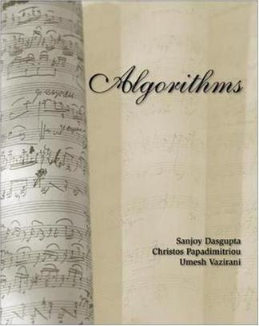
Textbook
[DPV] Sanjoy Dasgupta, Christos Papadimitriou, Umesh Vazirani. Algorithms, McGraw-Hill Science/Engineering/Math. 2006

Slide 17
References
Classics
Donald E.Knuth. The Art of Computer Programming
Vol.1 Fundamental Algorithms
Vol.2 Semi-numerical Algorithms
Vol.3 Sorting and Searching
Popular textbooks
Thomas H.Cormen, etc. Introduction to Algorithms
Robert Sedgewick. Algorithms (with different versions using different programming languages)
Advanced mathematical techniques
Graham, Knuth, etc. Concrete Mathematics: A Foundation for Computer Science

Slide 18
More References
Design Techniques Oriented Textbooks
Anany Levitin. Introduction to the Design and Analysis of Algorithms
M.H.Alsuwaiyel. Algorithms Design Techniques and Analysis
G.Brassard & P.Bratley: Fundamentals of Algorithmics
Evergreen Textbook
Aho, Hopcroft and Ullman. The Design and Analysis of Computer Algorithm
Something New
J.Kleinberg & E.Tardos: Algorithm Design

Slide 19
考核方式
平时书面作业15%
平时编程练习15%
期中考试20%
期末考试50%
注1：适用于所有同学（包括免修不免考）
注2：原则上书面作业不接受补交；如有特殊情况，必须在期末考试开考前补交，但书面作业得分会被打折。

Slide 20
学术诚信
诚信是学术活动中最重要的品格
所有提交的作业都必须是自己完成的
任何抄袭和作弊将导致最后课程成绩为0分，并有可能上报给学校进行进一步处分

Slide 21
教学资源发布
课件发布：QQ群
第1、2周线上授课录播视频：教学立方
“算法设计与分析（张胜班）2022春季”的邀请码是XYV3RG7N， 1.请同学们在微信中搜索“教学立方”公众号并关注 2.点击公众号底部“学生”菜单 3.如未登录，请先注册/登录 4.点击课程列表页面中的“加入课程”输入邀请码即可加入
书面作业发布：QQ群
提交方式：上课时提交纸质作业本

Slide 22
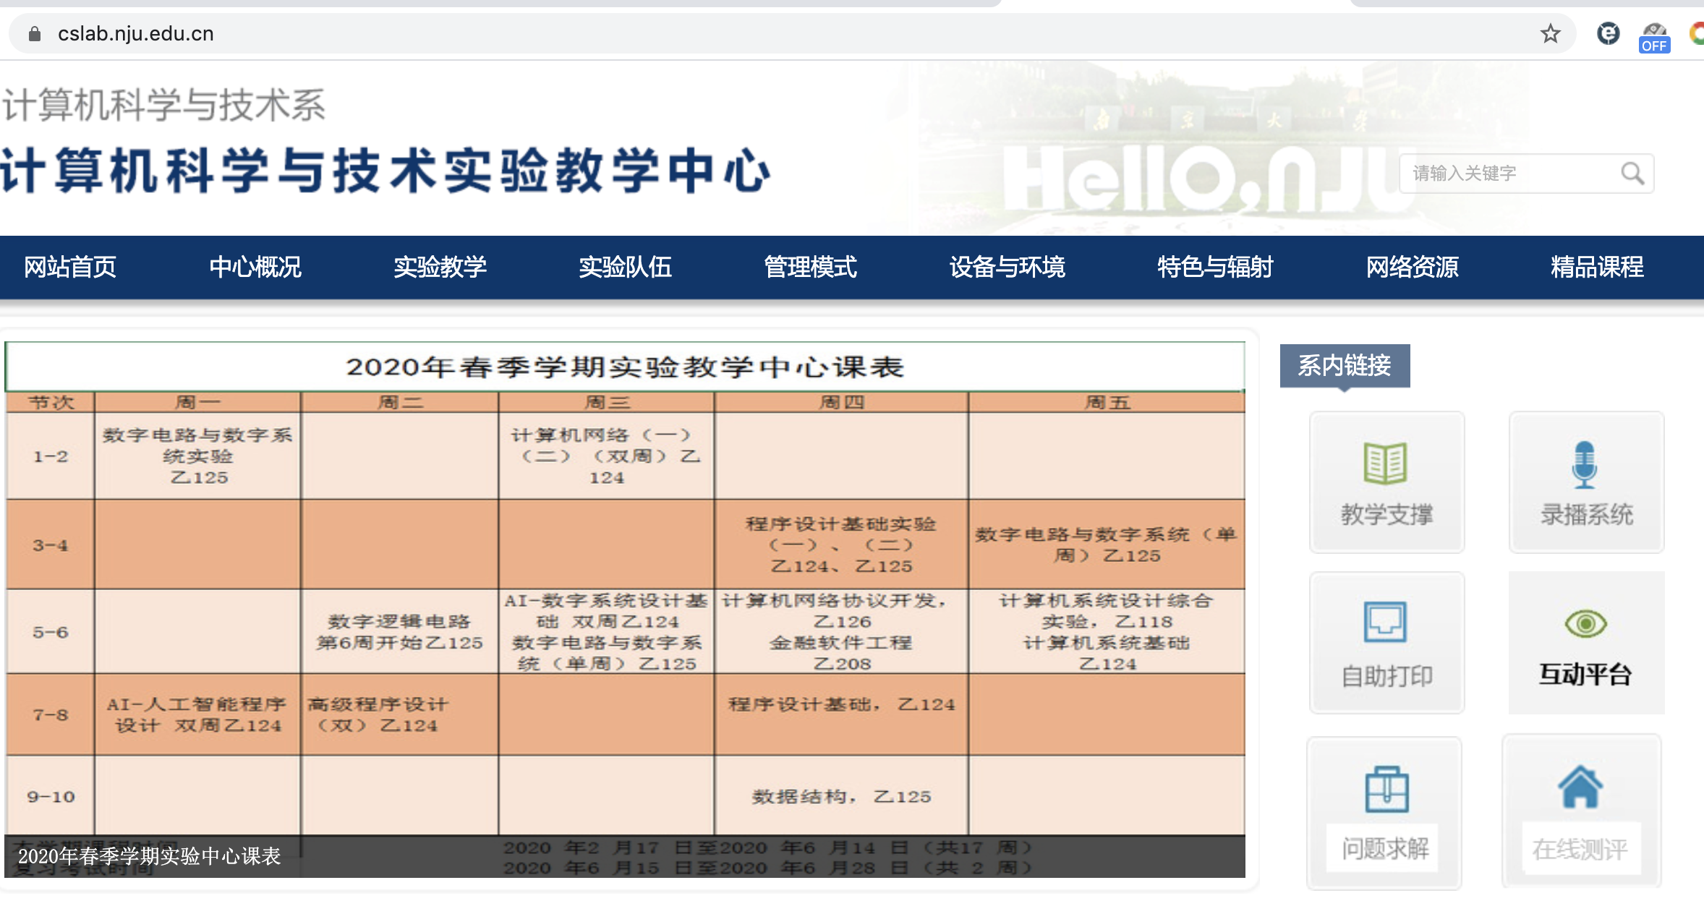
编程作业发布
我系实验教学中心主页（cslab.nju.edu.cn）右侧的“在线评测”就是OJ系统。OJ新服务器没有申请出校权限，所以学生们在家访问需要通过VPN。
预计8次作业，每次3-4题，每次你们有2-3周时间完成作业。

Slide 23
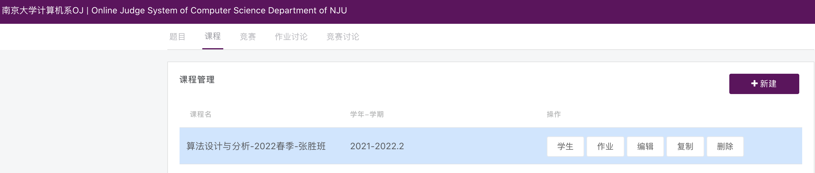
编程作业发布
选择课程“算法设计与分析-2022春季-张胜班”。
进入作业。
后续作业发布时不再另行通知。请自行前往OJ网站查看，并在截止时间之前做完。

Slide 24

交流讨论答疑
QQ群697391412
联系教师或助教
教师联系方式
张胜 sheng@nju.edu.cn
助教联系方式
程珂 kecheng.nju@gmail.com
施霄航 15952022585@163.com

