Slide 1
Introduction
张胜
sheng@nju.edu.cn
南京大学

Slide 2

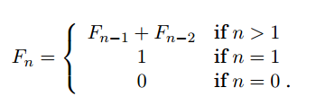
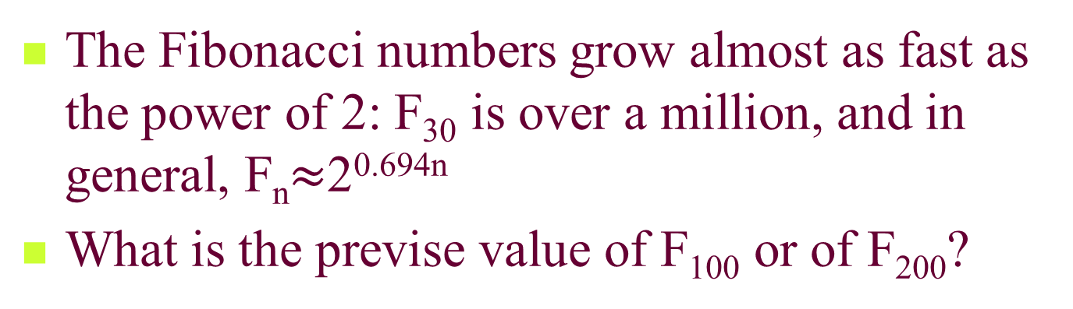
Example: Fibonacci
The Fibonacci numbers grow almost as fast as the power of 2: F₃₀ is over a million, and in general, F_{n}$≈$2^{0.694n}
What is the previse value of F₁₀₀ or of F₂₀₀?
Notes:
No other sequence of numbers has been studied as extensively as Fibonacci numbers.
Together with the powers of 2, it is computer science’s favourite sequence.

Slide 3
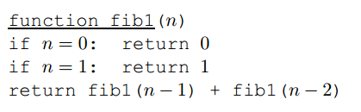
Fibonacci
Whenever we have an algorithm, there are 3 questions we always ask about it:
Is it correct?
How much time does it take, as a funtion of n?
And can we do better?

Slide 4

Q1: Is it correct? Yes.
Q2: How much time does it take, as a funtion of n?
We use T(n) to denote the time it takes to compute F(n). We have T(0)=1, T(1)=2, and
We see that T(n) is larger than F(n). This is a bad news, which implies that the algorithm is impractically slow.
For example, to compute F₂₀₀, this algorithm needs 2⁹² seconds on the fastest computer in 2006 (40 trillion steps per second)
Q3: Can we do better?
Notes:
This means that, if we start the computation today, it would still be going long after the sun turns into a red giant star.

Slide 5
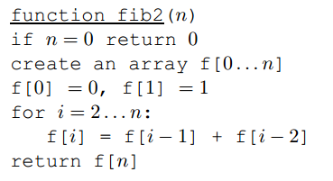
Q3: Can we do better?
Exponential time.
Linear time.

Slide 6
Introduction to Algorithm Analysis
Goal of the Course
Algorithm, the concept
Algorithm Analysis: the criteria
Average and Worst-Case Analysis
Lower Bounds and the Complexity of Problems

Slide 7
Goal of the Course
Learning to solve real problems that arise frequently in computer application
Learning the basic principles and techniques used for answering the question: “How good, or, how bad is the algorithm”
Getting to know a group of “very difficult problems” categorized as “NP-Complete”

Slide 8
Algorithmically Solvable Problem
Informally speaking
A problem for which a computer program can be written that will produce the correct answer for any valid input if we let it run long enough and allow it as much storage space as it needs.
Unsolvable (or un-decidable) problem
Problems for which no algorithms exist
the Halting Problem for Turing Machine

Slide 9
Design and Analysis, in general
Design
Understanding the goal
Select the tools
What components are needed
How the components should be put together
Composing functions to form a process
Analysis
How does it work?
Breaking a system down to known components
How the components relate to each other
Breaking a process down to known functions

Slide 10

Probably the Oldest Algorithm
Euclid algorithm
input: nonnegative integer m, n
output: gcd (m, n)
procedure
E1. n divides m, the remainder→r
E2. if r =0 then return n
E3. n→m; r→n; goto E1
Specification
The Problem:
Computing the greatest common divisor of two nonnegative integers

Slide 11

Euclid Algorithm: Recursive Version
Euclid algorithm
input: nonnegative integer m, n
output: gcd (m, n)
procedure
Euclid (int m, n)
if n=0
then return m
else return Euclid (n, m mod n)
Specification
Recursion
Algorithm Pseudocode

Slide 12
Criteria for Algorithm Analysis
Correctness
Amount of work done
Amount of space used
Simplicity, clarity
Optimality

Slide 13
Correctness of Euclid Algorithm
m=k₁d, n= k₂d
m mod n= k₁d - k₃k₂d
Euclid algorithm
input: nonnegative integer m,n
output: gcd(m,n)
procedure
Euclid(int m,n)
if n=0
then return m
else return Euclid(n, m mod n)
if d is a common divisor of m and n, it must be a common divisor of n and (m mod n)
2
1
(m mod n) is always less than n, so, the algorithm must terminate

Slide 14
Proving Correctness by Induction
Induction on n. That is, we need to prove:
Euclid(m,0) gives the correct output for any nonnegative m
Euclid(m,1) gives the correct output for any nonnegative m
……
Euclid(m,k) gives the correct output for any nonnegative m

Slide 15
How to measure the amount of work done?
Not too general
Giving some indication to make useful comparison for algorithms
Not too precise
Machine independent
Language independent
Programming style independent
Implementation independent
Notes:
目的：比较算法

Slide 16
How to measure?
A tradeoff between “not too general” and “not too precise” is the number of simple operations (e.g., multiplications and additions in matrix multiplication)
Running time is usually proportional to the number of simple operations
A better one is the number of critical operations, which greatly simplifies the analysis of algorithm running time.

Slide 17
Critical operation
Search or sorting an array comparison
Multiply 2 matrices multiplication
Find the gcd mod
Traverse a tree processing an edge
Non-iterative procedure procedure invocation
Running time is usually proportional to the number of critical operations

Slide 18
Presenting the Analysis Results
Amount of work done usually depends on the size of the inputs
Amount of work done usually doesn’t depend on the size solely

Slide 19
Worst-case Complexity
Worst-case complexity, of a specified algorithm A for a specified problem P of size n:
Giving the maximum number of operations performed by A on any input of size n
Being a function of n
Denoted as W(n)
W(n)=max{t(I) | I∈D_{n}}, where D_{n} is the set of input and t(I) is the running time on I.

Slide 20
Worst-Case Complexity of Euclid Algorithm
For your reference:
φ = (1+√5)/2≈1.6180…
For any integer k≥1, if m>n≥1 and n<F_{k+1}, then the call Euclid(m,n) makes fewer than k recursive calls. (to be proved in the next page)
Since F_{k} is approximately , the number of recursive calls in Euclid is O(lgn).
Euclid(int m,n)
if n=0
then return m
else return Euclid(n, m mod n)
measured by the number of recursive calls
F_{k}<n<F_{k+1} => k<lg($\sqrt{5}$n)<k+1 => k=O(lgn)
Notes:
这个结果也证明了辗转相除法的运算步骤不会超过较小数十进制下的位数的五倍。因为如果算法需要N步，那么b一定大于或等于F_{N+1}，也就是一定大于或等于φ^{N−1}，其中φ是黄金分割比。因为b ≥ φ^{N−1}，所以N − 1 ≤ log_{φ}b。因为log₁₀φ > 1/5，(N − 1)/5 < log₁₀φ log_{φ}b = log₁₀b，所以N ≤ 5 log₁₀b。所以，辗转相除法不会进行超过O(h)次除法，其中h是较小数b在十进制下的位数。

Slide 21
Euclid Algorithm and Fibonacci
If m>n≥1 and the invocation Euclid(m,n) performs k≥1 recursive calls, then m≥F_{k+2} and n≥F_{k+1}.
Proof by induction
Basis: k=1, then n≥1=F₂. Since m>n, m≥2=F₃.
For larger k, Euclid(m,n) calls Euclid(n, m mod n) which makes k-1 recursive calls. So, by induction hypothesis, n≥F_{k+1}, (m mod n)≥F_{k}.
Note that m ≥ n+(m-⎣m/n⎦n) = n+(m mod n) ≥ F_{k+1}+F_{k} = F_{k+2}

Slide 22
The Bound is Tight
The upper bound for Euclid(m,n) is tight, by which we mean that: “if n<F_{k+1}, the call Euclid(m,n) makes fewer than k recursive calls” is best possible result.
There do exist some inputs for which the algorithm makes the same number of recursive calls as the upper bound.
Euclid (F_{k+1}, F_{k}) recurs exactly k-1 times.

Slide 23
Average Complexity
Weighted average A(n)
How to get Pr(I)
By previous experience
By simple assumptions
By assuming a particular application
Pr(I) is the probability of the occurrence of input I

Slide 24
Sequential Search, another Example
Procedure:
Int seqSearch(int[] E, int n, int K)
int ans, index;
ans=-1;
for (index=0; index<n; index++)
if (K==E[index])
ans=index;
break;
Return ans;
The Problem: Searching a list for a specific key.
Input:
an unordered array E with n entries, a key K to be matched
Output:
the location of K in E (or fail)

Slide 25
Average Behavior Analysis of Sequential Search
Case 1: assuming that K is in E
Assuming no same entries in E
Taking all inputs with K in the ith location as one input
Each input occurs with the same probability (i.e. 1/n)
A_{succ}(n)=Σ_{i=0..n-1}Pr(I_{i}|succ)t(I_{i})
=Σ_{i=0..n-1}(1/n)(i+1)
=(n+1)/2

Slide 26
Average Behavior Analysis of Sequential Search
Case 2: K may not be in E
Assume that q is the probability for K in E
A(n) = Pr(succ)A_{succ}(n)+Pr(fail) A_{fail}(n)
=q((n+1)/2)+(1-q)n

Slide 27
Optimality: Definition
Definition of the optimal algorithm
For problem P, the algorithm A does at most W_{A}(n) steps in the worst case (upper bound)
For some function F, it is provable that for any algorithm in the class under consideration, there is some input of size n for which the algorithm must perform at least F(n) steps (lower bound)
If W_{A}=F, then A is optimal and F is the lower bound of problem P.

Slide 28
Optimality: How to prove?
1. Devise what seems to be an efficient algorithm; call it A. Analyze A and find a function W_{A} such that, for inputs of size n, A does at most W_{A}(n) steps in the worst case (upper bound).
2. For some function F, prove a theorem stating that, for any algorithm in the class under consideration, there is some input of size n for which the algorithm must perform at least F(n) steps (lower bound).
If W_{A}=F, then A is optimal and F is the lower bound of problem P. If not, it may be that there is a better algorithm or that there is a better lower bound.

Slide 29
Eastblishing a lower bound
Procedure:
int findMax(E,n)
max=E(0)
for (index=1;index<n;index++)
if (max<E(index)
max=E(index);
return max
Lower bound
For any algorithm A that can compare and copy numbers exclusively, if A does fewer than n-1 comparisons in any case, we can always provide a right input so that A will output a wrong result.
The problem:
Input: number array E with n entries indexed as 0,…n-1
Output: Return max, the largest entry in E

Slide 30
Bounds: Upper and Lower
For a specific algorithm (to solve a given problem), the “upper bound” is a cost value no less than the maximum cost for the algorithm to deal with the worst input.
For a given problem, the “lower bound” is a cost value no larger than any algorithm (known or unknown) can achieve for solving the problem.
A computer scientist want to make the two bounds meet.

