Slide 1
Asymptotic Behavior
张胜
sheng@nju.edu.cn
南京大学

Slide 2
In the last class…
Goal of the Course
Algorithm: the Concept
Algorithm Analysis: the Contents
Average and Worst-Case Analysis
Lower Bounds and the Complexity of Problems

Slide 3
Asymptotic Behavior
Asymptotic growth rate
The Sets Ο, Ω and Θ
Complexity Classes
An Example: Binary Search
Binary Search is Optimal

Slide 4
How to Compare two Algorithms?
W(n) and A(n) could be used to present the complexity of an algorithm.
Simplifying the analysis: the principle
assumption that the total number of steps is roughly proportional to the number of basic operations counted (a constant coefficient)
only the leading term in the formula is considered
constant coefficient is ignored

Slide 5
The Set “Big Oh”
Definition
Giving g:N→R⁺, then Ο(g) is the set of f:N→R⁺, such that for some c>0 and some n₀∈N, f(n)≤cg(n) for all n≥n₀.
A function f∈Ο(g) if
Note: c may be zero. In that case, f∈ο(g), “little Oh”

Slide 6

Example
Using L’Hopital’s Rule
Let f(n)=n², g(n)=nlgn, then:
f∉Ο(g), since
g∈Ο(f), since
For your reference: L’Hôpital’s rule
with some constraints

Slide 7

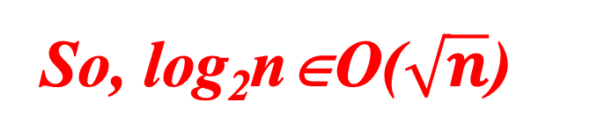
Logarithmic Functions and Powers
Which grows faster?
So, log₂n∈O($\sqrt{n}$)

Slide 8
The Result Generalized
The log function grows more slowly than any positive power of n
lgn ∈ o(n^{α}) for any α>0
By the way:
The power of n grows more slowly than any exponential function with base greater than 1
n^{k} ∈ o(c^{n}) for any c>1

Slide 9

Dealing with big-O correctly

Slide 10
Factorials and Exponential Functions
n! grows faster than 2^{n} for positive integer n.

Slide 11
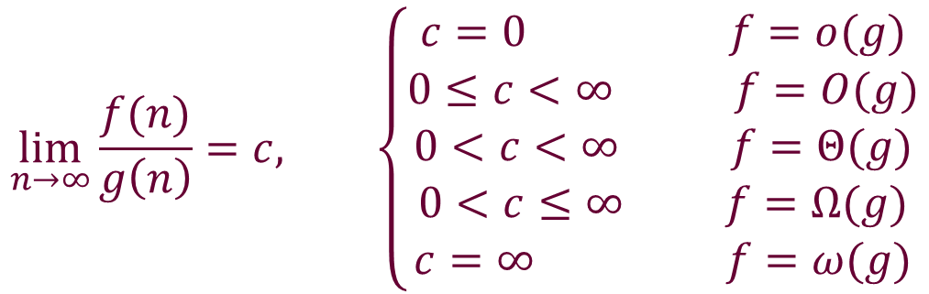
The Sets Ω and Θ
$$\lim_{n→∞}{\frac{f(n)}{g\left(n\right)}}=c, \left\{\begin{aligned}c=0 f=o(g) \\ 0≤c<∞ f=O(g) \\ 0<c<∞ f=Θ(g) \\ 0<c≤∞ f=Ω(g) \\ c=∞ f=ω(g)\end{aligned}\right.$$

Slide 12
Relative Growth Rate
Ω(g):functions that grow at least as fast as g
Θ(g):functions that grow at the same rate as g
g
Ο(g):functions that grow no faster as g

Slide 13
Properties of O, Ω and Θ
Transitive property:
If f∈O(g) and g∈O(h), then f∈O(h)
Symmetric properties
f∈O(g) if and only if g∈Ω(f)
f∈Θ(g) if and only if g∈Θ(f)
Order of sum function
O(f+g)=O(max(f,g))

Slide 14
Complexity Class
Let S be a set of f:N→R* under consideration, define the relation ~ on S as following: f~g iff. f∈Θ(g)
then, ~ is an equivalence.
Each set Θ(g) is an equivalence class, called complexity class.
We usually use the simplest element as possible as the representative, so, Θ(n), Θ(n²), etc.

Slide 15
Effect of the Asymptotic Behavior
algorithm
1
2
3
4
Run time in ns
1.3n³
10n²
47nlogn
48n
10³
10⁴
10⁵
10⁶
10⁷
1.3s
22m
15d
41yrs
41mill
10ms
1s
1.7m
2.8hrs
1.7wks
0.4ms
6ms
78ms
0.94s
11s
0.05ms
0.5ms
5ms
48ms
0.48s
time for size
max
Size in time
sec
min
hr
day
920
3,600
14,000
41,000
10,000
77,000
6.0×10⁵
2.9×10⁶
1.0×10⁶
4.9×10⁷
2.4×10⁹
5.0×10¹⁰
2.1×10⁷
1.3×10⁹
7.6×10¹⁰
1.8×10¹²
time for 10 times size
×1000
×100
×10+
×10
on 400Mhz Pentium II, in C
from: Jon Bentley: Programming Pearls

Slide 16
Searching an Ordered Array
The Problem: Specification
Input:
an array E containing n entries of numeric type sorted in non-decreasing order
a value K
Output:
index for which K=E[index], if K is in E, or, -1, if K is not in E

Slide 17
Sequential Search
Int seqSearch(int[] E, int n, int K)
1. Int ans, index;
2. ans=-1; // Assume failure
3. For (index=0; index<n; index++)
4. If (K= =E[index]) ans=index; break; //success!
5. Else if (K<E[index]) break; //failure!
6. Else;
7. return ans;

Slide 18
Searching a Sequence
For a given K, there are two possibilities
K in E (say, with probability q), then K may be any one of E[i] (say, with equal probability, that is 1/n)
K not in E (with probability 1-q), then K may be located in any one of gap(i) (say, with equal probability, that is 1/(n+1))
gap(0)
gap(i-1)
gap(n+1)
E[1]
E[2]
E[i-1]
E[i]
E[I+1]
E[n]

Slide 19
Analysis of Sequential Search
Worst-case complexity: n
Average complexity
Note: A(n)∈Θ(n)
Roughly n/2

Slide 20
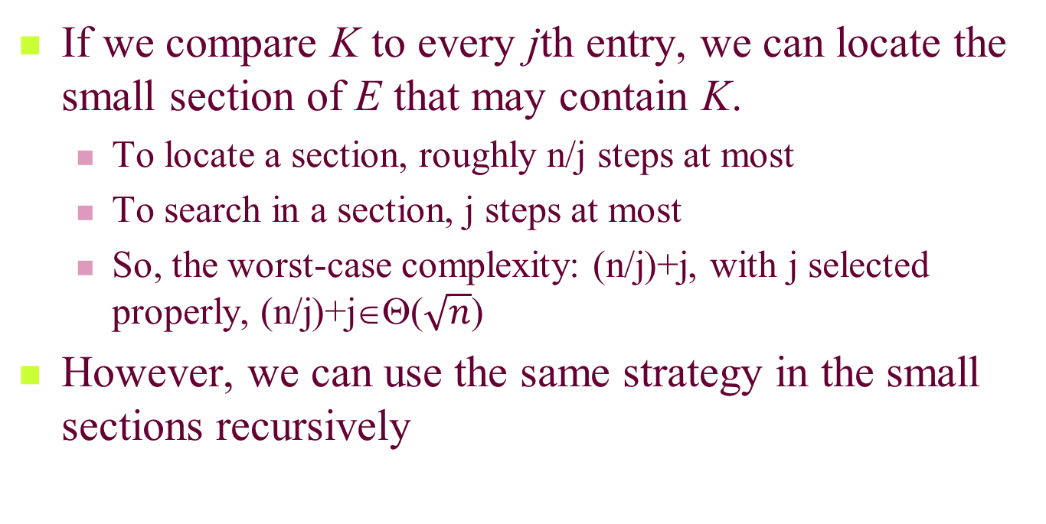
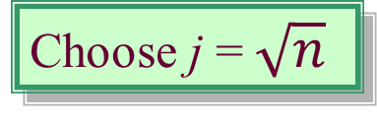
Divide and Conquer
If we compare K to every jth entry, we can locate the small section of E that may contain K.
To locate a section, roughly n/j steps at most
To search in a section, j steps at most
So, the worst-case complexity: (n/j)+j, with j selected properly, (n/j)+j∈Θ($\sqrt{n}$)
However, we can use the same strategy in the small sections recursively
Choose j = $\sqrt{n}$

Slide 21
Binary Search
int binarySearch(int[] E, int first, int last, int K)
if (last<first)
index=-1;
else
int mid=(first+last)/2
if (K==E[mid])
index=mid;
else if (K<E[mid])
index=binarySearch(E, first, mid-1, K)
else if (K>E[mid])
index=binarySearch(E, mid+1, last, K)
return index;

Slide 22
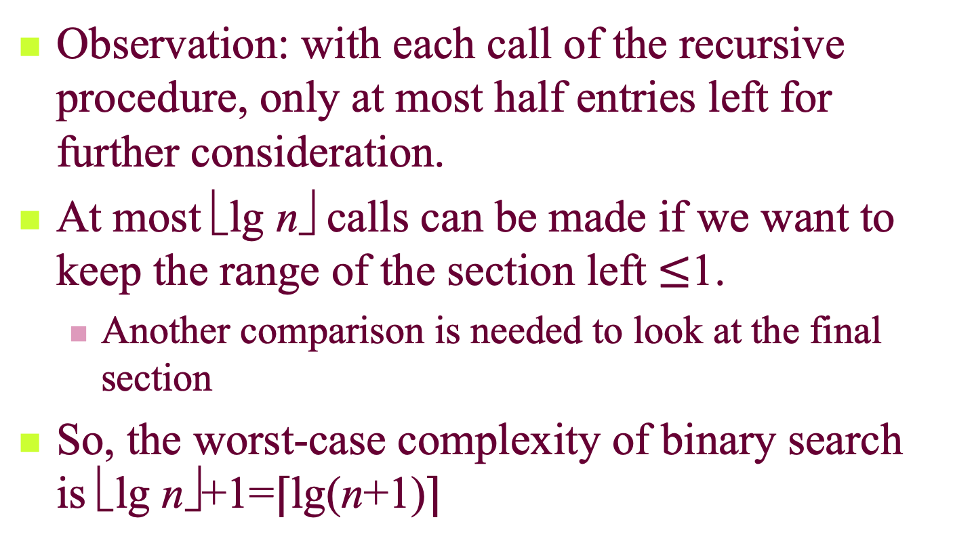
Worst-case Complexity of Binary Search
Observation: with each call of the recursive procedure, only at most half entries left for further consideration.
At most ⎣lg n⎦ calls can be made if we want to keep the range of the section left $≤$1.
Another comparison is needed to look at the final section
So, the worst-case complexity of binary search is ⎣lg n⎦+1=⌈lg(n+1)⌉

Slide 23
Average Complexity of Binary Search
Observations:
for most cases, the number of comparison is or is very close to that of the worst case
particularly, if n=2^{k}-1, all failure positions need exactly k comparisons
Assumptions:
all success positions have the same probability (1/n)
n=2^{k}-1

Slide 24
Average Complexity of Binary Search
Let s_{t} be the number of inputs for which the algorithm does t comparisons. If n=2^{k}-1, s_{t}=2^{t-1}.

Slide 25


Slide 26
Decision Tree (决策树)
A decision tree for an algorithm A and a given input of size n is a binary tree whose nodes are labeled with numbers between 0 and n-1
Root: labeled with the index
first compared
If the label on a particular node
is i, then the left child is labeled
the index next compared if K<E[i],
the right child the index next
compared if K>E[i], and no branch
for the case of K=E[i].
4
1
7
5
8
0
2
9
3
6

Slide 27
Binary Search is Optimal
If the number of comparison in the worst case is p, then the length of the longest path from root to a leaf is p-1, so there are at most 2^{p}-1 node in the tree.
There are at least n node in the tree.
(We can prove that, for all i∈{0,1,…,n-1}, there exists a node with label i.)
Conclusion: n≤ 2^{p}-1, that is p≥lg(n+1)

Slide 28
Binary Search is Optimal
For all i∈{0,1,…,n-1}, there exists a node with label i.
Proof:
If otherwise, suppose that i doesn’t appear in the tree.
Assume there are two inputs E₁ and E₂, with E₁[i]=K, E₂[i]=K’, K’>K; and for any j≠i, (0≤j≤n-1), E₁[j]=E₂[j]. (Arrange the values to keeping the order in both arrays).
Since i doesn’t appear in the tree, for both K and K’, the algorithm behaves the same, thus gives the same output, among which at least one is wrong. Therefore, A is not a right algorithm.

