Slide 1
Fundamentals of Algorithm Analysis
Algorithm : Design & Analysis
[Tutorial - 1]
张胜
sheng@nju.edu.cn
南京大学

Slide 2
In Previous Classes…
Introduction to Algorithm Analysis
Asymptotic Behavior of Functions
Recursion and Master Theorem

Slide 3
In Tutorial 1
About the Tutorial
Revisiting Asymptotic Behavior
Useful Summation Formulae
Example: Maximum Subsequence Sum
Revisiting Recursion

Slide 4
About the Tutorial
The tutorial: Reemphasize important issues by
Further explanation
Typical examples
Interaction
…

Slide 5
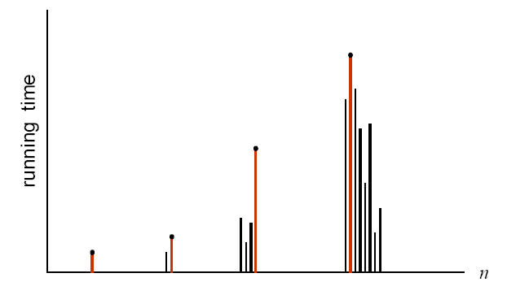
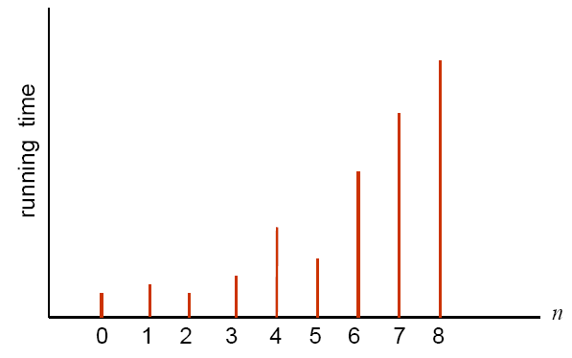
Worst Case Measure
For each input size we select the worst case.
Notes:
对于单个input size，由于具体input内容的不一样，运行时间也不一样，我们选择最大（坏）的运行时间

Slide 6
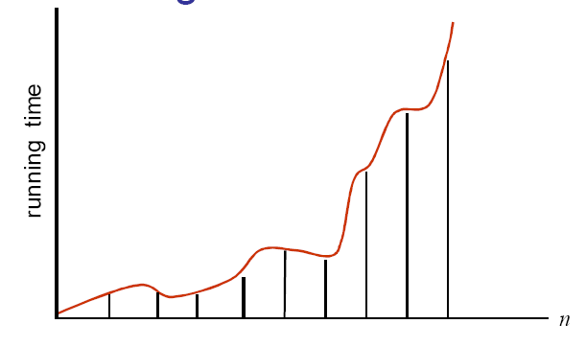
Running Time not Monotonic
Actual running time may not be monotonic in n.

Slide 7
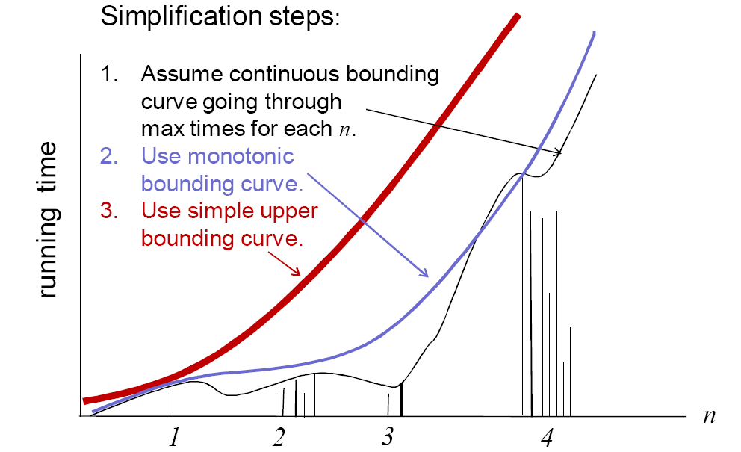
To use a “simple” Function

Slide 8
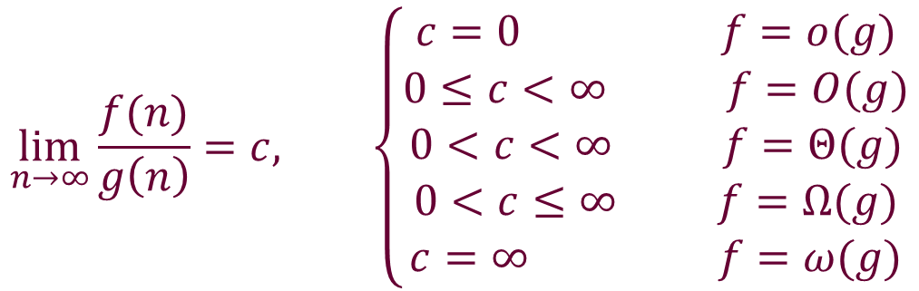
Asymptotic Behavior
$$\lim_{n→∞}{\frac{f(n)}{g\left(n\right)}}=c, \left\{\begin{aligned}c=0 f=o(g) \\ 0≤c<∞ f=O(g) \\ 0<c<∞ f=Θ(g) \\ 0<c≤∞ f=Ω(g) \\ c=∞ f=ω(g)\end{aligned}\right.$$

Slide 9
Analogy
f∈Ο(g) ≈ a ≤ b
f∈Ω(g) ≈ a ≥ b
f∈Θ(g) ≈ a = b
f∈o(g) ≈ a < b
f∈ω(g) ≈ a > b
What about the relationship between f(n) and g(n), if f(n) = n and g(n) = n^{1+sinn} ?
Notes:
Lim f/g = 1/n^{sin n} could be 0 or infinity, thus , f and g do not have any relationship mentioned in this slide.
-1 <= Sin n <=1

Slide 10
Properties of O(o), Ω(ω) and Θ
Transitive property(O, Θ, Ω, ω, o):
If f∈O(g) and g∈O(h), then f∈O(h), …
Reflexive property:
f(n)∈Θ(f(n)), f(n)∈O(f(n)), f(n)∈Ω (f(n))
Symmetric properties
f∈Θ(g) if and only if g∈Θ(f)
f∈O(g) if and only if g∈Ω(f)
f∈o(g) if and only if g∈ω(f)
Order of sum function
O(f+g)=O(max(f, g))

Slide 11
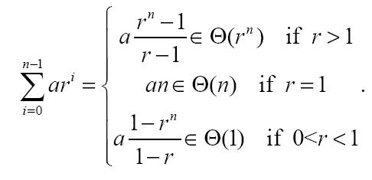

Useful Summation Formulae
Geometric Sequences
Harmonic Sequence

Slide 12
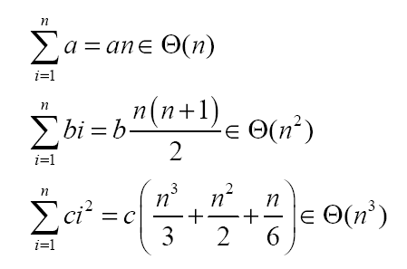
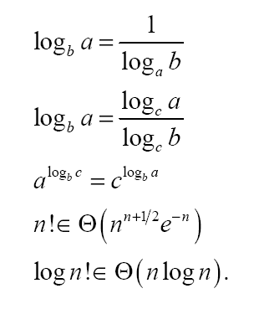
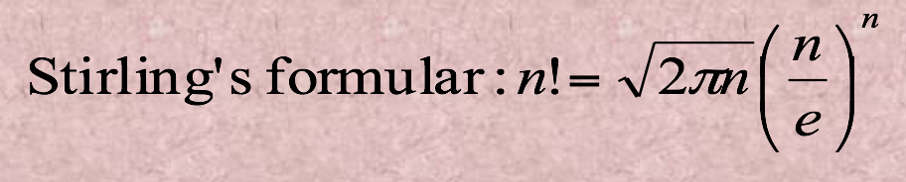
Useful Summation Formulae (Cont.)
Arithmetic Sequences
Miscellaneous

Slide 13


Example: Maximum Subsequence Sum
The problem: Given a sequence S of integer, find the largest sum of a consecutive subsequence of S. (0, if all negative items)
An example: -2, 11, -4, 13, -5, -2; the result 20: (11, -4, 13)
A brute-force algorithm:
MaxSum = 0;
for (i = 0; i < N; i++)
for (j = i; j < N; j++)
{
ThisSum = 0;
for (k = i; k <= j; k++)
ThisSum += A[k];
if (ThisSum > MaxSum)
MaxSum = ThisSum;
}
return MaxSum;
j=0
the sequence
j=1
j=2
j=n-1
i=0
i=1
k
i=2
……
in O(n³)
i=n-1

Slide 14
More Precise Complexity

Slide 15
Decreasing the number of loops
An improved algorithm
MaxSum = 0;
for (i = 0; i < N; i++)
{
ThisSum = 0;
for (j = i; j < N; j++)
{
ThisSum += A[j];
if (ThisSum > MaxSum)
MaxSum = ThisSum;
}
}
return MaxSum;
the sequence
i=0
i=1
i=2
j
in O(n²)
i=n-1

Slide 16
Power of Divide-and-Conquer
Part 1
Part 2
the sub with largest sum may be in:
recursion
Part 1
Part 2
or:
The largest is the result
Part 1
Part 2
in O(nlogn)

Slide 17

Divide-and-Conquer: the Procedure
Center = (Left + Right) / 2;
MaxLeftSum = MaxSubSum(A, Left, Center); MaxRightSum = MaxSubSum(A, Center + 1, Right);
MaxLeftBorderSum = 0; LeftBorderSum = 0;
for (i = Center; i >= Left; i--)
{
LeftBorderSum += A[i];
if (LeftBorderSum > MaxLeftBorderSum) MaxLeftBorderSum = LeftBorderSum;
}
MaxRightBorderSum = 0; RightBorderSum = 0;
for (i = Center + 1; i <= Right; i++)
{
RightBorderSum += A[i];
if (RightBorderSum > MaxRightBorderSum) MaxRightBorderSum = RightBorderSum;
}
return Max3(MaxLeftSum, MaxRightSum, MaxLeftBorderSum + MaxRightBorderSum);
Note: this is the core part of the procedure, with base case and wrap omitted.

Slide 18
A Linear Algorithm
ThisSum
0
-2
0
-1
0
4
10
2
-3
0
2
5
4
2
11
MaxSum
0
0
0
0
4
4
10
10
10
10
10
10
10
10
11
-2
-1
4
6
-8
-5
2
2
3
3
-1
-1
-2
-2
9
the sequence
9
ThisSum = MaxSum = 0;
for (j = 0; j < N; j++)
{
ThisSum += A[j];
if (ThisSum > MaxSum)
MaxSum = ThisSum;
else if (ThisSum < 0)
ThisSum = 0;
}
return MaxSum;
j
This is an example of “online algorithm”
in O(n)
Negative item or subsequence cannot be a prefix of the subsequence we want.
Notes:
In computer science, an online algorithm is one that can process its input piece-by-piece in a serial fashion, i.e., in the order that the input is fed to the algorithm, without having the entire input available from the start.
In contrast, an offline algorithm is given the whole problem data from the beginning and is required to output an answer which solves the problem at hand.

Slide 19
ThisSum
0
-2
0
-1
0
4
10
2
-3
0
2
5
4
2
11
MaxSum
0
0
0
0
4
4
10
10
10
10
10
10
10
10
11
-2
-1
4
6
-8
-5
2
2
3
3
-1
-1
-2
-2
9
the sequence
9
Let the sequence be S[1:n], that is S[1], S[2], …, S[n].
Let the largest sum of a consecutive sequence in S[i:j] be M[i:j].
Our goal is to find M[1:n].
We have
M[1:1] = S[1]
M[1:2] = max{S[1], S[2], S[1]+S[2]}=max{M[1:1], S[?]+S[2]}
M[1:3] = max{S[1], S[2], S[1]+S[2], S[1]+S[2]+S[3], S[2]+S[3], S[3]}
= max{M[1:2], S[?] + …+ S[3]}
…
M[1:n] = max{M[1:n-1], S[?] + …+ S[n]}
use ThisSum to compute
Notes:
In computer science, an online algorithm is one that can process its input piece-by-piece in a serial fashion, i.e., in the order that the input is fed to the algorithm, without having the entire input available from the start.
In contrast, an offline algorithm is given the whole problem data from the beginning and is required to output an answer which solves the problem at hand.

Slide 20
Recursion: The Solution
Solving directly: Backward
Characteristic Equation
Guess and Prove (Substitution Method)
Master Theorem

Slide 21
Thinking Recursively: Problem 1
Towers of Hanoi
How many moves are need to move all the disks to the third peg by moving only one at a time and never placing a disk on top of a smaller one.
T(1) = 1
T(n) = 2T(n-1) +1

Slide 22

Solution of Towers of Hanoi
T(n) = 2T(n-1) + 1
2T(n-1) = 4T(n-2) + 2
4T(n-2) = 8T(n-3) + 4
…….
2^{n-2}T(2) = 2^{n-1}T(1) + 2^{n-2}
T(n) = 2^{n}-1

Slide 23
Thinking Recursively: Problem 2
Cutting the plane
How many sections can be generated at most by n straight lines with infinite length.
L(0) = 1
L(n) = L(n-1) +n
Intersecting all n-1 existing lines to get as most sections as possible
Line n

Slide 24

Solution of Cutting the Plane
L(n) = L(n-1)+n
= L(n-2)+(n-1)+n
= L(n-3)+(n-2)+(n-1)+n
= ……
= L(0)+1+2+……+(n-2)+(n-1)+n
L(n) = n(n+1)/2 + 1

Slide 25
Characteristic Equation
If the characteristic equation of the recurrence relation has two distinct roots s₁ and s₂, then
where u and v depend on the initial conditions, is the explicit formula for the sequence.

Slide 26
Proof of the Solution
the

Slide 27
Number of Valid Strings
String to be transmitted on the channel
Length n
Consisting of symbols ‘a’, ‘b’, ‘c’
If “aa” exists, cannot be transmitted
E.g. strings of length 2: ‘ab’, ‘ac’, ‘ba’, ‘bb’, ‘bc’, ‘ca’, ‘cc’, ‘cb’
Number of valid strings?

Slide 28
Divide and conquer
f(n)=2f(n-1)+2f(n-2), n>2
f(1)=3, f(2)=8
b
c
n-1
n-1
a
b
a
c
n-2
n-2

Slide 29
Analysis of the D&C solution
Characteristic equation
Solution

Slide 30
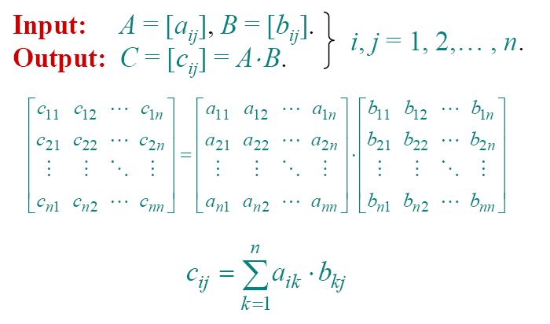
Example: Matrix Multiplication

Slide 31
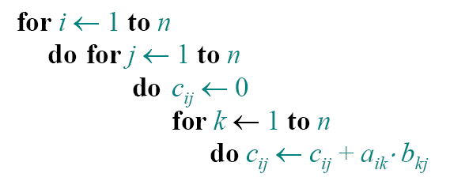
Standard Algorithm – by definition
Run time = Θ (n³)

Slide 32
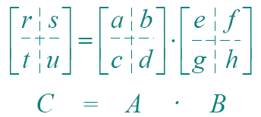
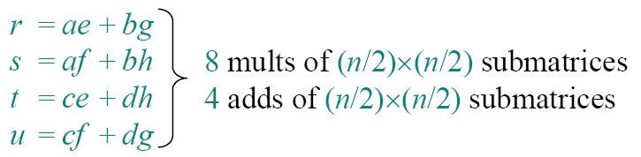
Divide-and-conquer Algorithm
Idea: n*n matrix = 2*2 of (n/2) * (n/2) sub-matrices:

Slide 33
Analysis of the D&C Algorithm
# sub-matrices
Adding sub-matrices
Sub-matrix size

Slide 34


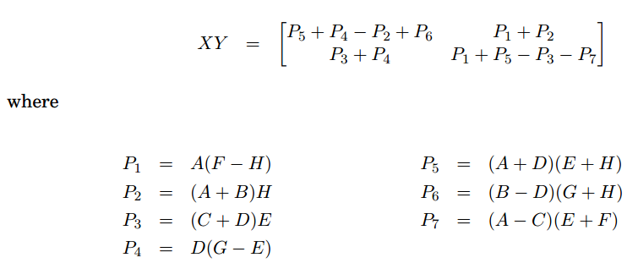
复杂的组合为了减少一次乘法
Strassen’s algorithm runs in O(n^{2.81})

Slide 35
Recursion Tree for
T(n)=bT(n/c)+f(n)
f(n)
f(n)
b
f(n/c)
f(n/c)
f(n/c)
b
log_{c}n
f(n/c²)
f(n/c²)
f(n/c²)
f(n/c²)
f(n/c²)
f(n/c²)
f(n/c²)
f(n/c²)
f(n/c²)
……
……
…
T(1)
T(1)
T(1)
T(1)
T(1)
T(1)
T(1)
T(1)
T(1)
T(1)
…
T(1)
T(1)
T(1)
Note:
Total ?

Slide 36
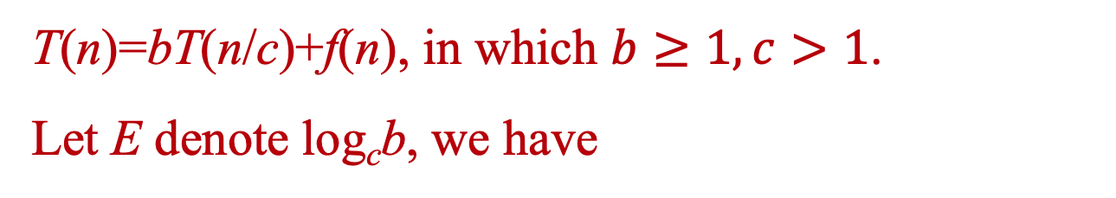
Master Theorem
The positive ε is critical, resulting gaps between cases as well
T(n)=bT(n/c)+f(n), in which $b≥1, c>1$.
Let E denote log_{c}b, we have
Case 1: f(n)∈O(n^{E-ε}), (ε>0), then:
T(n)∈Θ(n^{E})
Case 2: f(n)∈Θ(n^{E}), as all node depth contribute about equally:
T(n)∈Θ(f(n)log(n))
Case 3: f(n)∈Ω(n^{E+ε}), (ε>0), and f(n)∈O(n^{E+δ}), (δ≥ε), then:
T(n)∈Θ(f(n))

Slide 37
An Example
T(n) = 9T(n/3) + O(n²)
Consider the worst case,
Case 2,
Generally,

Slide 38
Looking at the Gap
T(n)=2T(n/2)+nlgn
a=2, b=2, E=1, f(n)=nlgn
We have f(n)=Ω(n^{E}), but no ε>0 satisfies f(n)=Ω(n^{E+ε}), since lgn grows slower that n^{ε} for any small positive ε.
So, case 3 doesn’t apply.
However, neither case 2 applies.
How to handle it?
Notes:
O(n lg^2 n) using substitution method.

Slide 39
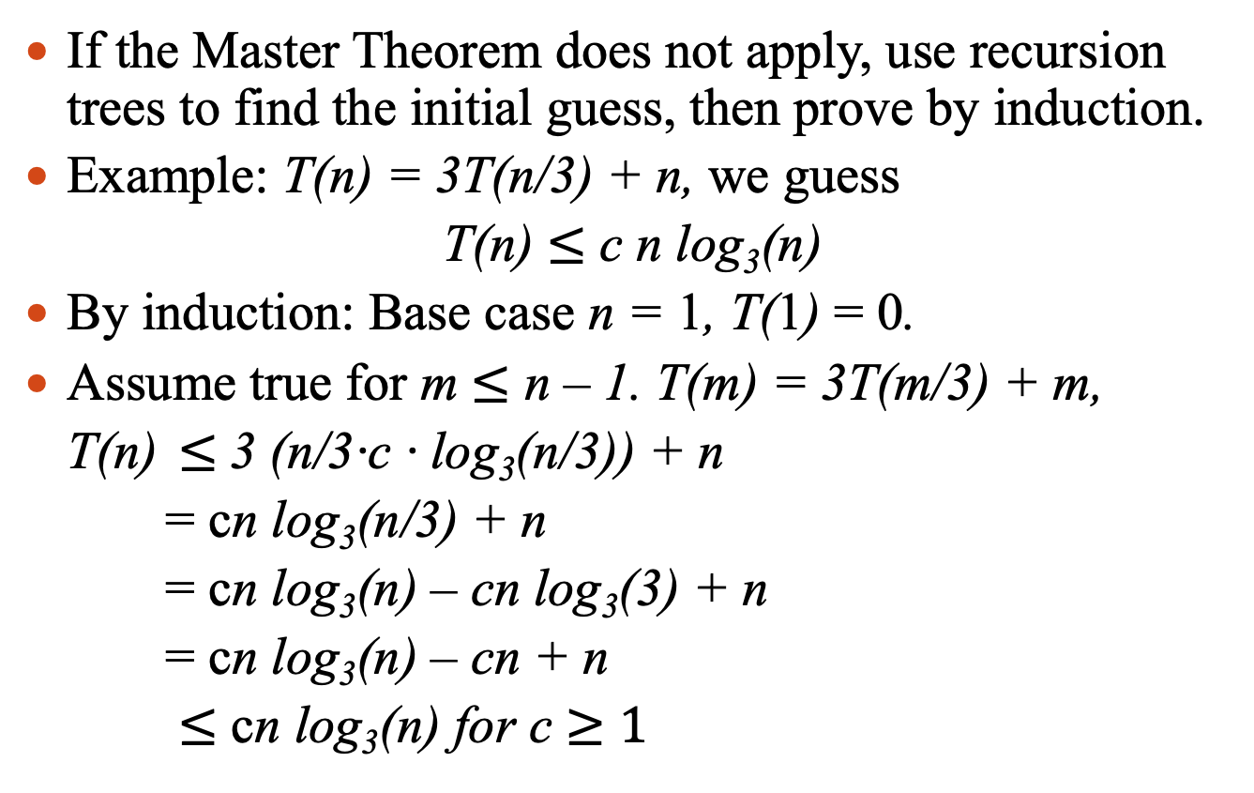
Guess and Prove (Substitution Method)
If the Master Theorem does not apply, use recursion trees to find the initial guess, then prove by induction.
Example: T(n) = 3T(n/3) + n, we guess
T(n) $≤$ c n log₃(n)
By induction: Base case n = 1, T(1) = 0.
Assume true for m $≤$ n – 1. T(m) = 3T(m/3) + m,
T(n) $≤$3 (n/3·c · log₃(n/3)) + n
= cn log₃(n/3) + n
= cn log₃(n) – cn log₃(3) + n
= cn log₃(n) – cn + n
$≤$ cn log₃(n) for c $≥1$

Slide 40
Notes
For example consider the recurrence:
T(n) = 2T(n/2) + c, T(1) = c.
First guess: T(n) ∈ O(n) with the following inductive proof that T(n) < k n (induction on n):
Base case: true if k > c.
Induction step: Assuming that T(m) < km for all m < n, we get:
T(n) = 2T(n/2) + c < 2(k n/2) + c since n/2 < n.
So, T(n) < k n + c.
Since this is not the same form as the induction hypothesis, should we try for T(n) ∈ O(n log n)?

Slide 41
Notes (Cont.)
A small modification gives us T(n) ∈ O(n):
Consider the same recurrence:
T(n) = 2T(n/2) + c, T(1) = c.
But now use the guess that T(n) < kn – b:
Base case: true if k – b > c.
Induction step:
Assuming that T(m) < km – b for all m < n, we get:
T(n) = 2T(n/2) + c < 2(kn/2 – b) + c since n/2 < n.
So, T(n) < kn – 2b + c = kn – b – b + c < kn – b as long as: b > c.
Now having proved that T(n) < kn – b, we are justified in claiming that T(n) ∈ O(n).

Slide 42
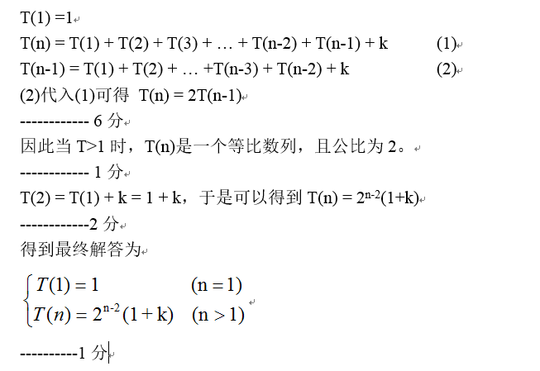
【2007年期中第2题】求解下列递归式

Slide 43
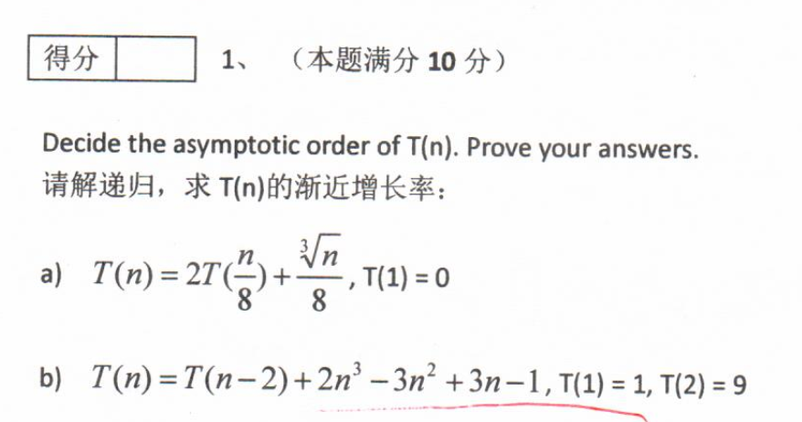
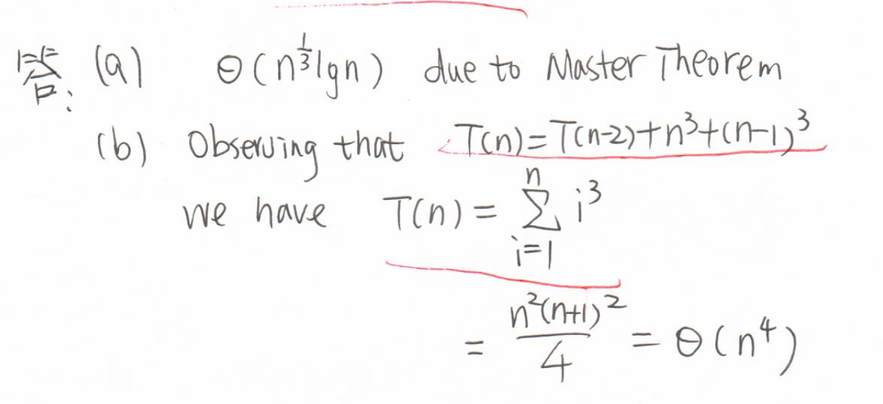
【2017年期中第1题】

