Slide 1
In the 1st week…
Given an algorithm, we usually want to answer three questions
Is it correct?
How much time does it take?
Can we do better?

Slide 2
In the 1st week…
Algorithm analysis
Correctness: Proving it by Induction
Complexity
Worst-case Complexity
Is it tight?
Average Complexity

Slide 3
In the 1st week…
Bounds: Upper and Lower
For a specific algorithm, we want to know the upper bound of its complexity
For a specific problem, we want to know its lower bound

Slide 4
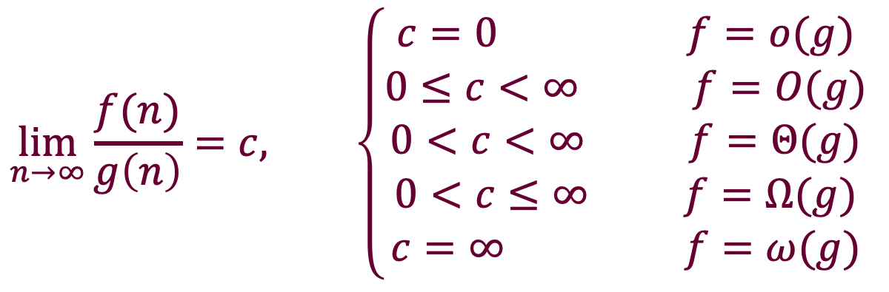
In the 1st week…
$$\lim_{n→∞}{\frac{f(n)}{g\left(n\right)}}=c, \left\{\begin{aligned}c=0 f=o(g) \\ 0≤c<∞ f=O(g) \\ 0<c<∞ f=Θ(g) \\ 0<c≤∞ f=Ω(g) \\ c=∞ f=ω(g)\end{aligned}\right.$$

Slide 5
In the 1st week…
Binary search is optimal
What is its worst-case complexity?
⌈lg(n+1)⌉
What is the lower bound of the “search an ordered array”?
Using decision tree
What is the average complexity of binary search?
lg(n+1)-q
Let s_{t} be the number of inputs for which binary search does t comparisons. If n=2^{k}-1, s_{t}=2^{t-1}.

Slide 6
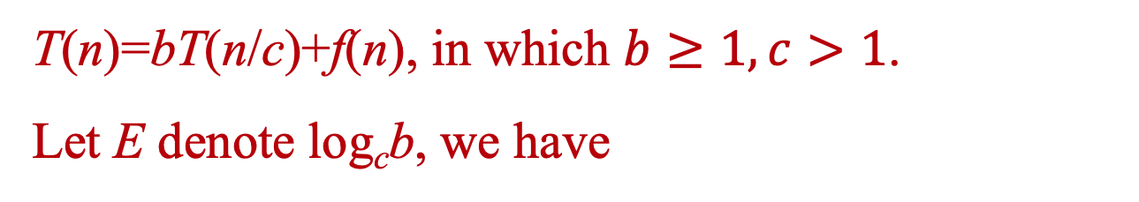
In the 2nd week…
T(n)=bT(n/c)+f(n), in which $b≥1, c>1$.
Let E denote log_{c}b, we have
Case 1: f(n)∈O(n^{E-ε}), (ε>0), then:
T(n)∈Θ(n^{E})
Case 2: f(n)∈Θ(n^{E}), as all node depth contribute about equally:
T(n)∈Θ(f(n)log(n))
Case 3: f(n)∈Ω(n^{E+ε}), (ε>0), and f(n)∈O(n^{E+δ}), (δ≥ε), then:
T(n)∈Θ(f(n))

Slide 7


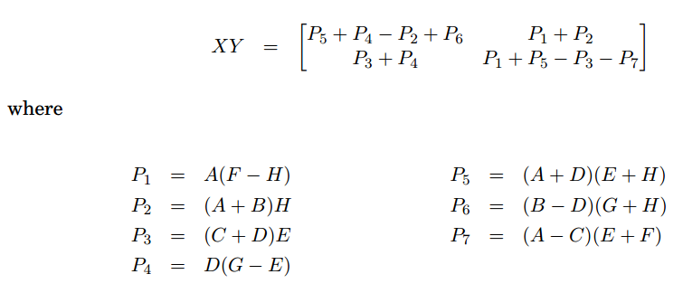
Matrix Multiplication
Strassen’s algorithm runs in O(n^{2.81})

Slide 8
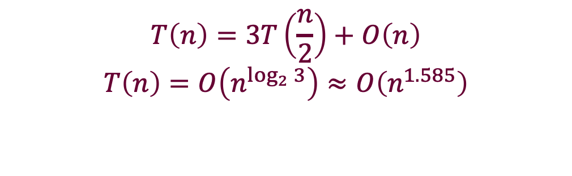
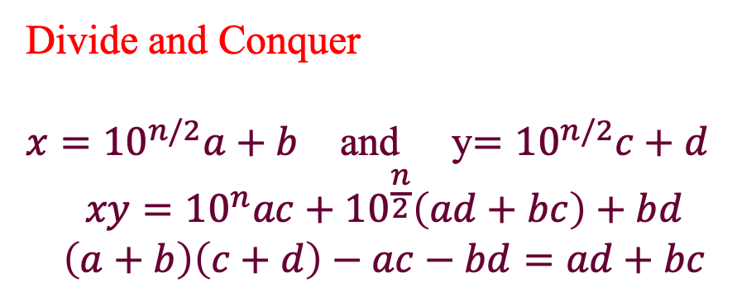
假如我们将“1位数乘”作为基本“关键”操作
你是否会认为两个n 位整数相乘是平分复杂度的呢？
Divide and Conquer
$x={10}^{n/2}a+b$ and y$={10}^{n/2}c+d$
$$xy={10}^{n}ac+{10}^{\frac{n}{2}}\left(ad+bc\right)+bd$$
$$\left(a+b\right)\left(c+d\right)−ac−bd=ad+bc$$
$$T\left(n\right)=3T\left(\frac{n}{2}\right)+O\left(n\right)$$
$$T\left(n\right)=O\left(n^{\log_{2}{3}}\right)≈O\left(n^{1.585}\right)$$

Slide 9
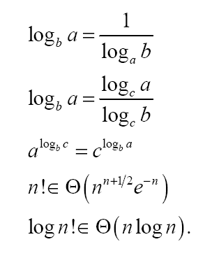
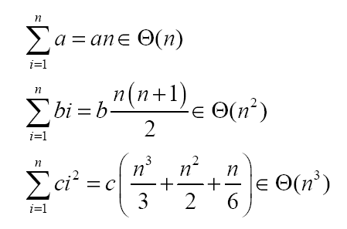
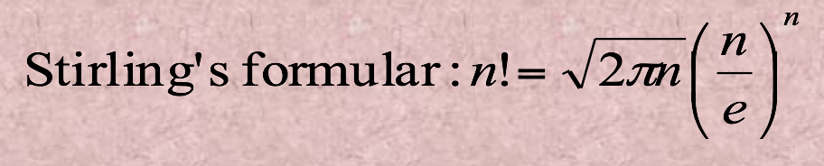
In the 2nd week…
Arithmetic Sequences
Miscellaneous

Slide 10
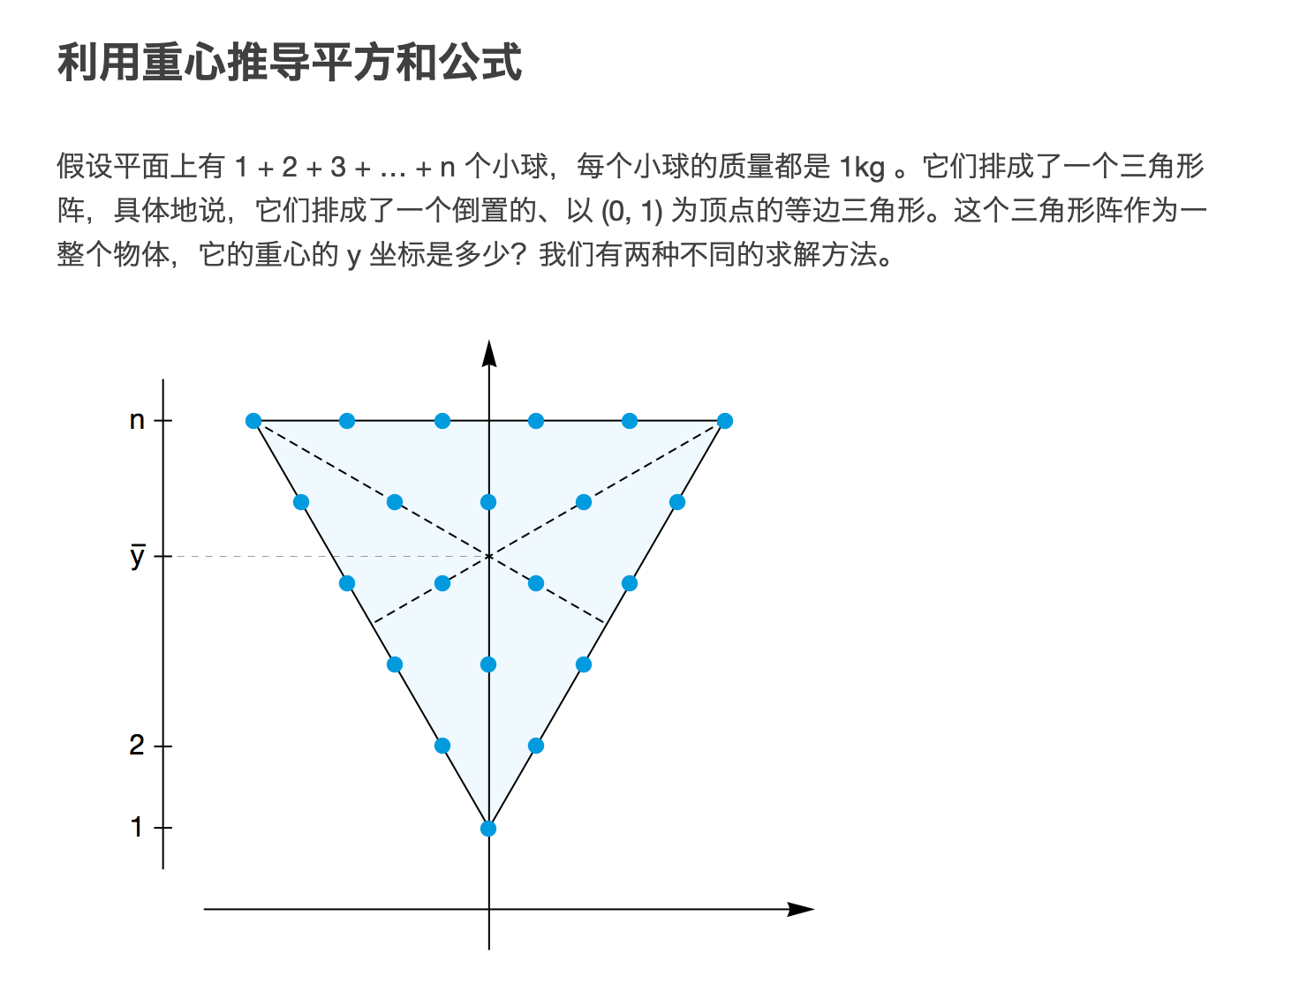

Slide 11
Quicksort
张胜
sheng@nju.edu.cn
南京大学

Slide 12
Quicksort
Insertion sort
Analysis of insertion sorting algorithm
Lower bound of local comparison based sorting algorithm
Quicksort
General pattern of divide-and-conquer
Analysis of Quicksort

Slide 13

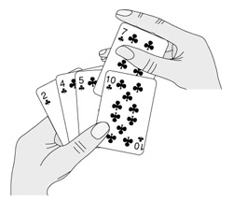

What is Sorting?
Sorting is arranging items in a sequence ordered by some criterion
Notes:
1. The most-used orders are numerical and lexicographical orders.
2. The elements (i.e., input) are in an array, allowing random access.

Slide 14
Comparison-Based Algorithm
The class of “algorithms that sort by comparison of keys”
no other operations are allowed
The measure of work used for analysis is the number of comparisons.
Notes:
桶排序bucket sorting
基数排序 radix sorting
等

Slide 15
As Simple as Inserting

Slide 16
Shifting Vacancy: the Specification
int shiftVac(Element[ ] E, int vacant, Key x)
Precondition (先验条件): vacant is nonnegative
Postconditions (后验条件): Let xLoc be the value returned to the caller, then:
Elements in E at indexes less than xLoc are in their original positions and have keys less than or equal to x.
Elements in E at positions (xLoc+1,…, vacant) are greater than x and were shifted up by one position from their positions when shiftVac was invoked.
vacant
Notes:
有n个元素的数组E，下标为0,1,2,…..，n-1

Slide 17
Shifting Vacancy: Recursion
int shiftVacRec(Element[] E, int vacant, Key x)
int xLoc;
1. if (vacant==0)
2. xLoc=vacant;
3. else if (E[vacant-1].key≤x)
4. xLoc=vacant;
5. else
6. E[vacant]=E[vacant-1];
7. xLoc=shiftVacRec(E,vacant-1,x);
8. Return xLoc;
The recursive call is working on a smaller range, so terminating;
The second argument is non-negative, so precondition holding
Worse case：
stack size is Ο(n)

Slide 18
Shifting Vacancy: Iteration
int shiftVac(Element[] E, int xindex, Key x)
int vacant, xLoc;
vacant=xindex;
xLoc=0; //Assume failure
while (vacant>0)
if (E[vacant-1].key≤x)
xLoc=vacant; //Succeed
break;
E[vacant]=E[vacant-1];
vacant--; //Keep Looking
return xLoc；

Slide 19
Insertion Sorting: the Algorithm
Input: E (array), n≥0 (size of E)
Output: E, ordered nondecreasingly by keys
Procedure:
void insertSort(Element[] E, int n)
int xindex;
for (xindex=1; xindex<n; xindex++)
Element current=E[xindex];
Key x=current.key;
int xLoc=shiftVac(E,xindex,x);
E[xLoc]=current;
return;

Slide 20
Worst-Case Analysis
Sorted (i entries)
At the beginning, there are n-1 entries in the unsorted segment, so:
x
To find the right position for x in the sorted segment, i comparisons must be done in the worst case.
The input for which the upper bound is reached does exist, so: W(n)∈Θ(n²)

Slide 21
Average Behavior
Sorted (i entries)
Assumptions:
All permutations of the keys are equally likely as input.
There are no different entries with the same keys.
Note: For the (i+1)th interval (leftmost), only i comparisons are needed.
x
x may be located in any one of the i+1 intervals(inclusive), assumingly, with the same probabiliy

Slide 22

Average Complexity
The average number of comparisons in shiftVac to find the location for the ith element:
For all n-1 insertions:
for the leftmost interval
$$−$$

Slide 23
Inversion and Sorting
An unsorted sequence E:
x₁, x₂, x₃, …, x_{n-1}, x_{n}
If there are no same keys, for the purpose of sorting, it is a reasonable assumption that {x₁, x₂, x₃, …, x_{n-1}, x_{n}}={1,2,3,…,n-1,n}
<x_{i}, x_{j}> is an inversion if x_{i}>x_{j}, but i<j
All the inversions must be eliminated during the process of sorting.

Slide 24
Eliminating Inverses: Worst Case
Local comparison is done between two adjacent elements.
At most one inversion is removed by a local comparison.
There do exist inputs with n(n-1)/2 inversions, such as (n,n-1,…,3,2,1)
The worst-case behavior of any sorting algorithm that removes at most one inversion per key comparison must be in Ω(n²)

Slide 25
Eliminating Inverses: Average
Computing the average number of inversions in inputs of size n (n>1):
Transpose: x₁, x₂, x₃, …, x_{n-1}, x_{n}
x_{n}, x_{n-1}, …, x₃, x₂, x₁
For any i, j, (1≤j≤i≤n), the inversion (x_{i}, x_{j}) is in exactly one sequence in a transpose pair.
The number of inversions (x_{i}, x_{j}) on n distinct integers is n(n-1)/2.
So, the average number of inversions in all possible inputs is n(n-1)/4, since exactly n(n-1)/2 inversions appear in each transpose pair.
The average behavior of any sorting algorithm that removes at most one inversion per key comparison must be in Ω(n²)

Slide 26
Quicksort: the Strategy
Dividing the array to be sorted into two parts: “small” and “large”, which will be sorted recursively.
[first]
[last]
for any element in this segment, the key is not less than pivot.
for any element in this segment, the key is less than pivot.

Slide 27
QuickSort: the algorithm
Input: Array E and indexes first, and last, such that elements E[i] are defined for first≤i≤last.
Output: E[first],…,E[last] is a sorted rearrangement of the same elements.
The procedure:
void quickSort(Element[ ] E, int first, int last)
if (first<last)
Element pivotElement=E[first];
Key pivot=pivotElement.key;
int splitPoint=partition(E, pivot, first, last);
E[splitPoint]=pivotElement;
quickSort(E, first, splitPoint-1);
quickSort(E, splitPoint+1, last);
return
The splitting point is chosen arbitrarily, as the first element in the array segment here.

Slide 28
Partition: the Strategy

Slide 29
Partition: the Process
Always keep a vacancy before completion.
First met key that is less than pivot
Moving as far as possible!
highVac
First met key that is larger than pivot
lowVac
Vacant left after moving

Slide 30
Partition: the Algorithm
Input: Array E, pivot, the key around which to partition, and indexes first, and last, such that elements E[i] are defined for first+1≤i≤last and E[first] is vacant. It is assumed that first<last.
Output: Returning splitPoint, the elements origingally in first+1,…,last are rearranged into two subranges, such that
the keys of E[first], …, E[splitPoint-1] are less than pivot, and
the keys of E[splitPoint+1], …, E[last] are not less than pivot, and
first≤splitPoint≤last, and E[splitPoint] is vacant.

Slide 31
Partition: the Procedure
int partition(Element [ ] E, Key pivot, int first, int last)
int low, high;
1. low=first; high=last;
2. while (low<high)
3. int highVac=extendLargeRegion(E,pivot,low,high);
4. int lowVac = extendSmallRegion(E,pivot,low+1,highVac);
5. low=lowVac; high=highVac-1;
6 return low; //This is the splitPoint
highVac has been filled now.

Slide 32
Extending Regions
Specification for
Precondition:
lowVac<high
Postcondition:
If there are elements in E[lowVac+1],...,E[high] whose key is less than pivot, then the rightmost of them is moved to E[lowVac], and its original index is returned.
If there is no such element, lowVac is returned.
extendLargeRegion(Element[ ] E, Key pivot, int lowVac, int high)

Slide 33
Example of Quicksort
45 14 62 51 75 96 33 84 20
45 as pivot
high
low
20 14 62 51 75 96 33 84
highVac
20 14 51 75 96 33 84 62
lowVac
20 14 51 75 96 33 84 62
low
high =highVac-1
20 14 33 51 75 96 84 62
highVac
20 14 33 75 96 51 84 62
lowVac
highVac
To be processed in the next loop

Slide 34
Divide and Conquer: General Pattern
solve(I)
n=size(I);
if (n≤smallSize)
solution=directlySolve(I)
else
divide I into I₁,… I_{k};
for each i∈{1,…,k}
S_{i}=solve(I_{i});
solution=combine(S₁ ,… ,S_{k});
return solution
T(n)=B(n) for n≤smallSize
T(n)=D(n)+ T(size(I_{i}))+C(n)
for n>smallSize

Slide 35
Workhorse
“Hard division, easy combination” （难分易合）
“Easy division, hard combination”
Usually, the “real work” is in one part.

Slide 36
Worst Case: a Paradox
For a range of k positions, k-1 keys are compared with the pivot (one is vacant).
If the pivot is the smallest, then the “large” segment has all the remaining k-1 elements, and the “small” segment is empty.
If the elements in the array to be sorted has already in ascending order (the Goal) or the descending order, then the number of comparison that Partition has to do is:

Slide 37
Average Analysis
Assumption: all permutation of the keys are equally likely to appear.
A(n) is the average number of key comparisons when the problem size is n.
In the first cycle of Partition, n-1 comparisons are done
If split point is E[i] (each i has probability 1/n), Partition is to be executed recursively on the subrange [0,…i] and [i+1,…,n-1]

Slide 38

The Recurrence Equation
Why the assumed probability is still hold for each subrange?
E[0]
splitPoint: E[i]
E[n-1]
with i∈{0,1,2,…n-1}, each value with the probability 1/n
So, the average number of key comparison A(n) is:
and A(1)=A(0)=0
No two keys within a subrange have been compared each other!
subrange 1: size= i
subrange 2: size= n-1-i
The number of key comparison in the first cycle(finding the splitPoint) is n-1

Slide 39
Simplified Recurrence Equation
Note:
So:
Two approaches to solve the equation
Guess and prove by induction
Solve directly

Slide 40
Guess the Solution
A special case as the clue for guess
Assuming that Partition divide the problem range into 2 subranges of about the same size.
So, the number of comparison Q(n) satisfy:
Q(n) ≈ n+2Q(n/2)
Applying Master Theorem, case 2:
Q(n)∈Θ(nlogn)
Note: here, b=c=2, so E=lg(b)/lg(c)=1, and, f(n)=n=n^{E}

Slide 41
Inductive Proof: A(n)∈O(nlnn)
Theorem: A(n)≤cnlnn for some constant c, with A(n) defined by the recurrence equation above.
Proof:
By induction on n, the number of elements to be sorted. Base case(n=1) is trivial.
Inductive assumption: A(i)≤cilni for 1≤i<n

Slide 42


For Your Reference
If f(x) is nondecreasing
Harmonic Series
a
b

Slide 43
Inductive Proof: A(n)∈Ω(nlnn)
Theorem: A(n)>cnlnn for some constant c, with large n
Inductive reasoning:
Inductive
assumption

Slide 44
Directly Derived Recurrence Equation
Combining the 2 equations in some way, we can remove all A(i) for i=1,2,…,n-2

Slide 45

Solving the Equation
Let it be B(n)
We have equation:
Note: lnn ≈ 0.693 lgn

Slide 46
Space Complexity
Good news:
Partition is in-place
Bad news:
In the worst case, the depth of recursion will be n-1
So, the largest size of the recursion stack will be in Θ(n)

Slide 47
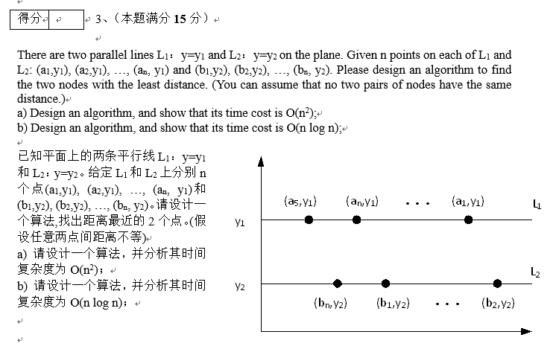
2016年期中第3题

Slide 48
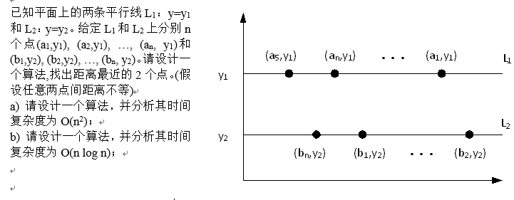
（1）将2条直线上的n个点按横坐标大小排序；
（2）对L1上的每个点Pi=(ai,y1)，使用折半查找，决定在直线L2上距离最 近的点：
（2.1）如果L2上有某个点与Pi的x坐标相同，则该两点之间的距离是Pi到L2上点的最短距离。
（2.2）如果L2上没有点与Pi的坐标相同，则通过折半查找得到L2上x坐标与Pi最接近的两个点（也可能是一个点）。比较这两个点与Pi的距离，得到Pi到L2上点的最短距离。
（3）为每个点计算上述最短距离后，遍历L1上所有的点，得到全局最小的L1和L2间点的最短距离。
（4）遍历L1和L2上，相邻2个点间的最短距离，最终得到全局最小的，任意2点之间的距离。

