Slide 1
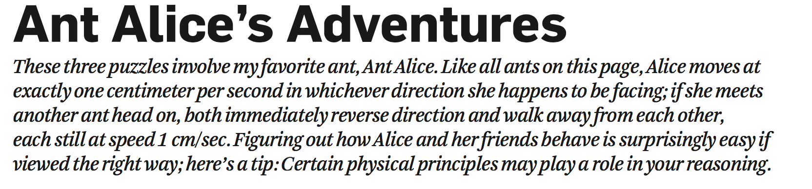
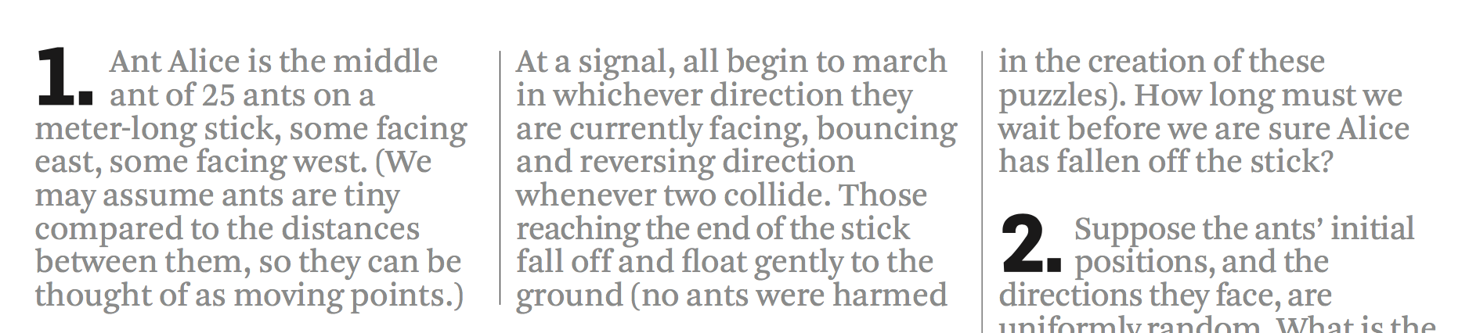
Notes:
100 seconds at most.

Slide 2
MergeSort
张胜
sheng@nju.edu.cn
南京大学

Slide 3
In the last class…
Insertion sort
Analysis of insertion sorting algorithm
Lower bound of local comparison based sorting algorithm
Quicksort
General pattern of divide-and-conquer
Analysis of Quicksort

Slide 4
Mergesort
Mergesort
Merge and its analysis
Mergesort and its analysis
Lower Bounds for Comparison-based Sorting
Worst Case
Average Behavior

Slide 5
MergeSort: the Strategy
Easy division
No comparison is done during the division
This is to minimize the size difference between the sub-problems
Hard combination
Merge two sorted subranges using Merge

Slide 6
Merging Sorted Arrays
A[0]
A[k-1]
B[0]
B[m-1]

Slide 7
Merge: the Specification
Input: Array A with k elements and B with m elements, each in nondecreasing order of their key.
Output: C, an array containing n=k+m elements from A and B in nondecreasing order. C is passed in and the algorithm fills it.

Slide 8
Merge: the Recursive Version
merge(A,B,C)
if (A is empty)
rest of C = rest of B
else if (B is empty)
rest of C = rest of A
else
if (first of A ≤ first of B)
first of C =first of A
merge(rest of A, B, rest of C)
else
first of C =first of B
merge(A, rest of B, rest of C)
return
Base cases

Slide 9
Worst Case Complexity of Merge
Observations:
After each comparison, at least one element is inserted into Array C.
After entering Array C, an element will never be compared again
After the last comparison, at least two elements (the two just compared) have not yet been moved to Array C.
Worst case is that the last comparison is conducted between A[k-1] and B[m-1]
In worst case, n-1 comparisons are done, where n=k+m

Slide 10
Optimality of Merge
Any algorithm to merge two sorted arrays, each containing k=m=n/2 entries, by comparison of keys, does at least n-1 comparisons in the worst case.
Choose keys so that:
b₀<a₀<b₁< a₁<...<b_{i}<a_{i}<b_{i+1},...,<b_{m-1}<a_{m-1}
Then the algorithm must compare a_{i} with b_{i} for every i in [0,m-1], and must compare a_{i} with b_{i+1} for every i in [0, m-2], so, there are n-1 comparisons.
Notes:
一个序列的元素远小于另一个序列，这样的merge如何处理？

Slide 11
Optimality of Merge
Choose keys so that:
b₀<a₀<b₁< a₁<...<b_{i}<a_{i}<b_{i+1},...,<b_{m-1}<a_{m-1}
If for some i, the algorithm never compares a_{i} with b_{i}, then choosing keys in the same order as in the above, except that a_{i} < b_{i,} will also satisfy these conditions and the algorithm would not be able to determine the correct ordering.
Similarly for a_{i} and b_{i+1} ……

Slide 12

Optimality of Merge
Any algorithm to merge two sorted arrays, each containing k=m=n/2 entries, by comparison of keys, does at least n-1 comparisons in the worst case.
Valid for |k-m|≤1, as well.
Notes:
一个序列的元素远小于另一个序列，这样的merge如何处理？Using binary search.
Fortunately, in mergesort, the sizes of the two sub-arrays are always the same or their difference is only 1.

Slide 13
What is an in-place algorithm (原地排序算法)?
An algorithm is “in space”, if the extra space it has to use is in Θ(1)
Merge is not a algorithm “in space”, since it need enough extra space to store the merged sequence during the merging process.
However, the extra space is not large
For two arrays, A has k elements, B has m elements, then min(k,m) extra space is enough.

Slide 14
Overlapping Arrays for Merge
extra space
Before the merge
0
k-1
k+m-1
0
B
m-1
A
Merge from the right
Partly finished
Merged
0
k-1
k+m-1
0
m-1
0
k-1
k+m-1
0
m-1
A/C
Finished

Slide 15
For your reference: Space Complexity of QuickSort
Good news:
Partition is in-place
Bad news:
In the worst case, the depth of recursion will be n-1
So, the largest size of the recursion stack will be in Θ(n)

Slide 16
MergeSort
Input: Array E and indexes first, and last, such that the elements of E[i] are defined for first≤i≤last.
Output: E[first],…,E[last] is a sorted rearrangement of the same elements.
Procedure
void mergeSort(Element[] E, int first, int last)
if (first<last)
int mid=(first+last)/2;
mergeSort(E, first, mid);
mergeSort(E, mid+1, last);
merge(E, first, mid, last)
return

Slide 17
Worst Case Analysis of Mergesort
The recurrence equation for Mergesort
W(n)=W(⎣n/2⎦)+W(⎡n/2⎤)+n-1
W(1)=0
where n=last-first+1, the size of range to be sorted
The Master Theorem applies for the equation, we have:
W(n)∈Θ(nlogn)

Slide 18
Average Case Analysis of Mergesort
In the following, we show the average case complexity A(n) of mergesort is A(n)= Θ(nlgn) in an indirect way.

Slide 19
Decision Tree for Sorting
Internal node
An example for n=3
Decision tree is a 2-tree.(Assuming no same keys)
The action of Sort on a particular input corresponds to following a path in its decision tree from the root to a leaf associated to a specific output.
External node

Slide 20
2-Tree
2-Tree
internal nodes
external nodes
no child
any type
Notes:
2-tree：叶节点外所有节点都有两个子节点。

Slide 21
Characteristics of the Decision Tree
For a sequence of n distinct elements, there are n! different permutation, so, the decision tree has at least n! leaves, and exactly n! leaves can be reached from the root. So, for the purpose of lower bounds evaluation, we use trees with exactly n! leaves.
The number of comparisons done in the worst case is the height of the tree (The height of a tree is the number of edges on the longest downward path between the root and a leaf).
The average number of comparison done is the average of the lengths of all paths from the root to a leaf.

Slide 22
Lower Bound for Worst Case
Theorem: Any algorithm to sort n items by comparisons of keys must do at least ⎡lgn!⎤, or approximately ⎡nlgn-1.443n⎤, key comparisons in the worst case.
Note: Let L=n!, which is the number of leaves, then L≤2^{h}, where h is the height of the tree, that is h≥ ⎡lgL⎤=⎡lgn!⎤
For the asymptotic behavior:
derived using:
Notes:
Level: The level of a node is defined as: 1 + the number of edges between the node and the root.
Depth: The depth of a node is defined as: the number of edges between the node and the root.
Height of node: The height of a node is the number of edges on the longest path between that node and a leaf.
Height of tree: The height of a tree is the height of its root node.

Slide 23
Average Case?
More exactly, what is the average length of all paths from the root to each leaf?
Two methods:
(1) Using External Path Length.
(2) Which type of 2-tree has the smallest value of the average length of all paths from the root to each leaf?

Slide 24
Method 1: External Path Length (EPL)
The EPL of a 2-tree t is defined as follows:
[Base case] 0 for a single external node
[Recursion] t is non-leaf with sub-trees L and R, then the sum of:
the external path length of L;
the number of external nodes of L;
the external path length of R;
the number of external nodes of R;

Slide 25
Method 1: Properties of EPL
Let t is a 2-tree, then the epl of t is the sum of the paths from the root to each external node.
epl ≥mlg(m), where m is the number of external nodes in t
epl=epl_{L}+epl_{R}+m≥ m_{L}lg(m_{L})+m_{R}lg(m_{R})+m,
note f(x)+f(y)≥2f((x+y)/2) for f(x)=xlgx
so,
epl ≥ 2((m_{L}+m_{R})/2)lg((m_{L}+m_{R})/2)+m = m(lg(m)-1)+m =mlgm.

Slide 26
Method 2: Which type of 2-tree has the smallest value of the average length of all paths from the root to each leaf?
Assuming that h-k>1, when calculating epl, h+h+k is replaced by (h-1)+2(k+1). The net change in epl is k-h+1<0, that is, the epl decreases.
So, more balanced 2-tree has smaller epl.
X
level
k
X
level
k
+1
Y
level
h
-
1
Y
level
h

Slide 27
Method 2: Which type of 2-tree has the smallest value of the average length of all paths from the root to each leaf?
The trees that minimize epl are as balanced as possible.
In a perfect 2-tree with n! leaves (this is the most balanced tree), the length of the path from the root to each leaf is the same, which is lg(n!)= Θ(nlgn).
Hence, for an arbitrary 2-tree, its epl is no less than Θ(n!lgn!).

Slide 28
Lower Bound for Average Behavior
Since a decision tree with L leaves is a 2-tree, the average path length from the root to a leaf is .
Recall that epl ≥ Llg(L) (we have proved this using two methods).
Theorem: The average number of comparison done by an algorithm to sort n items by comparison of keys is at least lg(n!), which is about nlgn-1.443n. (也就是说，任意比较排序算法(包括MergeSort)的平均情况时间复杂度有下界A(n)=𝛺(n lg n))

Slide 29
Mergesort Has Optimal Average Performance
We have proved that the average number of comparisons done by an algorithm to sort n items by comparison of keys is 𝛺(nlgn). Hence, the average case complexity A(n) of mergesort is A(n)= 𝛺(nlgn).
The worst case complexity W(n) of mergesort is Θ(nlgn)
But, the average performance can not be worse than the worst case performance. That is, A(n)=O(W(n))=O(nlgn)
Combining the above together, we have A(n)=Θ(nlgn). That is, mergesort is optimal as for its average performance.

Slide 30
Can you implement MergeSort using Merge without recursion?

Slide 31
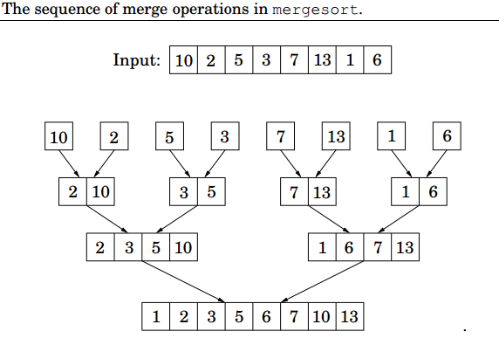
A different view of MergeSort

Slide 32
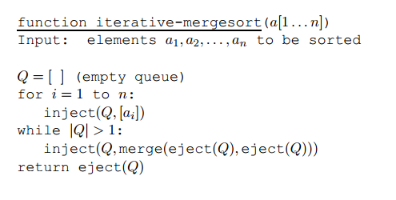
Iterative-mergesort

