Slide 1
Sorting
Algorithm : Design & Analysis
[Tutorial - 2]
张胜
sheng@nju.edu.cn
南京大学

Slide 2
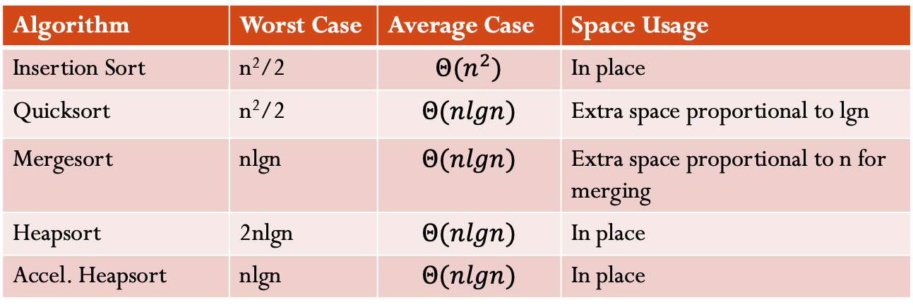
Comparison of 4 sorting algorithms
Algorithm | Worst Case | Average Case | Space Usage
Insertion Sort | n²/2 | $$Θ(n^{2})$$ | In place
Quicksort | n²/2 | $$Θ(nlgn)$$ | Extra space proportional to lgn
Mergesort | nlgn | $$Θ(nlgn)$$ | Extra space proportional to n for merging
Heapsort | 2nlgn | $$Θ(nlgn)$$ | In place
Accel. Heapsort | nlgn | $$Θ(nlgn)$$ | In place

Slide 3
Please design a new comparison-based sorting algorithm.
Notes:
打破思维束缚还是很难的。

Slide 4
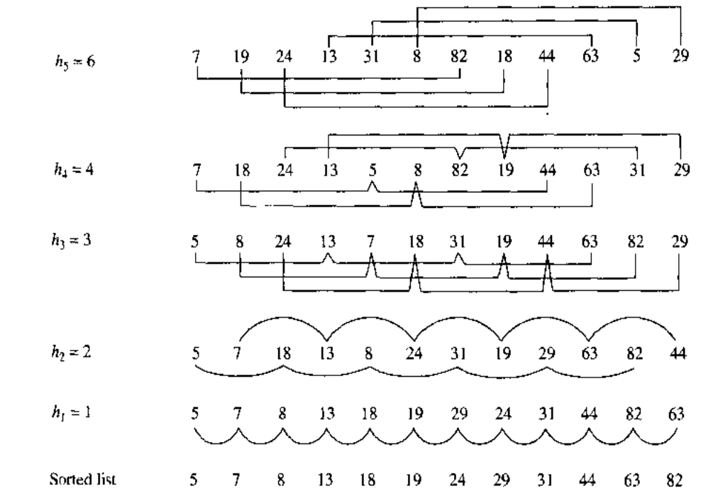
Shell Sort

Slide 5
What algorithm should be used to sort the subsequences?
Shellsort may be efficient if, and indeed would be efficient only if, the method used to sort subsequences is one that does very little work if the array is already sorted or nearly sorted. Insertion Sort has this property.

Slide 6
A complete analysis on the # of comparisons in ShellSort is extremely difficult and requires answers to some mathematical problems that have not yet been solved.

Slide 7
In previous sorting algorithms, the basic operation is a comparison of two keys. If we can perform other operations on these keys, we may have some other algorithms. Radix sort* （基数排序） Bucket sort*（桶排序、箱排序）

Slide 8
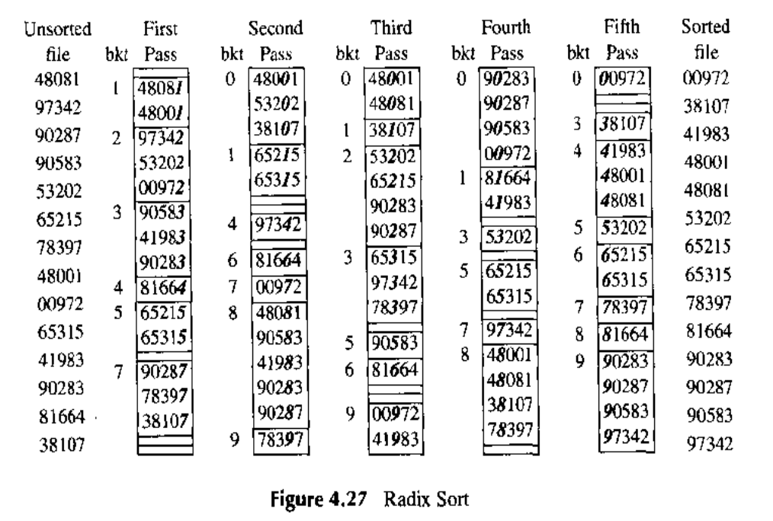
Radix Sort
O(n) time.
It is not based on comparison.

Slide 9
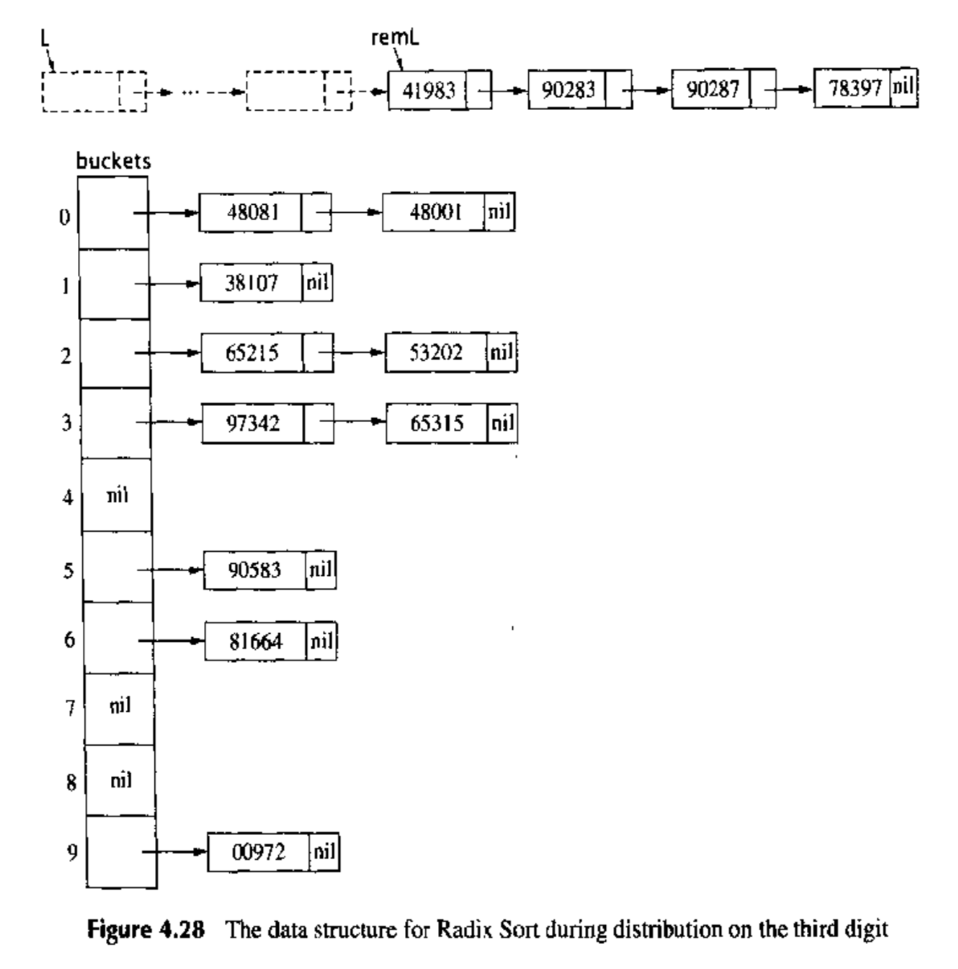
Radix Sort

Slide 10
Bucket sort
Bucket sort, or bin sort, is a sorting algorithm that works by distributing the elements of an array into a number of buckets. Each bucket is then sorted individually, either using a different sorting algorithm, or by recursively applying the bucket sorting algorithm. It is a distribution sort, a generalization of pigeonhole sort, and is a cousin of radix sort in the most-to-least significant digit flavor.
Bucket sort can be implemented with comparisons and therefore can also be considered a comparison sort algorithm. The computational complexity depends on the algorithm used to sort each bucket, the number of buckets to use, and whether the input is uniformly distributed.

Slide 11
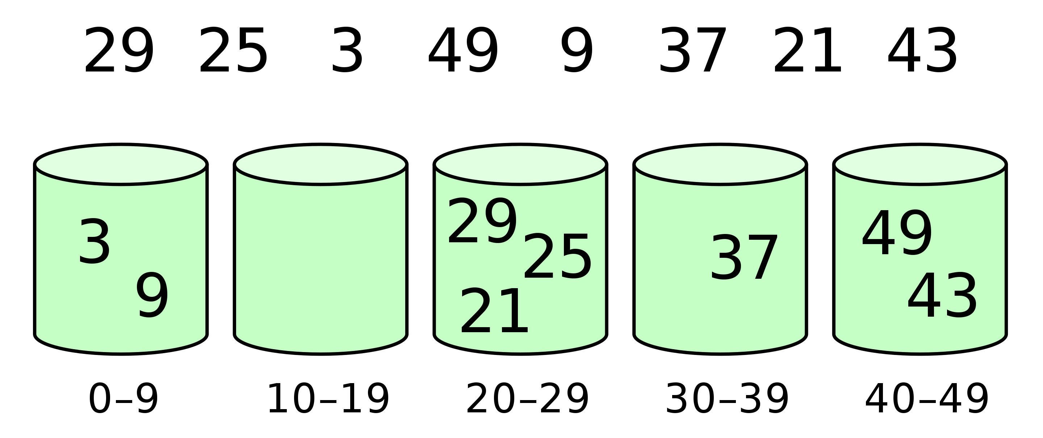
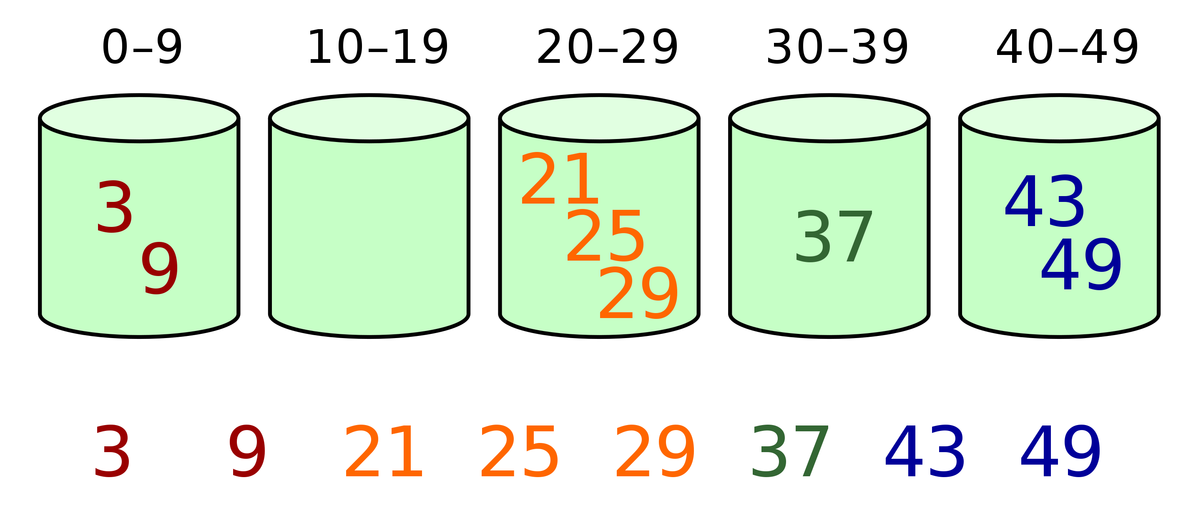
Bucket sort

Slide 12
Analysis on Quicksort
Average behavior analysis
Another implementation of partition
Randomized quicksort
Expected performance
Matching bolts and nuts

Slide 13
Balanced Partitioning
The average-case running time is much closer to the best case than to the worst case.
Suppose the partitioning algorithm always produces a 9-to-1proportional split.
T(n) ≤ T(9n/10) + T(n/10) + cn
T(n) ≤ cn log _{10/9}n
T(n) = O (nlgn)
Notes:
递归树求解

Slide 14
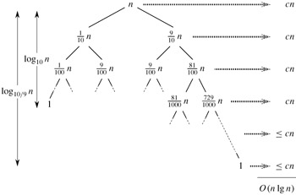
Balanced Partitioning
The average-case running time is much closer to the best case than to the worst case.
Suppose the partitioning algorithm always produces a 9-to-1proportional split.
T(n) ≤ T(9n/10) + T(n/10) + cn
T(n) ≤ cn log _{10/9}n
T(n) = O (nlgn)

Slide 15
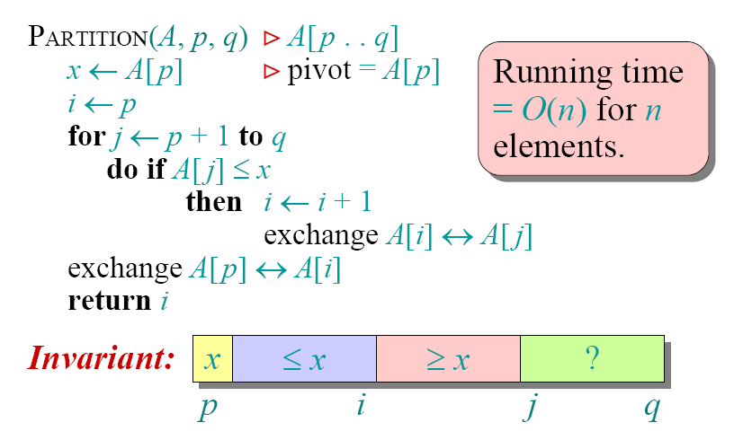
A Different Partition Method

Slide 16
Ordering the Elements with 3 Colors
Suppose an array A consists of n element, each of which is red, white or blue. Design a linear algorithm to sort the array so that all the reds come before the whites, and which come before all the blues. The only operations permitted are:
Examine(A, i) – report the color of the ith element, and
Swap(A, i, j) – swap the ith element of A with the jth element.
Notes:
利用quciksort中的partition操作
设定 red < white < blue
1）选择white作为pivot， 那么 <= white 的为 red和white， >white 的为blue
2）选择red或者white作为pivot，对 “<= white 的为 red和white” 部分进行排序
<=2(n-2) = O(n), where n is the number of all elements in the given array

Slide 17
Randomized Quicksort
PARTITION(A, p, q)
Exchange(A[p], A[rand])
x ← A[p]
Good expected performance
n lg n
Same performance for any (hostile) arrangement of elements

Slide 18
Analysis on the Expected Performance
Learn the mathematical tools
Indicator random variable
Manipulating expectations
Notations
X : total number of comparisons
Elements of A can be denoted as z₁,z₂,…, z_{n} (z₁<z₂<…<z_{n})
Notes:
Zn表示已排序的元素序列，从整体上分析这些元素的比较次数。

Slide 19
Analysis on the Expected Performance
Each pair is compared at most once
Manipulating the expectations

Slide 20
Pr{z_{i} is compared to z_{j}}
When two items are compared? – an example
A={1,3,2,5,4,6}, if pivot=4, A is separated into L={1,2,3}, R={5,6}
4 is compared to all elements in L and R
Elements in L is never compared to elements in R
Consider Z_{ij} = {z_{i}, z_{i+1},…, z_{j}}
If z_{x} (i<x<j) is chosen as a pivot first, then z_{i} and z_{j} will never be compared
z_{i} is compared to z_{j} <=> if z_{i} (or z_{j}) is chosen as a pivot before any other item in Z_{ij}

Slide 21
Pr{z_{i} is compared to z_{j}}
Probability that each item is chosen in Z_{ij} is equal
Pr{z_{i} is compared to z_{j}}
= Pr{z_{i} or z_{j} is first chosen as pivot from Z_{ij}}
= Pr{z_{i} is first chosen as pivot from Z_{ij}} +
Pr{z_{j} is first chosen as pivot from Z_{ij}} = 2/(j-i+1)

Slide 22


Expected Performance
$$≤$$
Recall:
BG

Slide 23
Counting Inversions
For a₁, a₂, …,a_{n} is a permutation of {1, 2,…, n}
Inversion: i < j, a_{i} > a_{j}
Given an array of n (distinct) numbers, how many inversions?
E.g.: 1,2,7,5, 6. (7,5), (7,6) are inversions
Simple solution
O(n²)

Slide 24
Merging Sorted Arrays
A[0]
A[k-1]
B[0]
B[m-1]
Notes:
下面两种方法之一（不能都计算，否则会双重计算）
方法一：
如果A[indexA]小，那么A[indexA]和B[0]。。。。B[indexB-1]构成inversion，个数为indexB
如果如果B[indexB]小，do nothing
方法二：
如果B[indexB]小，那么B[indexB]和A[indexA]。。。。A[k-1]构成inversion，个数为k-indexA
如果如果A[indexA]小，do nothing

Slide 25
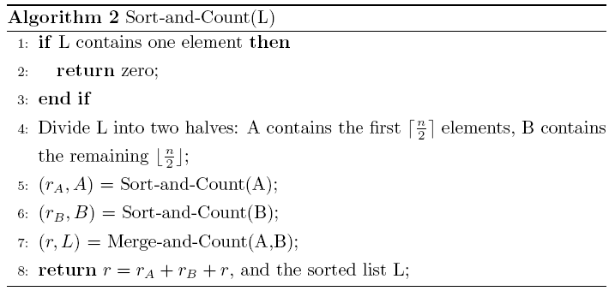
Divide and Conquer
Simple division inspired by merge sort
Counting Inversions in O(n lg n)

Slide 26
Finding Two Elements
Both A and B are two arrays with n integers. For a given integer x, design an algorithm to find out whether exists a∈A and b∈B, satisfying x = a + b. Analyse the complexity of your algorithm.
Notes:
对B排序：nlgn
For each element a in A, using binary search to search x-a in B. This incurs nlgn operations.
Overall, nlgn

Slide 27
Array Sums
Two unsorted arrays A and B, both of which has n integers. Swap one integer in A and one in B to minimize the difference of the two array sums.
Notes:
设A、B序列分别为m、n个元素。
算法设计（12分）
计算序列A与B的和，并得到两者之差的一半S=(S_{A}-S_{B})/2; O(m+n)
将A序列排序；O(mlogm)
初始化差值d为max（S_{A}，S_{B}），待交换元素a、b；
B序列中取元素b_{i}，在A序列中采用二分法，查找b_{i}+S；O(nlogm)
如果查找到b_{i}+S，算法中止，并返回b_{i}+S；
如果找不到b_{i}+S，则找到与之最接近的元素，并记录两者之差d_{i}；
如果d_{i}<d，则d=d_{i}，且待交换元素a=b_{i}+S、b=b_{i}；
重复上述步骤，直到算法中止，或者B中元素全部取完。
复杂度分析（3分，每处1分）
O(m+n)+ O(mlogm)+ O(nlogm)= O((n+m)logm)

Slide 28
Matching Bolts and Nuts
You are given a collection of n bolts of different widths and n corresponding nuts. You can determine whether the nut is
larger than the bolt
smaller than the bolt
matches the bolt exactly
However, there is no way to compare two nuts together or two bolts together.
The problem is to match each bolt to its nut.

Slide 29
Matching (B, N)
Choose one bolt as the pivot to partition the nuts
B≤, B₌, and B≥ O(n)
Get b from B₌ as the pivot to partition the bolts,
N≤, N₌, and N≥ O(n)
Matching (B≤, N≤) and Matching (B≥, N≥)
Worst case, T(n) = 2n - 1 + T(n - 1)=O(n²)
Average case,

Slide 30
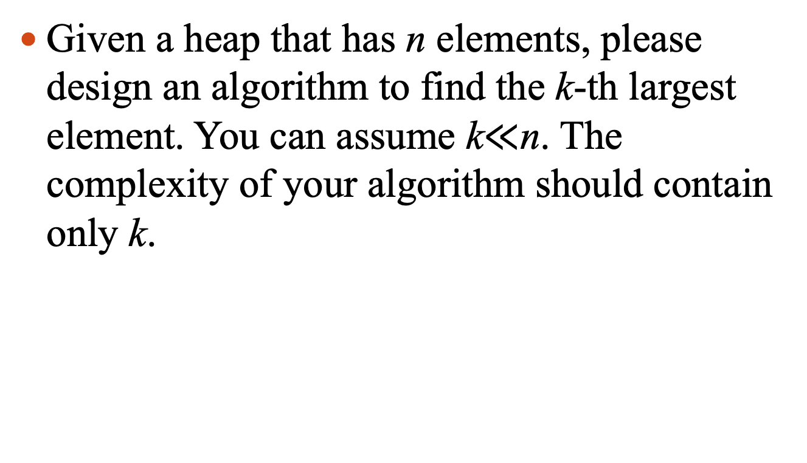
The k-th largest element in a heap
Given a heap that has n elements, please design an algorithm to find the k-th largest element. You can assume k$≪$n. The complexity of your algorithm should contain only k.
Notes:
The k-th largest element can only be in the first k levels. The number of elements in these k levels is no more than 2^k-1.
We can extract the max and fix the heap (that has no more than 2^k-1 elements) k times.
Therefore, the complexity is k lg (2^k - 1) = k^2

Slide 31
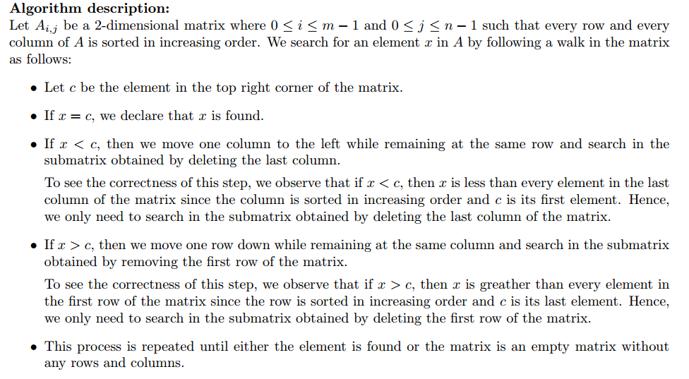
Given an m*n matrix in which each row and column is sorted in ascending order, design an algorithm to find a given element.

Slide 32
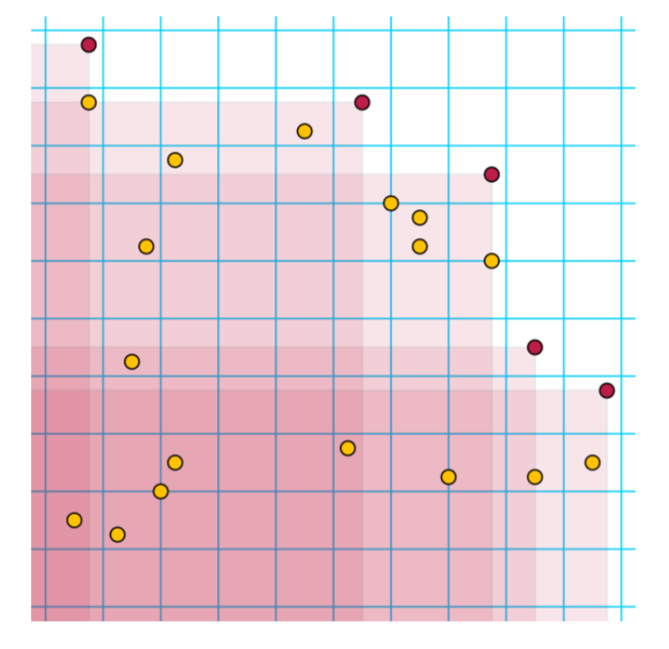
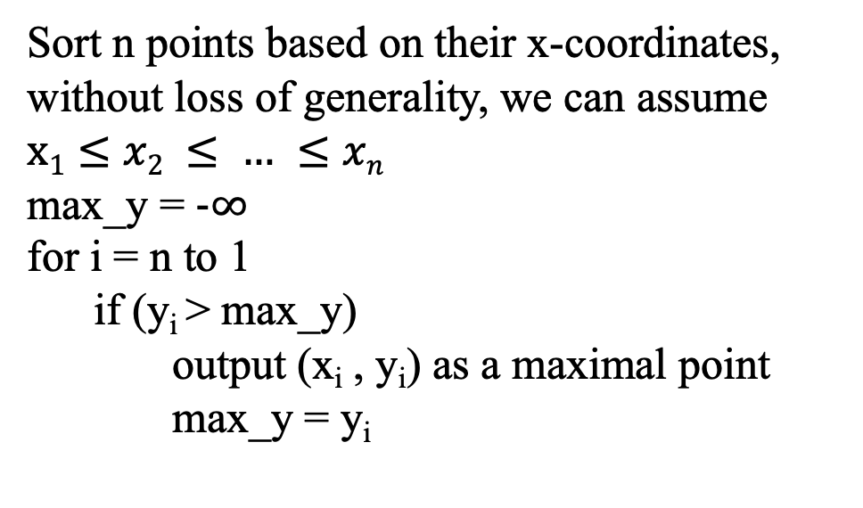
Maxima of a point set
Given n points in a 2D plane, define the $≻$ relation as follows:
Please design an algorithm to find all maximal points.
Sort n points based on their x-coordinates, without loss of generality, we can assume $x1≤x2 ≤ … ≤xn$
max_y = $−∞$
for i = n to 1
if (y_{i} > max_y)
output (x_{i} , y_{i}) as a maximal point
max_y = y_{i}

