Slide 1
Selection
张胜
sheng@nju.edu.cn
南京大学

Slide 2
Contents
Finding the maximum
Finding the maximum and the minimum
Finding the second largest key
Finding the median
Select-Elinear: Expectation is linear
Select-Wlinear: Worst case is linear

Slide 3
The Selection Problem
Problem:
Suppose E is an array containing n elements with keys from some linearly order set, and let k be an integer such that 1≤k≤n. The selection problem is to find an element with the kth smallest key in E.
Two special cases
Max: k=n
Min: k=1

Slide 4
Finding the max
The problem:
Input: number array E with unsorted n entries indexed as 0,…n-1
Output: Return max, the largest entry in E
Procedure:
int findMax(E,n)
max=E(0)
for (index=1;index<n;index++)
if (max<E(index)
max=E(index);
return max

Slide 5
Decision Tree and Lower Bound
Since the decision tree for the selection problem must have at least n leaves, the height of the tree is at least ⎡lgn⎤. It’s not a good lower bound.
Example: n=4
0:1
≤
>
1:2
0:2
2:3
1:3
……
3
2
3
1
There are more than n leaves!

Slide 6
Instead, we use adversary argument to estabilish better lower bounds for the selection problem.
Suppose we have an algorithm that we think is efficient. Imagine an adversary who wants to prove otherwise. At each point in the algorithm where a decision (e.g., a key comparison) is made, the adversary tells us the result of the decision. The adversary chooses its answers to try to force the algorithm to work hard, i.e., to make lots of decisions. You may think of the adversary as gradually constructing a “bad” input for the algorithm while it answers the decisions. The only constraint is that, the adversary’s answers must be internally consistent: there must be some input for the problem for which its answers would be correct. If the adversary can force the algorithm to perform f(n) steps, then f(n) is a lower bound for the number of steps done in the worst case.

Slide 7
Lower Bound of Finding the Max
For any algorithm A that can compare and copy numbers exclusively, in the worst case, A cannot do fewer than n-1 comparisons to find the largest entry in an array with n entries.
Proof: an array with n distinct entries is assumed. We can exclude a specific entry from being the largest entry only after it is determined to be “loser” to at least one entry. So, n-1 entries must be “losers” in comparisons done by the algorithm. However, each comparison has only one loser, so at least n-1 comparisons must be done.

Slide 8
Finding max and min
The strategy
Pair up the keys, and do n/2 comparisons(if n odd, having E[n] uncompared);
Doing findMax for larger key set and findMin for small key set respectively (if n odd, E[n] included in both sets)
Number of comparisons
For even n: n/2+2(n/2-1)=3n/2-2
For odd n: (n-1)/2+2((n-1)/2+1-1)=⎡3n/2⎤-2
Notes:
Is this strategy the optimal one?

Slide 9
Unit of Information
x is max can only be known
when it is sure that every key other than x has lost some comparison.
y is min can only be known
when it is sure that every key other than y has win some comparison.
Each win or loss is counted as one unit of information, then any algorithm must have at least 2n-2 units of information to be sure of specifying the max and min.

Slide 10

Adversay Strategy
The principle: let the key win if it never lose, or, let the key lose if it never win, and
change one value if necessary

Slide 11
Lower Bound by Adversary Strategy
Construct a input to force the algorithm to do more comparisons as possible, that is, to give away as few as possible units of new information with each comparison.
It can be achieved that 2 units of new information are given away only when the status is N,N.
It is always possible to give adversary response for other status so that at most one new unit of information is given away, without any inconsistencies.
So, the Lower Bound is n/2+n-2(for even n)

Slide 12

An Example Using Adversary
8 Comparisons!
The lower bound is 7.
Now, x₃ is the only one which never loses, so, Max is x₃
Now, x₄ is the only one which never wins, so, x₄ is Min
Raising/lowering the value according to strategy

Slide 13
Finding the Second-Largest Key
Using FindMax twice is a solution with 2n-3 comparisons.
For a better algorithm, the idea is to collect some useful information from the first FindMax to decrease the number of comparisons in the second FindMax.
Useful information: the key which lost to a key other than max cannot be the second-Largest key.

Slide 14
Second Largest Key by Tournament
The length of the longest path is ⎡lgn⎤ , as many as those compared to max at most.
Larger key bubbles up
2
6
x₂ is max
Only x₁, x₃, x₅, x₆ may be the second largest key.
2
2
5
6
9
2
3
4
5
6
7
8
9
1
2

Slide 15
Analysis of Finding the Second
Any algorithm that finds secondLargest must also find max before. (n-1)
The secondLargest can only be in those which lose directly to max.
On its path along which bubbling up to the root of tournament tree, max beat ⎡lgn⎤ keys at most.
Pick up secondLargest. (⎡lgn⎤ -1)
n+ ⎡lgn⎤-2

Slide 16
Lower Bound by Adversary
Theorem
Any algorithm (that works by comparing keys) to find the second largest in a set of n keys must do at least n+⎡lgn⎤-2 comparisons in the worst case.
Proof
There is an adversary strategy that can force any algorithm that finds secondLargest to compare max to ⎡lgn⎤ distinct keys.
Notes:
后面将提出这个策略

Slide 17
Weighted Key
Note: for one comparison, the weight increasing is no more than doubled.
Assigning a weight w(x) to each key. The initial values are all 1.
Adversary rules:
Zero=Loss
Notes:
证明要找到max，必须至少有lgn个元素“输给”“max”，于是至少在lgn个元素中再找max。

Slide 18
Lower Bound by Adversary: Details
Note: the sum of weights is always n.
Let x is max, then x is the only nonzero weighted key, that is w(x)=n.
By the adversary rules:
w_{k}(x)≤ 2w_{k-1}(x)
Let K be the number of comparisons x wins against previously undefeated keys:
n=w_{K}(x)≤2^{K}w₀(x)=2^{K}
So, K≥⎡lgn⎤

Slide 19

Tracking the Losers to MAX
Can you prove it using induction?
x₈
To be filled with winners
Building a heap structure of 2n-1 entries, using n-1 extra space
x₈
x₈
x₈
x₁
x₂
x₃
x₄
x₅
x₆
x₇
x₈
x₉
x₁₀
n entries in input

Slide 20
Finding the Median: the Strategy
Observation: If we can partition the problem set of keys into 2 subsets: S1, S2, such that any key in S1 is smaller than that of S2, then the median must located in the set with more elements.
Divide-and-Conquer: only one subset is needed to be processed recursively.

Slide 21
Adjusting the Rank
The rank of the median (of the original set) in the subset considered can be evaluated easily.
An example
Let n=255
The rank of median we want is 128
Assuming |S₁|=96, |S₂|=159
Then, the original median is in S₂, and the new rank is 128-96=32

Slide 22
Partitioning: Larger and Smaller
Dividing the array to be considered into two subsets: “small” and “large”, the one with more elements will be processed recursively.
A “bad” pivot will give a very uneven partition!
[splitPoint]:
pivot
for any element in this segment, the key is less than pivot.
for any element in this segment, the key is not less than pivot.
small
large
To be
p
rocessed
recursively

Slide 23
Select-Elinear: the Algorithm (期望线性时间的选择算法)
Input: S, a set of n keys; and k, an integer such that 1≤k≤n.
Output: The kth smallest key in S.
Note: Median selection is only a special case of the algorithm, with k=⎡n/2⎤.

Slide 24
Select-Elinear: the Algorithm (期望线性时间的选择算法)
How to find the median of 5 elements using at most 6 comparisons?
Element Select-Elinear (SetOfElements S, int k)
if (|S|≤5) return direct solution; else
Choose a pivot to partition S into S₁ in which the elements are smaller than pivot and S₂ in which the elements are not smaller than pivot;
If |S₁|=k-1, return pivot;
Else if |S₁|>k-1, select-elinear(S₁,k);
Else select-elinear(S₂,k- |S₁|-1);
There is the same question with quicksort-imbalanced partition

Slide 25
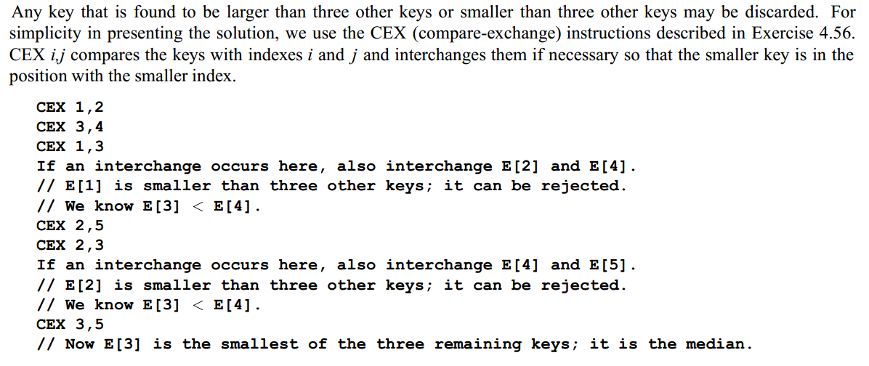
How to find the median of 5 elements using at most 6 comparisons? (Method 1)

Slide 26
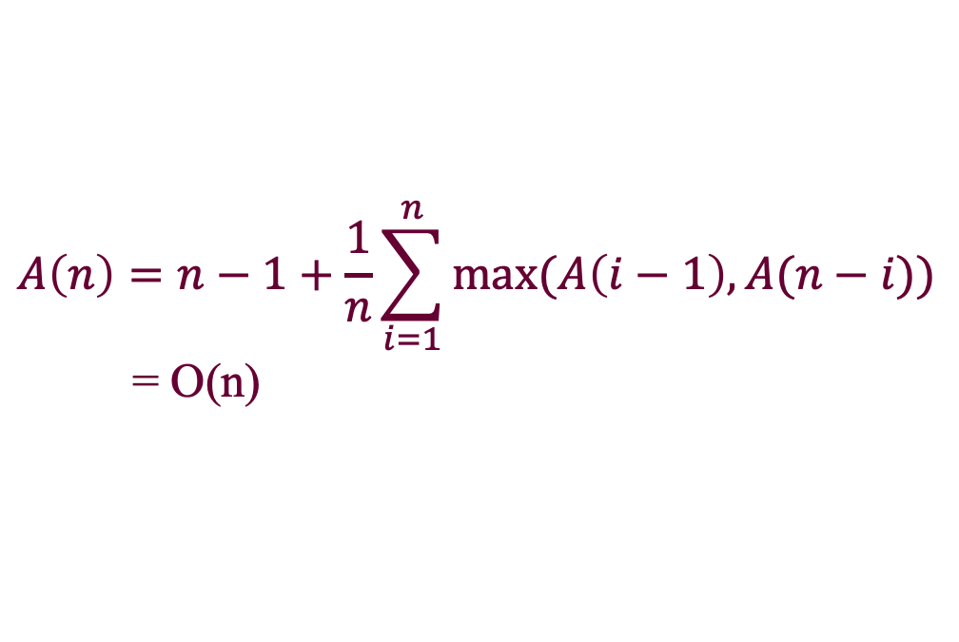
Select-Elinear: Analysis Sketch (期望线性时间的选择算法)
大致估算：假设每次partition的结果都是完全均匀的，则平均情况时间复杂度A(n) = n + n/2 + n/4 + … =O(n)
严格分析(细节可查阅黄宇老师教材)：
$$A\left(n\right)=n−1+\frac{1}{n}\sum_{i=1}^{n}{max⁡(A\left(i−1\right),A(n−i))}$$
= O(n)

Slide 27
Select-Elinear to Select-Wlinear (期望线性时间的选择算法) (最坏情况线性时间的选择算法)
All the elements are put in groups of 5
Medians
Increasing
Increasing by medians

Slide 28
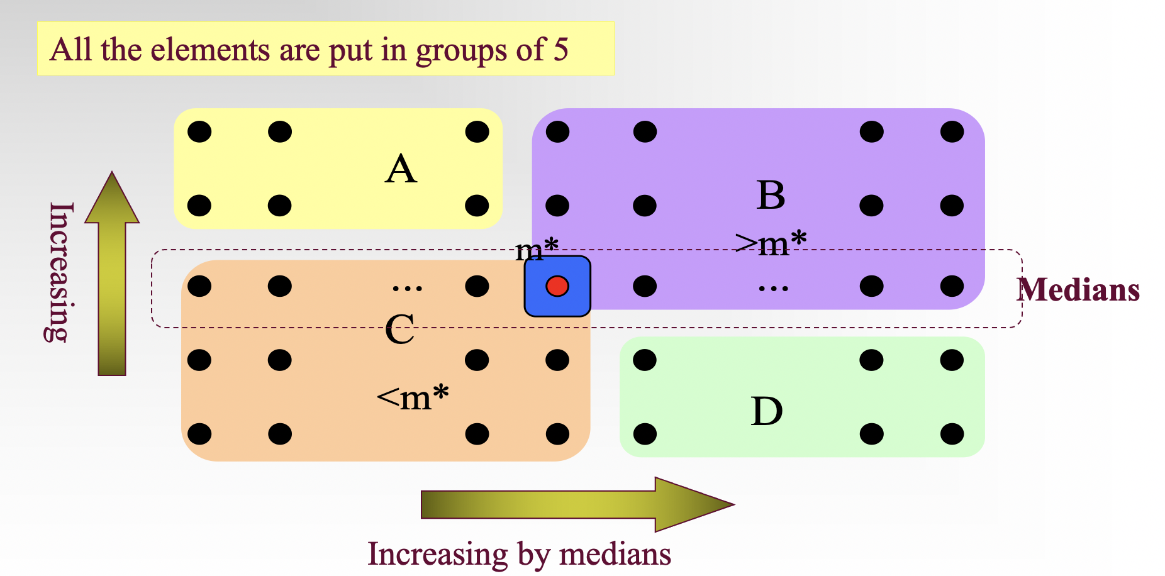
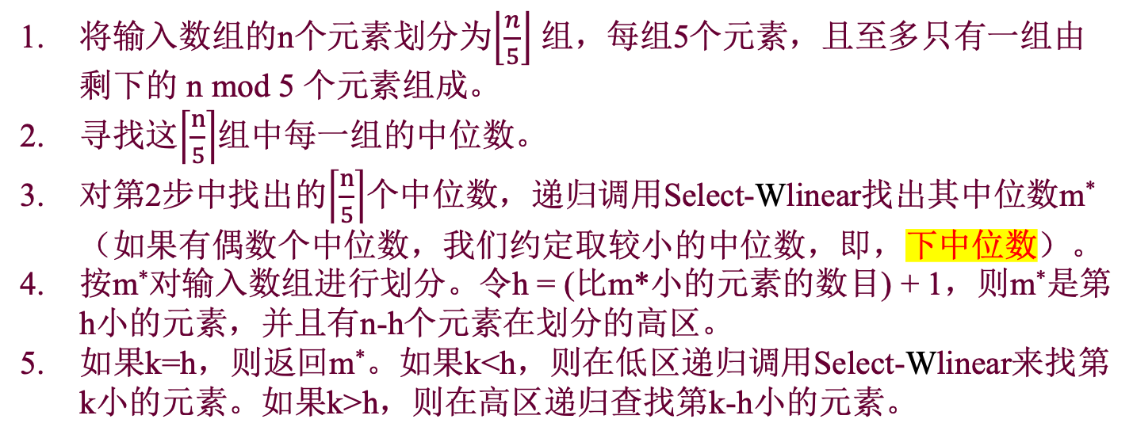
Select-Wlinear (最坏情况线性时间的选择算法)
Select-Wlinear (n, k)
将输入数组的n个元素划分为$\left\lfloor \frac{n}{5}\right\rfloor$ 组，每组5个元素，且至多只有一组由剩下的 n mod 5 个元素组成。
寻找这$\left\lceil \frac{n}{5}\right\rceil$组中每一组的中位数。
对第2步中找出的$\left\lceil \frac{n}{5}\right\rceil$个中位数，递归调用Select-Wlinear找出其中位数m*（如果有偶数个中位数，我们约定取较小的中位数，即，下中位数）。
按m*对输入数组进行划分。令h = (比m*小的元素的数目) + 1，则m*是第h小的元素，并且有n-h个元素在划分的高区。
如果k=h，则返回m*。如果k<h，则在低区递归调用Select-Wlinear来找第k小的元素。如果k>h，则在高区递归查找第k-h小的元素。

Slide 29
Constructing the Partition
Find the m*, the median of medians of all the groups of 5, as illustrated previously.
Compare each key in sections A and D to m*, and
Let S₁=C∪{x|x∈A∪D and x<m*}
Let S₂=B∪{x|x∈A∪D and x>m*}
(m* is to be used as the pivot for the partition)

Slide 30
Divide and Conquer
if (k=|S₁|+1)
return m*;
else if (k≤|S₁|)
return select(S₁,k); //recursion
else
return select(S₂,k-|S₁|-1); //recursion

Slide 31
Counting the Number of Comparisons
For simplicity:
Assuming n=5(2r+1) for all calls of select.
Note: r is about n/10, and 0.7n+2 is about 0.7n, so
The extreme case: all the elements in A∪D in one subset.
Comparing all the elements in A∪D with m*
Finding the median in every group of 5
Finding the median of the medians
Notes:
（2r+1）列

Slide 32
Worst Case Complexity of Select
W(n) 1.6n
1.6n
Note: Row sums is a decreasing geometric series, so
W(n)∈Θ(n)
W(.2n) 1.6(.2n)
W(.7n) 1.6(.7n)
1.6(. 9)n
1.6(. 81)n
W(.04n) 1.6(.04n)
W(.14n) 1.6(.14n)
W(.14n) 1.6(.14n)
W(.49n) 1.6(.49n)
1.6(. 9)³n
W(.2³n)
W(.2²(.7)n)
W(.2²(.7)n)
W(.2(.7)²n)
W(.2²(.7)n)
W(.2(.7)²n)
W(.2(.7)²n)
W(.2³n)

Slide 33
Relation to Median
Observation: Any algorithm of selection must know the relation of every element to the median.
y
Median
y
Wrong

Slide 34
Crucial Comparison (关键比较)
A crucial comparison establishes the relation of some x to the median.
Definition (for a comparison involving a key x)
Crucial comparison for x: the first comparison where x>y, for some y≥median, or x<y for some y≤median
Non-crucial comparison: the comparison between x and y where x>median and y<median

Slide 35
Adversary for Lower Bound
Status of the key during the running of the Algorithm:
L: Has been assigned a value larger than median
S: Has been assigned a value smaller than median
N: Has not yet been in a comparison
Adversary rule:
Comparands Adversary’s action
N,N one L, the another S
L,N or N,L change N to S
S,N or N,S change N to L
(In all other cases, just keep consistency)

Slide 36
Notes on the Adversary Arguments
All actions explicitly specified above make the comparisons un-crucial.
At least, (n-1)/2 L or S can be assigned freely.
If there are already (n-1)/2 S, a value larger than median must be assigned to the new key, and if there are already (n-1)/2 L, a value smaller than median must be assigned to the new key. The last assigned value is the median.
So, an adversary can force the algorithm to do (n-1)/2 un-crucial comparisons at least(In the case that the algorithm start out by doing (n-1)/2 comparisons involving two N.

Slide 37
Lower Bound for Selection Problem
Theorem: Any algorithm to find the median of n keys(for odd n) by comparison of keys must do at least 3n/2-3/2 comparisons in the worst case.
Argument:
There must be done n-1 crucial comparisons at least.
An adversary can force the algorithm to perform as many as (n-1)/2 uncrucial comparisons. (Note: the algorithm can always start out by doing (n-1)/2 comparisons involving 2 N-keys, so, only (n-1)/2 L or S left for the adversary to assign freely as the adversary rule.

