Slide 1
Dynamic Sets and Balanced Binary Search Tree
张胜
sheng@nju.edu.cn
南京大学

Slide 2
In this class…
Dynamic Sets and Searching
Red-Black Tree

Slide 3
Dynamic Sets and Searching
Dynamic Set: a set of elements that may be changed (e.g., deletion, insertion) by the algorithm/application
The element in a dynamic set usually includes
(1) a key （关键字）
(2) satellite data（卫星数据）

Slide 4
Operations on Dynamic Sets
Search(S, k): return the element the key of which is k
Insert(S, x): insert the new element x into S
Delete(S, x): delete x from S
Minimum(S): return the element the key of which is the smallest
Maximum(S): return the element the key of which is the largest
Successor(S, x): return the element the key of which is the smallest among all elements that have larger keys than x
Predecessor(S, x): return the element the key of which is the largest among all elements that have smaller keys than x
Binary Search Tree: supports all these 7 operations

Slide 5
Searching: the most important operation
Selection vs. Searching
Select the “rank 2” student: The partial order relation matters
Search for “Alice” or “Bob”: The key itself matters
Expected cost for searching
Brute force case: O(n)
Trivial. Easy to implement.
Ideal case: O(1)
The expectation of the search cost in Hash is O(1), but the worst case search cost is still O(n). We will introduce Hash in the next class.
Can we achieve O(lgn)?

Slide 6
O(lgn) Search
Essential of Searching
How to organize the data to enable efficient search?
O(lgn) search
Each search should cut off half of the search space
O(lgn) search techniques
Binary search for sorted (static) sequences
Binary Search Tree (BST) for dynamic sets
Red-black tree: a balanced BST

Slide 7
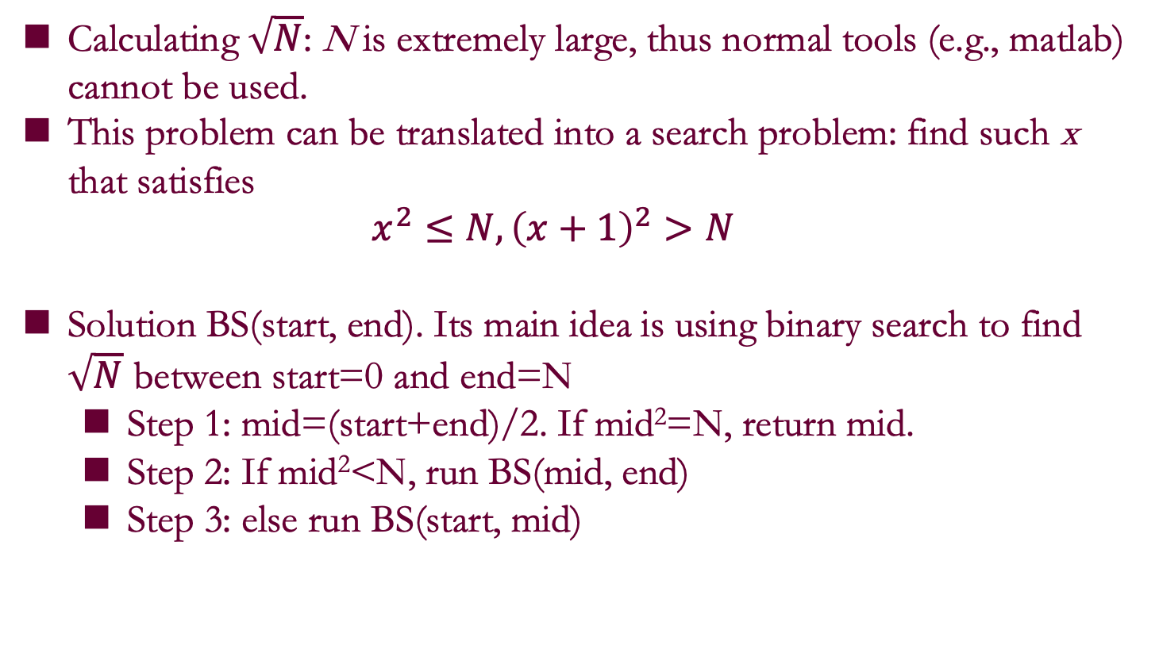
Binary search for sorted static sequence - Two Examples
Calculating $\sqrt{N}$: N is extremely large, thus normal tools (e.g., matlab) cannot be used.
This problem can be translated into a search problem: find such x that satisfies
$$x^{2}≤N, {\left(x+1\right)}^{2}>N$$
Solution BS(start, end). Its main idea is using binary search to find $\sqrt{N}$ between start=0 and end=N
Step 1: mid=(start+end)/2. If mid²=N, return mid.
Step 2: If mid²<N, run BS(mid, end)
Step 3: else run BS(start, mid)

Slide 8
Binary search for sorted static sequence - Two Examples
Peak-number: Given an array that has the unimodal (单峰：先上升再下降) property, how to find the peak?

Slide 9
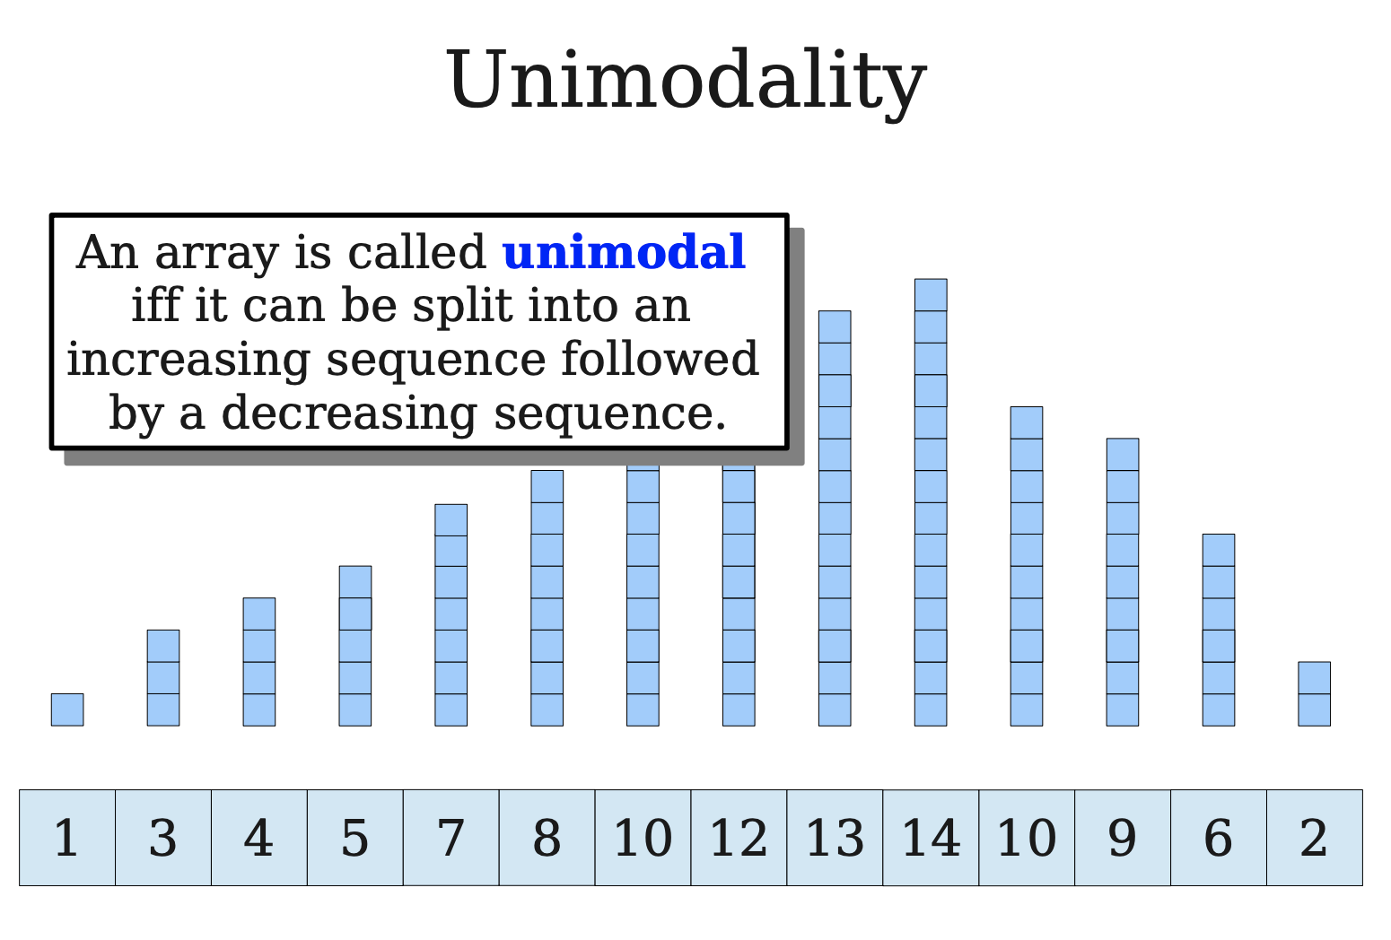

Slide 10
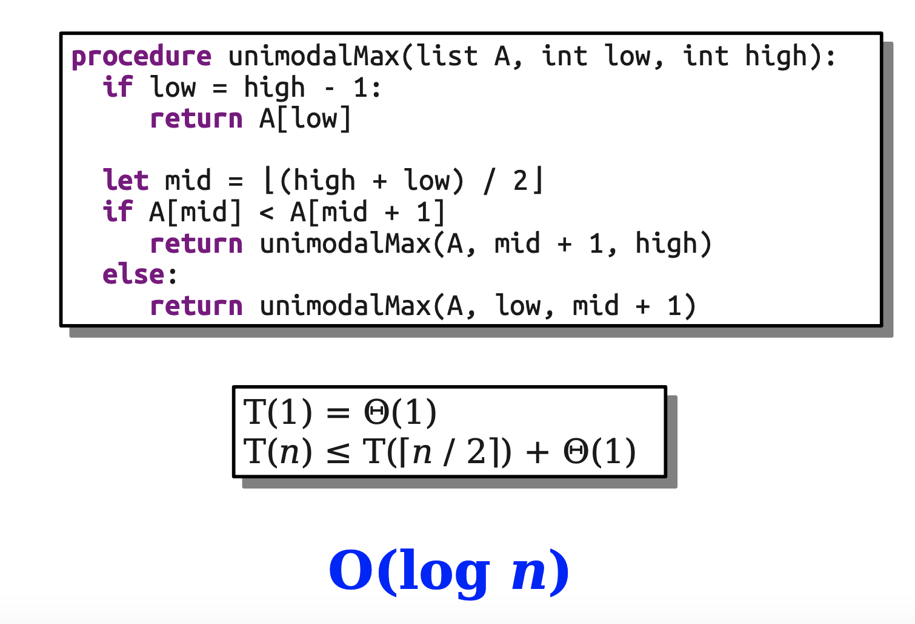

Slide 11
What if weakly unimodal?

Slide 12
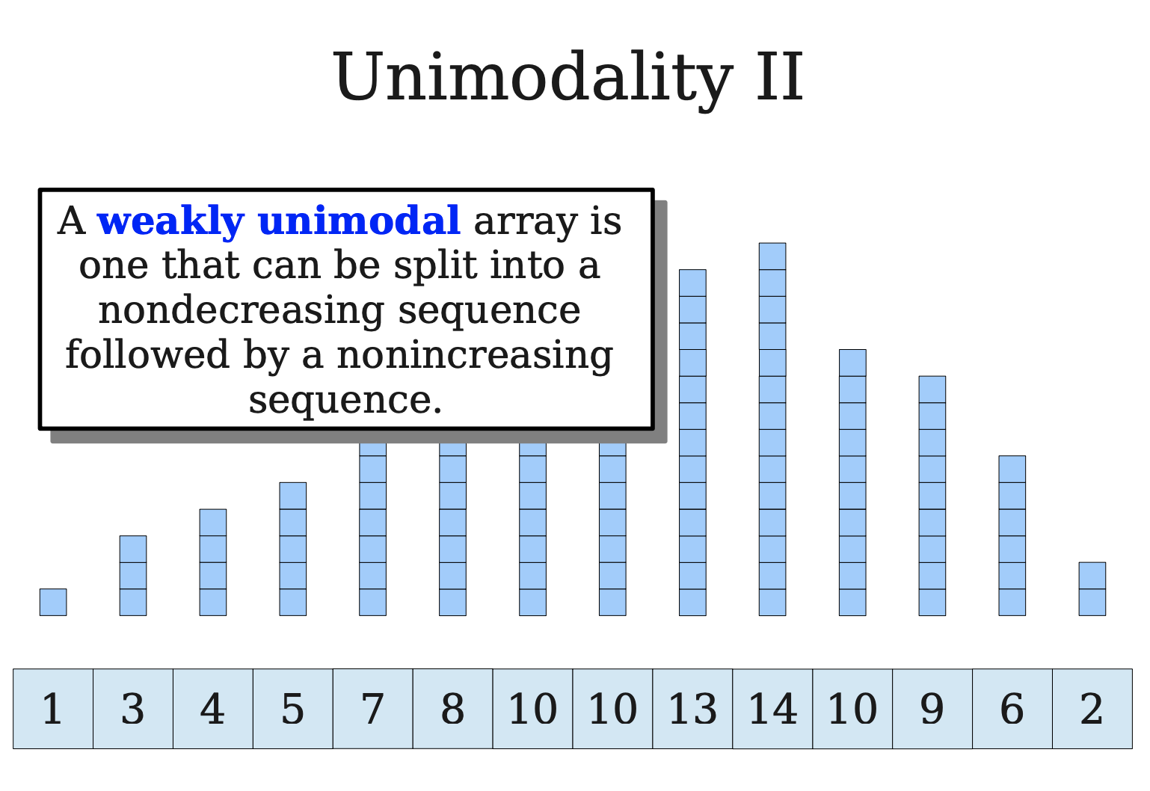

Slide 13
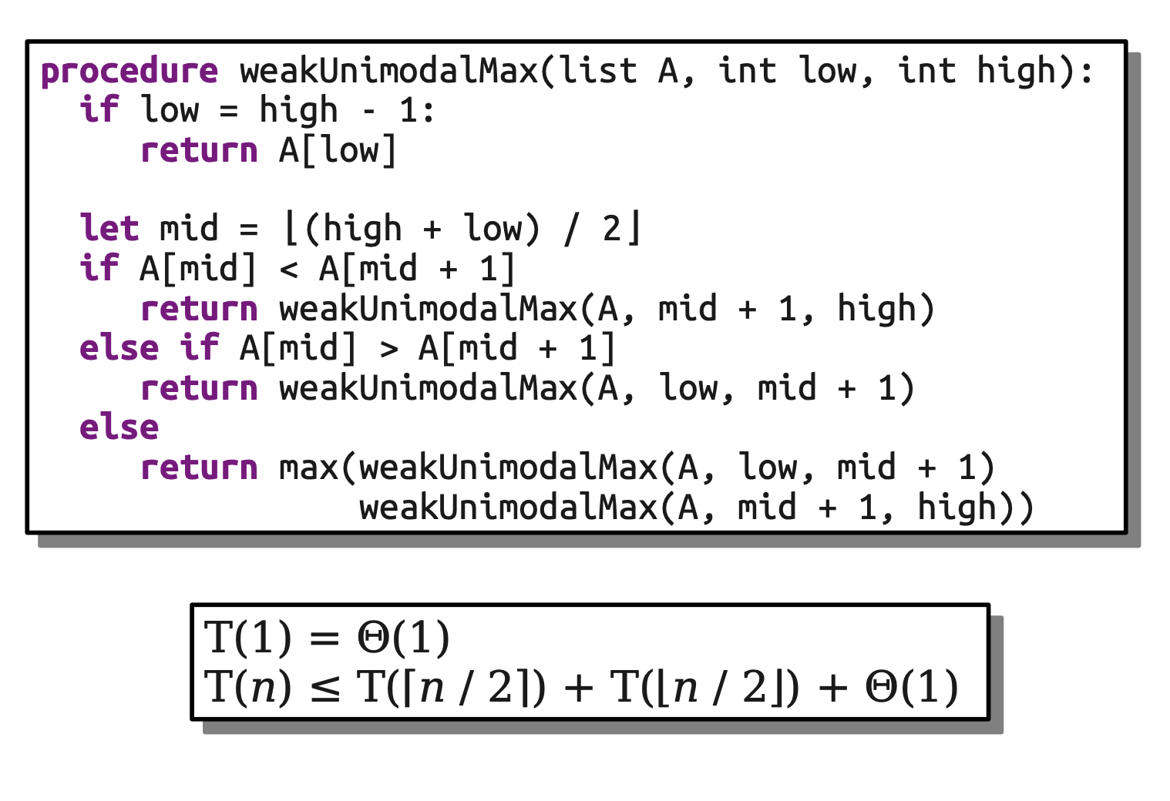
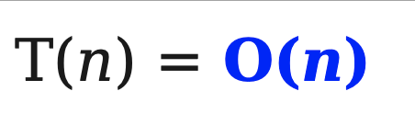
Please note this is not a binary search algorithm.

Slide 14
Binary Search Tree (BST)
A binary search tree is (1) a binary tree, and (2) the key at each node is greater than all the keys in its left subtree and less than or equal to all keys in its right subtree.
40
20
60
30
50
80

Slide 15
Binary Search Tree: Example
Good balancing
Θ(logn)
Poor balancing
Θ(n)
40
30
20
60
80
20
30
50
80
60
In a properly drawn tree, pushing forward to get the ordered list.
40
50
Each node has a key, belonging to a linear ordered set
An inorder traversal (中序遍历) produces a sorted list of the keys

Slide 16
Node Group
A node group is any connected group of internal nodes of a binary tree. A subtree S is a principal subtree of a node group if the parent of the root of S is in the group, but no node of S is. A principal subtree of a node group can be an external node (empty tree).
As in 2-tree, the number of external node is one more than that of internal node
50
Node group
70
70
15
25
60
80
60
80
10
20
40
65
75
90
75
30
5 principal subtrees
Notes:
node group 是任意连通的内部节点群
S是一个节点群的principal subtree，如果S的父节点在这个节点群中，但是S中没有任何节点在这个群中。

Slide 17
Improving the Balancing by Rotation
The node group to be rotated
50
50
25
Root of the group is changed.
15
15
40
10
25
10
20
30
20
40
30
The middle principal subtree changes parent

Slide 18
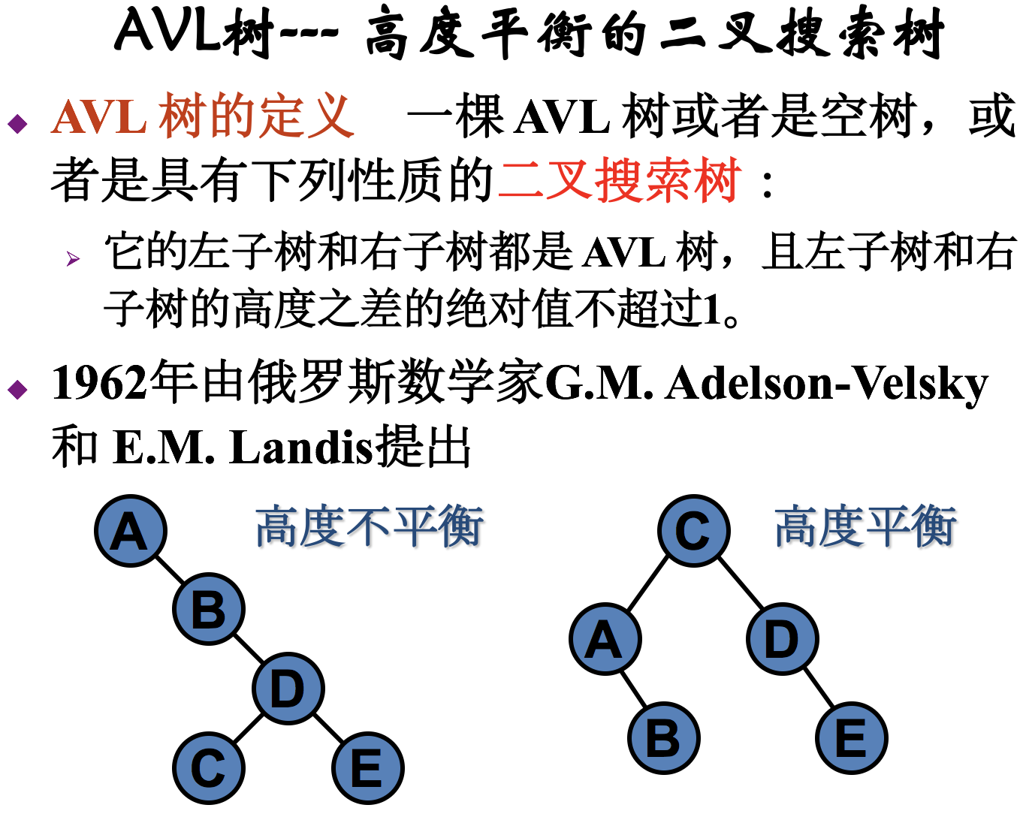
Improving the balance by rotation seems practical. But what is “balance”? How to define balance?
Notes:
G.M. Adelson-Velsky、E.M. Landis

Slide 19
Red-Black Tree: direct definition
If T is a binary tree in which each node has a color, red or black, and all external nodes are black, then T is a red-black tree if and only if:
The root is black.
[Color constraint] No red node has a red child
[Black height constraint] The black length of all external paths from a given node u is the same (the black height of u)
Almost-red-black tree(ARB tree)
Root is red, satisfying the other constraints.
Balancing is under controlled

Slide 20
Tree
Height of node. The height of a node is the number of edges on the longest path between that node and a leaf.
Height of tree. The height of a tree is the height of its root node.
Black Height of node. The black height of a node is the number of black nodes on the longest path between that node and an external black node minus 1.
Height of tree. The black height of a tree is the black height of its root node.

Slide 21
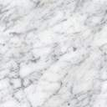
RB_{i} and ARB_{i}
RB₀
(1)
(2)
ARB₁
(3)
(4)
RB₁

Slide 22
Red-Black Tree: recursive definition
(A red-black tree of black height h is denoted as RB_{h})
Definition:
An external node is an RB₀ tree, and the node is black.
A binary tree is an ARB_{h} (h≥1) tree if:
Its root is red, and
Its left and right subtrees are each an RB_{h-1} tree.
A binary tree is an RB_{h} (h≥1) tree if:
Its root is black, and
Its left and right subtrees are each either an RB_{h-1} tree or an ARB_{h} tree.
No ARB₀

Slide 23
Red-Black Tree with 6 (Internal) Nodes (black height=2)
40
20
60
poorest balancing: height (normal) is 4
30
30
50
80
20
60
Black edge
40
50
80
20
60
40
30
50
80

Slide 24
Black-Depth Convention
All with the same largest black depth: 2
40
20
30
50
60
80
30
60
20
40
50
80
40
60
20
30
50
80
ARB Trees

Slide 25
Properties of Red-Black Tree
The black height of any RB_{h} tree or ARB_{h} tree is well defind and is h.
Let T be an RB_{h} tree, then:
T has at least 2^{h}-1 internal black nodes.
T has at most 4^{h}-1 internal nodes.
The depth of any black node is at most twice its black depth.
Let A be an ARB_{h} tree, then:
A has at least 2^{h}-2 internal black nodes.
A has at most (4^{h})/2-1 internal nodes.
The depth of any black node is at most twice its black depth.

Slide 26
Well-Defined Black Height
That “the black height of any RB_{h} tree or ARB_{h} tree is well defind” means the black length of all external paths from the root is the same.
Proof: induction on h
Base case: h=0, that is RB₀ (there is no ARB₀)
In ARB_{h+1}, its two subtrees are both RB_{h}.Since the root is red, the black length of all external paths from the root is h, that’s the same as its two subtrees.
In RB_{h+1}:
Case 1: two subtrees are RB_{h}’s
Case 2: two subtrees are ARB_{h+1}’s
Case 3: one subtree is an RB_{h}(black height=h), and the another is an ARB_{h+1}(black height=h)

Slide 27
Bound on Depth of Node in RBTree
Let T be a red-black tree with n internal nodes. Then no node has depth greater than 2lg(n+1), which means that the height of T in the usual sense is at most 2lg(n+1).
Proof:
Let h be the black height of T. The number of internal nodes, n, is at least the number of internal black nodes, which is at least 2^{h}-1, so h≤lg(n+1). The node with greatest depth is some external node. All external nodes are with black depth h. So, the depth is at most 2h.

Slide 28
Influences of Insertion into an RBTree
Black height constrain:
No violation if inserting a red node.
Color constraint:
Critical clusters(external nodes excluded), which originated by color violation, with 3 or 4 red nodes
40
20
30
50
60
80
40
Inserting 70
20
30
50
60
70
80

Slide 29
Repairing 4-node Critical Cluster
40
No new critical cluster occurs, inserting finished.
20
30
50
60
70
80
Color flip:
Root of the critical cluster exchanges color with its subtrees
40
60
20
30
50
70
80

Slide 30
Repairing 4-node Critical Cluster
2 more insertions
40
60
Critical cluster
20
30
50
70
80
85
90
New critical cluster with 3 nodes.
Color flip doesn’t work,
Why?
40
60
80
20
30
50
70
85
90

Slide 31
Patterns of 3-Node Critical Cluster
B
A
L
M
R
L
M
R
LL
LR
RL
RR
LL
LR
RL
RR
Shown as properly drawn
C
D
L
M
R
L
M
R
LL
LR
RL
RR
LL
LR
RL
RR
85

Slide 32
Repairing 3-Node Critical Cluster
The 4 patterns can be translated into the same pattern
Root of the critical cluster is changed to M, and the parentship is adjusted accordingly
L
M
R
LL
LR
RL
RR
The incurred critical cluster is of pattern A
40
60
80
20
30
50
70
85
90

Slide 33
Complexity of Operations on RBTree
With reasonable implementation
A new node can be inserted correctly in a red-black tree with n nodes in Θ(logn) time in the worst case.
Repairs for deletion do O(1) structural changes, but may do O(logn) color changes.

Slide 34
Dynamic Sets and Searching

Slide 35
MAX in a Circularly Shifted Array
Given an array A of n sorted distinct numbers that has been circularly shifted k positions to the right. For example, {35, 42, 5, 15, 27, 29} is a sorted array that has been circularly shifted k = 2 positions, while {27, 29, 35, 42, 5, 15} has been shifted k = 4 positions.
Suppose you do not know what k is. Design an O(logn) algorithm to find the largest number A.
Notes:
Unimodal算法

Slide 36
扔鸡蛋问题
假设有n级台阶，现在从台阶上往下扔鸡蛋，在某层台阶之上往下摔，鸡蛋就会摔破。问在最坏情况下至少要测试多少次才能测出这个层数？
如果只有一个鸡蛋
如果有无穷多个相同鸡蛋
如果有两个相同鸡蛋
1）从第一层开始，逐层尝试，最坏O(n)
2）binary search，O(lgn)
3） x(x+1)/2=n，例如n=100时，x=14即可。
第一次在14层楼测试，若碎，则用另外一个鸡蛋从1试到13，最多需要14次。
若不碎，继续用第一个鸡蛋到27层楼测试，若碎，则用另外一个鸡蛋从15试到26，最多需要14次。
Notes:
1）从第一层开始，逐层尝试，最坏O(n)
2）binary search，O(lgn)
3） x(x+1)/2=n，例如n=100时，x=14即可。
第一次在14层楼测试，若碎，则用另外一个鸡蛋从1试到13，最多需要14次。
若不碎，继续用第一个鸡蛋到27层楼测试，若碎，则用另外一个鸡蛋从15试到26，最多需要14次。
==============
先用第一个鸡蛋，从下往上每隔√n级摔一次，直到摔碎为止；然后第二个鸡蛋在最后刚好摔碎鸡蛋的√n级区间，从下往上摔，直到摔碎为止。
最坏情况下摔 2√n 次（渐进意义上的）。
进一步:如果有k个鸡蛋，则结果是k乘以（n开k次方）次。当k= log₂ n时，该方法退化为二分查找法。

Slide 37
kth Smallest Element in Two Arrays
Given two sorted arrays with n and m elements respectively, design an algorithm to find the kth smallest element in the totally (m+n) elements in O (logm + logn) and explain the time complexity.
Assumption: The inputs are right. i.e. k is in the range [0, len(a)+len(b)]
Two arrays are denoted as a and b.
Base cases:
If length of one of the arrays is 0, the answer is kth element of the other array.
Reduction steps:
If (mid index of a) + (mid index of b) is less than k
If mid element of a is greater than mid element of b, we can ignore the first half of b, adjust k.
else ignore the first half of a, adjust k.
Else
If mid element of a is greater than mid element of b, we can safely ignore second half of a
else we can ignore second half of b
Notes:
Assumption: The inputs are right. i.e. k is in the range [0, len(a)+len(b)]
Two arrays are denoted as a and b.
Base cases:
If length of one of the arrays is 0, the answer is kth element of the other array.
Reduction steps:
If (mid index of a) + (mid index of b) is less than k
If mid element of a is greater than mid element of b, we can ignore the first half of b, adjust k.
else ignore the first half of a, adjust k.
Else
If mid element of a is greater than mid element of b, we can safely ignore second half of a
else we can ignore second half of b
https://stackoverflow.com/questions/4607945/how-to-find-the-kth-smallest-element-in-the-union-of-two-sorted-arrays

