Slide 1
Hash
张胜
sheng@nju.edu.cn
南京大学

Slide 2
In the last class
O(lgn) search techniques
Binary search for sorted (static) sequences
Binary Search Tree (BST) for dynamic sets
Red-black tree: a balanced BST

Slide 3
Operations on Dynamic Sets
Hash: supports Search, Insert, Delete
Search(S, k): return the element the key of which is k
Insert(S, x): insert the new element x into S
Delete(S, x): delete x from S
Minimum(S): return the element the key of which is the smallest
Maximum(S): return the element the key of which is the largest
Successor(S, x): return the element the key of which is the smallest among all elements that have larger keys than x
Predecessor(S, x): return the element the key of which is the largest among all elements that have smaller keys than x
Binary Search Tree: supports all these 7 operations

Slide 4
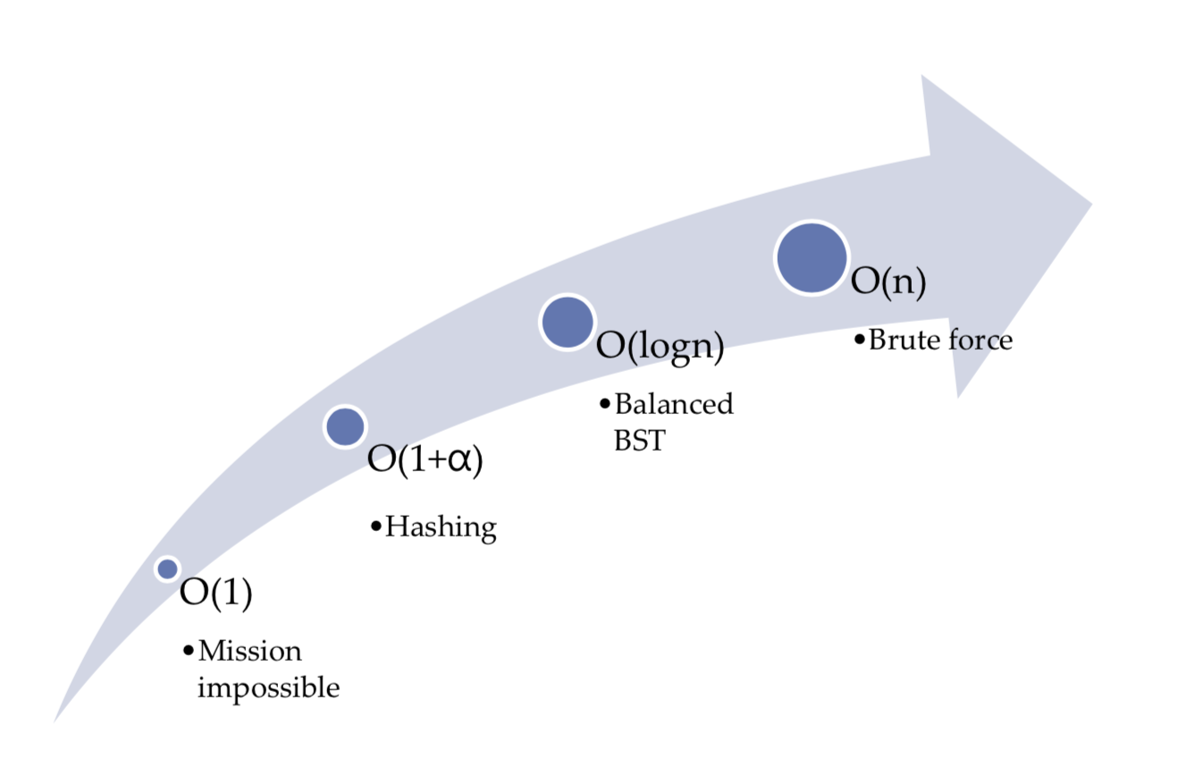
The Ambition of Hashing
Almost constant time
In the worst case, the searching time is still O(n)

Slide 5
Motivating example of Hash
Suppose, for instance, that you need to maintain an ever-changing list of about 250 IP addresses, perhaps the addresses of the currently active customers of a web service. Each IP address is associated with a record that contain customer details. How can you maintain them to ensure fast lookup？

Slide 6
Motivating example of Hash
Suppose, for instance, that you need to maintain an ever-changing list of about 250 IP addresses, perhaps the addresses of the currently active customers of a web service. Each IP address is associated with a record that contain customer details. How can you maintain them to ensure fast lookup？
Solution 1: maintain the records in an array indexed by IP address
O(1) search time, but memory is wasted, since the array would have 2³² entries and most of them are empty.

Slide 7
Motivating example
Suppose, for instance, that you need to maintain an ever-changing list of about 250 IP addresses, perhaps the addresses of the currently active customers of a web service. Each IP address is associated with a record that contain customer details. How can you maintain them to ensure fast lookup？
Solution 2: a linked list of 250 records
The memory is proportional to the # of records, but search would be very slow, in the worst case, it may need to access all 250 records.

Slide 8
Is there a way to get the best of them?
Solution 1: maintain the records in an array indexed by IP address
O(1) search time, but memory is wasted, since the array would have 2³² entries and most of them are empty.
Solution 2: a linked list of 250 records
The memory is proportional to the # of records, but search would be very slow, in the worst case, it may need to access all 250 records.

Slide 9
Fortunately, we have Hashing!
Index
H
Hash function: h(x)=5x mod 8
0
8
1
hashing
2
8
55
3
55
4
4
4
1918
5
6
1918
7

Slide 10
Fortunately, we have Hashing!
Index
H
Hash function: h(x)=5x mod 8
0
8
1
hashing
2
8
55
3
55
4
4
4
1918
5
6
1918
7

Slide 11
Hashing: the idea
The purpose of hashing is to translate an extremely large key space into a reasonably small range of integers (these integers are usually used as indexes).
The translated value of the key is called the hash code (散列值/哈希值/哈希码) for that key, and it is computed by some hash function.

Slide 12
Illustration of hashing
Very large, but only a small part is used in an application
In feasible size
E[0]
E[1]
x
Hash Function
Key Space
E[k]
H(x)=k
Value of a specific key
Hash code: A calculated array index for the key
E[m-1]
slot (槽)
Notes:
介绍随机存储与链式存储
考察链式存储：两个没有环的链表，判断是否相交，如果相交，找到第一个交点。

Slide 13

Collision
Collision: $≥$2 keys are hashed to the same hash code
Index
H
Hash function: h(x)=5x mod 8
0
1776
1
1055, 1492, 1776, 1918
, 1812
2
1812
3
1055
4
1492
1812
5
6
1918
7

Slide 14
Content
Collision Handling
Closed Address Hashing (闭地址/开散列)
Analysis
Open Address Hashing (开地址/闭散列)
Analysis
Hash Functions

Slide 15
Collision Handling: Closed Address
When inserting a key, we add it to the beginning of the linked list.
Each address is a linked list
k₁
k₁
k₄
k₅
k₂
k₇
k₃
k₆
Notes:
分析时间开销，包括插入，搜索，以及删除

Slide 16
Collision Handling: Closed Address
When inserting a key, we add it to the beginning of the linked list.
Each address is a linked list
k₁
k₁
k₂
k₄
k₅
k₂
k₇
k₃
k₆
Notes:
分析时间开销，包括插入，搜索，以及删除

Slide 17
Collision Handling: Closed Address
When inserting a key, we add it to the beginning of the linked list.
Each address is a linked list
k₁
k₁
k₂
k₄
k₅
k₂
k₇
k₃
k₆
k₃
Notes:
分析时间开销，包括插入，搜索，以及删除

Slide 18
Collision Handling: Closed Address
When inserting a key, we add it to the beginning of the linked list.
Each address is a linked list
k₄
k₁
k₁
k₂
k₄
k₅
k₂
k₇
k₃
k₆
k₃
Notes:
分析时间开销，包括插入，搜索，以及删除

Slide 19
Collision Handling: Closed Address
When inserting a key, we add it to the beginning of the linked list.
Each address is a linked list
k₄
k₁
k₁
k₅
k₂
k₄
k₅
k₂
k₇
k₃
k₆
k₃
Notes:
分析时间开销，包括插入，搜索，以及删除

Slide 20
Collision Handling: Closed Address
When inserting a key, we add it to the beginning of the linked list.
Each address is a linked list
k₄
k₁
k₁
k₅
k₂
k₄
k₅
k₂
k₇
k₃
k₆
k₆
k₃
Notes:
分析时间开销，包括插入，搜索，以及删除

Slide 21
Collision Handling: Closed Address
When inserting a key, we add it to the beginning of the linked list.
Each address is a linked list
k₄
k₁
k₁
k₇
k₅
k₂
k₄
k₅
k₂
k₇
k₃
k₆
k₆
k₃
Notes:
分析时间开销，包括插入，搜索，以及删除

Slide 22
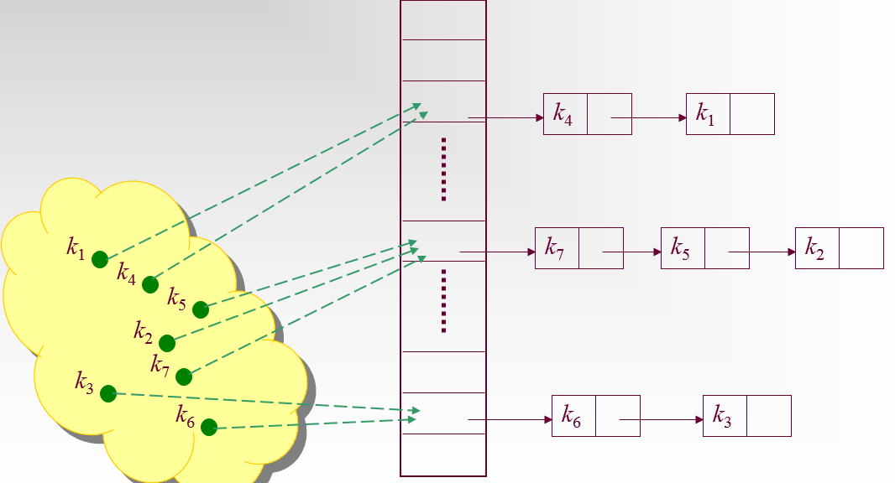
Closed Address：Insertion & Deletion
The cost of computing hashing function is 1.
The cost of accessing one node is 1.
The worst case running time for insertion is O(1).
The worst case running time for deletion is O(1) if the list is doubly linked.(删除的前提假设：已查找过（已知具体位置）)
Notes:
删除的前提假设（已查找过）

Slide 23
Closed Address：Search
The worst case running time for search is Θ(n) if all keys are hashed to the same hash code.
What is the average running time for search?

Slide 24
Assumption: Simple Uniform Hashing (简单一致哈希)
Any given key is equally likely to hash into any of the hash codes.
Notes:
1. 简单一致哈希：哈希函数将关键字平均分布到各个地址，并且对于一个关键字，等概率进入任意一个地址
2。一次不成功检索，哈希函数计算代价为1，查找长度平均为n/m，即1+α

Slide 25
Closed Address: Analysis
Assming there are n keys and the hash table has m slots. Then, for j=0,1,2,...,m-1, the average length of the list at E[j] is n/m.
The average cost of an unsuccessful search:
Any key that is not in the table is equally likely to hash to any of the m addresses. The average cost to determine that the key is not in the list E[h(k)] is the cost to search to the end of the list, which is n/m. So, the total cost is Θ(1+ n/m).
Notes:
1. 简单一致哈希：哈希函数将关键字平均分布到各个地址，并且对于一个关键字，等概率进入任意一个地址
2。一次不成功检索，哈希函数计算代价为1，查找长度平均为n/m，即1+α

Slide 26
Closed Address: Analysis(cont.)
For successful search: (assuming that x_{i} is the ith element inserted into the table, i=1,2,...,n)
For each i, the probability of that x_{i} is searched is 1/n.
For a specific x_{i}, the number of elements examined in a successful search is t+1, where t is the number of elements inserted into the same list as x_{i}, after x_{i} has been inserted. And for any j, the probability of that x_{j} is inserted into the same list of x_{i} is 1/m. So, the cost is:
Expected number of elements in front of the searched one in the same linked list.
1+
Cost for computing hashing

Slide 27
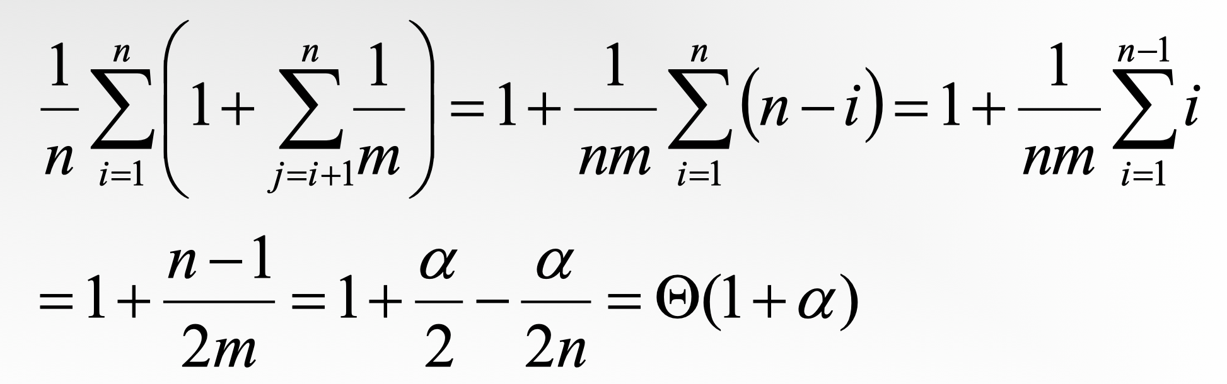
Closed Address: Analysis(cont.)
The average cost of a successful search:
Define α=n/m as load factor (装载因子),
The average number of elements to be examined is
Thus, the average cost of a successful search is 1 + 1+ $α$/2 = 2 + $α$/2 = $Θ$(1+ $α$)

Slide 28
Collision Handling: Open Address
Index
H
Hash function: h(x)=5x mod 8
0
1776
1
2
1812
3
1055
hashing
4
1492
1945
rehashing
hashing
5
1812
6
1918
Rehash function: rh(x, i)=(h(x)+i) mod 8. Here, i starts from 0.
7
1945
chain of rehashings

Slide 29
Collision Handling: Open Address
All elements are stored in the hash table, no linked list is used. So, α, the load factor, can not be larger than 1.
Collision is settled by “rehashing” (再哈希): a function is used to get a new hashing address for each collided address, i.e. the hash table slots are probed successively, until a valid location is found.
Notes:
1。所有元素在哈希表中，无链表
2。再哈希
3。探测序列是0至m-1的全排列

Slide 30
Probe Sequence (探查序列)
Given a key x, if we use open address hash to handle collision and the rehash function is rh(x,i), then
<rh(x,0), rh(x,1), …, rh(x,m-1)>
is called a probe sequence.
A probe sequence is a permutation of (0,1,2,..., m-1).
Notes:
1。所有元素在哈希表中，无链表
2。再哈希
3。探测序列是0至m-1的全排列

Slide 31
Commonly Used Probing Techniques
h(x) is called auxiliary hash function (辅助散列函数)
Linear probing: （线性探查）
rh(x,i)=(h(x)+i) mod m (i=0,1,...,m-1)
Quadratic Probing:（二次探查）
rh(x,i) = (h(x)+c₁i+ c₂i²) mod m (i=0,1,...,m-1)
Double hashing:（双重散列）
rh(x,i) = (h(x)+ ih₂(x)) mod m (i=0,1,...,m-1)

Slide 32
Linear Probing
Index
H
Auxiliary hash function: h(x)=5x mod 8
0
1776
Hash function: rh(x,i)=(h(x)+i) mod 8
1
2
1812
3
1055
hashing
4
1492
1945
rehashing
hashing
5
1812
给定再哈希函数后，初始探查位置决定了整个序列，故只有m种不同的探查序列
6
1918
7
1945
chain of rehashings
Notes:
线性探查法

Slide 33
Quadratic Probing
Index
H
Auxiliary hash function: h(x)=5x mod 8
0
1776
Hash function: rh(x,i)=(h(x)+i²) mod 8
1
1945
2
1812
3
1055
hashing
4
1492
1945
hashing
5
1812
6
1918
给定再哈希函数后，初始探查位置决定了整个序列，故只有m种不同的探查序列
7
Notes:
线性探查法

Slide 34
Double Hashing
Index
H
Auxiliary hash function: h(x)=5x mod 8
0
1776
Auxiliary hash function: h₂(x)= 1 + (3x mod 7)
1
1812
Hash function: rh(x,i)=(h(x)+i h₂(x)) mod 8
2
1812
3
1055
hashing
4
1492
1945
hashing
5
1945
6
1918
初始探查位置不能决定整个序列；
有m²种不同的探查序列
7
Notes:
线性探查法

Slide 35
Assumption: Uniform Hashing （一致哈希）
Each key is equally likely to have any of the m! permutations of (0,1,2...,m-1) as its probe sequence.
It is a generalization of the simple uniform hashing assumption.
注意：线性探查、二次探查、双重哈希均不满足一致哈希假设。

Slide 36
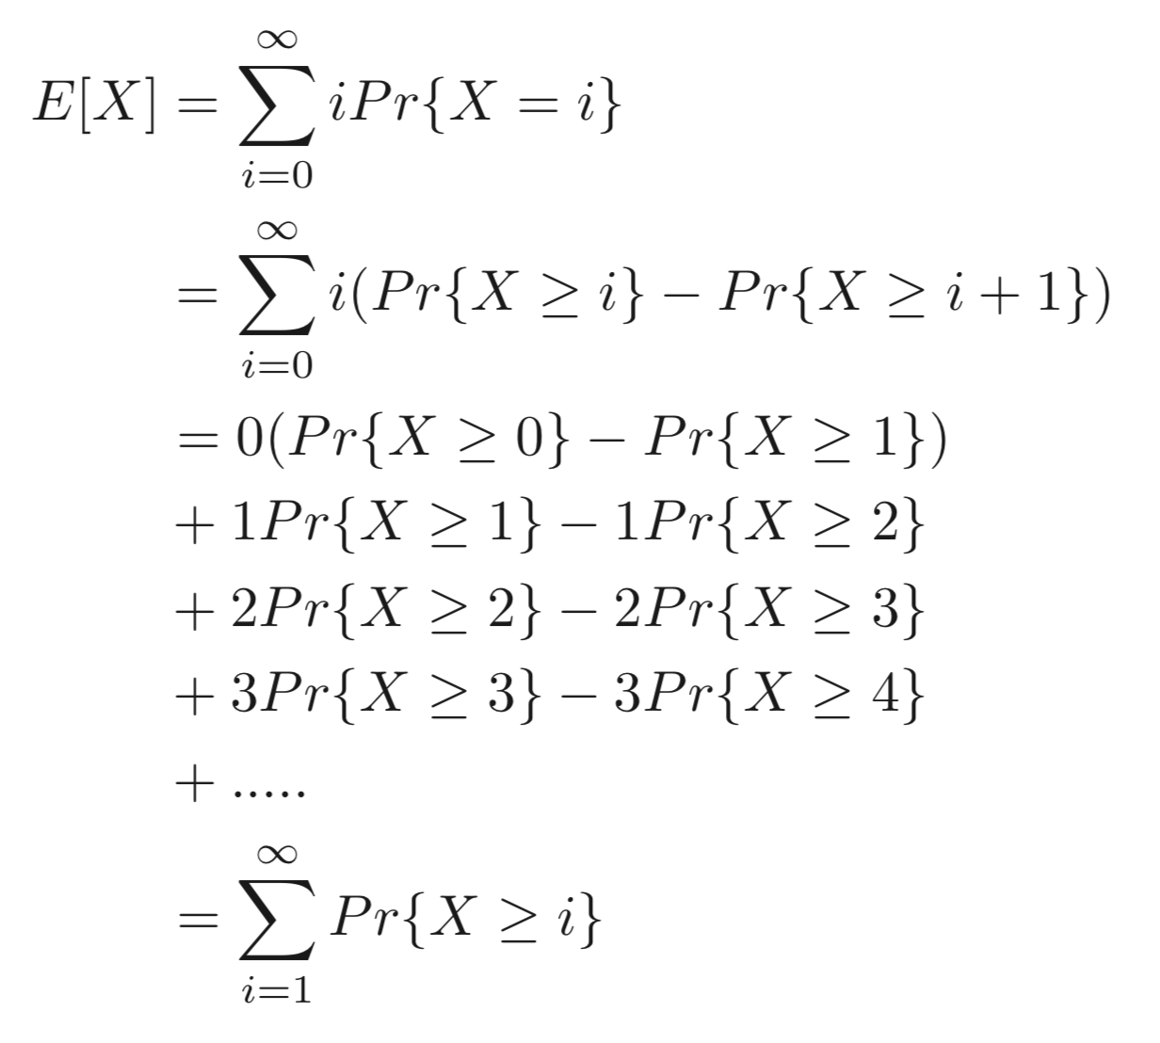
For your reference

Slide 37
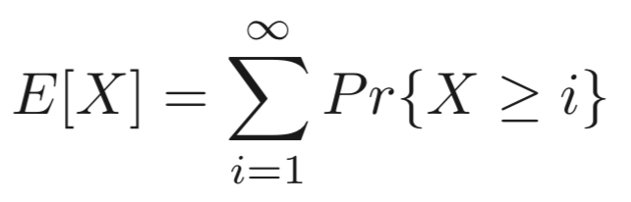
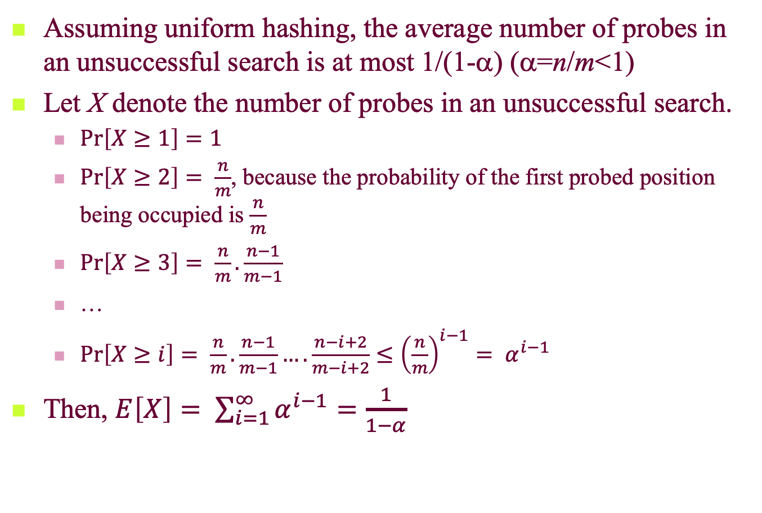
The average cost of an unsuccessful search
Assuming uniform hashing, the average number of probes in an unsuccessful search is at most 1/(1-α) (α=n/m<1)
Let X denote the number of probes in an unsuccessful search.
$\operatorname{Pr}\left[X≥1\right]=1$
$\operatorname{Pr}\left[X≥2\right]= \frac{n}{m}$, because the probability of the first probed position being occupied is $\frac{n}{m}$
$\operatorname{Pr}\left[X≥3\right]= \frac{n}{m}. \frac{n−1}{m−1}$
…
$\operatorname{Pr}\left[X≥i\right]= \frac{n}{m}. \frac{n−1}{m−1}….\frac{n−i+2}{m−i+2}≤{\left(\frac{n}{m}\right)}^{i−1}= α^{i−1}$
Then, $E\left[X\right]= \sum_{i=1}^{∞}{α^{i−1}}=\frac{1}{1−α}$

Slide 38
The cost of an insert
Assuming uniform hashing, we know the average number of probes in an unsuccessful search is at most 1/(1-α).
When we insert an item into the hash table, we are actually doing an unsuccessful search, and then insert the new item into the first empty slot we probed. Thus, the average number of probes in an insertion is also at most 1/(1-α).

Slide 39

The average cost of a successful search
Assuming uniform hashing, the average cost of probes in an successful search is at most (α=n/m<1)
For your reference:
Half full: 1.387; 90% full: 2.559
Notes:
第i+1个成功的探测，就是i个元素基础上的不成功探测。

Slide 40
Discussion on deletion in open address
It is hard to delete elements in open address hash table.
When we delete key k in slot i, we cannot simply put NULL in slot i. Otherwise, the keys hashed to slot i after key k is inserted cannot be searched.
A possible solution: When we delete key k in slot i, we put a special value “DELETED” in slot I
If so, when we search some key that is inserted after key k, we can just bypass “DELETED”.
However, if we use “DELETED”, the load factor changes and the search time would not relay on the load factor any more.
Recommended approach: use close address if we have to delete keys.

Slide 41
Hashing Function
A good hash function satisfies the assumption of simple uniform hashing.
Heuristic hashing functions
The division method: h(k)=k mod m
The multiplication method: h(k)=⎣m(kA mod 1)⎦ (0<A<1)
Notes:
统一哈希

Slide 42
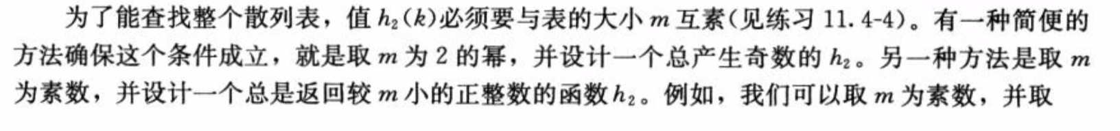

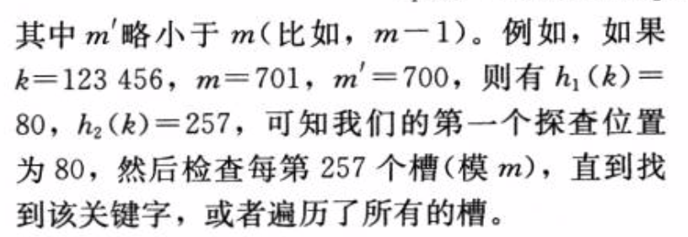
More on Double Probing

Slide 43
Hashing Function
No single function can avoid the worst case Θ(n), so, “Universal hashing”（统一哈希） is proposed. (We will shortly introduce it later.)
Notes:
统一哈希

