Slide 1
Union-Find
张胜
sheng@nju.edu.cn
南京大学

Slide 2
In the last class
Collision Handling
Closed Address Hashing (闭地址/开散列)
Analysis
Open Address Hashing (开地址/闭散列)
Analysis
Hash Functions

Slide 3
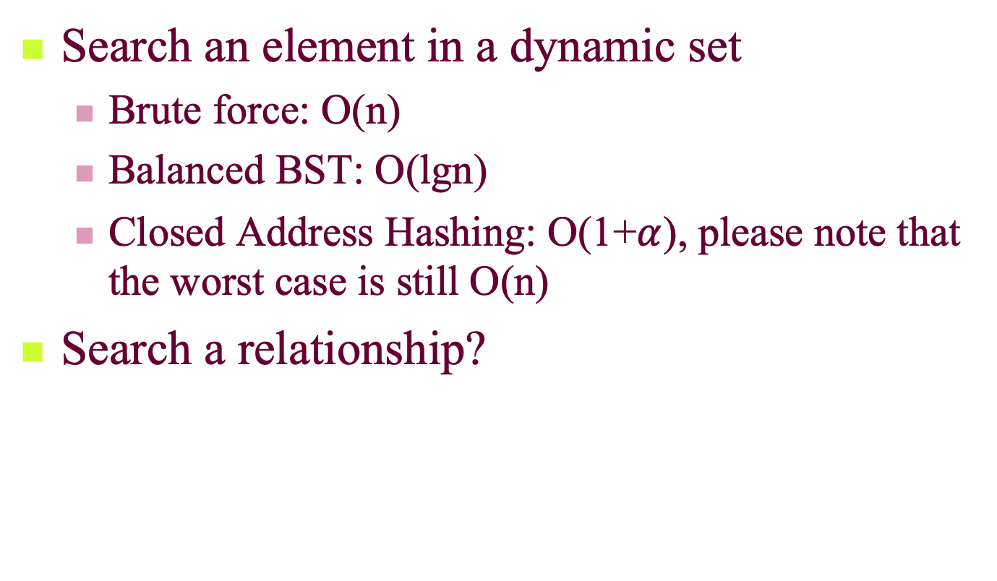
Search an element vs. a relationship
Search an element in a dynamic set
Brute force: O(n)
Balanced BST: O(lgn)
Closed Address Hashing: O(1+$α$), please note that the worst case is still O(n)
Search a relationship?

Slide 4
Maze Creating: An Example
Selecting a wall to pull down randomly
Inlet
i
If i,j are in same equivalence class, then select another wall to pull down, otherwise, joint the two classes into one.
The maze is complete when the inlet and outlet are in one equivalence class.
j
Outlet
Notes:
迷宫是很古老的，古希腊的克里特岛通过种树建造了巨大的迷宫。
原来所有的格子都有墙，不断地推倒这些墙。

Slide 5
Kruskal’s Algorithm for MST: A More Serious Example
A
2
B
Greedy strategy: Select the edge not in the tree with the minimum weight, which will NOT result in a cycle with the edges that have been selected.
How to know NO CYCLE?
3
6
7
G
4
1
3
5
F
I
H
C
4
2
6
2
8
2
E
1
D
edges included in the MST

Slide 6
In this class
Dynamic Equivalence Relation
Implementing Dynamic Set by Union-Find
Straight Union-Find
Making Shorter Tree by Weighted Union
Compressing Path by Compressing-Find
Amortized Analysis of wUnion-cFind（不作要求）
Array Doubling and Amortized Analysis

Slide 7
Dynamic Equivalence Relations
Equivalence
reflexive, symmetric, transitive
equivalent classes form a partition
Dynamic equivalence relation
changing in the process of computation
IS instruction: yes or no (in the same equivalence class)
MAKE instruction: combining two equivalent classes, by relating two unrelated elements, and influencing the results of subsequent IS instructions.

Slide 8

Implementation: How to Measure
The number of basic operations for processing a sequence of m MAKE and/or IS instructions on a set S with n elements.
An Example: S={1,2,3,4,5}
0. [create] {{1}, {2}, {3}, {4}, {5}}
1. IS 2≡4? No
2. IS 3≡5? No
3. MAKE 3≡5. {{1}, {2}, {3,5}, {4}}
4. MAKE 2≡5. {{1}, {2,3,5}, {4}}
5. IS 2≡3? Yes
6. MAKE 4≡1. {{1,4}, {2,3,5}}
7. IS 2≡4? No

Slide 9
Implementation: Possible Choices
For a sequence of m MAKE and/or IS instructions on n elements:
Matrix (relation matrix)
Space in Θ(n²), and worst-case cost in Θ(mn) (mainly for row copying for MAKE) (may copy several rows)
Array (for equivalence class id.)
Space in Θ(n), and worst-case cost in Θ(mn) (mainly for search and change for MAKE).
Union-Find
An Union-Find set is a collection of disjoint sets
There is no way to traverse through all the elements in one set.
Notes:
1。矩阵实现
2。数组实现
两者对于MAKE操作效率较低，需要mn操作
3。Union-Find实现：不相交集合的集合，无法遍历一个集合

Slide 10
Union-Find ADT (details can be found in BG 2.5.2 and Figure 2.19)
Constructors
Union-Find create(int n)
sets=create(n) refers to a newly created group of sets {1}, {2}, ..., {n} (n singletons)
makeSet(UnionFind sets, int e)
Access Function: int find(UnionFind sets, e)
Manipulation Function: void union(UnionFind sets, int s, int t)
Both s and t are set IDs (leaders); after union, s becomes a child of t.

Slide 11
Implementing Dynamic Equivalence Using Union-Find (inTree details can be found in BG 2.3.5 and Figure 2.14)
implementation by inTree
IS s_{i} ≡ s_{j} :
t=find(s_{i});
u=find(s_{j});
(t==u)?
MAKE s_{i} ≡ s_{j} :
t=find(s_{i});
u=find(s_{j});
union(t,u);
create(n): sequence of makeNode
0
1
i
n-1
n
u
union(t,u)
u
find(s_{j})=u
t
setParent(t,u)
parent^{k}(s_{j})
s_{j}

Slide 12
Union-Find Program
A union-find program of length m is (a create(n) operation followed by) a sequence of m union and/or find operations interspersed in any order.
A union-find program is considered as an input, on which the analysis is conducted.
The measure/metric for analysis: number of accesses to the parent
assignments: for union operations
lookups: for find operations
link operation
Notes:
link操作包括：父节点的访问或父节点的指派

Slide 13
Worst-case Analysis for Union-Find Program
Assuming each lookup/assignment take Ο(1).
Each makeSet or union does one assignment, and each find does d+1 lookups, where d is the depth of the node.
Union(1,2)
Union(2,3)
n-1. Union(n-1,n)
Find(1)
Find(1)
Example
The sequence of Union makes a chain of length n-1, which is the tree with the largest height
operations done:
n+(n-1)+(m-n+1)n
Θ (mn)
Find(1) needs n array lookups
Notes:
n for create
n-1 for lines 1 through n-1
(m-n+1)n for the rest m-n+1 lines

Slide 14
Weighted Union: for Short Trees
Weighted union: always have the tree with fewer nodes as subtree. (wUnion)
To keep the Union valid, each Union operation is replaced by:
t=find(i);
u=find(j);
union(t,u)
2
Not the worst case!
n
1
3
n-1
Tree made by wUnion
Cost for the program:
n+3+3+4(n-3)+2(m-n+1)=2m+3n-4
The order of (t,u) satisfies the requirement
The union in the last page requires that, t and u should be roots
Notes:
n:makeset
3：union(1,2)
3: union(2,3)
4(n-3):(n-3)次union的代价,每次2+1+1代价，t的in-树有两层，u的in-树只有一个节点，所以t=find(i)的代价是2，课本上按照1+1+1的代价计算，有误。

Slide 15

Upper Bound of Tree Height
After any sequence of Union instructions, implemented by wUnion, any tree that has k nodes will have height of at most ⎣lgk⎦
Proof by induction on k:
base case: k=1, the height is 0.
by inductive hypothesis:
h₁≤ ⎣lgk₁⎦, h₂≤ ⎣lgk₂⎦
Without loss of generality,
we assume u was attached to t.
h=max(h₁, h₂+1), k=k₁+k₂
if h=h₁, h≤ ⎣lgk₁⎦≤ ⎣lgk⎦
if h=h₂+1, note: k₂≤k/2
so, h₂+1≤ ⎣lgk₂⎦+1≤ ⎣lgk⎦
t
u
T₁
k₁ nodes
height h₁
T₂
k₂ nodes
height h₂
T
k nodes
height h

Slide 16
Upper Bound for wUnion-Find Program
A wUnion-Find program of size m, on a set of n elements, performs Θ(n+mlogn) link operations in the worst case if wUnion and straight find are used.
Proof:
At most n-1 wUnion can be done, building a tree with height at most ⎣lgn⎦. then, each find costs at most ⎣lgn⎦+1.
Each wUnion costs in Ο(1), so, the upper bound on the cost of any combination of m wUnion/find operations is the cost of m find operations, that is m(⎣lgn⎦+1)∈ Ο (mlogn)
The cost of create is n. So the total cost is Ο (n+mlogn).
There do exist programs requiring Ω(n+mlogn) steps.
wUnion(s,t)也要求s和t是set ids or leaders or roots。Each set root also has a weight that indicates the number of nodes in the set.

Slide 17
Path Compression
Path compressed
x
w
v
v
w
x
Change their parents to the root

Slide 18
Challenges for the Analysis
Path compressed
x
w
v
v
w
x
cFind does twice as many link operations as the find does for a given node in a given tree.
cFind will traverse shorter paths
But…
Notes:
cFind：是Find两倍的代价
1。Find父节点
2。所有父节点都设置root为父节点

Slide 19
Analysis: the Basic Idea
cFind may be an expensive operation, in the case that cFind(i) is executed and the node i has a large depth.
However, such cFind can be executed only for limited times.
We can use amortized analysis.

Slide 20
Co-Strength of wUnion and cFind
The number of link operations done by a Union-Find program implemented with wUnion and cFind, of length m on a set of n elements is in O((n+m)lg*(n)) in the worst case.
What’s lg*(n)?
Define the function H as following:
Then, lg*(j) for j≥1 is defined as:
lg*(j)=min{ k|H(k)≥j }

Slide 21
A Function Growing Extremely Slowly
Function Log-star
lg*(j) is defined as the least i such that:
H(i)≥j for j>0
Log-star grows extremely slowly
p is any fixed nonnegative constant
Function H:
H(0)=1
H(i+1)=2^{H (i)}
that is: H(k)=2
Note:
H grows extremely fast:
H(4)=2¹⁶=65536
H(5)=2⁶⁵⁵³⁶
2
2
2
k 2’s
For any x: 2¹⁶+1≤x≤2⁶⁵⁵³⁶, lg*(x)=5

Slide 22
Amortizing Scheme for wUnion-cFind
makeSet
Actual cost is 1
Accounting cost is 4lg*(n+1), so the amortized cost is 1+4lg*(n+1)
wUnion
Actual cost is 1
Accounting cost is 0, so the amortized cost is 1
cFind
Accounting cost is describes later in the supplementary material*.
Amortized cost ≤ 2k-2((k-1)-(lg*(n+1)-1))=2lg*(n+1) (Compare with the worst case cost of cFind, 2lgn)

Slide 23
Conclusion
The number of link operations done by a Union-Find program implemented with wUnion and cFind, of length m on a set of n elements is in O((n+m)lg*(n)) in the worst case.
Note: since the sum of accounting cost is never negative, the actual cost is always not less than amortized cost. And, the upper bound of amortized cost is: (n+m)(1+4lg*(n+1))

Slide 24

Looking at the Memory Allocation
Insert(Array H, ITEM x)
integer size=0, num=0;
if size=0 then allocate a block of size 1; size=1;
if num=size then
allocate a block of size 2size;
move all items into new array;
size=2size;
insert x into the array;
num=num+1;
return
Insertion with expansion: cost is size
Elementary insertion: cost 1

Slide 25
What is the average cost of inserting one item?
Array
Insert | Cost of Insertion
a | 1
c | 2
e | 3
g | 1
s | ?
a
a
c
a
c
e
a
c
e
g

Slide 26
Worst-case Analysis of the Insertion
For n execution of insertion operations
A bad analysis: the worst case for one insertion is the case when expansion is required, up to n
So, the worst case cost is in O(n²).
Note the expansion is required during the ith operation only if i=2^{k}, and the cost of the ith operation
Not tight!

Slide 27
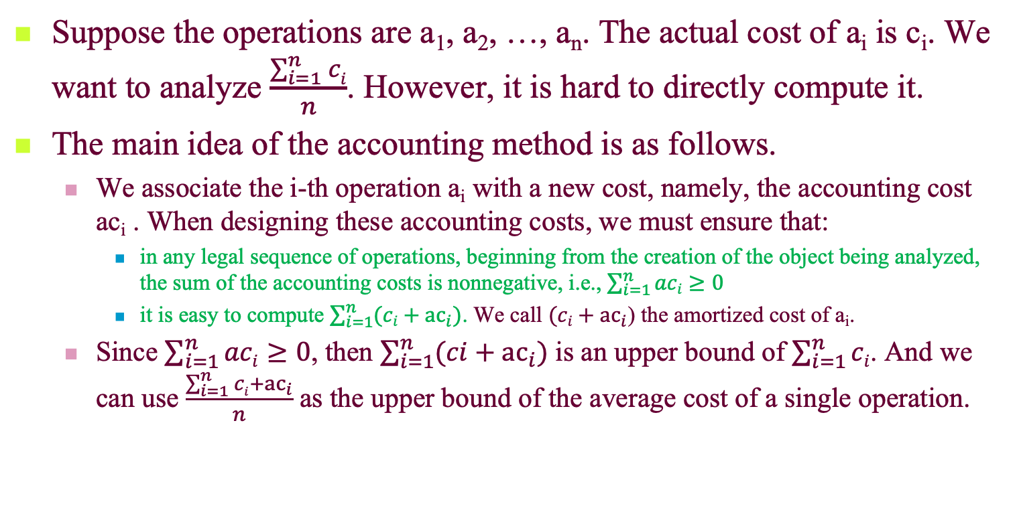
Amortized Analysis: the accounting method
Suppose the operations are a₁, a₂, …, a_{n}. The actual cost of a_{i} is c_{i}. We want to analyze $\frac{\sum_{i=1}^{n}{ci}}{n}$. However, it is hard to directly compute it.
The main idea of the accounting method is as follows.
We associate the i-th operation a_{i} with a new cost, namely, the accounting cost ac_{i} . When designing these accounting costs, we must ensure that:
in any legal sequence of operations, beginning from the creation of the object being analyzed, the sum of the accounting costs is nonnegative, i.e., $\sum_{i=1}^{n}{aci}≥0$
it is easy to compute $\sum_{i=1}^{n}{(ci+{ac}_{i})}$. We call $(ci+{ac}_{i}$) the amortized cost of a_{i}.
Since $\sum_{i=1}^{n}{aci}≥0$, then $\sum_{i=1}^{n}{(ci+{ac}_{i})}$ is an upper bound of $\sum_{i=1}^{n}{ci}$. And we can use $\frac{\sum_{i=1}^{n}{ci}+{ac}_{i}}{n}$ as the upper bound of the average cost of a single operation.

Slide 28
Accounting Scheme for Array Doubling
Actual cost
No resize triggered: 1
Resize(n→2n) triggered: n+1
Accounting cost
No resize triggered: 2
Resize(n→2n) triggered: -n+2
So, the amortized cost of each individual insert operation is 1+2∈Θ(1)

