Slide 1

Looking at the Memory Allocation
Insert(Array H, ITEM x)
integer size=0, num=0;
if size=0 then allocate a block of size 1; size=1;
if num=size then
allocate a block of size 2size;
move all items into new array;
size=2size;
insert x into the array;
num=num+1;
return
Insertion with expansion: cost is size
Elementary insertion: cost 1

Slide 2
Accounting Scheme for Array Doubling
Actual cost
No resize triggered: 1
Resize(n→2n) triggered: n+1
Accounting cost
No resize triggered: 2
Resize(n→2n) triggered: -n+2
So, the amortized cost of each individual insert operation is 1+2∈Θ(1)

Slide 3
Hashing, Amortized Analysis and Union-Find
张胜
sheng@nju.edu.cn
南京大学

Slide 4
Content
Hashing & Universal Hashing
Amortized Analysis
Union-Find Examples

Slide 5
Hashing Examples

Slide 6
例题1
将关键字序列(7、8、30、11、18、9、14)散列存储到散列表中，散列表的存储空间是一个下标从0开始的一个一维数组散列，函数为：H(key)=(key * 3) mod T，处理冲突采用线性探测再散列法，要求装载因子为0.7，T为散列表的长度。问题：
请画出所构造的散列表。
分别计算等概率情况下，查找成功和查找不成功的平均查找长度。

Slide 7
将关键字序列(7、8、30、11、18、9、14)散列存储到散列表中，散列表的存储空间是一个下标从0开始的一个一维数组散列，函数为：H(key)=(key * 3) mod T，处理冲突采用线性探测再散列法，要求装载因子为0.7，T为散列表的长度。问题：
请画出所构造的散列表。
分别计算等概率情况下，查找成功和查找不成功的平均查找长度。
T=10.
0 1 2 3 4 5 6 7 8 9
30 7 14 11 8 18 9
这里需要针对这7个数（查找成功）来具体计算。
成功: (1+1+1+1+1+1+2)/7=8/7
不成功：(7+6+5+4+3+2+1+2+1+1)/10=16/5

Slide 8
例题2
闭地址哈希表是由引用列表组成的一个数组，而开地址哈希表是由关键字组成的数组。假定一个关键字需要一个存储单元，则一个链表节点需要两个单元（一个存储关键字，一个存放链表指针）。考虑在闭地址哈希表中，负载因子α分别为0.4和1.5两种情况下计算下面两题。假定h_{C}是闭地址哈希表中的单元数。
在闭地址哈希的情况下，估算空间需求，包括链表空间。假定开地址哈希的情况下使用相同的空间（即所占用的总空间和包含关键字的空间数量相同），计算相应的开地址哈希的负载因子。
现在假定一个关键字占用3个单元，那么一个链表节点占用4个单元（3个用于存放关键字，1个用于存放链表指针），重新解a)中的问题。

Slide 9
闭地址哈希表是由引用列表组成的一个数组，而开地址哈希表是由关键字组成的数组。假定一个关键字需要一个存储单元，则一个链表节点需要两个单元（一个存储关键字，一个存放链表指针）。考虑在闭地址哈希表中，负载因子(α)分别为0.4和1.5两种情况下计算下面两题。假定h_{C}是闭地址哈希表中的单元数。
在闭地址哈希的情况下，估算空间需求，包括链表空间。假定开地址哈希的情况下使用相同的空间（即所占用的总空间和包含关键字的空间数量相同），计算相应的开地址哈希的负载因子。
现在假定一个关键字占用3个单元，那么一个链表节点占用4个单元（3个用于存放关键字，1个用于存放链表指针），重新解a)中的问题。
(a) 当α=0.4时h_{C}+0.4h_{C}*2 = 1.8h_{C}
对应在开地址哈希情况下α = 0.4h_{C}/1.8h_{C} = 2/9
当α=1.5时h_{C}+1.5h_{C}*2 = 4h_{C}
对应在开地址哈希情况下α = 1.5h_{C}/4h_{C} = 3/8

Slide 10
闭地址哈希表是由引用列表组成的一个数组，而开地址哈希表是由关键字组成的数组。假定一个关键字需要一个存储单元，则一个链表节点需要两个单元（一个存储关键字，一个存放链表指针）。考虑在闭地址哈希表中，负载因子(α)分别为0.4和1.5两种情况下计算下面两题。假定h_{C}是闭地址哈希表中的单元数。
在闭地址哈希的情况下，估算空间需求，包括链表空间。假定开地址哈希的情况下使用相同的空间（即所占用的总空间和包含关键字的空间数量相同），计算相应的开地址哈希的负载因子。
现在假定一个关键字占用3个单元，那么一个链表节点占用4个单元（3个用于存放关键字，1个用于存放链表指针），重新解a)中的问题。
(b)当α=0.4时h_{C}+0.4h_{C}*4 = 2.6h_{C}
对应在开地址哈希情况下α = 0.4h_{C}/(2.6h_{C} /3)
当α=1.5时h_{C}+1.5h_{C}*4 = 7h_{C}
对应在开地址哈希情况下α = 1.5h_{C}/(7h_{C} /3)

Slide 11
Universal Hashing (全域散列)

Slide 12
Design Hash Functions
Design hash functions
On one hand, a hash function must be in some sense “random” so it scatters keys around.
On the other hand, it should be a function and therefore “consistent”, so that we get the same result every time we apply it.
Let us have a try!
Suppose, for instance, that you need to maintain an ever-changing list of about 250 IP addresses, perhaps the addresses of the currently active customers of a web service. Each IP address is associated with a record that contains customer details. How can you maintain them to ensure fast lookup？Using hash.

Slide 13
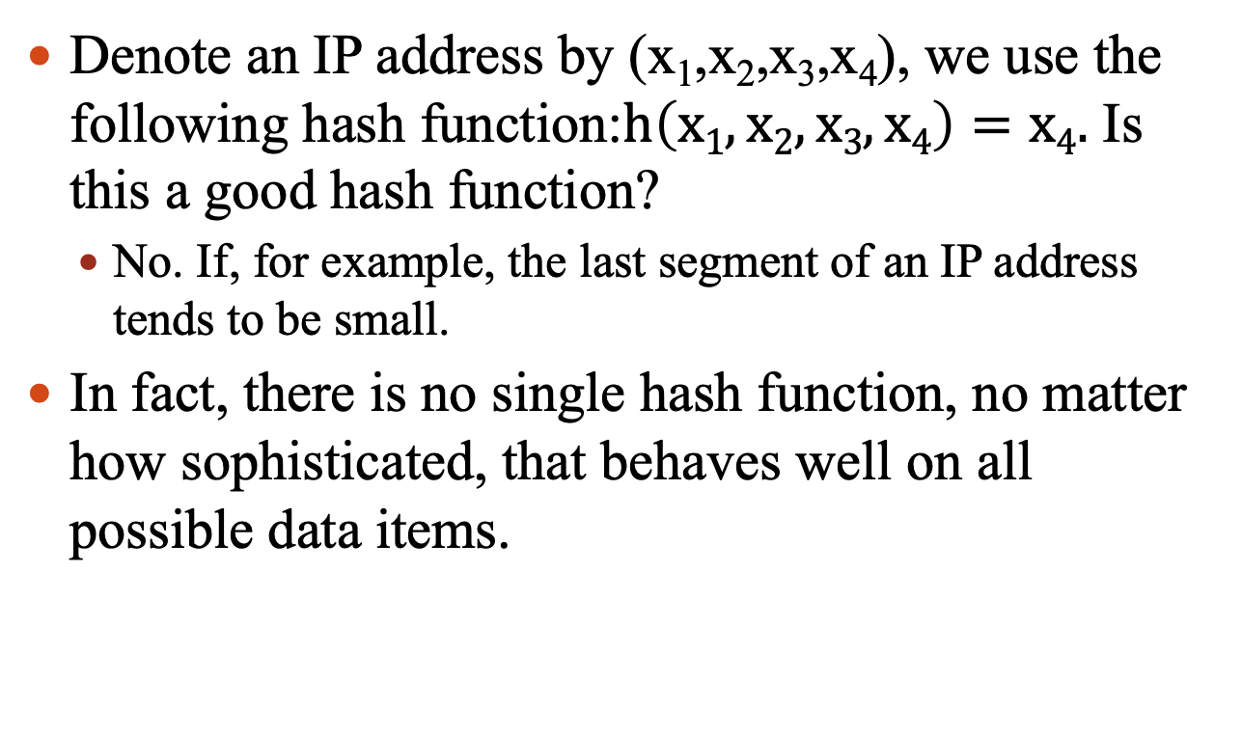
Let us have a try
Denote an IP address by (x₁,x₂,x₃,x₄), we use the following hash function:$h\left(x1,x2,x3,x4\right)=x4.$ Is this a good hash function?
No. If, for example, the last segment of an IP address tends to be small.
In fact, there is no single hash function, no matter how sophisticated, that behaves well on all possible data items.

Slide 14
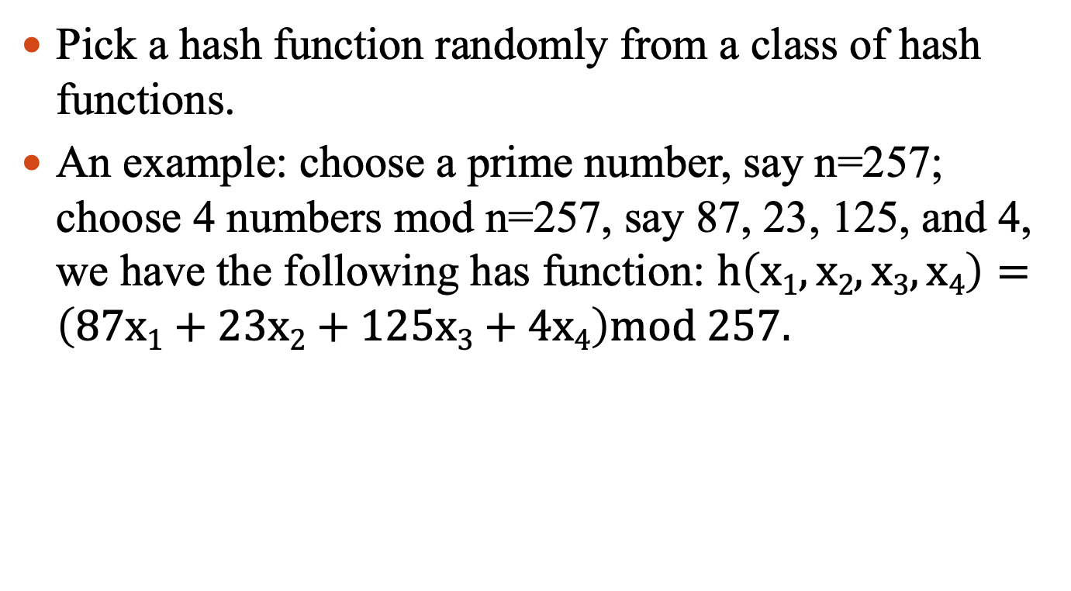
Universal Hashing
Pick a hash function randomly from a class of hash functions.
An example: choose a prime number, say n=257; choose 4 numbers mod n=257, say 87, 23, 125, and 4, we have the following has function: $h\left(x1,x2,x3,x4\right)=\left(87x1+23x2+125x3+4x4\right)mod 257.$

Slide 15
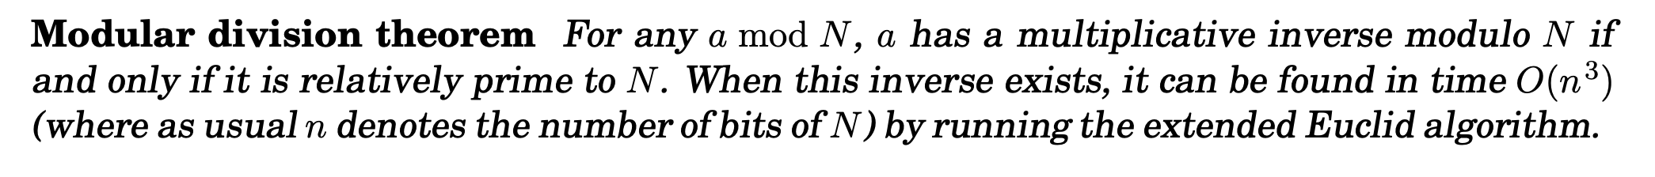
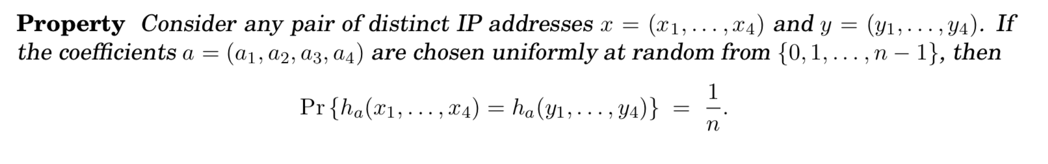
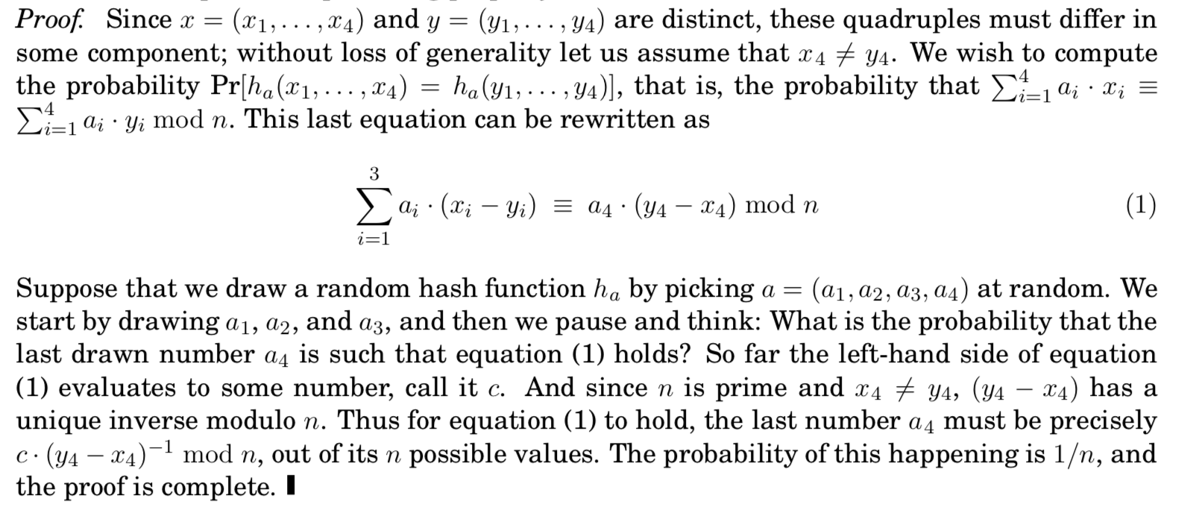
Universal Hashing
$$h\left(x1,x2,x3,x4\right)=\left(87x1+23x2+125x3+4x4\right)mod 257$$

Slide 16
Amortized Analysis

Slide 17
Amortized Analysis
Not just consider one operation, but a sequence of operations on a given data structure.
The cost of operations usually follows some pattern.
We are interested in analyzing the average cost of a sequence of operations.

Slide 18
The Methods of Amortized Analysis
Accounting method:
Assign each type of operation an (different) amortized cost
overcharge some operations,
store the overcharge as credit on specific objects,
then use the credit for compensation for some later operations.
Aggregate method:
Total cost of n operations
Potential method (考试不作要求)

Slide 19
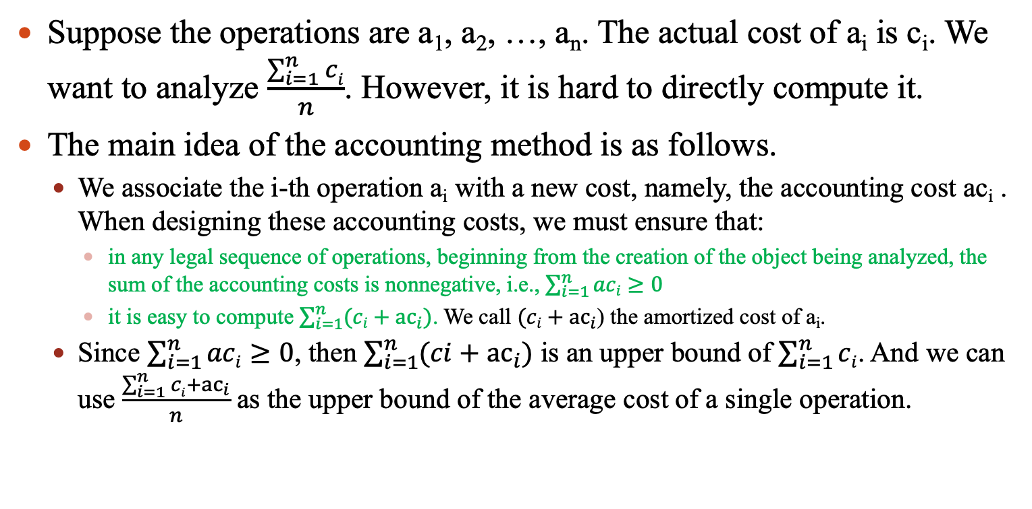
Amortized Analysis: the accounting method
Suppose the operations are a₁, a₂, …, a_{n}. The actual cost of a_{i} is c_{i}. We want to analyze $\frac{\sum_{i=1}^{n}{ci}}{n}$. However, it is hard to directly compute it.
The main idea of the accounting method is as follows.
We associate the i-th operation a_{i} with a new cost, namely, the accounting cost ac_{i} . When designing these accounting costs, we must ensure that:
in any legal sequence of operations, beginning from the creation of the object being analyzed, the sum of the accounting costs is nonnegative, i.e., $\sum_{i=1}^{n}{aci}≥0$
it is easy to compute $\sum_{i=1}^{n}{(ci+{ac}_{i})}$. We call $(ci+{ac}_{i}$) the amortized cost of a_{i}.
Since $\sum_{i=1}^{n}{aci}≥0$, then $\sum_{i=1}^{n}{(ci+{ac}_{i})}$ is an upper bound of $\sum_{i=1}^{n}{ci}$. And we can use $\frac{\sum_{i=1}^{n}{ci}+{ac}_{i}}{n}$ as the upper bound of the average cost of a single operation.

Slide 20

Amortized Analysis: MultiPop Stack
Pop:
Cost=1
MultiPop:
Cost=min(s,k)
Push:
Cost=1
s
k

Slide 21
Stack operations
PUSH(S, x), O(1)
POP(S), O(1)
MULTIPOP(S, k), min(S, k)
while not STACK-EMPTY(S) and k>0
do POP(S)
k=k-1

Slide 22
Example for amortized analysis
Let us consider a sequence of n PUSH, POP, MULTIPOP.
The worst case cost for MULTIPOP in the sequence is O(n), since the stack size is at most n.
thus the cost of the sequence is O(n²). Correct, but not tight.
 | actual | accounting | amortized
Push | 1 | 1 | 2
Pop | 1 | -1 | 0
Multipop | min(S, k) | -min(S, k) | 0

Slide 23
Graph Operations
Consider the following operations on a set of nodes in a graph:
Connect(A, B): add an edge from node A to node B in the graph (if there already exists such an edge, do nothing);
Disconnect(A, B): if there are paths from A to B, remove all edges in the paths(if there is no path, do nothing);
Assume the cost of adding an edge is 1, removing an edge is 2, and the cost of finding a path in the graph is omitted. There is no edge in the graph at the beginning. Consider a sequence of n operations on the graph, apply amortized analysis on the cost of Connect and Disconnect operations in the worst case.

Slide 24
Connect(A, B): add an edge from node A to node B in the graph (if there already exists such an edge, do nothing);
Disconnect(A, B): if there are paths from A to B, remove all edges in the paths(if there is no path, do nothing);
Assume the cost of adding an edge is 1, removing an edge is 2, and the cost of finding a path in the graph is omitted. There is no edge in the graph at the beginning.
Connect(A,B):
Actual cost: 1 Accounting cost: 2
Amortized cost: 1+2=3
Disconnect(A,B): (assume there are t edges in the paths between A,B)
Actual cost: 2t Accounting cost: -2t
Amortized cost: 2t-2t=0
Notes:
根据 Amortized cost= actual cost +accounting cost
我们可以采用以下的accounting scheme: (8分)
Connect(A,B):
Actual cost: 1
Accounting cost: 2
Amortized cost: 1+2=3
Disconnect(A,B): (assume there are t edges in the paths between A,B)
Actual cost: 2t
Accounting cost: -2t
Amortized cost: 2t-2t=0

Slide 25
Implement a Queue with two Stacks
Describe how to implement a queue with two stacks which are implemented by arrays. Analyze the complexity of Enqueue and Dequeue with amortized analysis.
Enqueue
将入队元素压入栈A。
Dequeue
若栈B为空，将栈依次将栈A中元素出栈，然后压入栈B，直至栈A为空（或剩余一个元素），将栈B顶端元素出栈（或将栈A剩余元素出栈）。
若栈B不为空，直接将栈B顶端元素出栈。
Notes:
时间复杂度分析：
入队和一些出队的情况复杂度均为O(1)，但有些出队情况复杂度较高达到O(n)，故采用平摊分析的方法。
Amortized cost = actual cost + accounting cost
入队：actual cost = 1, accounting cost = 3
出队：
栈B不为空actual cost = 1, accounting cost = -1
栈B为空actual cost = 2s + 1, accounting cost = -2s - 1 （其中s为栈A中当前元素个数）
入队操作的Amortized cost为4，出队操作为0。由于任意元素出队的前提是该元素要入队，故在元素出队前有3个accounting cost，而任何元素出队都需要从栈A出栈，压入栈B，再从栈B出栈，因此需要消耗3个代价，由此可见任何元素出队前均能保证accounting cost大于等于0。
一种更低的代价：
入队：actual cost = 1, accounting cost = 2
出队：
栈B不为空actual cost = 1, accounting cost = 0
栈B为空actual cost = 2s + 1, accounting cost = -2s （其中s为栈A中当前元素个数）
入队操作的Amortized cost为3，出队操作为1。

Slide 26
Implement a Queue with two Stacks
Enqueue
将入队元素压入栈A。
Dequeue
若栈B为空，将栈依次将栈A中元素出栈，然后压入栈B，直至栈A为空（或剩余一个元素），将栈B顶端元素出栈（或将栈A剩余元素出栈）。
若栈B不为空，直接将栈B顶端元素出栈。
入队和一些出队的情况复杂度均为O(1)，但有些出队情况复杂度较高达到O(n)，故采用平摊分析的方法。
Amortized cost = actual cost + accounting cost
入队：actual cost = 1, accounting cost = 3
出队：
栈B不为空actual cost = 1, accounting cost = -1
栈B为空actual cost = 2s + 1, accounting cost = -2s - 1 （其中s为栈A中当前元素个数）
入队操作的Amortized cost为4，出队操作为0。由于任意元素出队的前提是该元素要入队，故在元素出队前有3个accounting cost，而任何元素出队都需要从栈A出栈，压入栈B，再从栈B出栈，因此需要消耗3个代价，由此可见任何元素出队前均能保证accounting cost大于等于0。
Notes:
时间复杂度分析：
入队和一些出队的情况复杂度均为O(1)，但有些出队情况复杂度较高达到O(n)，故采用平摊分析的方法。
Amortized cost = actual cost + accounting cost
入队：actual cost = 1, accounting cost = 3
出队：
栈B不为空actual cost = 1, accounting cost = -1
栈B为空actual cost = 2s + 1, accounting cost = -2s - 1 （其中s为栈A中当前元素个数）
入队操作的Amortized cost为4，出队操作为0。由于任意元素出队的前提是该元素要入队，故在元素出队前有3个accounting cost，而任何元素出队都需要从栈A出栈，压入栈B，再从栈B出栈，因此需要消耗3个代价，由此可见任何元素出队前均能保证accounting cost大于等于0。
一种更低的代价：
入队：actual cost = 1, accounting cost = 2
出队：
栈B不为空actual cost = 1, accounting cost = 0
栈B为空actual cost = 2s + 1, accounting cost = -2s （其中s为栈A中当前元素个数）
入队操作的Amortized cost为3，出队操作为1。

Slide 27
Implement a Queue with two Stacks
Enqueue
将入队元素压入栈A。
Dequeue
若栈B为空，将栈依次将栈A中元素出栈，然后压入栈B，直至栈A为空（或剩余一个元素），将栈B顶端元素出栈（或将栈A剩余元素出栈）。
若栈B不为空，直接将栈B顶端元素出栈。
一种更低的代价：
入队：actual cost = 1, accounting cost = 2
出队：
栈B不为空actual cost = 1, accounting cost = 0
栈B为空actual cost = 2s + 1, accounting cost = -2s （其中s为栈A中当前元素个数）
入队操作的Amortized cost为3，出队操作为1。
Notes:
时间复杂度分析：
入队和一些出队的情况复杂度均为O(1)，但有些出队情况复杂度较高达到O(n)，故采用平摊分析的方法。
Amortized cost = actual cost + accounting cost
入队：actual cost = 1, accounting cost = 3
出队：
栈B不为空actual cost = 1, accounting cost = -1
栈B为空actual cost = 2s + 1, accounting cost = -2s - 1 （其中s为栈A中当前元素个数）
入队操作的Amortized cost为4，出队操作为0。由于任意元素出队的前提是该元素要入队，故在元素出队前有3个accounting cost，而任何元素出队都需要从栈A出栈，压入栈B，再从栈B出栈，因此需要消耗3个代价，由此可见任何元素出队前均能保证accounting cost大于等于0。
一种更低的代价：
入队：actual cost = 1, accounting cost = 2
出队：
栈B不为空actual cost = 1, accounting cost = 0
栈B为空actual cost = 2s + 1, accounting cost = -2s （其中s为栈A中当前元素个数）
入队操作的Amortized cost为3，出队操作为1。

Slide 28
Amortized Analysis: MultiPop Stack
Pop:
Cost=1
MultiPop:
Cost=min(s,k)
Push:
Cost=1
s
k

Slide 29
Aggregate Method
In fact, a sequence of n operations on an initially empty stack cost at most O(n). Why?
Each object can be POP only once (including in MULTIPOP) for each time it is PUSHed. #POPs is at most #PUSHs, which is at most n.
Thus the average cost of an operation is O(n)/n = O(1).
Amortized cost in aggregate analysis is defined to be average cost.

Slide 30
Aggregate Method: Binary Counter
Cost measure: bit flip
0 0 0 0 0 0 0 0 0 0
0 0 0 0 0 0 0 1 1
2 0 0 0 0 0 0 1 0 3
3 0 0 0 0 0 0 1 1 4
4 0 0 0 0 0 1 0 0 7
5 0 0 0 0 0 1 0 1 8
6 0 0 0 0 0 1 1 0 10
7 0 0 0 0 0 1 1 1 11
8 0 0 0 0 1 0 0 0 15
9 0 0 0 0 1 0 0 1 16
10 0 0 0 0 1 0 1 0 18
11 0 0 0 0 1 0 1 1 19
12 0 0 0 0 1 1 0 0 22
13 0 0 0 0 1 1 0 1 23
14 0 0 0 0 1 1 1 0 25
0 0 0 0 1 1 1 1 26
0 0 0 1 0 0 0 0 31
A[0] flips every time, total n times.
A[1] flips every other time, ⎣n/2⎦ times.
A[2] flips every forth time, ⎣n/4⎦ times.
….
for i=0,1,…,k-1, A[i] flips ⎣n/2^{i}⎦ times.
Thus total #flips is ∑_{i=0}^{k-1} ⎣n/2^{i}⎦
< n∑_{i=0}∞ 1/2^{i}
=2n.

Slide 31
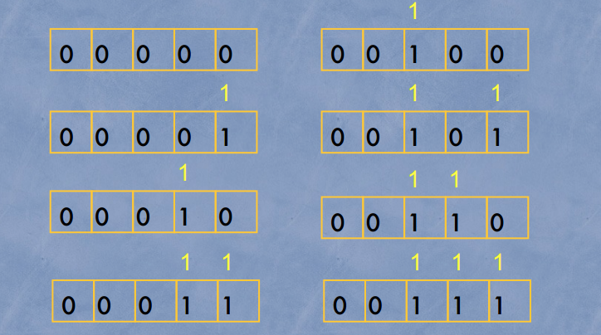
Accounting Method : Binary Counter
Operation | Actual cost | Accounting cost
Change 0 to 1 | 1 | 1
Change 1 to 0 | 1 | -1

Slide 32
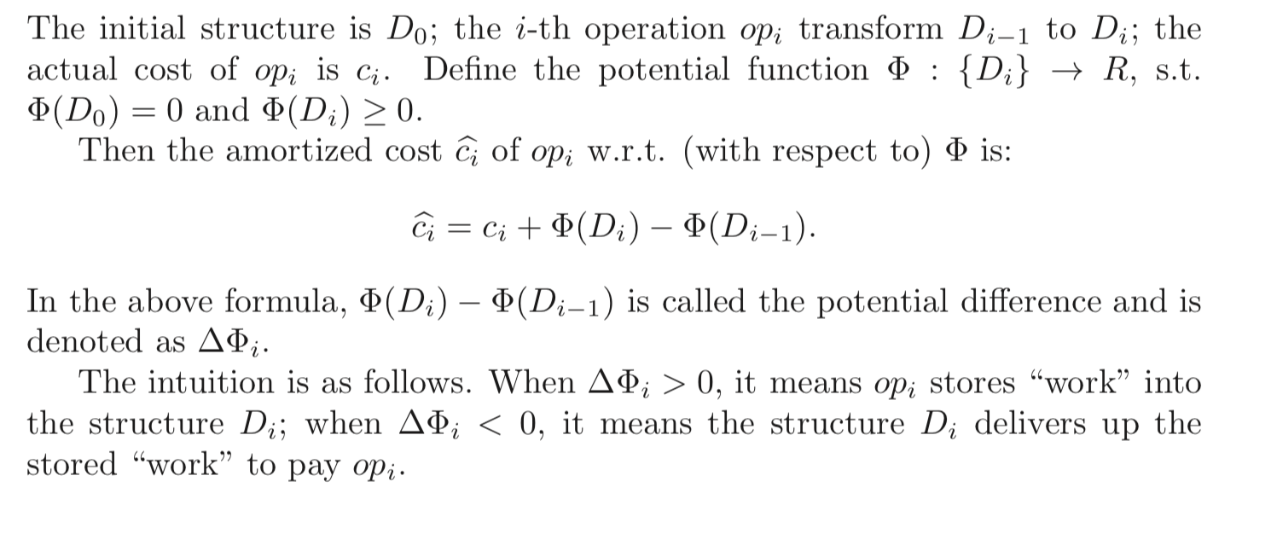
Potential Method

Slide 33
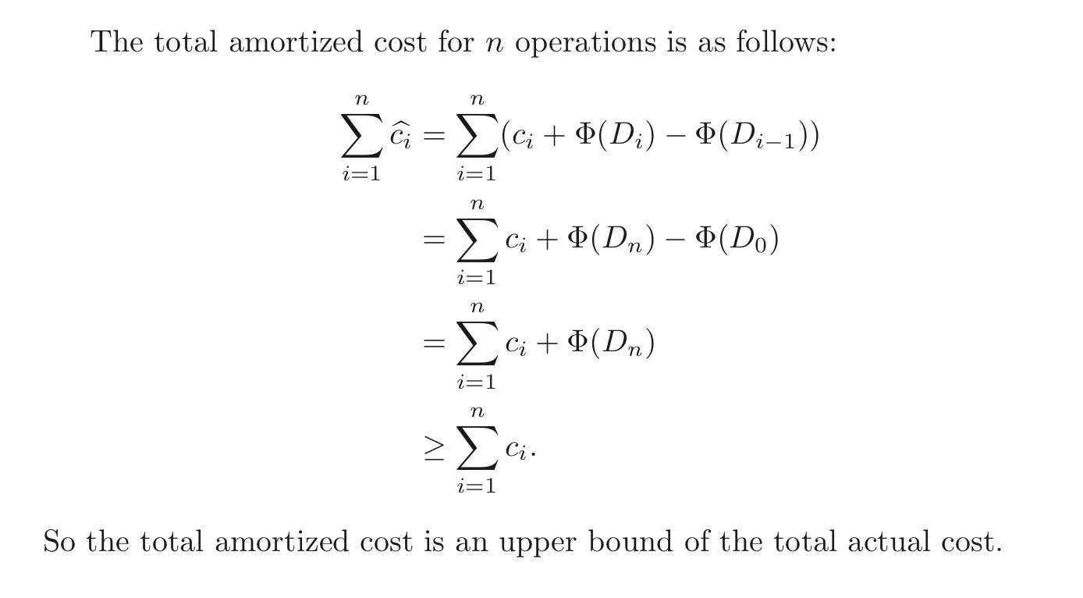
Potential Method

Slide 34
Looking at the Memory Allocation
Insert(Array H, ITEM x)
integer size=0, num=0;
if size=0 then allocate a block of size 1; size=1;
if num=size then
allocate a block of size 2size;
move all items into new array;
size=2size;
insert x into the array;
num=num+1;
return
Insertion with expansion: cost is size
Elementary insertion: cost 1

Slide 35
Worst-case Analysis of the Insertion
For n execution of insertion operations
A bad analysis: the worst case for one insertion is the case when expansion is required, up to n
So, the worst case cost is in O(n²).
Note the expansion is required during the ith operation only if i=2^{k}, and the cost of the ith operation
Of course NOT !

Slide 36
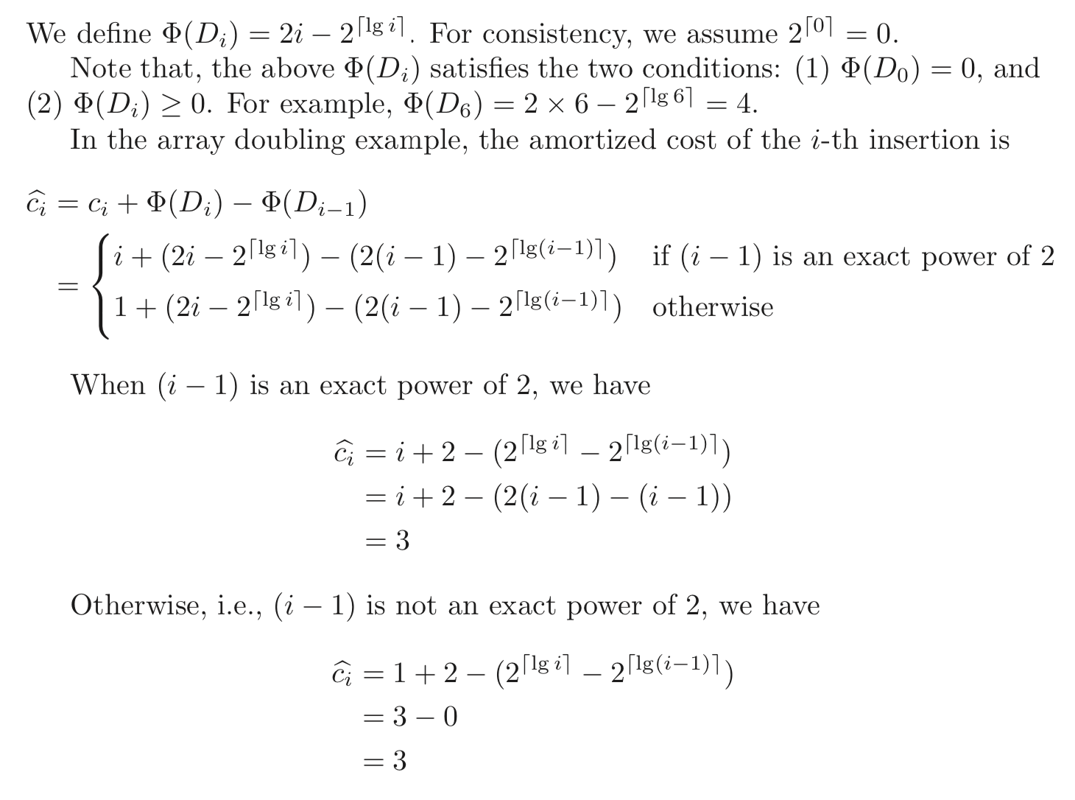
Applying the Potential Method to Array Doubling

Slide 37
Union-Find

Slide 38
How Many Tables do We Need?
Today is Turing’ birthday. He invites a lot of friends. Now it’s dinner time. Turing wants to know how many tables he needs at least. You have to notice that not all the friends know each other, and all the friends do not want to stay with strangers.
For example: If A knows B, B knows C, and D knows E, so A, B, C can stay in one table, and D, E have to stay in the other one. So Turing needs 2 tables.

Slide 39
More is Better
Mr. Wang wants some boys to help him with a project. Because the project is rather complex, the more boys come, the better it will be. Of course there are certain requirements.
Mr. Wang selected a room big enough to hold the boys. The boy who are not been chosen has to leave the room immediately. There are 10,000,000 boys in the room numbered from 1 to 10,000,000 at the very beginning. After Mr. Wang’s selection any two of them who are still in this room should be friends (direct or indirect), or there is only one boy left. Given all the direct friend-pairs, you should decide the best way.
Notes:
题意：Wang挑选后留下来的人必须相互认识（可以是间接认识）；
本质：采用Union-Find结构，找最大的集合。

Slide 40
Maze Creating
Selecting a wall to pull down randomly
Inlet
If i,j are in same equivalence class, then select another wall to pull down, otherwise, joint the two classes into one.
The maze is complete when the inlet and outlet are in one equivalence class.
i
j
Outlet
The algorithm of Maze creating with wUnion and cFind.
The complexity of the algorithm.

Slide 41
Amortizing Scheme for wUnion-cFind
makeSet
Accounting cost is 4lg*(n+1)
So, the amortized cost is 1+4lg*(n+1)
wUnion
Accounting cost is 0
So the amortized cost is 1
cFind
Amortized cost ≤ 2k-2((k-1)-(lg*(n+1)-1))=2lg*(n+1) (Compare with the worst case cost of cFind, 2lgn)

Slide 42
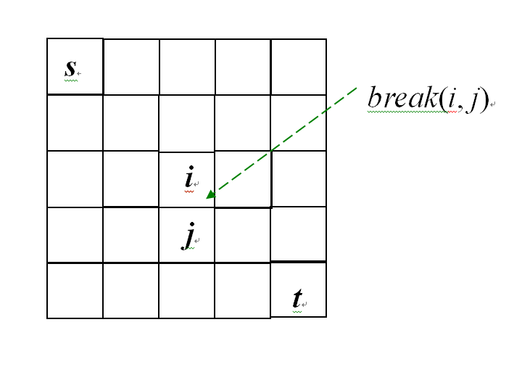
初始化：makeset将所有单元格都独立形成一个类；
While（cFind(s) != cFind(t)）{
randomly select 单元格i与j;
x=cFind(i);
y= cFind(j);
if (x!=y){
break(i, j);
wUnion(x, y);
}
}
makeset的代价为[1+4log*(nm+1)](nm)
while循环最坏情况执行nm次，每一次代价为2log*(nm+1)+O(1)+O(1)
总代价：[1+4log*(nm+1)](nm)+ 2log*(nm+1) (nm)=O(nmlog*(nm))

