Slide 1
DFS on Undirected Graphs
张胜
sheng@nju.edu.cn
南京大学

Slide 2
In the last class…
Directed Acyclic Graph
Topological Order
Critical Path
Strongly Connected Component (SCC)
Analysis
Algorithm

Slide 3
In this class…
DFS on Undirected Graph
Edge types
How to modify DFS on digraph for undirected graph?
Example 1: Biconnected Components
Articulation Points and Biconnectedness
Biconnected Component Algorithm
Analysis of the Algorithm
Example 2: Bridge

Slide 4
An edge in undirected graph is processed twice!
What happens if we use DFS for digraph on undirected graph?
For most problems, it does not matter.
However, problem involving cycles in undirected graphs must process each edge once. (e.g., biconnected component)
Notes:
无向图的访问，包括边的两次访问。

Slide 5
What’s different for Undirected
The issue related to traversals for undirected graph is that one edge may be traversed for two times in opposite directions.
For an undirected graph, the depth-first search provides an orientation for each of its edges; they are oriented in the direction in which they are first encountered.
Notes:
无向图的访问，包括边的两次访问。

Slide 6
Nontree edges in symmetric digraph
Cross edge: not existing.
Back edge:
Back to the direct parent: second encounter
Otherwise: first encounter
Forward edge: always second encounter, and first time as back edge
Notes:
1。有向图中的cross边vw：w已经black，v是gray，且访问w的时候没有涉及v；
2。有向图中的back边vw：w是gray，v是gray。直接父子关系，第二次访问；非直接第一次访问，第二次就是forward。
3。Forward 边vw：w是black，v是gray，那么必然wv已经先访问过。

Slide 7
Modifications to the DFS Skeleton
Edge types in Undirected | How to handle it
Tree edge | Same as DFS for digraph
Back edge | We need to distinguish two cases: Back to the directed parent Back to the other ancestors
Descendant edge | Always second encounter. Just bypass it.
Cross edge | Does not exist
We need to know the parent of each node on the DFS tree

Slide 8
DFS Skeleton for Undirected Graph
int dfsSweep(IntList[] adjVertices,int n, …)
int ans;
<Allocate color array and initialize to white>
For each vertex v of G, in some order
if (color[v]==white)
int vAns=dfs(adjVertices, color, v, -1, …);
<Process vAns>
// Continue loop
return ans;
Recording the parent

Slide 9
DFS Skeleton for Undirected Graph
int dfs(IntList[] adjVertices, int[] color, int v, int p, …)
int w; IntList remAdj; int ans;
color[v]=gray;
<Preorder processing of vertex v>
remAdj=adjVertices[v];
while (remAdj≠nil)
w=first(remAdj);
if (color[w]==white)
<Exploratory processing for tree edge vw>
int wAns=dfs(adjVertices, color, w, v …);
< Backtrack processing for tree edge vw , using wAns>
else if (color[w]==gray && w≠p)
<Checking for nontree edge vw>
else
<In all other cases, the edges are the second encounter, so, ignored.>
remAdj=rest(remAdj);
<Postorder processing of vertex v, including final computation of ans>
color[v]=black;
return ans;

Slide 10
Complexity of Undirected DFS
If each inserted statement for specialized application runs in constant time, the time cost is the same as for directed DFS, that is Θ(m+n).
Extra space is in Θ(n) for array color, or activation frames of recursion.

Slide 11
Biconnected Componnet (bicomponent)
A connected undirected graph G is said to be biconnected if it remains connected after removal of any one vertex and the edges that are incident upon that vertex.
A biconnected component (bicomponent for short) of an undirected graph is a maximal biconnected subgraph.

Slide 12
Bicomponents
What is the key to find bicomponents in an undirected graph?
G
I
B
G
B
I
Partitioning the set of edges, not of the vertices
C
B
E
C
E
E
F
H
F
J
H
F
J
A
D
A
D

Slide 13
Articulation Point/Cut Point 关节点/割点
G
I
A vertex v is an articulation point for an undirected graph G if there are distinct verteces w and x (they are distinct from v) such that v is in every path from w to x.
B
C
E
H
F
J
An alternative but equivalent definition:
A cut vertex is any vertex whose removal increases the number of connected components.
A
D

Slide 14
Bicomponent Algorithm: the Idea
v is an articulation point if and only if no back edges linking any vertex in w-rooted subtree and any proper ancestor of v.
Proper ancestors of v
If v is the articulation point farthest away from the root on the branch, then one bicomponent is detected.
v
w
Subtree rooted at w
Back edge
Notes:
Articulation点，也称为割点cut point。

Slide 15
Keeping the Track of Backing
Tracking data
For each vertex v, a local variable v.back is used to store the required information
Testing for bicomponent
At backtracking from w to v, the condition implying a bicomponent is:
w.back ≥ discoverTime(v)
(where w.Back is the back value returned from w)

Slide 16
Updating v.back
which means: v.back is the smallest discoverTime a back edge “sees” from any subtree of v.
v is first discovered
v.back=discoverTime(v)
Trying to explore, but a back edge vz from v is encountered
v.back=min(v.back, discoverTime(z))
Backtracking from w to v
v.back=min(v.back, w.back)
(where w.back is the back value returned for w)

Slide 17
Bicomponent: an Example
discoverTime(v)/v.back
second back edge encountered
G
G
I
I
5/5
B
B
C
C
E
E
6/6
4/4
3/3
3/1
H
F
J
H
F
J
A
D
A
D
2/2
1/1
2/2
1/1
first back edge encountered

Slide 18
Bicomponent: an Example
G
8/8
9/9
backtracking
G
third back edge
encountered
I
I
5/4
B
5/4
B
C
C
E
6/4
4/4
E
6/4
4/4
3/1
3/1
H
F
J
H
F
J
A
D
A
D
1/1
2/2
1/1
2/2

Slide 19
Bicomponent: an Example
8/5
backtracking: G.back≥discoverTime(B), so, first bicomponent detected.
G
9/5
8/5
G
9/5
I
I
backtracking
5/4
B
5/4
B
C
C
E
6/4
4/4
E
6/4
4/4
3/1
3/1
H
F
J
H
F
J
A
D
A
D
1/1
2/2
1/1
2/2

Slide 20
Bicomponent: an Example
8/5
G
9/5
I
Backtracking from B to E:
B.back≥discoverTime(E), so, the second bicomponent is detect
5/4
B
C
E
6/4
4/4
14/1
3/1
16/2
H
F
J
Backtracking from E to F:
E.back>discoverTime(F), so, the third bicomponent is detect
A
D
1/1
2/2

Slide 21
Bicomponent Algorithm: Core
int bicompDFS(v)
color[v]=gray; time++; discoverTime[v]=time;
back=discoverTime[v];
while (there is an untraversed edge vw)
<push vw into edgeStack>
if (vw is a tree edge)
w.back=bicompDFS(w);
if (w.back≥discoverTime[v])
Output a new bicomponent
by popping edgeStack down through vw ;
back=min(back, w.back);
else if (vw is a back edge)
back=min(discoverTime[w], back);
time++; finishTime[v]=time; color[v]=black;
return back;
If w.back≥discoverTime[v], then back≤w.back
注意！
这个算法没处理root

Slide 22
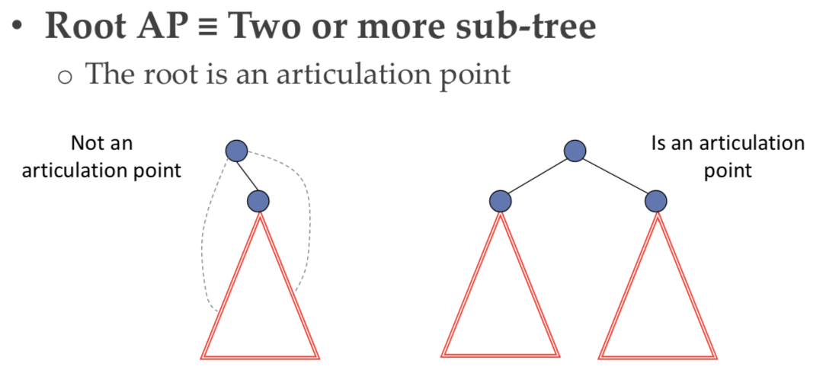
Characteristics of Articulation Point
In a DFS tree, the root is an articulation point if and only if ???

Slide 23
Time and Space Analysis
The DFS skeleton on undirected graph takes time in Θ(n+m) time. If the amount of processing for each vertex and edge is bounded by a constant, the complexity of bicomponents is in Θ(n+m) time. It is not hard to see this is the case. The only place we need to pay attention to is, sometimes the loop pops zero or multiple edges from edgeStack. We know that each edge is stacked and popped exactly once. So the overall complexity is Θ(n+m).

Slide 24
Correctness of Bicomponent Algorithm
We have seen that:
If v is the articulation point farthest away from the root on the branch, then one bicomponent is detected.
So, we need only prove that:
In a DFS tree, a vertex (not the root) v is an articulation point if and only if
(1) v is not a leaf; and
(2) some subtree of v has no back edge incident with a proper ancestor of v.

Slide 25
Characteristics of Articulation Point
In a DFS tree, a vertex (not root) v is an articulation point if and only if (1) v is not a leaf; and (2) some subtree of v has no back edge incident with a proper ancestor of v.
⇐ Trivial
⇒
By definition, v is on every path between some x,y (different from v), so at least one of x,y is a proper descendent of v (otherwise there would be a path betweem x and y without going through v). Thus, v is not a leaf.
By contradiction, suppose that every subtree of v has a back edge to a proper ancestor of v, we can find a xy-path not containing v for all possible cases (only 2 cases)
Notes:
⬅某些子树没有back边，所以这个子树中的所有节点到其他节点都要经过v
➔对于某些x和y，v在x→y的所有路径上，至少x与y中的一个是v的子孙。用反证法。

Slide 26
Case 1
suppose that every subtree of v has a back edge to a proper ancestor of v, and, exactly one of x, y is a descendant of v (e.g, x is a descendant of v).
y
y
v
v
x
x
Case 1.1: y is not an ancestor of v
Case 1.2: y is an ancestor of v

Slide 27
Case 2
suppose that every subtree of v has a back edge to a proper ancestor of v, and, both x and y are descendants of v.
v
y
x

Slide 28
Bicomponents: Equivalentce Classes of Edges
Two edges e₁ and e₂ are equivalent if e₁ =e₂ or if there is a simple cycle containing both e₁ and e₂.
G
I
B
G
B
I
Partitioning the set of edges, not of the vertices
C
B
E
C
E
E
F
H
F
J
H
F
J
A
D
A
D

Slide 29
Edge Biconnected
A connected graph is edge biconnected if there is no edge whose removal disconnectes the graph.
Q1: A biconnected graph is edge biconnected.
A
B
Q2: An edge biconnected graph is biconnected.
H
F
J
A
D

Slide 30
Edge Biconnected
A connected graph is edge biconnected if there is no edge whose removal disconnectes the graph.
Bridge
A bridge in a graph is any edge whose removal increases the number of connected components of the graph.
Edge uv is a bridge iff. node u and v are connected only by uv.
How to find all the bridges in a graph?

Slide 31
How to find all the bridges in a graph?
We have only 2 types of edges when using DFS on undirected graphs.
TE
BE (back to its ancestor (not direct parent))
BE cannot be a bridge. Why?
BE (back to its ancestor (not direct parent)) is always on a cycle.
Not all TEs are bridges.

Slide 32
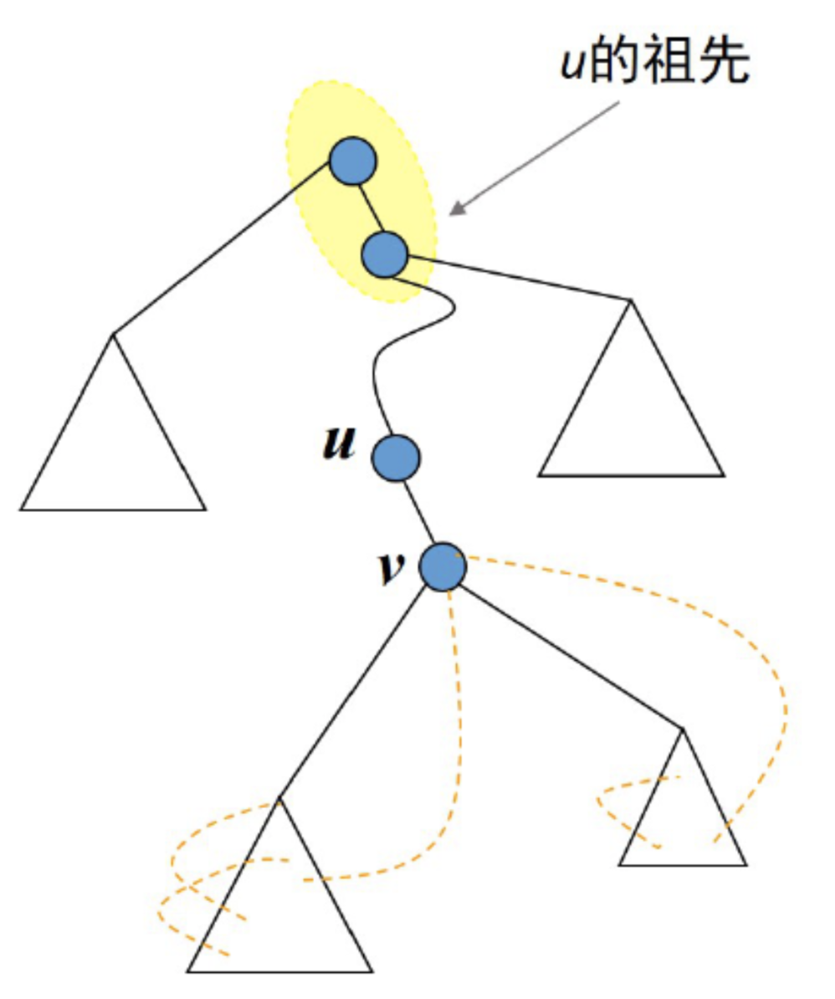
Defining Bridge using DFS
给定遍历树中的TE uv (u是v的父亲节点), uv是桥 iff. 以v为根的所有遍历树的子树中，没有BE指向v的祖先(包括u,不包括v自己).
u is first discovered
u.back=discoverTime(u)
Trying to explore, but a back edge uz from u is encountered
u.back=min(u.back,discoverTime(z))
Backtracking from v to u
u.back=min(u.back, v.back)
If v.back > disoverTime(u), then uv is a bridge

Slide 33
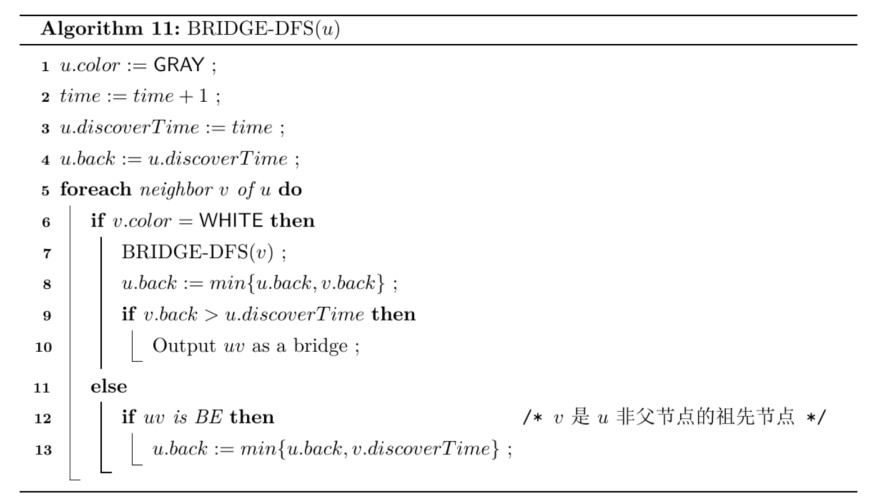
Bridge-DFS

Slide 34
k-connectivity* (考试不作要求)
Any pair of vertices has k vertex-disjoint paths between them.
See Hopcroft and Tarjan 1973a

