Slide 1
BFS
张胜
sheng@nju.edu.cn
南京大学

Slide 2
In the last class…
DFS on Undirected Graph
Edge types
How to modify DFS on digraph for undirected graph?
Example 1: Biconnected Components
Articulation Points and Biconnectedness
Biconnected Component Algorithm
Analysis of the Algorithm
Example 2: Bridge

Slide 3
In this class…
BFS overview
BFS properties
BFS on directed graphs
BFS on undirected graphs
BFS applications
Bipartite graph
k-degree subgraph
Searching

Slide 4


Slide 5

Outline of Breadth First Search
队列是整个遍历活动 的调度器
BFS(G, s)
mark s as “discovered”;
enqueue(pending, s);
while (pending is nonempty)
v=dequeue(pending);
for each vertex w that edge vw is in G
if w is “undiscovered”
mark w as “discovered” and enqueue(pending, w);
mark v as “finished”;

Slide 6
BFS example
A
B.E
D
访问顺序
AFCBD EG
C.E
B.E
B
G
C.E
B.E
C.E
F
C
E
C.E
C.E

Slide 7
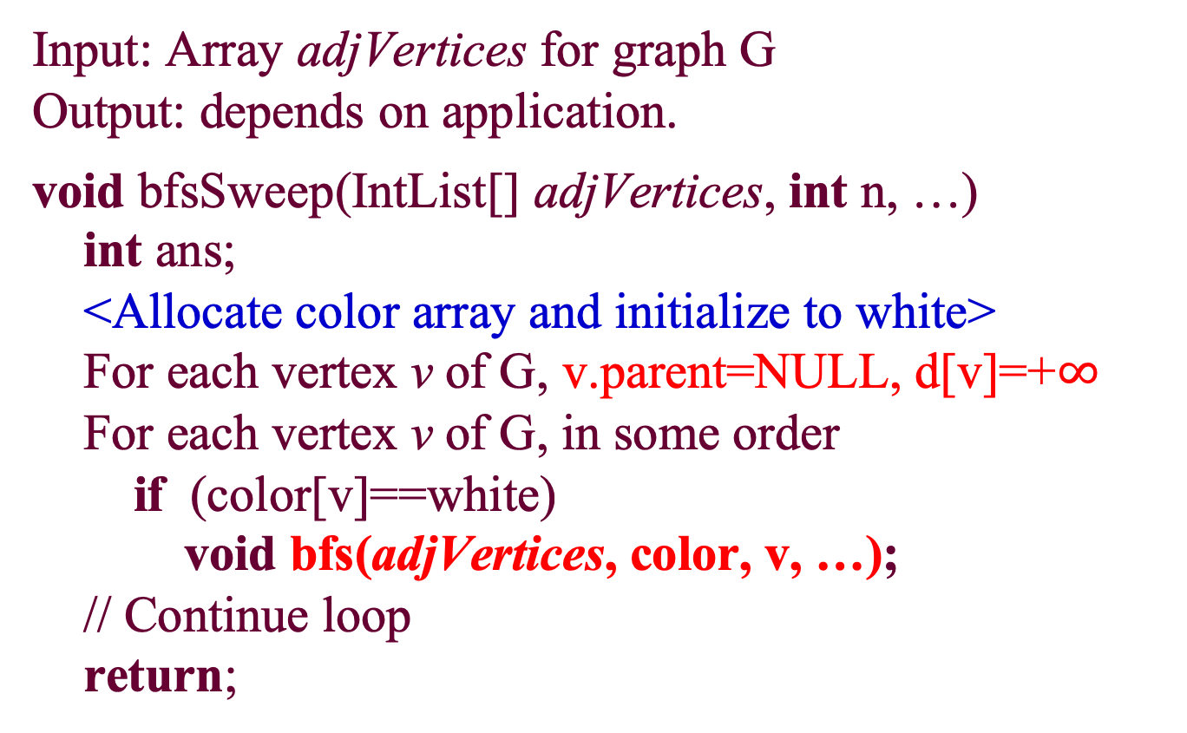
Breadth-First Search: the Skeleton
Input: Array adjVertices for graph G
Output: depends on application.
void bfsSweep(IntList[] adjVertices, int n, …)
int ans;
<Allocate color array and initialize to white>
For each vertex v of G, v.parent=NULL, d[v]=+$∞$
For each vertex v of G, in some order
if (color[v]==white)
void bfs(adjVertices, color, v, …);
// Continue loop
return;

Slide 8
Breadth-First Search: the Skeleton
void bfs(IntList[] adjVertices, int[] color, int v, …)
int w; IntList remAdj; Queue pending;
color[v]=gray; d[v]=0; enqueue(pending, v);
while (pending is nonempty)
w=dequeue(pending); remAdj=adjVertices[w];
while (remAdj≠nil)
x=first(remAdj);
if (color[x]==white)
color[x]=gray; x.parent=w; d[x]=d[w]+1;
enqueue(pending, x);
remAdj=rest(remAdj);
<processing of vertex w>
color[w]=black;
return ;

Slide 9
BFS example with distances
A
B.E
D
C.E
后面我们针对BFS tree的一个连通分支来讨论。一般将连通分支的源点记为s
B.E
B
G
C.E
B.E
C.E
F
C
E
C.E
C.E
v | A | F | C | B | D
d[v] | 0 | 1 | 1 | 1 | 2
v.parent | NULL | A | A | A | B
v | E | G
d[v] | 0 | 1
v.parent | NULL | E

Slide 10

BFS Property (1)
𝛿(s,𝑢): the length of the shortest path from source s to any node u.
Lemma 1: For any directed or undirected graph G, if there is an edge uv, then$δ\left(s,v\right)≤δ\left(s,u\right)+1.$
s
B.E
D
𝛿(s,s)=0
𝛿(s,C)=1
𝛿(s,D)=2
C.E
B.E
B
G
C.E
B.E
C.E
F
C
E
C.E
C.E

Slide 11
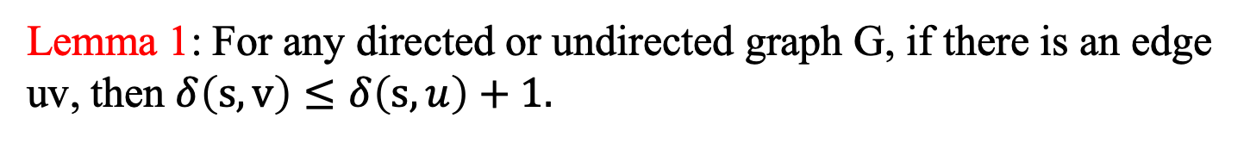
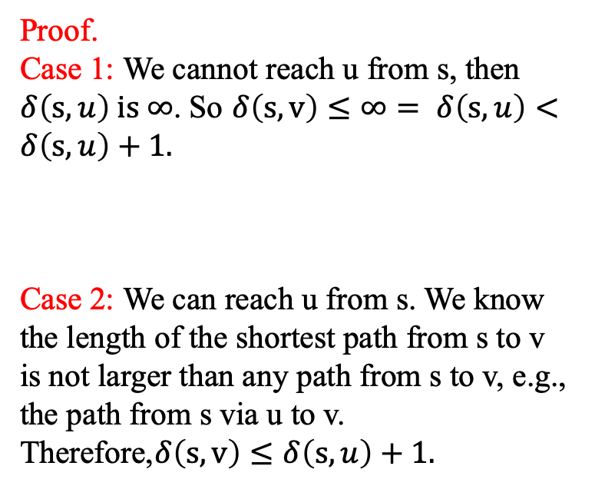
Lemma 1: For any directed or undirected graph G, if there is an edge uv, then$δ\left(s,v\right)≤δ\left(s,u\right)+1.$
s
Proof.
Case 1: We cannot reach u from s, then $δ\left(s,u\right) is ∞$. So $δ\left(s,v\right)≤∞= δ\left(s,u\right)<δ\left(s,u\right)+1.$
Case 2: We can reach u from s. We know the length of the shortest path from s to v is not larger than any path from s to v, e.g., the path from s via u to v. Therefore,$δ\left(s,v\right)≤δ\left(s,u\right)+1.$
v
u
s
v
u

Slide 12
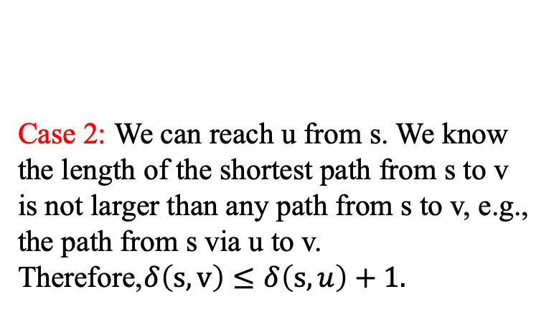
Lemma 1: For any directed or undirected graph G, if there is an edge uv, then$δ\left(s,v\right)≤δ\left(s,u\right)+1.$
Case 2: We can reach u from s. We know the length of the shortest path from s to v is not larger than any path from s to v, e.g., the path from s via u to v. Therefore,$δ\left(s,v\right)≤δ\left(s,u\right)+1.$
s
u
v

Slide 13

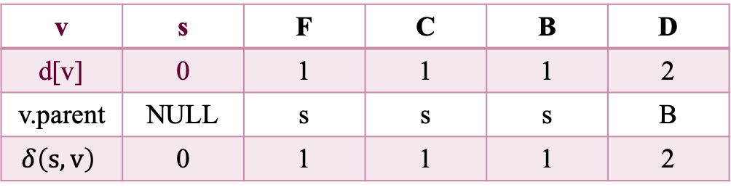
BFS Property (2)
Lemma 2: If we start BFS from source s, when BFS(s) is finished, we have d[v]$≥δ\left(s,v\right)$ for any node v.
s
B.E
D
B.E
B
C.E
C.E
F
C
v | s | F | C | B | D
d[v] | 0 | 1 | 1 | 1 | 2
v.parent | NULL | s | s | s | B
$$δ\left(s,v\right)$$ | 0 | 1 | 1 | 1 | 2
C.E

Slide 14
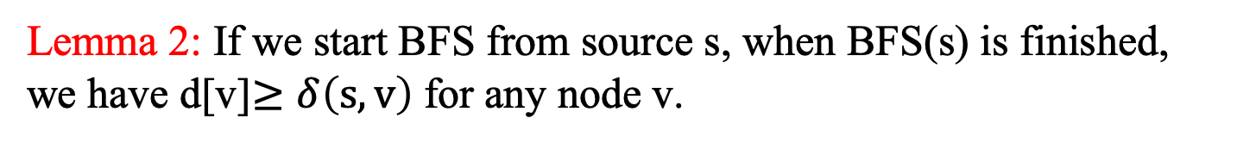
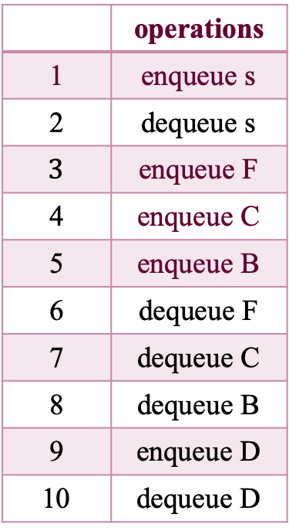
Lemma 2: If we start BFS from source s, when BFS(s) is finished, we have d[v]$≥δ\left(s,v\right)$ for any node v.
Proof. Induction on the number of operations on the queue.
 | operations
1 | enqueue s
2 | dequeue s
$$3$$ | enqueue F
4 | enqueue C
5 | enqueue B
6 | dequeue F
7 | dequeue C
8 | dequeue B
9 | enqueue D
10 | dequeue D
s
B.E
D
B.E
B
C.E
C.E
F
C
C.E

Slide 15
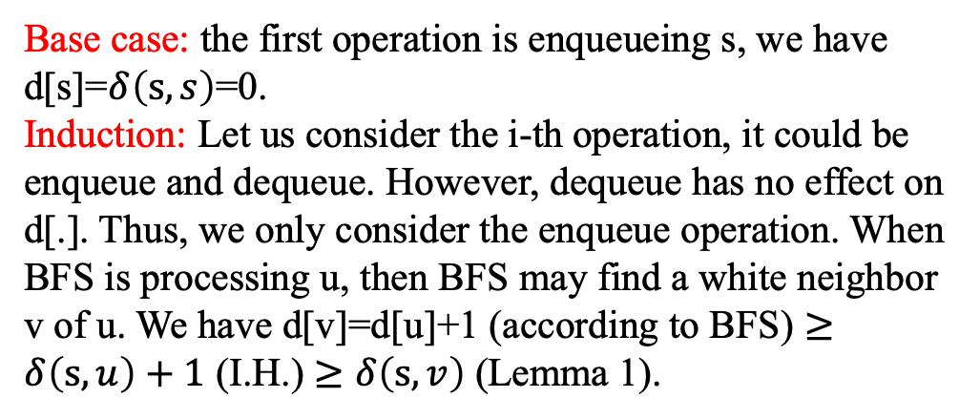
Lemma 2: If we start BFS from source s, when BFS(s) is finished, we have d[v]$≥δ\left(s,v\right)$ for any node v.
s
B.E
D
 | operations
1 | enqueue s
2 | dequeue s
$$3$$ | enqueue F
4 | enqueue C
5 | enqueue B
6 | dequeue F
7 | dequeue C
8 | dequeue B
9 | enqueue D
10 | dequeue D
B.E
B
C.E
C.E
F
C
C.E
Base case: the first operation is enqueueing s, we have d[s]=$δ\left(s,s\right)$=0.
Induction: Let us consider the i-th operation, it could be enqueue and dequeue. However, dequeue has no effect on d[.]. Thus, we only consider the enqueue operation. When BFS is processing u, then BFS may find a white neighbor v of u. We have d[v]=d[u]+1 (according to BFS) $≥δ\left(s,u\right)+1$ (I.H.) $≥δ\left(s,v\right)$ (Lemma 1).

Slide 16
BFS Property (3)
Lemma 3: BFS queue: <v₁, v₂, …,v_{r}>, with v₁ as the head
d[v_{i}] ≤ d[v_{i+1}], i = 1, 2, …, r-1
d[v_{r}] ≤d[v₁]+1

Slide 17
BFS Property (3)
Lemma 3: BFS queue: <v₁, v₂, …,v_{r}>, with v₁ as the head
d[v_{i}] ≤ d[v_{i+1}], i = 1, 2, …, r-1
d[v_{r}] ≤d[v₁]+1
Proof. Induction on the number of operations on the queue.
Base case: the first operation is enqueueing s, Lemma 3 holds.
Induction: (1) dequeue v₁ ：then v₂ becomes the head of the queue. We have d[v_{r}] ≤ d[v₁]+1 ≤ d[v₂]+1
v₁ | v₂ | v₃ | …… | v_{r}

Slide 18
BFS Property (3)
Lemma 3: BFS queue: <v₁, v₂, …,v_{r}>, with v₁ as the head
d[v_{i}] ≤ d[v_{i+1}], i = 1, 2, …, r-1
d[v_{r}] ≤d[v₁]+1
(2) Enqueue v_{r+1} ：Let us think when we should enqueue v_{r+1}. When we dequeue u from the head of the queue, we can enqueue the white neighbors of u, which may include v_{r+1}. According to BFS, we know d[v_{r+1}]= d[u]+1. Before dequeueing u, u is the head, hence d[u] ≤ d[v₁]. Therefore we have
d[v_{r+1}]=d[u]+1 ≤ d[v₁]+1. It is not hard to see, d[v_{r}] ≤ d[u]+1= d[v_{r+1}] .
u
v₁ | v₂ | v₃ | …… | v_{r}
v_{r+1}

Slide 19

BFS Property (4)
Theorem 1: Suppose we start BFS from source s, then for any node v, we have d[v]=$δ\left(s,v\right)$, meanwhile, the s-v path which is composed of the tree edges from s to v is one of the shortest paths.

Slide 20
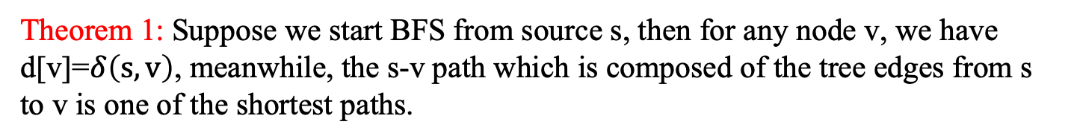

Theorem 1: Suppose we start BFS from source s, then for any node v, we have d[v]=$δ\left(s,v\right)$, meanwhile, the s-v path which is composed of the tree edges from s to v is one of the shortest paths.
Proof by contradiction: suppose there are some nodes whose d[.] value is not equal to$δ\left(s,.\right)$. Now we choose a special node among them. This special node is the node with the smallest$δ\left(s,.\right)$. Denote this special node as v.
(1.1) Since d[s]=$δ\left(s,s\right),$ v can not be s.
(1.2)$δ\left(s,v\right)<∞$. Otherwise, $δ\left(s,v\right)=∞≥d[v]$. Recall Lemma 2, we have $δ\left(s,v\right) ≤d[v]$ . Combining them together, we have$δ\left(s,v\right)=d\left[v\right].$ Contradiction. So we have$δ\left(s,v\right)<∞$.
According to (1.2), v can be reached from s. Now we take a close look at the shortest path from s to v. Denote the node before v on the path as u.
s
u
v

Slide 21

Theorem 1: Suppose we start BFS from source s, then for any node v, we have d[v]=$δ\left(s,v\right)$, meanwhile, the s-v path which is composed of the tree edges from s to v is one of the shortest paths.
s
u
v
Since this is one of the shortest path from s to v, we have$δ\left(s,v\right)$=$δ\left(s,u\right)+1.$
According to property 2, we have$d\left[v\right]>δ\left(s,v\right).$
Remember that v is the node with the smallest distance from s among all nodes whose d[.] value is not equal to$δ\left(s,.\right),$ we know $d\left[u\right]=δ\left(s,u\right)$.
Combining them together, we have
$d\left[v\right]>δ\left(s,v\right)=δ\left(s,u\right)+1=d\left[u\right]+1$.
Next, we try to prove the above inequality does not hold.

Slide 22
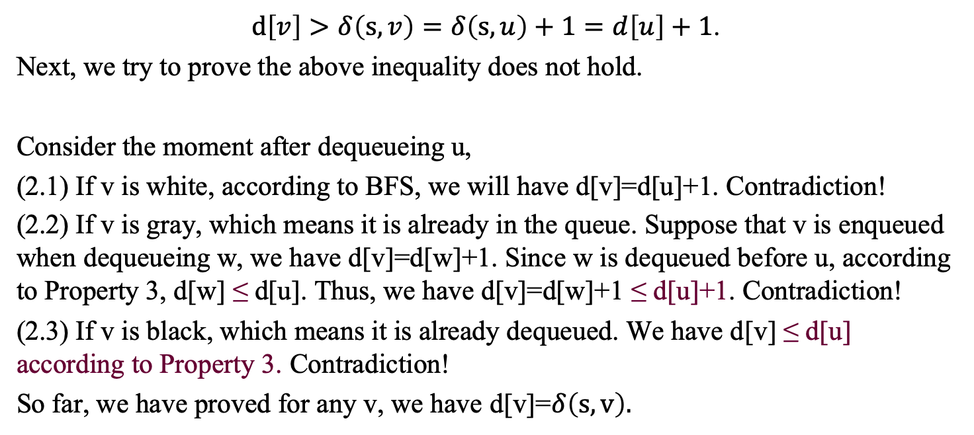
Theorem 1: Suppose we start BFS from source s, then for any node v, we have d[v]=$δ\left(s,v\right)$, meanwhile, the s-v path which is composed of the tree edges from s to v is one of the shortest paths.
s
u
v
$d\left[v\right]>δ\left(s,v\right)=δ\left(s,u\right)+1=d\left[u\right]+1$.
Next, we try to prove the above inequality does not hold.
Consider the moment after dequeueing u,
(2.1) If v is white, according to BFS, we will have d[v]=d[u]+1. Contradiction!
(2.2) If v is gray, which means it is already in the queue. Suppose that v is enqueued when dequeueing w, we have d[v]=d[w]+1. Since w is dequeued before u, according to Property 3, d[w] ≤ d[u]. Thus, we have d[v]=d[w]+1 ≤ d[u]+1. Contradiction!
(2.3) If v is black, which means it is already dequeued. We have d[v] ≤ d[u] according to Property 3. Contradiction!
So far, we have proved for any v, we have d[v]=$δ\left(s,v\right).$

Slide 23

Theorem 1: Suppose we start BFS from source s, then for any node v, we have d[v]=$δ\left(s,v\right)$, meanwhile, the s-v path which is composed of the tree edges from s to v is one of the shortest paths.
s
u
v
So far, we have proved for any v, we have d[v]=$δ\left(s,v\right).$
According to BFS, the length of the s-v path which is composed of the tree edges from s to v is d[v], therefore, this path is one of the shortest paths.

Slide 24
BFS in a Directed Graph
For tree edge (u, v), d[v] = d[u]+1
For back edge (u, v), 0 ≤ d[v] < d[u]
No forward edges
For cross edge (u, v), d[v] ≤ d[u]+1

Slide 25
BFS in a Directed Graph
For tree edge (u, v), d[v] = d[u]+1
A
B.E
D
B.E
B
C.E
C.E
F
C
C.E
v | A | F | C | B | D
d[v] | 0 | 1 | 1 | 1 | 2
v.parent | NULL | A | A | A | B

Slide 26
BFS in a Directed Graph
For back edge (u, v), 0 ≤ d[v] < d[u]
A
B.E
D
B.E
B
C.E
C.E
F
C
C.E
v | A | F | C | B | D
d[v] | 0 | 1 | 1 | 1 | 2
v.parent | NULL | A | A | A | B

Slide 27
BFS in a Directed Graph
No forward edges
A
B.E
D
B.E
B
C.E
C.E
F
C
C.E
v | A | F | C | B | D
d[v] | 0 | 1 | 1 | 1 | 2
v.parent | NULL | A | A | A | B

Slide 28
BFS in a Directed Graph
For cross edge (u, v), d[v] ≤ d[u]+1
A
B.E
D
B.E
B
C.E
C.E
F
C
C.E
v | A | F | C | B | D
d[v] | 0 | 1 | 1 | 1 | 2
v.parent | NULL | A | A | A | B

Slide 29
BFS in an Undirected Graph
No back edges, and no forward edges
For each tree edge (u, v), d[v]=d[u]+1
For each cross edge (u, v), d[v]=d[u] or d[v]=d[u]+1

Slide 30
BFS in an Undirected Graph
No back edges, and no forward edges
A
D
访问顺序AFBCD right
访问顺序AFCBD wrong
访问顺序ABFCD right
B
C.E
C.E
F
C
C.E
v | A | F | B | C | D
d[v] | 0 | 1 | 1 | 1 | 2
v.parent | NULL | A | A | A | B

Slide 31
BFS in an Undirected Graph
For each tree edge (u, v), d[v]=d[u]+1
A
D
访问顺序AFBCD right
访问顺序AFCBD wrong
访问顺序ABFCD right
B
C.E
C.E
F
C
C.E
v | A | F | B | C | D
d[v] | 0 | 1 | 1 | 1 | 2
v.parent | NULL | A | A | A | B

Slide 32
BFS in an Undirected Graph
For each cross edge (u, v), v must be a gray node, so we have d[v]=d[u] or d[v]=d[u]+1
A
D
访问顺序AFBCD right
访问顺序AFCBD wrong
访问顺序ABFCD right
B
C.E
C.E
F
C
C.E
v | A | F | B | C | D
d[v] | 0 | 1 | 1 | 1 | 2
v.parent | NULL | A | A | A | B

Slide 33
Bipartite Graph
A bipartite graph (or bigraph) is a graph whose vertices can be divided into two disjoint sets U and V such that every edge connects a vertex in U to one in V; that is, U and V are independent sets.
Notes:
用BFS,开始对任意一未染色的顶点染色，之后判断其相邻的顶点中，若未染色则将其染上和相邻顶点不同的颜色， 若已经染色且颜色和相邻顶点的颜色相同则说明不是二分图，若颜色不同则继续判断。

Slide 34
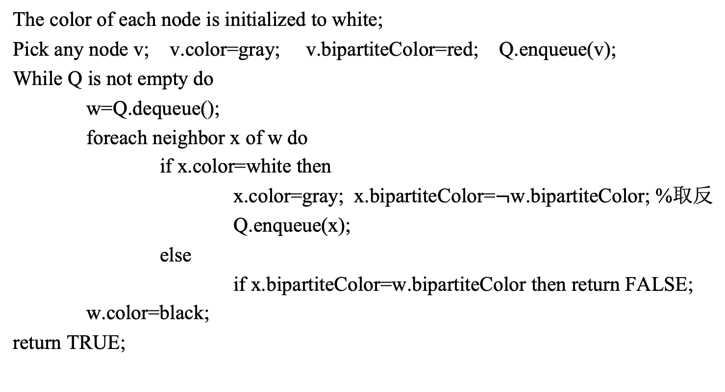
判断二分图
一个图是二分图，等价于它是可以二着色的。
The color of each node is initialized to white;
Pick any node v; v.color=gray; v.bipartiteColor=red; Q.enqueue(v);
While Q is not empty do
w=Q.dequeue();
foreach neighbor x of w do
if x.color=white then
x.color=gray; x.bipartiteColor=$¬$w.bipartiteColor; %取反
Q.enqueue(x);
else
if x.bipartiteColor=w.bipartiteColor then return FALSE;
w.color=black;
return TRUE;

Slide 35
寻找k度子图
给定无向图 G，对于某个图G的子图H，如果H的每个顶点的度均不低于一个输入的参数k，那么H是G的k度子图。

Slide 36
寻找k度子图
给定无向图 G，对于某个图G的子图H，如果H的每个顶点的度均不低于一个输入的参数k，那么H是G的k度子图。
Q is initialized to be empty;
Foreach node v in G do
if v.degree < k then
Q.enqueue(v);
While Q is not empty do
v=Q.dequeue();
foreach neighbor w of v do
delete edge wv;
if w.degree < k and w is not in Q then
Q.enqueue(w);
delete node v from G;
return G;

Slide 37
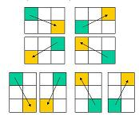
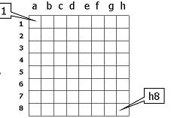
Knight Moves
To move the knight in legal knight chess moves from the initial position to the target position in as few moves as possible.
a1

Slide 38
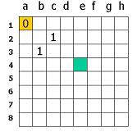
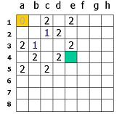
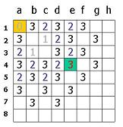
From a1 to e4
The 1st move
The 2nd move
The 3rd move

Slide 39
Characteristics of Search Algorithms
The state space, which is composed of all the states, is finite, which means the problem is not big.
In the process, one state can be transformed from/to another one with some pre-conditions.
We can judge whether the state is illegal, and there is a set of terminal states.
The problems are
Find the terminal states in accordance with the initial state;
Find a path from the given initial state to terminal states.

Slide 40
Using BFS
The extension of the nodes is based on the “distance” to the initial node.
First layer, second layer, …
For the nodes in same layer, we can expand them in any order.
For a new node, if it is target, then return; otherwise, insert it into the end of queue.
BFS is applicable to acquire the optimal solution.

Slide 41
Dividing Oil
Three bottles: 10kg, 7kg, 3kg. The 10kg bottle is full of oil. The problem is to divide 10kg oil into two 5kg parts through these three bottles.
State (T, S, R)
Initial state: (10, 0, 0)
Terminal states: (5, 2, 3), (5, 3, 2), (3, 5, 2), (2, 5, 3), (5, 5, 0)

Slide 42
Dividing Oil
State (T, S, R)
Initial state: (10, 0, 0)
Terminal states: (5, 2, 3), (5, 3, 2), (3, 5, 2), (2, 5, 3), (5, 5, 0)
(1) We can use (S,R) to represent the state. (why?)
(2) Oil can only flow in 6 directions:
T->S, T->R, S->T, S->R, R->T, R->S
(3) We stop oil flow only in two conditions:
The target bottle is full
Or the source bottle is empty

Slide 43
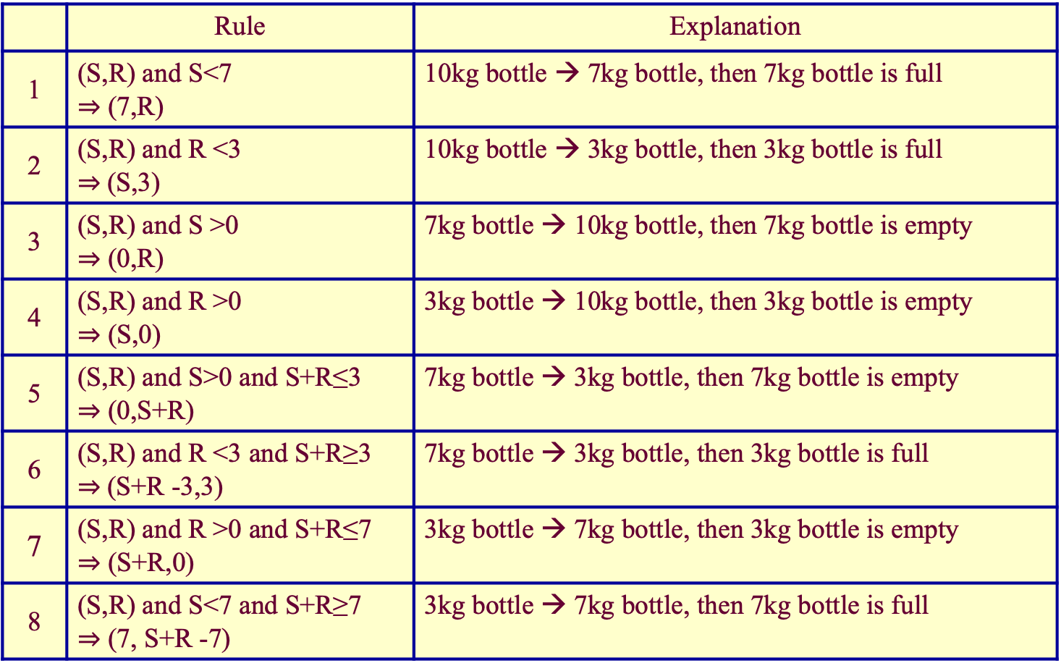
Transitions Between Two States
 | Rule | Explanation
1 | (S,R) and S<7 $⇒$ (7,R) | 10kg bottle → 7kg bottle, then 7kg bottle is full
2 | (S,R) and R <3 $⇒$(S,3) | 10kg bottle → 3kg bottle, then 3kg bottle is full
3 | (S,R) and S >0 $⇒$ (0,R) | 7kg bottle → 10kg bottle, then 7kg bottle is empty
4 | (S,R) and R >0 $⇒$ (S,0) | 3kg bottle → 10kg bottle, then 3kg bottle is empty
5 | (S,R) and S>0 and S+R≤3 $⇒$ (0,S+R) | 7kg bottle → 3kg bottle, then 7kg bottle is empty
6 | (S,R) and R <3 and S+R≥3 $⇒$(S+R -3,3) | 7kg bottle → 3kg bottle, then 3kg bottle is full
7 | (S,R) and R >0 and S+R≤7 $⇒$ (S+R,0) | 3kg bottle → 7kg bottle, then 3kg bottle is empty
8 | (S,R) and S<7 and S+R≥7 $⇒$ (7, S+R -7) | 3kg bottle → 7kg bottle, then 7kg bottle is full

Slide 44
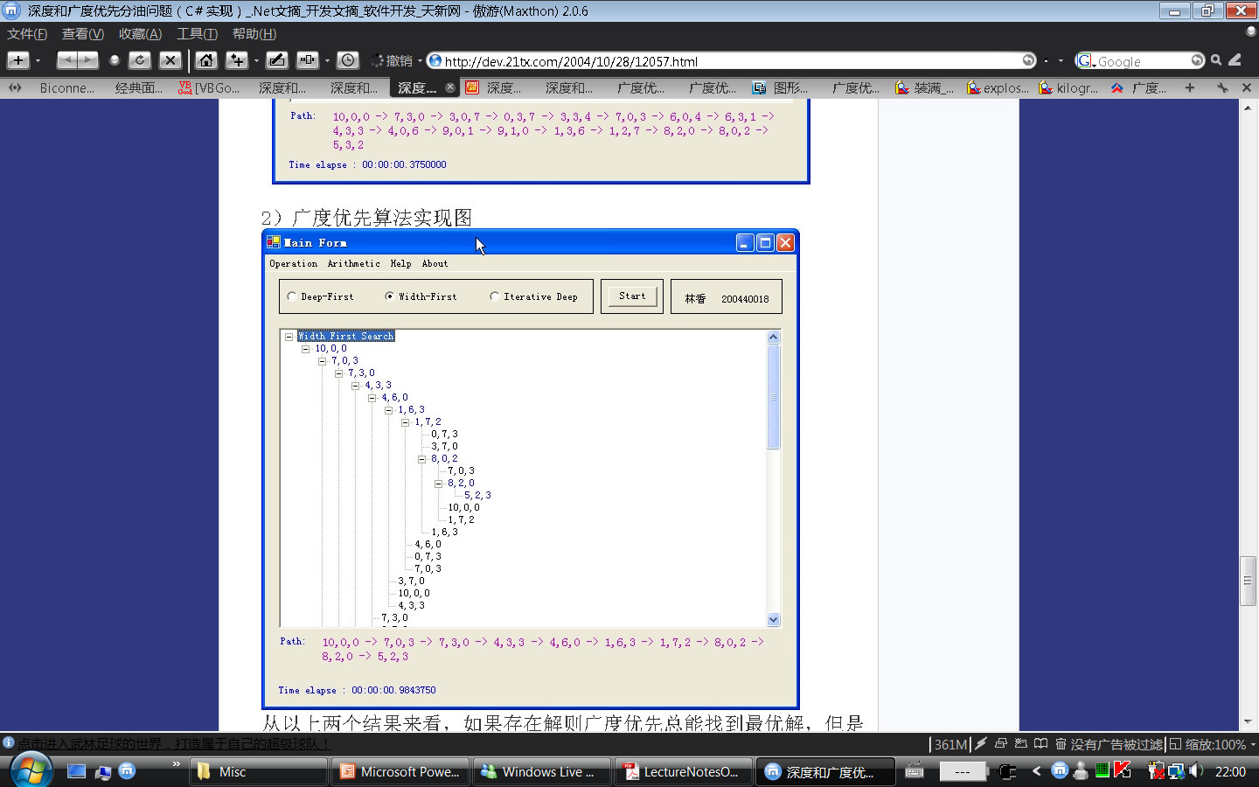
DFS vs. BFS
DFS
BFS
If the solution exists, BFS is able to find the optimal one. However, in most cases, DFS is faster than BFS, because BFS searches all the nodes.
This problem is simple, BFS can find the solution in the 9th step. But for some complex problems, BFS may lead to the explosion of states.

