Slide 1
Greedy and MST
张胜
sheng@nju.edu.cn
南京大学

Slide 2
In this class …
Optimization Problem
Greedy Strategy
MST Problem
Prim’s Algorithm
Kruskal’s Algorithm

Slide 3
Greedy Strategy for Optimization Problems
Coin Change Problem
[candidates] A finite set of coins, of 1, 5, 10 and 25 units, with enough number for each value
[constraints] Pay an exact amount by a selected set of coins
[optimization] minimize the number of coins in the selected set
Solution by greedy strategy
For each selection, choose the highest-valued coin as possible.

Slide 4
Greedy Fails Sometimes
We have to pay 15 in total.
If the available types of coins are {1,5,12}
The greedy choice is {12,1,1,1}
The optimal choice is {5,5,5}
If the available types of coins are {1,5,10,25}
The greedy choice is always optimal
When will the greedy strategy be optimal? A sufficient condition is that the problem satisfies the Matroid (拟阵) structure.
Notes:
A problem exhibits optimal substructure if an optimal solution to the problem contains optimal solutions to the sub-problems.

Slide 5
Greedy Strategy
Constructing the final solution by expanding the partial solution step by step, in each step a selection is made from a set of candidates, with the choice made must be:
[feasible] it has to satisfy the problem’s constraints
[locally optimal] it has to be the best local choice among all feasible choices on the step
[irrevocable] the candidate selected can never be de-selected on subsequent steps
set greedy(set candidate)
set S=Ø;
while not solution(S) and candidate≠Ø
select locally optimal x
from candidate;
candidate=candidate-{x};
if feasible(x) then S=S∪{x};
if solution(S) then return S
else return (“no solution”)
Notes:
1。必须满足问题的条件
2。局部优化解
3。选择的候选节点不能再重选

Slide 6

Weighted Graph
B
27
26
21
A
C
42
E
36
D
34
25
33
29
22
16
18
I
21
H
21
J
25
F
28
17
53
G
A weighted graph
The nearest neighbor of vertex I is H
The nearest neighbor of the shaded subset of vertices is G

Slide 7
MST (Minimum Spanning Tree)
B
A Spanning Tree: W(T)=257
The weight of a tree is defined as the sum of the weights of all edges of the tree.
A spanning tree of a graph is a tree that contains all vertices of the graph.
A MST of a graph is a spanning tree of the graph and it has the minimum weight.
27
26
A
21
C
42
E
36
D
34
25
33
29
22
16
18
I
21
21
H
J
25
F
17
28
53
G
B
A MST: W(T)=190
27
26
A
21
C
42
E
36
D
34
25
33
29
22
16
18
I
21
H
21
J
25
F
28
17
53
直接定义
G

Slide 8

Graph Traversal for MST
All other edges with weight 5
There are cases that a graph traversal tree is not a minimum spanning tree, with the vertices explored in any order.
1
1
1
1
1
in any ordering of vertex
DFS tree
BFS tree

Slide 9
Greedy Algorithms for MST
Prim’s algorithm:
Difficult selecting: best local optimization means no cycle and small weight
Easy checking: doing nothing
Kruskal’s algorithm:
Easy selecting: sorting edges by their weights
Difficult checking: no cycle

Slide 10
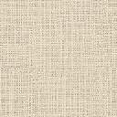

Prim’s Algorithm for MST
edges included in the MST
所有可能增长节点的集合为Fringe。例如，以A为起始点，其Fringe为{B,G,F}
A
2
B
3
6
Greedy strategy:
For each set of fringe vertices, select the edge with the minimal weight, that is, local optimal.
7
G
4
1
3
5
F
I
H
C
4
2
6
2
8
2
E
1
D

Slide 11
Key Issue in Implementation
To maintain the set of fringe (边缘) vertices, the data structure we use should be able to
Create the set and update it after each vertex is “selected” (deleting the vertex having been selected and inserting new fringe vertices)
Easy to decide the vertex with the “highest priority”
Change the priority of the vertices (decreasing key).
The choice: priority queue

Slide 12
Implementing the Prim Algorithm
Main Procedure
prim(G, n)
Initialize the priority queue pq as empty;
Initialize the status of each node as unseen;
Initialize edge set MST as empty;
Select an arbitrary vertex s to start;
Set s.candidateEdge as NULL;
Set s.status as fringe;
insert(pq, s, 0);
while (pq is not empty)
v=getMin(pq); deleteMin(pq);
Add v.candidateEdge to MST;
Set v.status as finished;
updateFringe(pq, G, v);
return
Updating the Queue
updateFringe(pq, G, v)
for each vertice w that is not finished and is adjcaent to v
newWgt = vw.weight;
if w.status is unseen then
Set w.status as fringe;
Set w.candidateEdge as vw;
insert(pq, w, newWgt);
else
if newWgt < getPriorty(pq, w)
Change w.candidateEdge to vw;
decreaseKey(pq, w, newWgt);
return
getMin(pq) always be the vertex with the smallest key in the fringe set.

Slide 13

Complexity of Prim’s Algorithm
Operations on priority queue: (for a graph with n vertices and m edges)
insert: n
getMin: n
deleteMin: n
decreasKey: m (execute at most m times)
So,
T(n,m) = O(nT(getMin)+nT(deleteMin)+ nT(insert)+mT(decreaseKey))

Slide 14
Complexity of Prim’s Algorithm
T(n,m) = O(nT(getMin)+nT(deleteMin)+ nT(insert)+mT(decreaseKey))
Operation | Using Array | Using Heap
getMin | O(n) | O(1)
deleteMin | O(n) | O(log n)
insert | O(1) | O(log n)
decreaseKey | O(1) | O(log n)
Implementing priority queue using array, we can get Θ(n²+m)
Implementing priority queue using heap, we can get Θ((n+m)log n)

Slide 15
How to Prove Prim’s Algorithm is Correct?
Step 1
Introduce a new definition of MST: the MST property
Step 2
In a connected, weighted graph G=(V,E,W), a tree T is a minimum spanning tree if and only if T has the MST property.
Step 3
Proving the correctness of Prim using the MST property

Slide 16
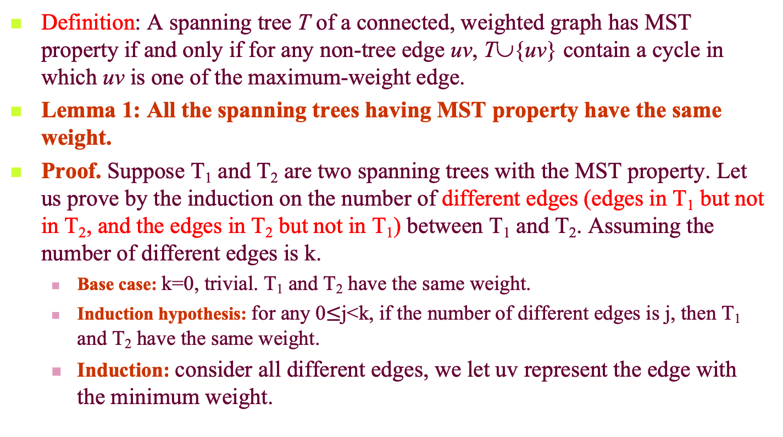
MST Property
Definition: A spanning tree T of a connected, weighted graph has MST property if and only if for any non-tree edge uv, T∪{uv} contain a cycle in which uv is one of the maximum-weight edge.
Lemma 1: All the spanning trees having MST property have the same weight.
Proof. Suppose T₁ and T₂ are two spanning trees with the MST property. Let us prove by the induction on the number of different edges (edges in T₁ but not in T₂, and the edges in T₂ but not in T₁) between T₁ and T₂. Assuming the number of different edges is k.
Base case: k=0, trivial. T₁ and T₂ have the same weight.
Induction hypothesis: for any 0$≤$j<k, if the number of different edges is j, then T₁ and T₂ have the same weight.
Induction: consider all different edges, we let uv represent the edge with the minimum weight.

Slide 17

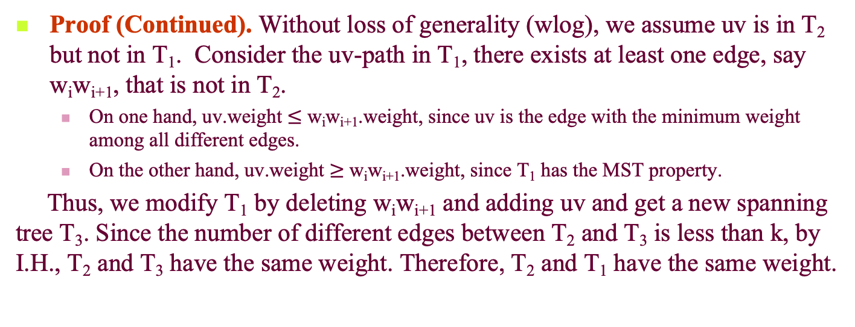
Proof (Continued). Without loss of generality (wlog), we assume uv is in T₂ but not in T₁. Consider the uv-path in T₁, there exists at least one edge, say w_{i}w_{i+1}, that is not in T₂.
On one hand, uv.weight $≤$ w_{i}w_{i+1}.weight, since uv is the edge with the minimum weight among all different edges.
On the other hand, uv.weight $≥$ w_{i}w_{i+1}.weight, since T₁ has the MST property.
Thus, we modify T₁ by deleting w_{i}w_{i+1} and adding uv and get a new spanning tree T₃. Since the number of different edges between T₂ and T₃ is less than k, by I.H., T₂ and T₃ have the same weight. Therefore, T₂ and T₁ have the same weight.
uv-path in T₁
u
u
edge exchange
Must have same weight
w_{i}
×
w_{i}
v
w_{i+1}
v
not in T₂
w_{i+1}
a new spanning tree T₃: same weight as T₁, less different edges from that of T₂
edge uv in T₂ but not in T₁ , with minimum weight among all different edges

Slide 18
MST Property and Minimum Spanning Tree
Theorem 1: In a connected, weighted graph G=(V,E,W), a tree T is a minimum spanning tree if and only if T has the MST property.
Proof
⇒ For a minimum spanning tree T, if it doesn’t has MST property. So, there is a non-tree edge uv, and T∪{uv} contains a cycle. And the cycle has an edge xy whose weight is larger than uv. Replacing xy with uv results a spanning tree with less weight than T. Contradiction.
⇐ Suppose T has the MST property. Suppose T_{min} is a MST. Due to the the first half of this theorem, T_{min} has the MST property. Due to Lemma 1, T_{min} has the same weight of T. Thus, T is also a MST.

Slide 19
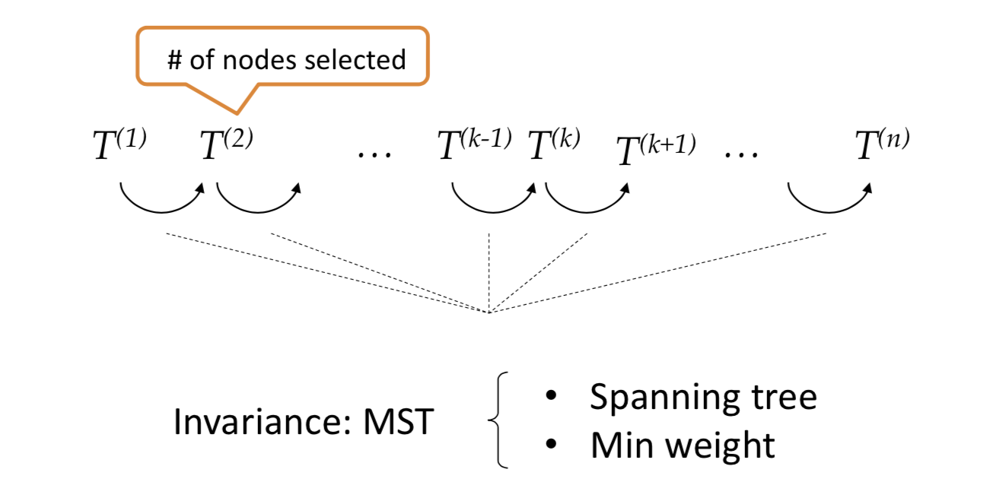
Step 3: Proving the correctness of Prim using the MST property

Slide 20
Correctness of Prim’s Algorithm (Proof 1)
Let T_{k} be the tree constructed after the kth step of Prim’s algorithm is executed, then T_{k} has the MST property in G_{k}, the subgraph of G induced by vertices of T_{k}.
w_{a+1}
w_{b-1}
assumed first and last edges with larger weight than w(u_{i}v), resulting contradictions.
w_{a}
w_{b}
T_{k-1}
……
u₁(w₁)
u_{i}(w_{p})
edge added in T_{k}
Note: w(u_{i}v)≥w(u₁v), and if w_{a} added earlier than w_{b}, then w_{a}w_{a+1} and w_{b-1}w_{b} added later than any edges in u₁w_{a}-path, and v as well
added in T_{k} to form a cycle,
only these need be considered
v, added in T_{k}
Notes:
需要证明Tk具有最小生成树的性质，假设此时加入节点v。
数学归纳法，对节点个数进行归纳。
设xy是Gk中的一条边，但并不存在于Tk，那么xy加入后会构成环，且xy的权值最大。
1、x、y都不等于v，那么xy必然存在于Gk-1，根据归纳假设xy必然构成环，且xy在环中权值最大；
2、xy存在于Tk-1中某些与v相连的边。（反证法）u1v是权值最小边，加入uiv后构成环，假设环中uiv不是权值最大的边。设wa……wb是权值比uiv更大的边。那么无论是wa或者wb先进入T，都与Prim算法的策略矛盾。

Slide 21
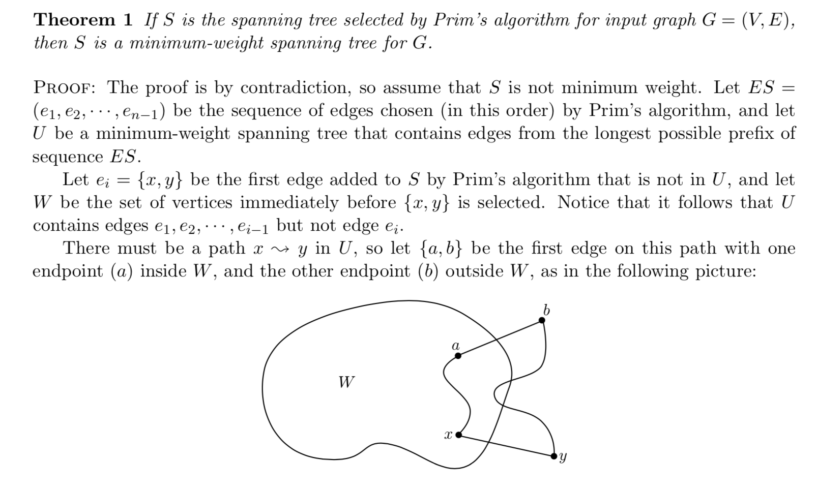
Correctness of Prim’s Algorithm (Proof 2)
Notes:
需要证明Tk具有最小生成树的性质，假设此时加入节点v。
数学归纳法，对节点个数进行归纳。
设xy是Gk中的一条边，但并不存在于Tk，那么xy加入后会构成环，且xy的权值最大。
1、x、y都不等于v，那么xy必然存在于Gk-1，根据归纳假设xy必然构成环，且xy在环中权值最大；
2、xy存在于Tk-1中某些与v相连的边。（反证法）u1v是权值最小边，加入uiv后构成环，假设环中uiv不是权值最大的边。设wa……wb是权值比uiv更大的边。那么无论是wa或者wb先进入T，都与Prim算法的策略矛盾。

Slide 22
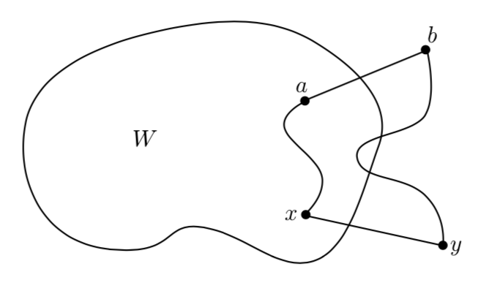
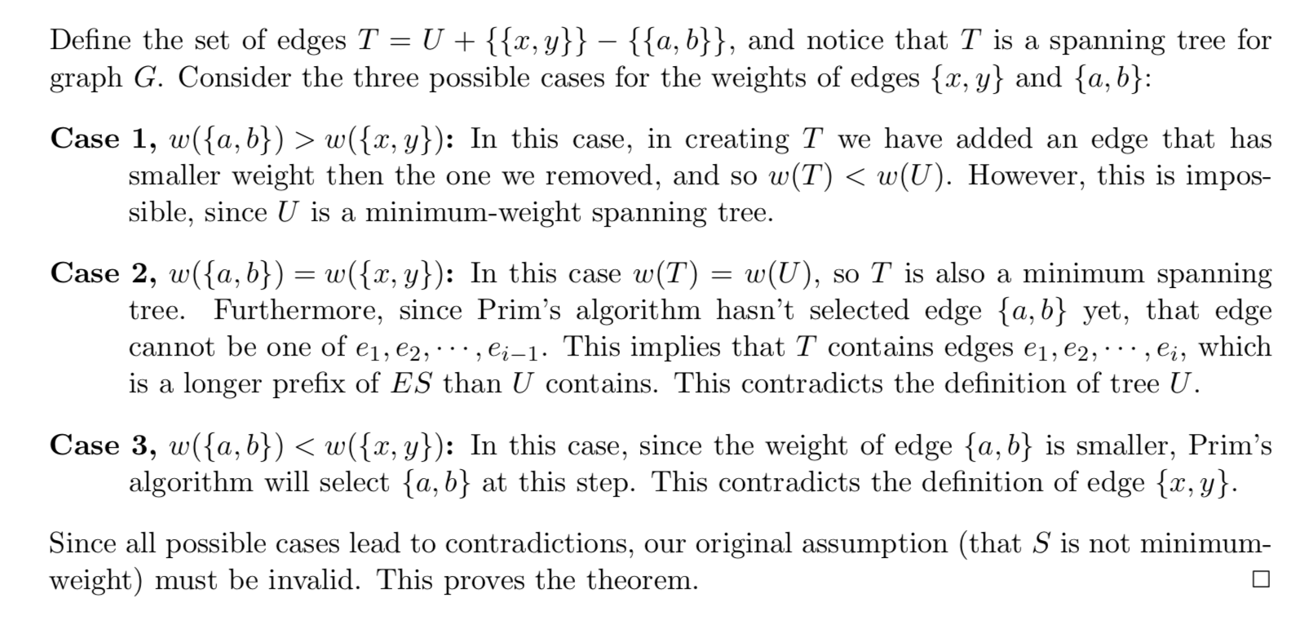
Correctness of Prim’s Algorithm (Proof 2 continued)
Notes:
需要证明Tk具有最小生成树的性质，假设此时加入节点v。
数学归纳法，对节点个数进行归纳。
设xy是Gk中的一条边，但并不存在于Tk，那么xy加入后会构成环，且xy的权值最大。
1、x、y都不等于v，那么xy必然存在于Gk-1，根据归纳假设xy必然构成环，且xy在环中权值最大；
2、xy存在于Tk-1中某些与v相连的边。（反证法）u1v是权值最小边，加入uiv后构成环，假设环中uiv不是权值最大的边。设wa……wb是权值比uiv更大的边。那么无论是wa或者wb先进入T，都与Prim算法的策略矛盾。

Slide 23
Kruskal’s Algorithm for MST
A
2
B
Also Greedy strategy:
From the set of edges not yet included in the partially built MST, select the edge with the minimal weight, that is, local optimal, in another sense.
3
6
7
G
4
1
3
5
F
I
H
C
4
2
6
2
8
2
E
1
D
edges included in the MST

Slide 24
Key Issue in Implementation
How to know an insertion of an edge will result in a cycle efficiently?
For correctness: the two endpoints of the selected edge can not be in the same connected components.
For the efficiency: connected components are implemented as dynamic equivalence classes using union-find.

Slide 25
Kruskal’s Algorithm: the Procedure
kruskalMST(G, n, F)
Build a minimizing priority queue, pq, of edges of G, prioritized by weight.
Initialize a Union-Find structure, sets, in which each vertex of G is in its own set.
F=φ;
while (the size of F is less than n-1)
vw = getMin(pq); deleteMin(pq);
int vRoot = find(sets, v);
int wRoot = find(sets, w);
if (vRoot ≠ wRoot)
Add vw to F;
union(sets, vRoot, wRoot)
return
Simply sorting, the cost will be Θ(mlogm)

Slide 26
Complexity of Kruskal’s Algorithm
Implementing priority queue using heap or simply sorting, it costs O(mlog m).
The number of getMin + deleteMin is at most m. If using heap to implement priority queue, then their cost is O(mlogn).
Assuming we use weighted-union and find.
The number of FIND operations is O(m). Their cost is O(mlogn).
The number of wUNION operations is O(n). Their cost is O(n).
In total, the complexity is O(mlog m).

Slide 27
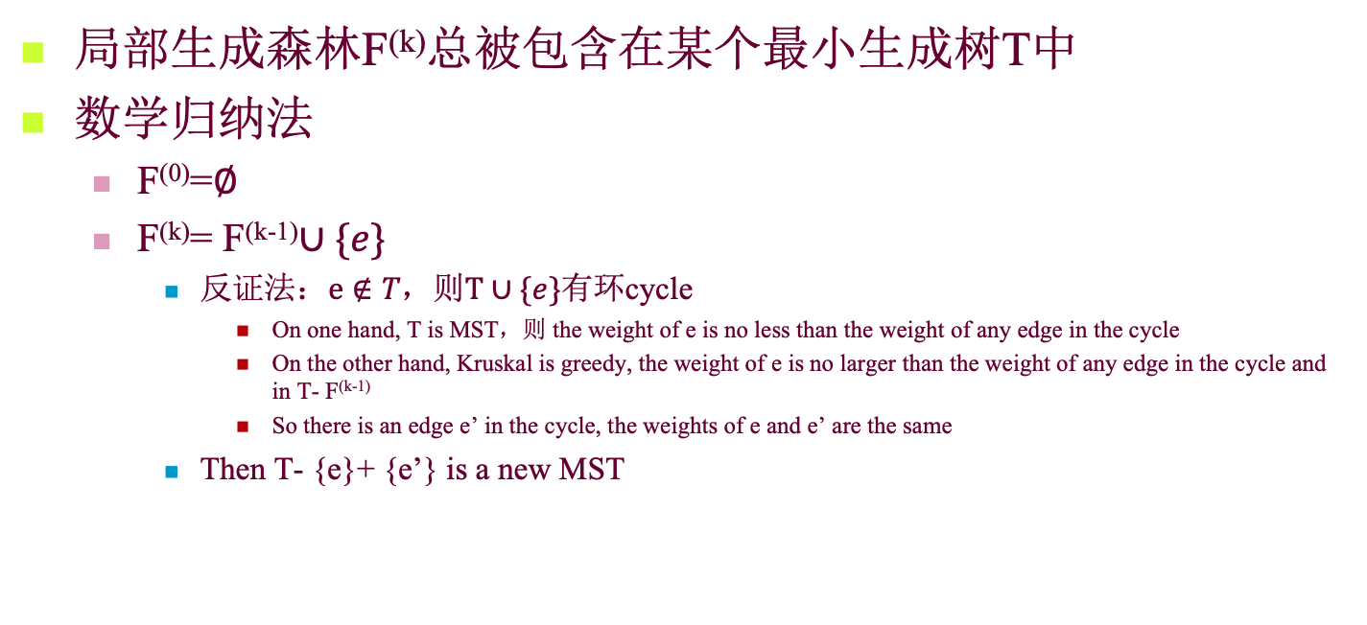
Correctness of Kruskal’s Algorithm
局部生成森林F^{(k)}总被包含在某个最小生成树T中
数学归纳法
F⁽⁰⁾=$∅$
F^{(k)}= F^{(k-1)}$∪\{e\}$
反证法：$e∉T，$则$T∪\{e\}$有环cycle
On one hand, T is MST，则 the weight of e is no less than the weight of any edge in the cycle
On the other hand, Kruskal is greedy, the weight of e is no larger than the weight of any edge in the cycle and in T- F^{(k-1)}
So there is an edge e’ in the cycle, the weights of e and e’ are the same
Then T- {e}+ {e’} is a new MST

Slide 28
Prim vs. Kruskal
Lower bound for MST
For a correct MST, each edge in the graph should be examined at least once.
So, the lower bound is Ω(m)
Θ(n²+m) and Θ(mlogm), which is better?
Generally speaking, depends on the density of edge of the graph.
When the graph is sparse, Θ(mlogm) will be better. Otherwise, the former is better.

