Slide 1
SSSP and Other Greedy Problems
张胜
sheng@nju.edu.cn
南京大学

Slide 2
In This Class
The MCE Framework
Shortest Path Problem
Single-source Shortest Path in a general graph
Single-source Shortest Path in DAG (this can be also solved by dynamic programming)
All-Pairs Shortest Paths (we will introduce it in the context of dynamic programming)
Greedy Algorithms

Slide 3
MCE (Minimum-weight Cut-crossing Edge)
Prim and Kruskal can be seen as special cases of this MCE framework.
MCE has two core concepts
Cut （割）
Cut-crossing edge （跨越割的边）

Slide 4
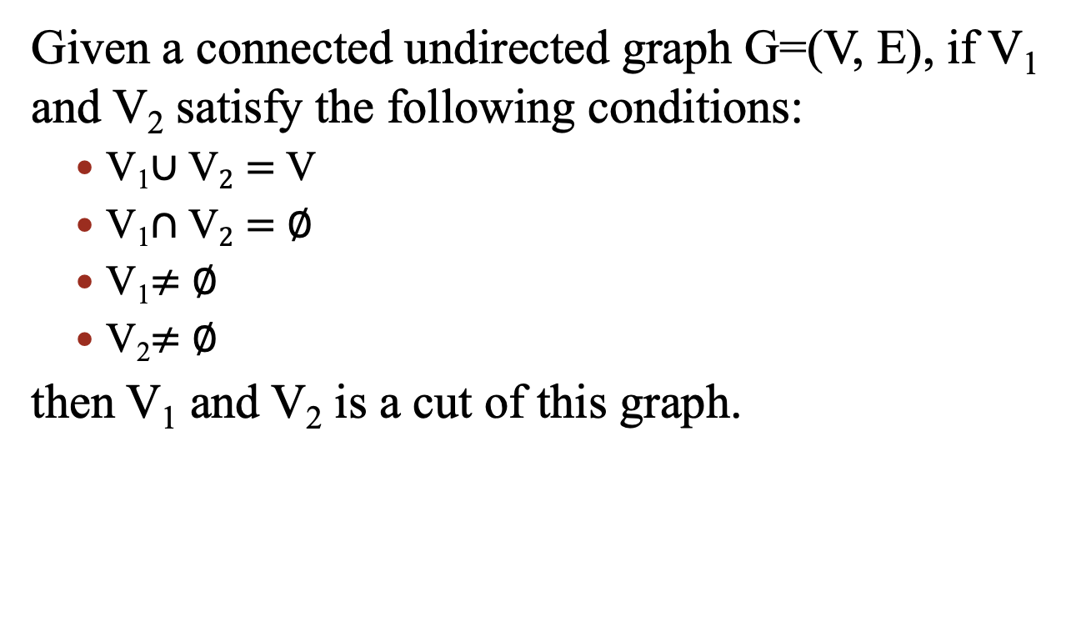
Cut
Given a connected undirected graph G=(V, E), if V₁ and V₂ satisfy the following conditions:
V₁$∪\text{V}2=$ V
V₁$∩\text{V}2=$ $∅$
V₁$≠$ $∅$
V₂$≠$ $∅$
then V₁ and V₂ is a cut of this graph.

Slide 5
Cut-crossing Edge
Given a cut V₁ and V₂ for a connected undirected graph G=(V, E), the set of cut-crossing edges contains all edges that has one endpoint in V₁ and the other one in V₂.
Since G is connected, the set of cut-crossing edges must be not empty. An edge with the minimum weight in this set is called a MCE.
MCE may not be unique.

Slide 6
Theorem: for an edge e, if there is a cut that makes e be a MCE, then e must be in one MST.
e'
e
V₁
V₂
Proof by contradiction: denote the cut that makes e be a MCE by V₁ and V₂. Let us assume e does not belong to any MST. Consider the MST T in the figure. Since T connects all nodes in the graph, there must be an edge e' that crosses the cut.
On one hand, according to the MST property, the weight of e is not smaller than e’ .
On the other hand, e is a MCE, thus, the weight of e is not larger than e’ .
Thus we have proved their weights are equal. Now we can remove e' and add e, we get another MST. A contradiction.

Slide 7
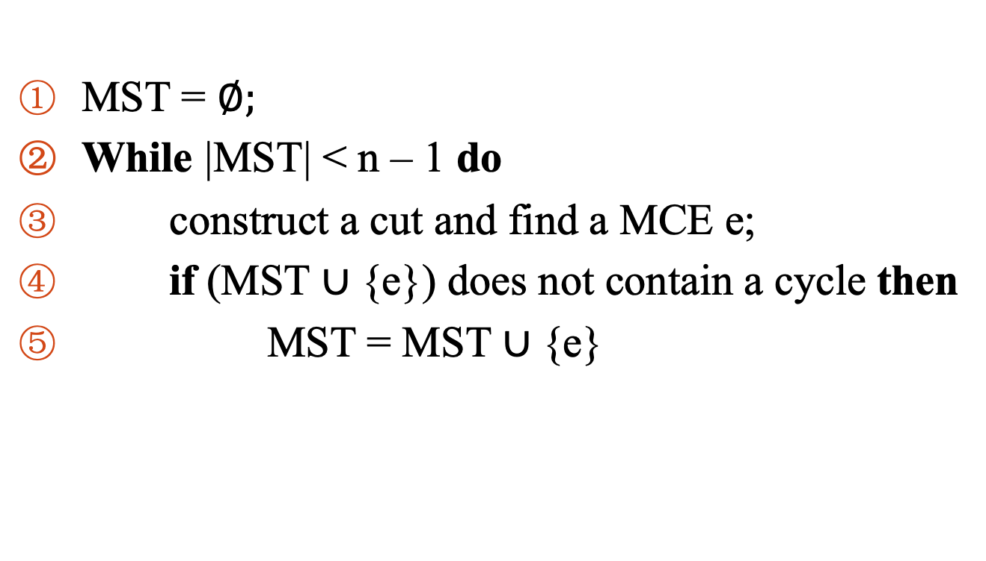
A General Framework for MST
MST = $∅;$
While |MST| < n – 1 do
construct a cut and find a MCE e;
if (MST $∪${e}) does not contain a cycle then
MST = MST$∪${e}

Slide 8
Re-examine Prim from MCE
A
B
7
3
6
G
4
1
3
5
F
I
H
C
4
2
6
2
8
2
E
1
D
edges included in the MST

Slide 9
Re-examine Kruskal from MCE
A
2
B
3
6
7
G
4
1
3
5
F
I
H
C
4
2
6
2
8
2
E
1
D
edges included in the MST

Slide 10


Single Source Shortest Paths
The single source
Red labels on each vertex is the length of the shortest path from s to the vertex.
Note:
The shortest path from o to 3 (the blue line in the right figure) does not contain the shortest edge leaving s which is the edge between 0 and 1.
1
2
2
7
5
3
1
1
2
8
7
6
3
6
s
0
3
4
3
4
2
4
6
4
5
9

Slide 11


Dijkstra’s Algorithm: an Example
1
∞
2
B
∞
2
A
7
1
3
5
1
2
∞
G
8
C
6
8
s
3
∞
7
6
4
7
3
D
0
∞
4
3
4
2
4
6
E
∞
4
9
∞
5
F

Slide 12

Implementing Dijkstra Algorithm
Main Procedure
dijkstra(G, n, s)
Initialize the priority queue pq as empty;
Initialize the status of each node as unseen;
Initialize edge set SSSP as empty;
Set s.ssspEdge as NULL;
Set s.status as fringe;
insert(pq, s, 0);
while (pq is not empty)
v=getMin(pq);
Set v.dis as getPriorty(pq, v);
Set v.status as finished;
deleteMin(pq);
Add v.ssspEdge to SSSP;
updateFringe(pq, G, v);
return
Updating the Queue
updateFringe(pq, G, v)
for each vertice w that is not finished and is adjcaent to v
newWgt = v.dis + vw.weight;
if w.status is unseen then
Set w.status as fringe;
Set w.ssspEdge as vw;
insert(pq, w, newWgt);
else
if newWgt < getPriorty(pq, w)
Change w.ssspEdge to vw;
decreaseKey(pq, w, newWgt);
return

Slide 13

Complexity of Dijkstra’s Algorithm
T(n,m) = O(nT(getMin)+nT(deleteMin)+ nT(insert)+mT(decreaseKey))
Operation | Using Array | Using Heap
getMin | O(n) | O(1)
deleteMin | O(n) | O(log n)
insert | O(1) | O(log n)
decreaseKey | O(1) | O(log n)
Implementing priority queue using array, we can get Θ(n²+m)
Implementing priority queue using heap, we can get Θ((n+m)log n)

Slide 14
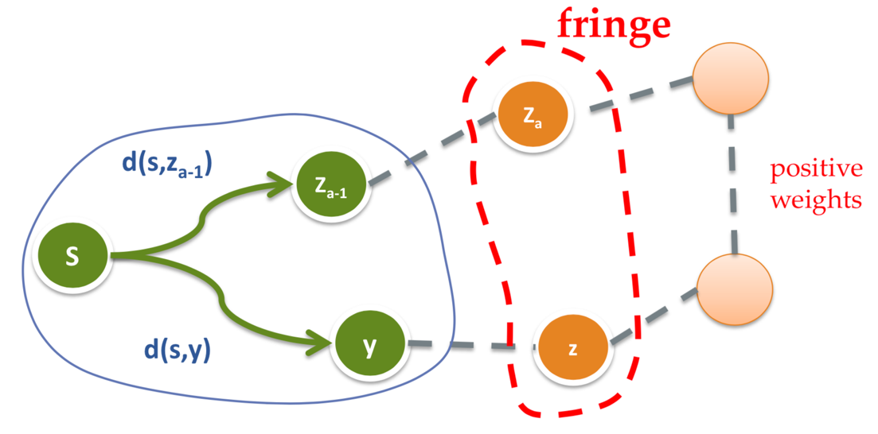
Dijkstra Algorithm’s Correctness
Dijkstra is now deleting z from the priority queue. We need to prove s-y-z is the shortest path from s to z.
The shortest paths from s to these vertices have been correctly computed by Dijkstra
Non-negative weights

Slide 15


Dijkstra vs. Prim
Main Procedure
dijkstra(G, n, s)
Initialize the priority queue pq as empty;
Initialize the status of each node as unseen;
Initialize edge set SSSP as empty;
Set s.ssspEdge as NULL;
Set s.status as fringe;
insert(pq, s, 0);
while (pq is not empty)
v=getMin(pq);
Set v.dis as getPriorty(pq, v);
Set v.status as finished;
deleteMin(pq);
Add v.ssspEdge to SSSP;
updateFringe(pq, G, v);
return
Main Procedure
prim(G, n)
Initialize the priority queue pq as empty;
Initialize the status of each node as unseen;
Initialize edge set MST as empty;
Select an arbitrary vertex s to start;
Set s.candidateEdge as NULL;
Set s.status as fringe;
insert(pq, s, 0);
while (pq is not empty)
v=getMin(pq); deleteMin(pq);
Add v.candidateEdge to MST;
Set v.status as finished;
updateFringe(pq, G, v);
return

Slide 16
Dijkstra vs. Prim
Updating the Queue
updateFringe(pq, G, v)
For each vertice w that is not finished and is adjcaent to v
newWgt = v.dis + vw.weight;
if w.status is unseen then
Set w.status as fringe;
Set w.ssspEdge as vw;
insert(pq, w, newWgt);
else
if newWgt < getPriorty(pq, w)
Change w.ssspEdge to vw;
decreaseKey(pq, w, newWgt);
return
Updating the Queue
updateFringe(pq, G, v)
For each vertice w that is not finished and is adjcaent to v
newWgt = vw.weight;
if w.status is unseen then
Set w.status as fringe;
Set w.candidateEdge as vw;
insert(pq, w, newWgt);
else
if newWgt < getPriorty(pq, w)
Change w.candidateEdge to vw;
decreaseKey(pq, w, newWgt);
return

Slide 17
The Dijkstra Skeleton
Single-source shortest path (SSSP)
SSSP + node weight constraint
E.g. in routing
Each router has its cost (node cost)
Each route has its cost (edge cost)
SSSP + capacity constraint
The “pipe problem”
Maximize the min edge weight
The “electric vehicle problem”
Minimize the max edge weight
“Dijkstra Skeleton”

Slide 18
Solve SSSP + node weight constraint using Dijkstra skeleton
Main Procedure
dijkstra_route(G, n, s)
Initialize the priority queue pq as empty;
Initialize the status of each node as unseen;
Initialize edge set Route as empty;
Set s.routeEdge as NULL;
Set s.status as fringe;
insert(pq, s, s.weight);
while (pq is not empty)
v=getMin(pq);
Set v.dis as getPriorty(pq, v);
Set v.status as finished;
deleteMin(pq);
Add v.routeEdge to Route;
updateFringe(pq, G, v);
return
Updating the Queue
updateFringe(pq, G, v)
For each vertice w that is not finished and is adjcaent to v
newWgt = v.dis + vw.weight + w.weight;
if w.status is unseen then
Set w.status as fringe;
Set w.routeEdge as vw;
insert(pq, w, newWgt);
else
if newWgt < getPriorty(pq, w)
Change w.routeEdge to vw;
decreaseKey(pq, w, newWgt);
return

Slide 19
SSSP + node weight constraint
The number next to A/B/…/G on each vertex is the node weight of each node.
Red labels on each vertex is the weight of the shortest path from s to the vertex.
5
2
4
B4
C2
7
1
2
5
3
1
11
8
7
12
11
A3
s
0
G5
3
D6
2
4
4
3
4
6
7
5
15
F3
E3

Slide 20
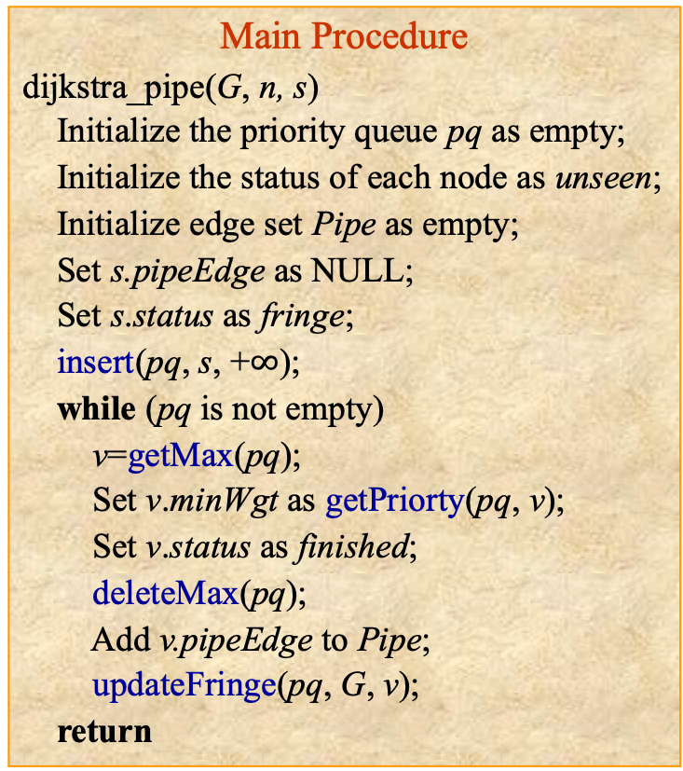
Solve the “pipe problem” (Maximize the min edge weight) using Dijkstra skeleton
Main Procedure
dijkstra_pipe(G, n, s)
Initialize the priority queue pq as empty;
Initialize the status of each node as unseen;
Initialize edge set Pipe as empty;
Set s.pipeEdge as NULL;
Set s.status as fringe;
insert(pq, s, +$∞$);
while (pq is not empty)
v=getMax(pq);
Set v.minWgt as getPriorty(pq, v);
Set v.status as finished;
deleteMax(pq);
Add v.pipeEdge to Pipe;
updateFringe(pq, G, v);
return
Updating the Queue
updateFringe(pq, G, v)
For each vertice w that is not finished and is adjcaent to v
newWgt = min{v.minWgt, vw.weight};
if w.status is unseen then
Set w.status as fringe;
Set w.pipeEdge as vw;
insert(pq, w, newWgt);
else
if newWgt > getPriorty(pq, w)
Change w.pipeEdge to vw;
increaseKey(pq, w, newWgt);
return

Slide 21
Solve the “pipe problem” (Maximize the min edge weight) using Dijkstra skeleton
Red labels on each vertex is the min edge weight from s to the vertex.
7
3
2
C
B
7
5
3
1
1
2
8
8
7
7
5
A
s
0
G
3
D
4
3
4
2
4
6
F
5
5
5
E

Slide 22
Solve “electric vehicle problem" (Minimize the max edge weight) using Dijkstra skeleton
Main Procedure
dijkstra_ev(G, n, s)
Initialize the priority queue pq as empty;
Initialize the status of each node as unseen;
Initialize edge set EV as empty;
Set s.evEdge as NULL;
Set s.status as fringe;
insert(pq, s, 0);
while (pq is not empty)
v=getMin(pq);
Set v.maxWgt as getPriorty(pq, v);
Set v.status as finished;
deleteMin(pq);
Add v.evEdge to EV;
updateFringe(pq, G, v);
return
Updating the Queue
updateFringe(pq, G, v)
For each vertice w that is not finished and is adjcaent to v
newWgt = max{v.maxWgt, vw.weight};
if w.status is unseen then
Set w.status as fringe;
Set w.evEdge as vw;
insert(pq, w, newWgt);
else
if newWgt < getPriorty(pq, w)
Change w.evEdge to vw;
decreaseKey(pq, w, newWgt);
return

Slide 23
Single-source Shortest Paths in DAG
DAG-SHORTEST-PATHS (G, s)
1 Topologically sort the vertices of G
2 Initialize the distance of each node as a sufficiently large number
3 s.distance = 0
4 for each vertex u, taken in the topologically sorted order
5 for each directed edge uv
6 if v.distance > u.distance + weight(u, v)
7 v.distance = u.distance + weight(u, v)
8 v.parent = u
RELAX(u, v)

Slide 24
The Correctness of the Algorithm
Assuming the topological order is v₁, v₂, …, v_{n}
Induction on the vertices in the topologic order
Question: How about the negative weights in DAG?
DAG中没有环；
拓扑序可以保证负权值不会出错，类似于Bellman-ford。
我们后面再次从动态规划的角度来解决这个问题。
Notes:
根据拓扑序进行relax是可以得到正确结果的。

Slide 25
Framework for Greedy Algorithms
At each stage, we have a partial solution which can be extended to a larger solution.
We have a set of choices for this next step and we select a “good” choice to extend the solution.
We have some sort of predefined measure of what a good choice is.
Take the “best” choice under that measure.
Repeat until a complete solution is obtained.

Slide 26
Scheduling Activities
Instance: a set of n activities, each with start time s_{i} and finishing time f_{i}
Problem: find the subset of activities with the maximum number of non-overlapping activities.
We say activities i and j are compatible if they do not overlap (i.e.: s_{i} ≥ f_{j} or s_{j} ≥ f_{i})
Notes:
1。最早开始时间
2。最小时间区间
3。最小不相容个数（提问：举出反例）
4。最小结束时间

Slide 27
3 Simple (and not optimal) Ideas
Earliest start time first
Shortest activity first
Least conflicting activity first
Notes:
1。最早开始时间
2。最小时间区间
3。最小不相容个数（提问：举出反例）
4。最小结束时间

Slide 28
A Scheduling Algorithm
Sort activities by finish time.
Choose first activity.
Repeatedly choose the next activity that is compatible with all previously chosen ones.
Running time: ϴ(n log n) time to sort, ϴ(n) time for the rest.
How do we prove this is correct?

Slide 29
Notation
Let S = {a₁, a₂, …, a_{n}} be the list of activities.
Assume each activity is represented by a half-open interval, i.e.: a_{i} = [s(a_{i}), f(a_{i})).
Sort the list of activities such that
f(a₁) < f(a₂) < f(a₃) < … < f(a_{n}).
So compatibility of a_{i} and a_{k} implies that:
s(a_{k}) > f(a_{i}) or s(a_{i}) > f(a_{k}).
That is, they do not overlap.

Slide 30
The Greedy Algorithm Objective
Greedy selection scans the sorted activities and always chooses the earliest finishing activity that is compatible with all previously selected activities.
The scan has cost O(n).
At each step this greedy strategy will maximize the amount of unscheduled remaining time.
We now show that this strategy will derive an optimal set of activities (it is impossible to find a larger set of activities that are mutually compatible).
Note: The activity problem may have several optimal solutions (of course each optimal solution has the same number of activities).
Notes:
1、Greedy策略扫描已排序的活动，并总是选择满足约束条件且结束时间最早的活动。
1-1扫描代价O（n）；
1-2每一次调度，总是使得留下的时间最多。
2、证明该策略是最佳策略，也就是，不可能找到满足约束的更多活动构成的集合。

Slide 31
Notations
Suppose greedy selection has chosen activities:
G = {g₁, g₂, g₃, …, g_{m}} where each g_{i} is some a_{k}. G is sorted by finishing time, i.e. f(g_{i}) < f(g_{i+1}).
Suppose one of the optimal solution is:
O = {j₁, j₂, j₃, …, j_{z}} where each j_{i} is some a_{k}. O is sorted by finishing time, i.e. f(j_{i}) < f(j_{i+1}).
We will show by induction that m=z.
Notes:
Exchange argument

Slide 32
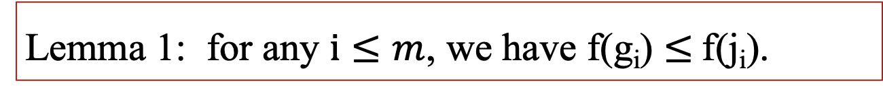
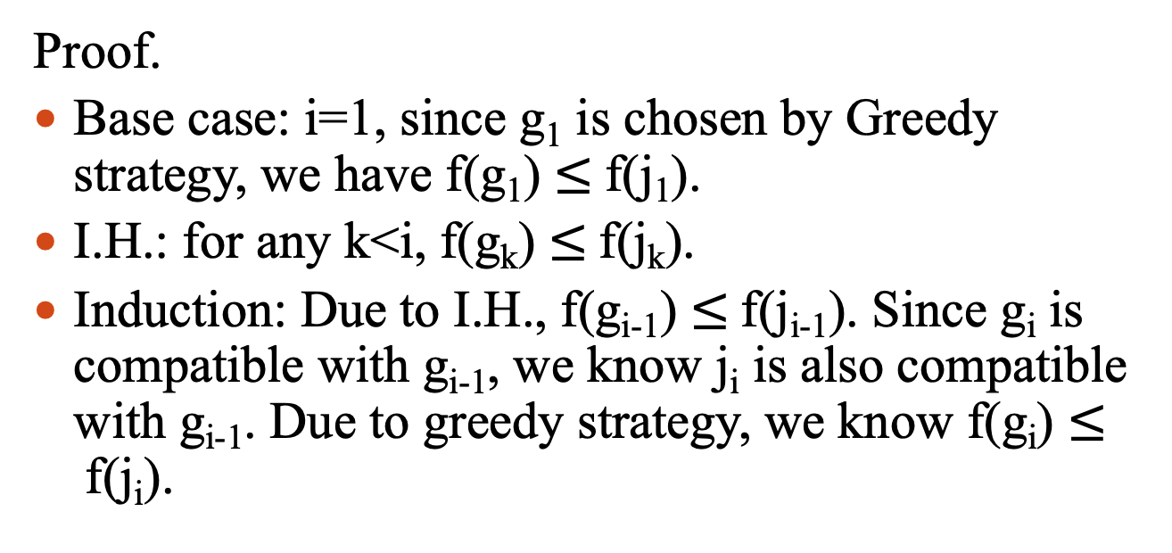
Lemma 1: for any $i≤m$, we have f(g_{i}) $≤$f(j_{i}).
Greedy Solution: G = {g₁, g₂, g₃, …, g_{m}}
Optimal Solution: O = {j₁, j₂, j₃, …, j_{z}}
Proof.
Base case: i=1, since g₁ is chosen by Greedy strategy, we have f(g₁) $≤$f(j₁).
I.H.: for any k<i, f(g_{k}) $≤$f(j_{k}).
Induction: Due to I.H., f(g_{i-1}) $≤$f(j_{i-1}). Since g_{i} is compatible with g_{i-1}, we know j_{i} is also compatible with g_{i-1}. Due to greedy strategy, we know f(g_{i}) $≤$f(j_{i}).
Notes:
Exchange argument

Slide 33
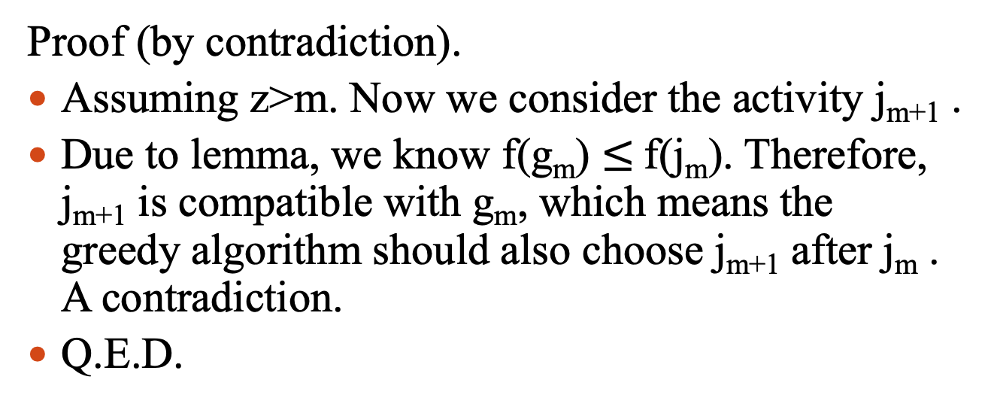
Theorem 1: Greedy selection will produce an optimal solution for the activity selection problem, i.e., m=z.
Greedy Solution: G = {g₁, g₂, g₃, …, g_{m}}
Optimal Solution: O = {j₁, j₂, j₃, …, j_{z}}
Proof (by contradiction).
Assuming z>m. Now we consider the activity j_{m+1} .
Due to lemma, we know f(g_{m}) $≤$f(j_{m}). Therefore, j_{m+1} is compatible with g_{m}, which means the greedy algorithm should also choose j_{m+1} after j_{m} . A contradiction.
Q.E.D.
Notes:
Exchange argument

Slide 34
钢管切割问题
有一根长度为n的钢管，需要切成小段后零售，而市场上对不同长度的钢管有不同的价格，如下所示
设计一个贪心算法求解该问题。
该贪心算法是否一定能得到最优解？
长度 | 1 | 2 | 3 | 4 | 5 | 6 | 7 | 8 | 9 | 10
价格 | 1 | 5 | 8 | 9 | 10 | 17 | 17 | 20 | 24 | 30
（1） 价格/长度=单位价格；贪心地选择单位价格最大的方式切割；例如该问题中单位价格分别为
1，2.5，2.67，2.25，2，2.83，2.43，2.5，2.67，3
当n=38时，先切3个长度为10的，再切1个长度为6的，最后切1个长度为2的。
（2）不一定。例如，n=4, 该算法结果为{3,1}，价格为9，最优方案则为{2,2}=10

