Slide 1
All-Pairs Shortest Paths (APSP)
张胜
sheng@nju.edu.cn
南京大学

Slide 2
In this class
All-pairs shortest paths (APSP)
Shortest path and transitive closure
Warshall algorithm for transitive closure
Warshall algorithm
Floyd algorithm for shortest paths
Bellman-ford algorithm
Multiplication of Boolean Matrices

Slide 3
We are going to answer the following two questions in this class
For each pair of vertices in a graph, say, u, v:
Is there a path from u to v?
What is the shortest path from u to v?

Slide 4
For each pair of vertices u, v in a graph, is there
a path from u to v?

Slide 5
For each pair of vertices u, v in a graph, is there
a path from u to v?
Reachability as a (reflexive) transitive closure of the adjacency relation, which can be represented as a bit matrix
To compute transitive closure, we present three algorithms
Brute Force (BF) 1: Shortcut Algorithm
BF2: Enumerate all edges
BF3: Enumerate all path lengths

Slide 6
Transitive Closure by Shortcuts
The idea: if there are edges s_{i}s_{k}, s_{k}s_{j}, then an edge s_{i}s_{j}, i.e., the “shortcut”, is inserted.
1
2
1
2
1
2
5
3
5
3
5
3
4
4
4
Pass one
Pass two
不多、不少

Slide 7
BF1: Shortcut Algorithm
Input: A, an n×n boolean matrix that represents a binary relation
Output: R, the boolean matrix for the transitive closure of A
Procedure
void simpleTransitiveClosure(boolean[ ][ ] A, int n, boolean[ ][ ] R)
int i,j,k;
Copy A to R;
Set all main diagonal entries, r_{ii}, to true;
while (any entry of R changed in the previous round of loop)
for (i=1; i≤n; i++)
for (j=1; j≤n; j++)
for (k=1; k≤n; k++)
r_{ij}=r_{ij}∨(r_{ik}∧r_{kj})
O(n⁴)
The order of (i,j,k) matters

Slide 8
BF2: Enumerate all edges
for every u
Enumerate all edges (x,v)
v as the destination
Enumerate all possible sources u
u
x
v
While any entry of R changed
for all vertices u
for every edge (x,v)
r_{uv}=r_{uv} ∨ (r_{ux} ∧ r_{xv})
for each edge xv
n-1 round
iteration
O(n²m)

Slide 9
BF3: Enumerate all path lengths
Recursion
Reachable via at most k edges
Enumeration
Enumerate all path lengths
Enumerate all sources and destinations
for every u
u
k path
O(n⁴)
k-1 path
1 path
for k=1 to n-1
for all vertices u
for all vertices v
for all vertices x such that there is an edge xv
r^{k}_{uv} = r^{k-1}_{uv} ∨ (r^{k-1}_{ux} ∧ r_{xv})
x
v
for every x
for every v
r_{xv} = 1

Slide 10
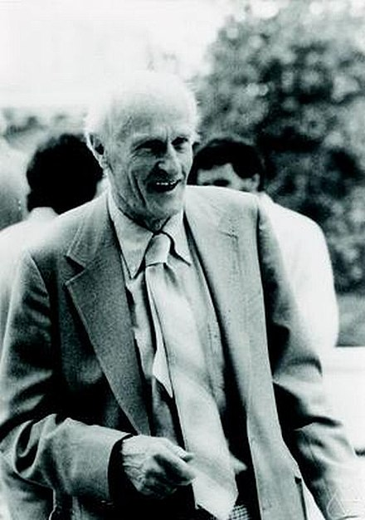
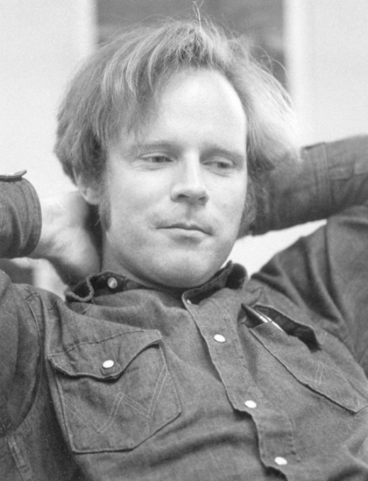
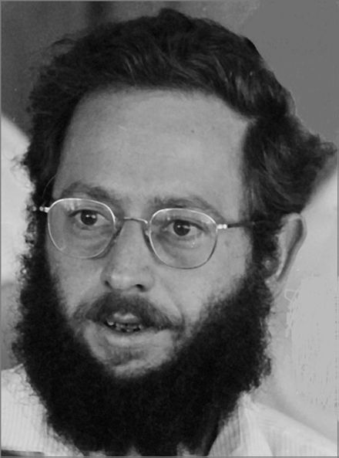
The Kleene-Floyd-Warshall Algorithm
Stephen Kleene
(1909 - 1994)
Formal language theory
Robert W Floyd
(1936 - 2001)
APSP
Stephen Warshall
(1935 - 2006)
Transitive closure

Slide 11
Change the Order: the Warshall Algorithm
void Warshall(boolean[][] A, int n, boolean[][] R)
int i,j,k;
Copy A to R;
Set all main diagonal entries, r_{ii}, to true;
for (k=1; k≤n; k++)
for (i=1; i≤n; i++)
for (j=1; j≤n; j++)
r_{ij}=r_{ij}∨(r_{ik}∧r_{kj})
k varys in the outmost loop

Slide 12
Why the Warshall Algorithm Works
<k,i,j> or <i,j,k>
The order matters
That’s why Dijkstra fails

Slide 13
Correctness of the Warshall Algorithm
Notation:
The value of r_{ij} changes during the execution of the body of the “for k…” loop
After initializations: r_{ij}⁽⁰⁾
After the k^{th} time of execution: r_{ij}^{(k)}

Slide 14
Correctness of the Warshall Algorithm
If there is a simple path from s_{i} to s_{j} (i≠j) in which the highest-numbered intermediate vertex is s_{k}, then r_{ij}^{(k)}=true.
Proof by induction:
Base case: r_{ij}⁽⁰⁾=true if and only if s_{i}s_{j}∈E
Hypothesis: the conclusion holds for h<k(h≥0)
Induction: the simple s_{i}s_{j}-path can be looked as s_{i}s_{k}-path+s_{k}s_{j}-path, with the indices h1, h2 of the highest-numbered intermediate vertices of both segment strictly (simple path) less than k. So, r_{ik}^{(h1)}=true, r_{kj}^{(h2)}=true, then r_{ik}^{(k-1)}=true, r_{kj}^{(k-1)}=true(Remember, false to true can not be reversed). So, r_{ij}^{(k)}=true

Slide 15
Highest-numbered Intermediate Vertex
The highest intermediate vertex in the intervals (s_{i}s_{k}), (s_{k}s_{j}) are both less than s_{k}
s_{j}
s_{k}
s_{i}
A specific order is assumed for all vertices
Vertical position of vertices reflect their vertex numbers
r_{ij}=r_{ij}∨(r_{ik}∧r_{kj})

Slide 16
Correctness of the Warshall Algorithm
If r_{ij}^{(k)}=true, then there is a (s_{i}, s_{j})^{(k)} path
Proof
If r_{ij}⁽⁰⁾=true, then there is (s_{i},s_{j})⁽⁰⁾ path
If r_{ij} first becomes true in round k, then
r_{ik}^{(k-1)} = true, r_{kj}^{(k-1)} = true
We have a “s_{i}->s_{k}->s_{j}” path
Intermediate nodes in {1, 2, …, k-1} ∪ {k}

Slide 17
For each pair of vertices u, v in a graph,
what is the shortest path from u to v?

Slide 18
All-pairs Shortest Paths
Shortest path property
If a shortest path from x to z consisting of path P from x to y followed by path Q from y to z. Then P is a shortest xy-path, and Q, a shortest yz-path.
The matrix representing the reachability of a graph can easily be transformed into a (minimum) distance matrix D
(just replacing 1 by edge weight, 0 by infinity,
and setting main diagonal elements as 0)

Slide 19
Computing the Distance Matrix
Basic formula:
D⁽⁰⁾[i][j]=w_{ij}
D^{(k)}[i][j]=min(D^{(k-1)}[i][j], D^{(k-1)}[i][k]+ D^{(k-1)}[k][j])
Basic property:
D^{(k)}[i][j] = d_{ij}^{(k)}
where d_{ij}^{(k)} is the weight of a shortest path from v_{i} to v_{j} with highest numbered intermediate vertex v_{k}.

Slide 20
All-pairs Shortest Paths
Floyd algorithm
Only slight changes on Washall’s algorithm.
Void allPairsShortestPaths(float [][] W, int n, float [][] D)
int i, j, k;
Copy W into D;
for (k=1; k≤n; k++)
for (i=1; i≤n; i++)
for (j=1; j≤n; j++)
D[i][j] = min (D[i][j], D[i][k]+D[k][j]);

Slide 21
All-pairs Shortest Paths
Construction of the routing table
Forward, backward
APSP + capacity constraints
The pipeline problem
Maximize the min edge weight
The electric vehicle problem
Minimize the max edge weight
Floyd algorithm => Floyd skeleton

Slide 22
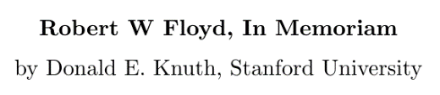
Floyd’s Lemma
组合问题的优良算法具有巨大回报，这个事实激励了技术水平的突飞猛进。… … 大约从1970年起，计算机科学家们经历了所谓的‘Floyd引理’现象：看似需用n³次运算的问题实际上可能用O(n²)次运算就能求解，看似需用n²次运算的问题实际上可能用O(nlogn)次运算就能处理，而且nlogn通常还可以减少到O(n)。一些更难的问题的运行时间也从O(2^{n})减少到O(1.5^{n})，再减少到O(1.3^{n})，等等。
- Knuth, Volumn4A, TAOCP

Slide 23
Negative Weight
5
6
“shortest path” is not well defined
11
-2
1
1
Negative weight cycle
1
-5

Slide 24
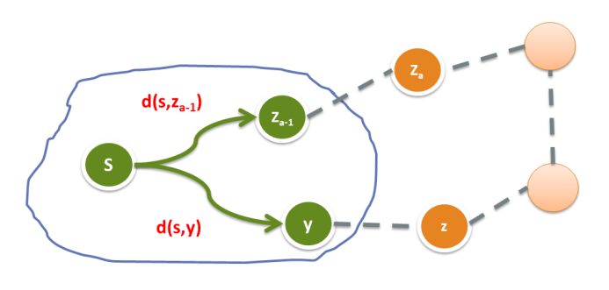
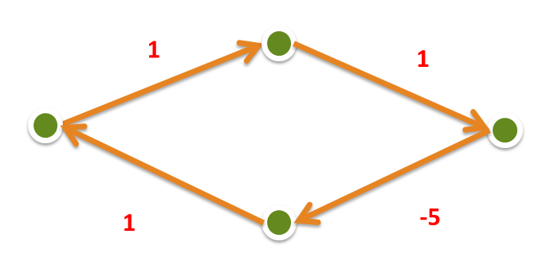
Negative Weight
Can the shortest path algorithm work correctly?
Dijkstra algorithm
No negative weight edge
Floyd algorithm
No negative weight cycle
Bellman-Ford algorithm
Solves SSSP and detects negative cycles

Slide 25
Solve SSSP and detect negative cycles

Slide 26
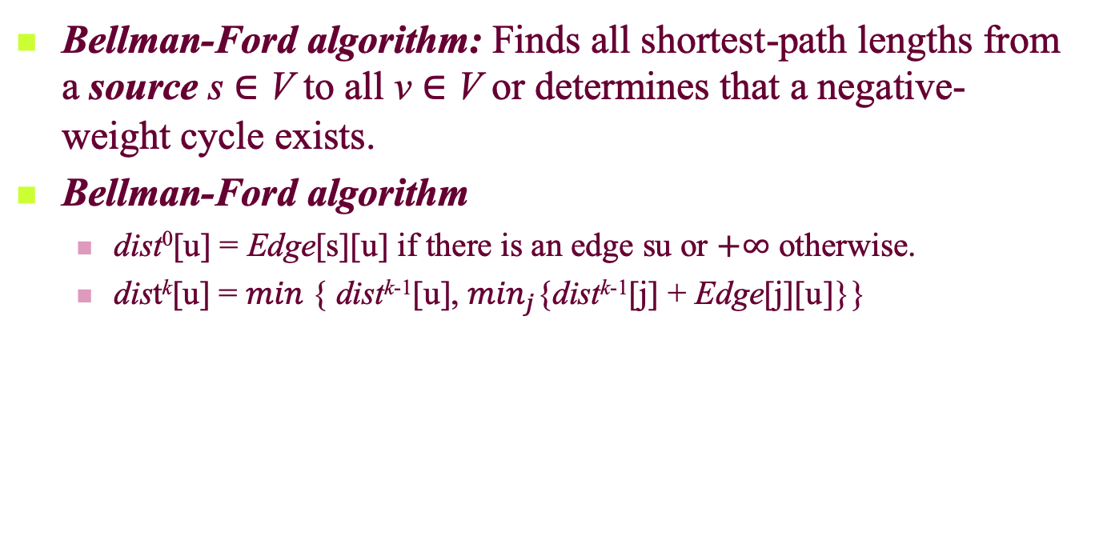
Shortest-path with Negative Weights
Bellman-Ford algorithm: Finds all shortest-path lengths from a source s ∈ V to all v ∈ V or determines that a negative-weight cycle exists.
Bellman-Ford algorithm
dist⁰[u] = Edge[s][u] if there is an edge su or $+∞$ otherwise.
dist^{k}[u] = $min⁡${ dist^{k-1}[u], $\min_{j}${dist^{k-1}[j] + Edge[j][u]}}

Slide 27
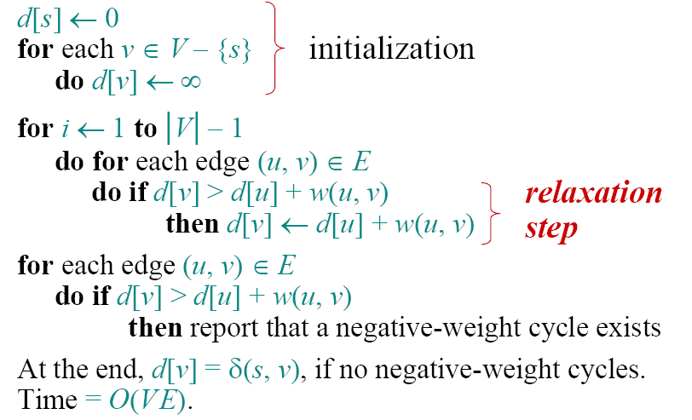
Bellman-Ford algorithm
Θ (n)
Θ (nm)
Θ (m)

Slide 28
Example of Bellman-Ford

Slide 29
Example of Bellman-Ford

Slide 30
Example of Bellman-Ford

Slide 31
Example of Bellman-Ford

Slide 32
Example of Bellman-Ford

Slide 33
Example of Bellman-Ford

Slide 34
Example of Bellman-Ford

Slide 35
Example of Bellman-Ford

Slide 36
Example of Bellman-Ford

Slide 37
Example of Bellman-Ford

Slide 38
Example of Bellman-Ford

Slide 39
Example of Bellman-Ford

Slide 40
Example of Bellman-Ford

Slide 41
Example of Bellman-Ford

Slide 42
Example of Bellman-Ford

Slide 43
Example of Bellman-Ford

Slide 44
Example of Bellman-Ford

Slide 45
Example of Bellman-Ford

Slide 46
Example of Bellman-Ford

Slide 47
Example of Bellman-Ford

Slide 48
Example of Bellman-Ford

Slide 49
Correctness of Bellman-Ford algorithm
Theorem. If G = (V, E) contains no negative-weight cycles, then after the Bellman-Ford algorithm executes, d[v] = δ(s, v) for all v ∈ V.
Proof. Let v ∈ V be any vertex, and consider a shortest path p from s to v.
Since p is a shortest path, we have
δ(s, v_{i}) = δ(s, v_{i–1}) + w(v_{i–1}, v_{i}).

Slide 50
Correctness (continued)
Initially, d[v₀] = 0 = δ(s, v₀), and d[v₀] is unchanged by subsequent relaxations.
After 1 pass through E, we have d[v₁] = δ(s, v₁).
After 2 passes through E, we have d[v₂] = δ(s, v₂).
…
After k passes through E, we have d[v_{k}] = δ(s, v_{k}).
Since G contains no negative-weight cycles, p is simple. Longest simple path has ≤ |V| – 1 edges.

Slide 51
Multiplication of Bit Matrix

Slide 52
Matrix Representation
Define family of matrix A^{(p)}:
a_{ij}^{(p)}=true if and only if there is a path of length p from s_{i} to s_{j}.
A⁽⁰⁾ is specified as identity matrix (main diagonal entries are 1’s). A⁽¹⁾ is exactly the adjacency matrix.
Note that a_{ij}⁽²⁾=true if and only if exists some s_{k}, such that both a_{ik}⁽¹⁾ and a_{kj}⁽¹⁾ are true. So, a_{ij}⁽²⁾=∨_{k=1,2,…,n} (a_{ik}⁽¹⁾∧a_{kj}⁽¹⁾), which is an entry in the Boolean matrix product.

Slide 53
Boolean Matrix Operations
Boolean matrix product C=AB as:
c_{ij}=∨_{k=1,2,…,n}(a_{ik}∧b_{kj})
Boolean matrix sum D=A+B as:
d_{ij}=a_{ij}∨b_{ij}
R, the transitive closure matrix of A, is the sum of all A^{p}, p is a non-negative integer.
For a digraph with n vertices, the length of the longest simple path is no larger than n-1.

Slide 54
Bit Matrix
A bit string of length n is a sequence of n bits occupying contiguous storage(word boundary) (usually, n is larger than the word length of a computer)
If A is a bit matrix of n×n, then A[i] denotes the ith row of A which is a bit string of length n. a_{ij} is the jth bit of A[i].
The procedure bitwiseOR(a,b,n) compute a∨b bitwise for n bits, leaving the result in a.

Slide 55
bitwiseOR(a, b, n)
The procedure bitwiseOR(a,b,n) compute a∨b bitwise for n bits, leaving the result in a.
Example: n=5
a = 1 0 1 0 0
b = 1 1 0 0 1, then bitwiseOR(a, b, n) makes
a = 1 1 1 0 1

Slide 56
Straightforward Multiplication of Bit Matrix
Computing C=AB
<Initialize C to the zero matrix>
for (i=1; i≤n, i++)
for (k=1; k≤n, k++)
if (a_{ik}==true) bitwiseOR(C[i], B[k], n)
Thought as a union of sets (row union), n² row unions are done at most
In the case of a_{ik} is true, c_{ij}=a_{ik}b_{kj} is true iff. b_{kj} is true. As a result: C[i]=∪_{k∈A[i]}B[k], (A[i]={k|a_{ik}=true)
Union for B[k] is repeated each time when the kth bit is true in a different row of A.

Slide 57
Example
Computing C=AB
<Initialize C to the zero matrix>
for (i=1; i≤n, i++)
for (k=1; k≤n, k++)
if (a_{ik}==true) bitwiseOR(C[i], B[k], n)
$$A=\left[\begin{matrix}1 & \begin{matrix}0 & 1\end{matrix} \\ \begin{matrix}0 \\ 1\end{matrix} & \begin{matrix}\begin{matrix}1 \\ 0\end{matrix} & \begin{matrix}1 \\ 0\end{matrix}\end{matrix}\end{matrix}\right] B=\left[\begin{matrix}0 & \begin{matrix}0 & 1\end{matrix} \\ \begin{matrix}1 \\ 1\end{matrix} & \begin{matrix}\begin{matrix}0 \\ 0\end{matrix} & \begin{matrix}1 \\ 0\end{matrix}\end{matrix}\end{matrix}\right] C=\left[\begin{matrix}1 & \begin{matrix}0 & 1\end{matrix} \\ \begin{matrix}1 \\ 0\end{matrix} & \begin{matrix}\begin{matrix}0 \\ 0\end{matrix} & \begin{matrix}1 \\ 1\end{matrix}\end{matrix}\end{matrix}\right]$$
When i=1, C[1] = bitwiseOR(C[1], B[1], 3)
C[1] = bitwiseOR(C[1], B[3], 3)
In fact, the above operations are equal to
C[1] = B[1] $∪$B[3]
You can verify that
C[2] = B[2] $∪$B[3]
C[3] = B[1]

Slide 58
Reducing the Duplicates by Grouping
Multiplication of A, B, two 12×12 matrices
A₁
A₂
A₃
A₄
A₅
A₆
A₇
A₈
A₉
A₁₀
A₁₁
A₁₂
1 0 1 1 0 1 0 1 0 0 0 1
12 rows of B are divided evenly into 3 groups, with rows 1-4 in group 1, etc.
With each group, all possible unions of different rows are pre-computed. (This can be done with 11 unions if suitable order is assumed.)
When the first row of AB is computed, (B[1]∪B[3]∪B[4]) is used in stead of 3 different unions, and this combination is used in computing the 3rd and 7th rows as well.
1 0 1 1 1 0 0 1 1 0 1 1
0 1 0 1
1 0 1 1 1 0 0 1 1 1 1 0
Segment
Length t

Slide 59
Cost as Function of Group Size
Cost for the pre-computation
There are 2^{t} different combination of rows in one group, including an empty and t singleton. Note, in a suitable order, each combination can be made using only one union. So, the total number of union is g[2^{t}-(t+1)], where g=n/t is the number of group.
Cost for the generation of the product
In computing one of n rows of AB, at most one combination from each group is used. So, the total number of union is n(g-1)

Slide 60
Selecting Best Group Size
The total number of union done is:
g[2^{t}-(t+1)]+n(g-1) ≈ (n2^{t})/t+n²/t (Note: g=n/t )
Trying to minimize the number of union
Assuming that the first term is of higher order:
Then t≥lgn, and the least value is reached when t=lgn.
Assuming that the second term is of higher order:
Then t≤lgn, and the least value is reached when t=lgn.
So, when t≈lgn, the number of union is roughly 2n²/lgn, which is of lower order than n². We use t=⎣lgn⎦
For symplicity, exact power for n is assumed

Slide 61
The Segmentation for Matrix A
The n×n array
1 2 … … t t+1 … … 2t … … (j-1)t+1 … jt …
A_{i}
bitSeg(A[i],1,t)
bitSeg(A[i],2,t)
bitSeg(A[i],j,t)
Bit string of length t, looked as a t-bit integer

Slide 62


An Example
bitSeg(A[7], 1, t)
= 1011₂ = 11
Group 1
(1…t)
Group 2
(t+1…2t)
Group 3
(2t+1…3t)
A₁A₂A₃A₄A₅A₆A₇A₈A₉A₁₀A₁₁A₁₂
B₁B₂B₃B₄B₅B₆B₇B₈B₉B₁₀B₁₁B₁₂
any union combination of {B₁,B₂,B₃,B₄}, totaling 16, 11 computed
Group 1
(1…t)
any union combination of {B₅,B₆,B₇,B₈}, totaling 16, 11 computed
Group 2
(t+1…2t)
any union combination of {B₉,B₁₀,B₁₁,B₁₂}, totaling 16, 11 computed
Group 3
(2t+1…3t)
t=4
Where to store?

Slide 63
Storage of the Row Combinations
Using one large 2-dimensional array
Goals
keep all unions generated
provide indexing for using
Coding within a group
One-to-one correspondence between a bit string of length t and one union for a subset of a set of t elements
Establishing indexing for union required
When constructing a row of AB, a segment can be notated as a integer. Use it as index.

Slide 64

Storage the Unions
allUnion
one row for one group
column indexed by bitSeg(A[i],j,t)
……
i,j,k stands for B_{i}∪B_{j}∪B_{k}

Slide 65
Array for Row Combinations
The array: allUnions
Containing in each row the union, of which the code is exactly i, looked as a t-bit binary number.
column i
row j
Indexed by segment coding for Matrix A
Containing all possible row combinations, totaling 2^{t}, within jth group of B

Slide 66
Sketch for the Procedure
t=⎣lgn⎦; g=⎡n/t⎤;
<Compute and store in allUnions unions of all combinations of rows of B>
for (i=1; i≤n; i++)
<Initialize C[i] to 0>
for (j=1; j≤g; j++)
C[i] = C[i] ∪ allUnions[j][bitSeg(A[i],j,t)]

Slide 67
Kronrod Algorithm
Input: A,B and n, where A and B are n×n bit matrices.
Output: C, the Boolean matrix product.
Procedure
The processing order has been changed, from “row by row” to “group by group”, resulting the reduction of storage space for unions.

Slide 68
Complexity of the Kronrod Algorithm
For computing all unions within a group, 2^{t}-1 union operations are done.
One union is bitwiseOR’ed to n row of C
So, altogether, (n/t)(2^{t}-1+n) row unions are done.
The cost of row union is ⎡n/w⎤ bitwise or operations, where w is word size of bitwise or instruction dependent constant.

