Slide 1
Dynamic Programming – MatrixOrder
张胜
sheng@nju.edu.cn
南京大学

Slide 2
Dynamic Programming
Motivation
Recursion and Subproblem Graph
Solution
Dynamic Programming
Example
Least Cost of Matrix Multiplication

Slide 3
Natural Recursion may be Expensive
1
6
The cost for recursion may be exponential.
2
17
5
4
3
12
18
23
4
3
3
2
The number of subproblems for computing F_{n} is 2F_{n}-1
13
16
19
22
4
9
1
3
2
2
2
1
1
0
24
25
5
8
15
20
21
2
1
1
0
1
0
1
0
10
11
14
6
7
1
0
Fibonacci: F_{n}= F_{n-1}+F_{n-2}
F₁=F₀=1
For your reference
1, 1, 2, 3, 5, 8, 13, 21, 35, ...
Notes:
Why 2F_{n+1}-1? 可用数学归纳法对n证明

Slide 4
Subproblem Graph
For any known recursive algorithm A for a specific problem P, a subproblem graph is defined as:
vertex: an instance of the problem
directed edge: the subproblem graph contains a directed edge I→J if and only if when A invoked on I, it makes a recursive call directly on instance J. (In other words, solving I relies on the solution of J.)

Slide 5
Subproblem Graph
Let P be a problem instance for algorithm A, then the subproblem graph for A(P) is the portion of the subproblem graph for A that is reachable from vertex P.
Here is fib(6)
6
5
4
3
2
1
0

Slide 6
Properties of Subproblem Graph
If A always terminates, the subproblem graph for A is a DAG.
For each path in the tree of activation frames of a particular call of A, say A(P), there is a corresponding path in the subproblem graph of A connecting vertex P and a base-case vertex.
A top-level recursive computation traverse the entire subproblem graph in some memoryless style.
The subproblem graph can be viewed as a dependency graph of subtasks to be solved.
Notes:
1。子问题图是一个DAG
2。对任意A（P）都有一个P到base-case的路径
3。顶层的递归计算以无记忆的方式在子问题图中运动
4。子问题图可以被视为一个子任务依赖图

Slide 7
Dynamic Programming Version DP(A) of a Recursive Algorithm A
Case 1: White Q
Case 2: Black Q
an instance, Q, to be called on
a instance, Q, to be called on
To backtracking, record the result into the dictionary (Q, turned black)
Q
Q
Q is finished (black), only “checking” the edge, retrieve the result from the dictionary
Q is undiscovered (white), go ahead with the recursive call
Note: for DAG, no gray vertex will be met
Notes:
回顾树的遍历中DFS的3类非树边。只有back edge才可能碰到灰色节点，也才可能形成环。

Slide 8
DP(fib): an Example
fibDP(soln,k)
int fib, f1, f2;
if (k<2) fib=1;
else
if (member(soln, k-1)==false)
f1=fibDP(soln, k-1);
else
f1= retrieve(soln, k-1);
if (member(soln, k-2)==false)
f2=fibDP(soln, k-2);
else
f2= retrieve(soln, k-2);
fib=f1+f2;
store(soln, k, fib);
return fib
fibDPwrap(n)
Dict soln=create(n);
return fibDP(soln,n)
This is the wrapper, which will contain processing existing in original recursive algorithm wrapper.

Slide 9
Basic Idea for Dynamic Programming
Computing each subproblem only once
Find a reverse topological order for the subproblem graph
In most cases, the order can be determined by particular knowledge of the problem.
For general cases, we can use DFS.
Solve the subproblems according to the reverse topological order
Record the subproblem solutions for later use
Notes:
1。逆拓扑序列
2。以逆拓扑序来调度
3。记住子问题的解

Slide 10
Matrix Multiplication Order Problem
The task:
Find the product: A₁×A₂×…×A_{n-1}×A_{n}
A_{i} is 2-dimentional array of different legal size
The issues:
Matrix multiplication is associative
Different computing orders probably result in great difference in the number of operations
The problem:
Find the best computing order that has the minimal cost

Slide 11
Cost of Matrix Multiplication
Let C = A_{p×q}×B_{q×r}
There are q multiplication
C has p×r elements as c_{i,j}
So, pqr multiplications altogether

Slide 12

Cost of Matrix Multiplication: Example
Let C = A_{p×q}×B_{q×r}
So, pqr multiplications altogether
An example: A₁ × A₂ × A₃ × A₄
30×1 1×40 40×10 10×25
((A₁×A₂)×A₃)×A₄: 20700 multiplications
A₁×(A₂×(A₃×A₄)): 11750
(A₁×A₂)×(A₃×A₄): 41200
A₁×((A₂×A₃)×A₄): 1400

Slide 13
Greedy is Good?
Strategy 1: “cheapest multiplication first”
Success: A_{30×1}×((A_{1×40}× A_{40×10})×A_{10×25})
Fail: (A_{4×1}×A_{1×100})×A_{100×5}
Strategy 2: “largest dimension first”
Success: A_{30×1}×((A_{1×40}× A_{40×10})×A_{10×25})
Success: A_{4×1}× ( A_{1×100}×A_{100×5} )
Fail: (A_{9×10}×A_{10×8}) × A_{8×1}
the cost is 792, while the optimal cost is 170

Slide 14
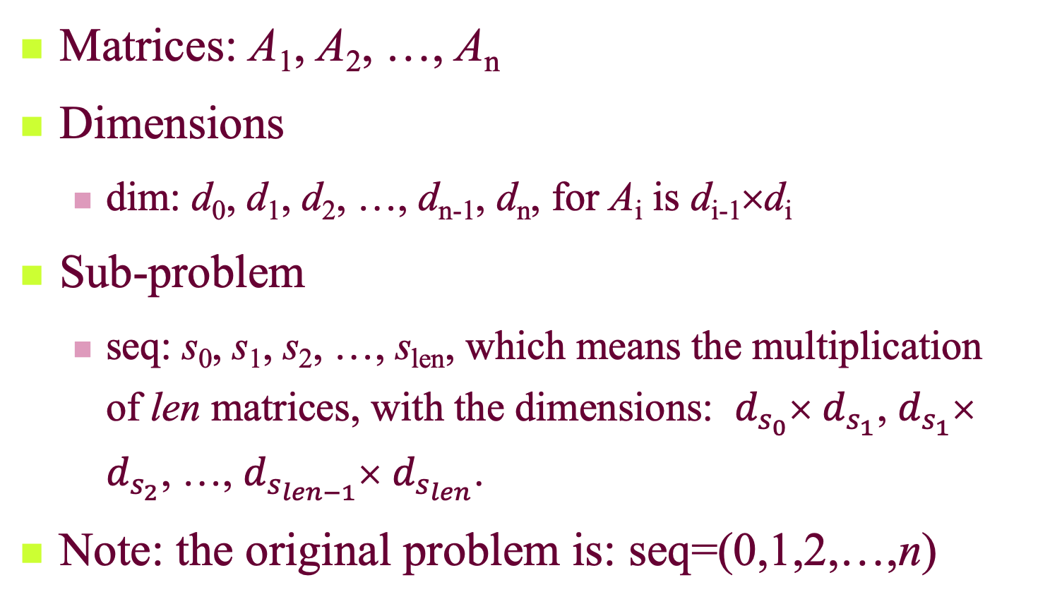
Problem and Subproblem: Intuition
Matrices: A₁, A₂, …, A_{n}
Dimensions
dim: d₀, d₁, d₂, …, d_{n-1}, d_{n}, for A_{i} is d_{i-1}×d_{i}
Sub-problem
seq: s₀, s₁, s₂, …, s_{len}, which means the multiplication of len matrices, with the dimensions: $d_{s_{0}}$× $d_{s_{1}}$, $d_{s_{1}}$× $d_{s_{2}}$, …, $d_{s_{len−1}}$× $d_{s_{len}}$.
Note: the original problem is: seq=(0,1,2,…,n)

Slide 15
Best Order for Minimal Cost: by Recursion
Recursion on index sequence:
(seq): 0, 1, 2, …, n (len=n)
with the kth matrix is A_{k} (k≠0) of the size d_{k-1}×d_{k}
mmTry1(dim, len, seq)
if (len<2) bestCost=0
else
bestCost=∞;
for (i=1; i≤len-1; i++)
c=cost of multiplication at position seq[i];
newSeq=seq with ith element deleted;
b=mmTry1(dim, len-1, newSeq);
bestCost=min(bestCost, b+c);
return bestCost
T(n)=(n-1)T(n-1)+ Θ (n), thus T(n) is in Θ((n-1)!)
Notes:
考虑哪个乘号先做

Slide 16
Constructing the Subproblem Graph
The key issue is: how can a sub-problem be denoted using a concise identifier?
For mmTry1, the difficulty originates from the varied intervals in each newSeq.
If we look at the last (contrast to the first) multiplication, the two (not one) resulted sub-problems are both contiguous subsequences, which can be uniquely determined by the pair:
<head-index, tail-index>

Slide 17
Best Order for Minimal Cost: by Recursion (Improved)
Only one matrix
mmTry2(dim, low, high)
if (high-low= =1) bestCost=0
else
bestCost=∞;
for (k=low+1; k≤high-1; k++)
a=mmTry2(dim, low, k);
b=mmTry2(dim, k, high);
c=cost of multiplication at position k;
bestCost=min(bestCost, a+b+c);
return bestCost
with dimensions: dim[low], dim[k], and dim[high]
T(n)=2 (T(n-1) + … + T(1)) + Θ (n) >2T(n-1), thus T(n) is Ω(2^{n})

Slide 18
Best Order for Minimal Cost: by Dynamic Programming
DFS can traverse the subproblem graph in time O(n³)
At most n²/2 vertices, as <i,j>, 0≤i<j≤n.
At most 2n edges leaving a vertex
mmTry2DP(dim, low, high, cost)
……
for (k=low+1; k≤high-1; k++)
if (member(low,k)==false) a=mmTry2DP(dim, low, k, cost);
else a=retrieve(cost, low, k);
if (member(k,high)==false) b=mmTry2DP(dim, k, high, cost);
else b=retrieve(cost, k, high);
……
store(cost, low, high, bestCost);
return bestCost
Corresponding to the recursive procedure of DFS
Notes:
1、最多n^2/2个点对（子问题）
2、最多2n条边从一个节点发出
Running time is \Theta(n^3)

Slide 19
Simplification Using Ordering Feature
matrixOrder(n, cost, last)
for (low=n-1; low≥0; low--)
for (high=low+1; high≤n; high++)
return cost[0][n]
For any subproblems: (low1, high1) depending on (low2, high2) if and only if low2≧low1, and high2≦high1
Computing subproblems according the dependency order
Compute solution of subproblem (low, high) and store it in cost[low][high] and last[low][high]

Slide 20
Matrix Multiplication Order: Algorithm
float matrixOrder(int[] dim, int n, int[] multOrder)
<initialization of last,cost,bestcost,bestlast…>
for (low=n-1; low≥0; low--)
for (high=low+1; high≤n; high++)
if (high-low==1) bestCost=0; bestLast=-1;
else bestcost=∞;
for (k=low+1; k≤high-1; k++)
a=cost[low][k];
b=cost[k][high]
c=multCost(dim[low], dim[k], dim[high]);
if (a+b+c<bestCost)
bestCost=a+b+c; bestLast=k;
cost[low][high]=bestCost;
last[low][high]=bestLast;
extrctOrderWrap(n, last, multOrder)
return cost[0][n]
Input: array dim =(d₀, d₁, …, d_{n}), the dimension of the matrices.
Output: array multOrder, of which the ith entry is the index of the ith multiplication in an optimum sequence.
Using the stored results

Slide 21
An Example
Last entry filled
Input: d₀=30, d₁=1, d₂=40, d₃=10, d₄=25
Note: cost[i][j] is the least cost of A_{i+1}×A_{i+2}×…A_{j}.
For each selected k, retrieving:
least cost of A_{i+1}×…×A_{k}.
least cost of A_{k+1}×…×A_{j}.
and computing:
cost of the last multiplication
0
1
2
3
4
0 1 2 3 4
First entry filled
cost as finished
Notes:
计算顺序：[3][4]=0，[2][3]=0，[2][4]=10000，[1][2]=0，[1][3]=400，[1][4]=min（[1][3]+[3][4]+1*10*25=650，[1][2]+[2][4]+1*40*25=20000）=650，
[0][1]=0，……[0][4]=[0][1]+[1][4]+30*1*25=0+650+750=1400

Slide 22
Array last and the Arithmetic-Expression Tree
Example input: d₀=30, d₁=1, d₂=40, d₃=10, d₄=25
last as finished
(0,4)
As root
×
(1,4)
0
1
2
3
4
×
A₁
(1,3)
(3,4)
(0,1)
×
A₄
Computing in post order
A₂
A₃
(1,2)
(2,3)
0 1 2 3 4

Slide 23

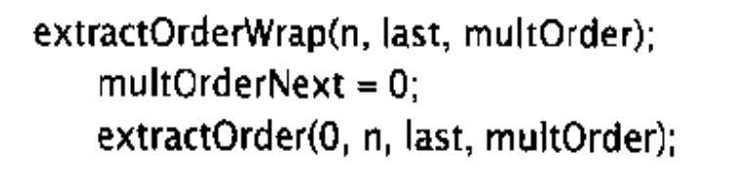
Extracting the Optimal Order
The core procedure is extractOrder, which fills the multiOrder array for subproblem (low,high), using informations in last array.
extractOrder(low, high, last, multOrder)
int k;
if (high-low>1)
k=last[low][high];
extractOrder(low, k, last, multOrder);
extractOrder(k, high, last, multOrder);
multOrder[multOrderNext]=k;
multOrderNext++;
Just a post-order traversal
initialized in the wrapper

Slide 24
Analysis of matrixOrder
Main body: 3 layer of loops
Time: the innermost processing costs is constant, thus, the total time complexity is Θ(n³).
Space: extra space for cost and last, both in Θ(n²)
Order extracting
There are 2n-1 nodes in the arithmetic-expression tree. For each node, extractOrder is called once. Since non-recursive cost for extractOrder is constant, so, the complexity of extractOrder is in Θ(n)

Slide 25
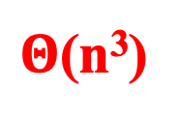
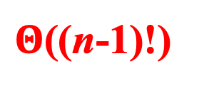
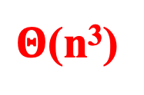
Summary from the Matrix Multiplication Problem
Better Decomposition
mmTry1
mmTry2
Ω(2^{n})
$Θ$((n-1)!)
DP using DFS
multiOrder
mmTry2DP
$Θ$(n³)
DP based on the understanding of the problem
$Θ$(n³)

Slide 26
A final note* (不作要求)
There is a $Θ$(n²) algorithm for determining the best multiplication order for a sequence of matrices. However, it is specialized to the cost function given by multiCost in multiOrder, whereas multiOrder does not depend on any particular cost function.
See more at Yao, F(1982). Speed-up in dynamic programming. SIAM journal on algebraic and discrete methods, 3(4):532-540

