Slide 1
Dynamic Programming
Algorithm : Design & Analysis [Tutorial]
张胜
sheng@nju.edu.cn
南京大学

Slide 2
Contents
Longest increasing subsequences
Programming? Actually, it is planning.
Recursion? No, thanks.
Longest common subsequence
The underlying DAG
Edit distance
Common subproblems decomposition
Knapsack with and without repetition
Memoization

Slide 3
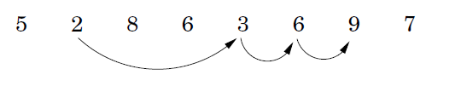
Longest increasing subsequences
The input is a sequence of numbers a₁,a₂,…,a_{n}.
A subsequence is any subset of these numbers taken in order, of the form a_{i1},a_{i2},…a_{ik} where 1<=i₁<=i₂<=…<=i_{k}<=n, and an increasing subsequence is one in which the numbers are getting strictly larger.
The task is to find the increasing subsequence of the greatest length.

Slide 4
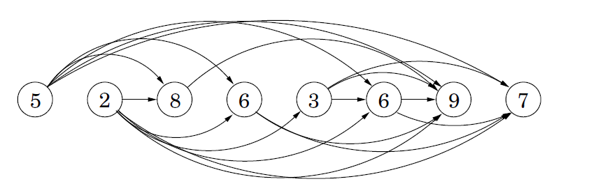
The dag of increasing subsequences
An edge from a_{i} to a_{j} iff. i<j and a_{i}<a_{j}
There is a 1-to-1 mapping between increasing subsequences and paths in this dag.
Our goal is simply to find the longest path in the dag!

Slide 5
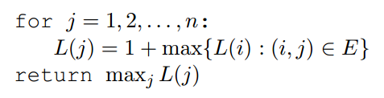
DP algorithm
Initialize all L(.) to 1, and process these vertices in linearized order

Slide 6
DP
In order to solve our original problem, we have defined a collection of subproblems with the following key property that allows them to be solved in a single pass:
There is an ordering on the subproblems, and a relation that shows how to solve a subproblem when given the answers to “smaller” subproblems that appear earlier in the ordering.

Slide 7
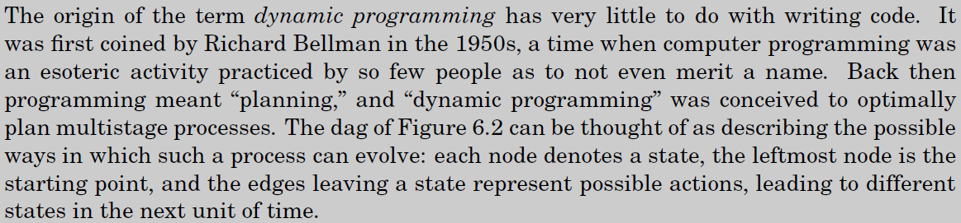
Programming?

Slide 8
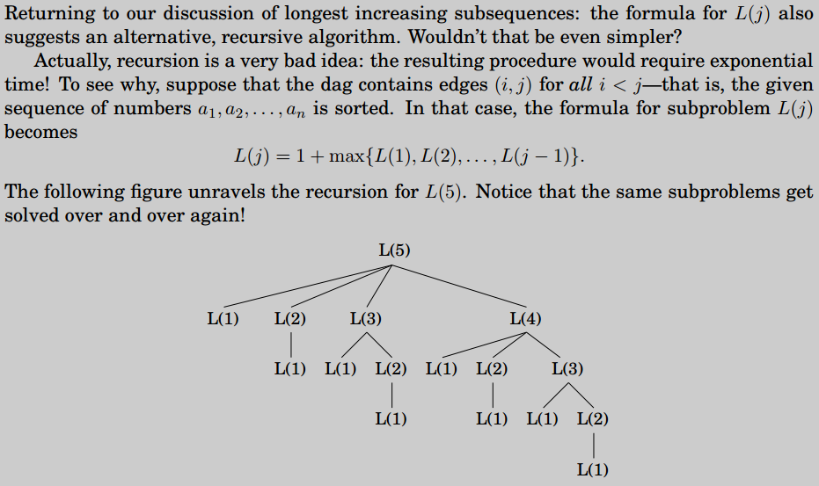
Recursion? No, thanks.

Slide 9
Why did recursion work so well with divide-and-conquer?
In divide-and-conquer, a problem is expressed in terms of subproblems that are substantially smaller, say half the size.
For example, in mergesort, n -> n/2
Thus, the recursion tree in a divide-and-conquer based algorithm probably has logarithmic depth.
In DP, a problem is reduced to subproblems that are only slightly smaller.

Slide 10
Subsequence
A subsequence of a given sequence is just the given sequence with zero or more elements left out.
Formally, given a sequence X = x₁, x₂, ..., x_{m}, another sequence Z = z₁, z₂, ..., z_{k} is a subsequence of X if there exists a strictly increasing sequence i₁,i₂, ..., i_{k} of indices of X such that for all j = 1, 2, ..., k, we have
x_{ij} = z_{j}
1 2 3 4 5 6 7
Example: X = A, B, C, B, D, A, B
Z = B C D B
Z = B, C, D, B is a subsequence of X with corresponding index sequence 2, 3, 5, 7.

Slide 11
Longest-Common-Subsequence Problem
Given two sequences X and Y , we say that a sequence Z is a common subsequence of X and Y if Z is a subsequence of both X and Y.
X = A, B, C, B, D, A, B
Y = B, D, C, A, B, A
Z = B, C, A is a common subsequence of both X and Y .
Longest-Common-Subsequence (LCS) problem: given two sequences X = x₁, x₂, ..., x_{m} and Y = y₁, y₂, ..., y_{n} and wish to find a maximum-length common subsequence of X and Y .

Slide 12
A brute-force approach
Enumerate all subsequences of X and check each subsequence to see if it is also a sub sequence of Y, keeping track of the longest subsequence found.
Subsequences of X ( m elements in X) → O (2^{m})

Slide 13
How to define a subproblem?

Slide 14
How to define a subproblem?
Longest-Common-Subsequence (LCS) problem: given two sequences X = x₁, x₂, ..., x_{m} and Y = y₁, y₂, ..., y_{n} and wish to find a maximum-length common subsequence of X and Y .
We use [i, j] to represent the following problem: find the LCS of x₁, x₂, ..., x_{i} and y₁, y₂, ..., y_{j}
Therefore, the problem we want to solve is [m, n]

Slide 15
How to use the solutions to small problems to construct the solution to a large problem?
We use [i, j] to represent the following problem: find the LCS of x₁, x₂, ..., x_{i} and y₁, y₂, ..., y_{j}
We use c[i, j] to represent the length of the LCS of x₁, x₂, ..., x_{i} and y₁, y₂, ..., y_{j}
Why?
Why?

Slide 16
Computing the length of an LCS
The recursive algorithm to compute the length of an LCS of two sequences needs exponential-time, while there are only Θ(mn) distinct subproblems in DP.
 | 0 | 1 | 2 | 3 | 4 | …
0 | 0
1
2
…
c [i, j]

Slide 17

The Algorithm based on DP
LCS-LENGTH(X, Y)
m ← length[X]
n ← length[Y]
for i ← 1 to m
do c[i, 0] ← 0
for j ← 0 to n
do c[0, j] ← 0
for i ← 1 to m
do for j ← 1 to n
do if x_{i} = y_{j}
then c[i, j] ← c[i - 1, j - 1] + 1
b[i, j] ← " "
else if c[i - 1, j] ≥ c[i, j - 1]
then c[i, j] ← c[i - 1, j]
b[i, j] ← "↑"
else c[i, j] ← c[i, j - 1]
b[i, j] ← "←"
return c and b
c[m, n] contains the length of an LCS of X and Y.
b[i, j] points to the table entry corresponding to the optimal subproblem solution chosen when computing c[i, j].
PRINT-LCS (b, X, i, j)
if i = 0 or j = 0
then return
if b[i, j] = " "
then PRINT-LCS(b, X, i - 1, j - 1)
print x_{i}
else if b[i, j] = "↑"
then PRINT-LCS(b, X, i - 1, j)
else PRINT-LCS(b, X, i, j - 1)
Θ(m+n)
Θ(mn)

Slide 18
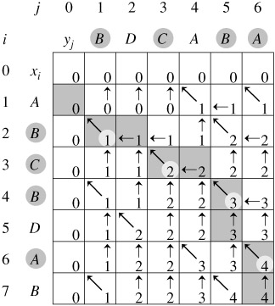
The underlying DAG
X = A, B, C, B, D, A, B
Y = B, D, C, A, B, A
Notes:
箭头优先向左上角指，其次向上，最后向左

Slide 19

Edit distance
When a spell checker encounters a possible misspelling, it looks in its dictionary for other words that are close by. What is the appropriate notion of closeness in this case?
Edit distance: the minimum number of edits (including insertions, deletions, and substitutions of characters) needed to transform one string into the other.

Slide 20
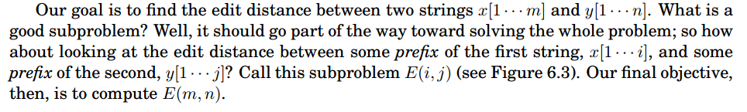
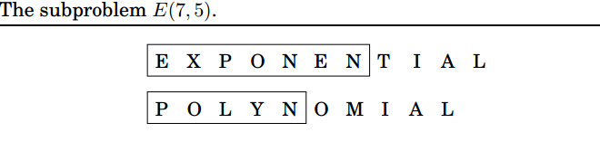
Edit distance

Slide 21
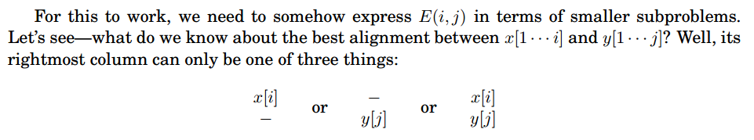
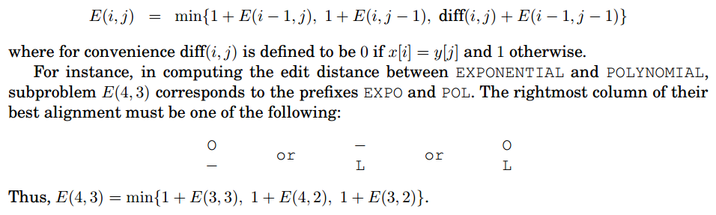

Slide 22
Two questions:
In what order should these subproblems be solved?
Any order is fine, as long as E(i-1,j), E(i,j-1), and E(i-1,j-1) are handled before E(i,j).
Base cases?
E(0,•) and E(•,0).

Slide 23
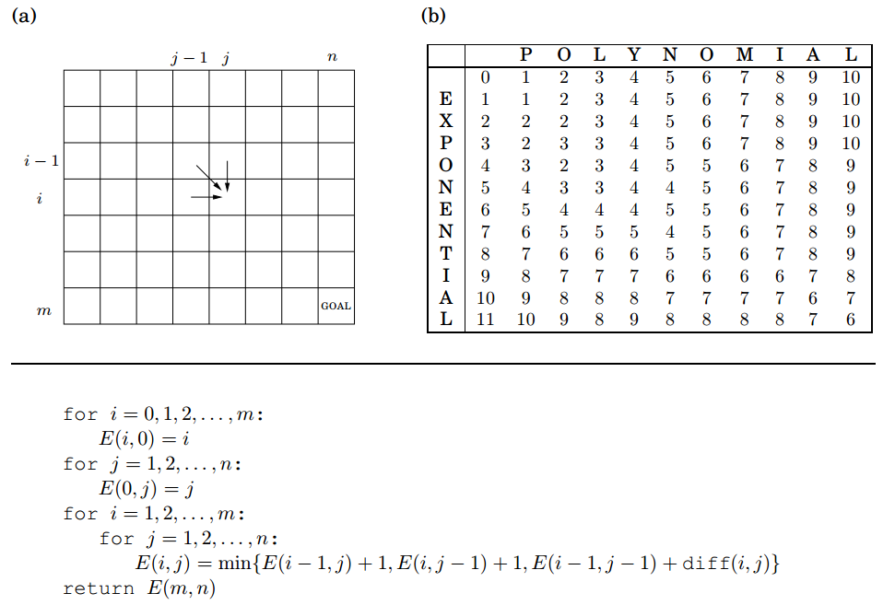

Slide 24
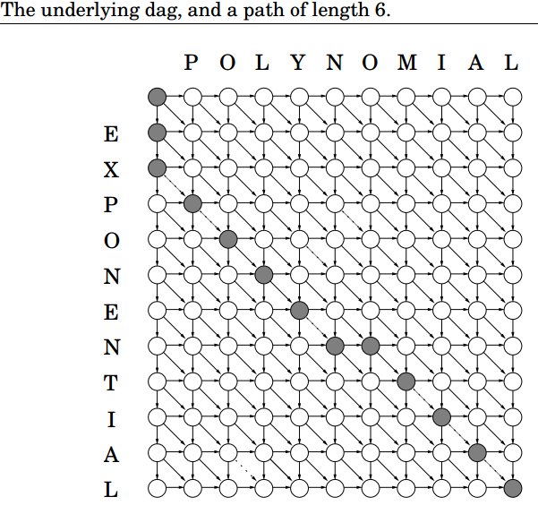
Generalized forms of edit distance: by altering weights on the DAG, we can achieve different costs of insertions, deletions, and substitutions.
Set all edges lengths to 1, except for {(i-1,j-1)->(i,j):x[i]=y[j]}, whose length is 0. The final answer is then simply the shortest path (distance) between (0,0) and (m,n).

Slide 25
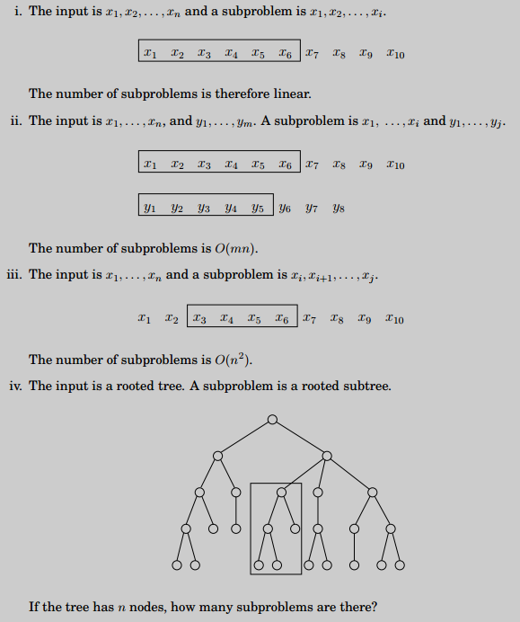
Finding the right subprobmes takes creativity and experimentation. But there are a few standard choices that seem to arise repeatedly in DP.

Slide 26
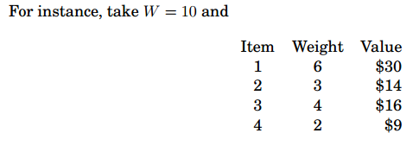
Knapsack
During a robbery, a burglar(盗贼) finds much more loot than he had expected and has to decide what to take. His bag (or knapsack) will hold a total weight of at most W pounds. There are n items to pick from, of weight w1, …, wn and dollar value v1,…vn. What is the most valuable combination of items he can fit into his bag?

Slide 27
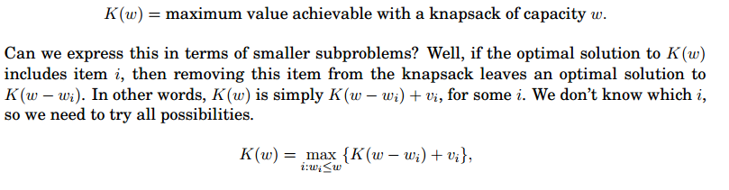
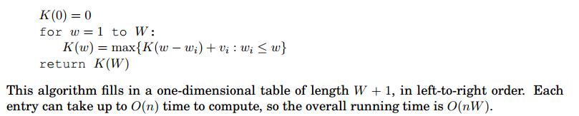
Knapsack with repetition
Try to construct the underlying dag!

Slide 28
Note that, this DP algorithm is not polynomial since the input size is proportional to logW rather than W.
如果一个问题的input size（输入规模或输入大小）为x，某个解决这个问题的算法的最坏时间复杂度为O(x^k)，其中x^k表示x的k次方，此处k为已知常数，那么这个算法可以成为多项式时间算法。
那么什么是input size呢？我们以前上课时没有很明确地说（因为不影响最后的结论），我们只有在knapsack问题时才提到（因为影响了最后的结论）。一个问题的input size是指这个问题的input用二进制表示所需的位数。
什么是伪多项式呢？如果一个问题的input以一进制（此处请自行想想一进制）表示所需的长度为y，某个解决这个问题的算法的最坏时间复杂度为O(y^h)，此处h为已知常数，那么这个算法可以称为伪多项式时间算法。

Slide 29
我们来看这个问题的input包含哪些？该问题的input包含W，w1, w2, ..., wn, v1, v2, ..., vn。一共2n+1个变量。我们一般认为wi和vi都不会特别大，或者说总是可以限定在某个范围内，例如我们可以认为wi和vi在计算机中有16个bit（也就是2个字节）足够了。因此这2n个变量一共需要的bit数为16*2n=32n。关键在于W，W可能十分大，这个W用二进制表示需要大约logW个比特位。好了。我们得到结论，这个问题的input size为32n+logW，令input size为y=32n+logW.
前面的动态规划算法复杂度为O(nW)。你会发觉nw是没有办法表示为y的多项式的。因此该算法并不是多项式时间算法。
如果上述的input用一进制来表示呢？那么输入规模为y=W+w1+w2+ ... + wn + v1+ v2 + ... +vn.
注意到y必然大于n；同时y必然大于W。上述动态规划复杂度中的nW < yy=y^2。因此是伪多项式时间算法。

Slide 30
（排序问题）：输入为n个数，假设每个数在计算机中有16个bit（也就是2个字节）足够了。因此这n个变量一共需要的bit数为16n。input size为16n，令y=16n。
快速排序最坏复杂度为(n^2)，我们尝试将n^2表示成y的多项式：n^2 = (y/16)^2，可以。因此是多项式时间算法。

Slide 31
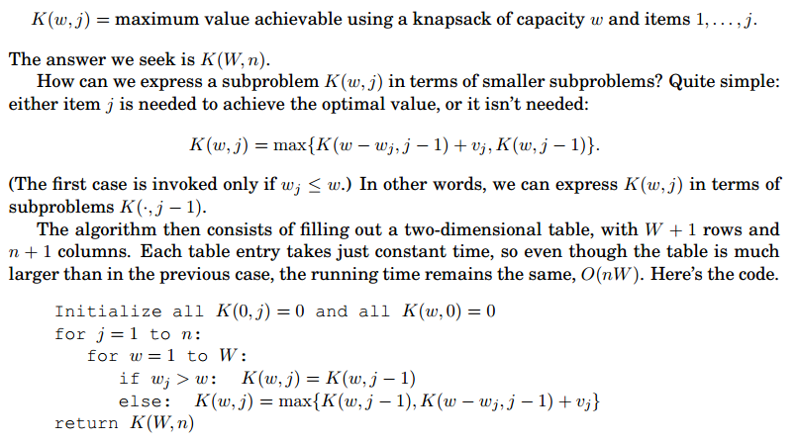
Knapsack without repetition

Slide 32
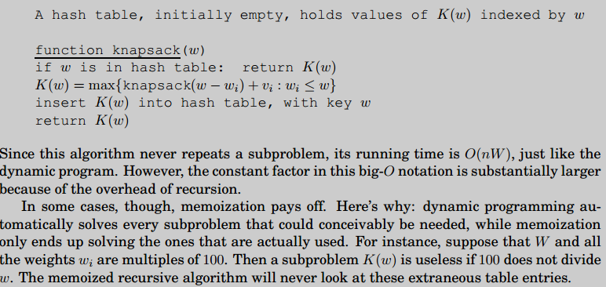
Memoization

