Slide 1
P, NP, and NP-Complete
张胜
sheng@nju.edu.cn
南京大学

Slide 2
In this class……
Decision Problem
The Class P
The Class NP
The Class NP-Complete
Polynomial Reduction

Slide 3
What is a decision problem?

Slide 4
Max Clique: an Example
A maximal complete subgraph of a graph G is called a clique, whose size is the number of vertices in it.
Optimization problem: Find the maximal clique in a given graph G.
Decision problem: Does G have a clique of size at least k for some given k?

Slide 5
Decision Problem
Statement of a decision problem
Part 1: instance description defining the input
Part 2: question stating the actual yes-or-no question
A decision problem is a mapping from all possible inputs into the set {yes, no}

Slide 6
Optimization vs. Decision
Usually, an optimization problem can be rephrased as a decision problem.
If an optimization problem is easy, then its related decision problem is easy as well.
Similarly, if we can provide evidence that a decision problem is hard, then its related optimization problem is hard.

Slide 7
Max Clique Revisited
The max clique problem can be solved in polynomial time iff. the corresponding decision problem can be solved in polynomial time.
If the size of a max clique can be found in time g(n), the corresponding decision may be settled in that time of course.
If deciClique is an algorithm for the decision problem with k. Its complexity is f(n). Then we apply the algorithm at most n times, for k=n, n-1, ..., 2, 1, to solve the max clique problem. In other words, we can solve the optimization problem with the complexity no larger than nf(n), which is polynomial if f(n) is polynomial.

Slide 8
Some Typical Decision Problems
Graph coloring
Given a undirected graph G and a positive integer k, is there a coloring of G using at most k colors?
Job scheduling with penalties
Given a group of jobs, each with its execution duration, deadline and penalty for missing the deadline, and a nonnegative integer k, is there a schedule with the total penalty bounded by k?

Slide 9
Some Typical Decision Problems
Bin packing
Given k bins each of capacity one, and n objects with size s₁, …, s_{n}, (where s_{i} is a rational number in (0,1] ). Do the n objects fit in k bins?
Knapsack
Given a knapsack of capacity C, n objects with sizes s₁, …, s_{n} and “profits” p₁, …, p_{n}, and a positive integer k. Is there a subset of the n objects that fits in the knapsack and has total profit at least k?
(Subset sum as a simplified version)

Slide 10

Some Typical Decision Problems
CNF-Satisfiability (合取范式可满足性)
Given a CNF formula, is there a truth assignment that satisfies it?
Hamiltonian cycles or Hamiltonian paths
Given a undirected graph G. Does G have a Hamiltionian cycle or a Hamiltonian path?
Traveling salesperson (TSP)
Given a complete, weighted graph and an integer k, is there a Hamiltonian cycle with total weight at most k?
And of ORs

Slide 11
When we say a problem is in P, what do we mean exactly?

Slide 12
The Class P
A polynomially bounded algorithm is one with its worst-case complexity bounded by a polynomial function of the input size.
A polynomially bounded problem is one for which there is a polynomially bounded algorithm.
The class P is the class of decision problems that are polynomially bounded.

Slide 13
Notes on the Class P
Class P has a too broad coverage, in the sense that not every problems in P has an acceptably efficient algorithm. However, the problem not in P must be extremely expensive and probably impossible to solve in practice.
The problems in P have nice “closure” properties for algorithm integration.

Slide 14
What do we mean by “NP”?

Slide 15
Nondeterministic: Deterministic Interpretation
Allowing unbounded parallelism in computation
One copy of the algorithm is made for each of the possible guess
All the copies are executing at the same time
The first copy output a “yes” terminates all other computations.

Slide 16
Answer of Nondeterministic Algorithm
For a particular decision problem with input x:
The answer computed by a nondeterministic algorithm is defined to be yes if and only if there is some execution of the algorithm that gives a yes output.
The answer is no, if for all executions (i.e., all certificates), there is no output.

Slide 17
The Class NP
A polynomial bounded nondeterministic algorithm is one for which there is a (fixed) polynomial function p such that for each input of size n for which the answer is yes , there is some execution of the algorithm that produces a yes output in at most p(n) steps.
The class NP is the class of decision problems for which there is a polynomial bounded nondeterministic algorithm.

Slide 18
Nondeterministic Algorithm
Phase 1 Guessing: generating arbitrarily “certificate”, i.e. proposed solution
void nondetA(String input)
String s=genCertif();
Boolean CheckOK=verifyA(input,s);
if (checkOK)
Output “yes”;
return;
The algorithm may behave differently on the same input in different executions: “yes” or “no output”.
Phase 2 Verifying: determining if s is a valid description of a object for answer, and satisfying the criteria for solution

Slide 19


Nondeterministic vs. Deterministic
void nondetSearch(int k; int[ ] S)
int i =genCertif();
if (S[i]==k)
Output “yes”;
return;
In O(1)
Note: Ω(n) for deterministic algorithm
void nondetSort(int[ ] S; int n)
int i, j; int[ ] out=0;
for i =1 to n do
j= genCertif(); // S[i] will be placed at out[j]
if out[j ]≠0 then return;
out[j]=S[i ];
for i =1 to n-1 do
if out[i ]>out[i+1] then return;
S=out;
Output(yes);
return
In O(n)
Note: Ω(nlogn) for deterministic algorithm

Slide 20
Nondeterministic Graph Coloring
1
Problem instance G
2
4
Input string:
4,5,(1,2)(1,4)(2,4)(2,3)(3,5)(2,5)(3,4)(4,5)
3
5
k,n
s Output Reason a
RGRBG false v₂ and v₅ conflict
RGRB false Not all vertices are colored
RBYGO false Too many colors used
RGRBY true A valid 4-coloring
R%*,G@ false Bad syntax
verified by phase 2
(G,4)→yes
generated by phase 1
Notes:
地图的4着色问题，1976年被UIUC的哈肯证明。地图是平面图，对于一般图而言，是一个很难的问题。

Slide 21
The class NP
NP means Non-deterministic P
From “deterministic” to “non-deterministic”
From “solve a problem” to “verify the yes answer of a problem”
What does NP indicates?
Probably harder problems
Not too hard
At least, you can quickly understand the yes answer (i.e., verifying the yes answer is polynomial)

Slide 22
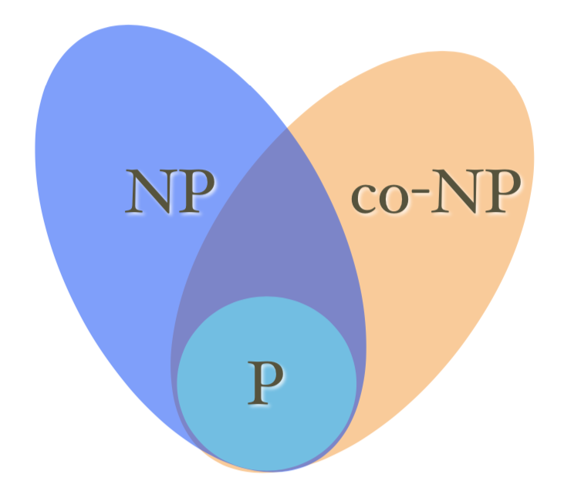
A simple illustration of P, NP
P: problems that are poly-time computable
NP: problems whose positive solutions are poly-time verifiable
example: Hamiltonian cycle
co-NP: problems whose negative solutions are poly-time verifiable
example: No Hamiltonian cycle

Slide 23
Proof of Being in NP
Generating the certificate is in polynomial time.
Checking the yes certificate is in polynomial time.

Slide 24

Max Clique Problem is in NP
void nondeteClique(graph G; int n, k)
set S=φ;
for int i=1 to k do
int t=genCertif();
if t∈S then return;
S=S∪{t };
for all pairs (i,j) with i,j in S and i≠j do
if (i,j ) is not an edge of G
then return;
Output(“yes”);
In O(n)
In O(k²)
So, we have an algorithm for the maximal clique problem with the complexity of O(n+k²)=O(n²)

Slide 25

Satisfiability Problem
An example of propositional conjunctive normal form (CNF) is like this:
Satisfiability Problem
Given a CNF formula, is there a truth assignment that satisfies it?
In other words, is there a assignment for the set of propositional variable in the CNF, such that the value of the formula is true.
void nondetSat(E, n)
boolean p[ ];
for int i =1 to n do
p[i ]= genCertif(true, false);
if E(p[1], p[2], ..., p[n])=true
then Output(“yes”);
So, the problem is in NP

Slide 26
Relation between P and NP
An deterministic algorithm for a decision problem is a special case of a nondeterministic algorithm, which means: P ⊆ NP
The deterministic algorithm is looked as the phase 2 of a nondeterministic one, which always ignores the certificate the phase 1 has written.
Intuition implies that NP is a much larger set than P.
The number of possible certificates is exponential in n.
No one problem in NP has been proved not in P.

Slide 27
The Class NP-Complete

Slide 28
Polynomial Reduction
Let T be a function from the input set for a decision problem E into the input set for Q. T is a polynomial reduction from E to Q if:
T can be computed in polynomial bounded time
x is a yes input for E → T(x) is a yes input for Q
x is a no input for E → T(x) is a no input for Q
T(x)
x
T
Algorithm for Q
an input for Q
yes or no
answer
(an input for E )
Algorithm for E
Solving a Problem Indirectly

Slide 29
An Example of Polynomial Reduction
Let T be a function from the input set for a decision problem E into the input set for Q. T is a polynomial reduction from E to Q if:
T can be computed in polynomial bounded time
x is a yes input for E → T(x) is a yes input for Q
x is a no input for E → T(x) is a no input for Q
An example:
E: Given a sequence of Boolean values, does at least one of them have the value true?
Q: Given a sequence of integers, is the maximum of them positive?
T(x₁, …, x_{n})= (y₁, …, y_{n}), where: y_{i}=1 if x_{i}=true, and y_{i}=0 if x_{i}=false

Slide 30
Relation of Reducibility
Problem E is polynomially reducible to Q if there exists a polynomial reduction from E to Q, denoted as: E≤_{P}Q
If E≤_{P}Q and Q is in P, then E is in P
The complexity of E is the sum of T, with the input size n, and Q, with the input size p(n), where p is the polynomial bound on T,
So, the total cost is: p(n)+q(p(n)), where q is the polynomial bound on Q.
(If E≤_{P}Q, then Q is at least as “hard” to solve as E)
Notes:
P：10个数中取最小的5个，并按照顺序取出；
Q：10个数排序。
P可以规约到Q，显然Q比P难以解决。

Slide 31
NP-complete Problems
A problem Q is NP-hard if every problem E in NP is polynomially reducible to Q, that is E≤_{P}Q.
(which means that Q is at least as hard as any problem in NP )
A problem Q is NP-complete if it is in NP and is NP-hard.
(which means that Q is at most as hard as to be solved by a polynomially bounded nondeterministic algorithm)

Slide 32
Summary: Theory of NP-Completeness
What it cannot do
Provide a method of obtaining polynomial time algorithms for “hard” problems
Negate the existence of algorithms of polynomial complexity for “hard” problems
What it can do
Show that many of the problems, for which there is no known polynomial time algorithm, are computationally related.

