Slide 1
Reduction
张胜
sheng@nju.edu.cn
南京大学

Slide 2
In the last class…
Decision Problem
The Class P
The Class NP
NP-Complete Problems
Polynomial Reductions
NP-hard and NP-complete

Slide 3
The Class P
A polynomially bounded algorithm is one with its worst-case complexity bounded by a polynomial function of the input size.
A polynomially bounded problem is one for which there is a polynomially bounded algorithm.
The class P is the class of decision problems that are polynomially bounded.

Slide 4
The Class NP
A polynomial bounded nondeterministic algorithm is one for which there is a (fixed) polynomial function p such that for each input of size n for which the answer is yes , there is some execution of the algorithm that produces a yes output in at most p(n) steps.
The class NP is the class of decision problems for which there is a polynomial bounded nondeterministic algorithm.

Slide 5
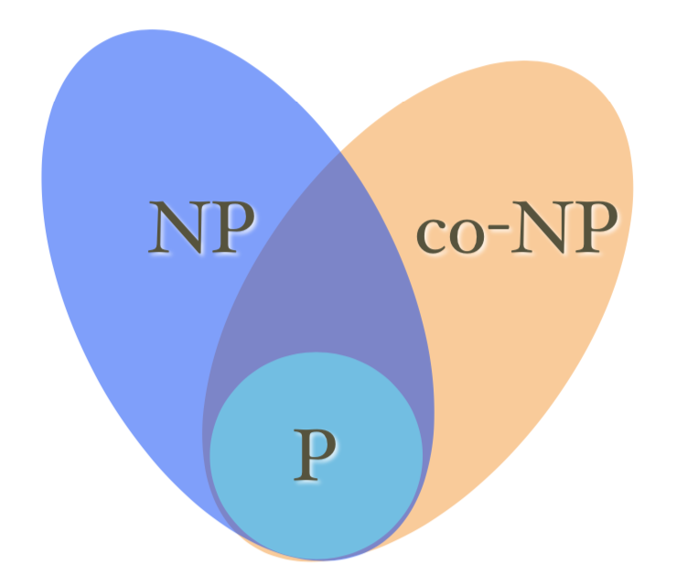
A simple illustration of P, NP
P: problems that are poly-time computable
NP: problems whose positive solutions are poly-time verifiable
example: Hamiltonian cycle
co-NP: problems whose negative solutions are poly-time verifiable
example: No Hamiltonian cycle

Slide 6

Satisfiability Problem
An example of propositional conjunctive normal form (CNF) is like this:
Satisfiability Problem
Given a CNF formula, is there a truth assignment that satisfies it?
In other words, is there a assignment for the set of propositional variable in the CNF, such that the value of the formula is true.
void nondetSat(E, n)
boolean p[ ];
for int i =1 to n do
p[i ]= genCertif(true, false);
if E(p[1], p[2], ..., p[n])=true
then Output(“yes”);
So, the problem is in NP

Slide 7
P and NP : Revisited
Intuition implies that NP is a much larger set than P.
The number of possible certificates is exponential in n.
No one problem in NP has been proved not in P.
If any NP-completed problem is in P , then NP =P .
Which means that every problems in NP can be reducible to a problem in P !
Waa...

Slide 8
Polynomial Reduction
Let T be a function from the input set for a decision problem E into the input set for Q. T is a polynomial reduction from E to Q if:
T can be computed in polynomial bounded time
x is a yes input for E → T(x) is a yes input for Q
x is a no input for E → T(x) is a no input for Q
T(x)
x
T
Algorithm for Q
an input for Q
yes or no
answer
(an input for E )
Algorithm for E
Solving a Problem Indirectly

Slide 9
An Example of Polynomial Reduction
Let T be a function from the input set for a decision problem E into the input set for Q. T is a polynomial reduction from E to Q if:
T can be computed in polynomial bounded time
x is a yes input for E → T(x) is a yes input for Q
x is a no input for E → T(x) is a no input for Q
An example:
E: Given a sequence of Boolean values, does at least one of them have the value true?
Q: Given a sequence of integers, is the maximum of them positive?
T(x₁, …, x_{n})= (y₁, …, y_{n}), where: y_{i}=1 if x_{i}=true, and y_{i}=0 if x_{i}=false

Slide 10
NP-complete Problems
A problem Q is NP-hard if every problem E in NP is polynomially reducible to Q, that is E≤_{P}Q.
(which means that Q is at least as hard as any problem in NP )
A problem Q is NP-complete if it is in NP and is NP-hard.
(which means that Q is at most as hard as to be solved by a polynomially bounded nondeterministic algorithm)

Slide 11
Contents of this class
Proving NPC by Reduction
Examples of Reduction
Max Clique
Dense Graph
Hamiltonian Cycle in Undirected Graph

Slide 12
An Example of NP-hard problem
Halt problem: Given an arbitrary deterministic algorithm A and an input I, does A with input I ever terminate?
A well-known undecidable problem, of course not in NP .
Satisfiability problem is reducible to it.
Construct an algorithm A whose input is a propositional formula X. If X has n variables then A tries out all 2^{n} possible truth assignments and verifies if X is satisfiable. If it is satisfiable then A stops. Otherwise, A enters an infinite loop.
So, A halts on X iff. X is satisfiable.

Slide 13
NPC as a Level of Complexity
If E is a NP-complete problem, then:
If there is a polynomial bounded algorithm for E, then there would be a polynomial bounded algorithm for each of the problems in NP.
E is as difficult to be solved as that no problem in NP is more difficult than E; and E is as easy to be solved as that there exists a polynomial bounded nondeterministic algorithm which solves E.

Slide 14
First Known NP-Complete Problem
Cook’s theorem:
The satisfiability problem is NP-complete.
Reduction as tool for proving NP-complete
Since CNF-SAT is known to be NP-hard, then all the problems, to which CNF-SAT is reducible, are also NP-hard. So, the formidable task of proving NP-complete is transformed into relatively easy task of proving of being in NP.

Slide 15
Proof of Cook’s Theorem*(不作要求)
COOK, S. 1971.
The complexity of theorem-proving procedures.
In
Conference Record of
3rd Annual ACM Symposium on Theory of Computing.
ACM New York, pp. 151–158.
Stephen Arthur Cook: b.1939 in Buffalo, NY. Ph.D of Harvard. Professor of Toronto Univ. 1982 Turing Award winner. The Turing Award lecture: “An Overview of Computational Complexity”, CACM, June 1983, pp.411-431
Notes:
加拿大多伦多大学cook证明此问题，由此获得图灵奖。NP问题的各种可能性罗列，并规约到SAT问题。

Slide 16
Proving NPC by Reduction
The CNF-SAT problem is NP -complete.
Prove problem Q is NP-complete, given a problem E known to be NP -complete
For all R∈NP, R≤_{P}E;
Show E≤_{P}Q;
By transitivity of reduction, for all R∈NP, R≤_{P}Q;
So, Q is NP-hard;
If Q is in NP as well, then Q is NP-complete.

Slide 17
Satisfiability Problem
CNF (And of ORs)(合取范式)
A literal is a Boolean variable or a negated Boolean variable, as x or
A clause is several literals connected with ∨’s
A CNF formula is several clause connected with ∧’s
CNF-SAT problem
Is a given CNF formula satisfiable, i.e. taking the value TRUE on some assignments for all x_{i}.
A special case: CNF-3-SAT
Notes:
Literal:字符
Clause：子句

Slide 18
Example 1: Max Clique Problem is NP-Complete

Slide 19

Max Clique Problem is in NP
void nondeteClique(graph G; int n, k)
set S=φ;
for int i=1 to k do
int t=genCertif();
if t∈S then return;
S=S∪{t };
for all pairs (i,j) with i,j in S and i≠j do
if (i,j ) is not an edge of G
then return;
Output(“yes”);
In O(n)
In O(k²)
So, we have an algorithm for the maximal clique problem with the complexity of O(n+k²)=O(n²)

Slide 20
CNF-SAT to Clique
Let φ=C₁∧C₂∧...∧C_{k} be a formula in CNF-3 with k clauses. For r =1,2,...,k, each clause C_{r}=(l₁^{r}∨l₂^{r}∨l₃^{r}), l_{i}^{r} is x_{i} or ¬x_{i}, any of the variables in the formula.
A graph can be constructed as follows. For each C_{r}, create a triple of vertices v₁^{r}, v₂^{r} and v₃^{r}, and create edges between v_{i}^{r} and v_{j}^{s} if and only if:
they are in different triples, i.e. r≠s, and
they do not correspond to the literals negating each other
(Note: there is no edges within one triple)

Slide 21


The Graph Corresponding 3-CNF
C₁
x₁
¬x₂
¬x₃
Two of satisfying assignments:
x₁=1/0, x₂=0; x₃=1, or
x₁=1, x₂=1/0, x₃=1
For corresponding clique, pick one “true” literal from each triple
C₂
¬x₁
x₁
x₂
x₂
x₃
C₃
x₃

Slide 22
Clique Problem is NP-Complete
φ, with k clauses, is satisfiable if and only if the corresponding graph G has a clique of size k.
Proof: ⇒
Suppose that φ has a satisfying assignment.
Then there is at least one “true” literal in each clause. Picking such a literal from each clause, their corresponding vertices in G can be proved to be a clique, since any two of them are in different triples and cannot be complements to each other (they are both true).

Slide 23
Clique Problem is NP-Complete
φ, with k clauses, is satisfiable if and only if the corresponding graph G has a clique of size k.
Proof: ⇐
Suppose that G has a clique V’ of size k.
Note there is no edge within one triple, so V’contains exactly one vertex from each triple. Assigning “true” to the literal corresponding to every vertices in V’, no inconsistency will be resulted according to the rule by which the graph is constructed. The assignment is a satisfying assignment. (The variables whose corresponding vertices are not in V’ can be assigned either 0 or 1.)

Slide 24
Example 2: Dense Subgraph Problem is NP-Complete

Slide 25
The Dense Subgraph
The dense subgraph problem is define as follows. Given an undirected graph G, does it contain a sub-graph H that has exactly K vertices and at least Y edges? Prove that this problem is NP-complete. You can pick any problem to reduce from.
Notes:
1、我们需要证明稠密子图问题是NP问题。对于G给定的子图H，我们遍历H中所有的点对，检查其间是否有边，并记录边数。由此，我们可以在多项式时间内验证H是否是问题的一个解。由此我们证明了稠密子图问题是NP问题。
2、我们需要证明稠密子图问题是NP-hard问题，为此，我们将CLIQUE问题，在多项式时间内，规约到稠密子图问题。
根据定义，CLIQUE问题要求G中是否有大小为k的团。为了完成规约，我们只需要将CLIQUE问题的输入按如下方式变成稠密子图问题的输入：问图G中，是否有子图H满足：H包含k个顶点，至少k*(k-1)/2条边。显然上述规约是多项式时间的。
3、综上，我们证明了稠密子图问题是NP-完全问题。

Slide 26
The Dense Subgraph
The dense subgraph problem is define as follows. Given an undirected graph G, does it contain a sub-graph H that has exactly K vertices and at least Y edges? Prove that this problem is NP-complete. You can pick any problem to reduce from.
It belongs to NP.
Show Clique ≤_{P} Dense Subgraph.
Notes:
1、我们需要证明稠密子图问题是NP问题。对于G给定的子图H，我们遍历H中所有的点对，检查其间是否有边，并记录边数。由此，我们可以在多项式时间内验证H是否是问题的一个解。由此我们证明了稠密子图问题是NP问题。
2、我们需要证明稠密子图问题是NP-hard问题，为此，我们将CLIQUE问题，在多项式时间内，规约到稠密子图问题。
根据定义，CLIQUE问题要求G中是否有大小为k的团。为了完成规约，我们只需要将CLIQUE问题的输入按如下方式变成稠密子图问题的输入：问图G中，是否有子图H满足：H包含k个顶点，至少k*(k-1)/2条边。显然上述规约是多项式时间的。
3、综上，我们证明了稠密子图问题是NP-完全问题。

Slide 27
Example 3: Undirected Hamiltonian Cycle Problem is NP-Complete

Slide 28
Turning Directed G into Undirected
G
G’
u
u¹
u²
u³
y
v
z
y¹
y²
y³
v¹
v²
v³
x
w
z¹
z²
z³
Each vertex in G →a set of 3 vertices in G’;
Note the position of the edges in G’
x¹
x²
x³
w¹
w²
w³

Slide 29
Rationale of the Construction of G’
Firstly, it is necessary to simulate in G’ the direction of edges of G, which means to distinguish the two roles of a vertex in G, as starting point or as ending point. So, it leads to the use of a group of 2 vertices in G’ as the counterpart of each vertex in G.
Consequently, the 2 vertices within one group must always be traversed by a possible H-cycle in consecution. So, a third vertex is added in each group as an inner-connected-only vertex.

Slide 30
Can we use two vertices to represent a vertex in directed HC? No!
G
x
G’
u
x¹
x²
y
v
u¹
u²
z
y¹
y²
z¹
z²
v¹
v²
w
Each vertex in G →a set of 2 vertices in G’;
Note the position of the edges in G’
w¹
w²

Slide 31
Hamiltonian Reduction
The directed Hamiltonian graph cycle problem is reducible to the undirected Hamiltonian cycle problem.
The polynomial reduction: G→G’, for any G with n vertices and m edges, G’ has 3n vertices and 2n+m edges, polynomially bounded.

Slide 32
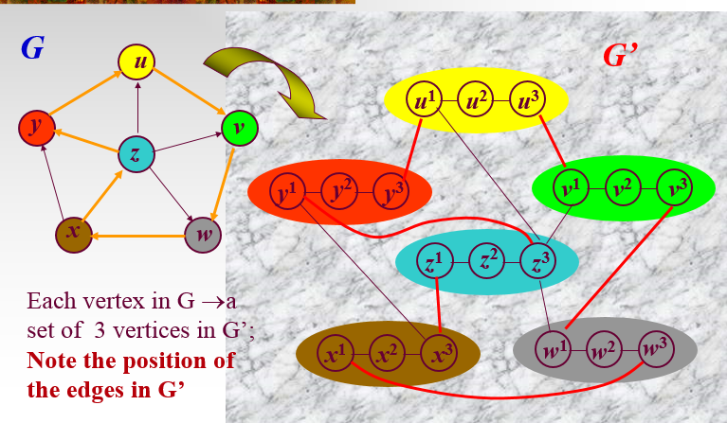
Proof of G is Haniltonian if and only if G’ is Hamiltonian
H-cycle in G ⇒H-cycle in G’ is trivial.
H-cycle in G’ ⇒H-cycle in G: consider the features of the H-cycle possibly found in G ’ :
For each triple, the H-cycle must traverse all 3 vertexes consecutively in the order (1,2,3) or (3,2,1)
For all triple, the order by which the vertices are traversed by an H-cycle must be same.
Orient the H-cycle such that within each triple, the vertices are traversed in the order of (1,2,3). It is trivial to find a directed H-cycle in G which corresponds to the above H-cycle in G’.
Notes:
→简单说明
←
1、每一个三元组，h-回路必然遍历3个结点；
2、每个三元组，在h-回路中的遍历顺序必然一致；
3、能够容易找到G中对应于G’的 h-回路

Slide 33
Known NP-Complete Problem
Garey & Johnson: Computer and Intractability: A Guide to the Theory of NP-Completeness, Freeman, 1979
About 300 problems, grouped in 12 categories:
1. Graph Theory 2. Network Design 3. Set and Partition
4. Storing and Retrieving 5. Sorting and Scheduling
6. Mathematical Planning 7. Algebra and Number Theory
8. Games and Puzzles 9. Logic
10. Automata and Theory of Languages
11. Optimization of Programs 12. Miscellaneous

