Slide 1
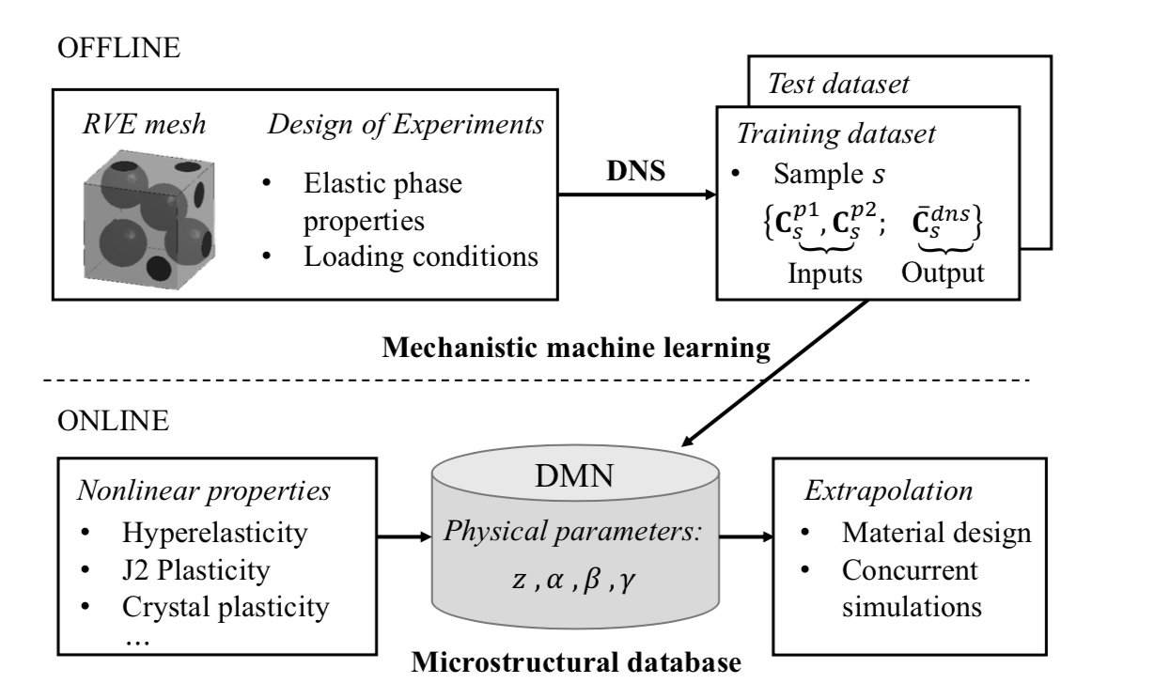
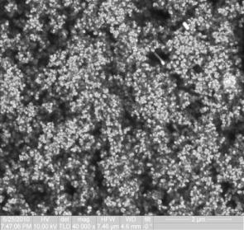
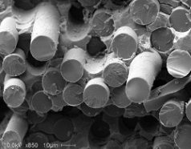
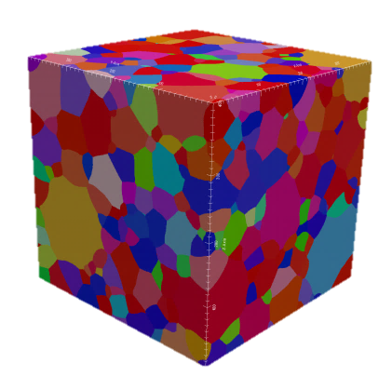

Slide 2
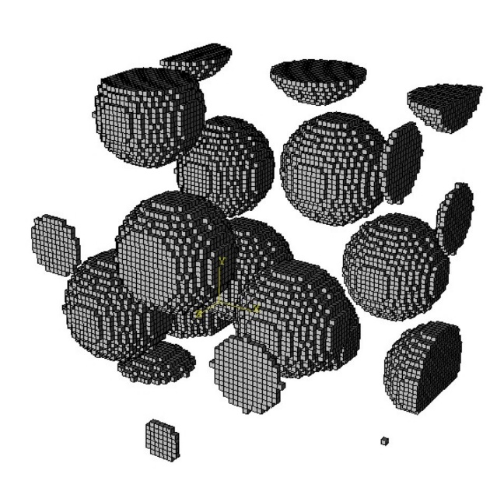
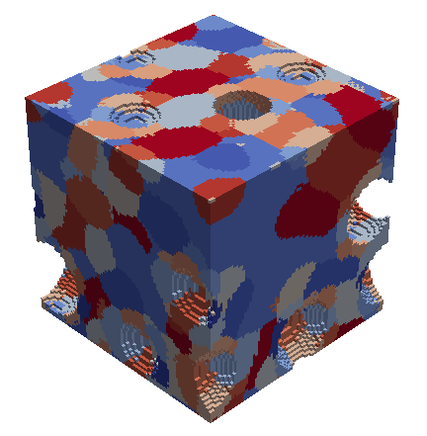
High-fidelity RVE
(DNS)
Offline or training stage (SCA)
Reduced Order Model
1) Domain decomposition (k-means clustering): find material clusters.
2) Compute the interaction tensors based on the Green’s function.
Online or predictive stage (SCA)
Self-consistent scheme for reduced Lippman-Schwinger equation.
Validation

Slide 3




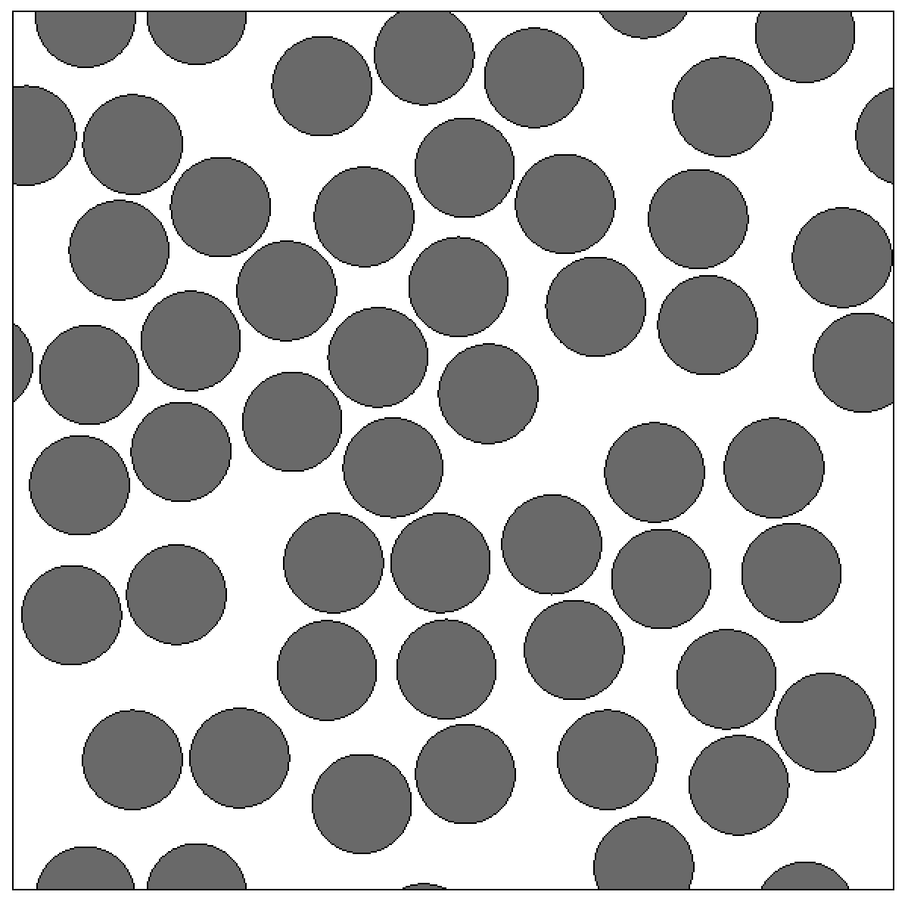
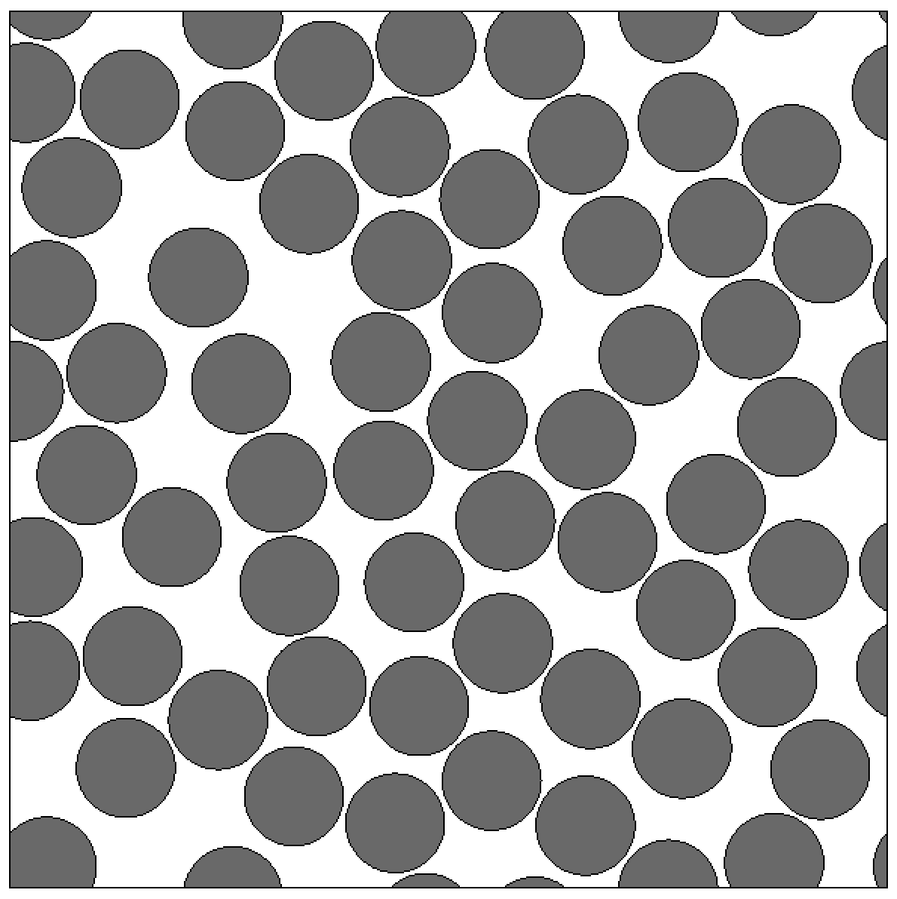






$${vf}_{2}=0.1$$
$${vf}_{2}=0.2$$
$${vf}_{2}=0.3$$
$${vf}_{2}=0.4$$
$${vf}_{2}=0.5$$
$$vf_{2}=0.6$$

Slide 5
RVE Preprocessing tools: design of experiment
Material properties
+
RVE Geometry
+
Boundary conditions
& Loading paths
Virtual Experiments on RVE
FEM in 2D&3D
Periodic BC, Displacement BC
Non-matching meshes
Homogenization/Averaging
RVE package for analysis and homogenization in LS-DYNA
Material informatics
Virtual material testing data
Machine learning for material modeling
Experimental testing data

