Slide 1
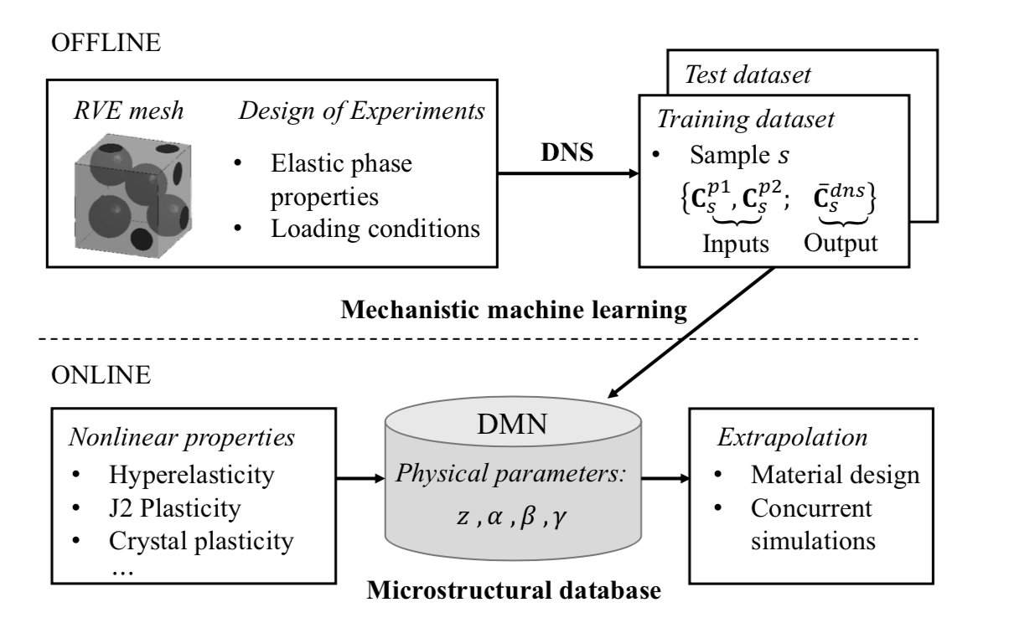
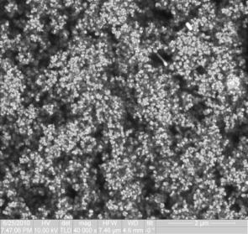
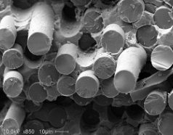
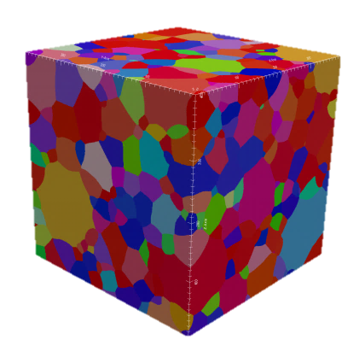

Slide 2
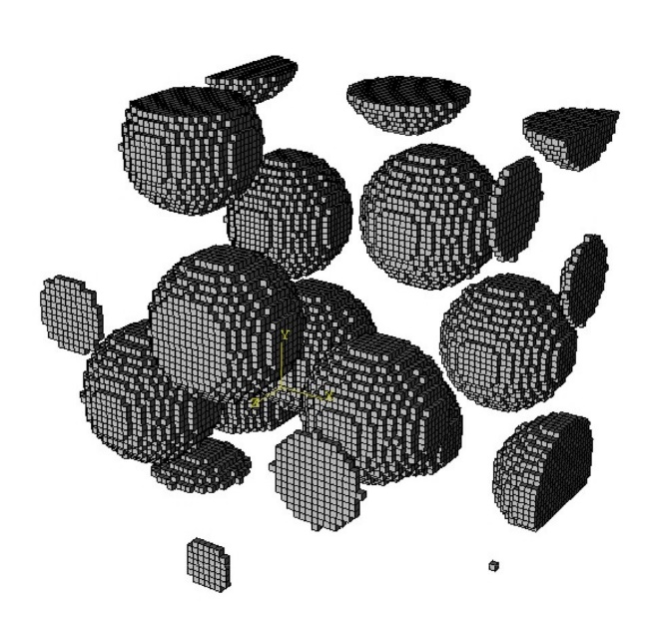
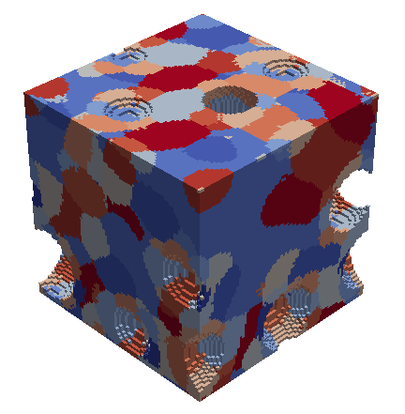
High-fidelity RVE
(DNS)
Offline or training stage (SCA)
Reduced Order Model
1) Domain decomposition (k-means clustering): find material clusters.
2) Compute the interaction tensors based on the Green’s function.
Online or predictive stage (SCA)
Self-consistent scheme for reduced Lippman-Schwinger equation.
Validation

Slide 3
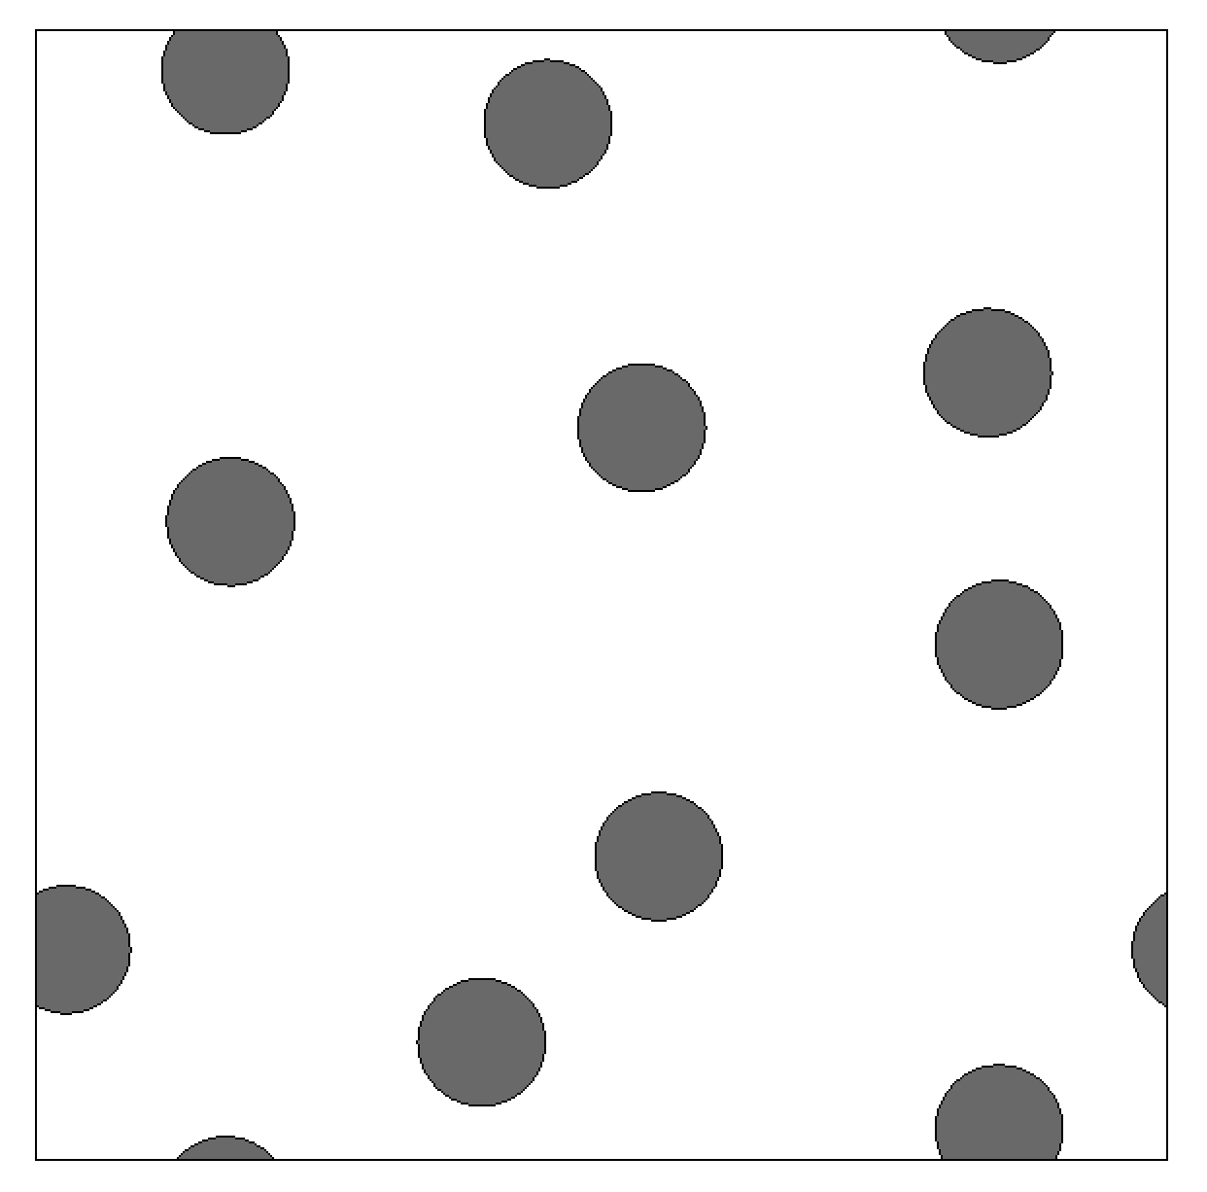
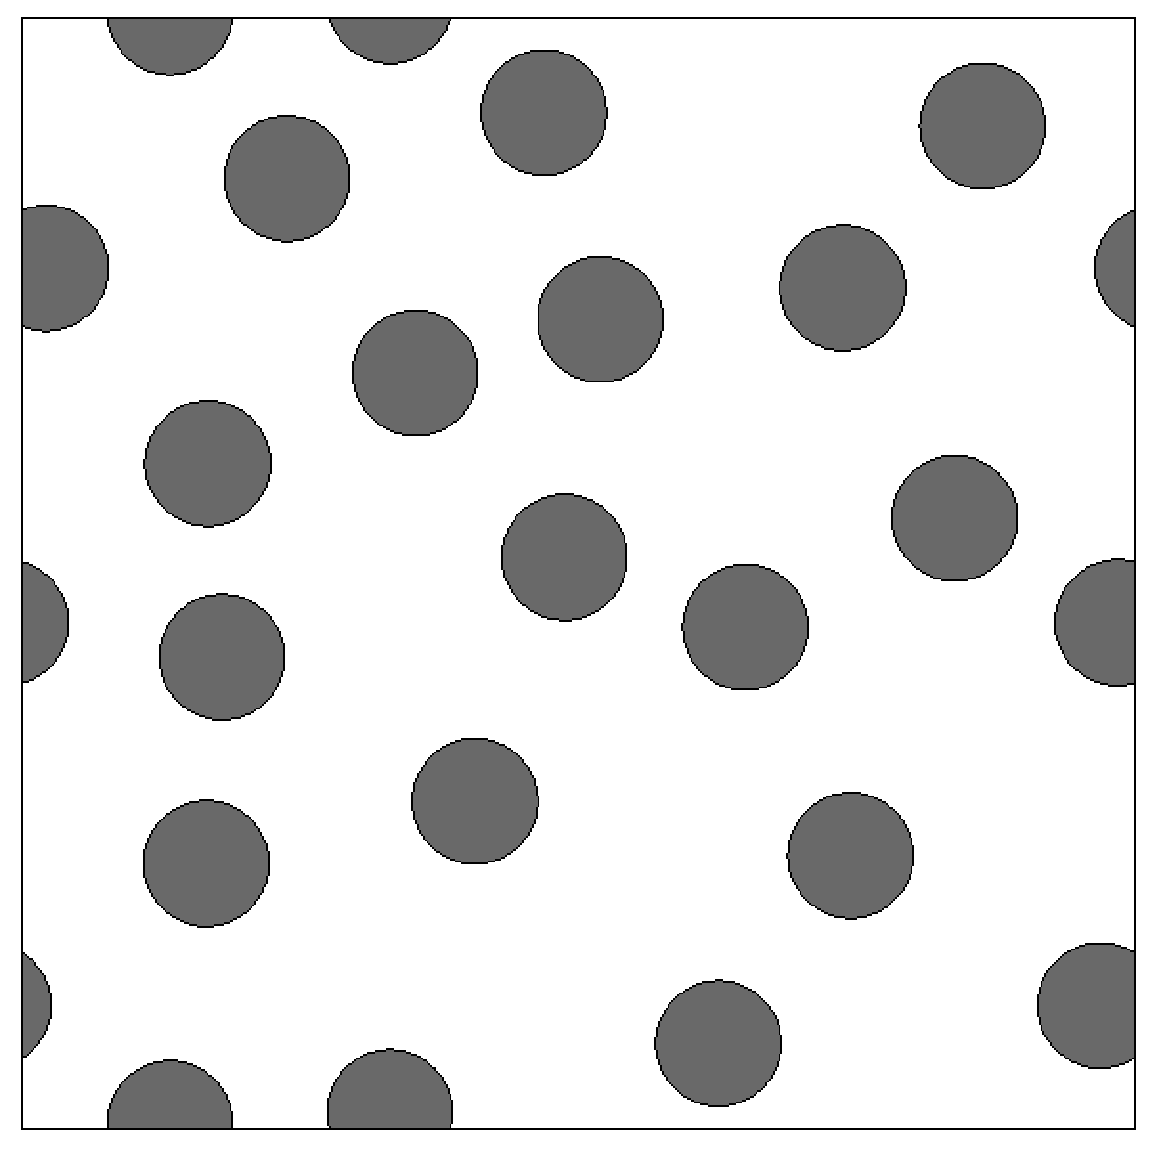
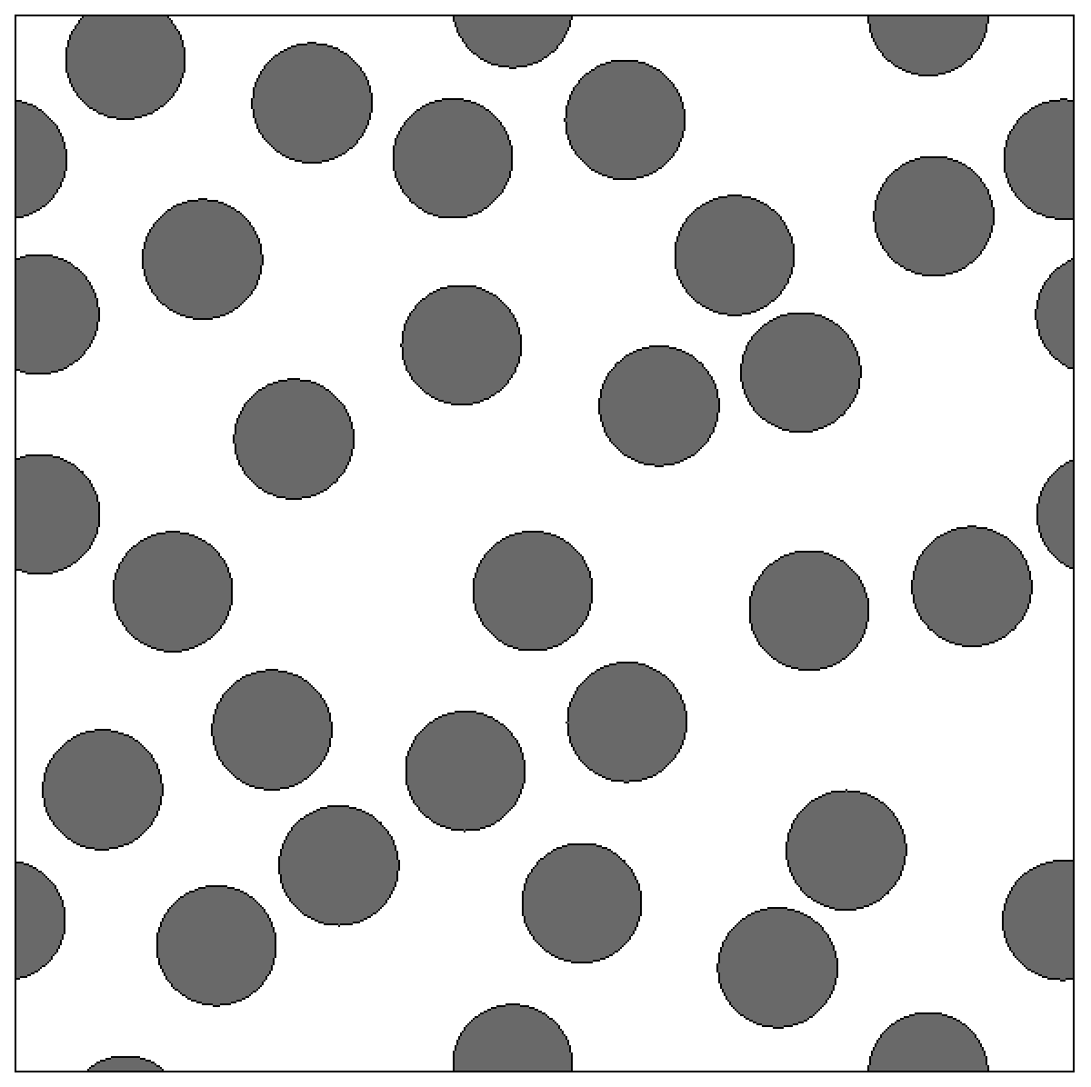

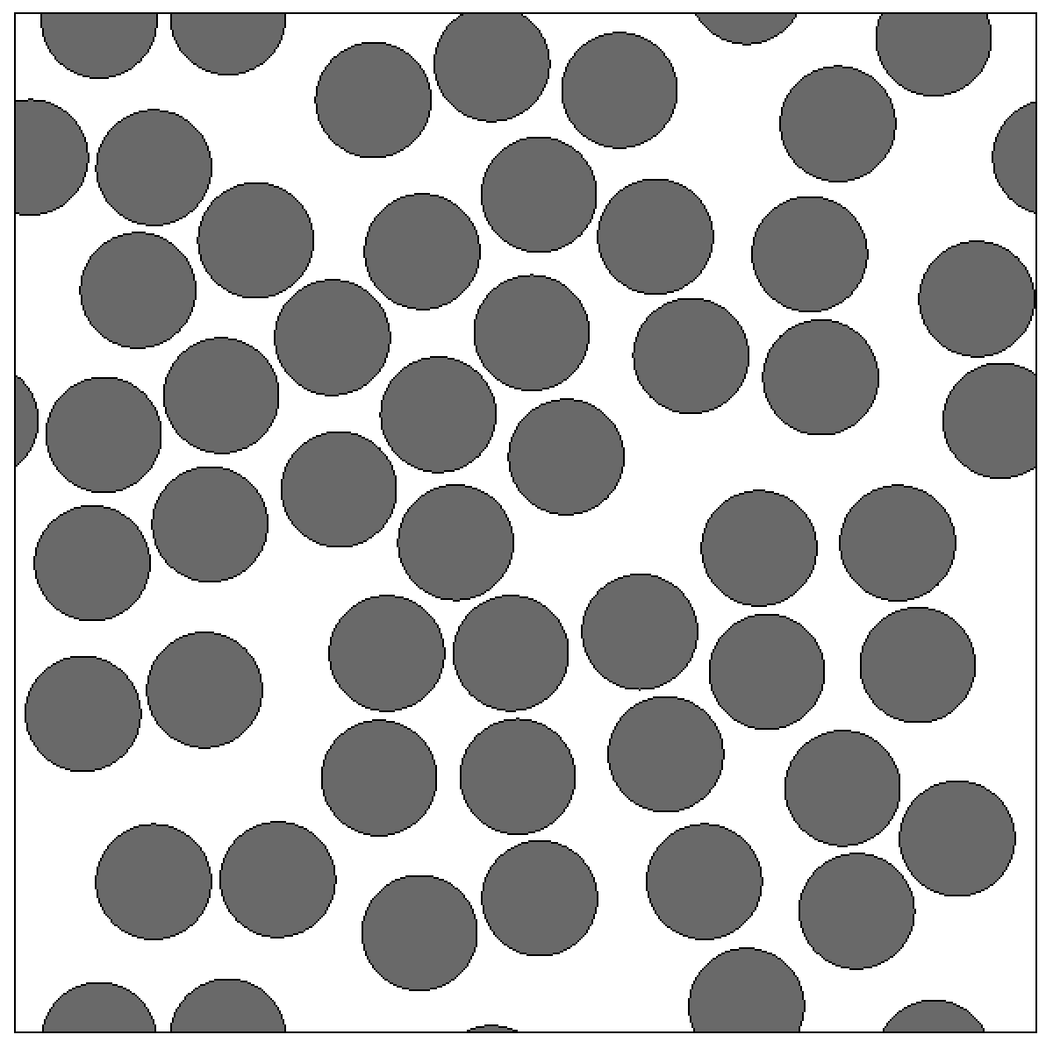
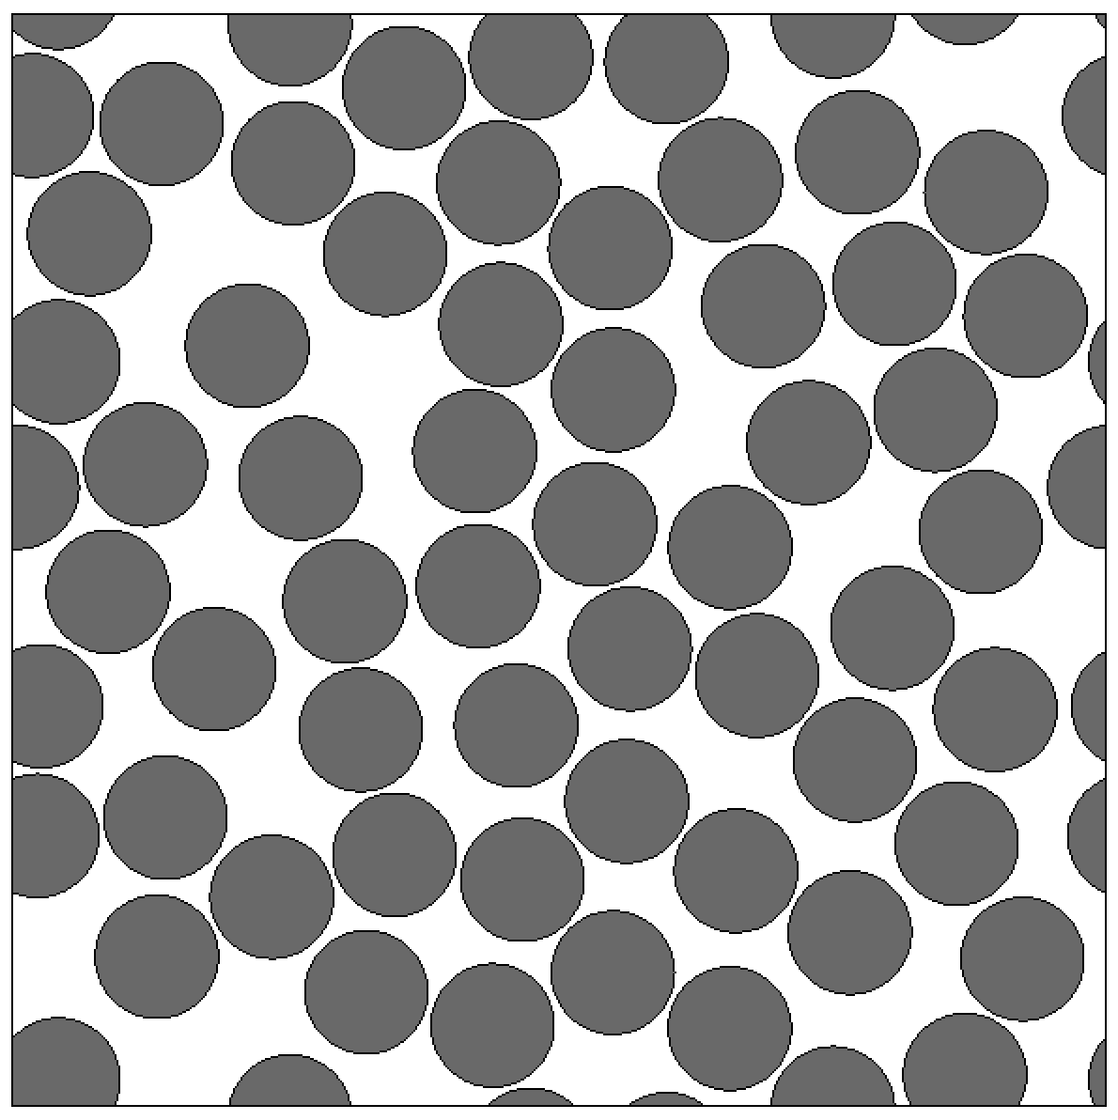






$${vf}_{2}=0.1$$
$${vf}_{2}=0.2$$
$${vf}_{2}=0.3$$
$${vf}_{2}=0.4$$
$${vf}_{2}=0.5$$
$$vf_{2}=0.6$$

