Slide 1
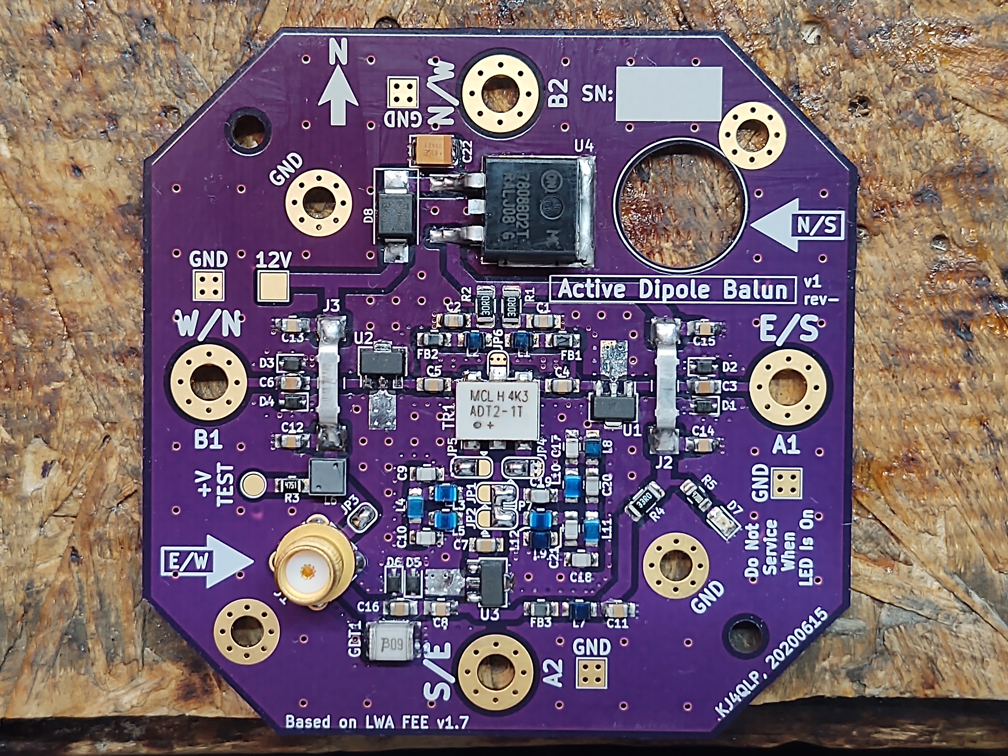
Active HF Dipole Balun
Candidate Active Antenna for HamSCI’s PSWS
Zach Leffke, KJ4QLP
zleffke@vt.edu
www.github.com/zleffke

Slide 2
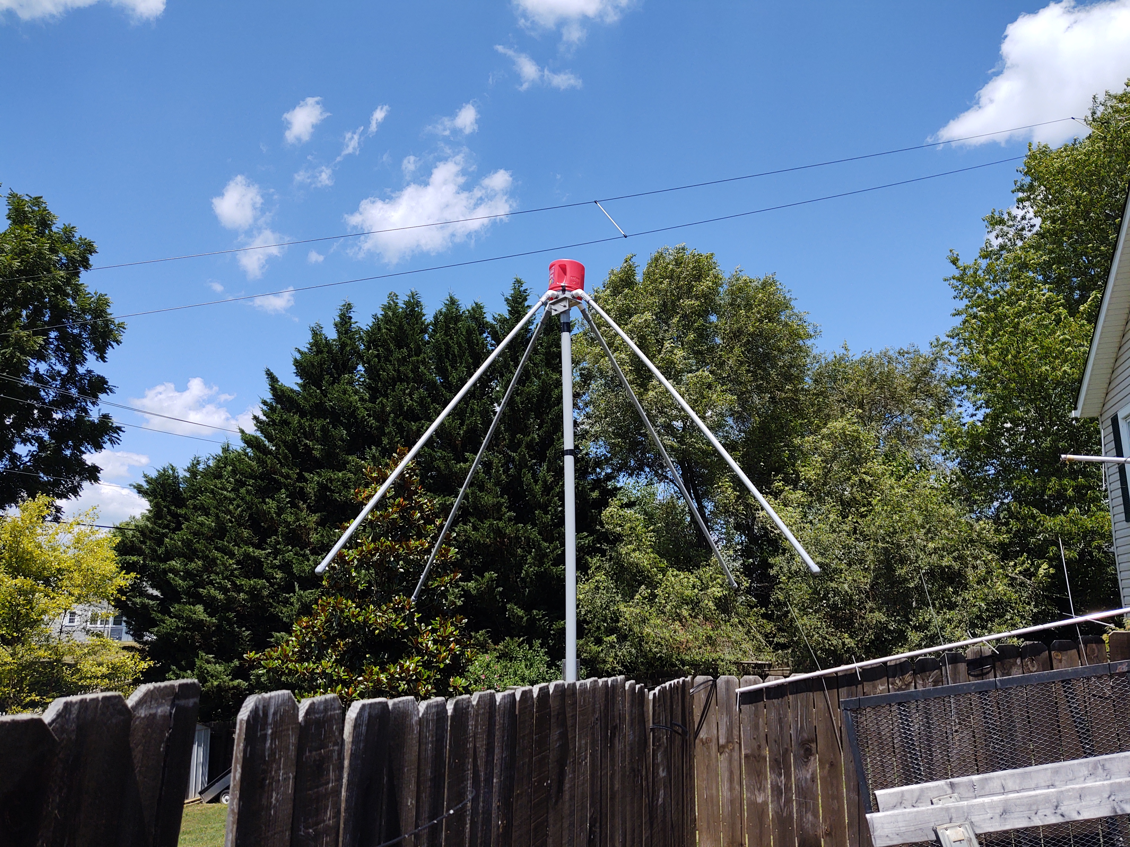
Agenda
Introduction & Overview
Schematic & PCB
Bench RF Measurements
On Air Comparisons Selected Screengrabs
  T2FD
  DXE-RF-PRO-1B

Slide 3
Introduction & Overview

Slide 4
Introduction, References, & Links
Long Wavelength Array
  Memo Series: www.faculty.ece.vt.edu/swe/lwa/
  Collected Engineering Memos for LWA-FEE (used heavily):
    www.faculty.ece.vt.edu/swe/lwa/memo/lwa0190.pdf
AHFDB Github
  www.github.com/zleffke/kicad_active_balun (current design, might rearrange a bit)
  kj4qlp.wordpress.com (coming soon…definition of ‘soon’ TBD...)
Item | Cost | Note
3 PCBs | $37.85 | Osh Park (x3 rule)
1 PCB | $12.62 | Per PCB
Single Balun BOM | $36.03 | Mouser/Digikey
Dual Balun BOM | $71.17 | Dual Pol
LWA-FEEv1.7 | AHFDB, v1, rev-
Freq: 10-88 MHz | Freq: 1.5-50 MHz
180º Hybrid | MC RF Transformer
Low Pass Filter | LPF, BPF, Bypass
12V Vreg | 8V Vreg
LWA-FEEv1.7 size | More Compact
Estimating ~$150-$200 for complete Dual Polarization system (everything in picture, not coax or backend systems)

Slide 5
RF Performance Summary
Parameter | Unit | Value
Design Frequency of Operation (-3dB) | MHz | 1.5 to 50
Realized Frequency of Operation (-3dB) | MHz | 4.0 to 47.5
Average Gain (passband) | dB | 36.1
Average Noise Figure (passband) | dB | 3.87
Input 1dB Compression Point (P1dB)* | dBm | -18.41
Input Third Order Intercept Point (IIP3)* | dBm | -2.5 to -3.0
DC Input Voltage Range | V | 10.0 to 35.0
DC Input Voltage, Nominal | V | 13.8
DC Supply Current, Nominal | mA | 0.250
DC Supply Method, Nominal | n/a | Bias-T via coax
DC Supply Method, Alternate | n/a | external
Note *: Linearity numbers without output protection diodes installed

Slide 6
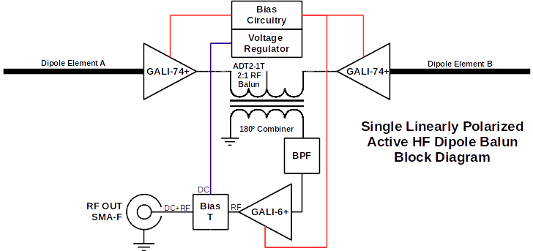
Active Dipole Balun - Simplified Block Diagram

Slide 7

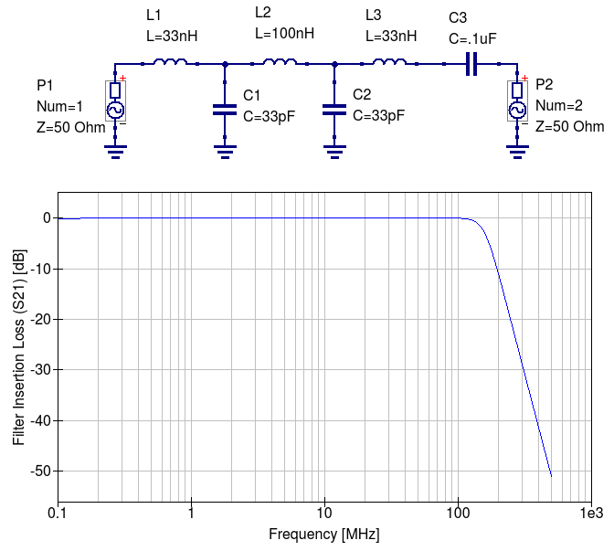
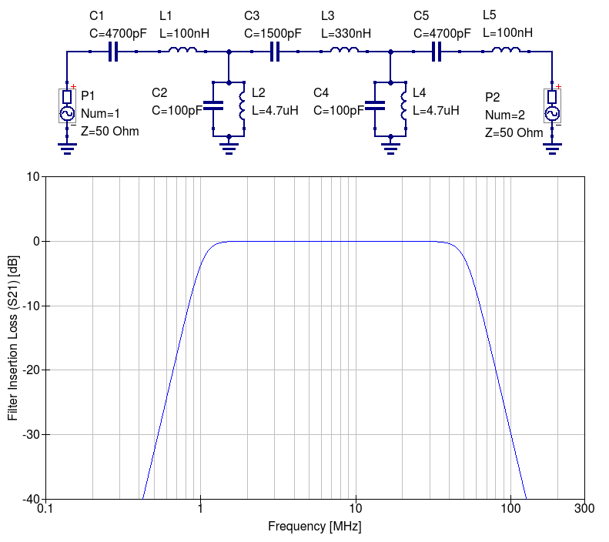
LWA-FEEv1.7 LPF vs AHFDB BPF - Simulated
AM
HF
FM
AM
FM
LWA LPF
AHFDB BPF

Slide 8
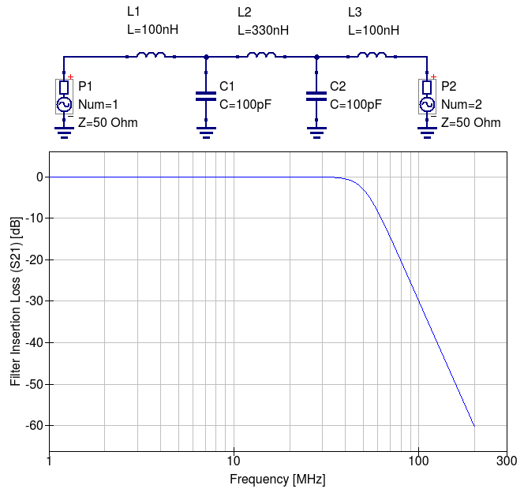
AHFDB Filter Simulations - QUCS
I went with this one for initial tests.

Slide 9
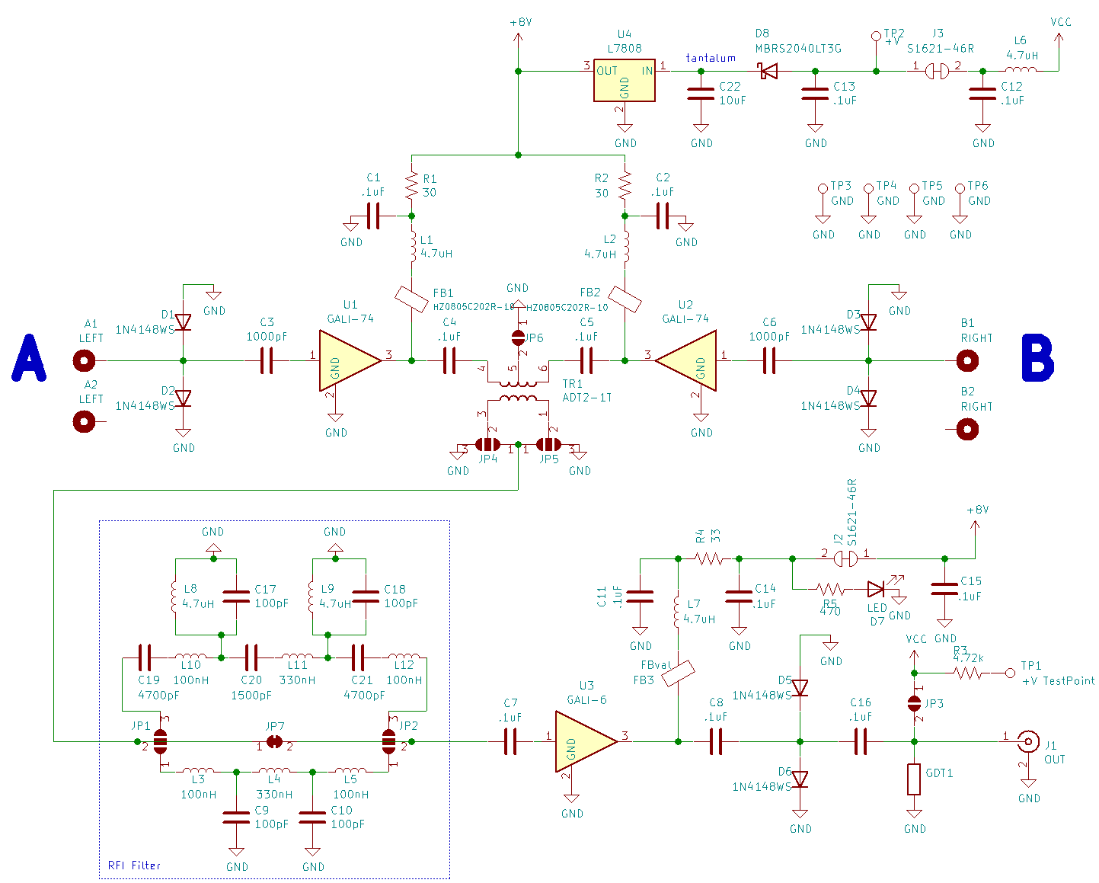
Schematic
NOTES:
Amp bias resistors R1, R2, & R4 Have been updated to 39Ω
This is to match datasheet recommended values

Slide 10
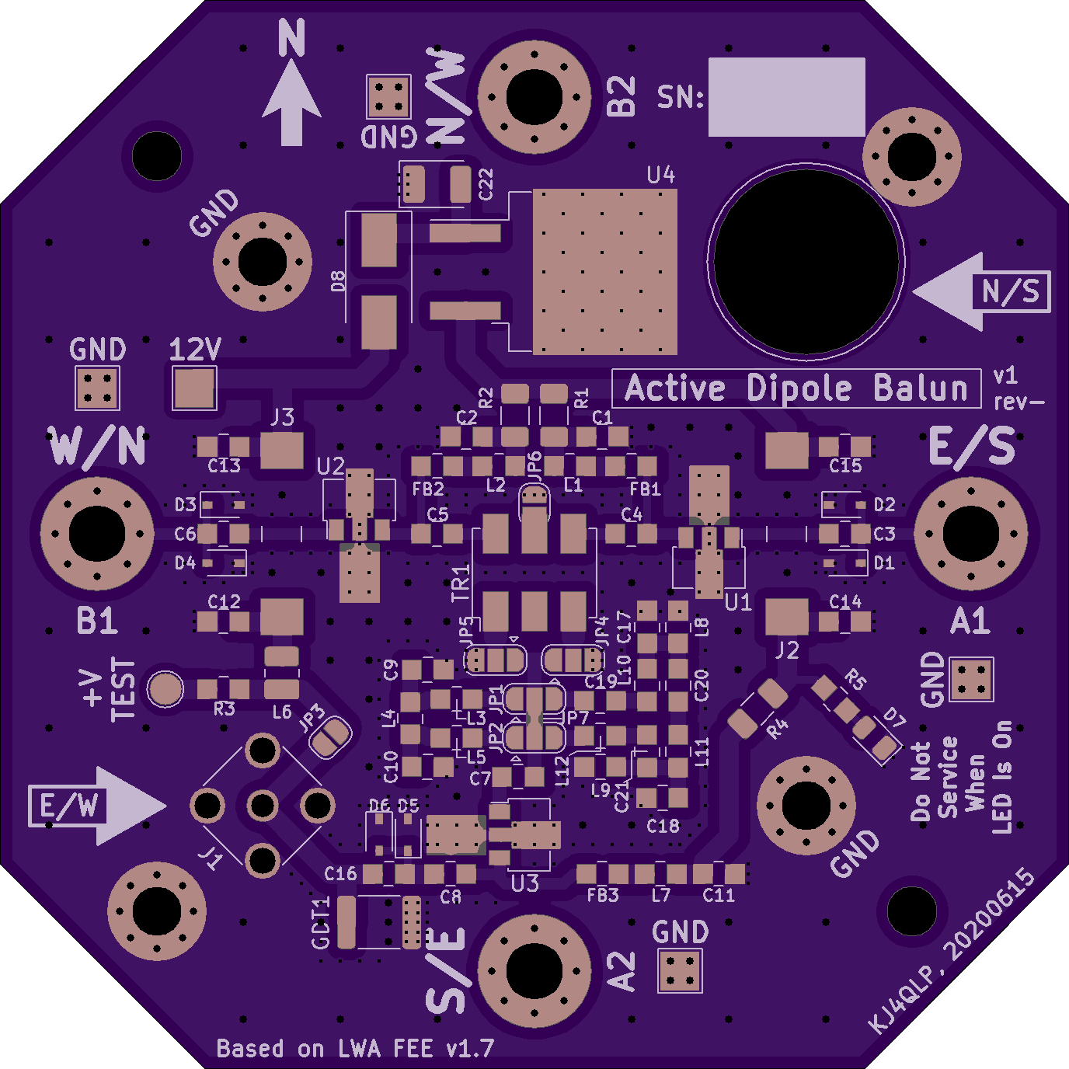
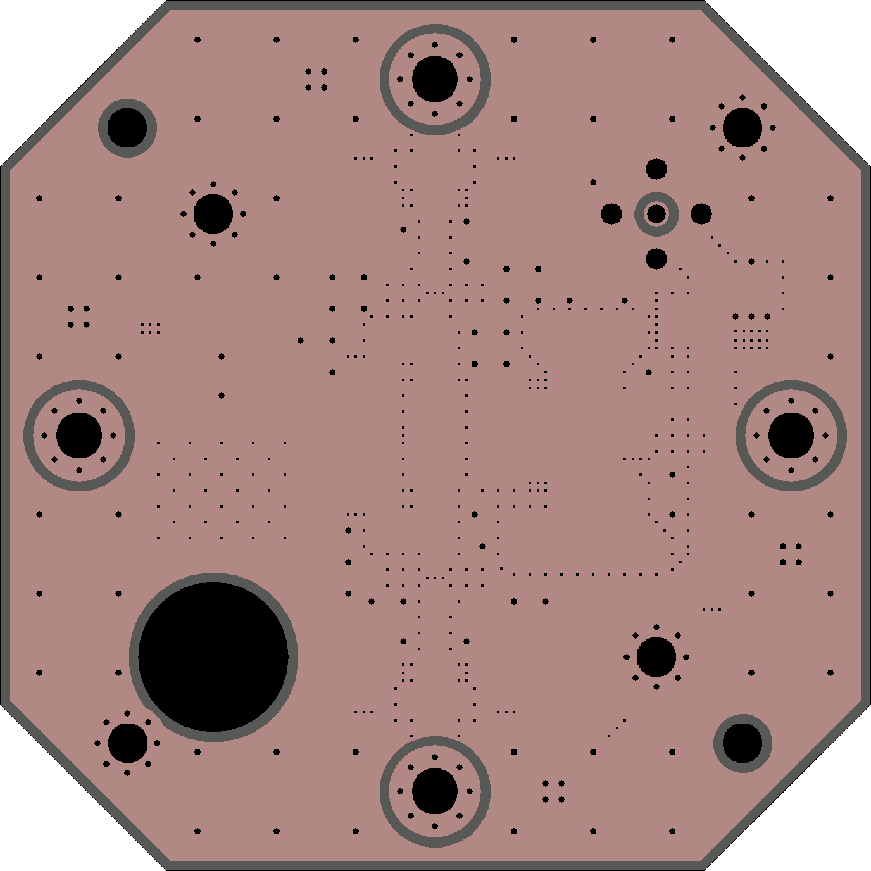
PCB Layout – Osh Park Images

Slide 11
Back to Back PCBs – Dual Polarization

Slide 12
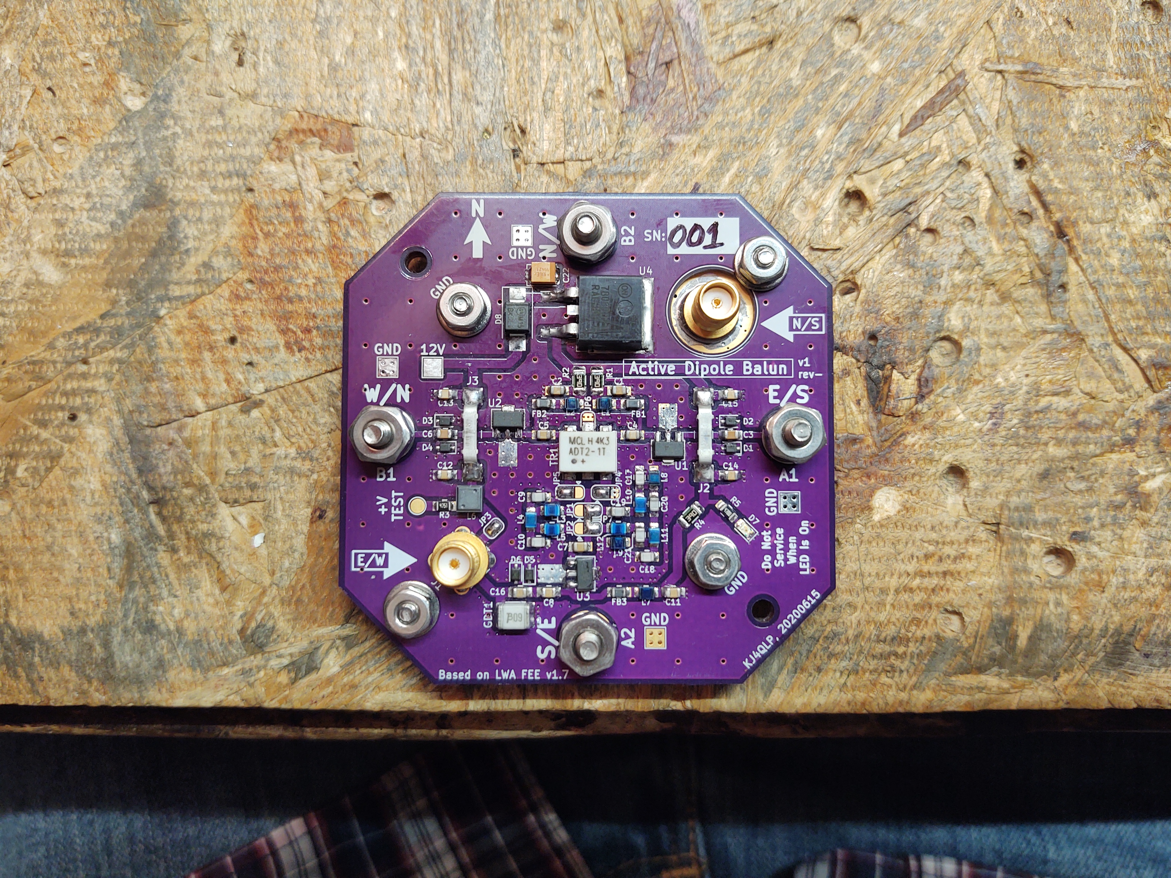
Populated PCBs
Single Balun
Double Balun

Slide 13
Solder Jumpers & some other details
LPF
RF Transformer
Polarity Selection
Bias-T
BPF
Bias-T
Disconnect
Filter Signal
Routing Selection
Gas Discharge Tube
Output Protection Diodes

Slide 14
Bench Top RF Measurements

Slide 15
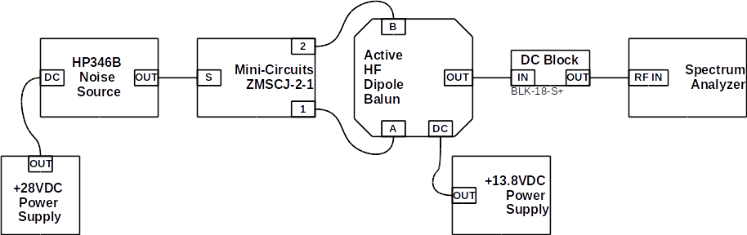
Noise Figure Measurement Setup
Noise Figure Measurement Setup
Based on Y-Factor Method
I don’t have time to present each configuration for each measurement type.
All measurements included component calibration, which are factored into the results presented.
More details may be presented in future documentation focused on the measurement process.

Slide 16
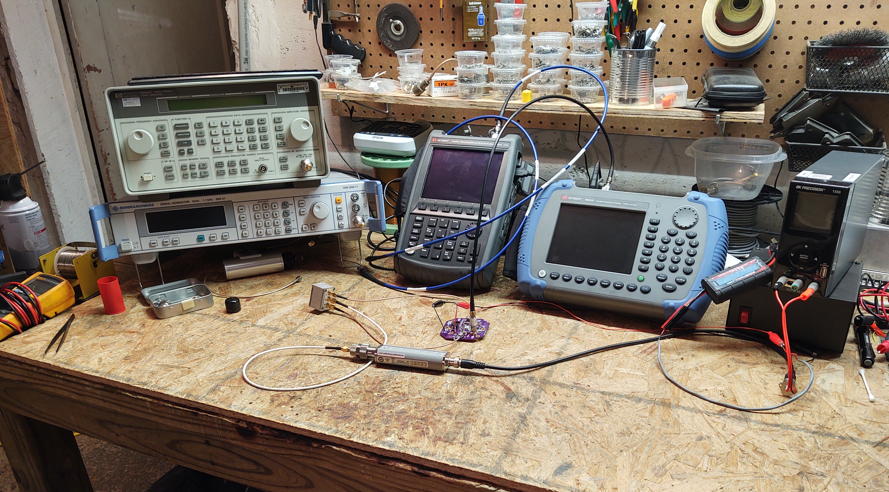

The Test Equipment
HP8648C
Keysight
N9926A
Keysight
N9343C
28V Supply
R&S SML01
Astron 13.8V
Linear Supply
MC ZMSCJ-2-1
HP346B
BLK-18-S+
Thank you Hume Center! Check us out: www.hume.vt.edu

Slide 17
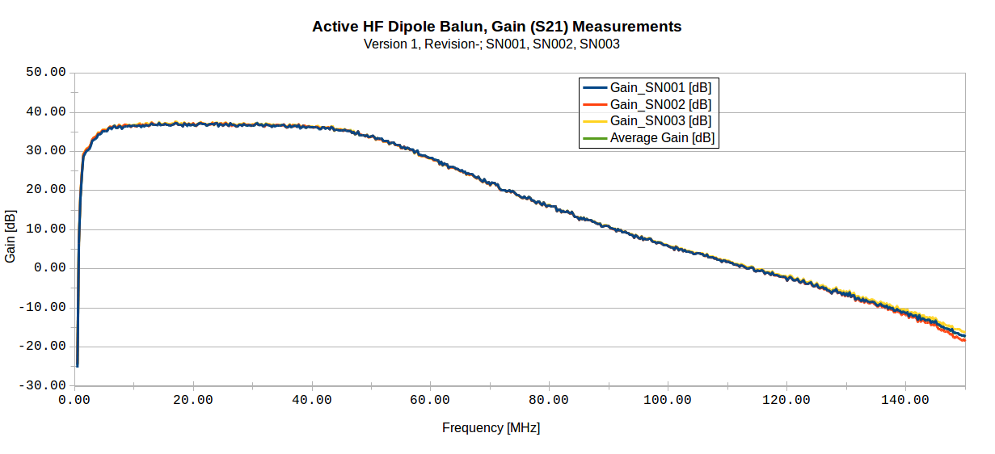
Gain, S21
36.1 dB
(Average)

Slide 18
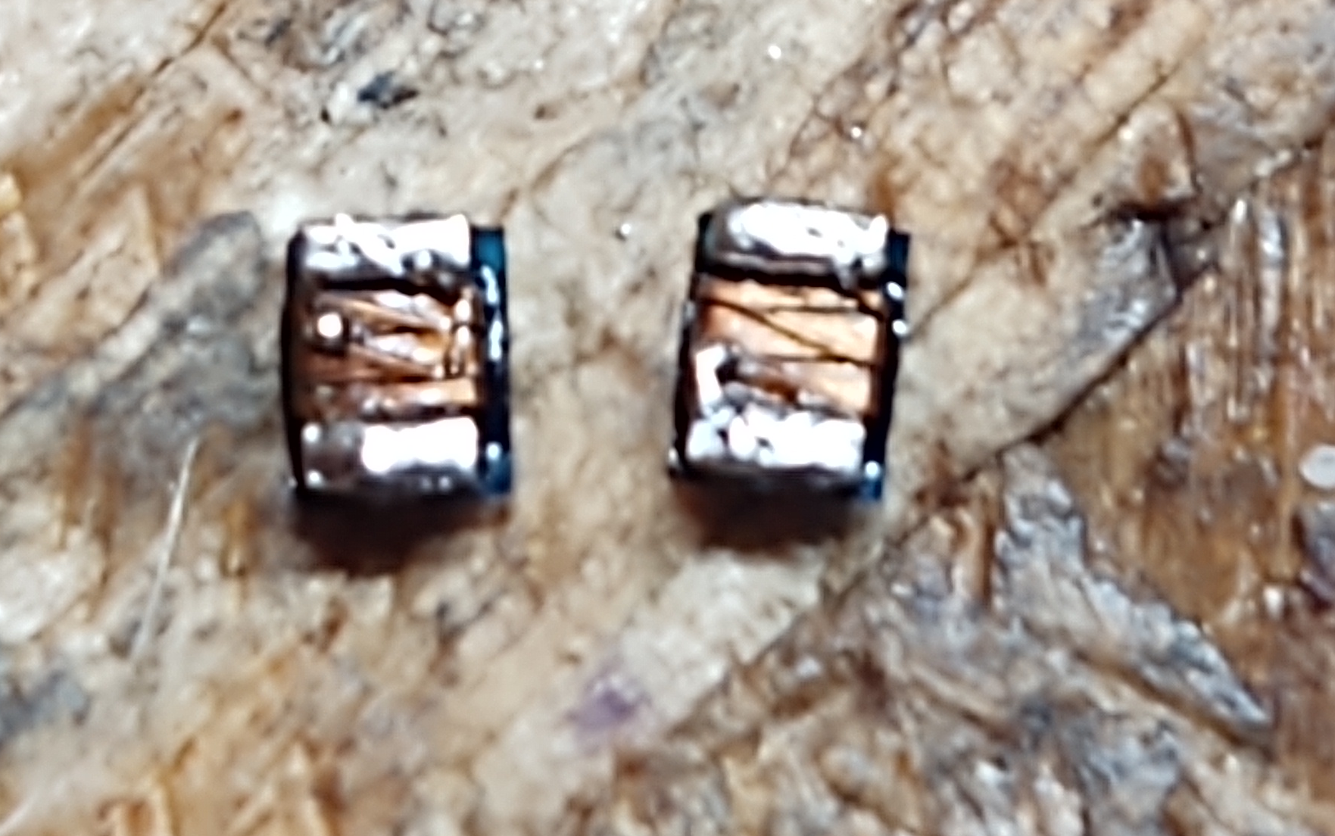
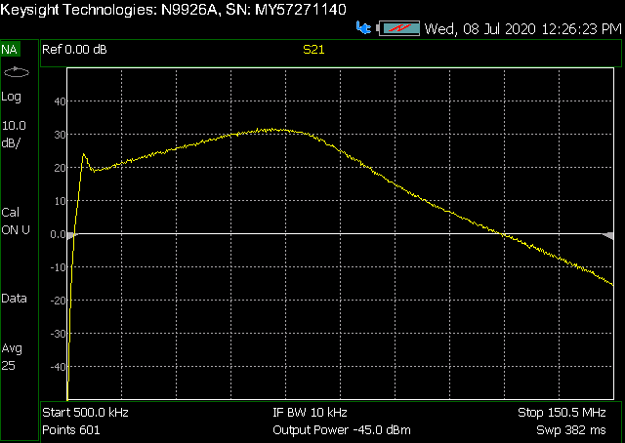
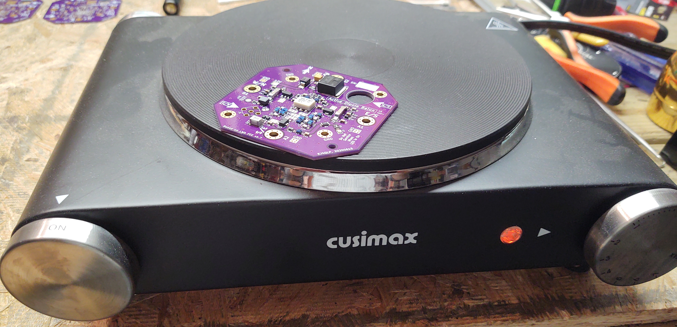
Bad SMT Solder Job = Bad Filter Response
With surface mount soldering by hand (no stencil)…Less is More!

Slide 19
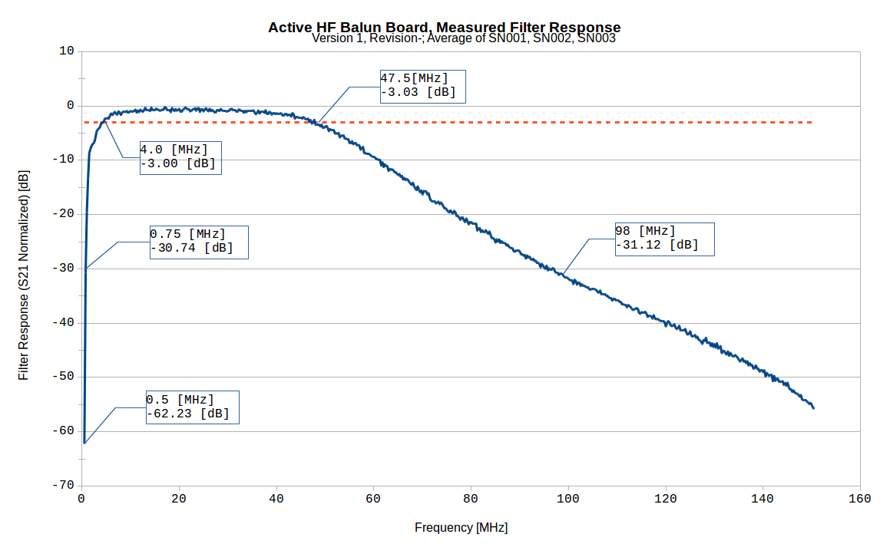
Integrated Band Pass Filter Response

Slide 20
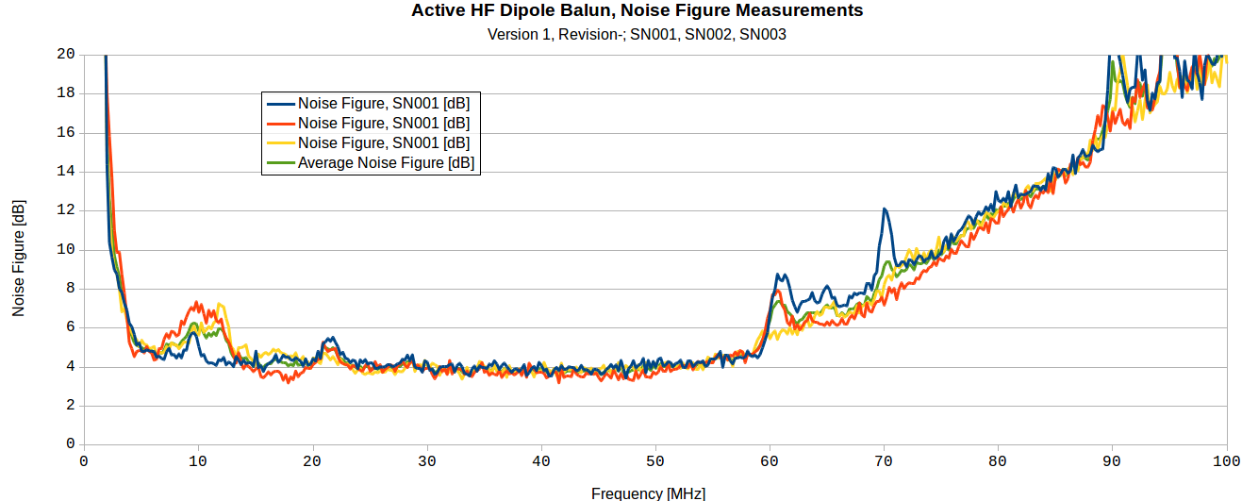
Noise Figure
Local EMI/RFI
Notice the RFI/EMI Spikes, may retake measurements in Faraday Cage

Slide 21
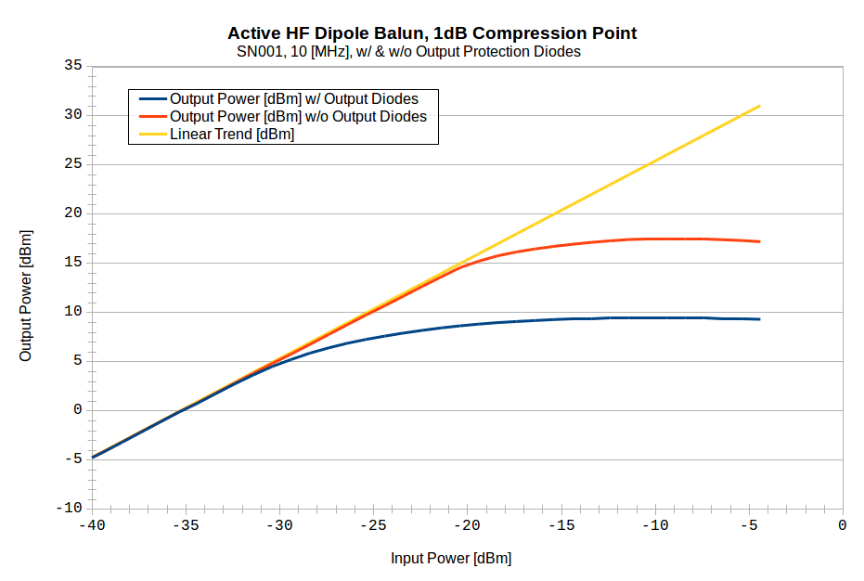
1dB Compression Point @ 10 MHz, SN001
(-18.9 [dBm], +15.5 [dBm]) w/o Output Diodes
(-28.4 [dBm], +5.9 [dBm]) w/ Output Diodes

Slide 22
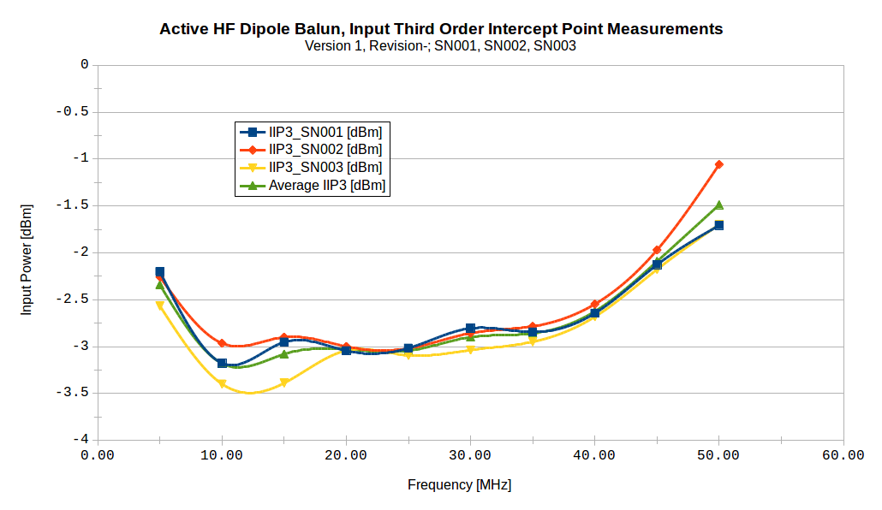
Input Third Order Intercept Point (IIP3)

Slide 23
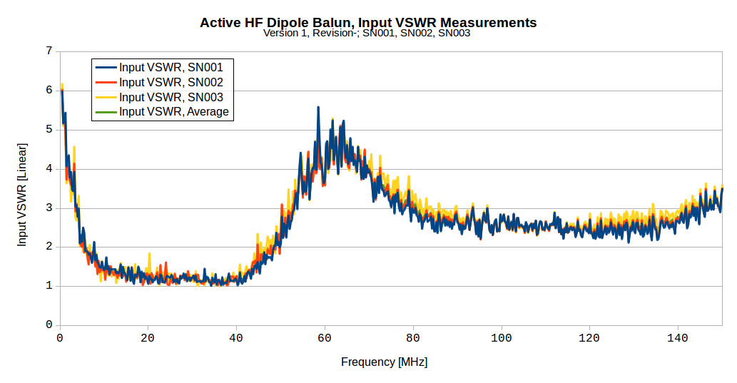
Input VSWR

Slide 24
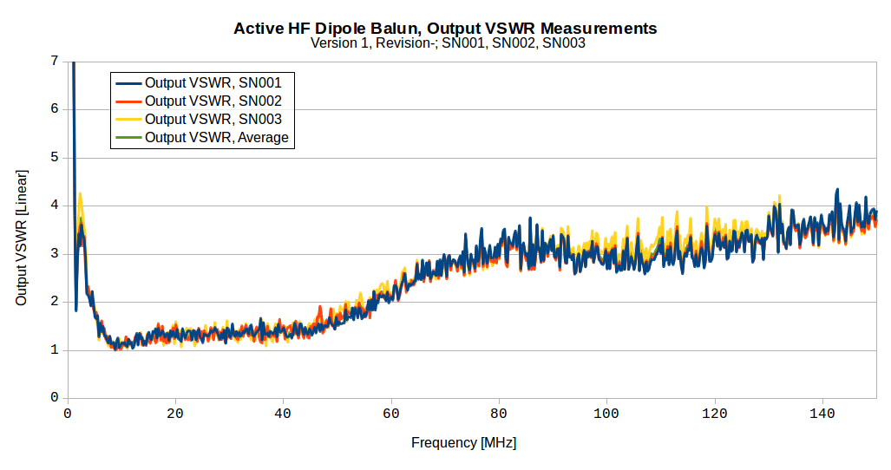
Output VSWR

Slide 25
On Air Test Measurements
Comparison to T2FD and DXE-RF-PRO-1B
Selected Screengrabs

Slide 26
Dual Polarization High Level System Diagram
True
North
N/S
Shack
75’ RG-8X
Lightning
Arrestor
Bias-T
Dual RX
SDR
RX 1
E/W
Lightning
Arrestor
Bias-T
RX 2
75’ RG-8X
13.8VDC
Power
Supply

Slide 27
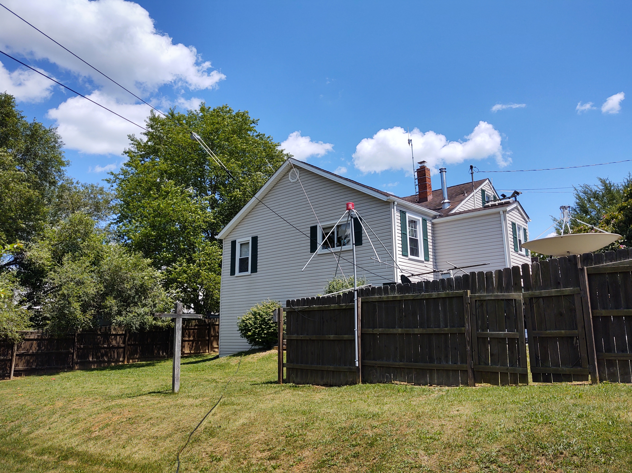
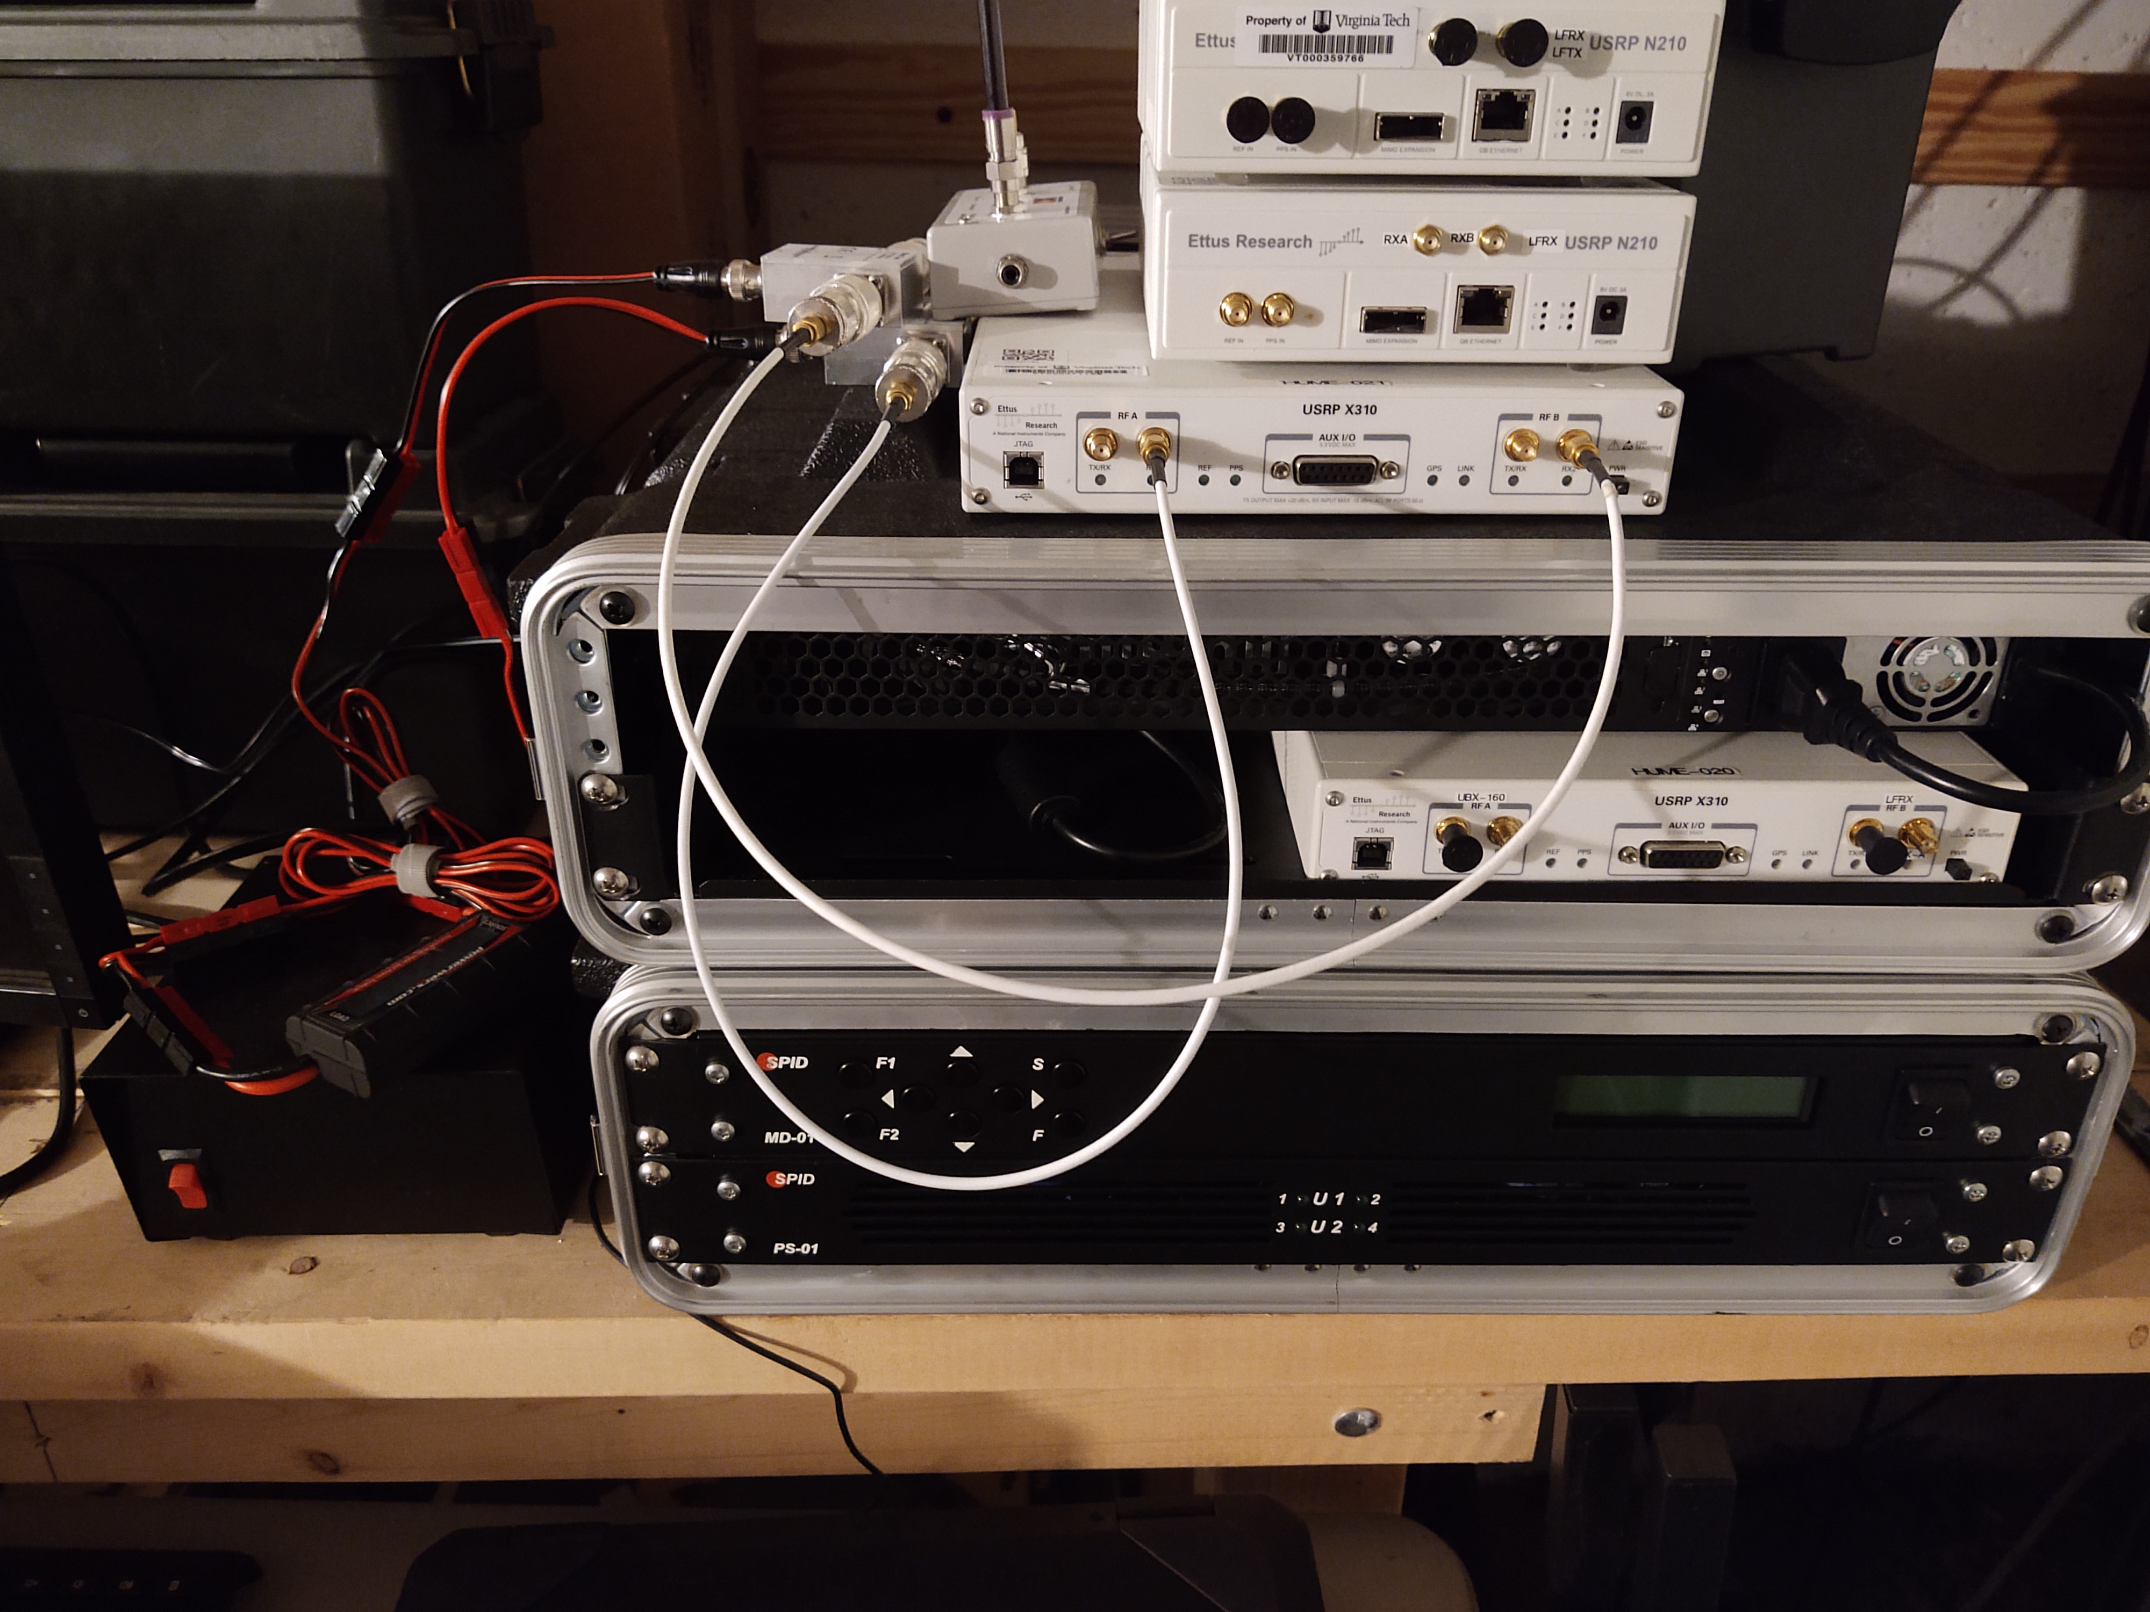
On Air Measurement Setup
Thank you again Hume Center!
Check us out: www.hume.vt.edu

Slide 28
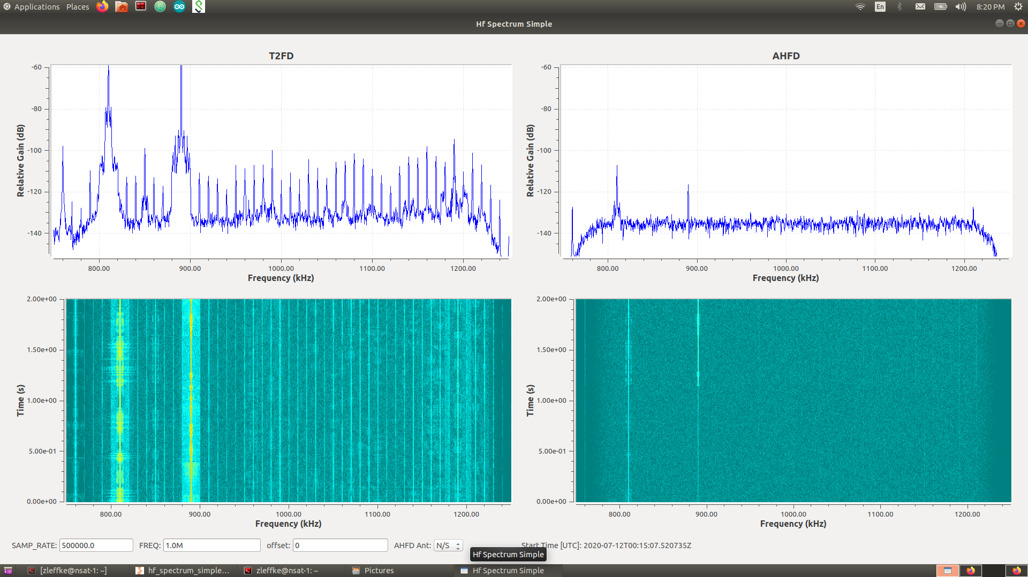
T2FD vs Active HF Dipole – 1.0 MHz
AM filter appears to be doing its job

Slide 29
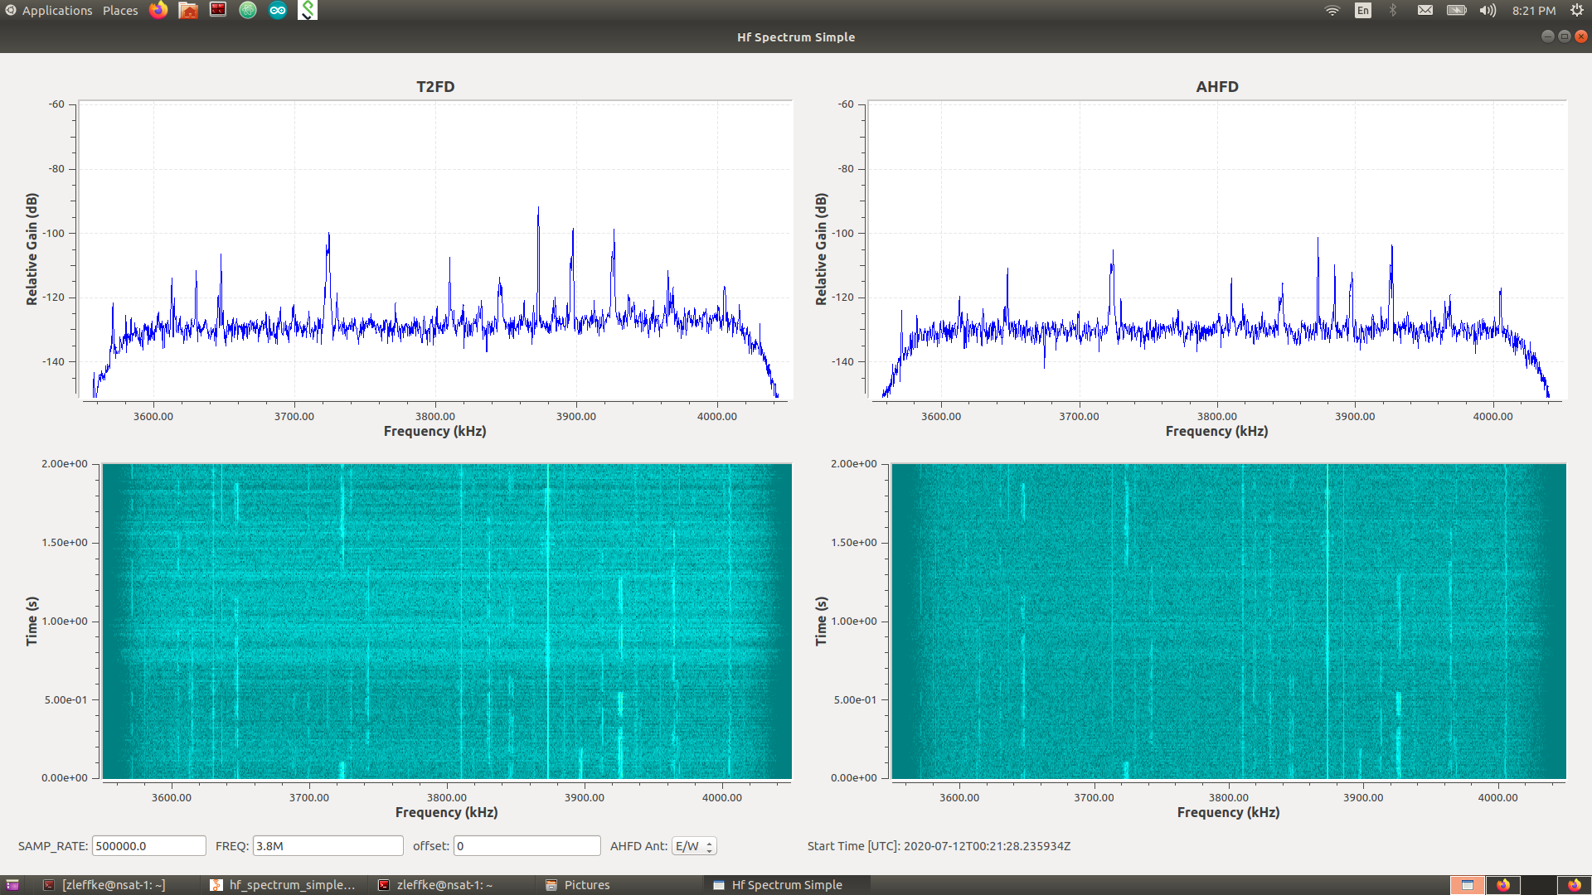
T2FD vs Active HF Dipole – 3.8 MHz

Slide 30
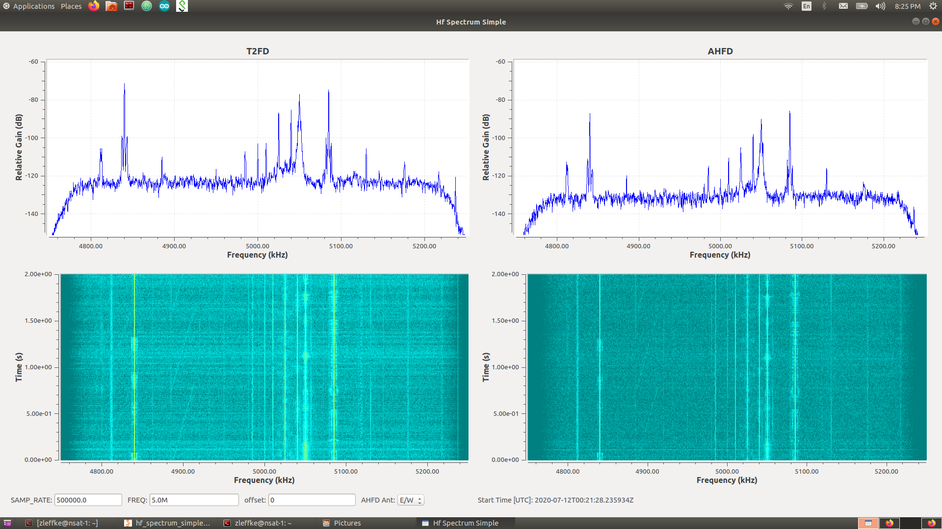
T2FD vs Active HF Dipole – 5.0 MHz

Slide 31
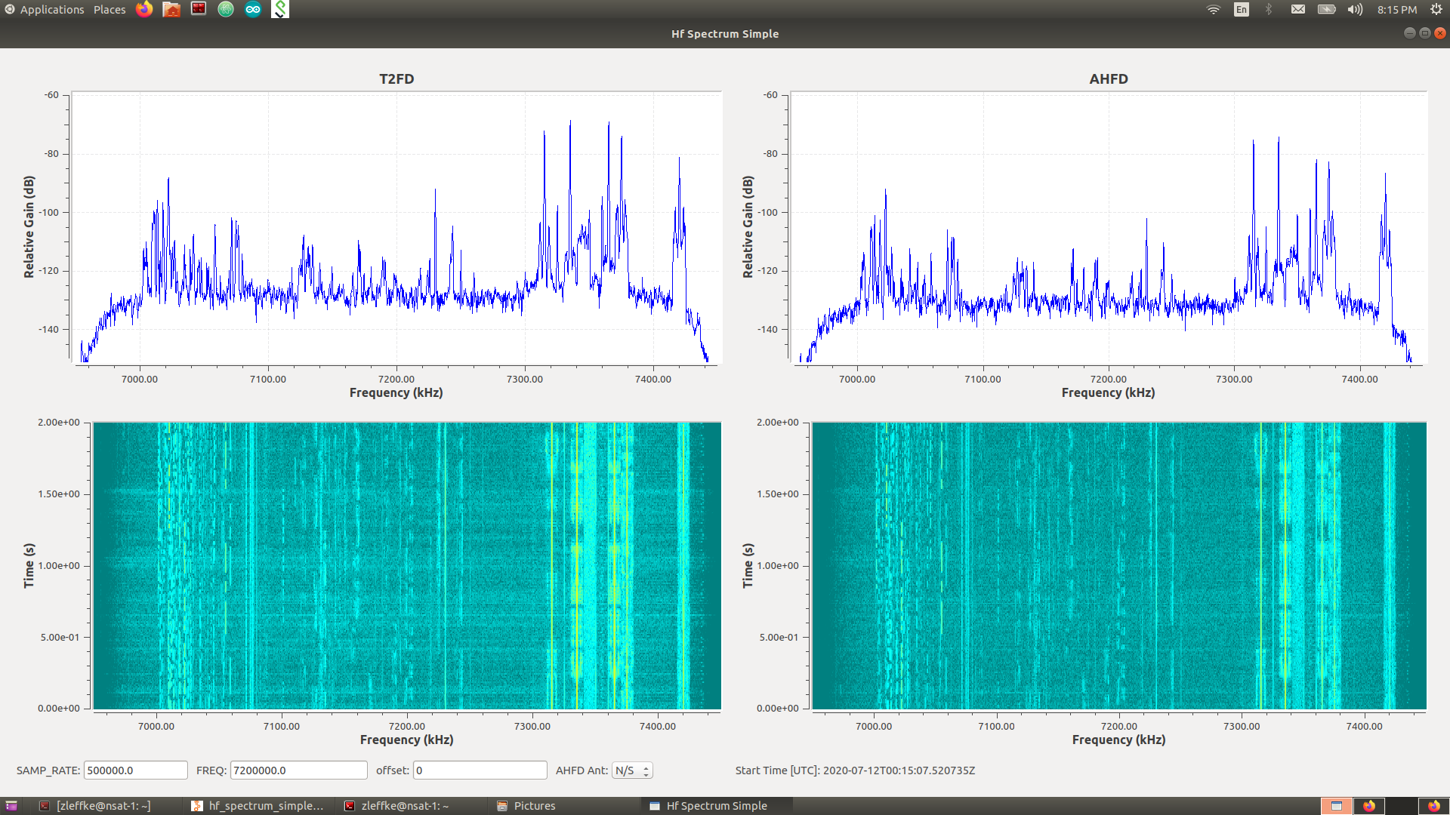
T2FD vs Active HF Dipole – 7.2 MHz

Slide 32
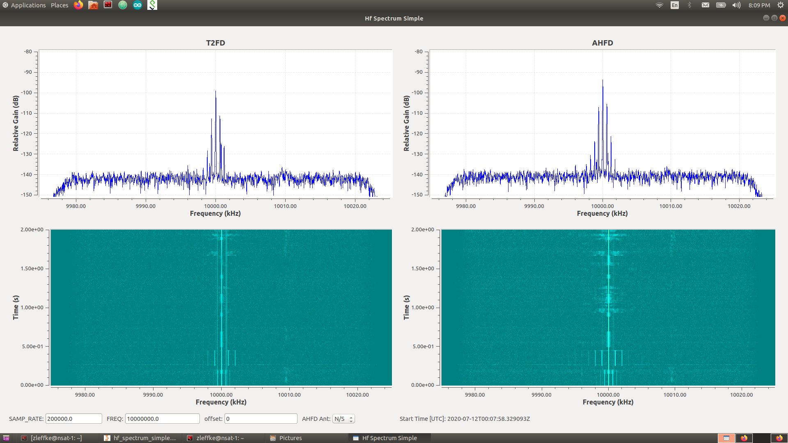
T2FD vs Active HF Dipole – 10.0 MHz

Slide 33
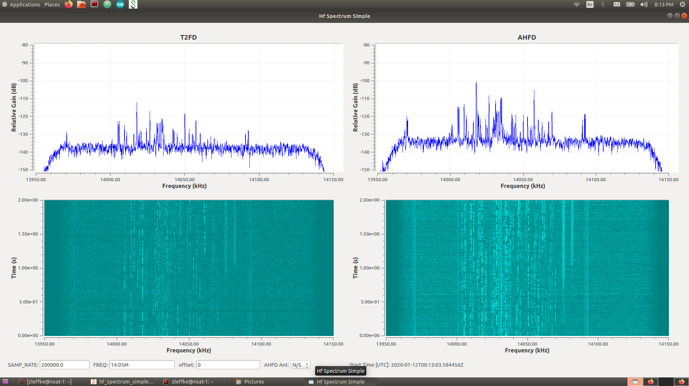
T2FD vs Active HF Dipole – 14.05 MHz

Slide 34
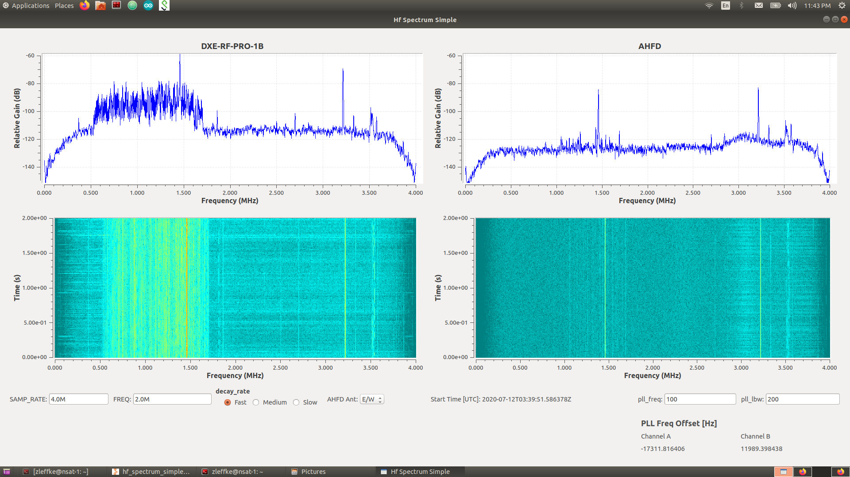
DXE-RF-PRO-1B vs Active HF Dipole – 2.0 MHz
AM filter appears to be doing its job

Slide 35
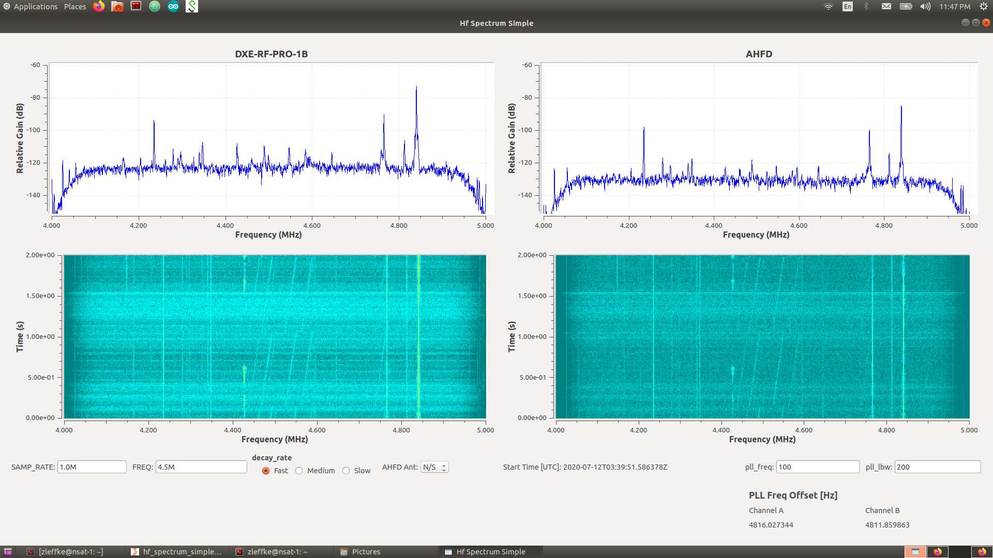
DXE-RF-PRO-1B vs Active HF Dipole – 4.5 MHz
Still in the AHFDB lower filter rolloff region

Slide 36
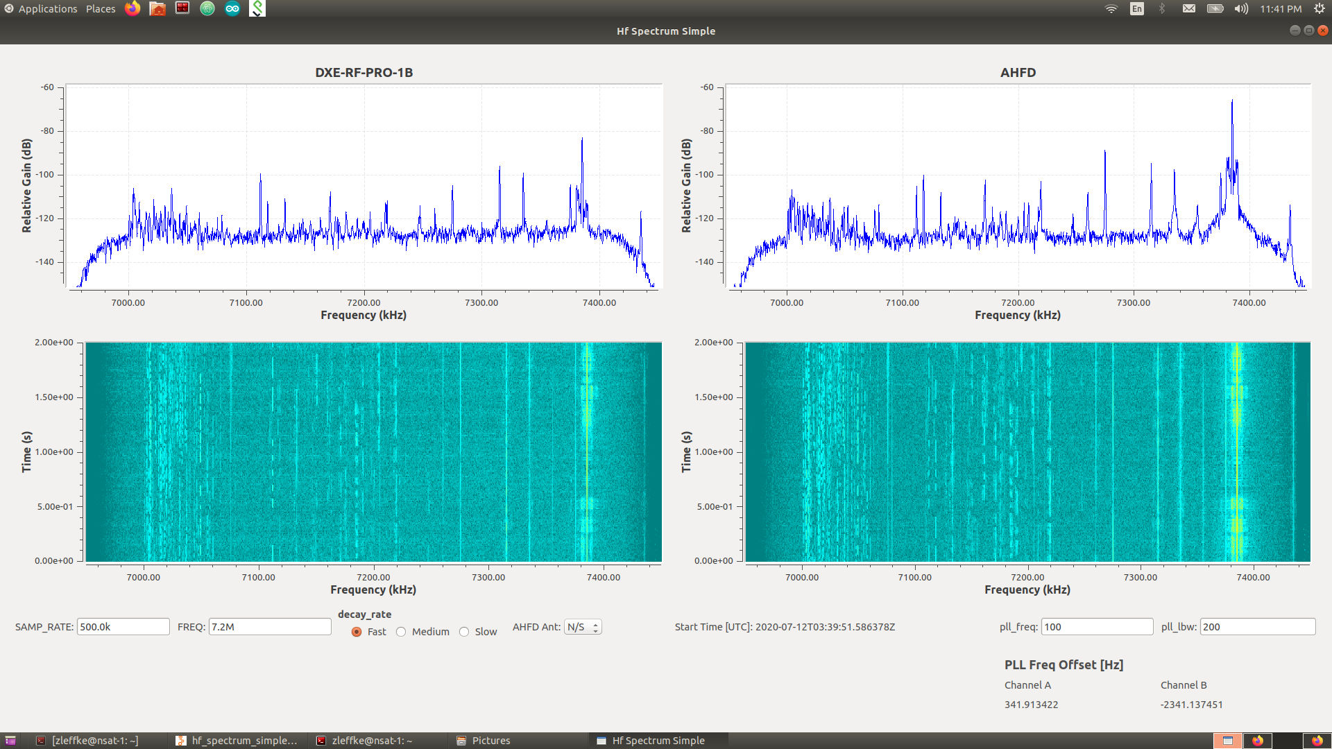
DXE-RF-PRO-1B vs Active HF Dipole – 7.2 MHz

Slide 37
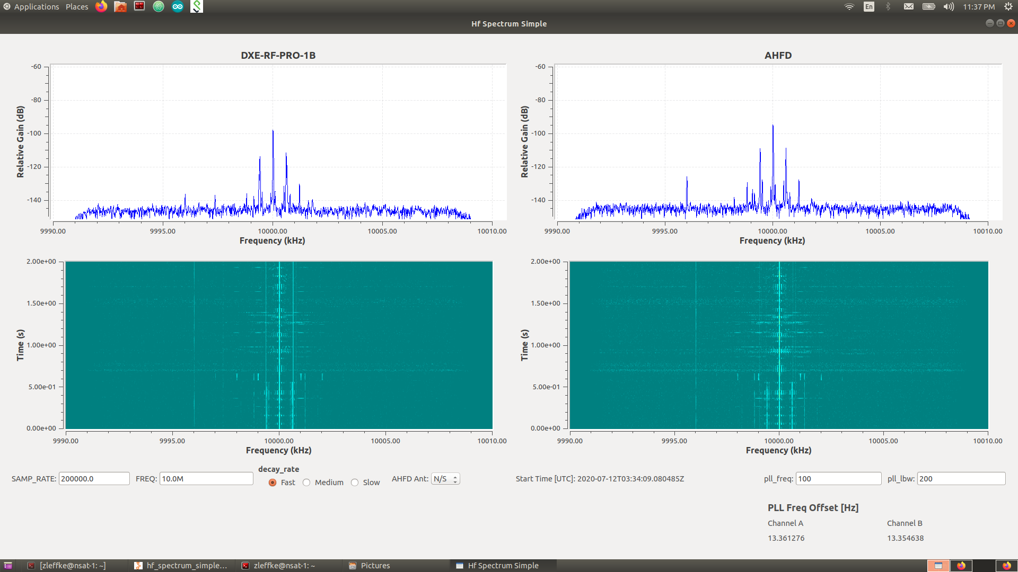
DXE-RF-PRO-1B vs Active HF Dipole – 10.0 MHz

Slide 38
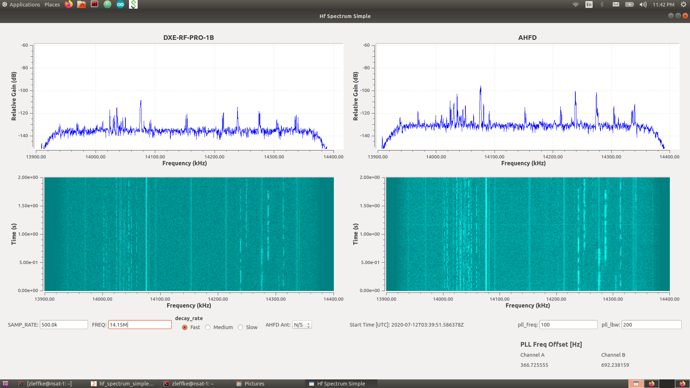
DXE-RF-PRO-1B vs Active HF Dipole – 14.15 MHz

Slide 39
Next Steps / To Do
Documentation!
  Documentation!
    Documentation!
      Documentation!
Investigate PGA-103 replacement for GALI-74s
  More measurements!
Next Revision of PCB
  Bigger keepout around antenna element mounting holes
  Wire to PCB terminal (screw lock)?
Schematic / Layout / PCB for Bias-T
  v1,rev1 out to Osh Park...more measurements to come!
And bunch of other areas for experimentation…
  Antenna patterns and element selection (better than the ~5ft 14AWG wire...4NEC2!)
  SDRs and phasing for Circular/Elliptical Polarization

Slide 40
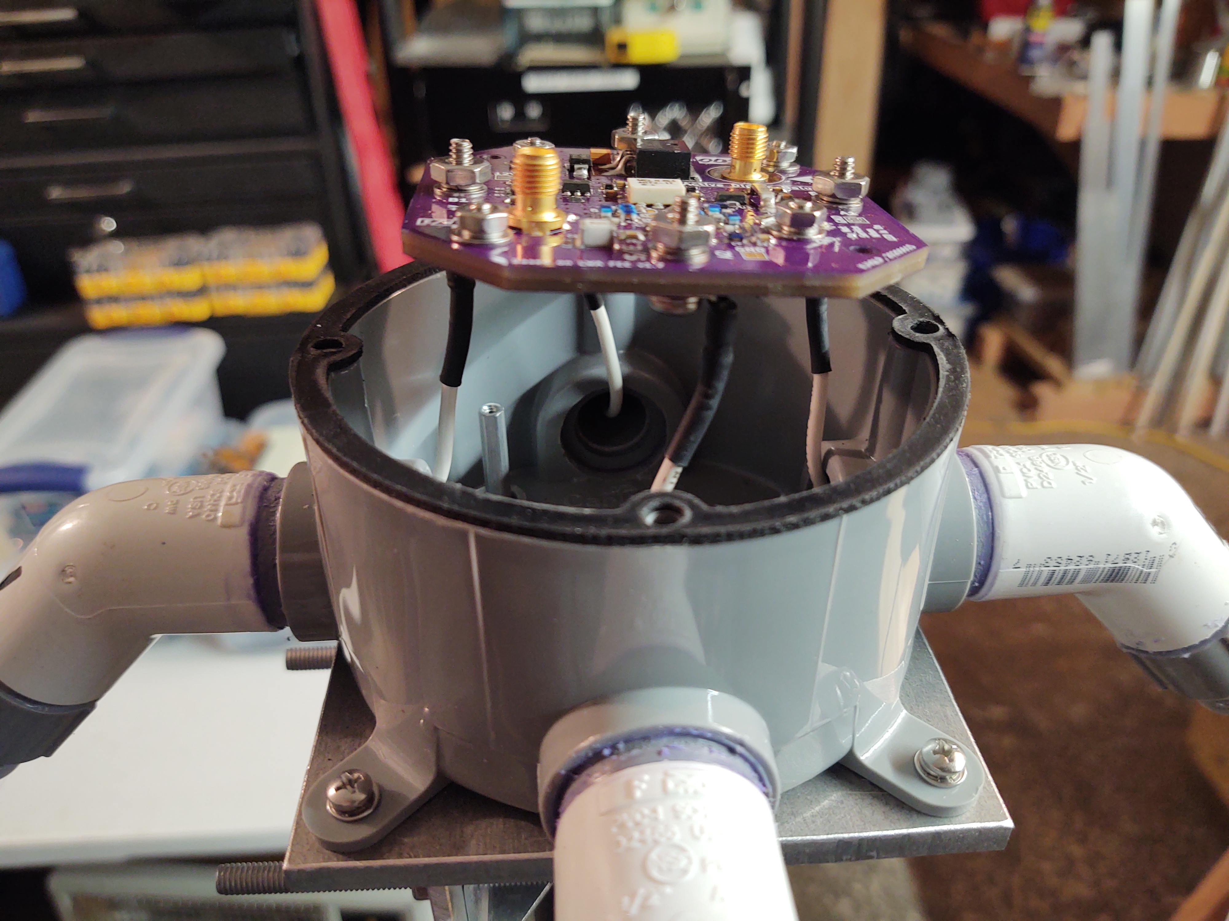
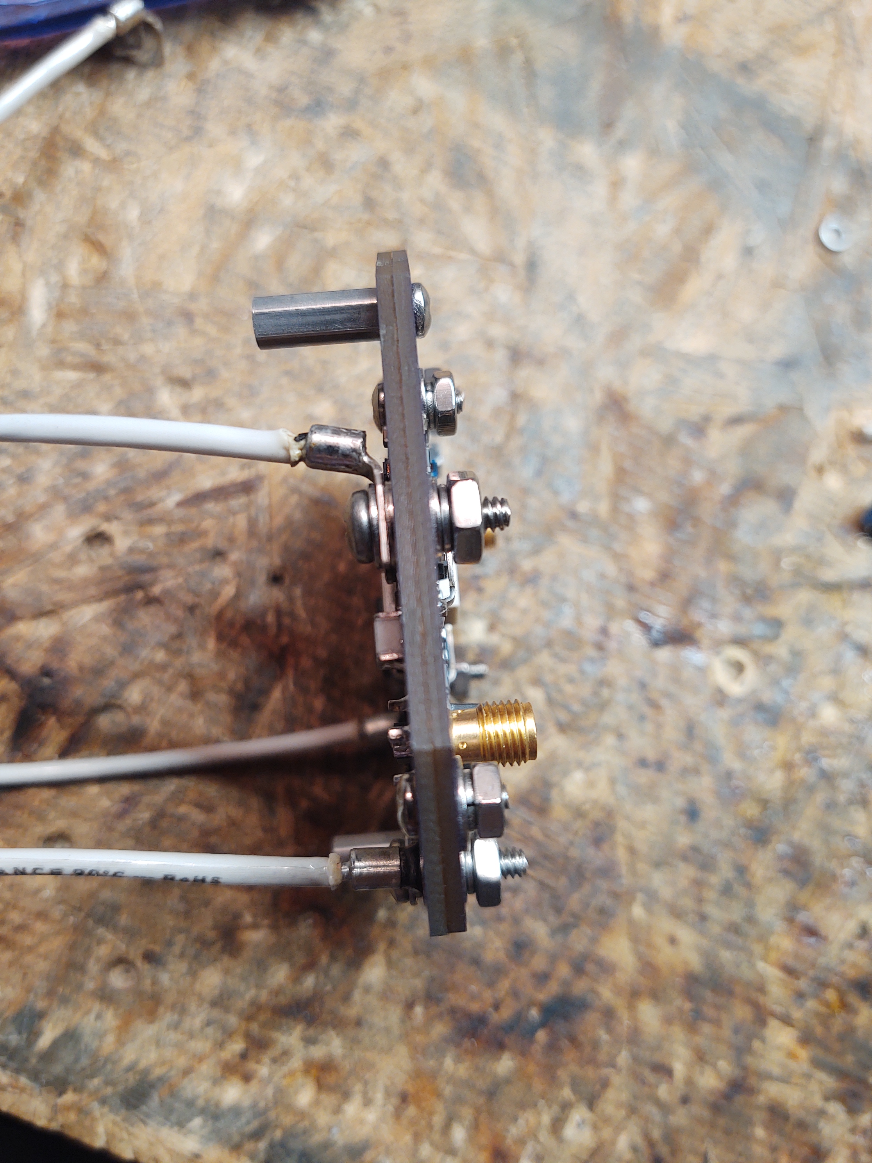
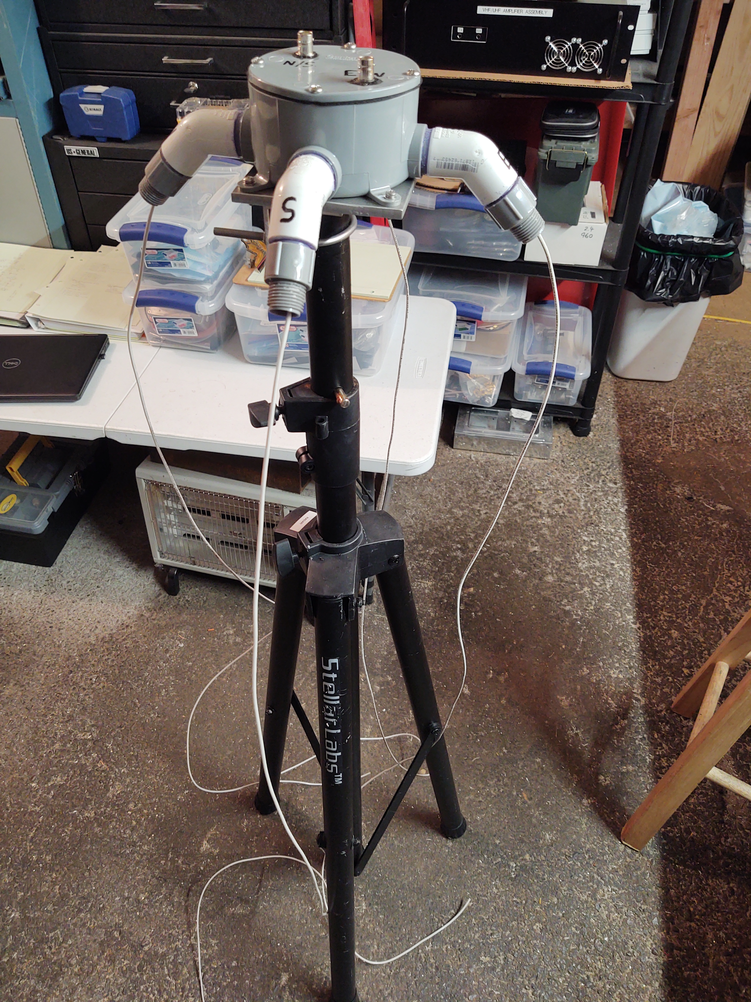
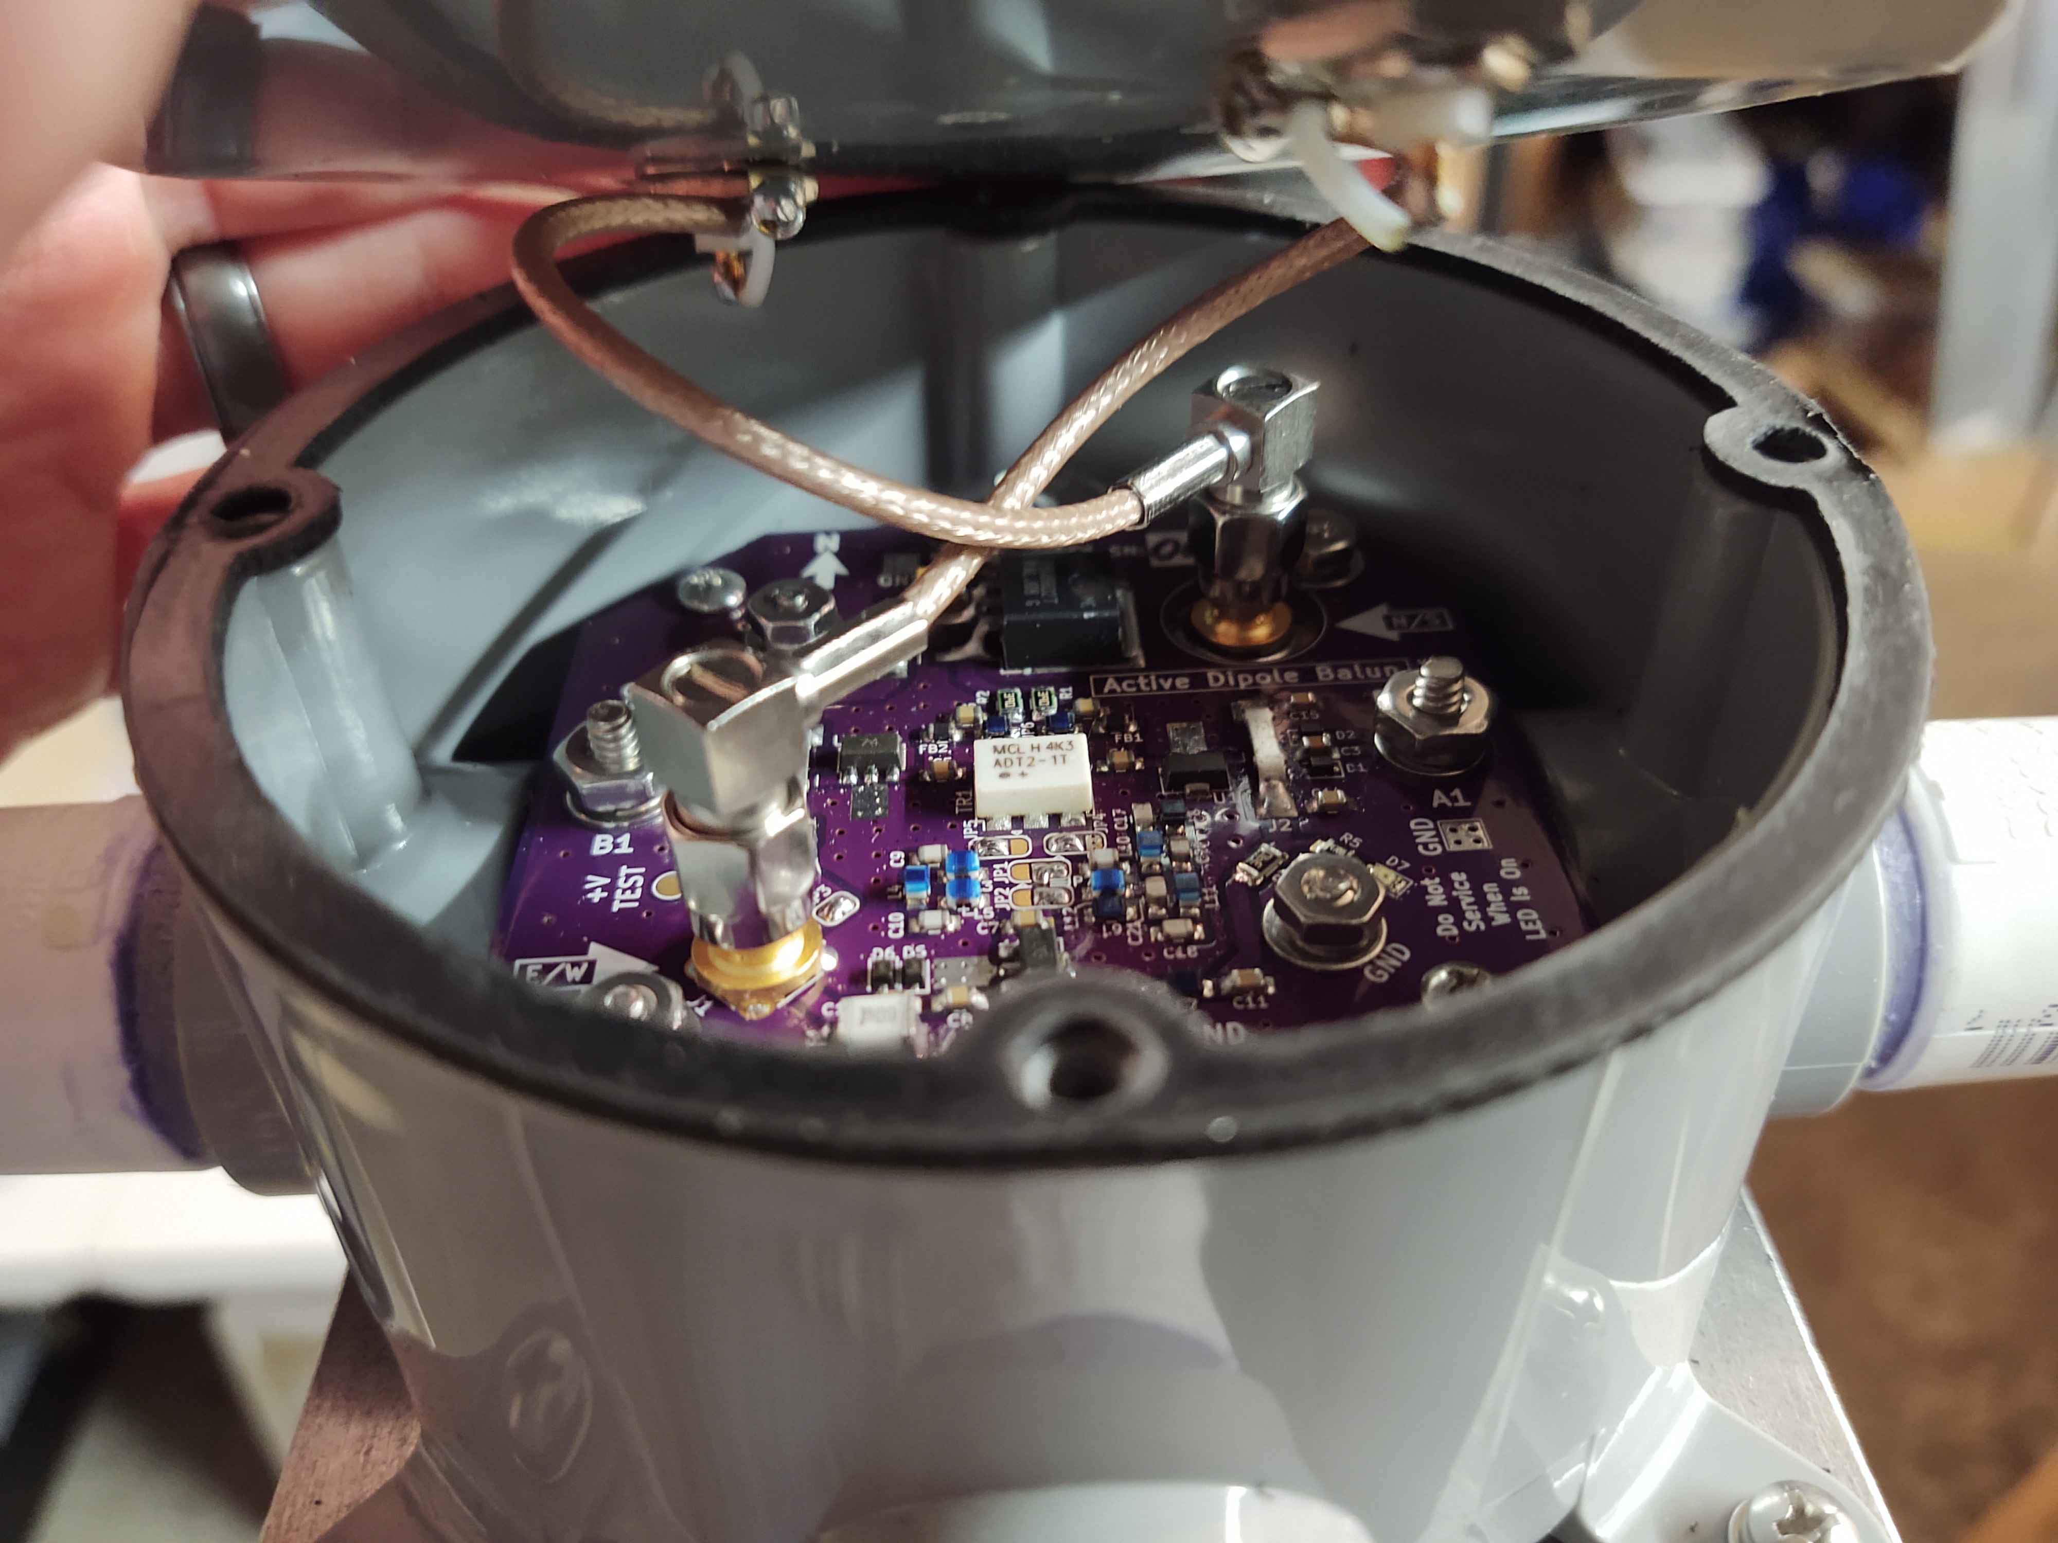





Thank You!

