Slide 1


FSAE Software
4/13/2025
Evan Steinhoff, Leo Dai, Aiden Mcdougould, Lawrence Benitez, Conner-Ryan Petersen

Slide 2
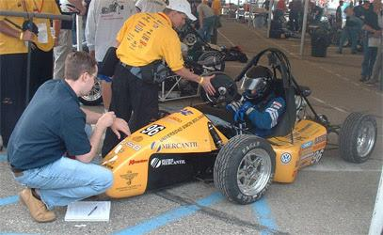

Introduction
We developed Trackside, a software tool designed to monitor car systems in real time. It also enables users to review data from previous laps, making it easier to identify issues and uncover performance insights.
The project focuses on building an integrated control system for a Formula SAE vehicle, covering data acquisition, real-time processing, and telemetry.

Slide 3
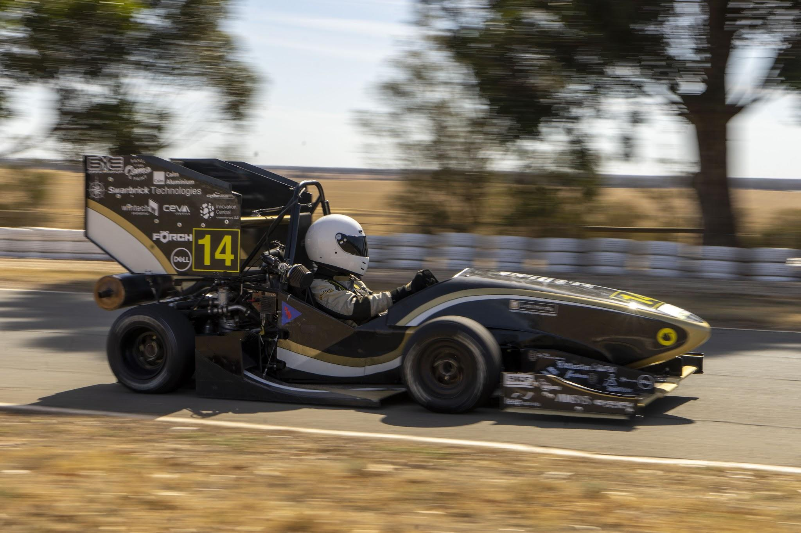
Justification
Why Trackside?
We want to make telemetry data clear and easy to understand.
We want to make improving or debugging the car more efficient.
Practical Experience:
Offers experience in:
Data Aggregation
Data Visualization
UI/UX
Most importantly this project allows for us to deal with data from physical environments.

Slide 4




Project Goals
Port over our previous project from Golang Fyne Frontend to Unity Engine
More capabilities
Better performance
Create
systems for the Car CCU to facilitate data management and input monitoring.
a functional and customizable console to read and send data from the car to a control system.
Implement a database using golang and sqlite3 to store and retrieve information in real time
Setup data collection from electronic sensors
GPS, Thermal Sensors, etc.

Slide 5
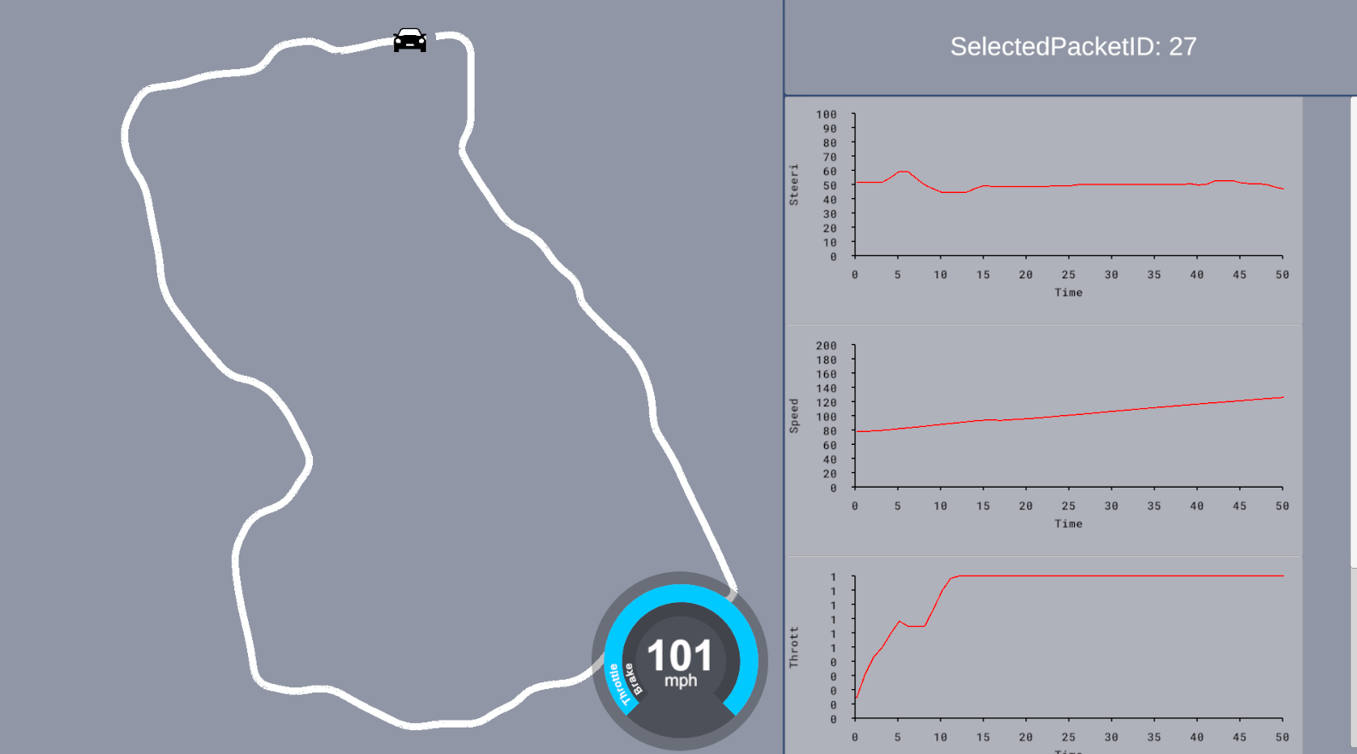
UI
We created UI elements to better access the data in Unity such as graphs and a speed gauge view.
Graphs:
The X and Y axis min and max can be changed along with the actual X and Y scale of the graph
Scrollable
Speedometer:
Actively updates the speedometer
Trackmap:
Dynamically tracks the car around the track

Slide 6
Demonstration

Slide 7
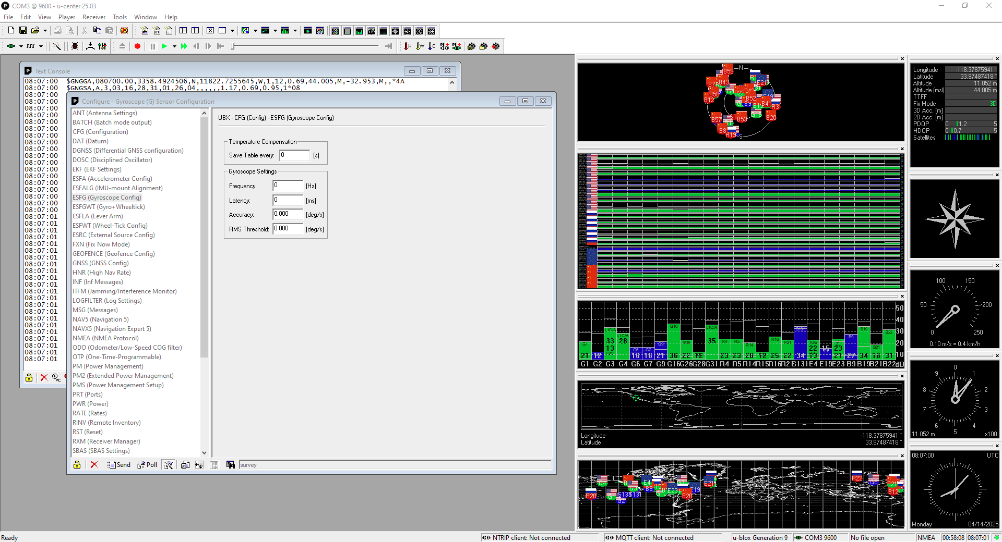
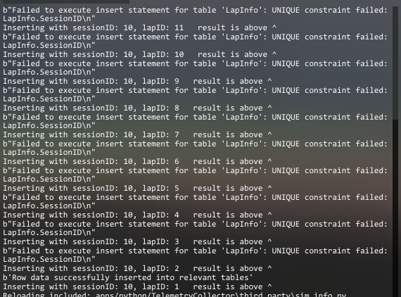
Challenges
Setting up GPS configuration software
RTK Support. Having the two gps units communicating and using each other to get better precision
Connecting Golang backend to Unity/Other Apps
Issues when appending/inserting data into the SQLite database h
Getting relevant data without a car
We have no way of actually getting real data right now since the car is not built.
Had to resort to making a lua plugin to collect telemetry data from the racing simulator Assetto Corsa. (took longer than coding the unity app)

Slide 8
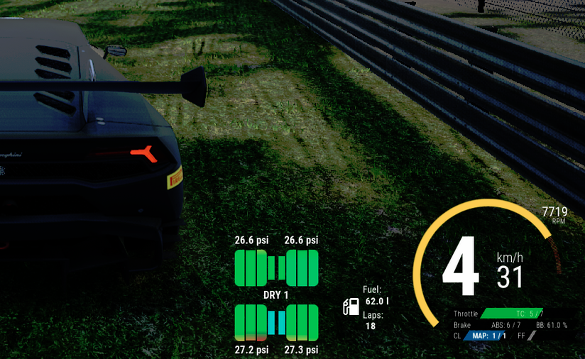
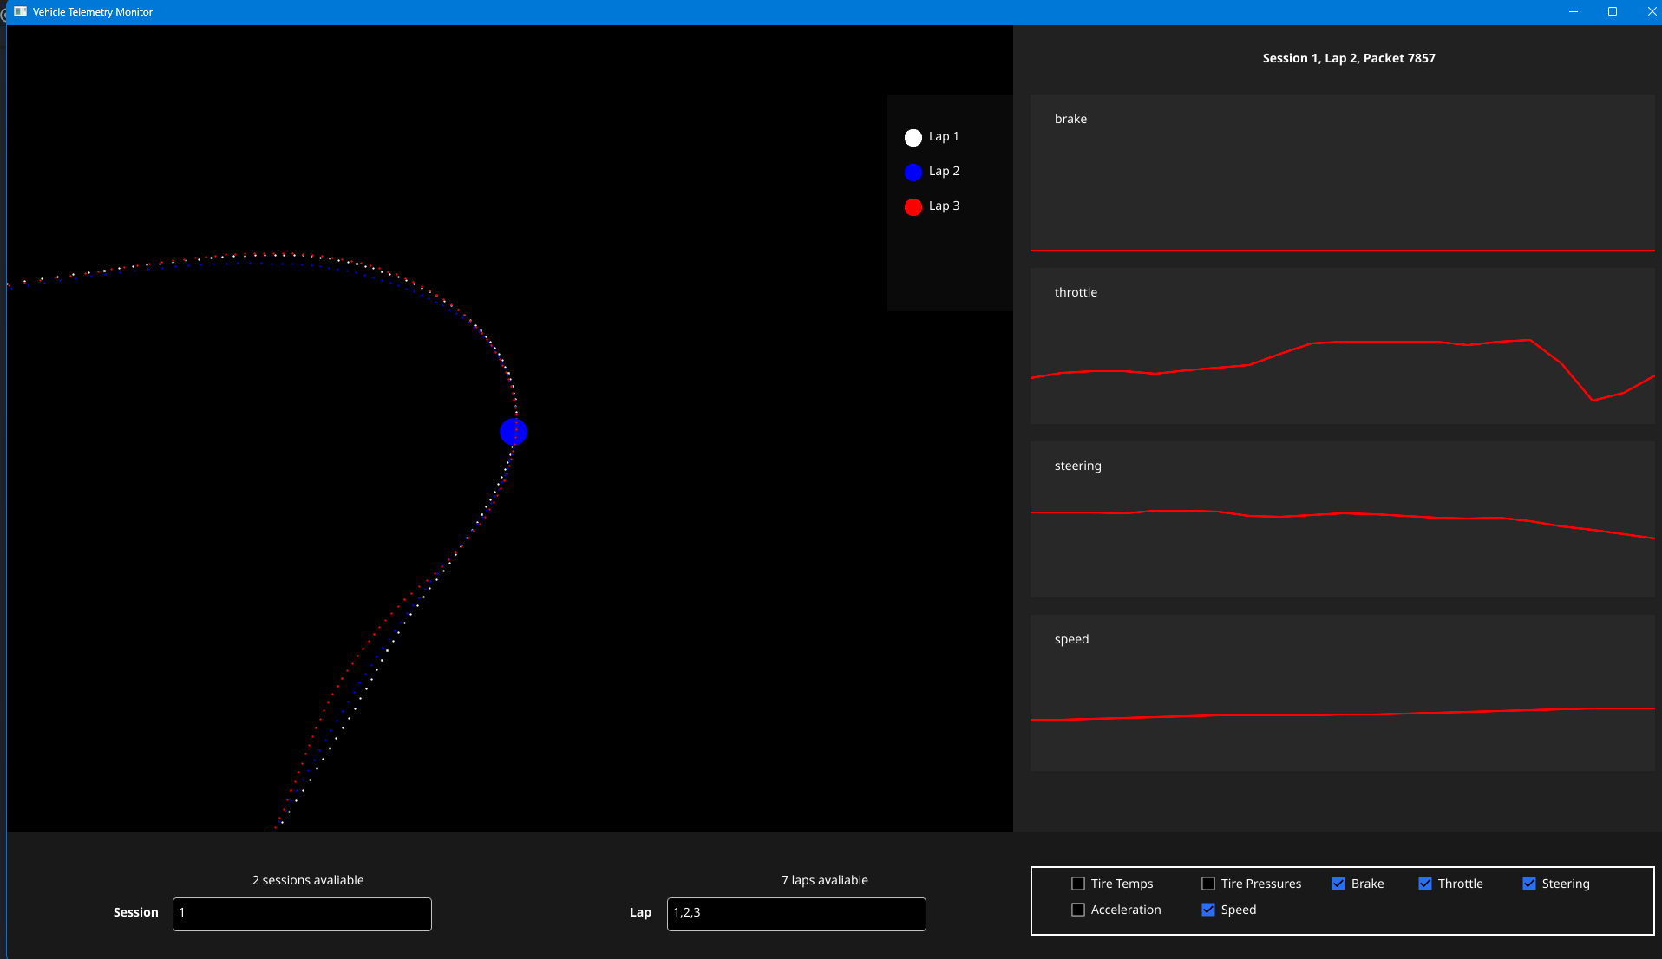
Status Update
Task | Status
Expanding functionality of app Port replay system from Golang version to Unity version | Ongoing
Working on a full console, with dynamic customizable panels containing all the features | Ongoing
Getting work on data collection from sensors for the central control unit (Raspberry PI). Mount CCU on RC car with sensors to test out functionality for now. | Ongoing

Slide 9
Thank you!
Questions?

