Slide 1
Methodology of Single Shot Instance Segmentation on Edge Device
Longfei Zeng
Lakehead University

Slide 2
1
Review
Content
2
Methodology
3
Experiment

Slide 3
Part one
01
Review

Slide 4
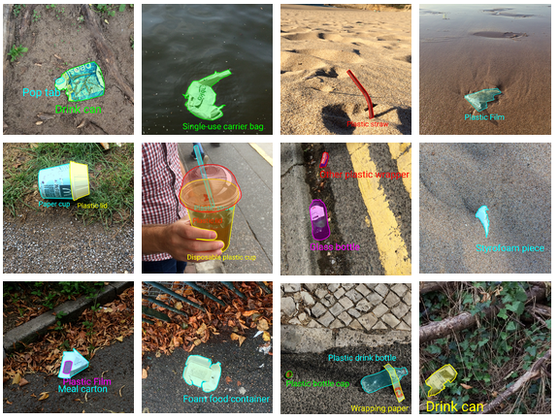
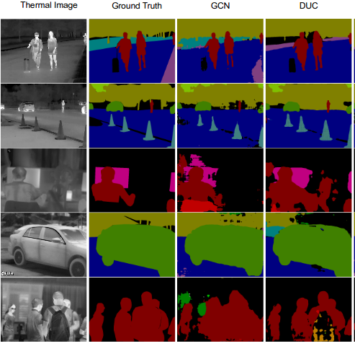
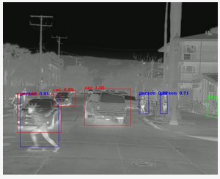
DataSet
Verify the correctness of the model: COCO
Extention tasks: TACO & SODA Dataset & FLIR
Instance Segmentation
Thermal Image Detection and Semantic Segmentation

Slide 5
Part two
02
Methodology

Slide 6
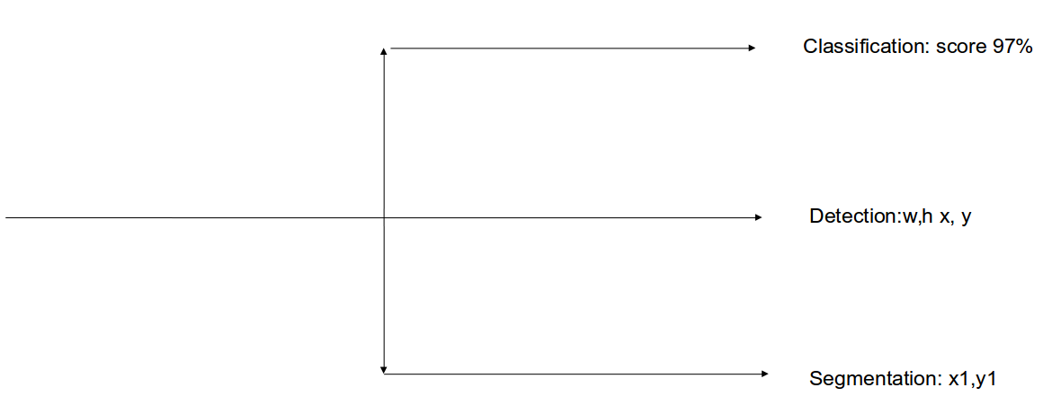
1. Three Branches

Slide 7
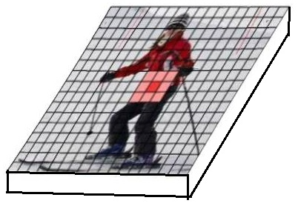
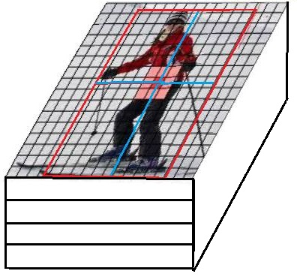
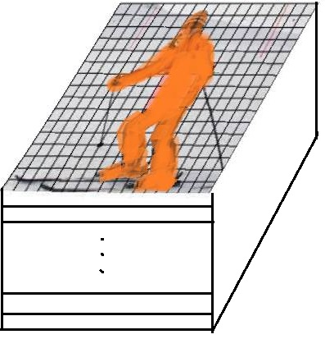
1. Three Branches
Center Heatmap
Channels: 1 (0~1)
LRTB Regression
Channels: 4 (for each pixel)
Semantic Segmentation
Channels: K (k classes)

Slide 8
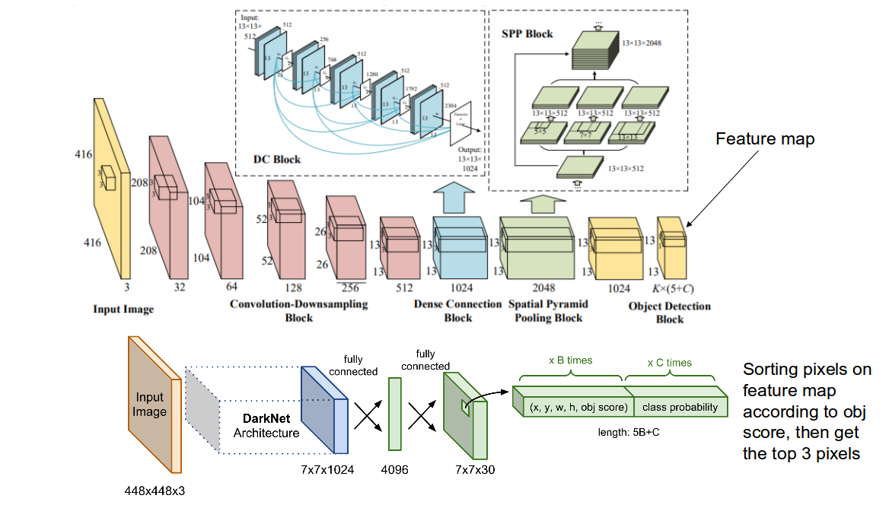
1. Three Branches

Slide 9
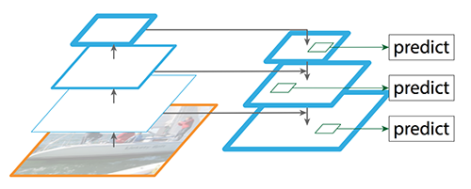
1. FPN

Slide 10





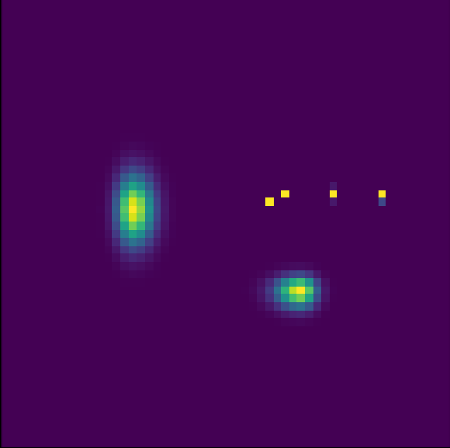
Quadrant
Gaussion Distribution
Part of ellipse

Slide 11
Part three
02
Experiment

Slide 12
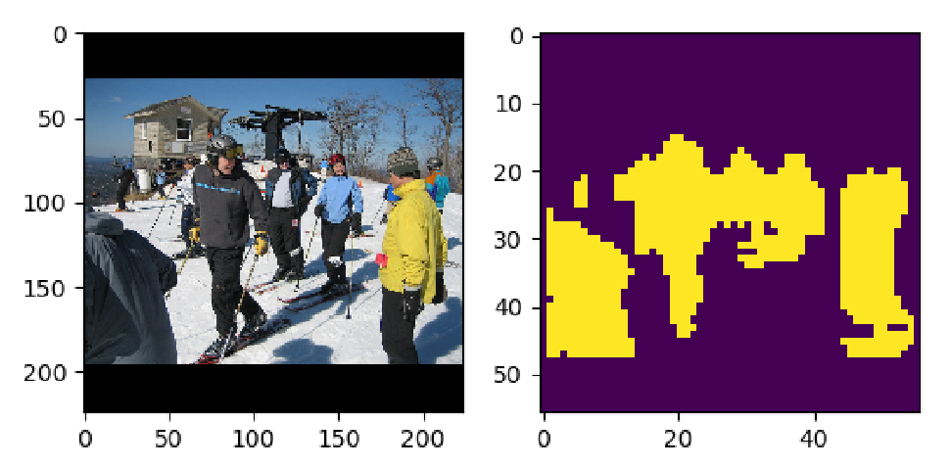
Center & LRTB Regression

Slide 13
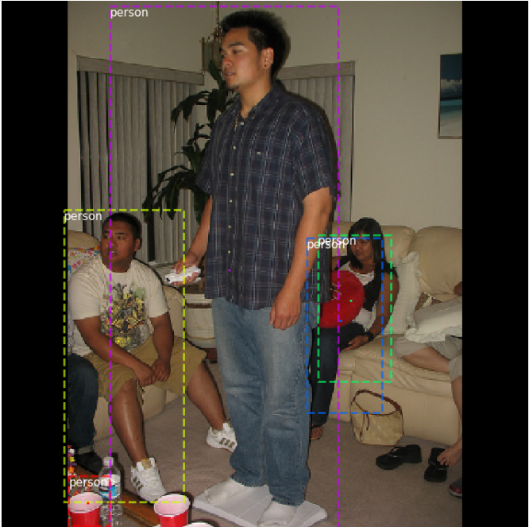
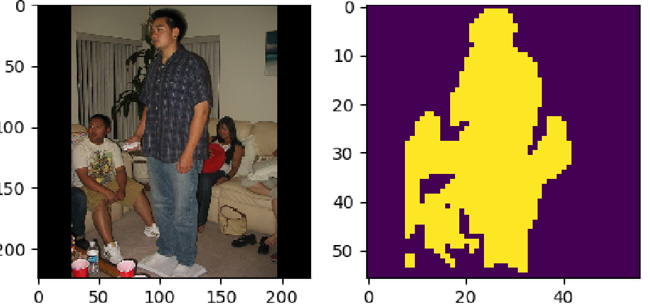
Center & LRTB Regression

Slide 14
WORK PLAN
Thanks
WORK PLAN

