Slide 1
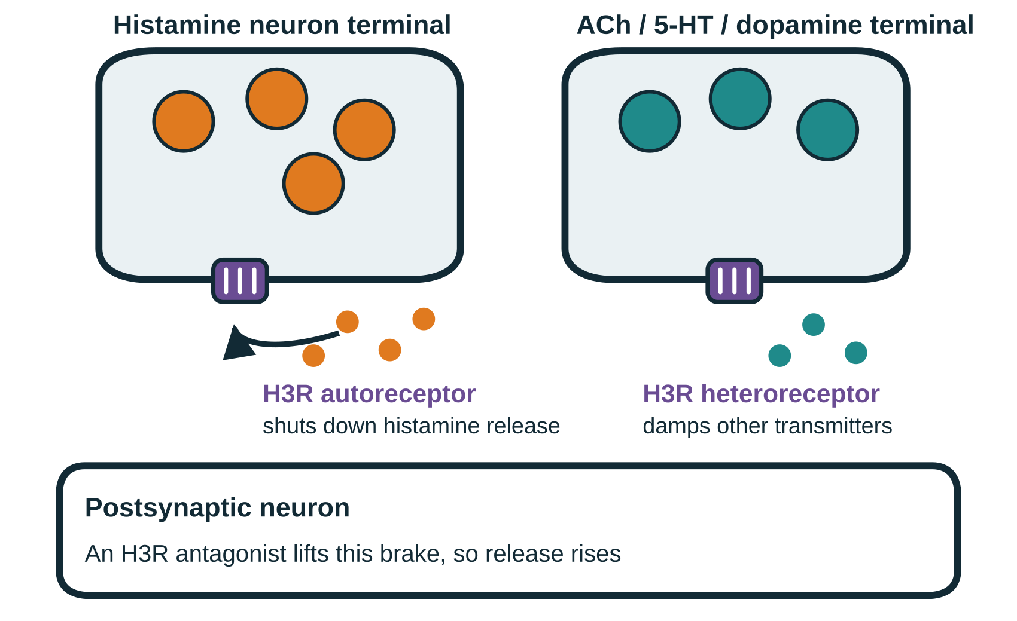
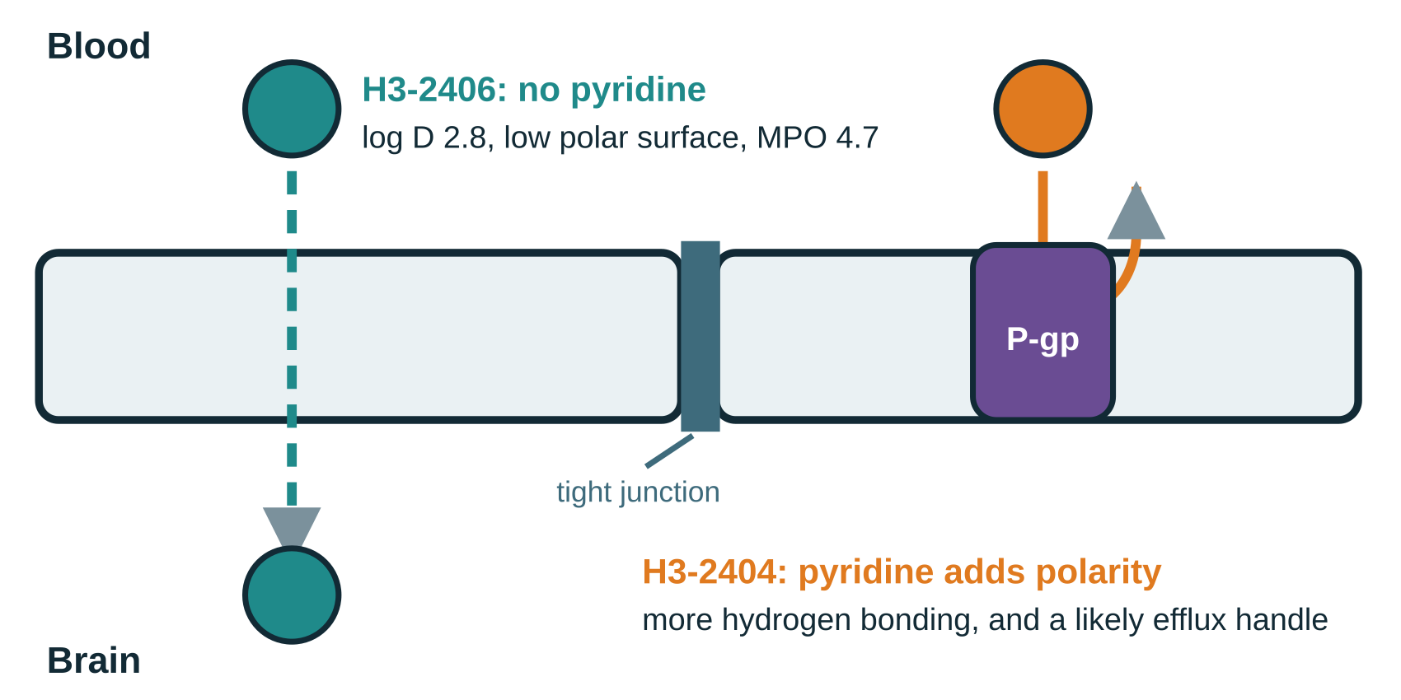
Development and preclinical characterization of [¹⁸F]H3-2406 and [¹⁸F]H3-2407 for PET imaging of the histamine H3 receptor
JOURNAL CLUB · PET RADIOCHEMISTRY
Song Z, Li Y, Dahl K, … Haider A, Elmore CS, Schou M, Liang SH
Emory University, AstraZeneca and Karolinska Institutet · J. Med. Chem., 16 July 2025
Two new fluorine-18 H3R antagonists: design, synthesis, radiolabelling and in vivo evaluation
Notes:
Title slide. A medicinal chemistry and radiochemistry paper: they design H3 receptor antagonists, label two of them with fluorine-18, and test whether either works as a brain PET tracer.

Slide 2



Background: why the H3 receptor, why PET, and why a new tracer
Why H3R: a brake on the whole transmitter system
One of four histamine receptors. H3R is a presynaptic autoreceptor that shuts off histamine synthesis and release, and a heteroreceptor that damps acetylcholine, serotonin and dopamine. It is dense in striatum, cortex, hypothalamus and hippocampus, and is implicated in Alzheimer’s and Parkinson’s disease, sleep-wake disorders, neuropathic pain and epilepsy. Antagonists such as AZD5213, GSK189254 and ABT-288 have reached clinical trials.
Why PET: the only way to measure target engagement in a living brain
PET quantifies where a receptor sits and how much of it a drug occupies, which is what dose-finding needs. For that you need a radioligand that is potent, selective, brain-penetrant and metabolically stable.
Why a new tracer: the existing probes fall short
Most H3R tracers are carbon-11 ([¹¹C]GSK189254, MK-8278, TASP457, AZ13198083). Its 20.4 min half-life ties scanning to an on-site cyclotron. Existing fluorine-18 ligands suffered low brain uptake or poor metabolic stability, and none reached routine human use. The team’s own [¹⁸F]H3-2404 took up poorly and non-specifically.
Their hypothesis: the pyridine ring of H3-2404 adds polarity and hydrogen bonding, and its nitrogen may invite P-glycoprotein efflux, so both hurt brain entry.
Notes:
Three questions answered in order: why this receptor, why imaging, and why the existing probes were not good enough. The key design hypothesis is at the bottom right: remove the pyridine of their earlier tracer to improve brain uptake.

Slide 3
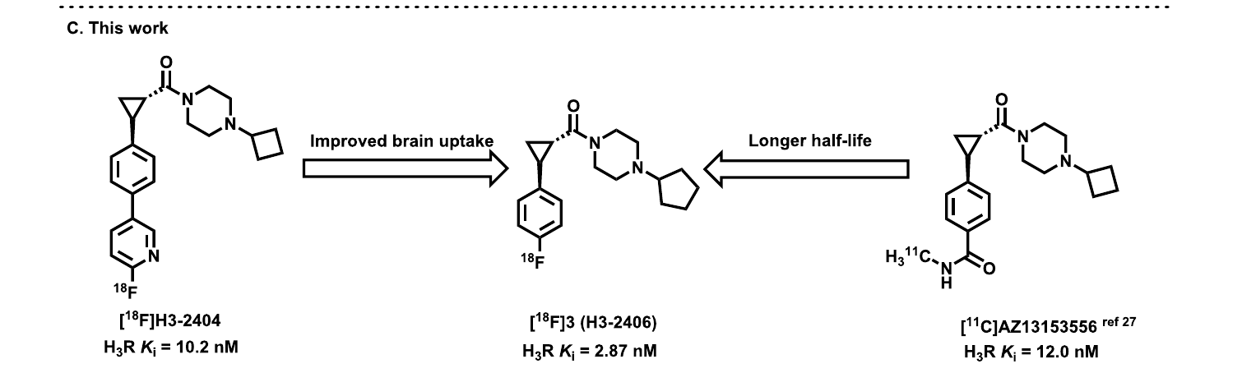


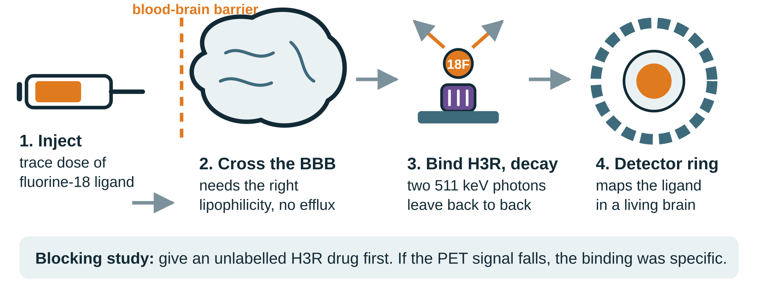

Objectives: redesign the scaffold, then prove the best candidate in vivo
1
Design and make the analogues
Build nine compounds around the H3-2404 core, varying the cycloalkyl ring on the piperazine and the saturated nitrogen heterocycle itself.
2
Screen potency, selectivity and physical properties
Fig. 1C The design: keep the fluorine-18 handle, drop the pyridine, lengthen the half-life
Measure H3R Ki and IC50 by competitive radioligand binding, screen a CNS off-target panel at 10 µM, and measure log D alongside predicted MPO and log BB.
3
Radiolabel the two winners with fluorine-18
Prepare boronate ester precursors and label them by copper-mediated radiofluorination, then check yield, purity and molar activity.
Starting point. [¹⁸F]H3-2404 (Ki 10.2 nM) had poor, non-specific brain uptake. [¹¹C]AZ13153556 (Ki 12.0 nM) bound well but decays too fast. The new compounds aim for the brain uptake of one and the half-life of the other.
4
Test them as imaging agents
Autoradiography in rat brain, dynamic PET with blocking in mice, whole-body biodistribution, and stability plus radiometabolite analysis.
Notes:
Four aims that map onto the rest of the deck: chemistry, pharmacology, radiochemistry, imaging.

Slide 4
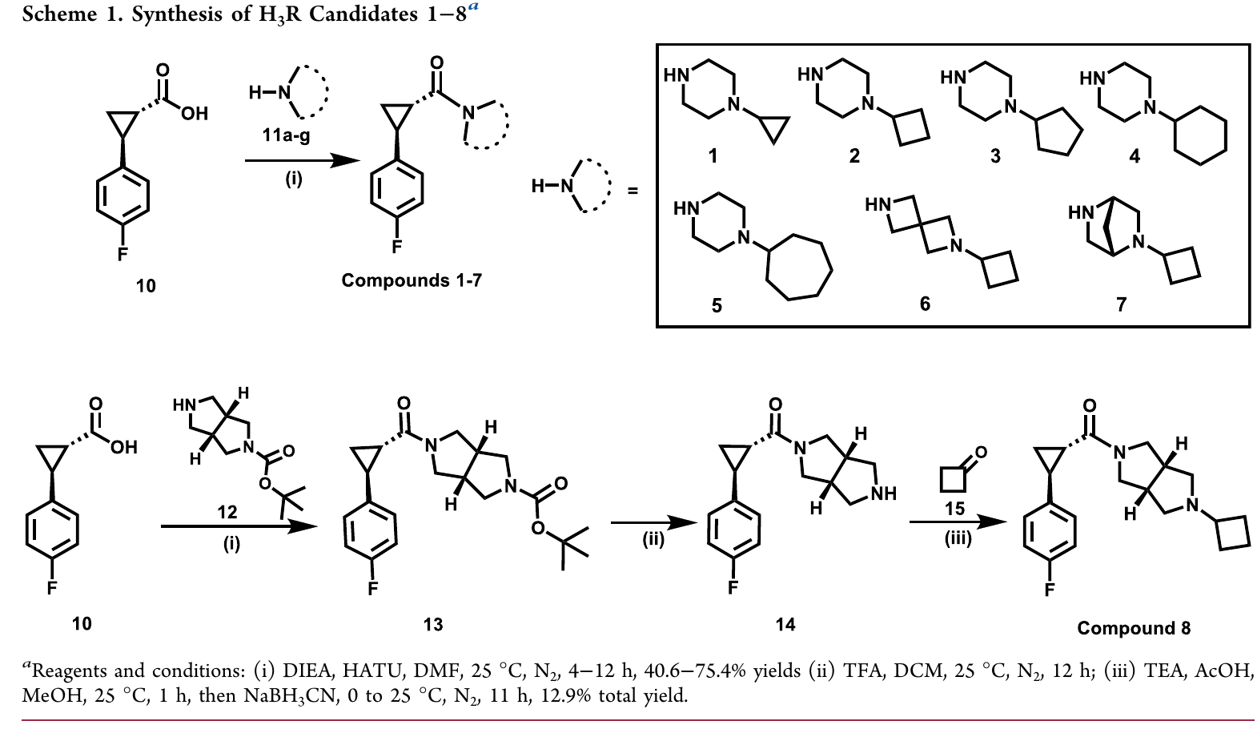
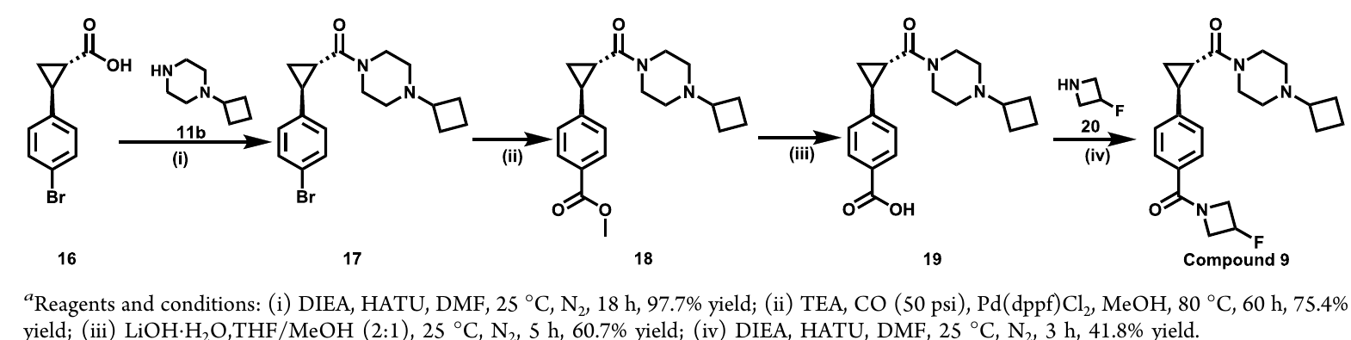
The chemistry: four reaction types build the whole series
Scheme 1 compounds 1-8
Reaction toolbox
Amide coupling
HATU with a base in DMF. The reagent turns the carboxylic acid into an activated ester that the amine attacks. It is fast and gentle, which matters because the cyclopropane here is a single defined stereoisomer that must not scramble.
Boc deprotection
Acid in dichloromethane removes the carbamate and frees the ring nitrogen for the next bond. Protect, couple, deprotect is the standard way to use a molecule with two reactive nitrogens.
Reductive amination
The free amine meets a ketone to form an iminium, which a mild hydride reagent reduces. The mildness is the point: it reduces the iminium and leaves the starting ketone alone.
Amide coupling of acid 10 with seven cyclic amines gives 1-7; compound 8 adds a protection, deprotection and reductive amination sequence
Scheme 2 compound 9
Palladium carbonylation
Under carbon monoxide with a palladium catalyst in methanol, an aryl bromide becomes an aryl ester. This installs a carbonyl where the halide was, which the halide alone cannot give.
Ester hydrolysis, then a second coupling
Base cleaves the methyl ester back to the acid, which is coupled again to attach the fluorinated azetidine of compound 9.
Carbonylation, hydrolysis, then a second amide coupling
Notes:
Walk the two schemes left to right, then use the toolbox on the right to name each reaction type and say why it was chosen. Yields: 40.6 to 75.4 percent for compounds 1-7, 12.9 percent overall for compound 8, 41.8 percent for the final step to compound 9.

Slide 5
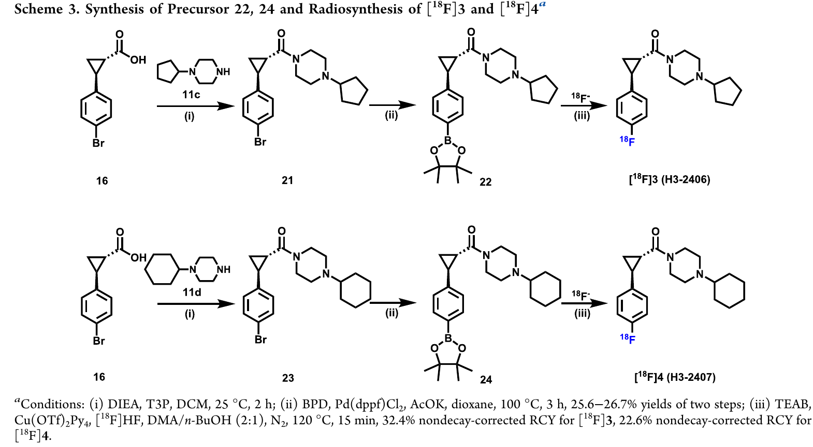

Radiochemistry: a boronate precursor lets copper deliver the fluorine-18
Why do it this way?
Step 1, amide coupling. A phosphonic anhydride reagent joins the bromo acid to the piperazine. It behaves like the earlier coupling agent but washes out in water, which simplifies work-up.
Step 2, borylation. A palladium catalyst swaps the aryl bromide for a pinacol boronate ester. This is the key move: the boronate is the handle copper needs.
Step 3, copper-mediated radiofluorination. A copper complex transfers fluoride onto the boronate-bearing ring. Classical aromatic substitution only works on electron-poor rings, so without this chemistry an electron-rich ring like this one could not carry fluorine-18 at all.
Why fluorine-18, not carbon-11. A 109.8 min half-life against 20.4 min means the tracer can be shipped off site, scans can run longer, and counting statistics improve. Its low positron energy also sharpens resolution.
Trace chemistry. Everything runs on about 1.5 mg of precursor in 15 min, then purifies by HPLC. Molar activity matters because the tracer must not occupy the receptor it is measuring.
Scheme 3 Precursor synthesis and radiolabelling of both tracers
15 min
32.4%
>99%
103
labelling step at 120 °C
radiochemical yield for [¹⁸F]3
radiochemical purity
GBq/µmol molar activity
Notes:
The point of this slide is the precursor strategy. Explain that the boronate ester is made specifically so the copper-mediated reaction can put fluorine-18 onto an electron-rich arene, which older nucleophilic chemistry cannot do. Yields were 32.4 percent for compound 3 and 22.6 percent for compound 4, both non-decay-corrected, with molar activities of 103 and 30 GBq per micromole.

Slide 6
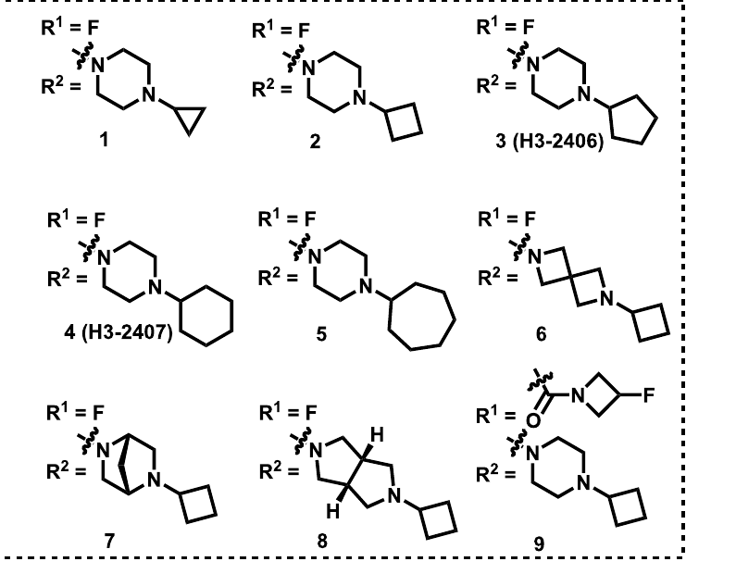
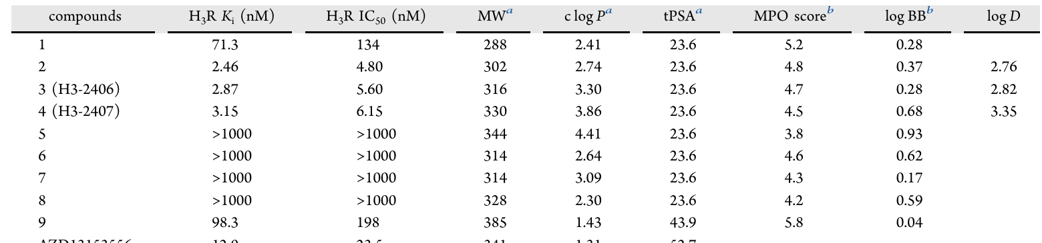
Result 1: a C5 or C6 ring on the piperazine is what the receptor wants
Table 1 Affinity and calculated properties
Table 1 The nine analogues
Ring size drives potency. Cyclopropyl (1) is only moderate at 71.3 nM. Moving to cyclobutyl (2), cyclopentyl (3) and cyclohexyl (4) gives 2.46, 2.87 and 3.15 nM, but cycloheptyl (5) collapses past 1000 nM. C4 to C6 is the window.
The piperazine itself cannot be replaced. Three rigid replacements (6, 7 and 8) all lose activity entirely, so the geometry and basicity of that ring are doing real work.
The fluorine handle has to stay on the ring. Swapping the fluoropyridine for a fluorinated azetidine (9) drops affinity to 98.3 nM.
Selectivity decided which two advanced
Compound 2 was dropped: it hits sigma-1 at 1.61 nM, making it a dual antagonist rather than an H3R probe.
Compound 3 keeps 69-fold selectivity over sigma-1 (199 nM) and compound 4 keeps 407-fold (1282 nM); both are clean at 5-HT2C.
Properties look drug-like: log D 2.76 to 3.35, low polar surface area, MPO above 4.5 and predicted log BB above -1, so all three should enter the brain.
Notes:
Read the table by column. The key number is the 69-fold sigma-1 selectivity of compound 3, because that single figure explains the off-target signal seen later in the imaging data.

Slide 7
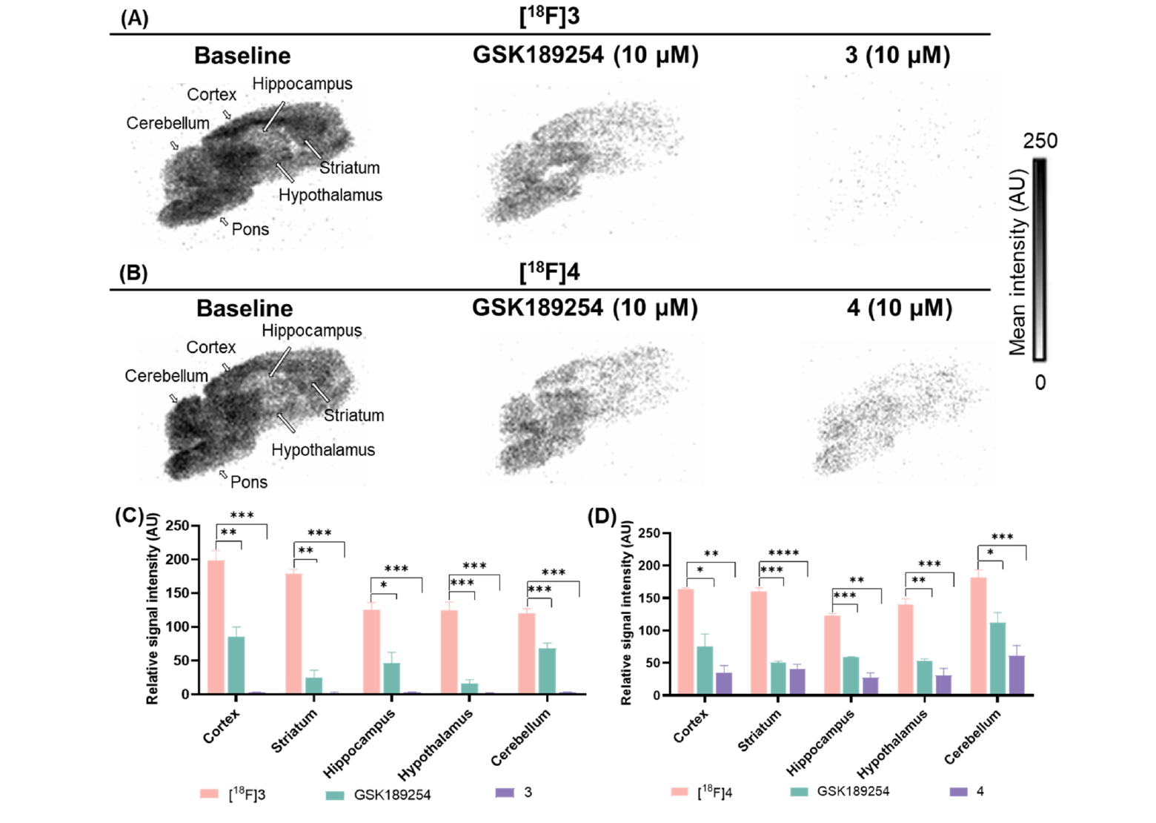
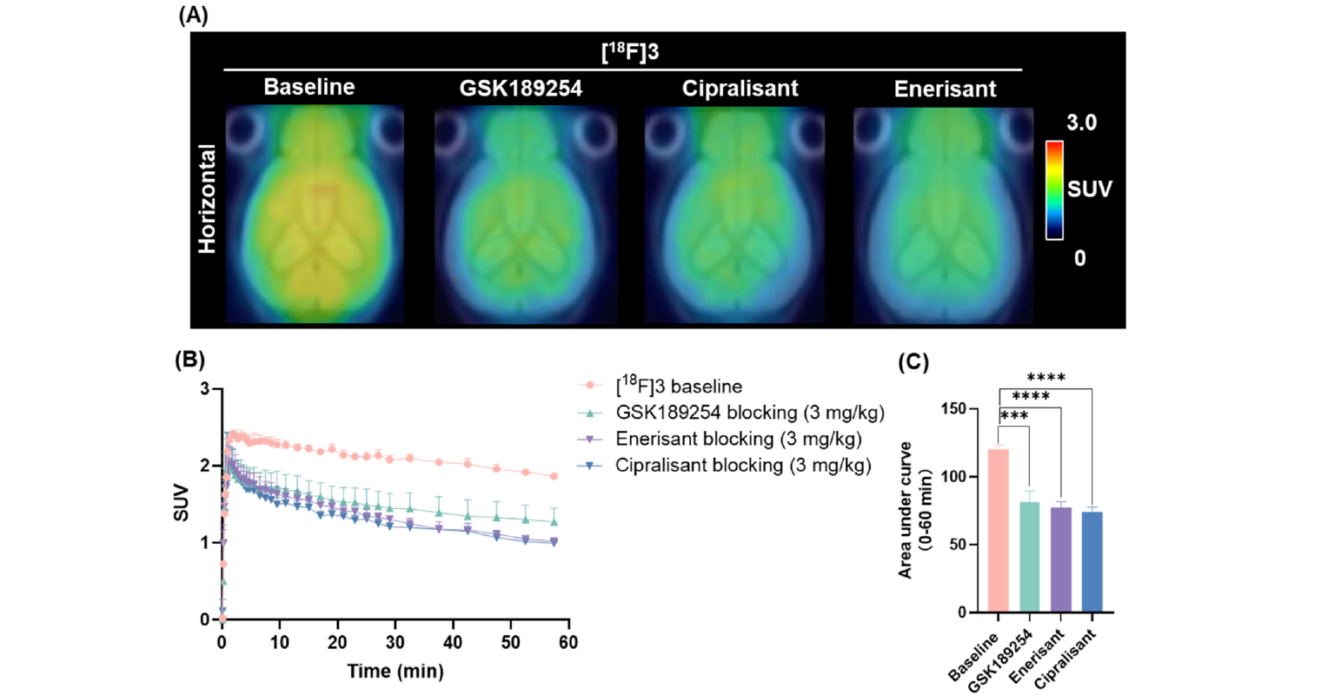
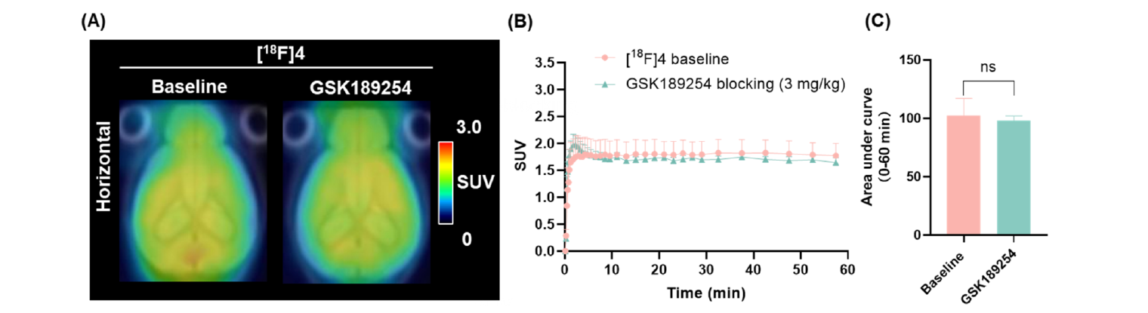
Result 2: both tracers reach the brain, but only one is blockable in vivo
Rat brain autoradiography
Dynamic PET in mice, 0 to 60 min
Fig. 3 [¹⁸F]3 blocked by three different H3R antagonists
Fig. 2 Baseline, blocked with GSK189254, and self-blocked
Both tracers trace the receptor. Signal is high in cortex, striatum, hippocampus and hypothalamus, matching known H3R distribution.
Blocking works, but not completely. An H3R antagonist cuts the signal by 43.6 to 86.0 percent, yet self-blocking with the cold compound removes over 90 percent. That gap, plus a stubborn cerebellar signal in a region poor in H3R, is the first hint of off-target binding.
Fig. 4 [¹⁸F]4 is not blocked at all
[¹⁸F]3 behaves like a tracer. Uptake peaks at SUV 2.4 by 2.3 min and washes out. Three structurally unrelated antagonists cut the area under the curve by 32.5, 35.6 and 38.4 percent.
[¹⁸F]4 does not. It peaks at 1.83 but blocking changes it by only 3.3 percent. Its higher log D of 3.35 points to non-specific binding in white matter.
Chasing the residue. A sigma-1 antagonist partly reduced uptake and a dual H3R/sigma-1 compound blocked it almost completely, so part of the retained signal really is sigma-1. An efflux inhibitor made no significant difference, so P-glycoprotein is not the problem.
Notes:
The contrast between figures 3 and 4 is the heart of the paper: near-identical in vitro affinity, completely different in vivo behaviour, and lipophilicity is the likely reason.

Slide 8
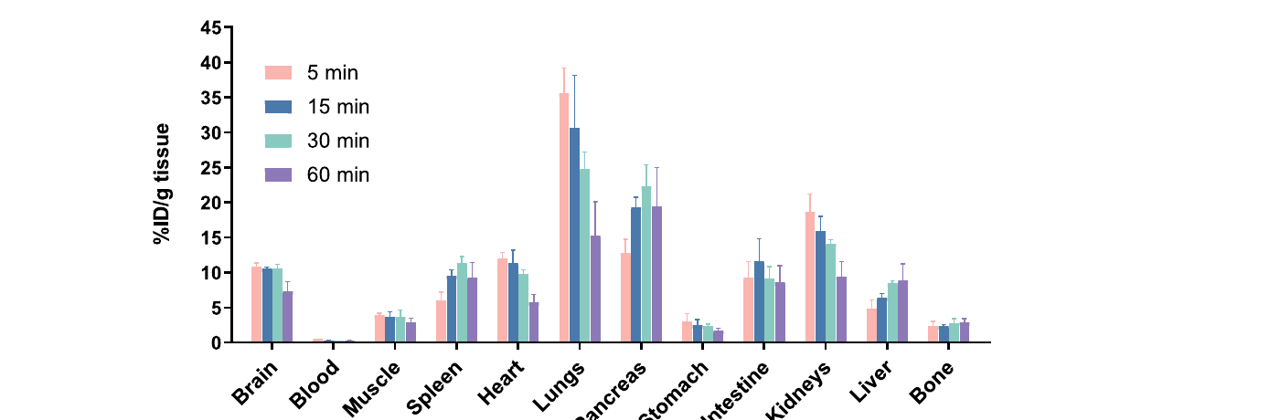
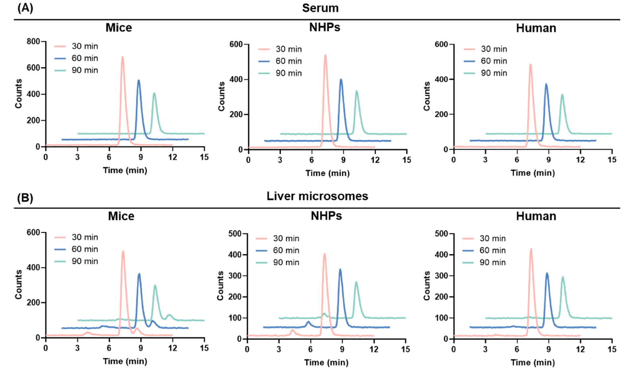
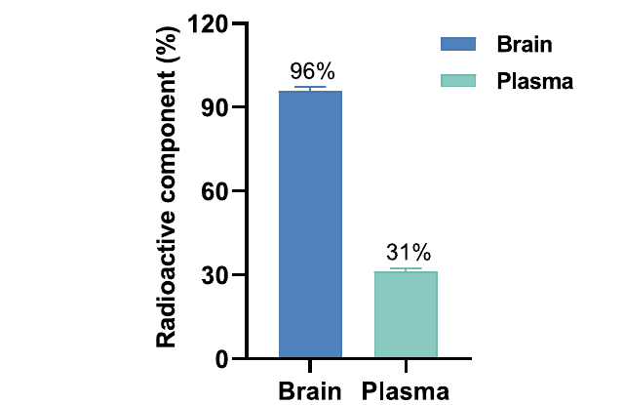
Result 3: good brain delivery, clean metabolism and no defluorination
Whole-body distribution
Stability and metabolites
Fig. 7 Parent fraction
Fig. 5 [¹⁸F]3 in mice at 5, 15, 30 and 60 min
Brain delivery is substantial: 10.9 percent of injected dose per gram at 5 min, then a steady washout, which is the shape a reversible tracer should have.
Clearance is hepatobiliary: early signal in heart, lung and kidney clears, while liver and intestine rise later.
Bone stays at about 2 percent and does not climb, so the carbon-fluorine bond is holding. Free fluorine-18 would accumulate in bone and ruin a brain scan.
The early lung and pancreas peak is what a lipophilic amine usually does, and it clears over the hour rather than building up.
Fig. 6 Serum and liver microsomes, three species
Stable in serum: over 95 percent of the parent compound survives at 90 min in mouse, monkey and human serum.
Stable in microsomes: 78 percent parent in mouse, 85 percent in monkey and 95 percent in human at 90 min, so the human prediction is the most favourable of the three.
What matters is the brain: at 30 min after injection, 96 percent of brain radioactivity is still intact tracer, against 31 percent in plasma. Radioactive fragments are staying out of the brain.
Notes:
Three different stability questions: does the molecule fall apart in blood, does the liver chew it up, and do any radioactive fragments follow the tracer into the brain. The answer is favourable on all three, and the flat bone uptake is the specific check for defluorination.

Slide 9


Take-aways and critical appraisal
What the paper delivers
Questions to raise in discussion
A one-ring edit paid off. Removing the pyridine from their earlier tracer and tuning the cycloalkyl gave compounds with low-nanomolar affinity and drug-like properties.
A clean radiochemical route. Copper-mediated labelling of boronate precursors delivered both tracers in 15 min with high purity and useful molar activity.
[¹⁸F]H3-2406 is the lead. Good brain uptake, the right regional pattern, blockade by three unrelated antagonists, 96 percent intact in brain and no defluorination.
A new scaffold for the field. The 4-cyclopentylpiperazine core had not been described for H3R imaging before.
A useful negative result. Its cyclohexyl twin failed in vivo despite near-identical affinity, a reminder that lipophilicity, not potency, often decides whether a tracer works.
Selectivity is the real limitation. 69-fold over sigma-1 sounds adequate until you remember sigma-1 is abundant in brain. The authors prove the problem themselves with the sigma-1 blocking experiments, and blockade never reaches baseline.
Quantification rests on assumptions. An image-derived input function without metabolite correction, Logan analysis, and n = 4 per PET group with n = 2 for metabolites.
Species are mixed. Autoradiography in rat, PET and biodistribution in mouse, stability in three species, but no primate imaging. Human translation is untested.
Missing pieces for a real probe. No test-retest reproducibility, no dosimetry, no occupancy study in a disease model, and no demonstration that the tracer detects a change in H3R rather than just finding it.
Where it should go next. Engineer out the sigma-1 affinity, repeat in non-human primates, then test in Alzheimer’s and Parkinson’s models where H3R is thought to be dysregulated.
Notes:
Close on the honest reading: this is a solid lead compound rather than a finished probe, and the authors say so. The sigma-1 cross-reactivity is the thing to fix.

