Slide 1
The four colour theorem

Slide 2
Four colour theorem
Thm:
Every planar graph is 4 colourable.
Let G be a counter-example (planar, non-4-colourable) minimizing |V(G)|.

Slide 3

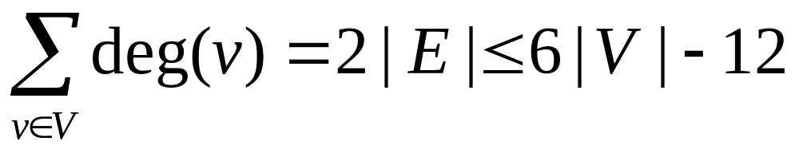
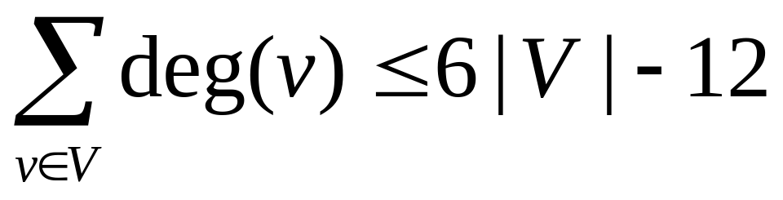
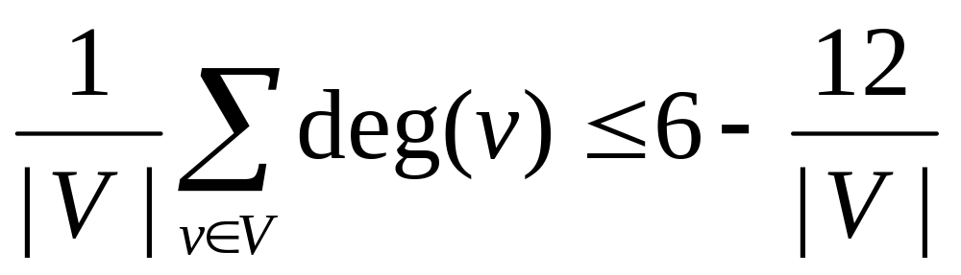
Main steps of the proof (5 colours)
Main steps of the proof (4 colours)
Use some counting argument
to find a specific induced subgraph
Change parts of the subgraph to make it smaller
There is a vertex v of degree at most 5.
Delete v
Colour the rest by minimality
Colour the changed graph by minimality
Extend the colouring to the original graph

Slide 4
Main steps
Use some counting argument to find a specific induced subgraph
Change parts of the subgraph to make it smaller, colour the changed graph by minimality and extend the colouring to the original graph
Discharging
Reducibility

Slide 5
Connectivity
A minimum counter-example to the 4CT is connected

Slide 6
2-connectivity
A minimum counter-example to the 4CT is 2-connected

Slide 7
Triangulation
deg=5
Take a counter-example maximizing |E(G)| (or equivalently, a triangulation).

Slide 8
Main steps
Use some counting argument to find a specific induced subgraph
Change parts of the subgraph to make it smaller, colour the changed graph by minimality and extend the colouring to the original graph
Discharging
Reducibility

Slide 9
Discharging (5 colours)
Use some counting argument to find a specific induced subgraph
Each edge starts with 2 tokens.
Each edge gives one token each vertex incident to it.
By Euler’s formula, we have at most
6|V|-12 tokens.
So we have a vertex v with at most 5 tokens.

Slide 10
Discharging (4 colours)
Use some counting argument to find a specific induced subgraph.
Each vertex v starts with 10(6-deg(v)) tokens (now called “charges”). Can be negative.
Redistribute the charges using some rules*.
By Euler’s formula, we have a vertex v with positive charge after redistributing.
The union of v, N(v) and N(N(v)) contains the subgraph we want.

Slide 11
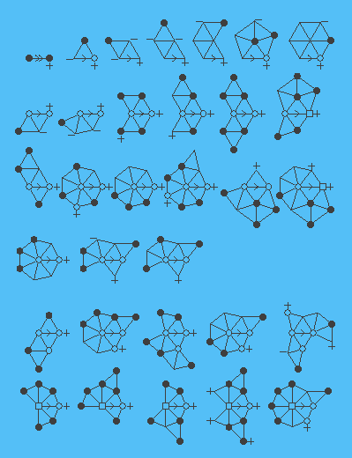
Discharging rules (4 colours)
For each copy of the following subgraphs in G, move a charge along the arrow.

Slide 12
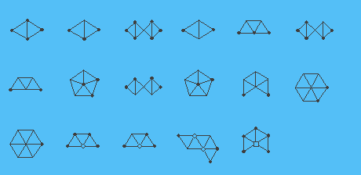
Unavoidable subgraph
So we’ve used the discharging rules to find one of many specific subgraphs.

Slide 13
Unavoidable subgraphs

Slide 14
Main steps
Use some counting argument to find a specific induced subgraph
Change parts of the subgraph to make it smaller, colour the changed graph by minimality and extend the colouring to the original graph
Discharging
Reducibility

Slide 15
Reducibility (5 colours)
v

Slide 16
Reducibility (4 colours)
The vertex inside help restrict the colouring on the outer ring.
Use the colouring of the smaller graph to obtain a colouring of the bigger graph.

Slide 17
Switching two colour
p
=
p
or
p

Slide 18
Main steps
Use some counting argument to find a specific induced subgraph
Change parts of the subgraph to make it smaller, colour the changed graph by minimality and extend the colouring to the original graph
Discharging
Reducibility

