Slide 1
Talks on Deep Learning, Caffe, RCNN
Zhe Li
08/28/2015

Slide 2
Outline
Introduction to Deep Learning
Caffe: (Open Source Library --Implementation)
RCNN: Object Detection Scheme Based on Caffe (Usage)

Slide 3
Deep Learning Library
Cuda-convnet
Very fast on state-of-the-art GPUs with Multi-GPU parallelism
C++/CUDA Library
Caffe
C++/CUDA Library
Seamless GPU/CPU switch
An active research and development community
Torch7, Theano, Mocha

Slide 4
Caffe Library
Pure C++/CUDA architecture for deep learning
Command line, python, MATLAB interfaces
Tools, reference models, demos and recipes
Seamless switch between CPU and GPU
Fast, Well tested code.

Slide 5
Caffe: look at deeper
There are three components more important
Blob
A wrapper over actual data being processed and passed along Caffe
Provides synchronization capacity between CPU and GPU
Actually, it is an N-dimensional array
Layer
Essence of a model and fundamental unit of computation, convolution, pooling, inner product, and so on
Define Forward and backward function
Net
the structure of neuron network
Composition of all layers

Slide 6
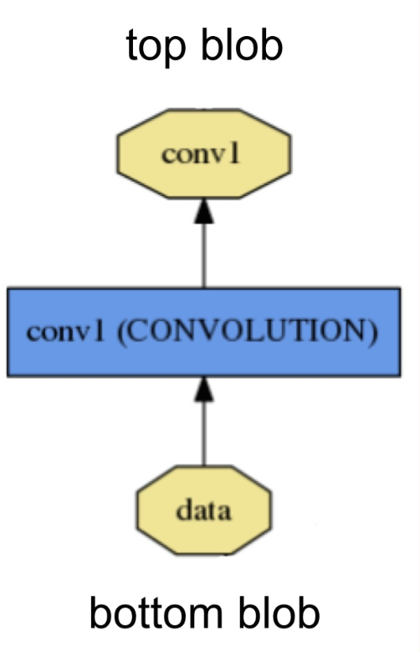
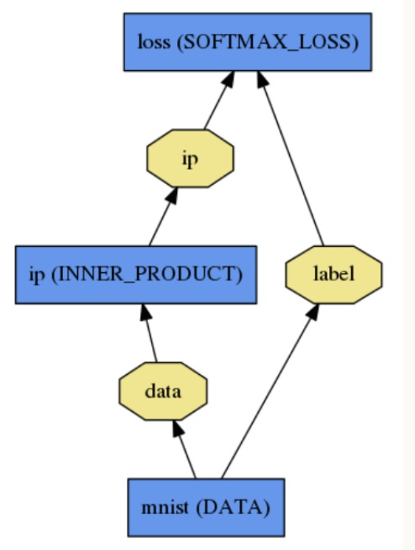
Blob, Layer, Net

Slide 7
Net
A network is a set of layers connected Directed Acyclic Graph(DAG)
name: "dummy-net"
layers { name: "data" …}
layers { name: "conv" …}
layers { name: "pool" …}
… more layers …
layers { name: "loss" …}

Slide 8
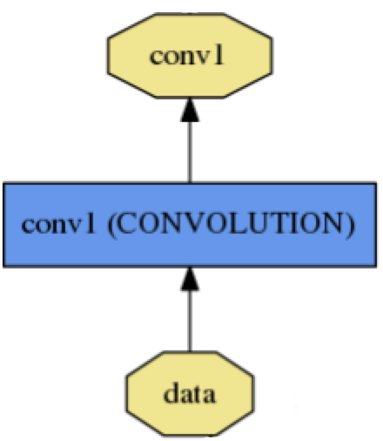
Layers
name: "conv1"
type: CONVOLUTION
bottom: "data"
top: "conv1"
convolution_param {
num_output: 20
kernel_size: 5
stride: 1
weight_filler {
type: "xavier"
}
}
name, type, and the connection structure
(input blobs and output blobs)
layer-specific parameters
Each layer defines Forward_cpu(), Backward_cpu() in C++ and Forward_gpu() and Backward_gpu() in CUDA.
Data layers (image_layer, window_layers); convolution, pooling layer …

Slide 9
Blob
Blobs are 4-D arrays for storing and communicating information.
hold data, derivatives, and parameters
lazily allocate memory
shuttle between CPU and GPU
Data
Number x K Channel x Height x Width
256 x 3 x 227 x 227 for ImageNet train input
Parameter: Convolution Weight
N Output x K Input x Height x Width
96 x 3 x 11 x 11 for CaffeNet conv1
Parameter: Convolution BIas
96 x 1 x 1 x 1 for CaffeNet conv1

Slide 10
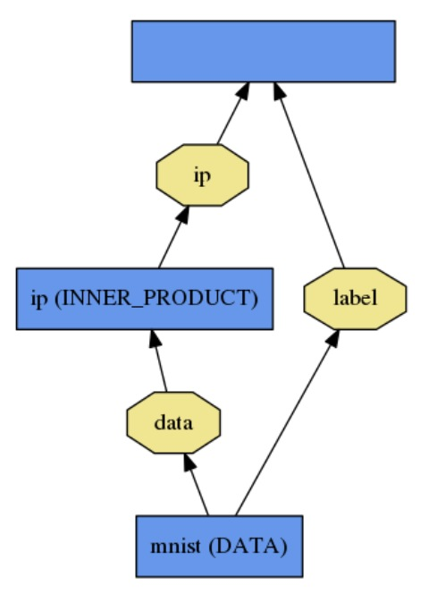
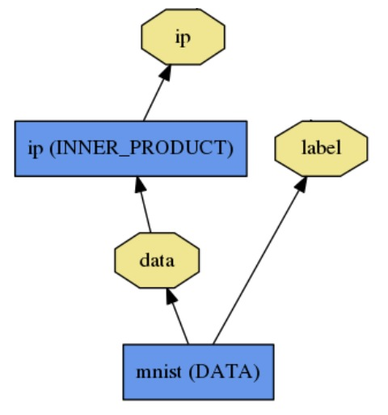
Loss layer
What kind of model is this?
Classification
SOFTMAX_LOSS
HINGE_LOSS
Linear Regression
EUCLIDEAN_LOSS
Attributes / Multiclassification
SIGMOID_CROSS_ENTROPY_LOSS
Others…
New Task
NEW_LOSS
loss (LOSS_TYPE)

Slide 11
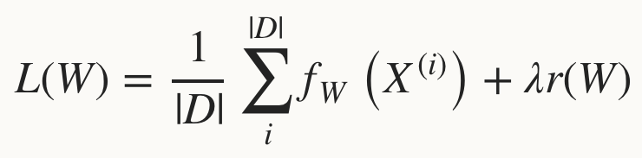
Loss Layer
Loss function determines the learning task.
Given data D, a Neuron Network typically minimizes

Slide 12
Solver
Solver optimizes the network weights W to minimize the loss L(w) over the data D
Caffe provides three different methods
Stochastic gradient descent
Nesterov’s accelerated gradient
Adaptive gradient

Slide 13
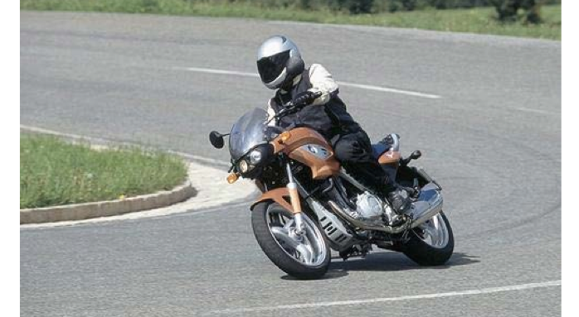
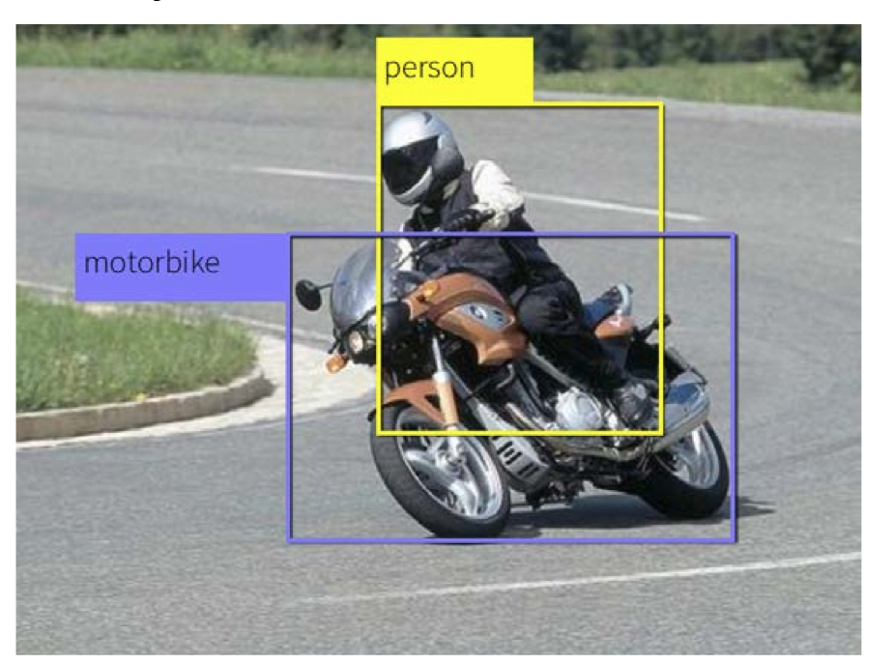
Object Detection -RCNN
Input Image
Output Image

Slide 14
Object Detection -RCNN
RCNN(University of California, Berkeley)
Segmentation
Extract regions
Proposals
Convolution
Neuron Network
DL
Feature
Input Image
Bounding Box
Regression
(rough 2,000/image)
Non Maximum
Suppression
linear SVM

Slide 15
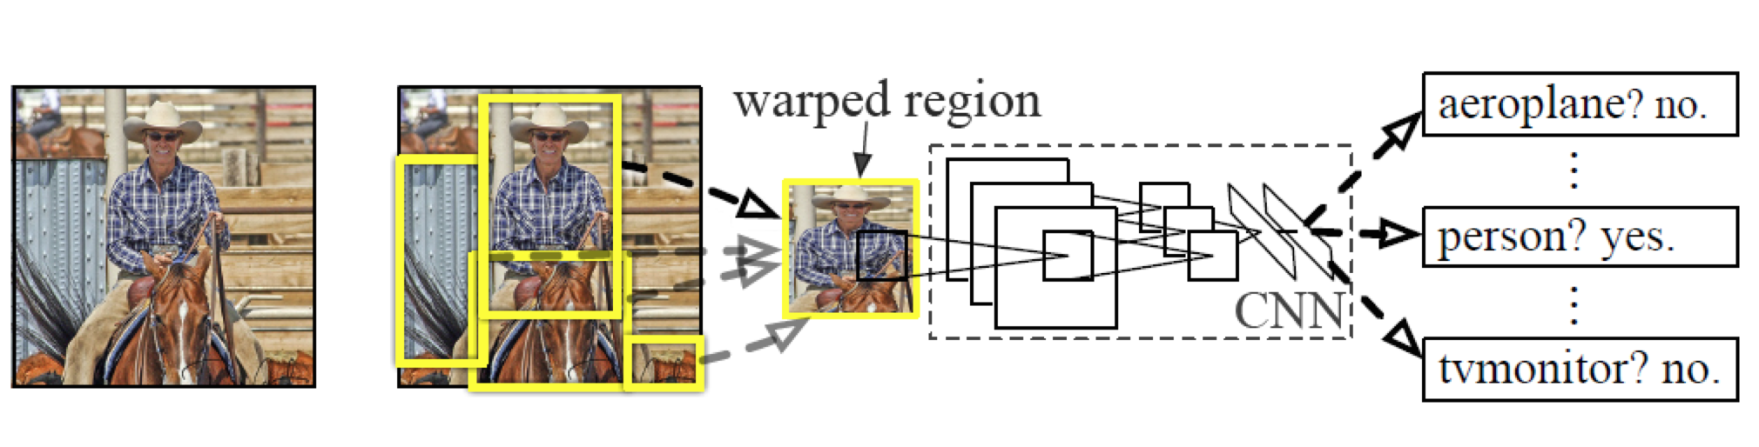
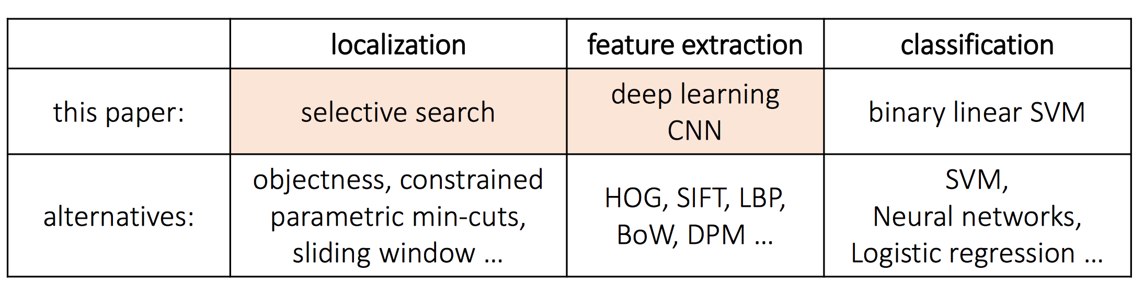
Object Detection -RCNN

Slide 16
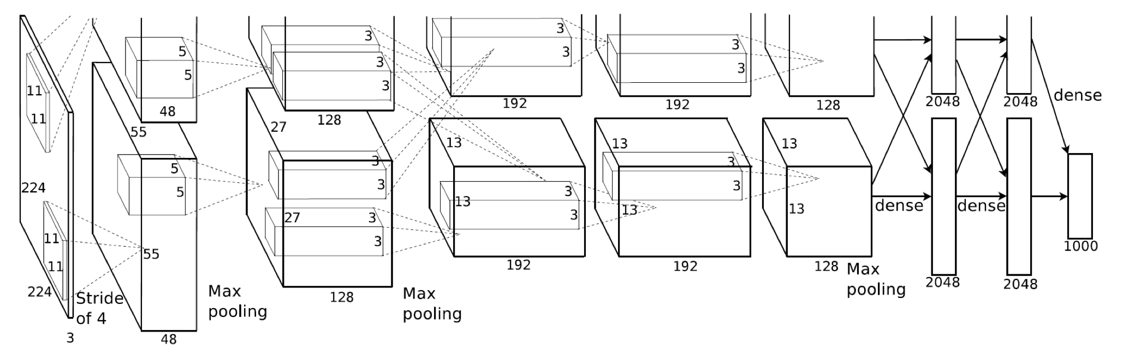
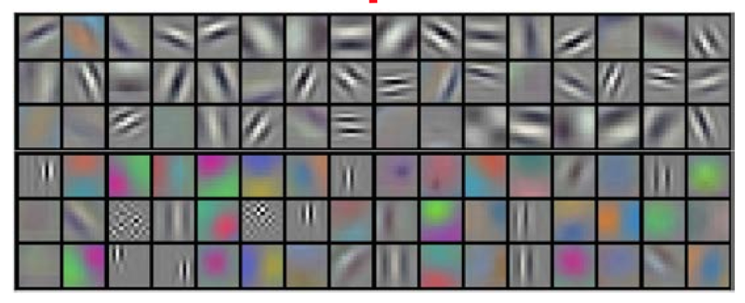
Alex Network
9126 x 4096 Weight Matrix
4096 x 4096 Weight Matrix
Pool5 9126 Dim
Fc7 4096-Dim
Fc6 4096-Dim

Slide 17
Implementation View
w * h * d
r * c * 1
2 * 2
1000 * 1
224 * 224 * 3
Convolution
Fully Connect
Forward Computation
Input Image
Max pooling
Backward
Update
w, h, d, r, c parameter are pre-defined.

Slide 18
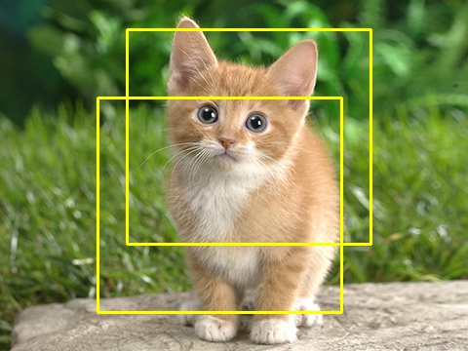
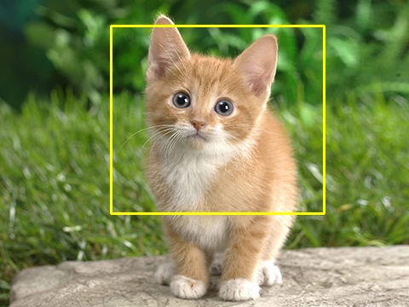
Non Maximum-Suppression
Functionality: If several boxes cover one same objects, they should be chosen or merged properly.
Basic idea: using overlap area and confidence score to determine which boxes that should be kept.

Slide 19
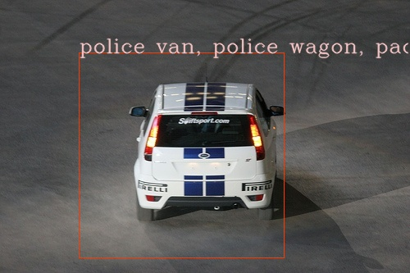
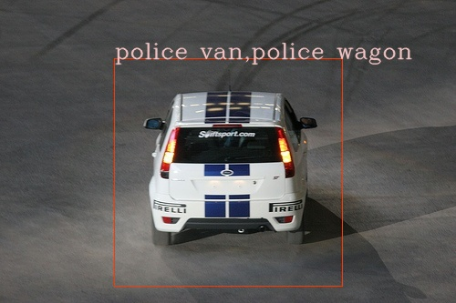
Bounding Box Regression
Functionality: Adjust bounding box that contains the object.

Slide 20
Bounding Box Regression
Cast as learning problem.
Input (Px,Py,Pw,Ph) four coordinates and features X on this batches
Output: (Gx,Gy,Gw,Gh) adjusted four coordinates for final bounding box
Structured learning problem.

Slide 21
Bounding Box Regression
Constructed models (w1,w2,w3,w4) for adjusting four coordinates.
Training:
proposal bounding boxes (Px,Py,Pw,Ph)
feature X
Ground truth bounding boxes(Gx,Gy,Gw,Gh)
Need to do some invariant transformation

Slide 22
Bounding Box Regression
Need to do some invariant transformation
Tx = (Gx – Px)/Px
Ty = (Gy - Py)/Py
Tw = log(Gw/Pw)
Th = log(Gh/Ph)
Feature: deep learning feature X
Target variable: Tx, Ty, Tw, Th

Slide 23
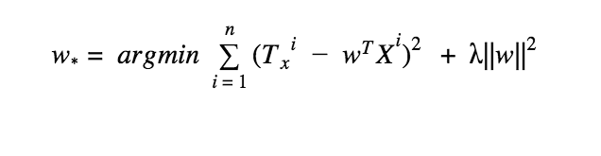
Bounding Box Regression
Solving ridge regression
Same for Ty, Tw,Th
Once models for (x,y,w,h) are constructed, models can be used to adjust predictive bounding boxes.

Slide 24
Take home message
Deep learning can be used for feature engineer
Caffe is well designed deep learning library and you can write your own layer!

