Slide 1
Covid-19 pandemic prediction
Zeren li
12/06/2024

Slide 2
What is a solid predictor for the confirm cases?
Initial guess: vaccination rate, and what else?
We’ll first investigate this at the country level and then dive into states.

Slide 3
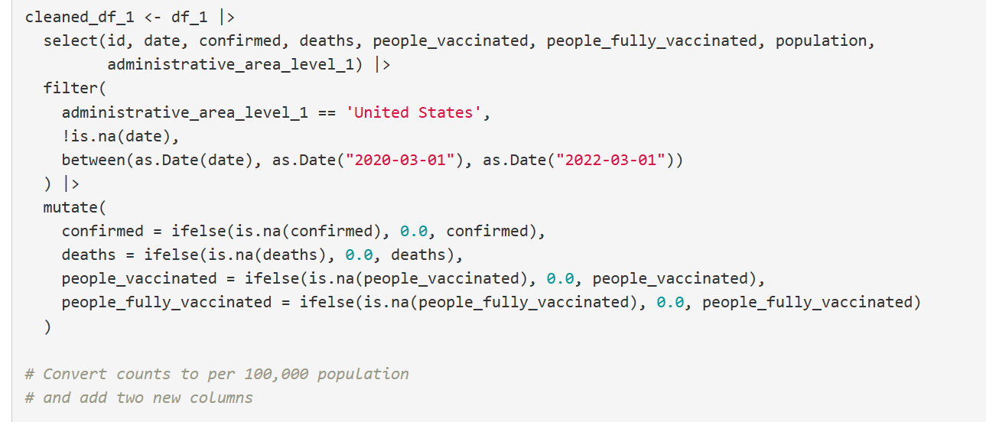
Data cleaning & preparation
we set confirmed, deaths, people_vaccinated, people_fully_vaccinated to be 0 if they are null.
we extract the date from 2020-03-01 to 2022-03-01

Slide 4
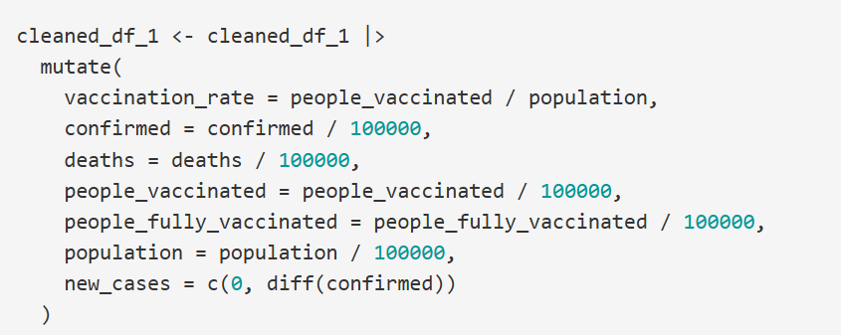
Data cleaning & preparation-continued
we added two columns, like new_cases and vaccination rates.
we divided population by 100,000 for easier caculation.

Slide 5
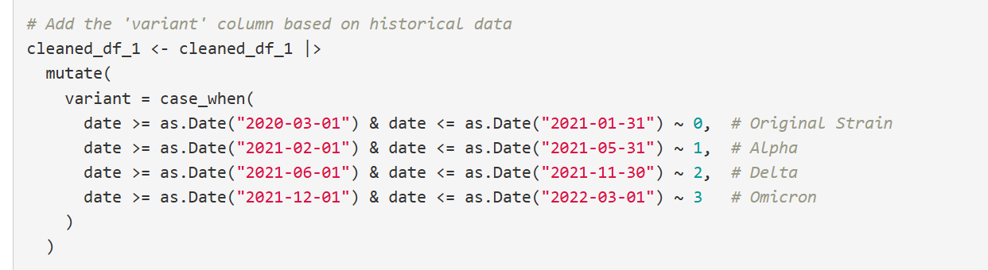
Data cleaning & preparation-continued
we also add a new column called variant to account for the number of variants of the virus that appeared.

Slide 6
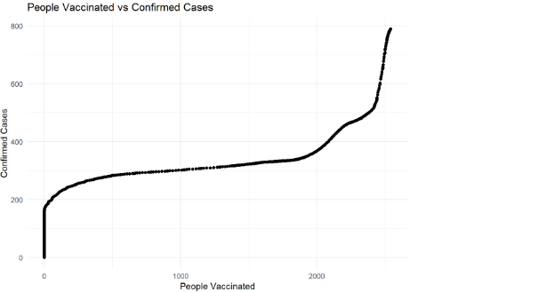
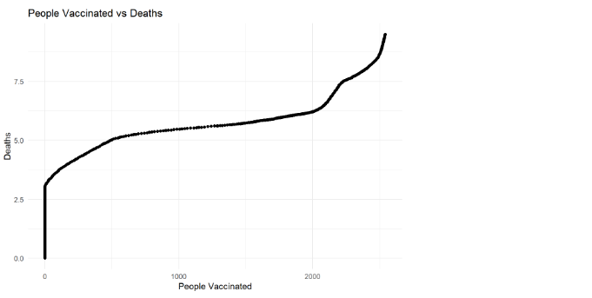
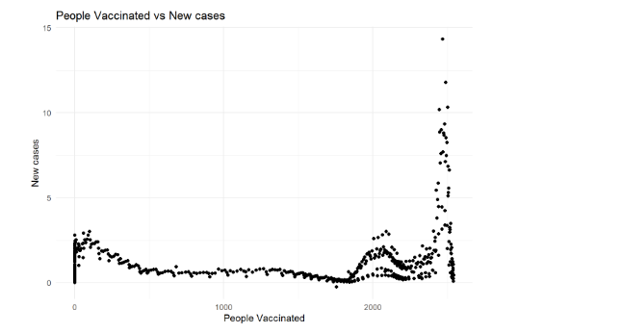
Scatterplot
we can make a scatterplot showing the relationship between the vaccination and confirmed cases, death, new cases.
this is for people_vaccinated

Slide 7
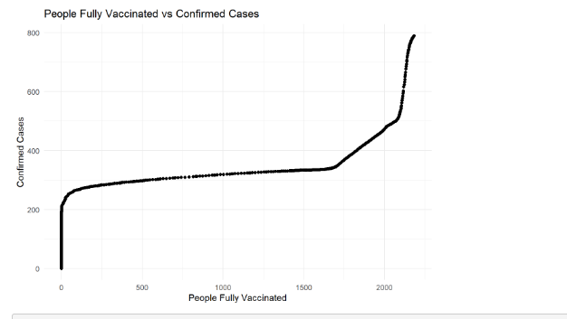
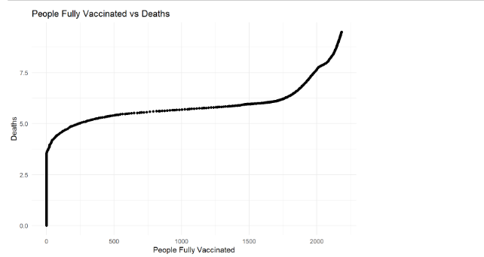
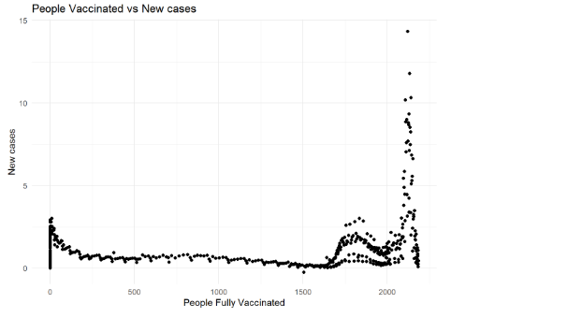
Scatterplot
this is for people_fully_vaccinated

Slide 8
Scatterplot
we used both people_fully_vaccinated, and people_vaccinated as the dependent variable. The graph shows that no matter which we choose as the dependent variable, the confirmed cases and death graph shows a “ladder”. That is the cases will quickly go up first, and then stay steady at some point, and then go up again at the end.

Slide 9
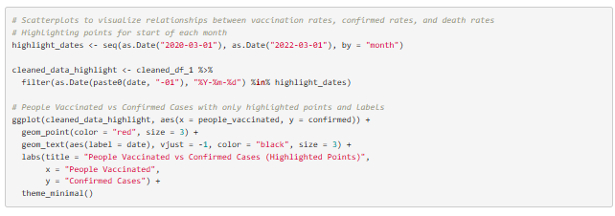
Highlight the points
To investigate this further, we can highlight those points for start of each month.

Slide 10
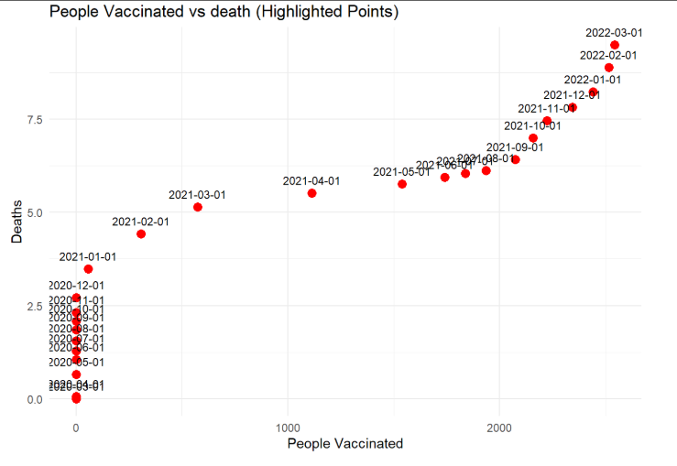
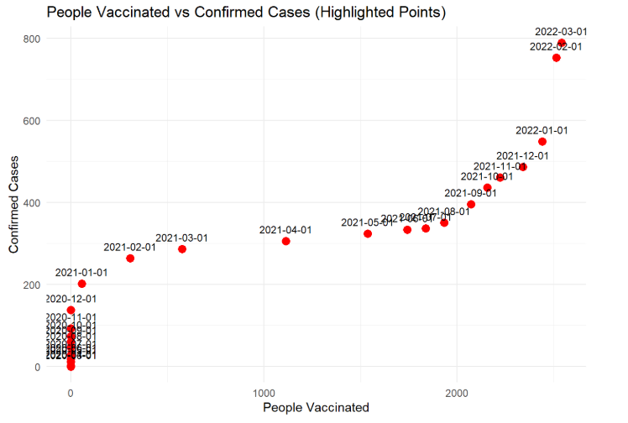
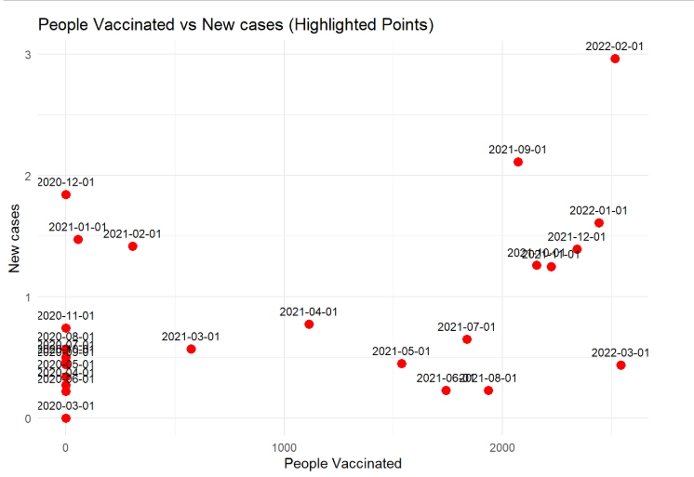
From the cases of confirmed and cases of death, we saw even clearer that both cases go up first, but become flat at the end of the 2020 till the end of the 2021, after which the cases go up again. What makes it stopped accelerating the end of the 2020? And what makes it go up again at the end of the 2021?

Slide 11
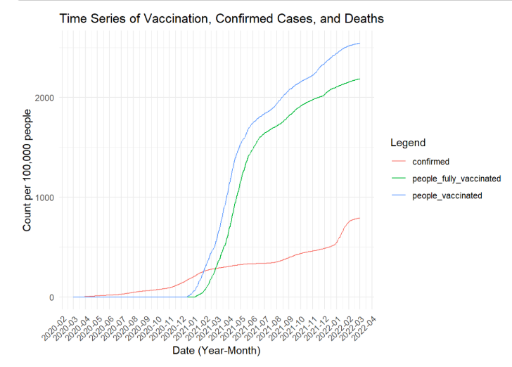
Time-series plot
From the first graph, we see the vaccination starts off in late dec 2020, and the number of people vaccinated quickly catch up the number confirmed.
To see the trend more clearly. we can make time series plot for people vaccinated, fully vaccinated, confirmed, and deaths, new cases

Slide 12
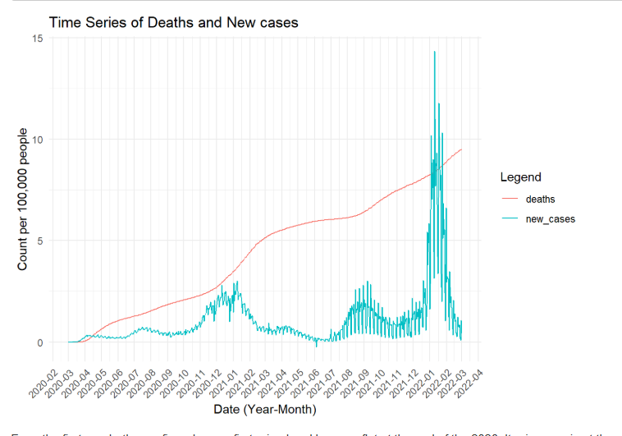
From the second graph, In New cases against people Vaccinated, we saw that it first rising quickly and drops around 2020-12, and then go a little up around 2021-03, and then go down, and then go up around 2021-06, and then dropped, and then go up again in 2022-12. New cases looks like a roller coaster.
The reason lies not in the original dataset, because the original one doesn’t include the appearance of the variants of the virus. But, we did.

Slide 13
Reasons
recall that from the history Original Strain: March 2020. Vaccination begins: Dec 2020 Alpha: Widespread in Spring 2021. Delta: June-July 2021. Omicron: December 2021-January 2022. Omicron Sub variants: Throughout 2022-2023.
Let’s take into account of the variant outbreak and go over it again.
In March 2020, pandemic outbreaks. At the end of the 2020, vaccination was adopted. Despite the appearance of the alpha variants, the number of cases dropped, showing the effectiveness of the vaccination. However, we experience a sudden spike during each variants outbreak, namely from variants of Alpha, Delta, Omicron.

Slide 14
we can compare the model fitness using the Vaccination along, or using both variant and vaccination.

Slide 15
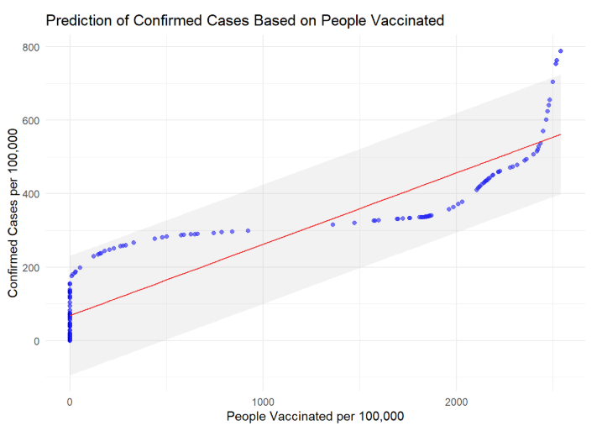
Prediction based soly on vaccination
with RMSE: 79.18228. From the prediction interval you saw that by a 95% of confidence, our model is actually not a bad model. It followed the general trend of the new cases well. However, we also wants to incorporate the variants as a variable together with vaccination.

Slide 16
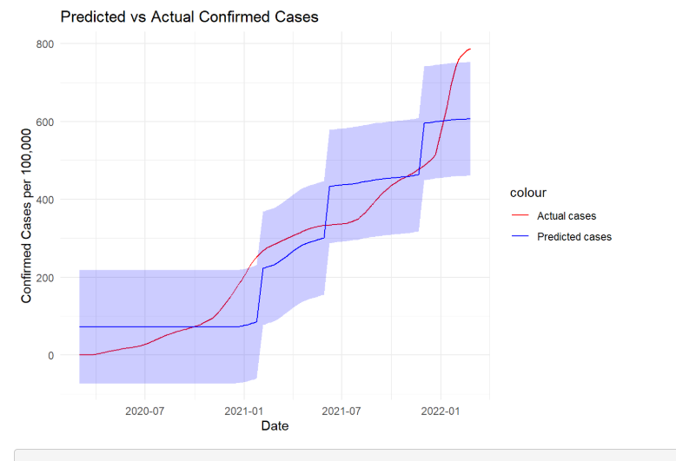
Prediction based on vaccination and variants
From model: P-value is less than 2.2e-16, and so is statistically significant. RMSE is 73.679 which is lower than RMSE of using just vaccination which is 79.18228.
From the interval you can also see the prediction is much closer to the trend of the actual data.

Slide 17
Prediction made for some sample states
We will first conduct a regression model on California, using variant and vaccination rate as predictor to predict the confirmed.

Slide 18
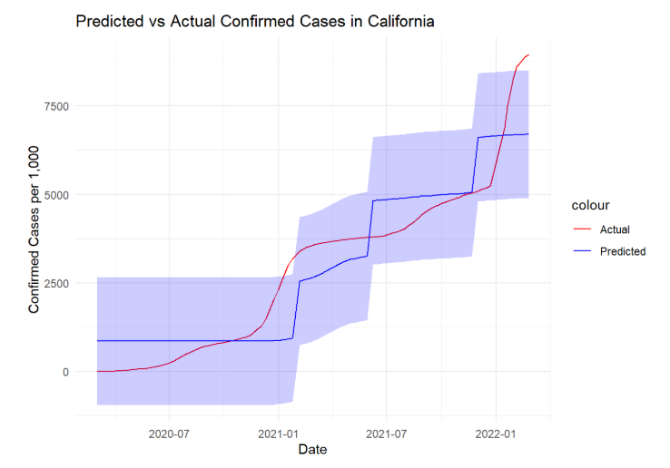
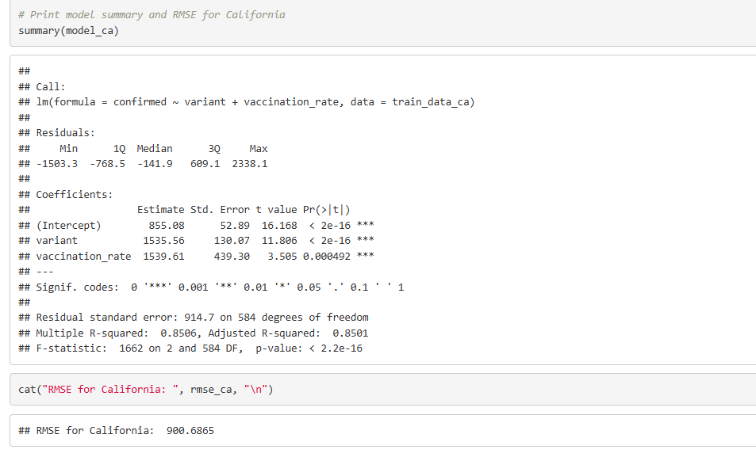
Prediction for california
Again, P-value is less than 2.2e-16(small). And the RMSE is around 900. As we saw from the graph, Prediction follows well with the actual data.

Slide 19
Next...
we will use the prediction model by california to predict the confirmed cases in different states like Maryland, New York to see if the prediction can be used accross the states.

Slide 20
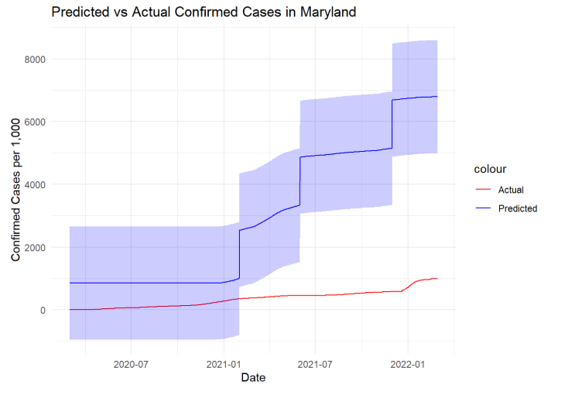

Prediction for Maryland based on california

Slide 21
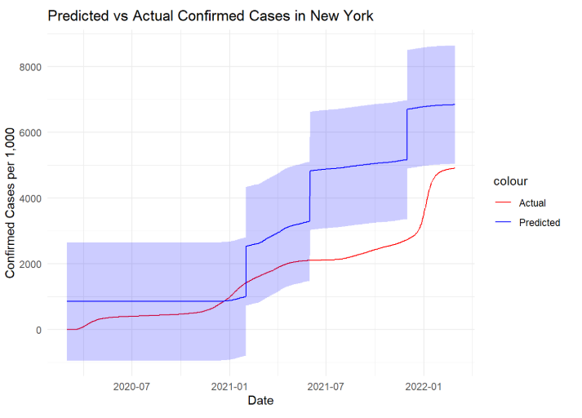

Prediction for New York based on california
For comparison, The RMSE of Maryland is 3278.314, while the RMSE of New York is 1761.337. Although the prediction of New York based on the situation of California is much better than the prediction of Maryland, both predictions deviate a lot from the actual data. This means that although variant and vaccination rate can be combined to well predict the confirmed cases, but this is only true for a specific region, like for a state or for a country as a whole. We cannot use the model trained by one state to predict the other, because of the difference that lies within the population base and/or policies enforced within that region.

Slide 22
Conclusion
the vaccination is effective in controlling the pandemic.
However, there are also other factors like variants of the virus that play a crucial roles in determining the future confirmed cases. When combined, vaccination rate and variants can be a good predictor of the confirmed cases.
Last but not least, the situation is different from state to state. Thus, we cannot use the model train by one state to predict other states without the assumption that ensures the high similarity between the state that was used to predict and the state that was actually predicted.

Slide 23
Reference
Guidotti, E., (2022), “A worldwide epidemiological database for COVID-19 at fine-grained spatial resolution”, Sci Data 9(1):112, doi: 10.1038/s41597-022-01245-1

Slide 24
Thank you for listening!

Slide 25
My video link
https://us06web.zoom.us/rec/share/QJT6rCZfiWn6s0zxZO2Jk5gwbV6_mpdGueU6tndmkLqCub-tnyXtgrCLl1K2mhek.G_Csjaiw1G6OwJPg?startTime=1733524536000
Passcode: 2bJ9=Y6n

