Slide 1
Obstacle Avoidance By Evolutionary Algorithms
Zeren Li, Yi Wei

Slide 2
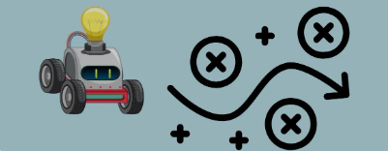
Introduction

Slide 3
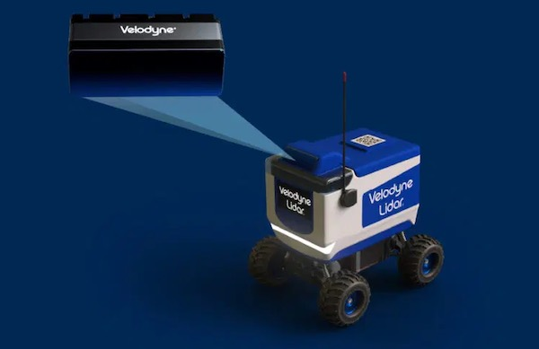
Design
Algorithm - Evolutionary Strategy
Input: Lidar sensor
Output: Fast turn speed, Left turn speed,
Right turn speed
Policy: threshold & too close threshold

Slide 4
Design
Algorithm Workflow
Initialize Population: Create an initial set of motor speed parameter for each rule.
Simulation: Run each individual (parameter set) in a simulation environment where the robot navigates using the predefined rules.
Evaluate Fitness:
Measure the fitness of each individual based on how well it avoids obstacles and minimizes turning time while navigating.
Collision Penalty: Assign a high penalty if the vehicle collides with an obstacle.
Turning Penalty: Apply a small penalty for time spent turning to encourage efficient obstacle avoidance.
Forward Movement Reward: Reward continuous forward movement without collisions.
Fitness=α×Time without collision−β×Time spent turning−γ×Collision penalty
Select and Evolve:
Select the top-performing individuals.
Optionally apply recombination to combine the best solutions.
Apply mutation to create new motor speed.
Repeat:
Iterate through generations until an optimal solution is found or a set number of generations are completed.
Deploy:
Once an optimal parameter set is found, deploy it on the robot for real-world testing.

Slide 5
Result
Obstacle_avoidance_presentation.mp4

Slide 6
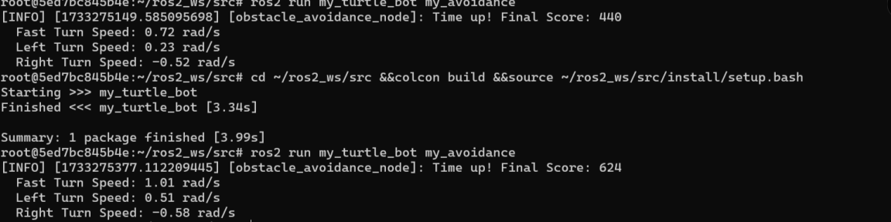
Comparison
Initial population score(440) -> Final population score(624). Around 40 percent of Score increase.

Slide 7
Conclusion
A faster speed means faster turning, but too fast can lead to a crash. Thus, in this project, we adopted the ES algorithm to find the better motor speed pairs for obstacle avoidance task for time efficiency while maintaining safety of the vehicle manipulation at all time.
ES algorithm can achieve a large score boost.
We also took the advantage of the Gazebo environment to speed up the simulation process, which can lead to a faster result.

Slide 8
Thanks for listening!

