Slide 1

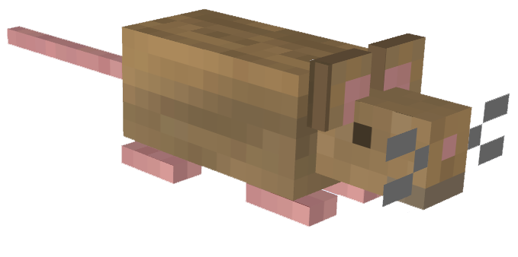
Pac-Rats
Group 8:
Amal Syed, Edward Liang,
Jennifer Alonso, and Jonathon Repta

Slide 2
Project overview
Pac-Rats is a multiplayer implementation of the arcade classic, Pac-Man. Pac-Rats offers a plethora of new features for players looking for a fresh take on a classic game.
Pac-Rats includes new game modes such as (co-op, free-for-all), a leaderboard system, community based features, powerups, map creation, etc.

Slide 3

Requirements
Performance
Security
Usability
Cultural
Environmental
Supportability

Slide 4
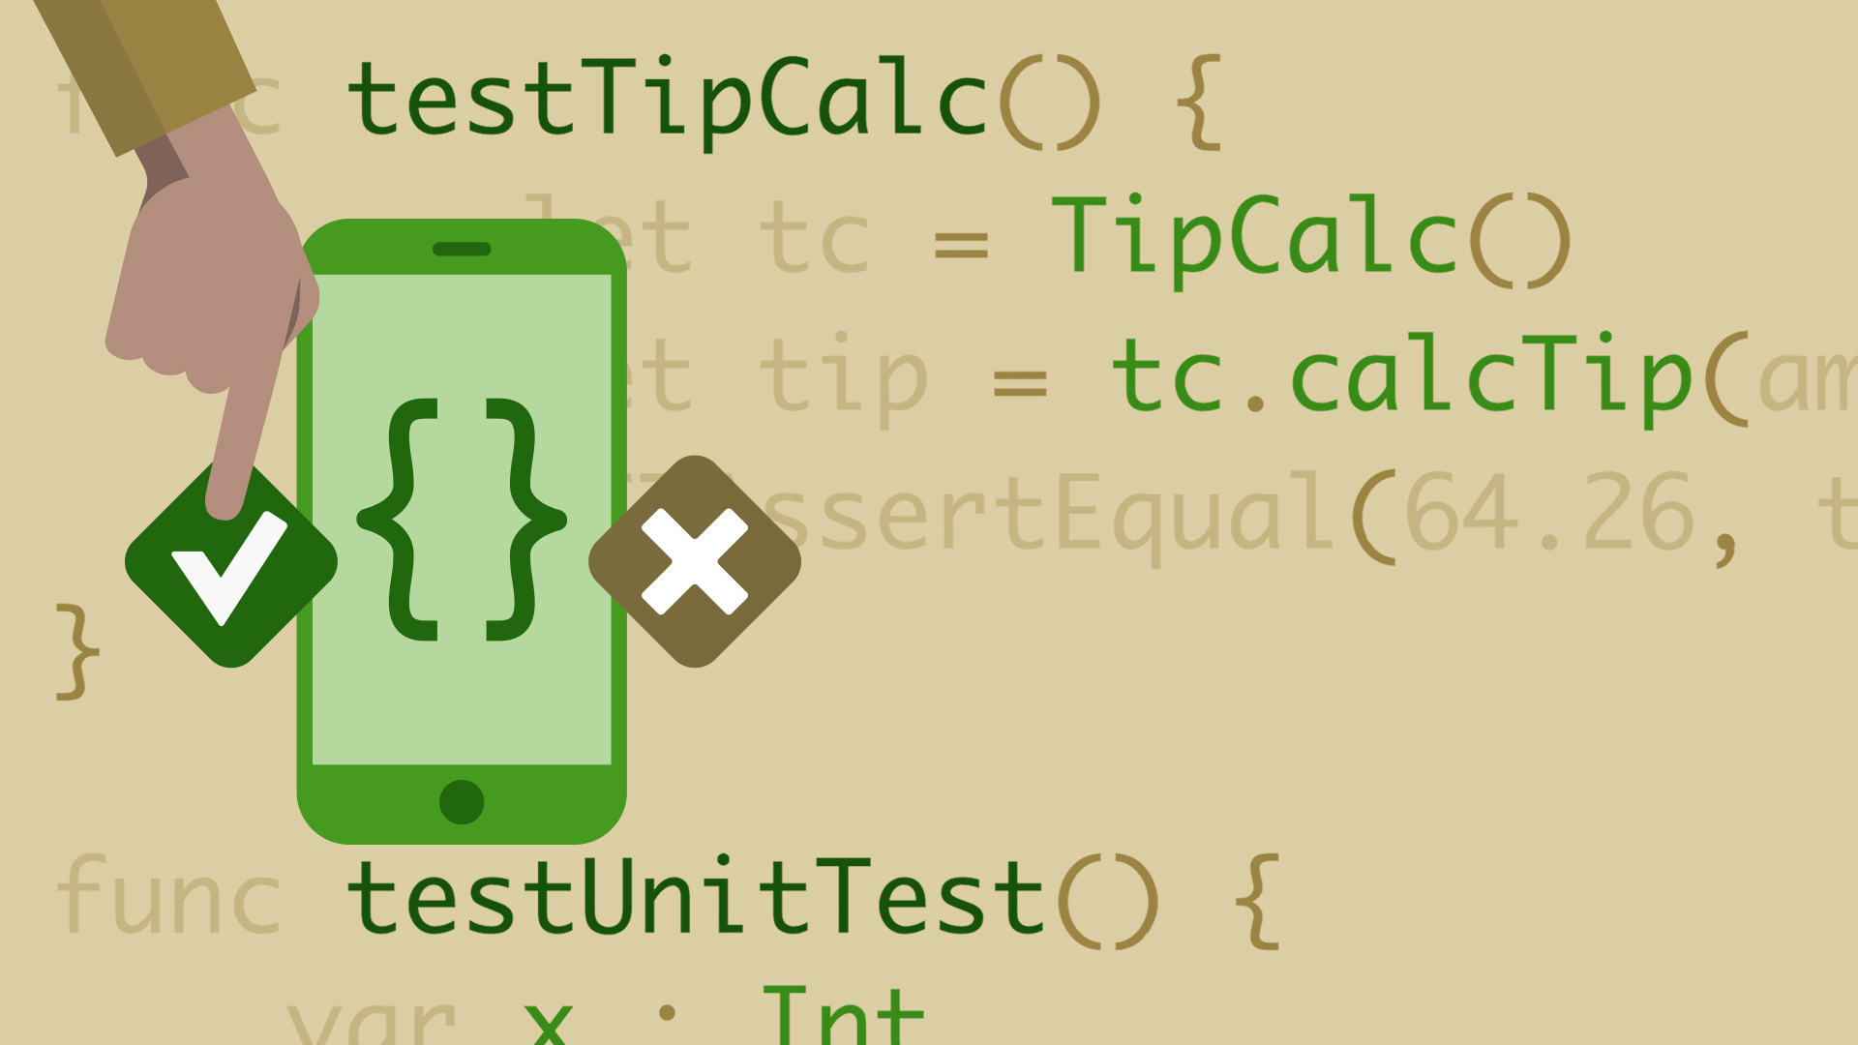
Test Plans
Account Handling
Gameplay loop
Data persistence
User experience
Accessibility

Slide 5
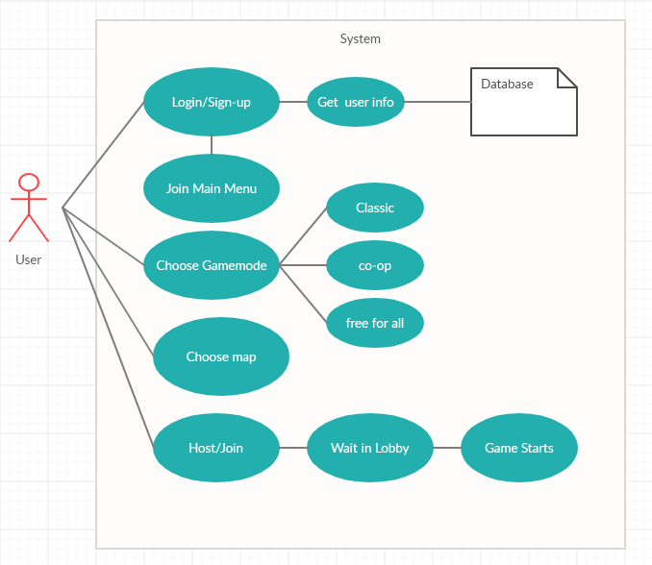
Use Case Diagram

Slide 6
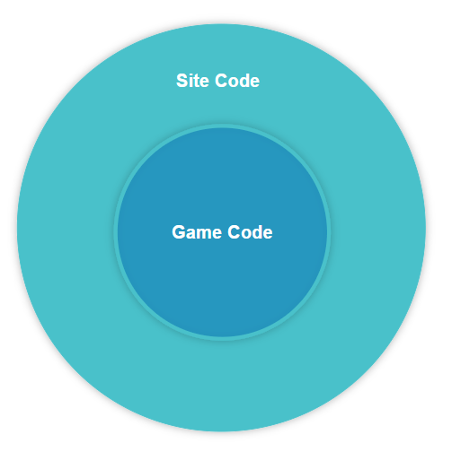
Separation of Concerns
Game will be broken into two modules:
Game module
code pertaining to the game itself
Site module
code pertaining to the site’s architecture
Notes:
Our design calls for

Slide 7
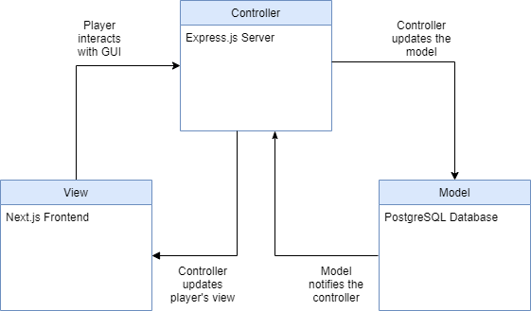
MVC Pattern
Notes:
Used for the game’s infrastructure. IE, the code required to ensure many of the site’s features are functional

Slide 8
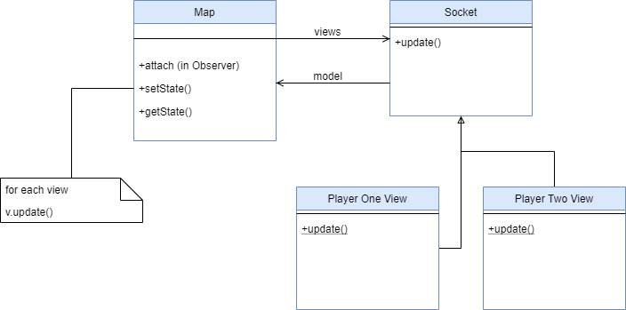
Observer Pattern
Notes:
Used for the game. The client server model will allow for us to utilize sockets so that real time communication between client and server can be established

Slide 9
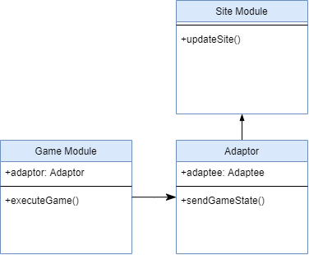
Adapter Pattern
Notes:
The adapter pattern connects the previous two patterns together and allows for developers working on each component to focus on their own module rather than spending time coordinating data transfer between modules.

