Slide 1

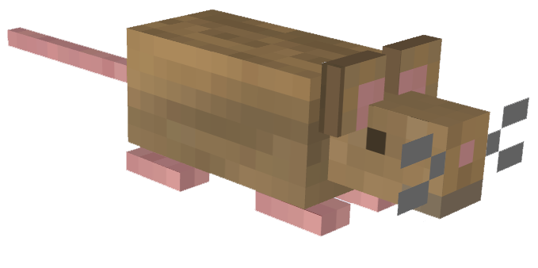
Pac-Rats
Group 8:
Amal Syed, Edward Liang,
Jennifer Alonso, Jonathon Repta

Slide 2
Overview
In compliance with the theme of scaling up a 2-player game to accommodate multiple players, we propose a Pac Man-esque browser-based game that would allow for up to thirty players to be in a match at the same time. The game will feature traditional Pac-Man style gameplay combined with a number multiplayer oriented additions.

Slide 3
Purpose
The purpose of this project is to offer a fun and exciting twist on a classic game - and to make a game that will appeal to a wide range of players with new features such as:
Cooperative mode
Free-for-all mode
Custom player maps
Option to share gameplay segments
Easily link up with friends

Slide 4
Scope of the Work
Project will focus on the production and delivery of a compelling multiplayer game.
Production will focus on the game itself rather than auxiliary code required to get the game running, meaning we’ll use existing game engines, I/O libraries, etc.
Currently, Pac-Man style games are constricted to dedicated gaming devices, require an upfront payment, and don’t use the “freemium” model
There are many competing Pac-Man style games, however, few of them are browser based and almost none are multiplayer

Slide 5
Scope of the Product
User connects to the game by registering/logging in/pressing “Play Now!”. Information will either be retrieved or added to the database accordingly.
Choose game mode (co-op, single, free for all) from the menu
Choose a specific map or let the game generate one procedurally
Choose to host a game or join an existing one
Wait until the lobby fills up and game starts

Slide 6
Stakeholders
Client: A game company that wants to remake classic games with a new spin.
Users: Everyone will be able to access to the game for free as long they have a computer and an internet connection.
Customers: Users who not only play them game, but also spend money on in-game purchases/microtransactions.

Slide 7
Mandated Constraints
Must run in the browser and be compatible with all major browsers (representing at least 80% of the world’s internet users)
Must be able to run on low power devices like Chromebooks
Must be accessible to colorblind users
Must provide provide a “free-tier” in order to accommodate players who are unable or unwilling to pay

Slide 8
Naming Conventions and Definitions
“Pac-Men” are represented as pack rats and “ghosts” are represented foxes in our implementation to make our game distinct from standard Pac-Man
“Free-for-all” is a game mode where there are no teams and individual players are pitted against every other player on the board
“Co-op” is a mode where players work together to achieve the highest score possible -- without the presence of foxes (opponents)

Slide 9
Relevant Facts and Assumptions
Assumption: the player is familiar with how a standard game of Pac-Man is played
Assumption: the player has a stable internet connection
Assumption: 90+% of users will not make any in game purchases
Fact: Game must be GDPR compliant for players in the European Union
Fact: Game must respect intellectual property laws and contain exclusively original content

