Slide 1
RobustState: Boosting Fidelity of Quantum State Preparation via Noise-Aware Variational Training
Hanrui Wang
MIT
Notes:
The current pace of hardware development in quantum computing is very fast
We have different technologies
The number of qubits

Slide 2
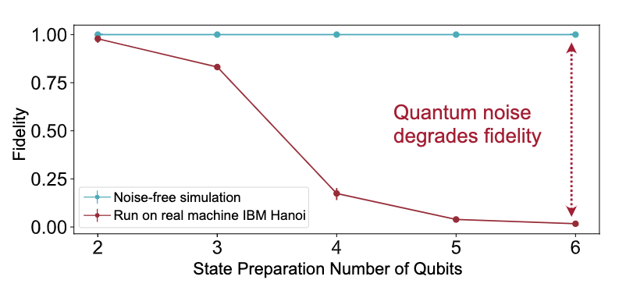
RobustState -- Robust Variational State Preparation
Noise degrades state prep fidelity

Slide 3
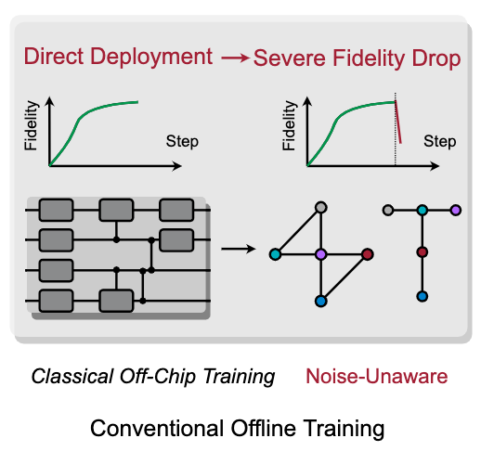
Robust Variational State Preparation
Noise degrades state prep fidelity

Slide 4
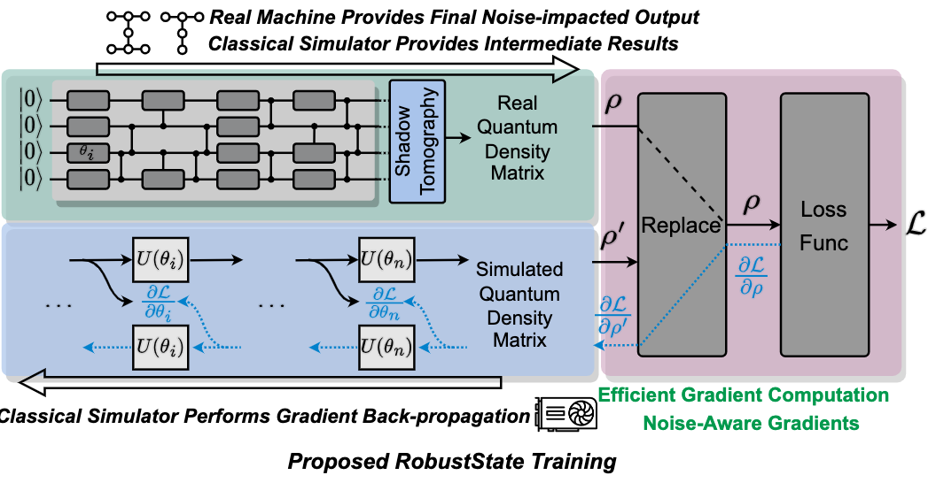
Forward on real device; backward on simulator
Make the parameters aware of the real noise

Slide 5
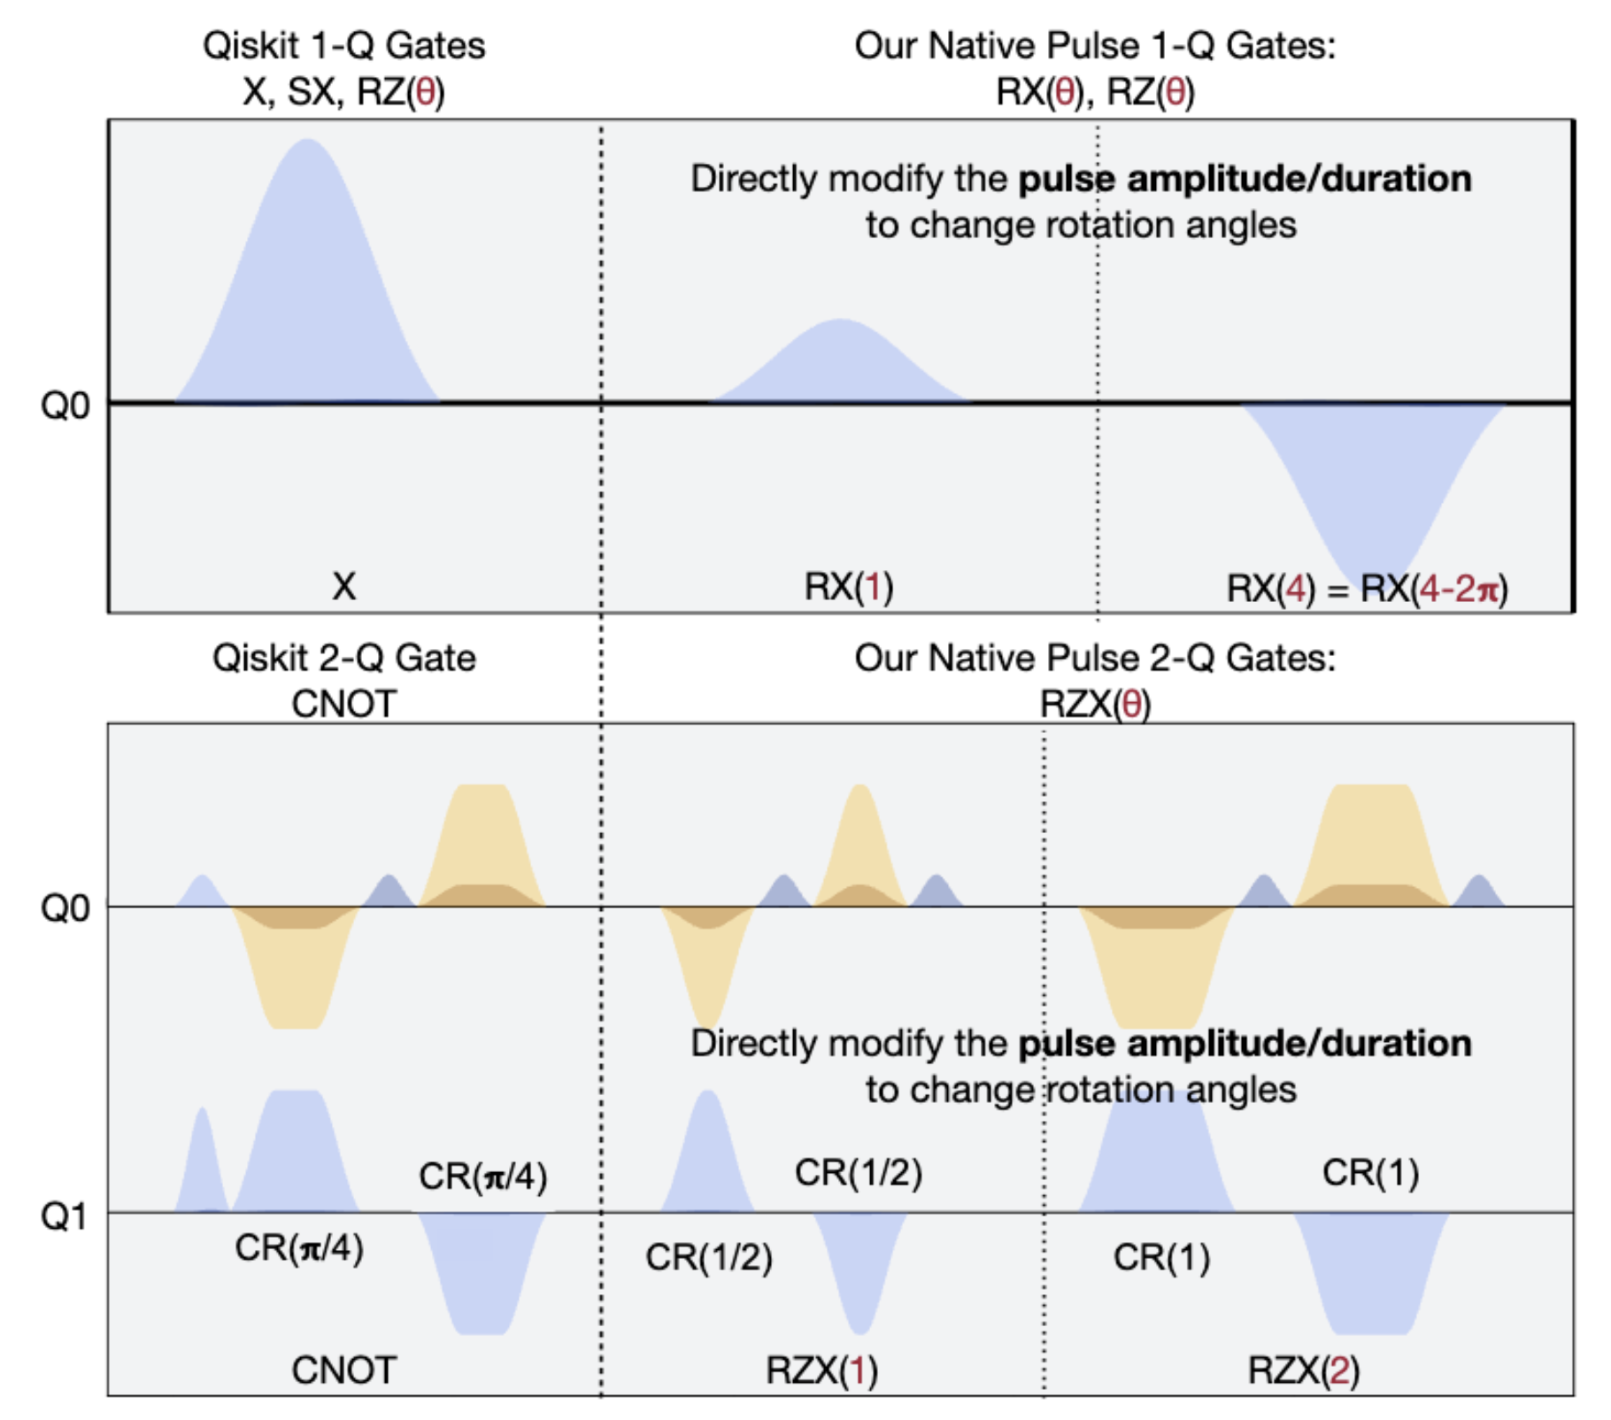
Optimize on the Pulse level

Slide 6
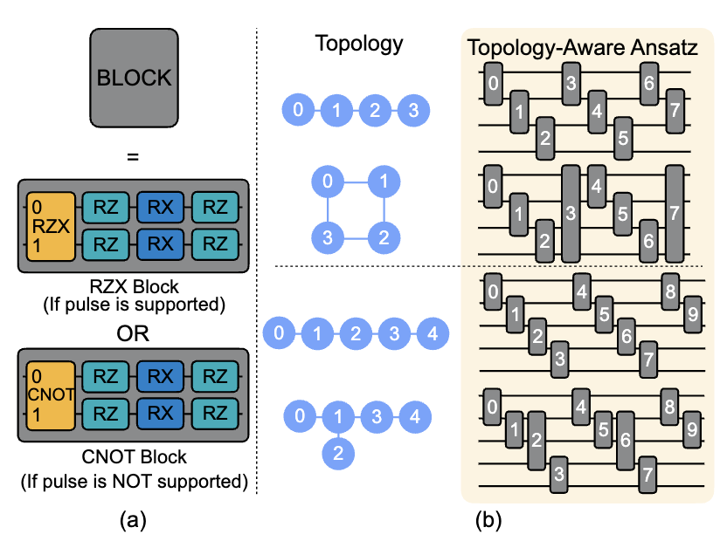
Hardware Efficient Ansatz

Slide 7
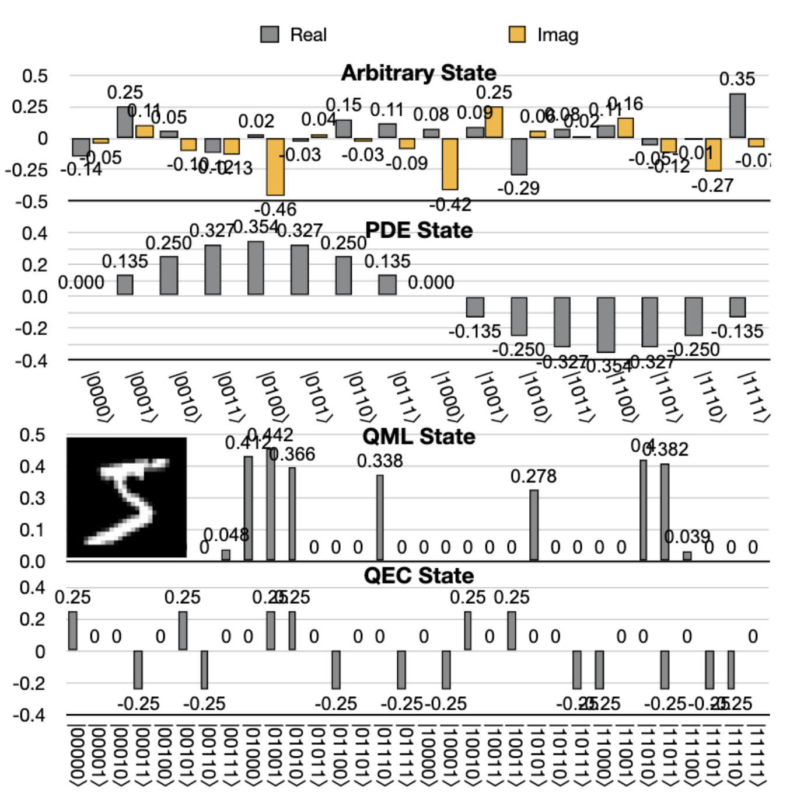
Evalution
Benchmarks

Slide 8
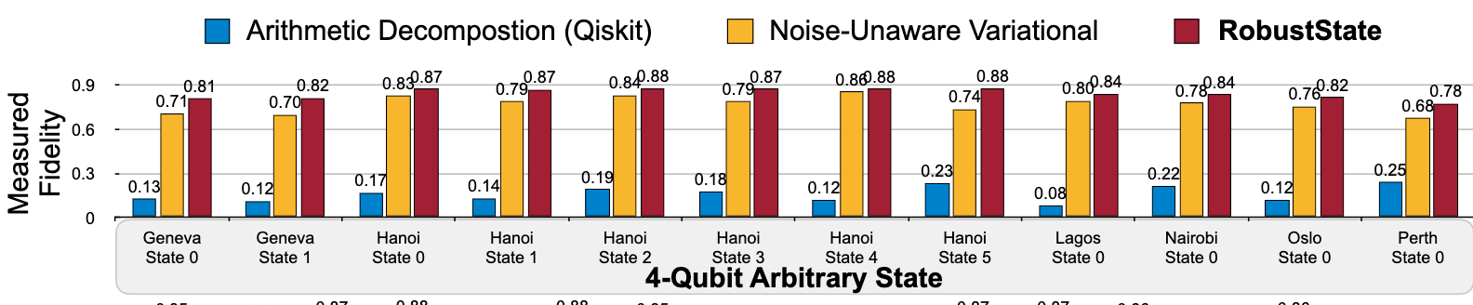
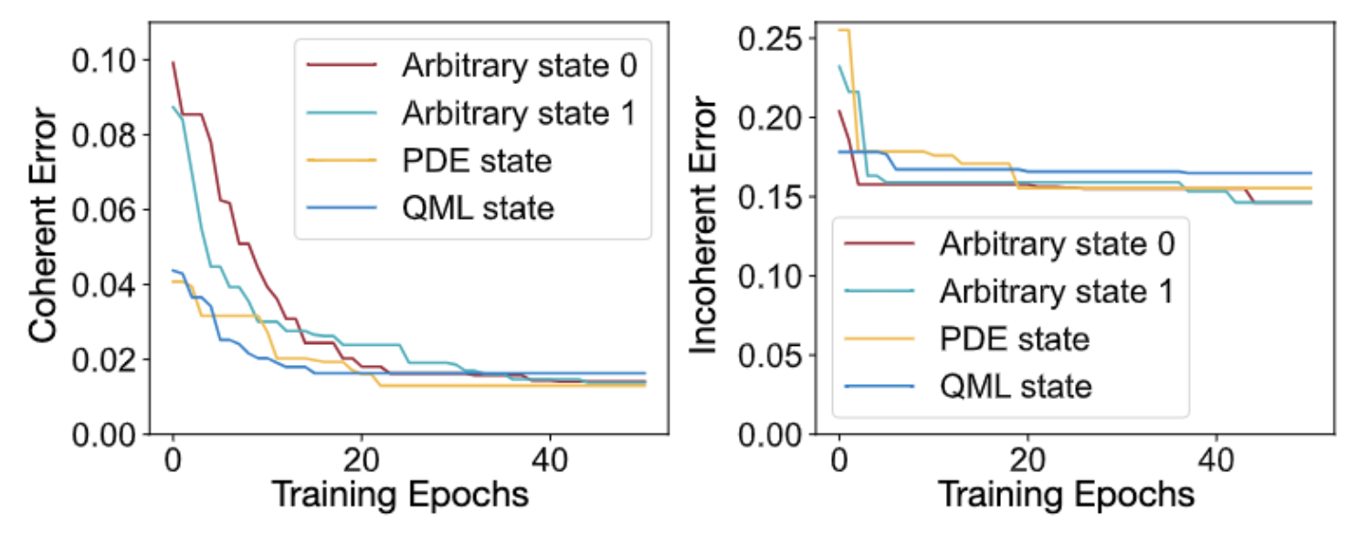
Evaluation
On real quantum device

Slide 9
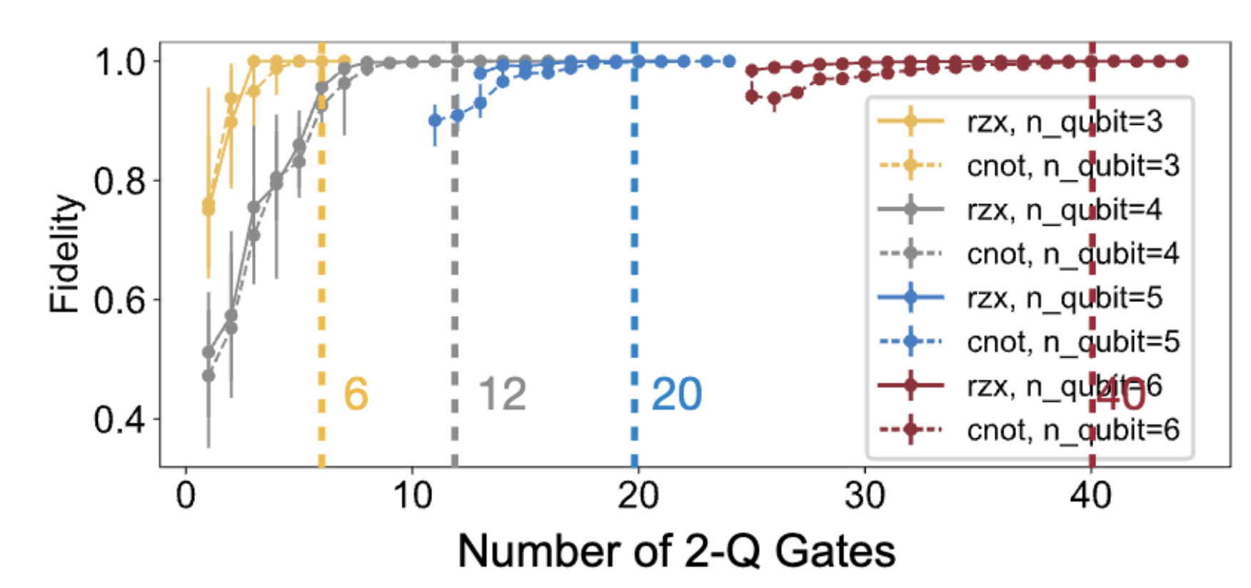
Number of 2Q gates

Slide 10
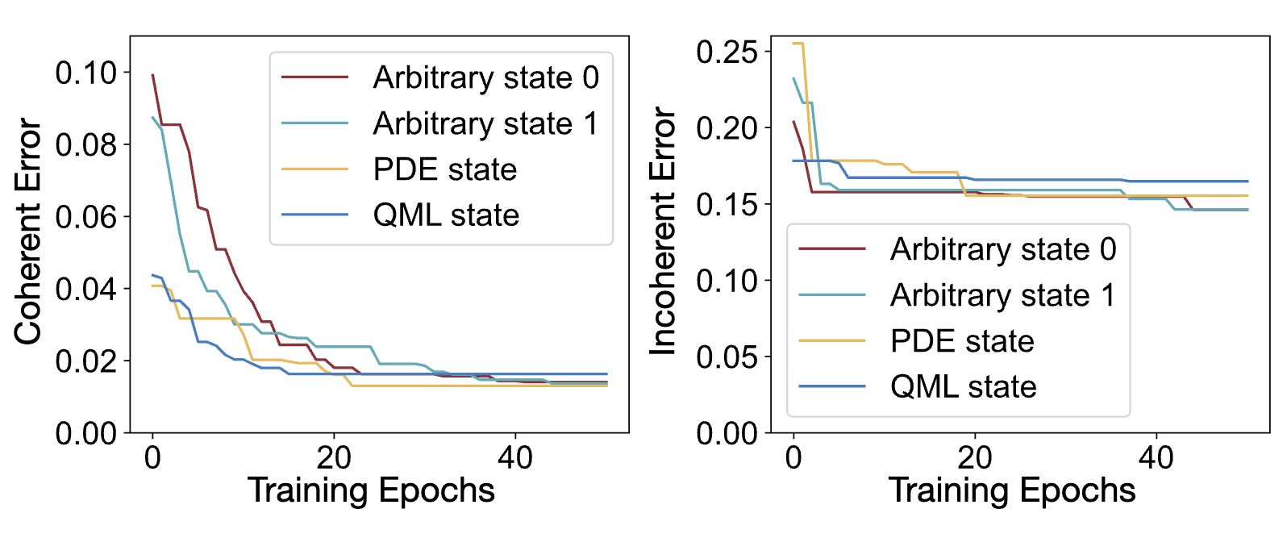
Reduction of Coherent Errors

Slide 11

Thank you for listening!
https://github.com/mit-han-lab/torchquantum
qmlsys.mit.edu

