Slide 1

Parameterized Quantum Pulse Circuit and its Application

Slide 2

QR Code for Materials

Slide 3
1.1 Towards Parameterized Quantum Pulses Advantage Speaker: Zhiding Liang (University of Notre Dame)
Session 1
1.2 Code Demo: Build Your Own Parameterized Pulses on Qiskit Dynamics and TorchQuantum
Mentor: Jinglei Cheng (Purdue University)
1.3 Hybrid Gate – Pulse Model for Variational Quantum Algorithms Speaker: Jinglei Cheng (Purdue University)
Session 2
2.1 qutip-qip: Pulse-level Circuit Simulation Speaker: Boxi Li (Forschungszentrum Jülich)
2.2 Code Demo: Pulse level Circuit Simulation on qutip
Mentor: Boxi Li (Forschungszentrum Jülich)
2.3 Boosting Fidelity of Quantum State Preparation via Noise-Aware Variational Training Speaker: Hanrui Wang (MIT)

Slide 4
Towards Parameterized Quantum Pulses Advantage
Zhiding Liang
University of Notre Dame
Notes:
The current pace of hardware development in quantum computing is very fast
We have different technologies
The number of qubits

Slide 5
Agenda
Compilation Workflow.
Control System, Software.
Translation from gate to pulse.
Single qubit control and two qubit control.
Pulse-level advantage
Expressivity analysis.
Time dependent noise model.
Pulse Simulator
Unitary time evolution.
Lindblad master equation.
Weyl Chamber
Pulse Ansatz

Slide 6



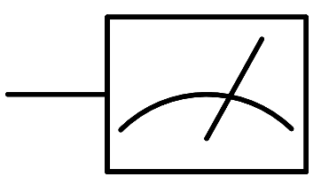

Control System
Application Software
Control Software
qc.measure
qubit(0)
qc.measure
qubit(1)

Slide 7

Control System
Application Software
Control Software
Control Hardware
1
0

Slide 8
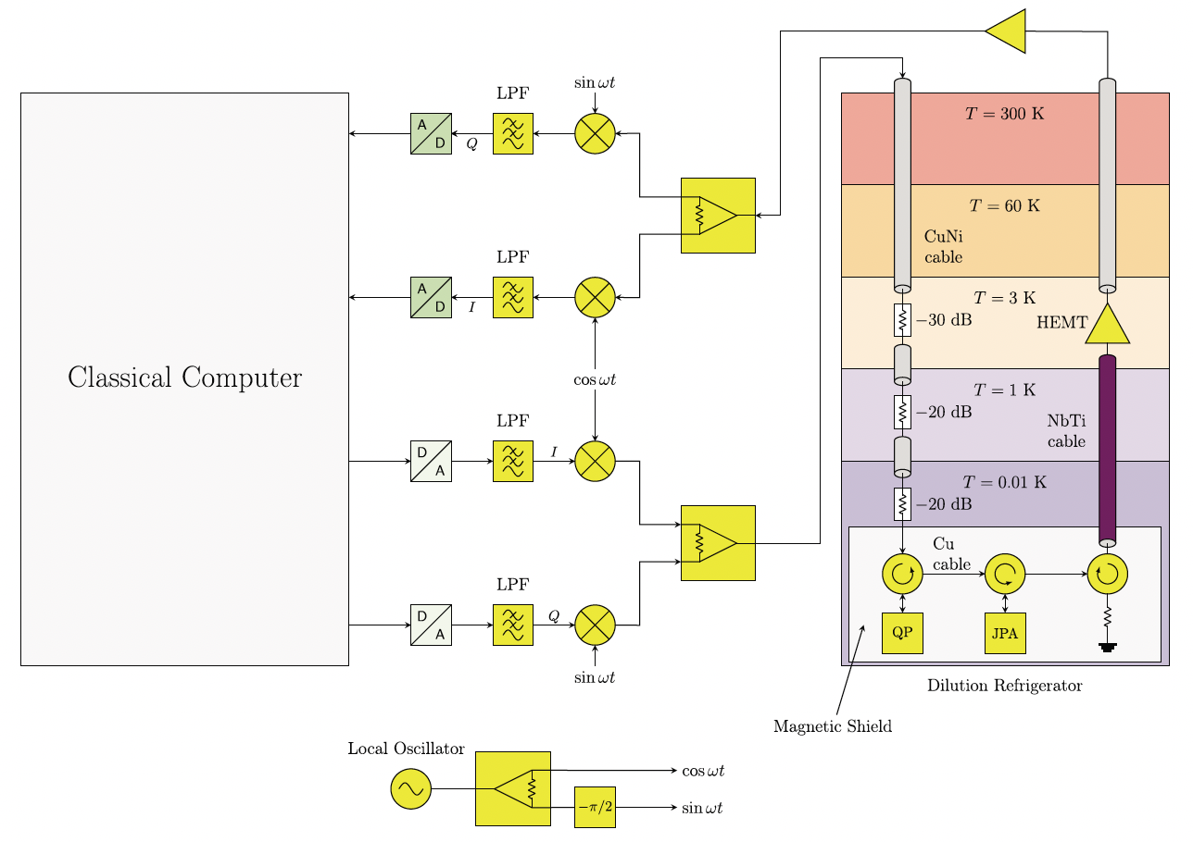
Control System
Stancil, Daniel D., and Gregory T. Byrd. Principles of superconducting quantum computers.
John Wiley & Sons, 2022.
Notes:
Junction Parametric Amplifier (JPA) quantum processor (QP) high electron mobility transistor(HEMT)—a type of transistor that is known for producing very low noise.

Slide 9
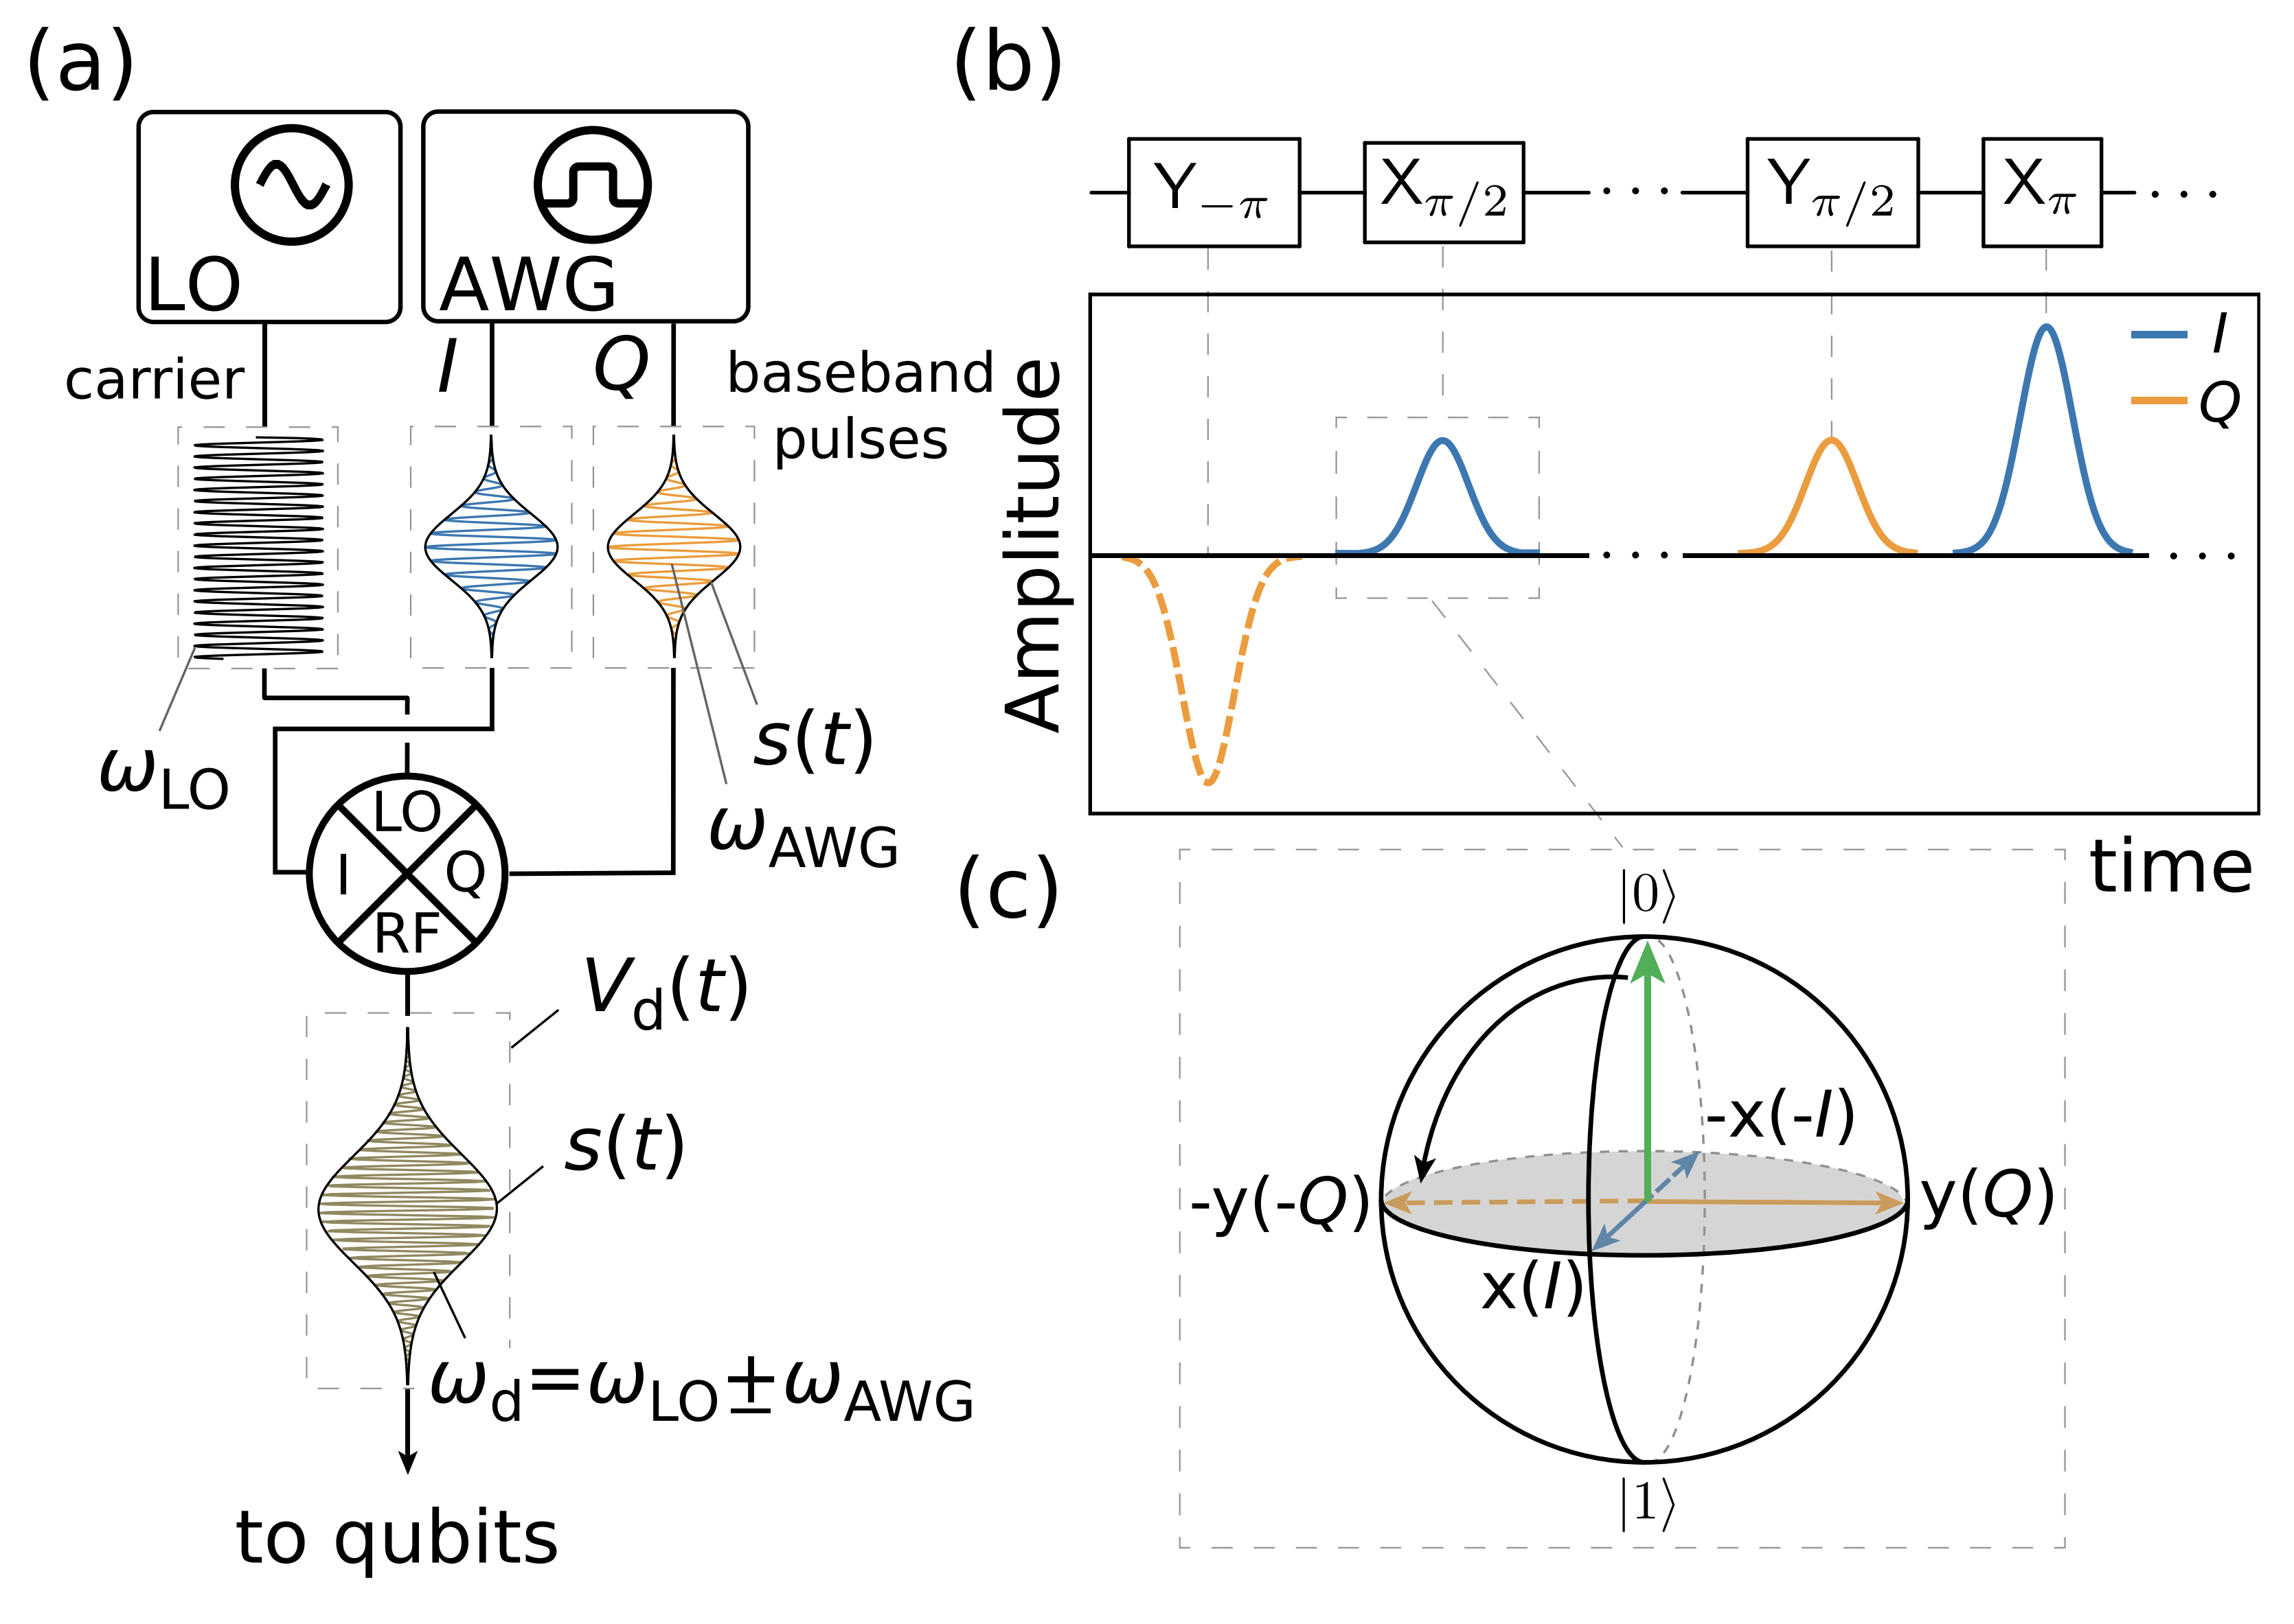
Control Hardware
The microwave is used to control the quantum bits.
Krantz, Philip, et al. "A quantum engineer's guide to superconducting qubits." Applied physics reviews 6.2 (2019).
Notes:
. (a) Schematic of a typical qubit drive setup. A microwave source supplies a high-frequency signal (ωLO), while an arbitrary waveform generator (AWG) supplies a pulseenvelope (s(t)), sometimes with a low frequency component, ωAWG, generated by the AWG. The IQ-mixer combines the two signals to generate a shaped waveform Vd(t) with a frequency ωd = ωLO ± ωAWG, typically resonant with the qubit.
(b) Example of how a gate sequence is translated into a waveform generated by the AWG. Colors indicate I and Q components.
(c) The action of a Xπ/2 pulse on a |0i state to produce the |−ii = √1 2 (|0i − i|1i) state.

Slide 10
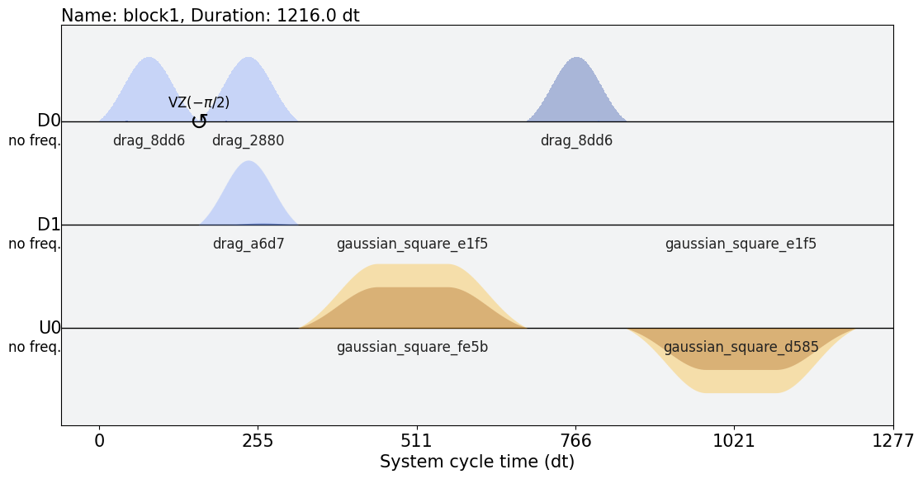
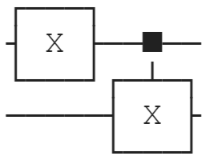

Control Software
Scheduling/
Compilation
Execution
Circuit
Pulse
Result

Slide 11
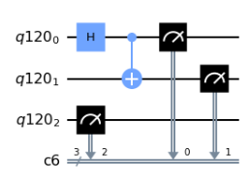
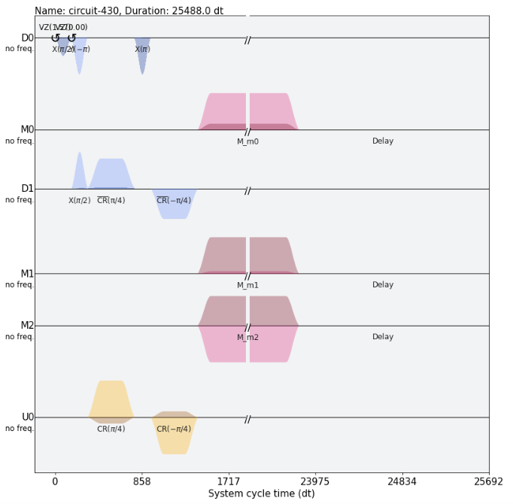
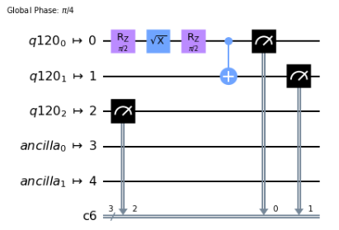
Control Software
Gate- and Pulse-level are two different abstraction layers.

Slide 12
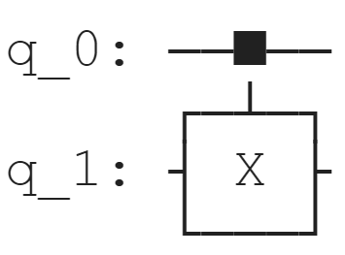
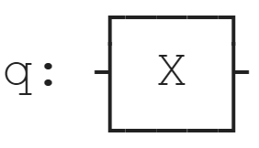
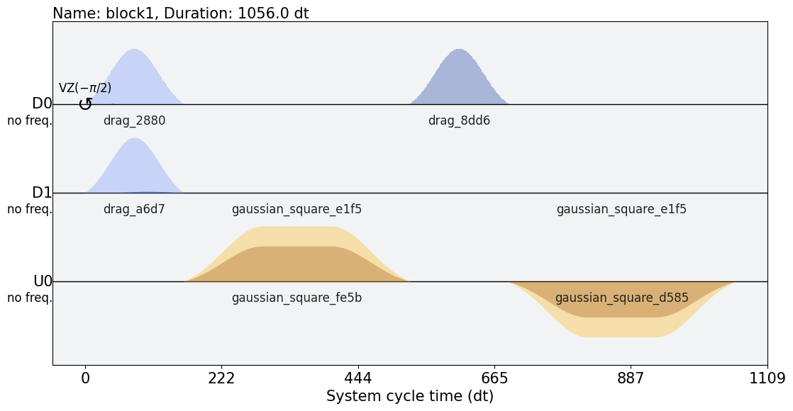
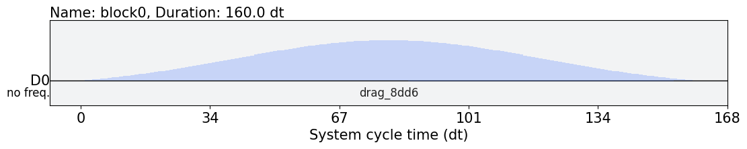
Gate – Pulse Translation
Map from gate to pulses
Single qubit gate to pulse, e.g., X gate.
Two qubit gate to pulse, e.g., CX gate.

Slide 13
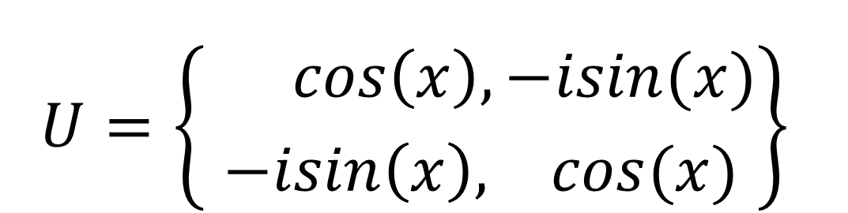

Gate – Pulse Translation
Map from gate to pulses: $U =e^{−iHt}$
For single qubit gate: e.g., X gate
Given the Hamiltonian is constant
$$U=\left\{{ cos\left(x\right), −isin(x) \atop −isin\left(x\right), cos(x)}\right\}$$
$$H \text{= }\text{σ}\text{x} \text{=}\left\{{0, 1 \atop 1, 0}\right\}$$

Slide 14
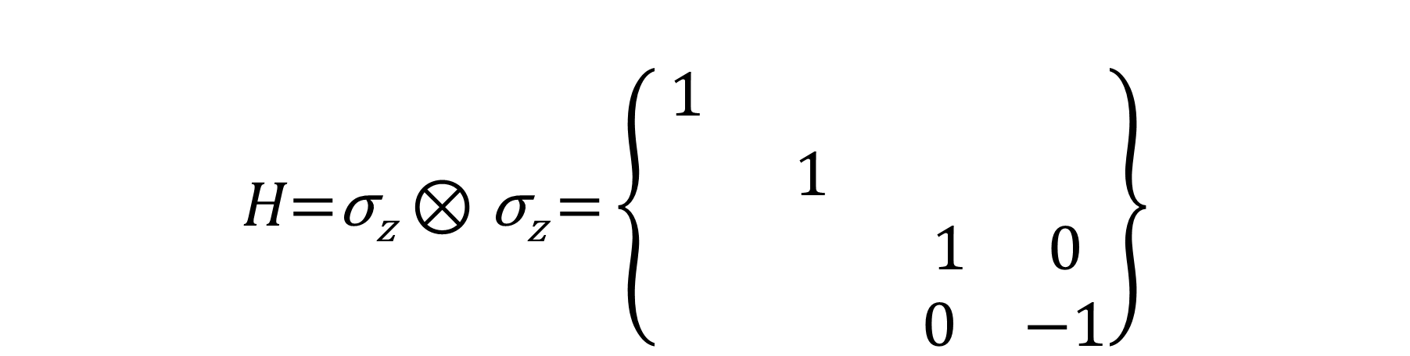

Gate – Pulse Translation
Map from gate to pulses: $U =e^{−iHt}$
For single qubit gate: e.g., X gate
Given the Hamiltonian is constant
For two qubit gate: e.g., CZ gate
Given the Hamiltonian is constant
$$U=\left\{{ cos\left(x\right), −isin(x) \atop −isin\left(x\right), cos(x)}\right\}$$
$$U=\left\{\begin{matrix}\begin{matrix}1 \\ \end{matrix} & \begin{matrix} \\ 1\end{matrix} & \begin{matrix}\begin{matrix} & \end{matrix} \\ \begin{matrix} & \end{matrix}\end{matrix} \\ & & \begin{matrix}1 & 0\end{matrix} \\ & & \begin{matrix} 0 & e^{−ix}\end{matrix}\end{matrix}\right\}$$
$$H\text{=}\text{σ}\text{z}⊗\text{σ}\text{z} \text{=}\left\{\begin{matrix}\begin{matrix}1 \\ \end{matrix} & \begin{matrix} \\ 1\end{matrix} & \begin{matrix}\begin{matrix} & \end{matrix} \\ \begin{matrix} & \end{matrix}\end{matrix} \\ & & \begin{matrix}1 & 0\end{matrix} \\ & & \begin{matrix} 0 & −1\end{matrix}\end{matrix}\right\}$$
$$H \text{= }\text{σ}\text{x} \text{=}\left\{{0, 1 \atop 1, 0}\right\}$$

Slide 15
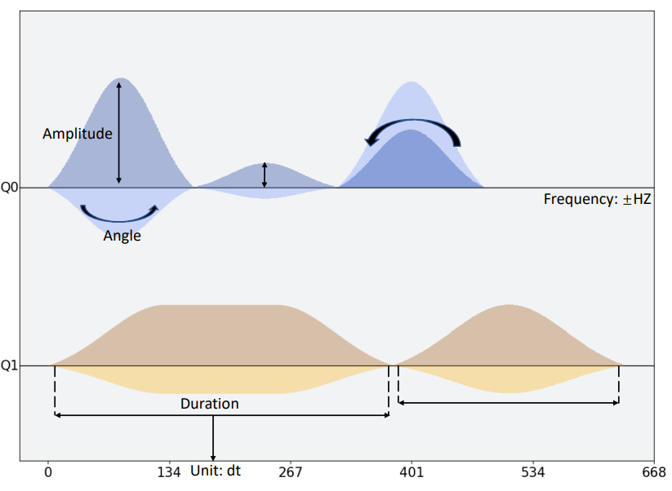
Gate – Pulse Translation
Map from gate to pulses: $U =e^{−iHt}$
$$Hd = ΩV0s\left(t\right)\left(I\sin\left(ωdt\right)− Q\cos\left(ωdt\right)\right)× \left(\cos\left(ωqt\right)σy −\sin\left(ωqt\right)σx\right)$$
I = cos(φ) (the ‘in-phase’ component)
Q = sin(φ) (the ‘out-of-phase’ component)
𝑉₀ is the amplitude.
φ is the angle.
Notes:
where Ω = (Cd/CΣ)Qzpf and ωq = (E1 − E0) e CΣ = C + Cd is the total capacitance to ground and Q˜ = CΣΦ˙ − CdVd(t) is a renormalized charge variable for the circuit.

Slide 16
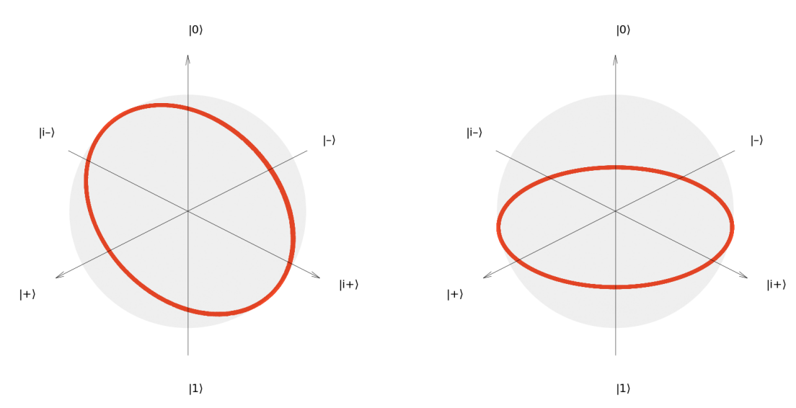
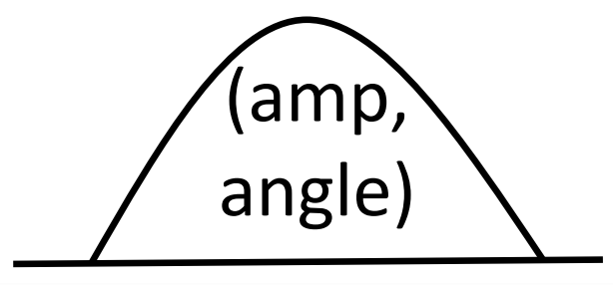
Single Qubit Control
Microwave pulse rotates the qubit around the Bloch sphere.

Slide 17
Two Qubit Control
For IBM superconducting quantum machines, the minimum 2 qubit control basis is cross resonance. The Hamiltonian of cross resonance can be express as following form:
$$H=\frac{Z\text{ ⊗} A}{2}+\frac{I\text{ ⊗} B}{2}=axZX+ayZY+azZZ+bxIX+byIY+bzIZ$$
Since IBM take CX as the 2 qubit basis gate, CX gate only require ZX term, thus, all other terms can be taken as unwanted terms and should be removed by calibration.

Slide 18
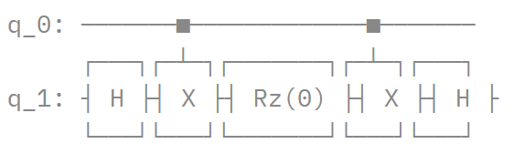
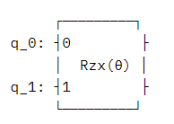
Two Qubit Control
Combining the pulse-level property, previous researchers proposed a method to accelerating the gate speed for RZX(θ), which is called pulse-efficient transpilation [1].
RZX gate also only require ZX term, for achieving RZX(θ), we need to make ZX term tunable. In [1], they make the change of θ proportional to the change of duration and amplitude of the pulse – stretching pulses to use only one echoed cross resonance to represent the RZX(θ).
=
~ 1 x
Instead of previous ~ 2 X
[1] Earnest, Nathan, Caroline Tornow, and Daniel J. Egger. "Pulse-efficient circuit transpilation for quantum applications on cross-resonance-based hardware." Physical Review Research 3.4 (2021): 043088.

Slide 19
Agenda
Compilation Workflow.
Control System, Software.
Translation from gate to pulse.
Single qubit control and two qubit control.
Pulse-level advantage
Expressivity analysis.
Time dependent noise model.
Pulse Simulator
Unitary time evolution.
Lindblad master equation.
Weyl Chamber
Pulse Ansatz

Slide 20
Noise Analysis
Noise on gate level:
Are usually independent among qubits.
Applied after each perfect gate operation.
Approximate picture
Noise on pulse level:
Operation and noise are together built in the same model not separate.
Noise are correlated both in time and space.
Realistic picture
Noise on real machine.

Slide 21
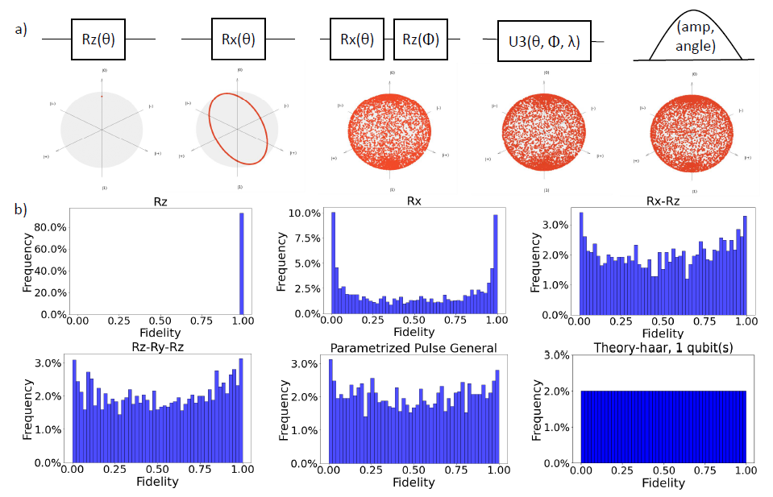
Expressivity Analysis
Sampling expressivity of single qubit pulse and compare with different single qubit gate operations.
Liang, Zhiding, et al. "Towards Advantages of Parameterized Quantum Pulses." arXiv preprint arXiv:2304.09253 (2023).

Slide 22
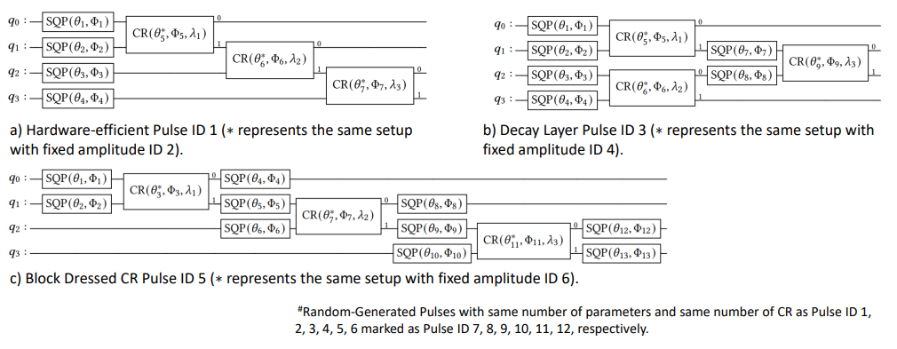
Expressivity Analysis
Give some pulse ansatz design space settings.

Slide 23
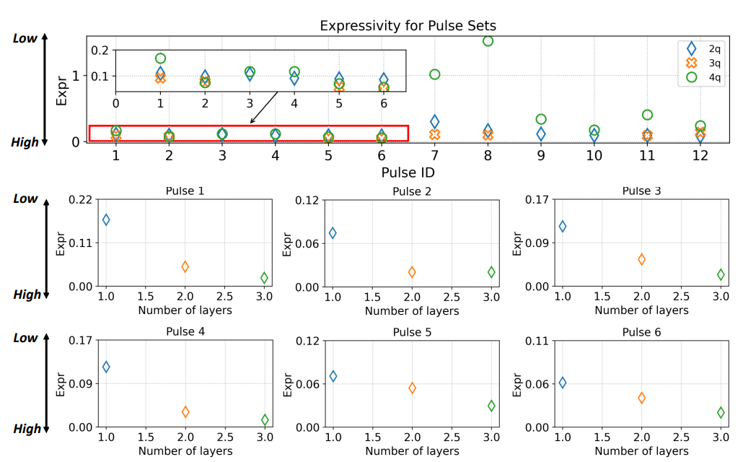
Expressivity Analysis
Expressivity getting better as the increase of qubits number and increase of circuit block layers.

Slide 24
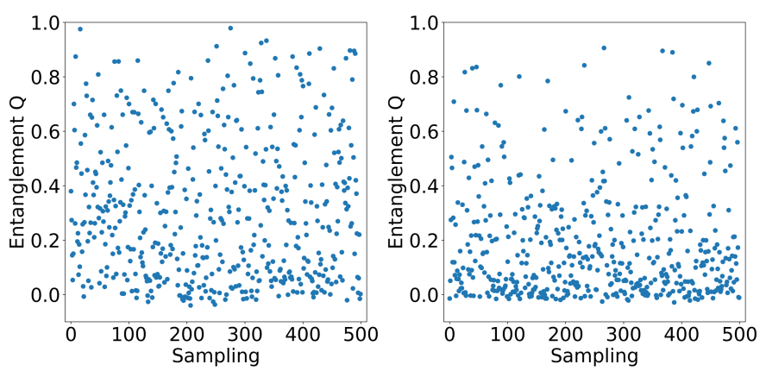
Entanglement Analysis
Change parameters on 2-qubit cross resonance pulse shift the entanglement power.
Two CR pulses fixed amplitude
Two CR pulses

Slide 25
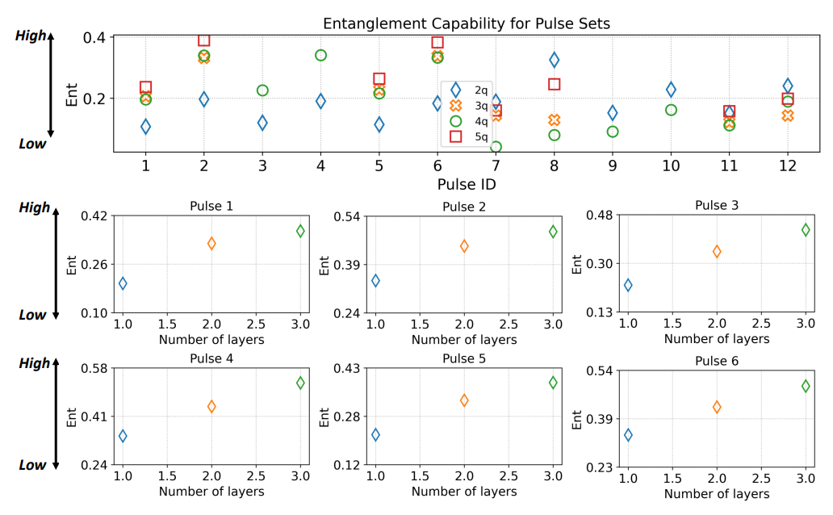
Entanglement Analysis
Entanglement capability keep increased with increasing of qubits number and circuit block layers.

Slide 26
Agenda
Compilation Workflow.
Control System, Software.
Translation from gate to pulse.
Single qubit control and two qubit control.
Pulse-level advantage
Expressivity analysis.
Time dependent noise model.
Pulse Simulator
Unitary time evolution.
Lindblad master equation.
Weyl Chamber
Pulse Ansatz

Slide 27
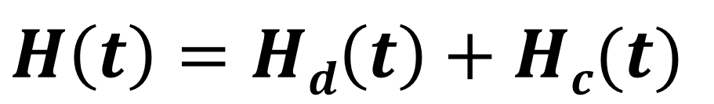
Closed Quantum System Simulation
For a closed quantum system, the dynamics is determined by the Hamiltonian and the initial state.
If we want to controlling this quantum system, the full system Hamiltonian can be expressed as non-controllable drift H_{d} and controllable terms combined as H_{c}
$$H\left(t\right)=Hd\left(t\right)+Hc(t)$$

Slide 28
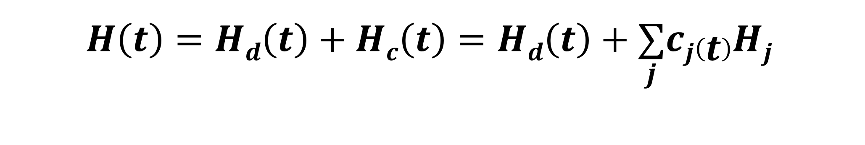
Closed Quantum System Simulation
The non-controllable drift term H_{d} captures the inherent evolution of the system and interactions that cannot be directly manipulated.
Controllable term (H_{c}) represent the parts of the Hamiltonian that can be actively manipulated or controlled. They typically involve external fields or control parameters that can be adjusted by an experimenter.
$$H\left(t\right)=Hd\left(t\right)+Hc(t)$$
$$H\left(t\right)=Hd\left(t\right)+Hc\left(t\right)=Hd\left(t\right)+\underset{j}{∑}cj\left(t\right)Hj$$

Slide 29
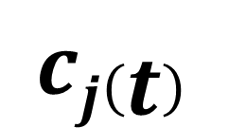
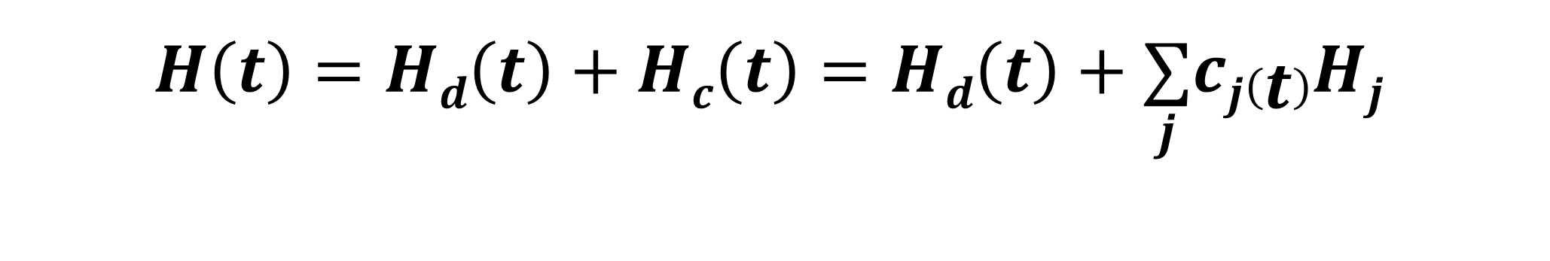
Closed Quantum System Simulation
The system Hamiltonian of closed quantum system illustrated as bellow:
$$H\left(t\right)=Hd\left(t\right)+Hc\left(t\right)=Hd\left(t\right)+\underset{j}{∑}cj\left(t\right)Hj$$
$$cj\left(t\right)$$
describe the strength of signals, which is determined by the user defined pulses.

Slide 30

Closed Quantum System Simulation
The system Hamiltonian of closed quantum system illustrated as bellow:
$$H\left(t\right)=Hd\left(t\right)+Hc\left(t\right)=Hd\left(t\right)+\underset{j}{∑}cj\left(t\right)Hj$$
$$cj\left(t\right)$$
describe the strength of signals, which is determined by the user defined pulses.
$$Hj$$
describes the effects of available physical controls on the system, which is the control Hamiltonian.

Slide 31
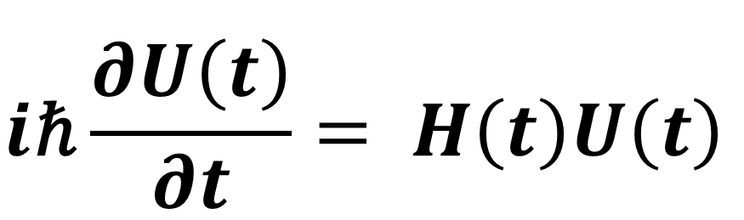
Unitary Time Evolution
Schrödinger Equation
$$i\text{ℏ}\frac{∂U\left(t\right)}{∂t}= H\left(t\right)U\left(t\right)$$
SESolver

Slide 32
Unitary Time Evolution
Schrödinger Equation
$$i\text{ℏ}\frac{∂U\left(t\right)}{∂t}= H\left(t\right)U\left(t\right)$$
SESolver
Given an initial state $U\left(t\right)$ and Hamiltonian $H\left(t\right)$

Slide 33
Unitary Time Evolution
Schrödinger Equation
$$i\text{ℏ}\frac{∂U\left(t\right)}{∂t}= H\left(t\right)U\left(t\right)$$
SESolver
Given an initial state $U\left(t\right)$ and Hamiltonian $H\left(t\right)$
What state will be in the future

Slide 34
Unitary Time Evolution
Schrödinger Equation
$$i\text{ℏ}\frac{∂U\left(t\right)}{∂t}= H\left(t\right)U\left(t\right)$$
SESolver
Statically describe the dynamics only for the perfect closed system
Given an initial state $U\left(t\right)$ and Hamiltonian $H\left(t\right)$
What state will be in the future

Slide 35

Open Quantum System Simulation
Now let’s look at how to describe the open quantum system Hamiltonian.
$$H\left(t\right)=Hd\left(t\right)+Hc\left(t\right)=Hd\left(t\right)+\underset{j}{∑}cj\left(t\right)Hj$$
Looks familiar :-D
Closed System Hamiltonian Description

Slide 36

Open Quantum System Simulation
Now let’s look at how to describe the open quantum system Hamiltonian.
$$H\left(t\right)=Hd\left(t\right)+Hc\left(t\right)=Hd\left(t\right)+\underset{j}{∑}cj\left(t\right)Hj$$
$$+ Hnoise$$
Looks familiar :-D
Closed System Hamiltonian Description
Now Different :-P
Open System Hamiltonian Description

Slide 37


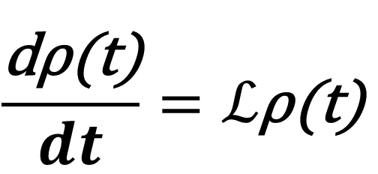
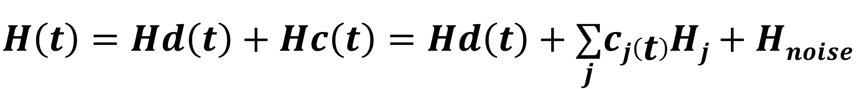

Lindblad Master Equation
Lindblad master equation is the key to describe the dynamics of the density matrix in the open quantum system.
$$H\left(t\right)=Hd\left(t\right)+Hc\left(t\right)=Hd\left(t\right)+\underset{j}{∑}cj\left(t\right)Hj+Hnoise$$
$$\frac{\text{d}\text{ρ}\text{(}\text{t}\text{)}}{dt}=ℒ\text{ρ}\text{(}\text{t}\text{)}$$
dynamics of the density matrix $\text{ρ}\text{(}\text{t}\text{)}\text{,}$
$ℒ$ is the superoperator
$\frac{dρ}{dt}=−i\left[H,\text{ρ}\right]+∑i(Li\text{ρ}L_{i}^{†} –\frac{1}{2}\{L_{i}^{†}Li$, $\text{ρ}\text{\})}$
Still familiar
Unitary Evolution
Dissipative Terms
L$i$is dissipative operators
Notes:
\(L_k\rho L_k^{\dagger}\) corresponds to the term responsible for the decay or relaxation of the system due to the interaction with the environment. It captures the process of the system losing energy to its surroundings.
\(-\frac{1}{2}\{L_k^{\dagger}L_k, \rho\}\) accounts for the dephasing or decoherence effects on the system. It describes how the system's coherence or quantum information can be degraded by interactions with the environment.
The Lindblad master equation combines the coherent evolution governed by the Hamiltonian with the dissipative effects due to the Lindblad operators, providing a comprehensive description of open quantum systems.

Slide 38
Agenda
Compilation Workflow.
Control System, Software.
Translation from gate to pulse.
Single qubit control and two qubit control.
Pulse-level advantage
Expressivity analysis.
Time dependent noise model.
Pulse Simulator
Unitary time evolution.
Lindblad master equation.
Weyl Chamber
Pulse Ansatz

Slide 39
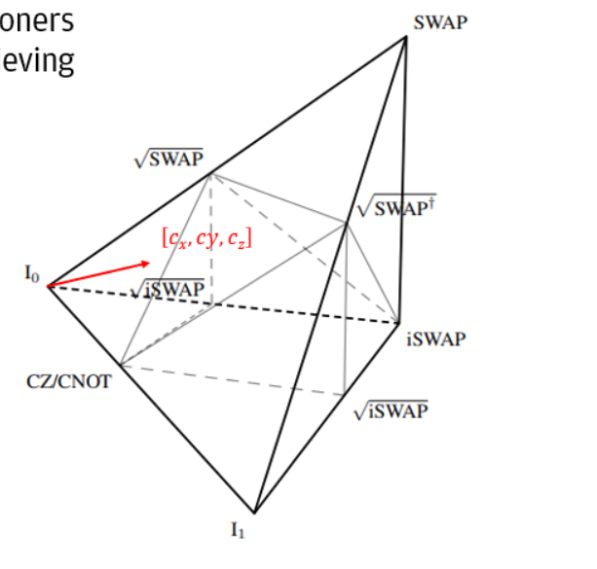
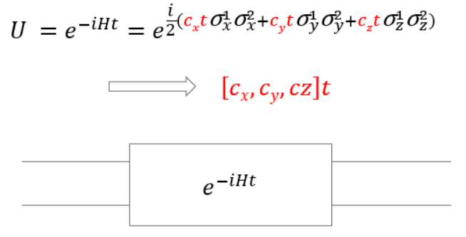
Weyl Chamber
The Weyl Chamber is a geometric representation of all possible two-qubit gates and understanding it can help researchers and practitioners in quantum computing to identify the best gate sequences for achieving a desired transformation.
Represent the time evolution of Hamiltonian in Weyl Chamber:
Notes:
\(L_k\rho L_k^{\dagger}\) corresponds to the term responsible for the decay or relaxation of the system due to the interaction with the environment. It captures the process of the system losing energy to its surroundings.
\(-\frac{1}{2}\{L_k^{\dagger}L_k, \rho\}\) accounts for the dephasing or decoherence effects on the system. It describes how the system's coherence or quantum information can be degraded by interactions with the environment.
The Lindblad master equation combines the coherent evolution governed by the Hamiltonian with the dissipative effects due to the Lindblad operators, providing a comprehensive description of open quantum systems.

Slide 40
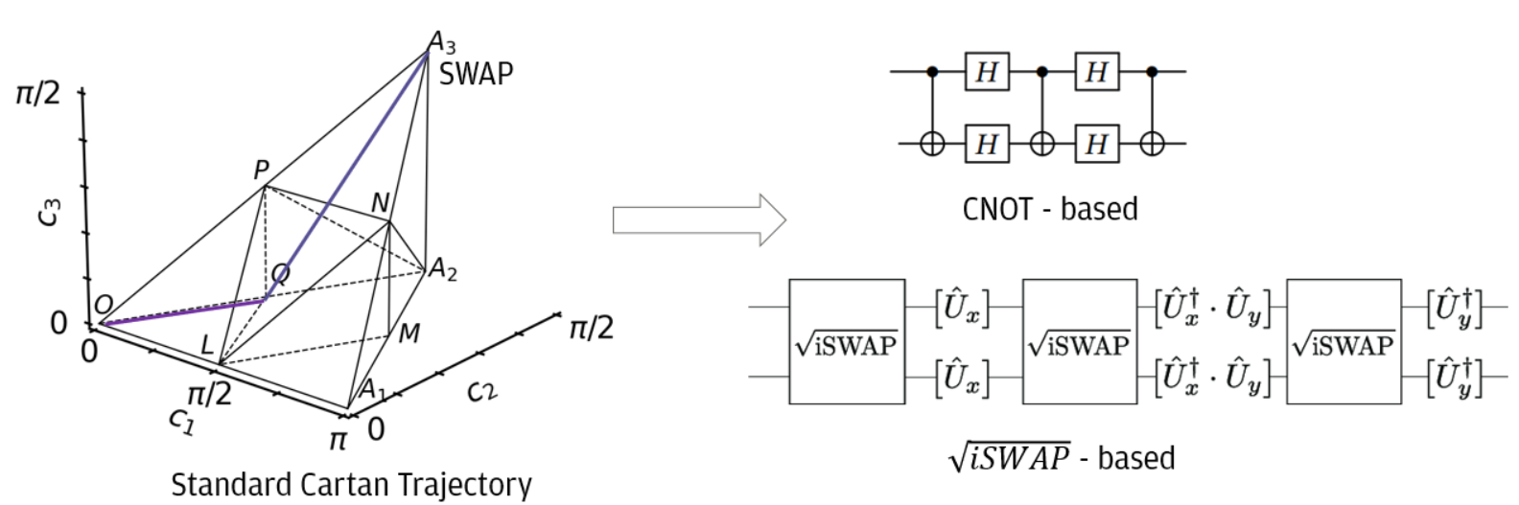
Trajectory
Each trajectory on Weyl Chamber indicate one target gate and a set of basis gates.
Notes:
\(L_k\rho L_k^{\dagger}\) corresponds to the term responsible for the decay or relaxation of the system due to the interaction with the environment. It captures the process of the system losing energy to its surroundings.
\(-\frac{1}{2}\{L_k^{\dagger}L_k, \rho\}\) accounts for the dephasing or decoherence effects on the system. It describes how the system's coherence or quantum information can be degraded by interactions with the environment.
The Lindblad master equation combines the coherent evolution governed by the Hamiltonian with the dissipative effects due to the Lindblad operators, providing a comprehensive description of open quantum systems.

Slide 41
Agenda
Compilation Workflow.
Control System, Software.
Translation from gate to pulse.
Single qubit control and two qubit control.
Pulse-level advantage
Expressivity analysis.
Time dependent noise model.
Pulse Simulator
Unitary time evolution.
Lindblad master equation.
Weyl Chamber
Pulse Ansatz

Slide 42
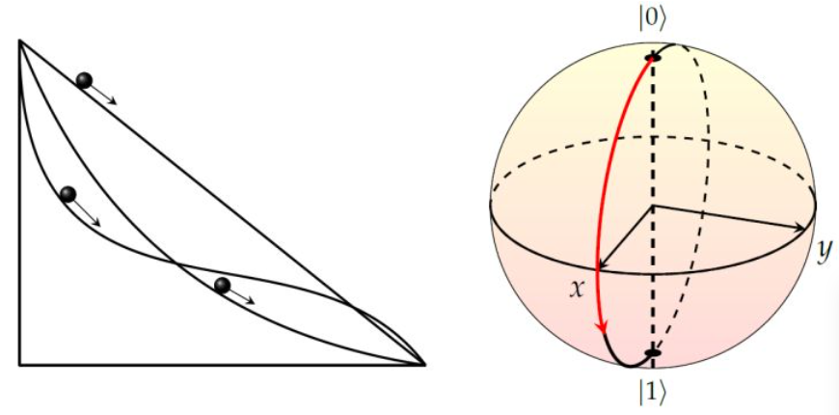
Motivation and Challenges
Given a unitary matrix, we can use optimal control to find a theoretically best control pulse achieving reduction of pulse latency and increase quantum volumes.
Challenges:
QOC is limited to few qubits since it is computationally expensive.
Most works demonstrate QOC on quantum simulators, however, it is hard to be evaluated on NISQ machines.

Slide 43

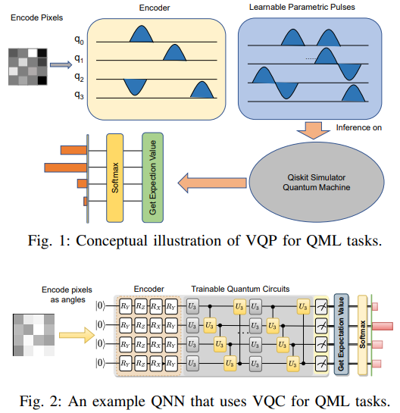
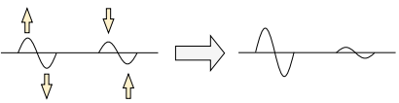
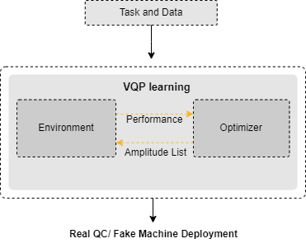
Attempt on Quantum Neural Network
Can we find an intermediate-level approach between the gate level operations and quantum optimal control?
Can we achieve benefits by doing so?
Liang, Zhiding, et al. "Variational quantum pulse learning." 2022 IEEE International Conference on Quantum Computing and Engineering (QCE). IEEE, 2022.

Slide 44
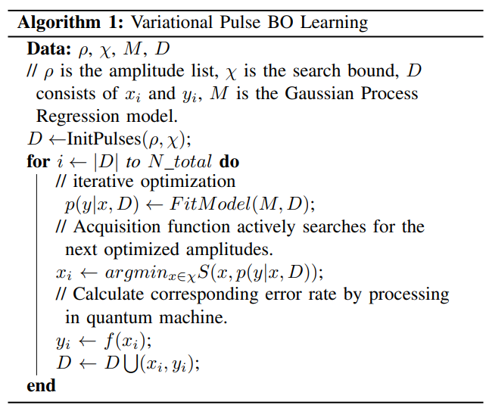
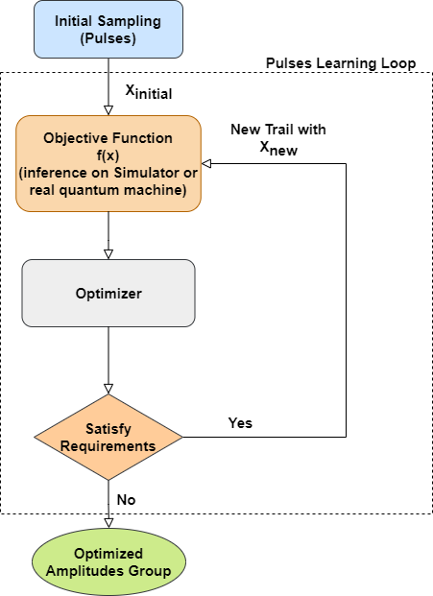
Optimization Framework

Slide 45
Pulse based Compare to Gate based
Pulse based method has higher accuracy than gate based with same depth/latency.
Model | # of Gates | Accuracy
Gate Based | 9 | 0.62
Pulse Based | 9 | 0.71
Gate Based | 12 | 0.68

Slide 46
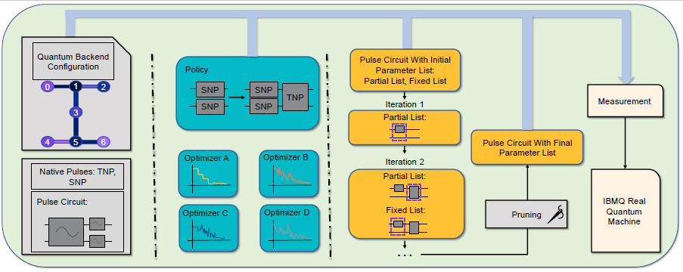
Pulse Ansatz on VQAs
Futher Questions:
If we can find a hardware efficient ansatz at the pulse level?
What is a good pulse ansatz?
Liang, Zhiding, et al. "Pan: Pulse ansatz on nisq machines." arXiv preprint arXiv:2208.01215 (2022).

Slide 47
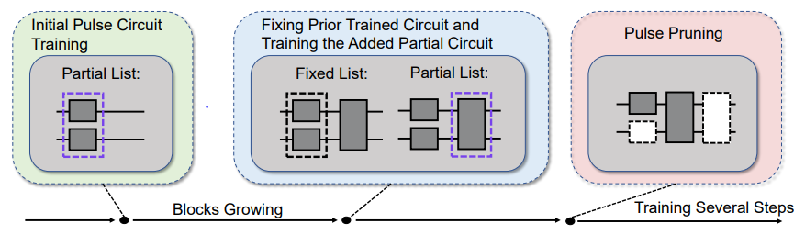
Framework and Evaluation
Progressive learning fix the problem that non gradient optimizer cannot hold high dimensional parameters, and progressive approaching to target point is also fit the quantum speed limit (QSL) theory.

Slide 48
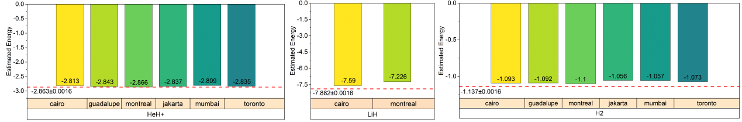
Framework and Evaluation
HeH+: average accuracy 99.336%, with 99.895% being the highest achievable accuracy. The absolute difference in energy is 0.003H, close to the requirement of computational chemistry error (0.0016H) with only a toy model.

Slide 49
Thanks for Listening!
Q & A

