Slide 1
Source Camera Identification GAN
Midterm reports
Jingtao Li, Yan Xiong, Xing Chen
Arizona State University (ASU), Tempe, AZ

Slide 2

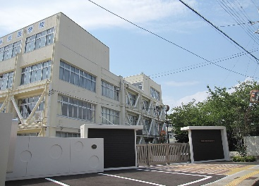

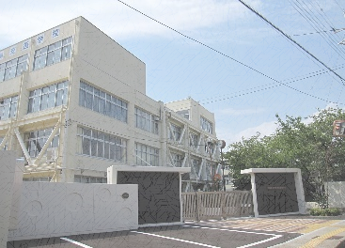

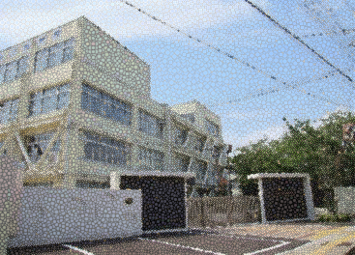
SCI Problem definition
SCI: Tell the camera model purely based on the image itself.
Scene
Different Cameras
Notes:
Note: words with * means their correctness needs further proof.

Slide 3
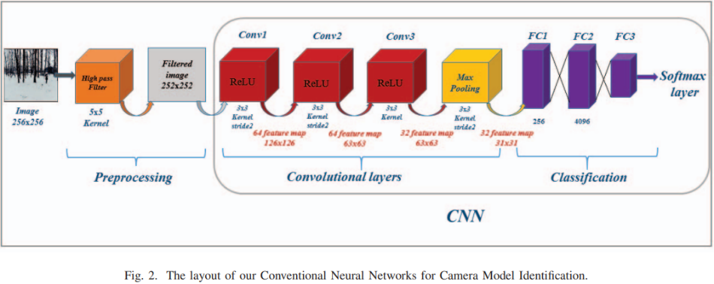
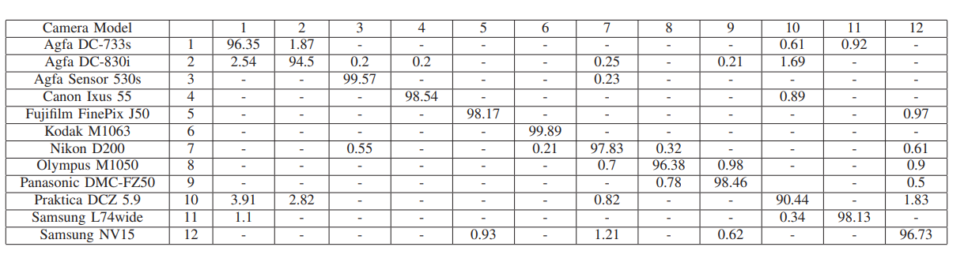
Prior Work
[1] Tuama et al. - 2016 - Camera model identification with the use of deep convolutional neural networks
Notes:
Note: words with * means their correctness needs further proof.

Slide 4
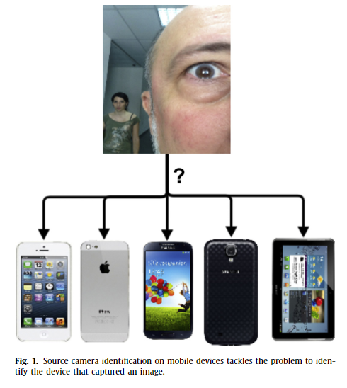
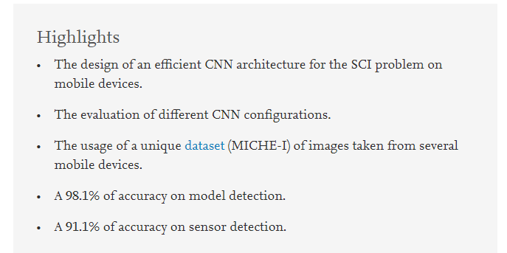
Prior Work
[2] Freire-obregón et al. - 2019 - Deep learning for source camera identification on mobile devices
Notes:
Note: words with * means their correctness needs further proof.

Slide 5
Motivation
However, these prior works solve the problem without explanation. (only showing hardworking towards a high accuracy)
We want to know what style feature is taken into account by the CNN model to get such high accuracy.
The difficulty is the content always mix with style and hard to separate the style and study it independently.
Use a GAN to perform camera style-transfer to separate the style from the content, and then we can perform a better analysis.
Notes:
Note: words with * means their correctness needs further proof.

Slide 6
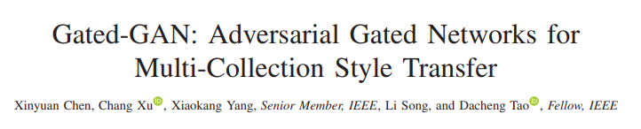
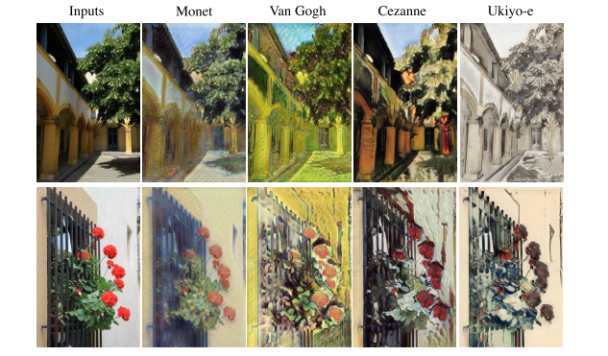
Training Diagram
Notes:
Note: Camera Model, Sensor Type, etc. Achieve this? How to prevent this?

Slide 7
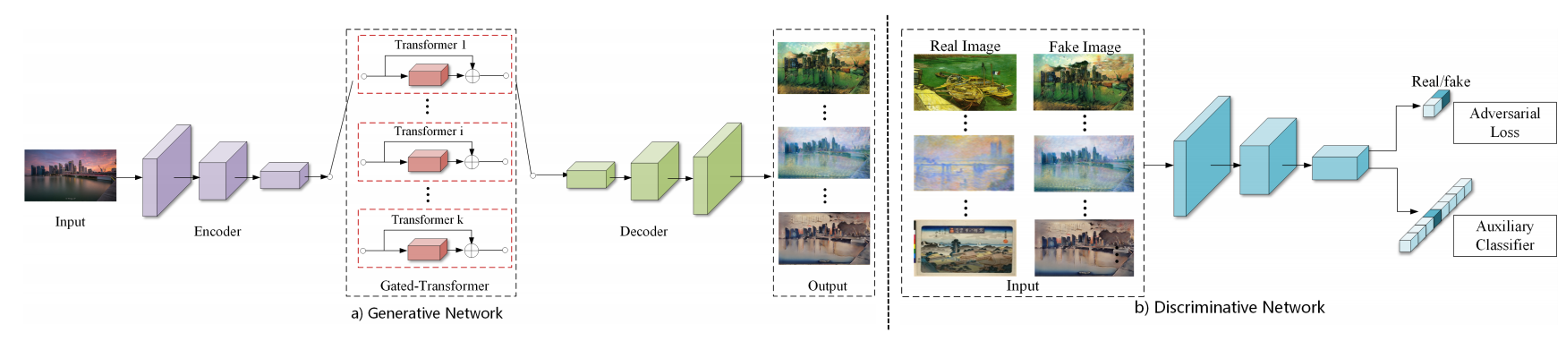
Training Diagram
A separate classifier used to stabilize the training
Notes:
Note: Camera Model, Sensor Type, etc. Achieve this? How to prevent this?

Slide 8
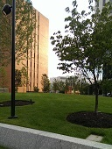
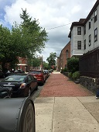

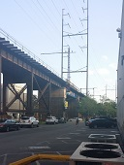
Customized 4-class toy dataset
HTC M7
iPhone 6
LG Nexus 5X
Samsung Galaxy Note 3
Notes:
Note: Camera Model, Sensor Type, etc. Achieve this? How to prevent this?

Slide 9
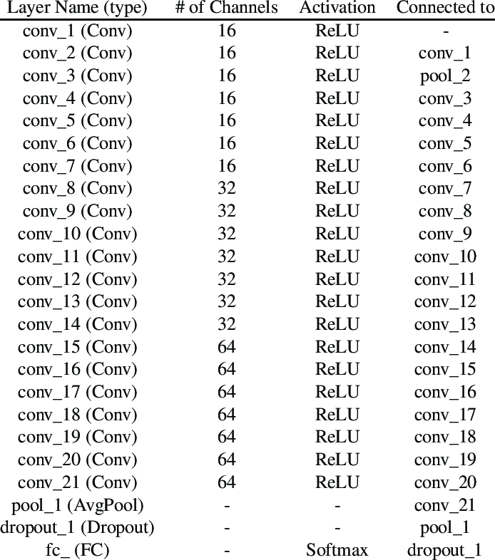
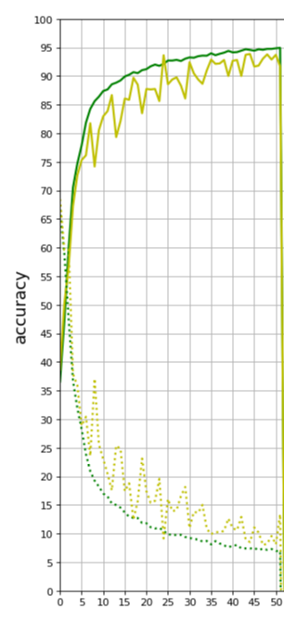
Auxiliary Classifier
33,000 images (4 category)
31,680 Training
1,320 Testing
Batch size = 64
Adam lr = 0.001 with decay
Crossentropy loss, 50 epochs
Resnet-20
Notes:
Note: Camera Model, Sensor Type, etc. Achieve this? How to prevent this?

Slide 10
Shallow understanding
Saliency Map
Filter Explanation
Lime Visualization
Notes:
Note: Camera Model, Sensor Type, etc. Achieve this? How to prevent this?

Slide 11
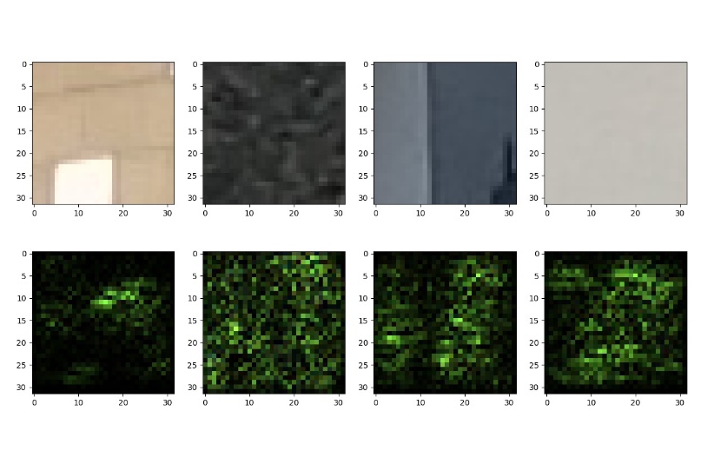
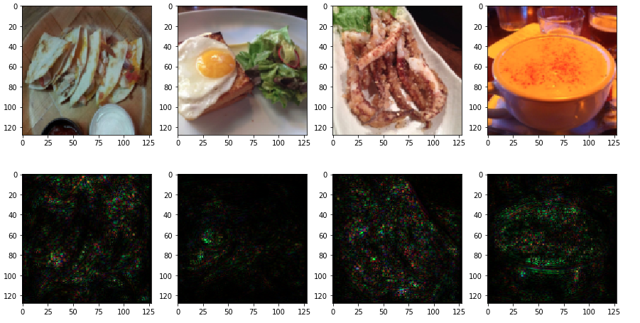
Saliency Map
Our Model
Content-based model
Our model avoid the edge and capture the smooth area. See fig.1, 3 and 4.
Notes:
Note: Avoiding the edge but catching the smooth area. Those are important.

Slide 12
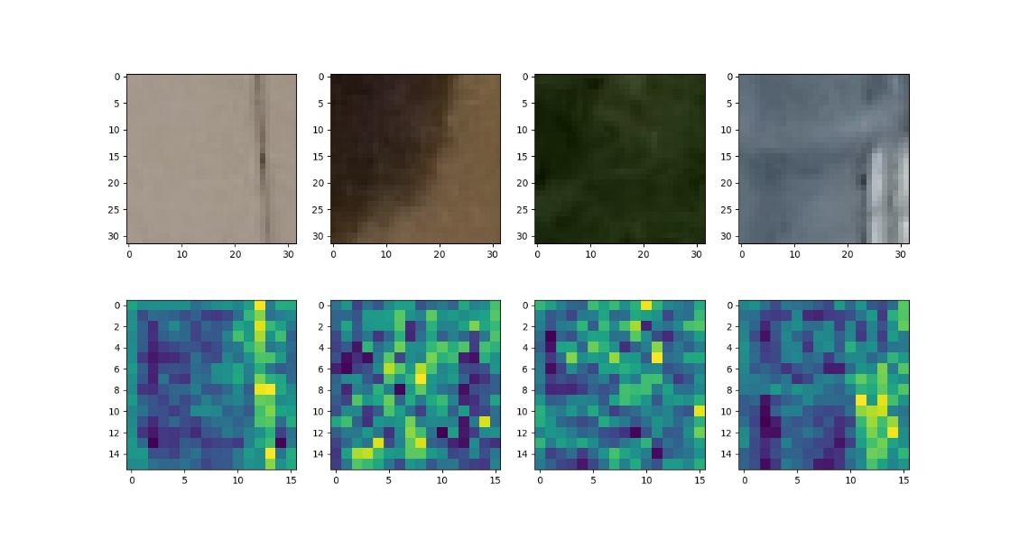
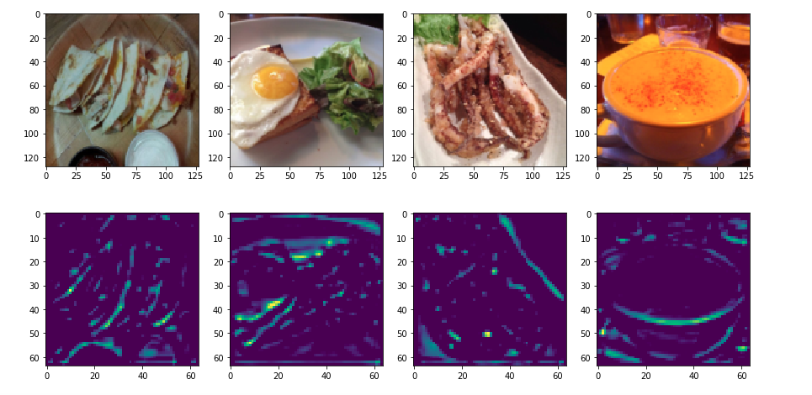
Filter Explanation
Our Model
Content-based model
However, filter seems to be interested in the content and capture the edge. See fig.1 and 4. Content clearly plays a role here…
Notes:
Note: Camera Model, Sensor Type, etc. Achieve this? How to prevent this?

Slide 13
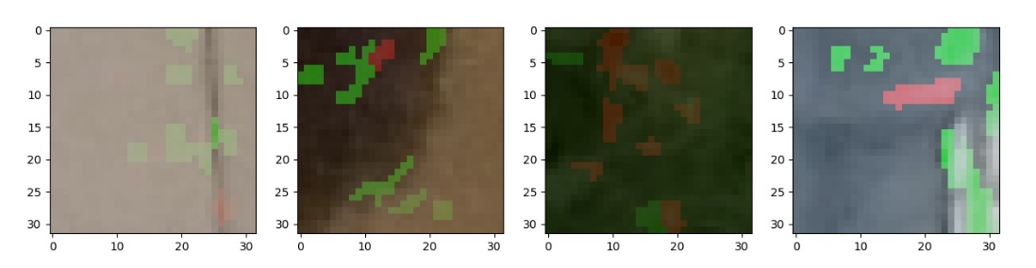
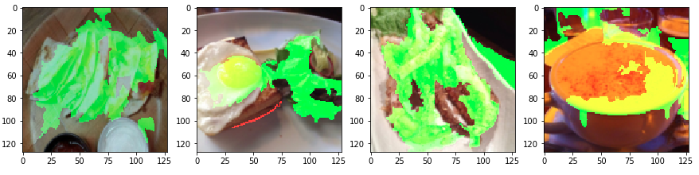
Lime Visualization
Our Model
Content-based model
The classification maybe based on small scattered regions. Or the lime simply fails for the style classification (because it is known to perform badly on high D.*).
Notes:
Note: Camera Model, Sensor Type, etc. Achieve this? How to prevent this?

Slide 14
Next Step
Working on GAN
Notes:
Note: Camera Model, Sensor Type, etc. Achieve this? How to prevent this?

Slide 15
Next Step
After Training…
Style being separated, we can then have deeper understanding…
Notes:
Note: Camera Model, Sensor Type, etc. Achieve this? How to prevent this?

