Slide 1
MGT 575 — MCP Demo Server
Custom Model Context Protocol server (Node.js, stdio) + Google Gemini / Lyria.
Built in lecture_21_mcp_server/test/mcp-demo-server/. Generated images in this deck were produced with the draw_image tool.

Slide 2
What this MCP server exposes
ping — local health check (no network)
ask_gemini — text Q&A via gemini-3.1-flash-lite-preview (GEMINI_TEXT_MODEL)
eagle_eye — primary-monitor screenshot (Windows) + Gemini vision
draw_image — image generation via gemini-3.1-flash-image-preview (GEMINI_IMAGE_MODEL)
make_song — music via Lyria lyria-3-clip-preview ~30s clips (GEMINI_MUSIC_MODEL); optional ffmpeg → MP3

Slide 3
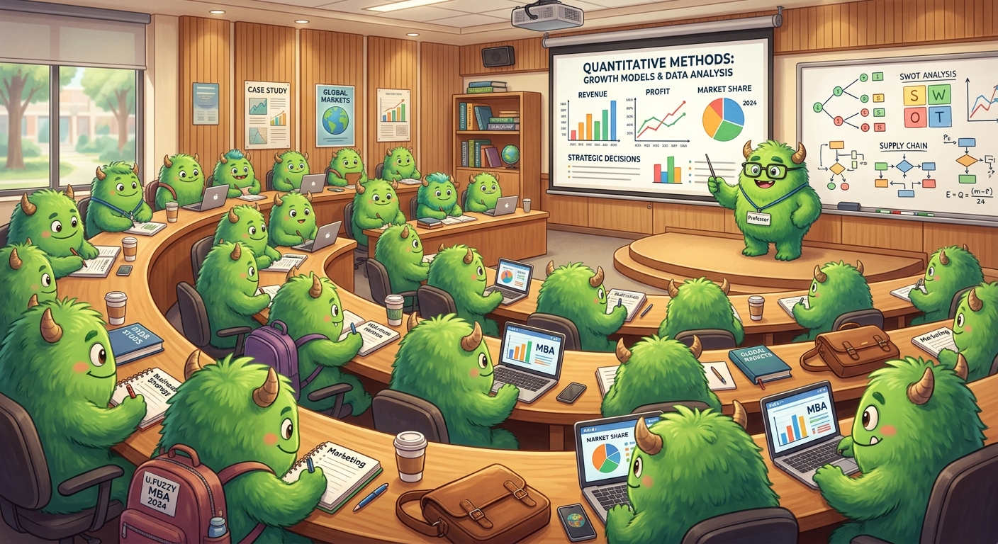
Generated: MBA classroom (fuzzy green creatures)

Slide 4
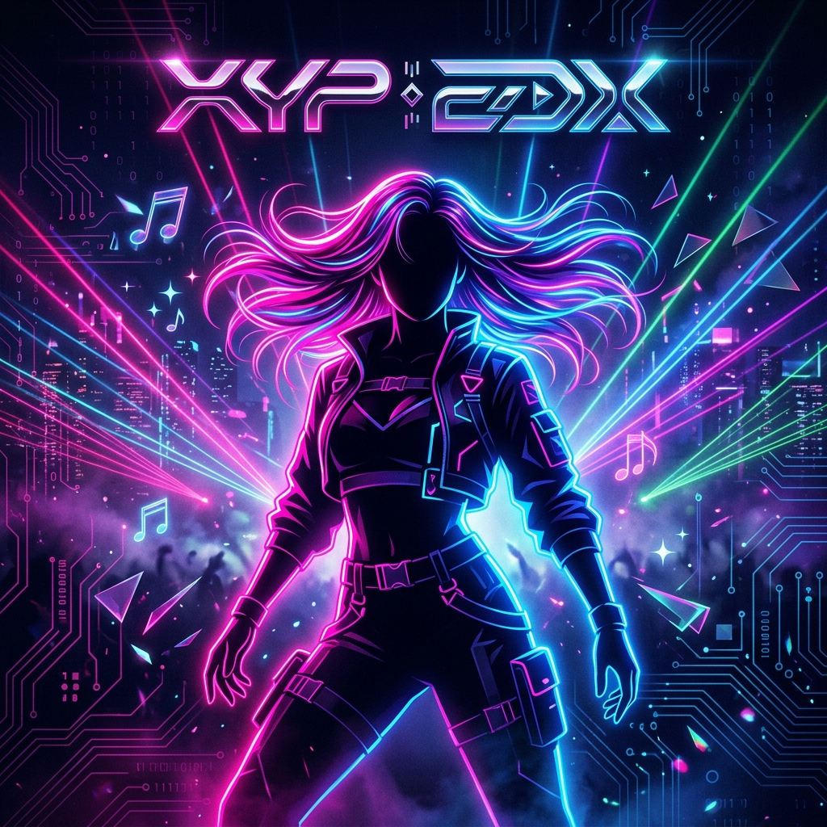
Z-Listo — EDM / K-pop vibe album cover

Slide 5

Photoreal — desert music festival energy

Slide 6
Beyond images: Lyria + Gmail (separate MCP)
make_song — Lyria 3 Clip generates ~30s audio; saved as MP3 in mcp-demo-server/generated-audio/ (e.g. edm-ai-kpop-vibe.mp3)
Other MCP servers in class setup: Gmail (send/read mail), PowerPoint (this deck)
Requires GEMINI_API_KEY; optional ffmpeg on PATH for WAV→MP3

