Slide 1

Note: The data and information in this document is reflective of a hypothetical situation and client. This document is to be used for KPMG Virtual Internship purposes only.
Sprocket Central Pty Ltd
Data analytics approach
[Division Name] - [Engagement Manager], [Senior Consultant], [Junior Consultant]

Slide 2
Note: The data and information in this document is reflective of a hypothetical situation and client. This document is to be used for KPMG Virtual Internship purposes only.
Agenda
Introduction
Data Exploration
Model Development
Interpretation

Slide 3
Note: The data and information in this document is reflective of a hypothetical situation and client. This document is to be used for KPMG Virtual Internship purposes only.
Introduction
Target the customer who drive the most value for the organisation
Data exploration to find potential correlation between features.
Conduct data preprocessing and feature engineering to be suitable for modelling
Determine model method and complete the calculating.
Interpretation of results and propose suggestions for targets.

Slide 4
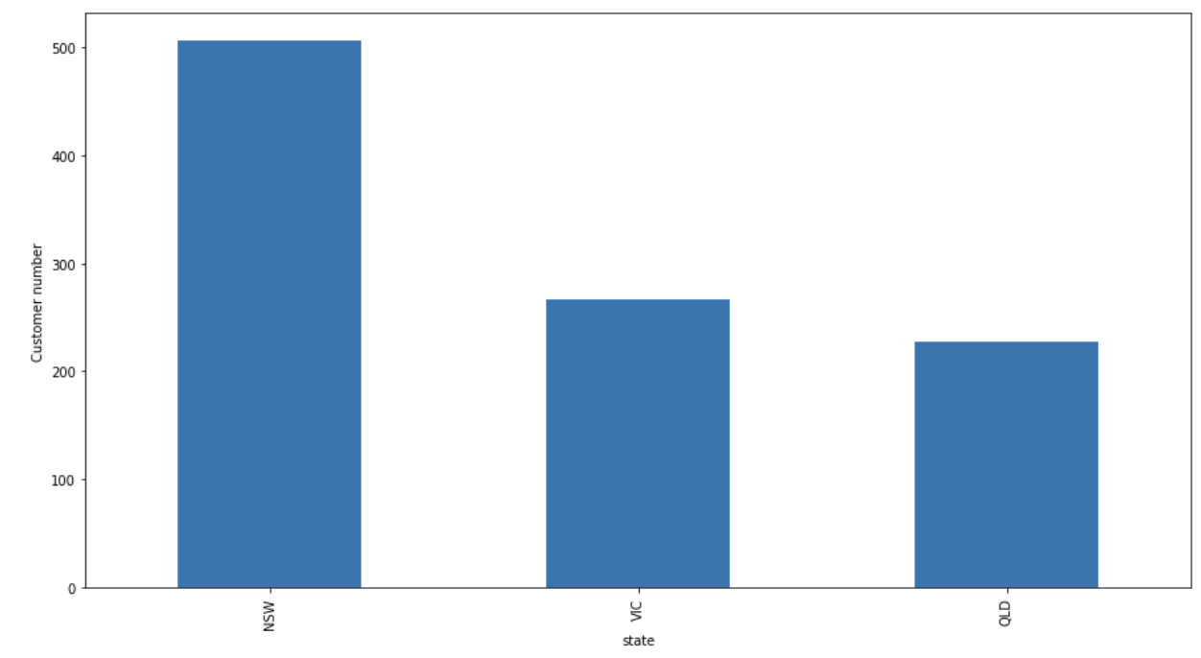
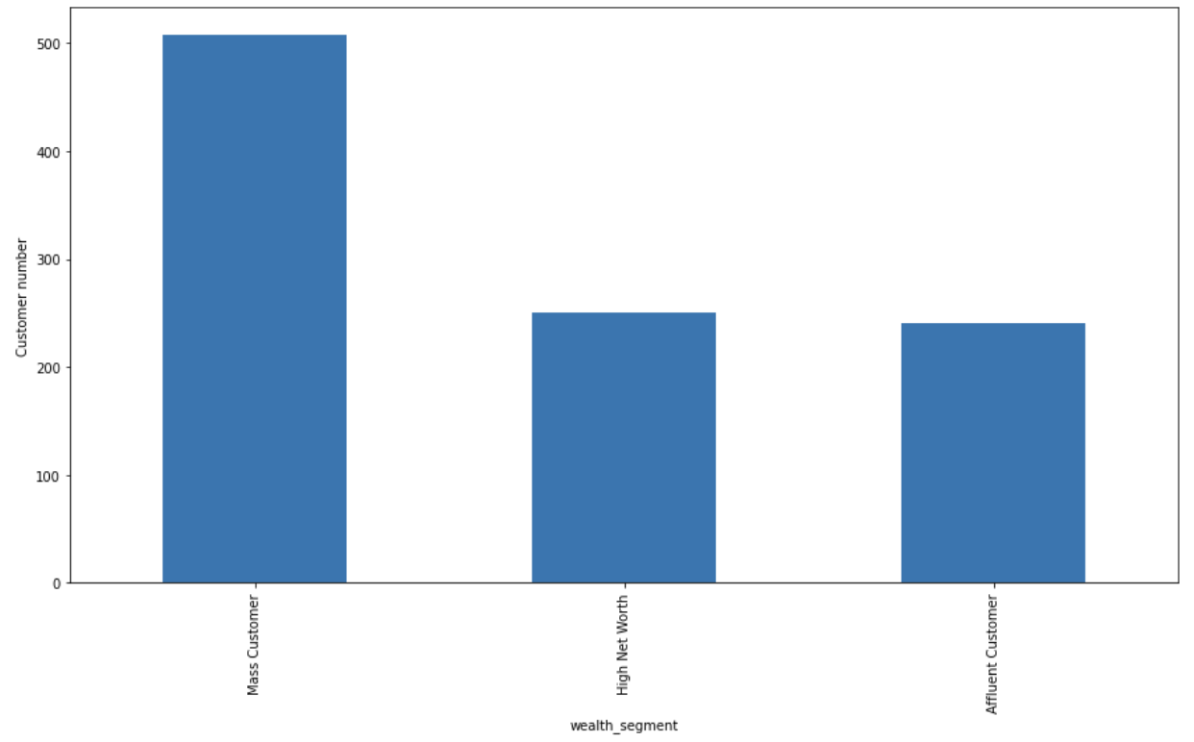
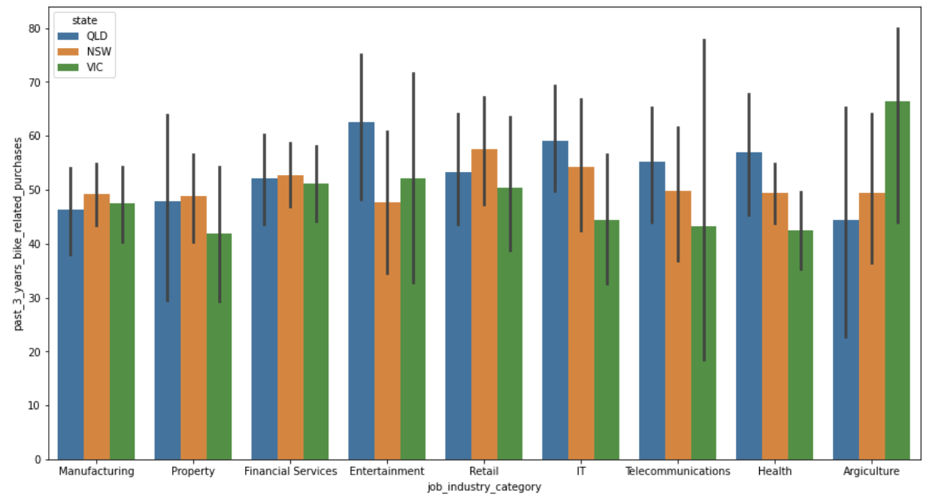
Note: The data and information in this document is reflective of a hypothetical situation and client. This document is to be used for KPMG Virtual Internship purposes only.
Data Exploration
Customers
State
2. Weath-segment
3. Job_industry_catergory

Slide 5
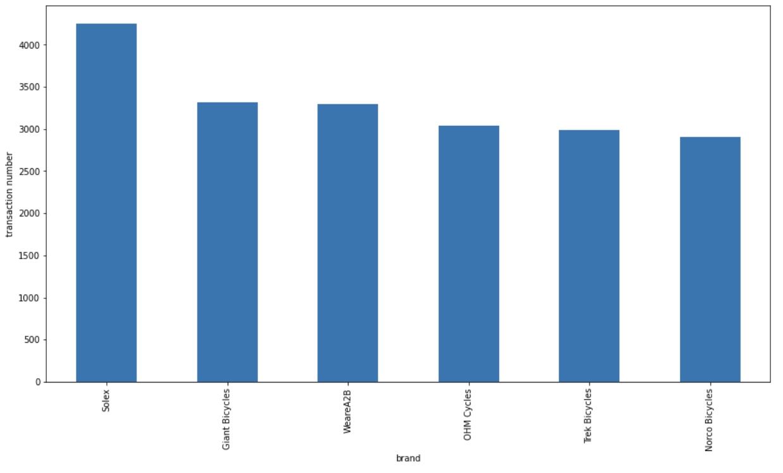
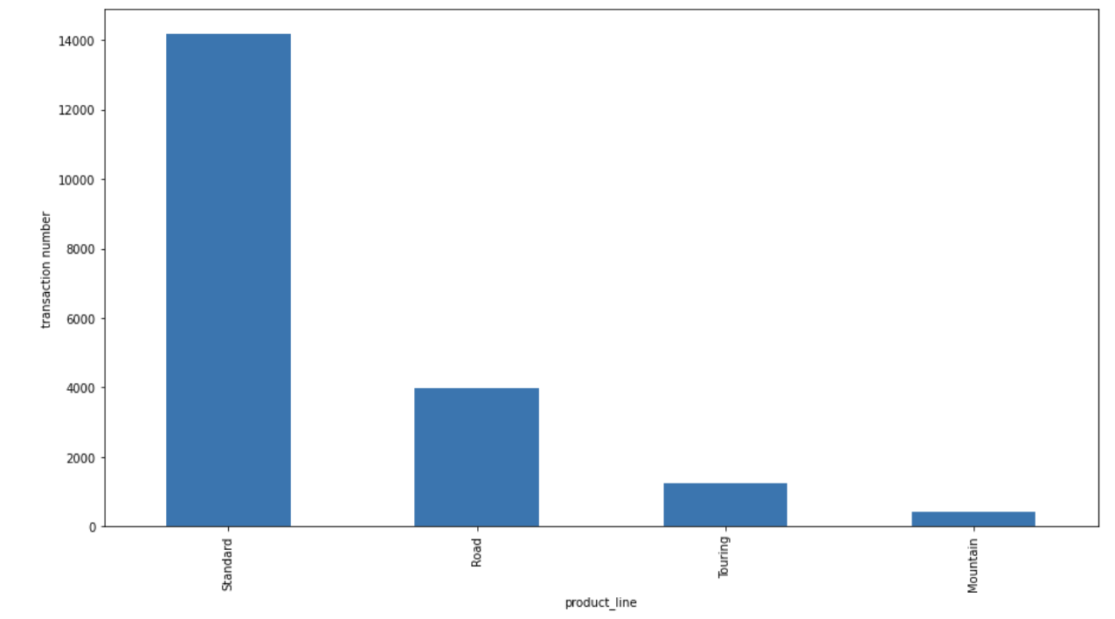
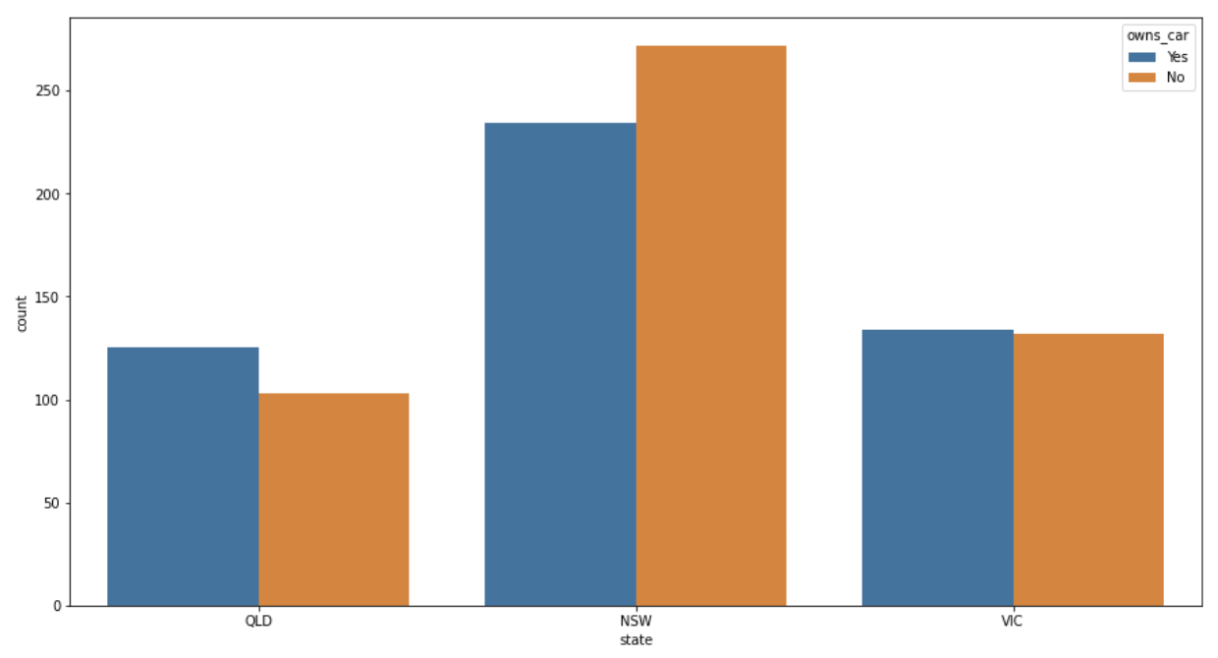
Note: The data and information in this document is reflective of a hypothetical situation and client. This document is to be used for KPMG Virtual Internship purposes only.
Data Exploration
Transactions
1. Brand
2. Product line
3. State

Slide 6
Note: The data and information in this document is reflective of a hypothetical situation and client. This document is to be used for KPMG Virtual Internship purposes only.
Data Exploration
Feature engineering
Drop less important features and null value.
Replace the inconsistent features.
Create new feature 'age’ and ‘age_group ’ by calculating DOB

Slide 7
Note: The data and information in this document is reflective of a hypothetical situation and client. This document is to be used for KPMG Virtual Internship purposes only.
Model Development
RFM method
Recency by calculating transaction date .
Frequency by counting the number of customer_id.
Monetary_value is the profit by calculating list_price and standard cost.

Slide 8
Note: The data and information in this document is reflective of a hypothetical situation and client. This document is to be used for KPMG Virtual Internship purposes only.
Model Development
K-means Clustering
Determine the K-means algorithm based on the RFM method.
Create elbow curve and find optimal number of clusters.
Build up the model and categorize different groups of customers.

Slide 9
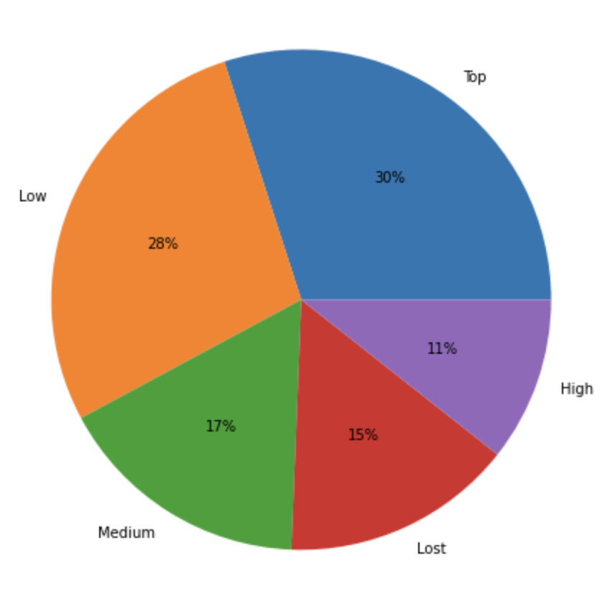
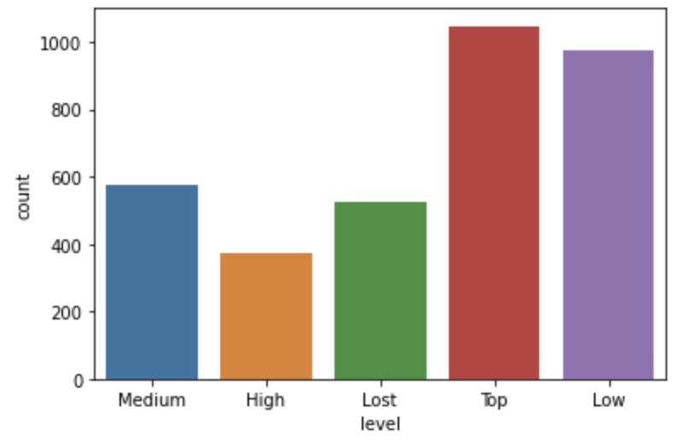
Note: The data and information in this document is reflective of a hypothetical situation and client. This document is to be used for KPMG Virtual Internship purposes only.
Interpretation
Customer Segment

Slide 10
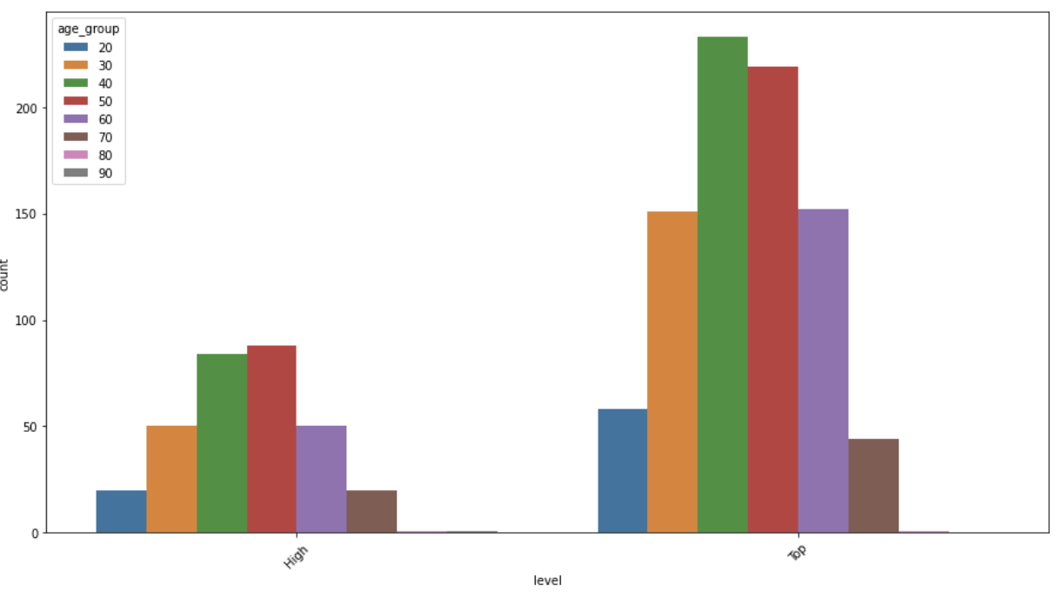
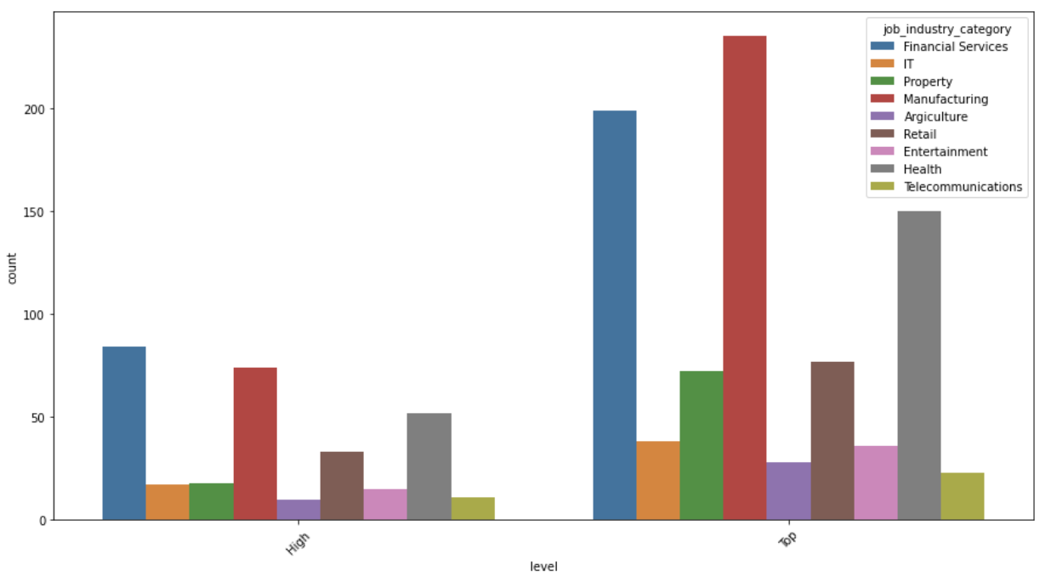
Note: The data and information in this document is reflective of a hypothetical situation and client. This document is to be used for KPMG Virtual Internship purposes only.
Interpretation
Data distribution for top and high level
Age_group
Job_industry_catergoty

Slide 11
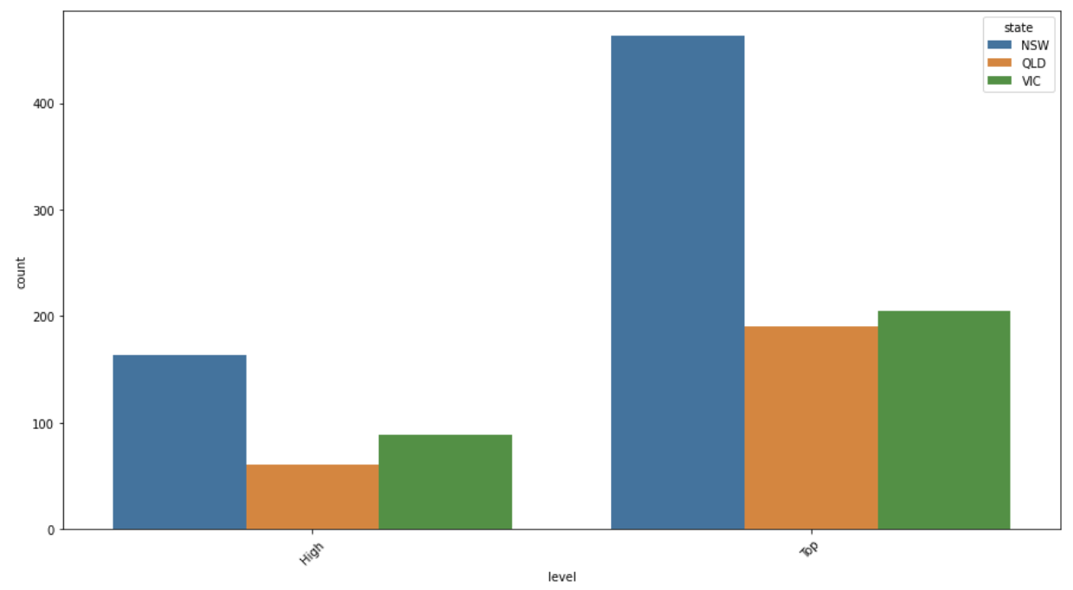
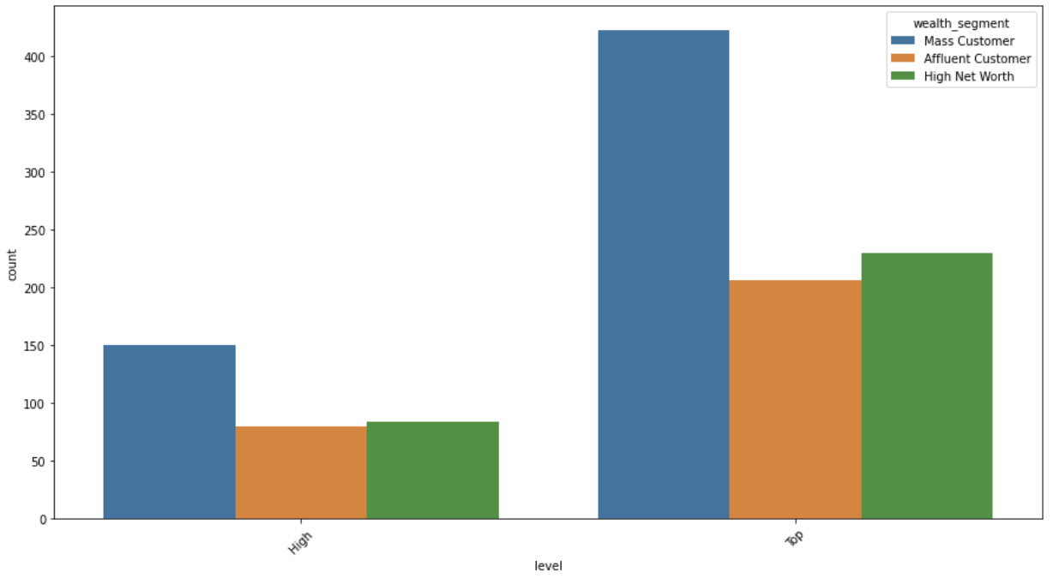
Note: The data and information in this document is reflective of a hypothetical situation and client. This document is to be used for KPMG Virtual Internship purposes only.
Interpretation
Data distribution for top and high level
State
wealth_segment

Slide 12
Note: The data and information in this document is reflective of a hypothetical situation and client. This document is to be used for KPMG Virtual Internship purposes only.
Interpretation
Target customer group:
age_group = ['40','50’]
state = ['NSW’]
wealth_segment = ['Mass Customer’]
job_industry_category = ['Financial Services','Manufacturing','Health’]
The number of potential customers to target : 175
:

Slide 13
Note: The data and information in this document is reflective of a hypothetical situation and client. This document is to be used for KPMG Virtual Internship purposes only.
Appendix

Slide 14
Note: The data and information in this document is reflective of a hypothetical situation and client. This document is to be used for KPMG Virtual Internship purposes only.
Appendix
The coding process can be found by : https://github.com/zliu15471

