Slide 1
web应用技术

Slide 2
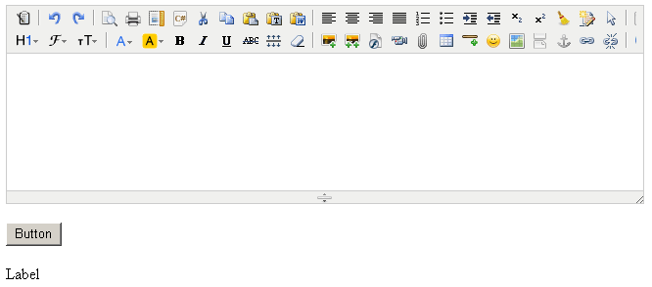
Kindeditor HTML编辑器
界面代码：<textarea id="content1" cols="100" rows="8" style="width:650px;height:200px;visibility:hidden;" runat="server"> </textarea>

Slide 3
赋值：
content1.Value = "测试";
取值：
Label1.Text = content1.Value;

Slide 4
1 解压缩kindeditor.rar
2 将kindeditor文件夹拷到站点根目录
3 kindeditor文件夹下的asp.net文件夹下的bin文件夹拷到站点根目录
4 将“站点根目录下使用的例子”文件夹下的HtmlEditor.aspx拷到站点根目录测试即可（特别注意界面代码的head标记中引用文件的路径）

Slide 5
<link rel="stylesheet" href="kindeditor/themes/default/default.css" />
<link rel="stylesheet" href="kindeditor/plugins/code/prettify.css" />
<script charset="utf-8" src="kindeditor/kindeditor.js"></script>
<script charset="utf-8" src="kindeditor/lang/zh_CN.js"></script>
<script charset="utf-8" src="kindeditor/plugins/code/prettify.js"></script>
<script>
KindEditor.ready(function(K) {
var editor1 = K.create('#content1', {
cssPath : 'kindeditor/plugins/code/prettify.css',
uploadJson : 'kindeditor/asp.net/upload_json.ashx',
fileManagerJson : 'kindeditor/asp.net/file_manager_json.ashx',
allowFileManager : true,
afterCreate : function() {
var self = this;
K.ctrl(document, 13, function() {
self.sync();
K('form[name=example]')[0].submit();});
K.ctrl(self.edit.doc, 13, function() {
self.sync();
K('form[name=example]')[0].submit();});
}
});
prettyPrint();
});
</script>

Slide 6
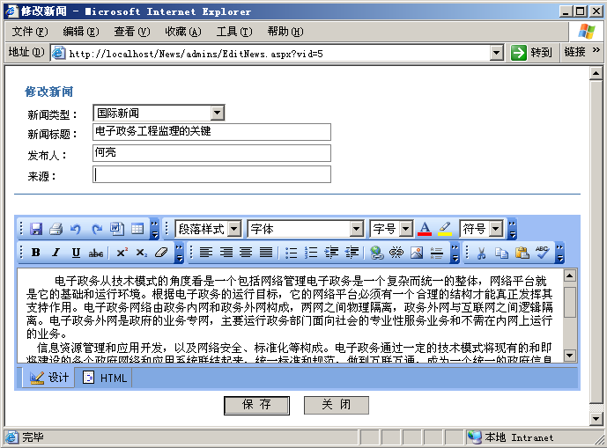
参考界面
◆更新信息

