Slide 1
Supply and Demand with More Math than Econ 1
Lecture 2
Prof. Chris Makler
Econ 50 | Stanford University
January 5, 2016
Notes:
Mention class participation

Slide 2
By the end of today, you should:
Know the difference between exogenous and endogenous variables
Know how to solve for endogenous variables in terms of exogenous variables
Be able to relate functional forms to economics concepts

Slide 3
Hour 1: Lecture
Hour 2: Group Work
Endogenous vs. Exogenous
Equilibrium
Individual and market demand
Individual and market supply
Consumer and producer surplus
Demand
Complements and Substitutes
Normal, Inferior, Giffen Goods
Income and Substitution Effects
Calculating equilibrium as a function of exogenous variables
Parsing demand equations

Slide 4
Endogenous vs. Exogenous

Slide 5
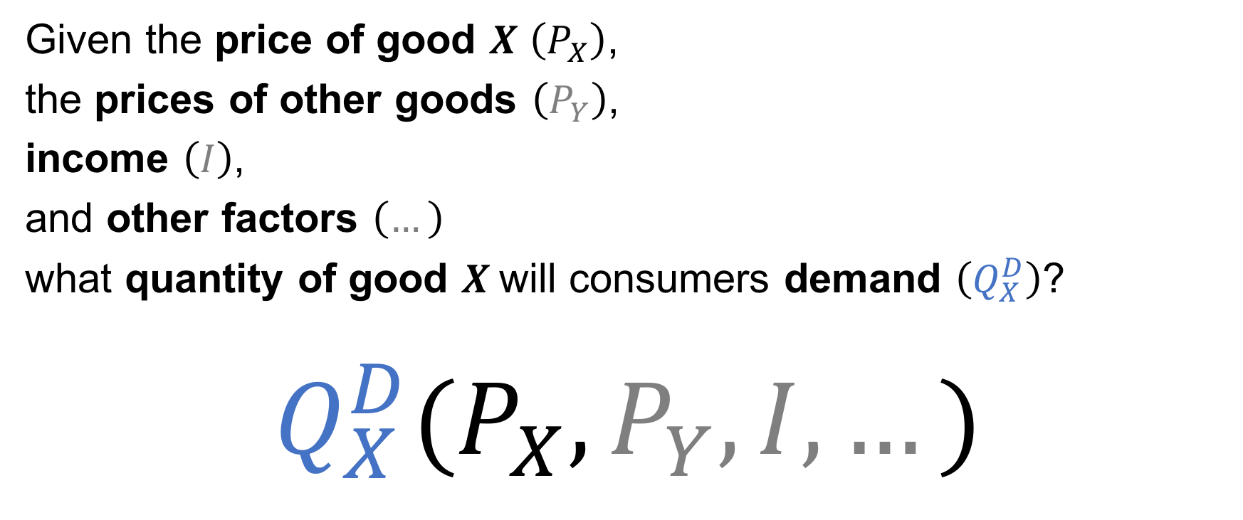
Demand
Given the price of good $X$ $\left(P_{X}\right)$,
the prices of other goods $\left(P_{Y}\right)$,
income $\left(I\right)$,
and other factors $\left(…\right)$
what quantity of good $X$will consumers demand $\left(Q_{X}^{D}\right)$?
$$Q_{X}^{D}(P_{X},P_{Y},I,…)$$

Slide 6
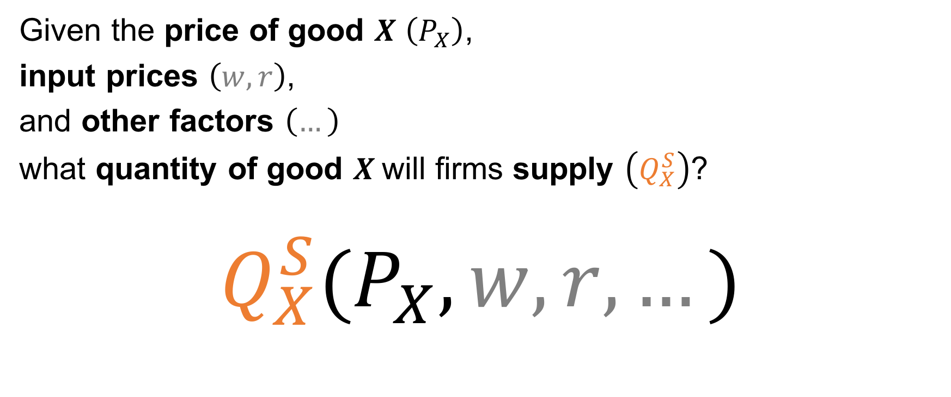
Supply
Given the price of good $X$ $\left(P_{X}\right)$,
input prices $\left(w,r\right)$,
and other factors $\left(…\right)$
what quantity of good $X$will firms supply $\left(Q_{X}^{S}\right)$?
$$Q_{X}^{S}(P_{X},w,r,…)$$

Slide 7
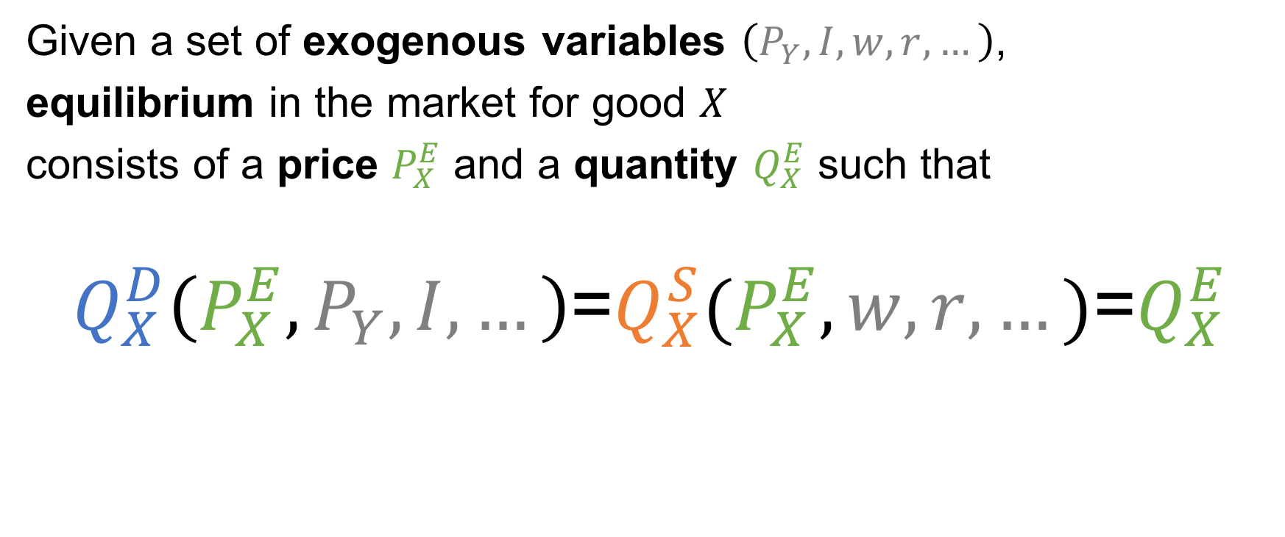
Equilibrium
Given a set of exogenous variables $\left(P_{Y},I,w,r,…\right)$,
equilibrium in the market for good $X$
consists of a price $P_{X}^{E}$ and a quantity $Q_{X}^{E}$ such that
$Q_{X}^{D}\left(P_{X}^{E},P_{Y},I,…\right)$=$Q_{X}^{S}(P_{X}^{E},w,r,…)\text{=}Q_{X}^{E}$

Slide 8
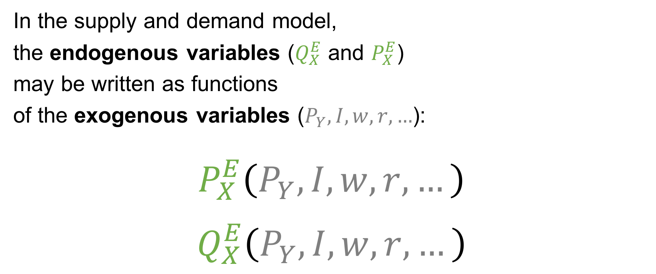
Equilibrium
In the supply and demand model,
the endogenous variables ($Q_{X}^{E}$ and $P_{X}^{E}$)
may be written as functions
of the exogenous variables ($P_{Y},I,w,r,…$):
$$P_{X}^{E}\left(P_{Y},I,w,r,…\right)$$
$$Q_{X}^{E}\left(P_{Y},I,w,r,…\right)$$

Slide 9
Individual and Market Demand

Slide 10
Individual and Market Demand (Cont’d)

Slide 11
Individual and Market Supply

Slide 12
Individual and Market Supply (Cont’d)

Slide 13
Consumer and producer surplus
P
Q

Slide 14
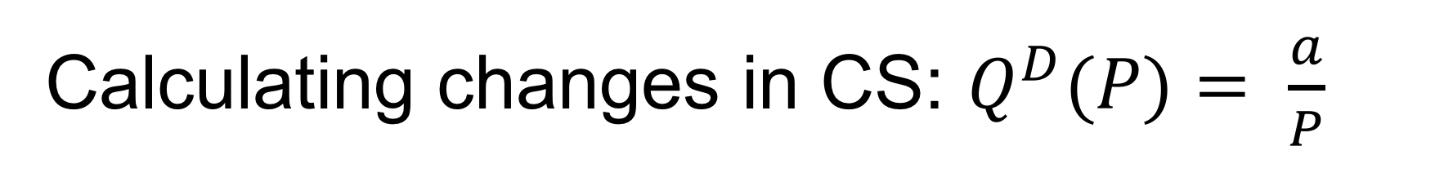
Calculating changes in CS: $Q^{D}(P)= \frac{a}{P}$
P
Q

Slide 15
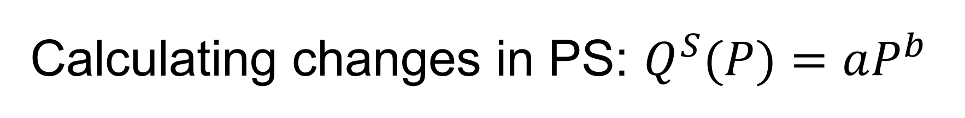
Calculating changes in PS: $Q^{S}(P)=aP^{b}$
P
Q

Slide 16
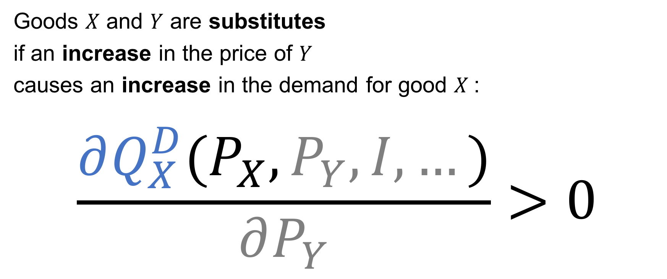
Substitutes
Goods $X$ and $Y$ are substitutes
if an increase in the price of $Y$
causes an increase in the demand for good $X$:
$$\frac{∂Q_{X}^{D}(P_{X},P_{Y},I,…)}{∂P_{Y}}>0$$

Slide 17

Complements
Goods $X$ and $Y$ are complements
if an increase in the price of $Y$
causes a decrease in the demand for good $X$:
$$\frac{∂Q_{X}^{D}(P_{X},P_{Y},I,…)}{∂P_{Y}}<0$$

Slide 18
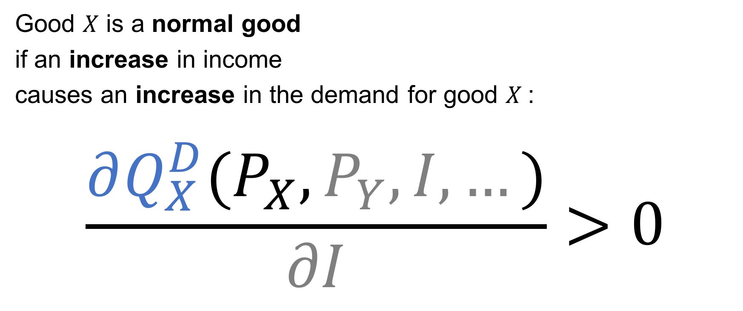
Normal goods
Good $X$ is a normal good
if an increase in income
causes an increase in the demand for good $X$:
$$\frac{∂Q_{X}^{D}(P_{X},P_{Y},I,…)}{∂I}>0$$

Slide 19

Inferior goods
Good $X$ is an inferior good
if an increase in income
causes a decrease in the demand for good $X$:
$$\frac{∂Q_{X}^{D}(P_{X},P_{Y},I,…)}{∂I}<0$$

Slide 20
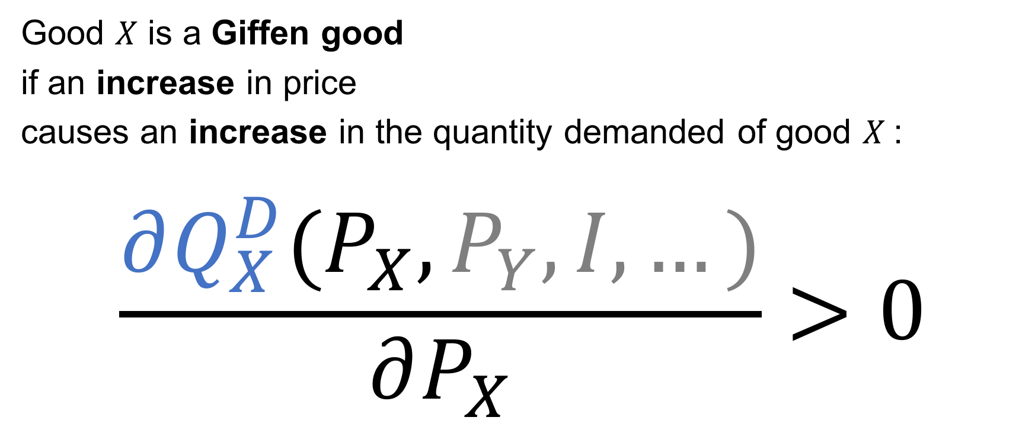
Giffen goods
Good $X$ is a Giffen good
if an increase in price
causes an increase in the quantity demanded of good $X$:
$$\frac{∂Q_{X}^{D}(P_{X},P_{Y},I,…)}{∂P_{X}}>0$$

Slide 21
Income and Substitution Effects
Income effect: When the price of good X goes up,
it’s as if your income goes down.
Substitution effect:
When the price of good X goes up,
other goods become relatively cheaper

