Slide 1
Group Work: Intro to Constrained Optimization
Optimization with one choice variable
Optimization with two choice variables

Slide 2
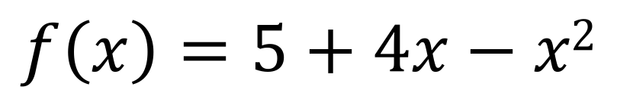
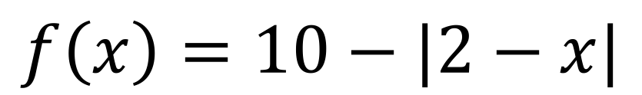
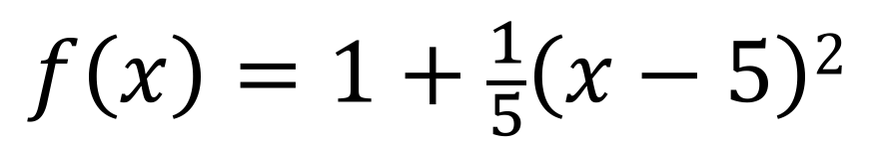
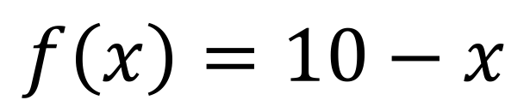
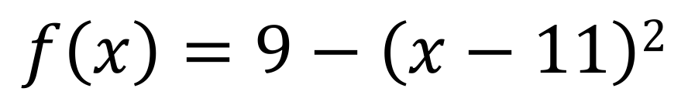
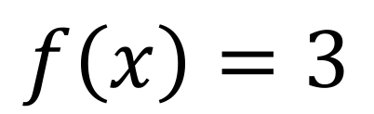

Group Work, Question 1
Find the value of $x$that maximizes each function’s value in the domain $0≤x≤10$.
$$f\left(x\right)=5+4x−x2$$
$$f\left(x\right)=1+\frac{1}{5}\left(x−5\right)2$$
$$f\left(x\right)=10−|2−x|$$
$$f\left(x\right)=10−x$$
$$f\left(x\right)=9−\left(x−11\right)2$$
$$f\left(x\right)=3$$

Slide 3

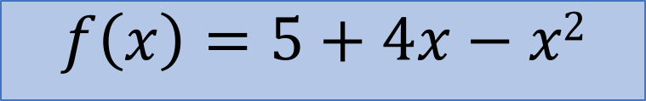

$$f\left(x\right)=5+4x−x2$$
$$f\left(x\right)$$
$$x$$

Slide 4

$$f\left(x\right)=5+4x−x2$$
$$f\left(x\right)$$
$$x$$
$$f′\left(x\right)$$

Slide 5

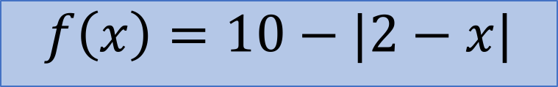
$$f\left(x\right)=10−|2−x|$$
$$f\left(x\right)$$
$$x$$

Slide 6


$$f\left(x\right)$$
$$f\left(x\right)=10−|2−x|$$
$$f\left(x\right)$$
$$x$$
$$f′\left(x\right)$$

Slide 7
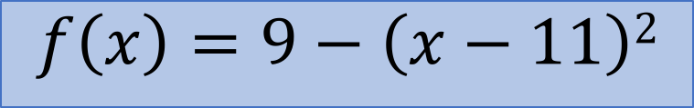

$$f\left(x\right)=9−\left(x−11\right)2$$
$$f\left(x\right)$$
$$x$$

Slide 8
$$f\left(x\right)=9−\left(x−11\right)2$$
$$f\left(x\right)$$
$$f′\left(x\right)$$
$$x$$

Slide 9

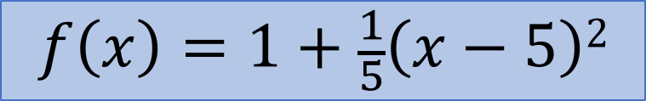

$$f\left(x\right)=1+\frac{1}{5}\left(x−5\right)2$$
$$f\left(x\right)$$
$$x$$

Slide 10

$$f\left(x\right)=1+\frac{1}{5}\left(x−5\right)2$$
$$f\left(x\right)$$
$$f′\left(x\right)$$
$$x$$

Slide 11


$$f\left(x\right)=10−x$$
$$f\left(x\right)$$
$$x$$

Slide 12

$$f\left(x\right)=10−x$$
$$f\left(x\right)$$
$$x$$
$$f′\left(x\right)$$

Slide 13


$$f\left(x\right)$$
$$f\left(x\right)=3$$
$$f\left(x\right)$$
$$x$$

Slide 14

$$f\left(x\right)$$
$$f\left(x\right)=3$$
$$f\left(x\right)$$
$$x$$
$$f′\left(x\right)$$

Slide 15
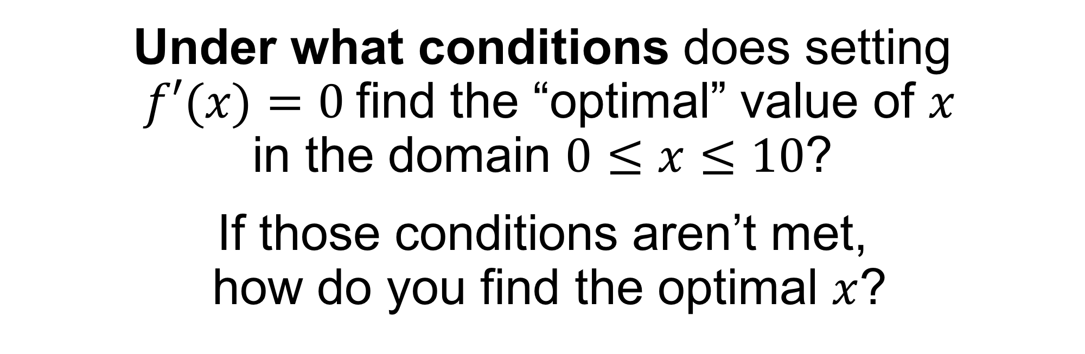
Group Work, Question 2
Under what conditions does setting $f′(x)=0$find the “optimal” value of $x$ in the domain $0≤x≤10$?
If those conditions aren’t met, how do you find the optimal $x$?

Slide 16
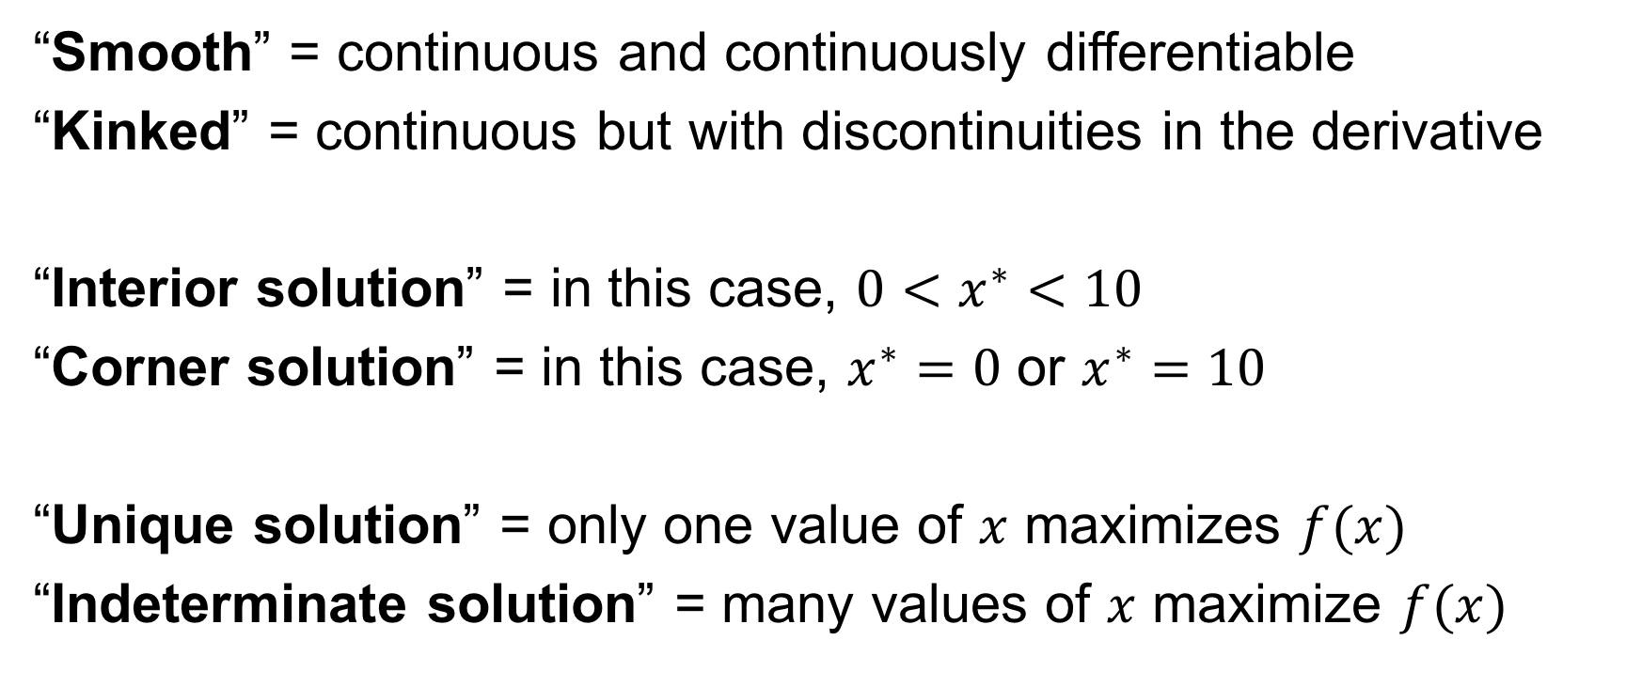
Things to think about
“Smooth” = continuous and continuously differentiable
“Kinked” = continuous but with discontinuities in the derivative
“Interior solution” = in this case, $0<x^{∗}<10$
“Corner solution” = in this case, $x^{∗}=0$ or $x^{∗}=10$
“Unique solution” = only one value of $x$ maximizes $f(x)$
“Indeterminate solution” = many values of $x$ maximize $f(x)$

Slide 17

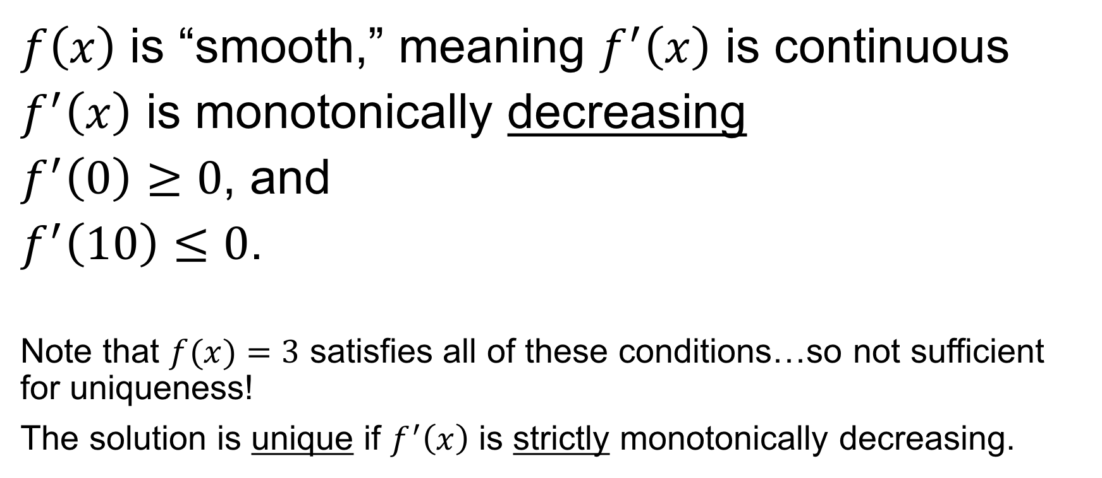
Setting $f^{′}\left(x\right)=0$ finds the solution if…
$f\left(x\right)$ is “smooth,” meaning $f^{′}\left(x\right)$ is continuous
$f^{′}\left(x\right)$ is monotonically decreasing
$f^{′}\left(0\right)≥0$, and
$f^{′}\left(10\right)≤0$.
Note that $f(x)=3$ satisfies all of these conditions…so not sufficient for uniqueness!
The solution is unique if $f^{′}\left(x\right)$ is strictly monotonically decreasing.

Slide 18
$$f\left(x\right)=5+4x−x2$$
$$f\left(x\right)$$
$$x$$
$$f′\left(x\right)$$

Slide 19
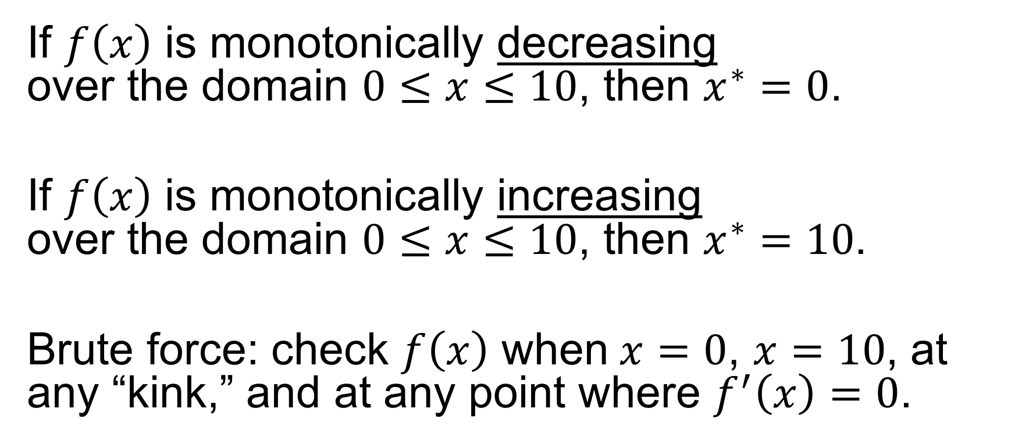
Other ways to find the solution...
If $f\left(x\right)$ is monotonically decreasing over the domain $0≤x≤10$, then $x^{∗}=0$.
If $f\left(x\right)$ is monotonically increasing over the domain $0≤x≤10$, then $x^{∗}=10$.
Brute force: check $f\left(x\right)$ when$x=0$, $x=10$, at any “kink,” and at any point where $f^{′}\left(x\right)=0$.

Slide 20
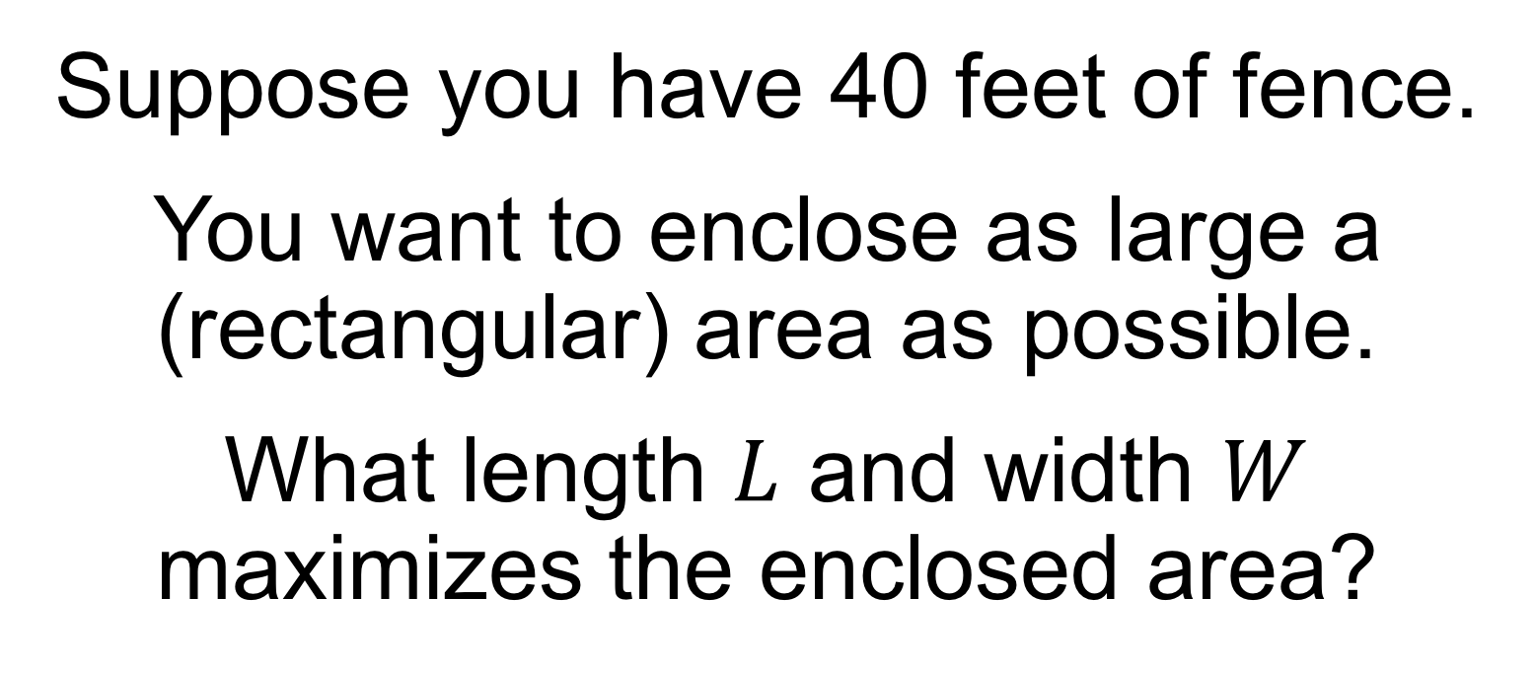
Group Work, Question 3
Suppose you have 40 feet of fence.
You want to enclose as large a (rectangular) area as possible.
What length $L$ and width $W$ maximizes the enclosed area?

Slide 21
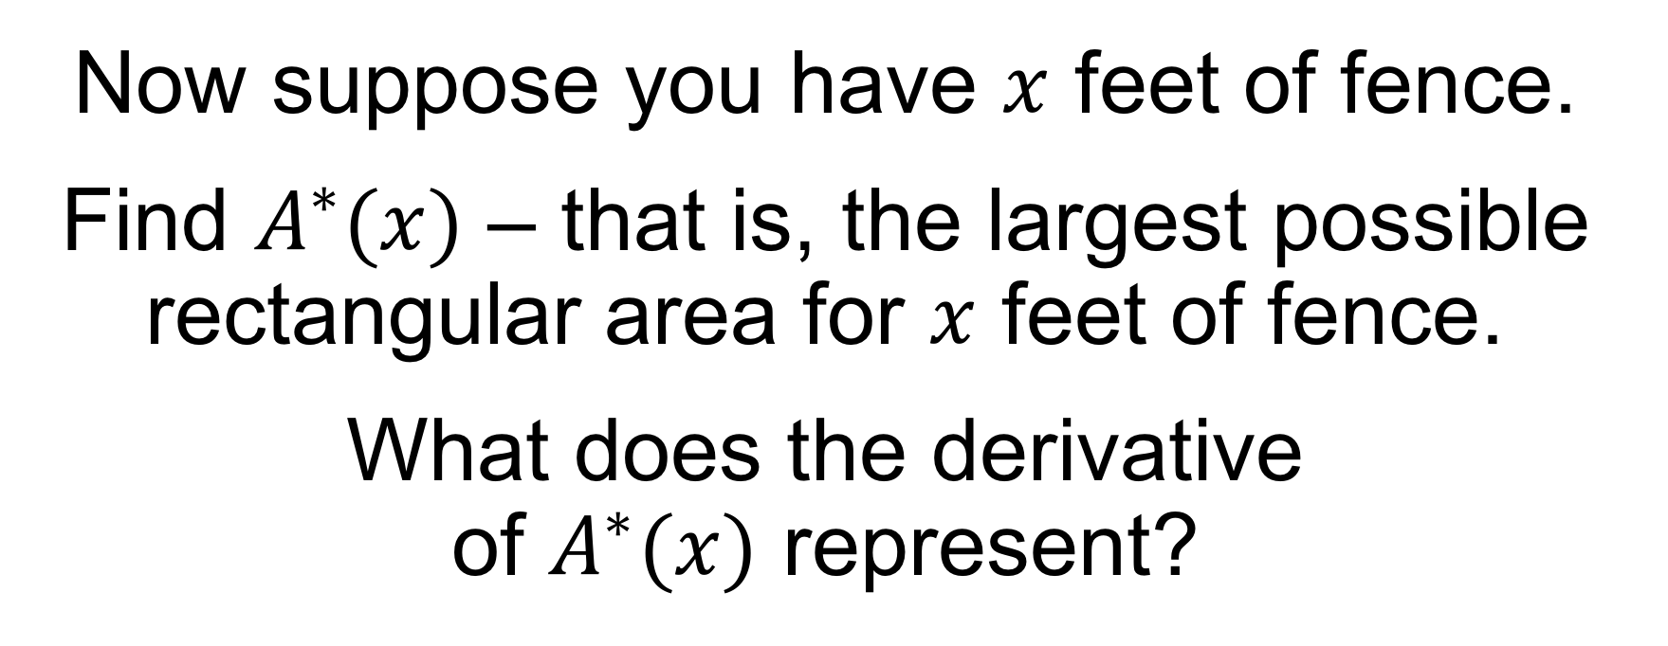
Group Work, Question 4
Now suppose you have $x$ feet of fence.
Find $A^{∗}(x)$ – that is, the largest possible rectangular area for $x$ feet of fence.
What does the derivative of $A^{∗}(x)$ represent?

