Slide 1
Supply and Demand with More Math than Econ 1
Lecture 2
Prof. Chris Makler
Econ 50 | Stanford University
January 5, 2016
Notes:
Mention class participation

Slide 2
Hour 1: Lecture
Hour 2: Group Work
Demand
Complements and Substitutes
Normal, Inferior, Giffen Goods
Income and Substitution Effects
Supply
Production and Cost
Supply in the Short and Long Run
Equilibrium
Welfare Analysis (CS, PS)
Parsing demand equations
Parsing supply equations
Calculating equilibrium as a function of exogenous variables
Using integrals to calculate changes in consumer and producer surplus

Slide 3
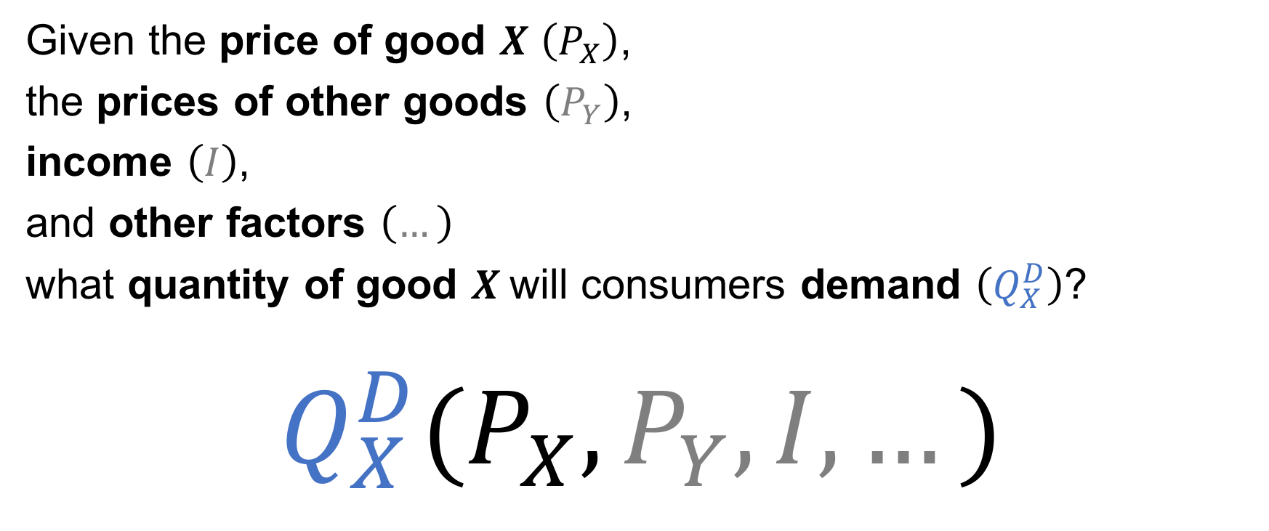
Demand
Given the price of good $X$ $\left(P_{X}\right)$,
the prices of other goods $\left(P_{Y}\right)$,
income $\left(I\right)$,
and other factors $\left(…\right)$
what quantity of good $X$will consumers demand $\left(Q_{X}^{D}\right)$?
$$Q_{X}^{D}(P_{X},P_{Y},I,…)$$

Slide 4
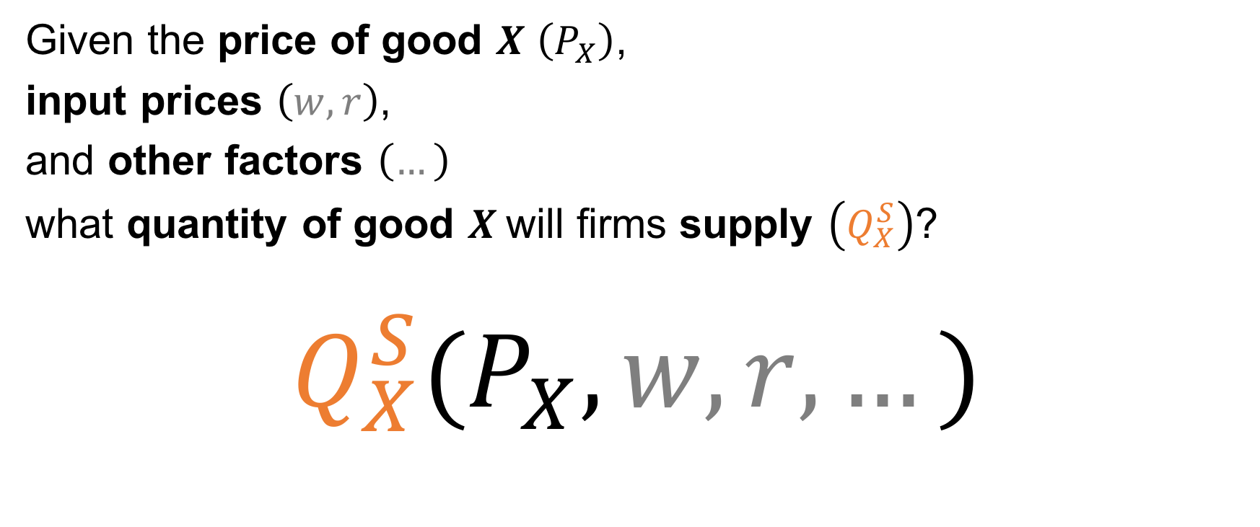
Supply
Given the price of good $X$ $\left(P_{X}\right)$,
input prices $\left(w,r\right)$,
and other factors $\left(…\right)$
what quantity of good $X$will firms supply $\left(Q_{X}^{S}\right)$?
$$Q_{X}^{S}(P_{X},w,r,…)$$

Slide 5
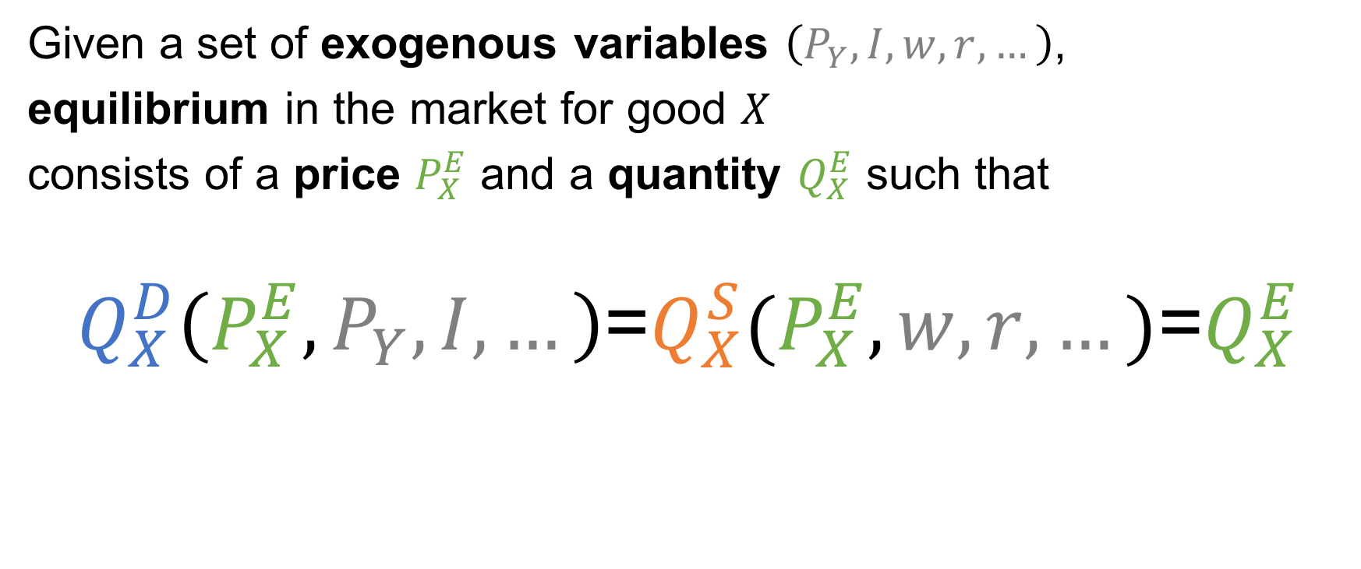
Equilibrium
Given a set of exogenous variables $\left(P_{Y},I,w,r,…\right)$,
equilibrium in the market for good $X$
consists of a price $P_{X}^{E}$ and a quantity $Q_{X}^{E}$ such that
$Q_{X}^{D}\left(P_{X}^{E},P_{Y},I,…\right)$=$Q_{X}^{S}(P_{X}^{E},w,r,…)\text{=}Q_{X}^{E}$

Slide 6
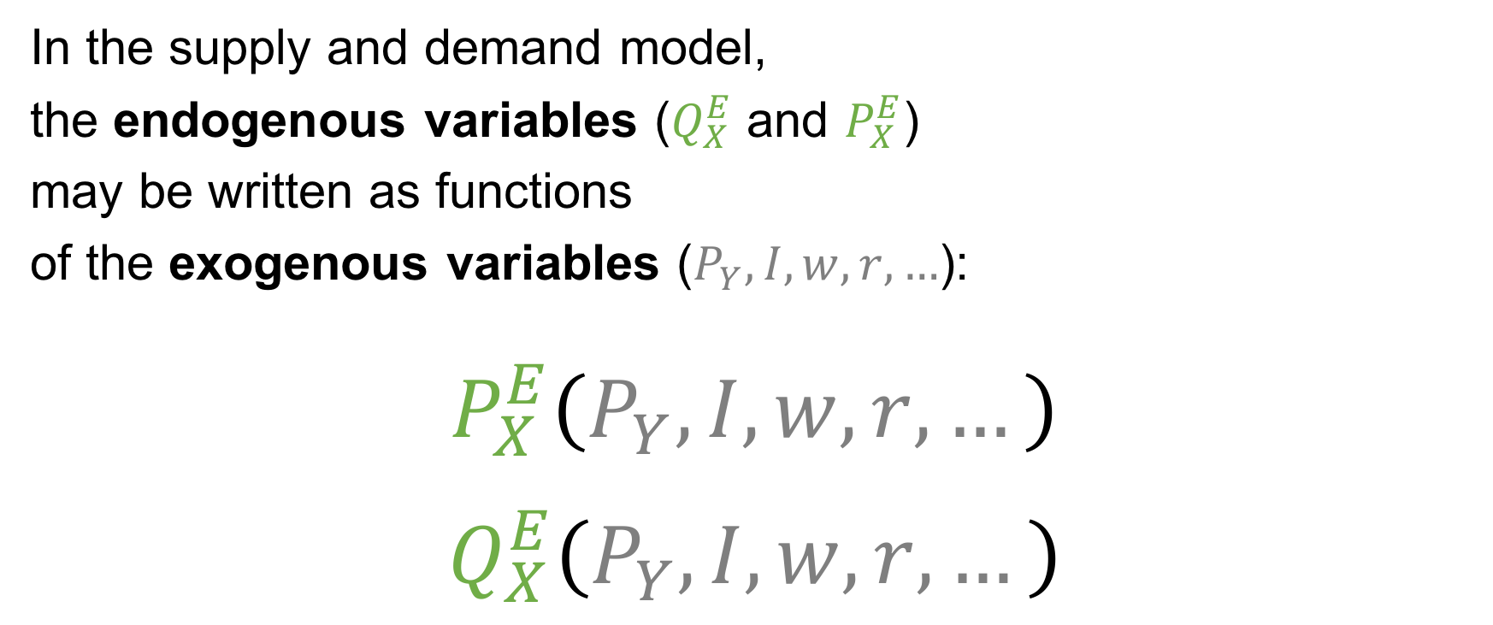
Equilibrium
In the supply and demand model,
the endogenous variables ($Q_{X}^{E}$ and $P_{X}^{E}$)
may be written as functions
of the exogenous variables ($P_{Y},I,w,r,…$):
$$P_{X}^{E}\left(P_{Y},I,w,r,…\right)$$
$$Q_{X}^{E}\left(P_{Y},I,w,r,…\right)$$

Slide 7
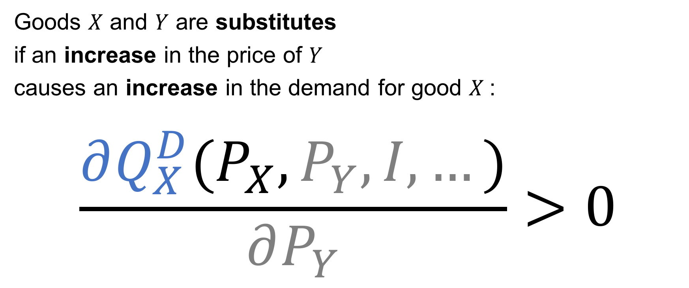
Substitutes
Goods $X$ and $Y$ are substitutes
if an increase in the price of $Y$
causes an increase in the demand for good $X$:
$$\frac{∂Q_{X}^{D}(P_{X},P_{Y},I,…)}{∂P_{Y}}>0$$

Slide 8

Complements
Goods $X$ and $Y$ are complements
if an increase in the price of $Y$
causes a decrease in the demand for good $X$:
$$\frac{∂Q_{X}^{D}(P_{X},P_{Y},I,…)}{∂P_{Y}}<0$$

Slide 9
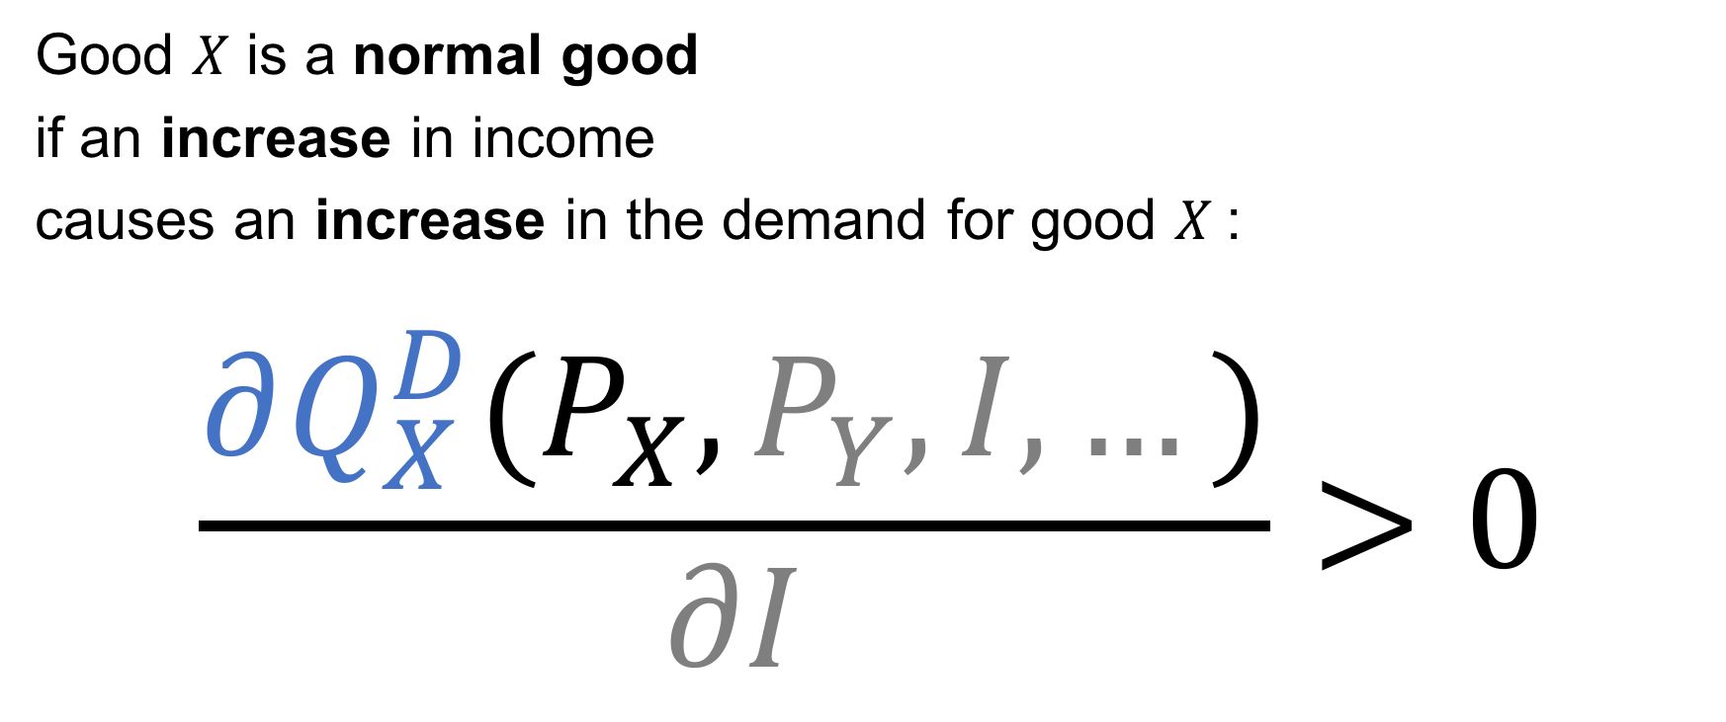
Normal goods
Good $X$ is a normal good
if an increase in income
causes an increase in the demand for good $X$:
$$\frac{∂Q_{X}^{D}(P_{X},P_{Y},I,…)}{∂I}>0$$

Slide 10

Inferior goods
Good $X$ is an inferior good
if an increase in income
causes a decrease in the demand for good $X$:
$$\frac{∂Q_{X}^{D}(P_{X},P_{Y},I,…)}{∂I}<0$$

Slide 11
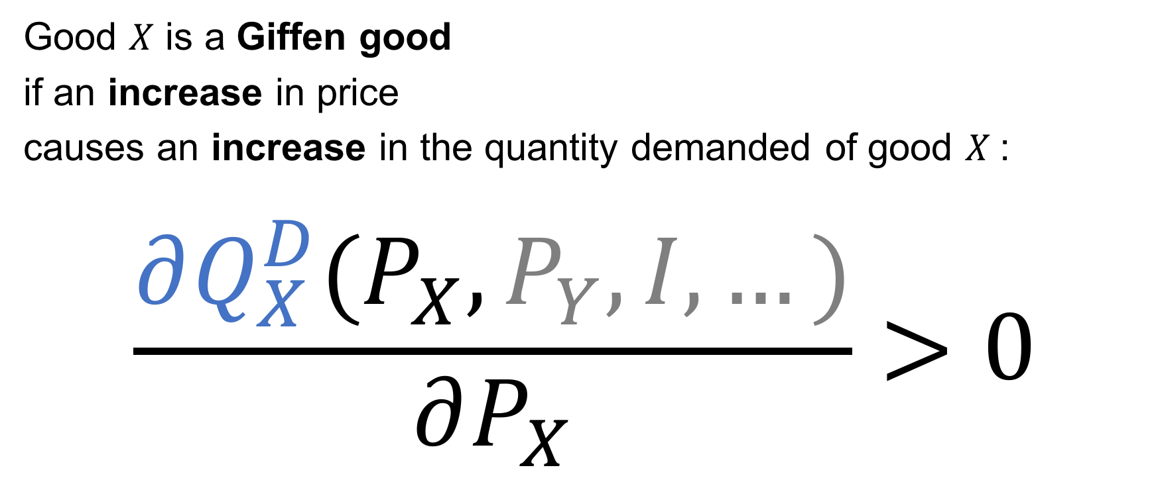
Giffen goods
Good $X$ is a Giffen good
if an increase in price
causes an increase in the quantity demanded of good $X$:
$$\frac{∂Q_{X}^{D}(P_{X},P_{Y},I,…)}{∂P_{X}}>0$$

Slide 12

Income and Substitution Effects
An increase in the price of
if an increase in price
causes an increase in the quantity demanded of good $X$:
$$\frac{∂Q_{X}^{D}(P_{X},P_{Y},I,…)}{∂P_{X}}>0$$

