Slide 1

CRISP-DM
© 2012 Kenneth Jensen / CC BY-SA 3.0 / http://tinyurl.com/yxuuhnyx

Slide 2
CRISP-DM
Accounting Data Analytics with Python
© 2012 Kenneth Jensen / CC BY-SA 3.0 / http://tinyurl.com/yxuuhnyx

Slide 3
CRISP-DM
Accounting Data Analytics with Python
Machine Learning for Accounting with Python
© 2012 Kenneth Jensen / CC BY-SA 3.0 / http://tinyurl.com/yxuuhnyx

Slide 4
Module 1: Introduction to Machine Learning
Machine Learning in General
Data Pre-processing
Python Machine Learning Demonstration

Slide 5
Module 3: Fundamental Algorithms II
Module 2: Fundamental Algorithms I
Six Machine Learning Algorithms
Implementation in Python

Slide 6
Module 4: Model Evaluation
Model Evaluation Metrics

Slide 7
Module 5: Model Optimization
Feature Selection
Cross Validation
Model Selection

Slide 8
Module 6: Introduction to Text Analysis
Text Document Process
Text Classification

Slide 9
Module 7: Introduction to Clustering
Unsupervised Learning
K-means
DBSCAN

Slide 10
Module 8: Introduction to Time Series Data
Data and Time Manipulation
Time Series Data and Analysis

Slide 11
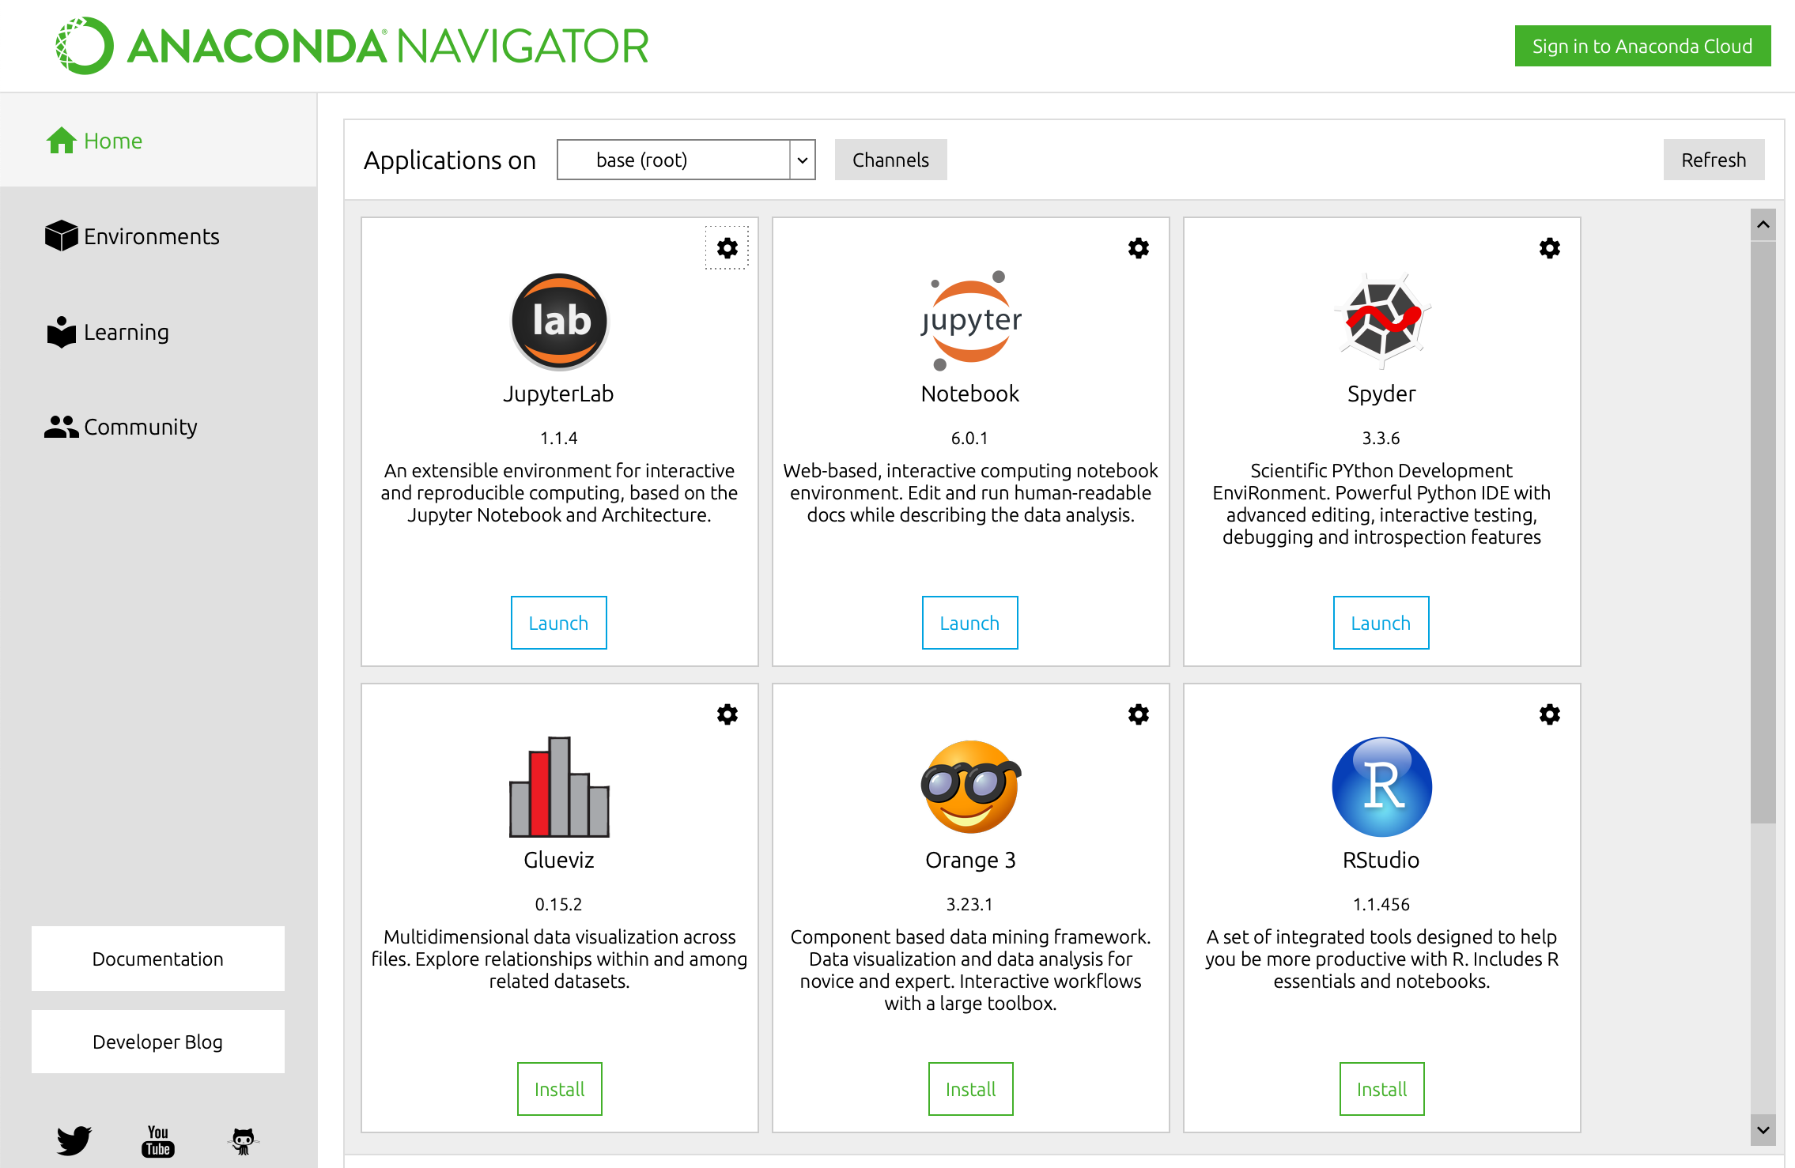
Course Platform: Jupyter Notebook

Slide 12
CRISP-DM
© 2012 Kenneth Jensen / CC BY-SA 3.0 / http://tinyurl.com/yxuuhnyx

Slide 13
CRISP-DM
Often overlooked but very important
© 2012 Kenneth Jensen / CC BY-SA 3.0 / http://tinyurl.com/yxuuhnyx

Slide 14
CRISP-DM
Often overlooked but very important
Tedious and most time consuming
© 2012 Kenneth Jensen / CC BY-SA 3.0 / http://tinyurl.com/yxuuhnyx

Slide 15
CRISP-DM
Often overlooked but very important
Tedious and most time consuming
Fun part
© 2012 Kenneth Jensen / CC BY-SA 3.0 / http://tinyurl.com/yxuuhnyx

Slide 16
Have Fun!

