Slide 1




OpenFlow on top of NetFPGA
Part I: Introduction to OpenFlow
NetFPGA Spring School 2010
Nadi Sarrar
TU-Berlin / T-Labs
Research group Prof. Anja Feldmann, Ph.D.
Some slides with permission from Prof. Nick McKeown.
OpenFlow was originally developed by Stanford University.

Slide 2
What is OpenFlow?
Support experimental protocols in production networks
→ Foundation for innovation
Specify an API to control Ethernet switch forwarding decisions
→ Towards software-defined, open-source networks
OpenFlow on top of NetFPGA - Introduction
Notes:
* Some high-level statements on what OpenFlow is.
* Innovation is hard, because in current network, we lack the possiblity to deploy experimental protocols
* How are we supposed to evaluate new ideas, without testing on real user data traffic?
* By allowing a remote control entity to modify the forwarding table of switches, we gain a very deep control of how a network behaves.
* We can decide, how flows are processed, what fields are modified, to which output port they are forwarded.
* With that approach, we achieve a software-defined network, that can handle production traffic.

Slide 3

Why OpenFlow?
Example:
New data center
Cost
500,000 servers
Fanout of 50  10,000 switches
$10k commercial switch  $100M
$1k custom-built switch  $10M
Savings in 10 data centers = $900M
Control
Optimize for features needed
Customize for services & apps
Quickly improve and innovate
OpenFlow on top of NetFPGA - Introduction

Slide 4
Why OpenFlow?
Network innovation today is difficult:
Switches and routers are “closed”
Software-only approach lacks performance and scalability
→ Need high-performance, programmable networking equipment (substrate)
OpenFlow on top of NetFPGA - Introduction

Slide 5
Networking hardware substrate
What do we mean by programmable equipment?
Need to define a substrate to build upon.
Let's learn from evolution of the PC!
OpenFlow on top of NetFPGA - Introduction

Slide 6
PC hardware abstraction
Application
. . .
Application
Application
Application
Operating System
Computer
Computer
OS abstracts hardware substrate
→ Innovation in applications
OpenFlow on top of NetFPGA - Introduction

Slide 7
PC hardware abstraction
App
. . .
App
Application
. . .
Application
Windows
(OS)
Windows
(OS)
Linux
(OS)
Mac OS
(OS)
or
or
Computer
Computer
Simple, common, stable, hardware substrate below.
Programmability and competition:
→ Innovation in OS and applications
OpenFlow on top of NetFPGA - Introduction

Slide 8
PC hardware virtualization
App
. . .
App
App
. . .
App
Windows
(OS)
Linux
(OS)
Mac OS
(OS)
or
or
Windows
(OS)
Linux
(OS)
Mac OS
(OS)
or
or
Virtualization
Computer
Computer
Strong isolation model:
→ Innovation in infrastructure
OpenFlow on top of NetFPGA - Introduction

Slide 9
Networking substrate
Let's apply a similar abstraction model to networking.
OpenFlow on top of NetFPGA - Introduction

Slide 10
Network hardware abstraction
App
. . .
App
Application
. . .
Application
Windows
(OS)
Controller
Computer
OpenFlow Network
Simple, common, stable, hardware substrate below.
Programmability and competition:
→ Innovation in network controllers
OpenFlow on top of NetFPGA - Introduction

Slide 11
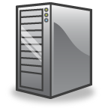
Step 1:
Separate intelligence from datapath
Operators, users,
3rd party developers, researchers, …
New function!
OpenFlow protocol (OFP)
OpenFlow on top of NetFPGA - Introduction

Slide 12
Step 2: Cache decisions in minimal flow-based datapath
“If header = x, send to port 4”
“If header = y, overwrite header with z, send to ports 5,6”
“If header = ?, send to me”
Flow
Table
OFP
OpenFlow on top of NetFPGA - Introduction

Slide 13


Example
Flow Table
If dest = B: send to port 2”
“Default: send to controller”
Host A
OFP
OF Switch
1
Controller
2
Host B
OpenFlow on top of NetFPGA - Introduction

Slide 14
Flow
Flow's can be defined via 10-tuples:
Allows for flexible, multidimensional flow definitions.
OpenFlow on top of NetFPGA - Introduction

Slide 15
Topology slicing
How to slice the network to allow production and experimental use at the same time?
How to do virtualization?
Again, let's learn from PC's :)
OpenFlow on top of NetFPGA - Introduction

Slide 16
Virtualization
App
. . .
App
App
. . .
App
Windows
(OS)
Linux
(OS)
Mac OS
(OS)
Controller 1
. . .
Controller N
or
or
Virtualization
Virtualization (FlowVisor)
Computer
OpenFlow Network
Strong isolation model:
→ Innovation in infrastructure
OpenFlow on top of NetFPGA - Introduction

Slide 17

FlowVisor
Rob Sherwood (rob.sherwood@stanford.edu)
Bob’s
Controller
Alice’s
Controller
OFP
OpenFlow
Switch
FlowVisor
OFP
OpenFlow
Switch
OpenFlow
Switch
OpenFlow on top of NetFPGA - Introduction

Slide 18
FlowVisor
Rob Sherwood (rob.sherwood@stanford.edu)
A proxy between switch and guest controller
  Parses and rewrites OpenFlow messages as they pass
Ensures that one experiment doesn’t affect another
Allows rich virtual network boundaries
  By port, by IP, by flow, by time, etc.
Define virtualization rules in software
OpenFlow on top of NetFPGA - Introduction

Slide 19
Available controllers and switches
NOX (http://noxrepo.org/, GNU GPLv3)
  Provides network-wide view of the topology
  C++ and Python modules make decisions
OpenVSwitch (http://openvswitch.org/, Apache 2)
  Soft-switch, replaces Linux bridge
  Designed to be used with VM's
Simple controller (reference implementation)
Hardware switches:
  Quanta LB4G (Broadcom), HP ProCurve 5400 series, NEC IP8800/S3640, Juniper MX, Cisco Catalyst, NetFPGA
OpenFlow on top of NetFPGA - Introduction

Slide 20
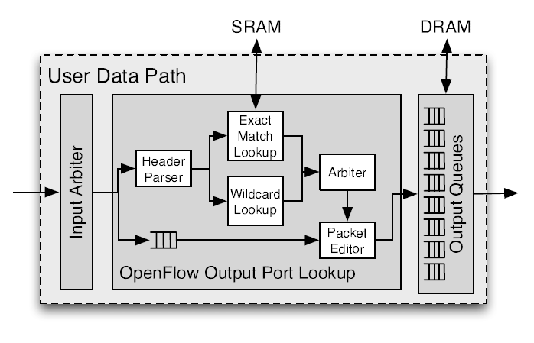
NetFPGA as an OpenFlow switch
J. Naous et. al., “ Implementing an OpenFlow Switch on the NetFPGA platform”, ANCS 2008
OpenFlow on top of NetFPGA - Introduction

Slide 21
OpenFlow activity in Europe
Successful EU proposals:
OFELIA (5 OpenFlow islands across Europe, partners from academia and industry)
CHANGE (Flow-processing research, uses OFELIA testbed)
SPARC (Split architecture, MPLS)
OpenFlow on top of NetFPGA - Introduction

Slide 22
Thank you!
http://www.openflowswitch.org
OpenFlow on top of NetFPGA - Introduction

Slide 23
OpenFlow on top of NetFPGA
Part II: Hands-on workshop
NetFPGA Spring School 2010
Nadi Sarrar
TU-Berlin / T-Labs
Research group Prof. Anja Feldmann, Ph.D.

Slide 24
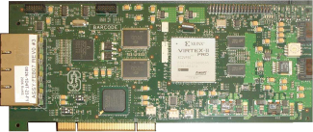

Exercise overview
PING
PC
192.168.1.1
NetFPGA
Controller
OpenFlow
protocol
192.168.2.1
OpenFlow on top of NetFPGA - Hands-on workshop

Slide 25
1. Bitfile
PC
192.168.1.1
NetFPGA
Controller
OpenFlow
protocol
openflow_switch.bit
192.168.2.1
Bitfile to program the NetFPGA:
/root/openflow/openflow_switch.bit
Download bitfile to NetFPGA:
nf2_download $bitfile
OpenFlow on top of NetFPGA - Hands-on workshop

Slide 26
2. Kernel modules
PC
192.168.1.1
NetFPGA
Controller
OpenFlow
protocol
openflow_switch.bit
ofdatapath.ko
ofdatapath_netfpga.ko
192.168.2.1
Load general OpenFlow datapath module:
insmod /root/openflow/ofdatapath.ko
Load NetFPGA datapath module:
insmod /root/openflow/ofdatapath_netfpga.ko
OpenFlow on top of NetFPGA - Hands-on workshop

Slide 27
3a. Datapath
PC
192.168.1.1
NetFPGA
Controller
OpenFlow
protocol
openflow_switch.bit
ofdatapath.ko
ofdatapath_netfpga.ko
192.168.2.1
Create a datapath:
dpctl adddp nl:0
Display datapath info:
dpctl show nl:0
OpenFlow on top of NetFPGA - Hands-on workshop

Slide 28
3b. Datapath
PC
192.168.1.1
NetFPGA
Controller
OpenFlow
protocol
openflow_switch.bit
ofdatapath.ko
ofdatapath_netfpga.ko
192.168.2.1
Add interfaces to datapath:
dpctl addif nl:0 nf2c0 nf2c1 nf2c2 nf2c3
Display datapath info:
dpctl show nl:0
OpenFlow on top of NetFPGA - Hands-on workshop

Slide 29
4. Statistics
PC
192.168.1.1
NetFPGA
Controller
OpenFlow
protocol
openflow_switch.bit
ofdatapath.ko
ofdatapath_netfpga.ko
192.168.2.1
Display flow table entries:
dpctl dump-flows nl:0
Display hardware information:
cat /proc/net/openflow/netfpga
OpenFlow on top of NetFPGA - Hands-on workshop

Slide 30
5. Controller
PC
192.168.1.1
NetFPGA
Controller
OpenFlow
protocol
openflow_switch.bit
ofdatapath.ko
ofdatapath_netfpga.ko
ofprotocol
controller
192.168.2.1
Run controller (passive mode):
controller ptcp:localhost:6633
Run OpenFlow protocol daemon (active mode):
ofprotocol nl:0 tcp:localhost:6633
OpenFlow on top of NetFPGA - Hands-on workshop

Slide 31
5. Controller
PC
192.168.1.1
NetFPGA
Controller
OpenFlow
protocol
openflow_switch.bit
ofdatapath.ko
ofdatapath_netfpga.ko
ofprotocol
controller
192.168.2.1
Kernel / Hardware
Userspace
Run controller (passive mode):
controller ptcp:localhost:6633
Run OpenFlow protocol daemon (active mode):
ofprotocol nl:0 tcp:localhost:6633
OpenFlow on top of NetFPGA - Hands-on workshop

Slide 32
6. Testing
PING
PC
192.168.1.1
NetFPGA
Controller
OpenFlow
protocol
openflow_switch.bit
ofdatapath.ko
ofdatapath_netfpga.ko
ofprotocol
controller
192.168.2.1
Kernel / Hardware
Userspace
Attach two nodes to any two ports.
Assign IP addresses.
IP should work (try to ping).
Monitor flow table: dpctl dump-flows nl:0
OpenFlow on top of NetFPGA - Hands-on workshop

