Slide 1
More Ruby
Homework review
How to write a test
Array and range
Symbol
Block
Pairing Lab

Slide 2
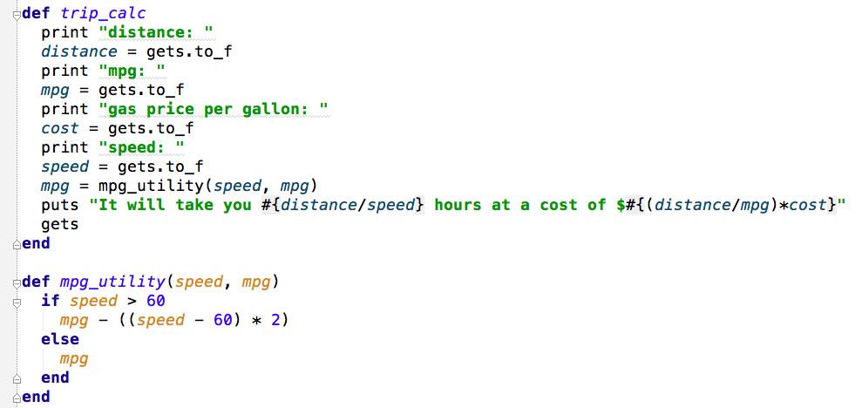
Homework Review

Slide 3
Testing Preview
test unit, part of Ruby
require ‘test/unit’
test mpg_utility
  when speed > 60
  when speed <= 60

Slide 4
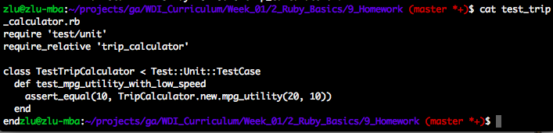

Slide 5
Array
Indexed collection of objects
Key is integer
a = [‘cat’, ‘dog’, 9]
  a[0]: ‘cat’
  a[2]: 9

Slide 6
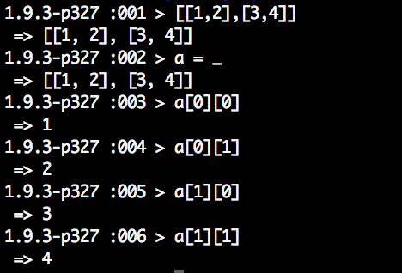
2-dimensional Array

Slide 7
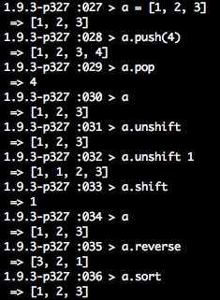
Array Operations

Slide 8
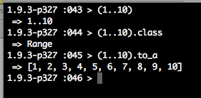
Range

Slide 9
Symbol
Unique constant names
colon + name
  :”1” v.s. :1
stored in symbol table during program execution

Slide 10
Symbol v.s. String
:symbol.object_id v.s. “string”.object_id

Slide 11
Symbol Usage
Used as keys in hashes
  {:key => ‘value’}
Hash is just like array, which an indexed collection of objects. Hash keys are usually symbols or strings, but it can be any type of object.

Slide 12
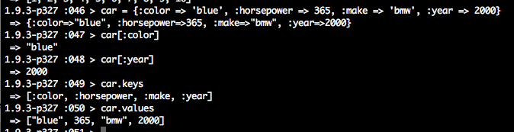
Hash Methods

Slide 13
Array v.s. Hash
Speed v.s. Flexibility

Slide 14
Code Blocks
Block of code between {} or “do .. end”
  { puts ‘hi’ }
  do
    puts ‘hi’
  end

Slide 15
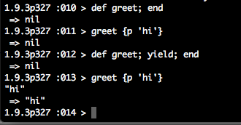
method { block }

Slide 16
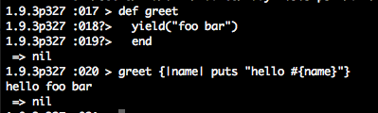
Black Parameter

Slide 17
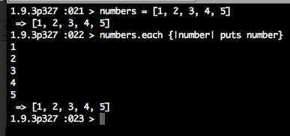
Iterating array

Slide 18
Lab - Random Pair
Working in pairs, create an app that will randomly assign groups for the class.The app takes a group size as input and prints out what the groups are. If the class does not divide evenly intothe group size, any remaining students should just be tacked on the last group.

Slide 19
Daily Review
Test-driven Development (TDD)
Array/Hash
Symbol
Block

Slide 20
Homework - Simple Subway
The program takes the line and stop that a user is getting on at and the line and stop that user is getting off at and prints the total number of stops for the trip.
There are 3 subway lines: - The N line has the following stops: Times Square, 34th, 28th, 23rd, Union Square, and 8th - The L line has the following stops: 8th, 6th, Union Square, 3rd, and 1st - The 6 line has the following stops: Grand Central, 33rd, 28th, 23rd, Union Square, and Astor Place.
All 3 subway lines intersect at Union Square, but there are no other intersection points. (For example, this means the 28th stop on the N line is different than the 28th stop on the 6 line.)
Bonus: write tests for it. Focus test on the logic, not standard IO.

